Slide 1

Pricing Illiquidity in Strategic Asset Allocation: A Calibration Framework for Practitioners
Replacing subjective judgement with a simulation-based calibration methodology
Supervisor: E. Barucci
Co-supervisor: V. Gisimundo
Candidate: L. Meloncelli
OCTOBER 2026
• Document for professional investors only
Notes:
[Commercial + Technical]
Cover. Always shown.

Slide 2
Executive Summary
Replacing subjective judgement with a simulation-based calibration methodology
01
The challenge
Standard mean-variance optimization treats liquid and illiquid assets symmetrically, ignoring the return drag that locking up capital imposes. These costs grow non-linearly with portfolio illiquidity and are investor-specific, yet no systematic tool exists to quantify them.
02
Our contribution
A simulation-based methodology to calibrate the illiquidity penalty curve by measuring return drag across illiquidity levels and fitting a parametric cost function to the results: subjective judgement is replaced by a transparent, replicable process grounded in portfolio dynamics.
03
The output
Investor-specific penalty curves calibrated on Amundi's Capital Market Assumptions for three institutional archetypes, feeding directly into a penalized mean-variance optimization.
Notes:
[Commercial]
The whole paper in one page: problem, contribution, output.

Slide 3
Contents
Why illiquidity needs a price
The penalized optimization framework
Calibrating the penalty curve by simulation
Implications for portfolio construction
Future developments
Notes:
[Commercial + Technical]
Agenda. Hide the chapters you do not need for a given audience.

Slide 4
Why illiquidity needs a price
01
The costs of locking up capital that mean-variance optimization does not see
Notes:
[Commercial + Technical]
Chapter divider.

Slide 5
Why Illiquidity Needs a Price
01 02 03 04 05 Why illiquidity needs a price
The hidden costs that mean-variance optimization ignores
01
02
Why it matters now
Private markets are now a central component of institutional portfolios: endowments hold the largest share of alternatives of any investor segment, and private pensions increased their allocations between 2020 and 2024 (Preqin, 2025).
These costs are not captured by the illiquidity premium, grow non-linearly with portfolio illiquidity, and depend on each investor's liabilities.
Rebalancing gap
Lock-up constraints restrict rebalancing, causing portfolio weights to drift away from their targets, potentially reducing performance.
Forced sales at a discount
When liquid assets fall below the minimum buffer, illiquid positions must be sold on the secondary market at a haircut.
03
04
Payout pressure
Distributions must be funded even when assets are locked. Payouts rise during market downturns, increasing the risk of liquidity shortfalls and costly asset sales.
Lost flexibility
Locked capital cannot be redeployed when new investment opportunities arise.
Notes:
[Commercial]
Frame the problem: MVO prices risk and return, but not the constraints of locked capital. The first three costs are exactly what the simulation measures.

Slide 6
Existing Approaches and Their Limits
01 02 03 04 05 Why illiquidity needs a price
Why the Hayes, Primbs & Chiquoine (2015) framework is the right starting point
Multi-period stochastic programming
Mean-variance-liquidity frontier
Shadow assets & liabilities
Penalty cost approach
Mulvey, Pauling & Madey (2003)
Lo, Petrov & Wierzbicki (2003)
Kinlaw, Kritzman & Turkington (2013)
Hayes, Primbs & Chiquoine (2015)
Strength
Detailed cash-flow modelling of illiquid assets and liabilities
Strength
Tractable extension of the MVO objective
Strength
Captures rebalancing, market timing and capital calls
Strength
Convex, portfolio-level and investor-specific; return-based language
Limitation
Computationally heavy and opaque for investment committees
Limitation
Marginal cost of illiquidity treated as constant
Limitation
Constant marginal cost, not investor-specific
Limitation
Penalty curve left to subjective judgement: the gap this paper fills
Notes:
[Technical]
Literature positioning (Sections 1.2-1.3).

Slide 7
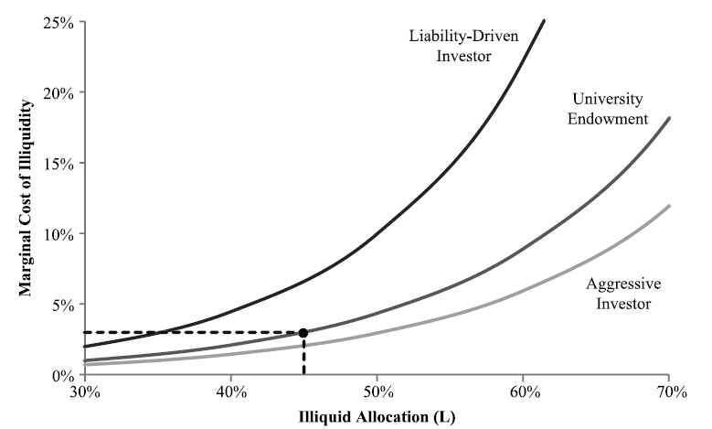
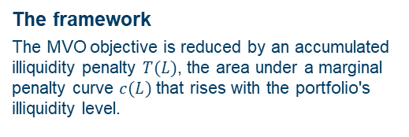
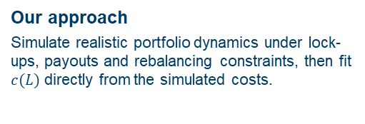
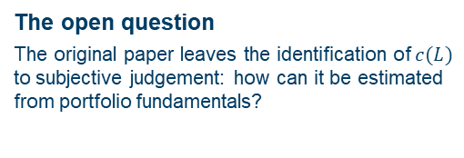
The Penalty Cost Approach
01 02 03 04 05 Why illiquidity needs a price
Hayes, Primbs & Chiquoine (2015): a marginal penalty curve inside the MVO
The framework
The MVO objective is reduced by an accumulated illiquidity penalty $T(L)$, the area under a marginal penalty curve $c(L)$ that rises with the portfolio's illiquidity level.
Marginal illiquidity penalty curves for different investor types
01
02
The open question
The original paper leaves the identification of $c(L)$ to subjective judgement: how can it be estimated from portfolio fundamentals?
03
Our approach
Simulate realistic portfolio dynamics under lock-ups, payouts and rebalancing constraints, then fit $c(L)$ directly from the simulated costs.
Source: Hayes, Primbs & Chiquoine (2015). At L = 45% the endowment's marginal penalty is about 3%.
Notes:
[Commercial + Technical]
Positioning: HPC (2015) gives the framework, we provide the calibration.

Slide 8
The penalized optimization framework
02
Extending Markowitz with a portfolio-level illiquidity penalty
Notes:
[Commercial + Technical]
Chapter divider.

Slide 9
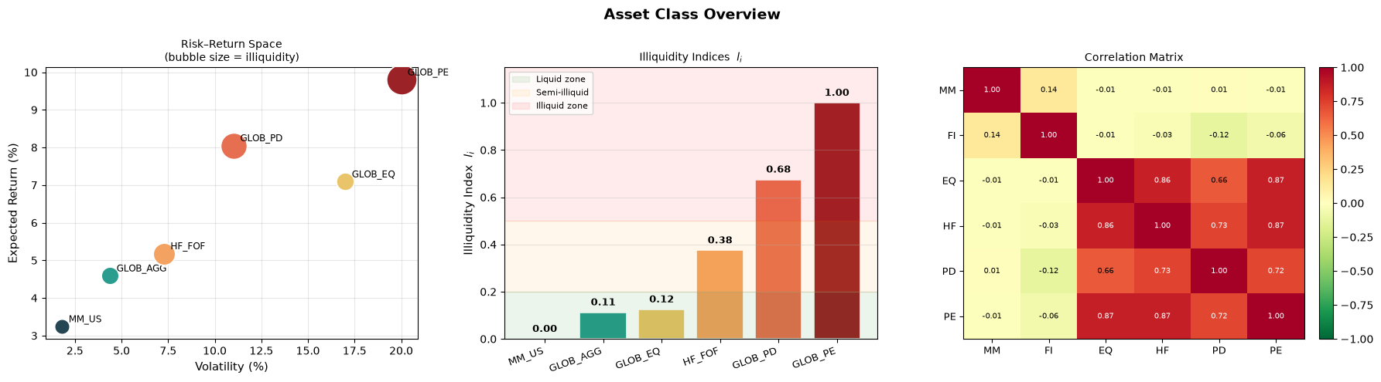
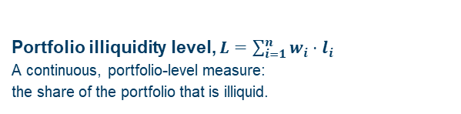
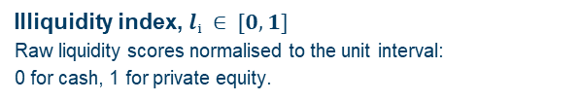
Asset Classes & Illiquidity Levels
01 02 03 04 05 The penalized optimization framework
Six asset classes spanning the full liquidity spectrum
Risk-return space · Illiquidity indices lᵢ · Correlation matrix
01
Illiquidity index, $lᵢ ∈ [0, 1]$
Raw liquidity scores normalised to the unit interval:
0 for cash, 1 for private equity.
02
Portfolio illiquidity level, $L=\sum_{i=1}^{n}{w_{i}}⋅l_{i}$
A continuous, portfolio-level measure:
the share of the portfolio that is illiquid.
Notes:
[Technical]

Slide 10
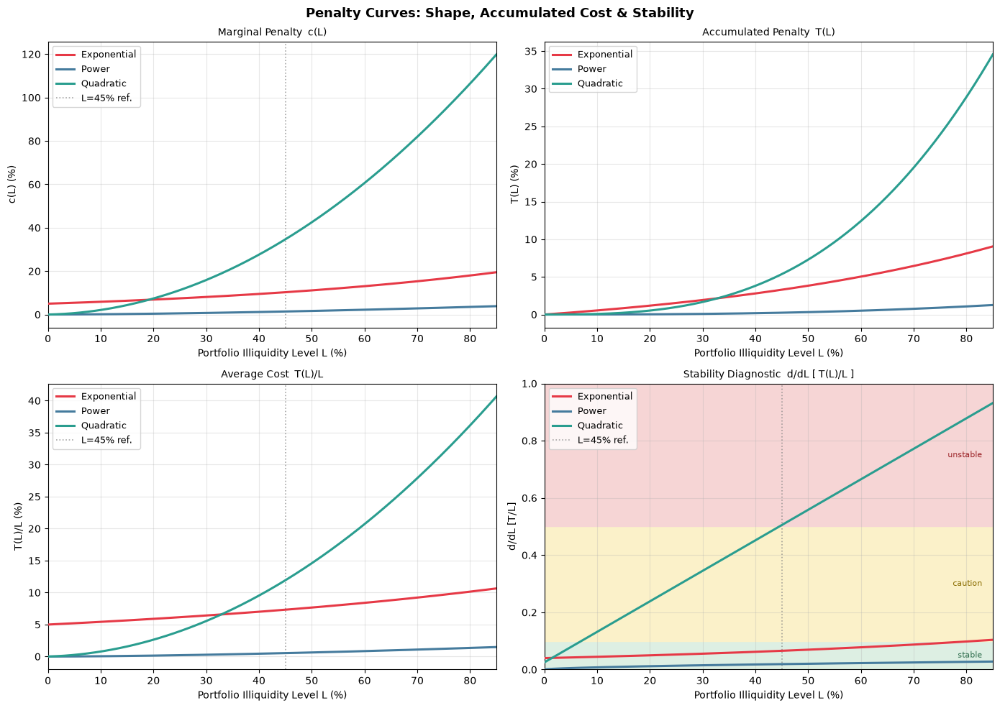
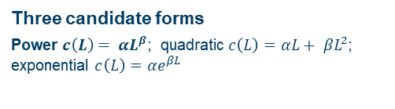
The Marginal Penalty Function
01 02 03 04 05 The penalized optimization framework
Three functional forms compared with identical parameters (α = 0.05, β = 1.6)
Marginal penalty, accumulated penalty, average cost and stability diagnostic
01
Three candidate forms
Power $c\left(L\right)= αL^{β}$; quadratic $c\left(L\right)={αL+ βL}^{2}$; exponential $c\left(L\right)={αe}^{βL}$
02
Desirable properties
Zero total and marginal costs at L = 0; increasing and convex marginal costs; interpretable parameters and stable optimization.
03
Reading the power form
In the power specification, α sets the overall penalty level, while β controls its curvature: low β implies costs arise early and gradually; high β implies tolerance at moderate illiquidity but sharply rising costs at high levels.
Notes:
[Technical]

Slide 11
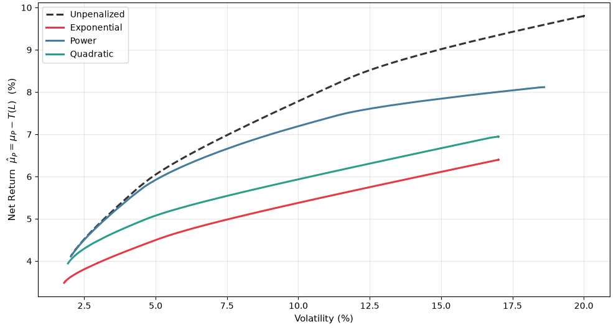

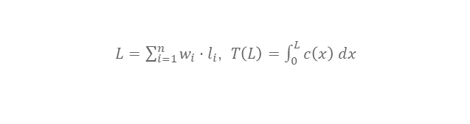
Portfolio Optimization with Illiquidity
01 02 03 04 05 The penalized optimization framework
Net efficient frontiers under the three penalties (α = 0.05, β = 1.6)
$$\max_{w}{ w^{⊤}μ − \frac{γ}{2} w^{⊤}Σ w − T\left(L\left(w\right)\right)}$$
Net return μ − T(L) along the efficient frontier
$L=\sum_{i=1}^{n}{w_{i}}⋅l_{i}$, $T\left(L\right)=\int_{0}^{L}{c\left(x\right) dx}$
01
A third trade-off
Return, variance and illiquidity cost: the penalty discourages illiquid concentration without hard constraints.
02
The γ → 0 limit
The optimizer maximises return net of the penalty and stops there: the more aggressive the penalty, the earlier it stops.
Notes:
[Technical]

Slide 12
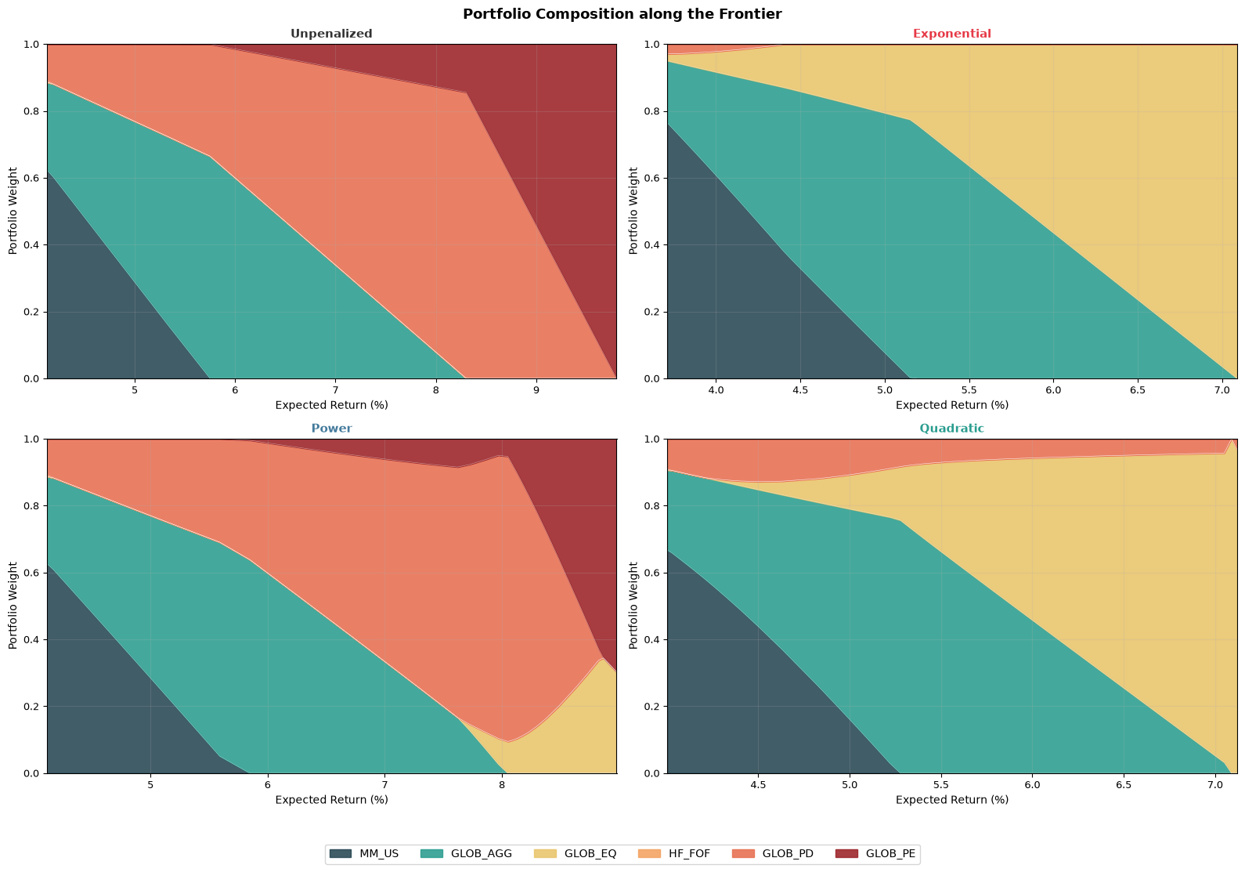
Efficient Frontiers & Portfolio Composition
01 02 03 04 05 The penalized optimization framework
Portfolio composition along the frontier (α = 0.05, β = 1.6)
Unpenalized · Exponential · Power · Quadratic
01
The penalty reshapes the allocation
PE and PD are reduced and the return range compressed; GLOB_EQ becomes the liquid substitute
02
Only the power form is stable
The exponential collapses the frontier to a narrow range; the quadratic shows erratic composition spikes.
Notes:
[Technical]

Slide 13

Illiquidity-Adjusted Expected Returns
01 02 03 04 05 The penalized optimization framework
Speaking the language of investment committees
$$\hat{μ}ᵢ = μᵢ − (T(L) / L ) · lᵢ$$
Who bears the penalty: each asset pays $lᵢ∙T(L)/L$
Asset class | Expected return μᵢ | Share of T(L)/L borne lᵢ
MM_US | 3.24% | none
GLOB_AGG | 4.59% | 11%
GLOB_EQ | 7.09% | 13%
HF_FOF | 5.18% | 38%
GLOB_PD | 5.48% | 68%
GLOB_PE | 9.80% | 100%
$T(L) / L$: average accumulated penalty per unit of portfolio illiquidity
01
A return hurdle
Each asset's expected return is reduced in proportion to its illiquidity index.
02
Same MVO, adjusted inputs
The penalized problem is a standard MVO on adjusted returns: no new risk concept to explain.
Source: Amundi Investment Institute, CMA 2026.
Notes:
[Commercial]
Equations (6)-(8) of the thesis. A liquid asset is untouched; private equity bears the full average penalty.

Slide 14
Calibrating the penalty curve by simulation
03
From subjective judgement to a curve grounded in portfolio dynamics
Notes:
[Commercial + Technical]
Chapter divider.

Slide 15
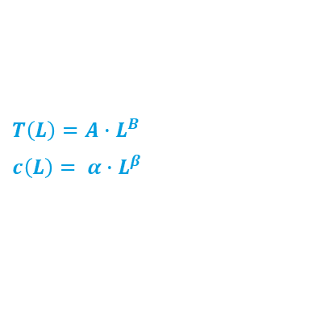
How the Calibration Works
01 02 03 04 05 Calibrating the penalty curve by simulation
A constrained real portfolio versus a frictionless liquid benchmark
Two portfolios, same world
Three sources of return drag
One calibrated curve
Real portfolio
Asset-specific lock-ups: tranches cannot be sold before expiry, or only at a secondary-market haircut.
01
Rebalancing gap
Lock-ups stop the portfolio from returning to target.
Calibrated penalty curve
The simulated average return drag across a range of portfolio illiquidity levels is fitted with a power function:
$T\left(L\right)=A∙L^{B}$
$c\left(L\right)= α∙L^{β}$
Ready to plug into the penalized mean-variance optimization.
02
Buffer restoration haircuts
Illiquid assets sold at a discount to restore the minimum buffer.
Liquid benchmark
Frictionless: rebalances freely to target weights every year and meets payouts at fair value.
03
Payout haircuts
Locked positions liquidated to pay distributions, often in downturns.
1,000 scenarios × 20 years per illiquidity level, parametrised on Amundi's Capital Market Assumptions.
Notes:
[Commercial]
Section 6 without equations. Two portfolios see the same world; the only difference is the lock-up.

Slide 16
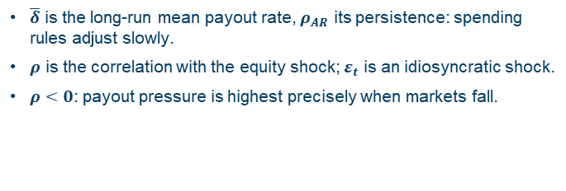

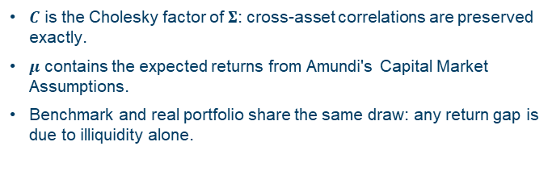

Simulation Design: Stochastic Dynamics
01 02 03 04 05 Calibrating the penalty curve by simulation
Correlated asset returns and a countercyclical payout process
The illiquidity cost curve $c\left(L\right)$is estimated through simulations of realistic portfolio dynamics: at each target illiquidity level L, N=1000 Monte Carlo scenarios are run over a 20-year horizon, and the average annual return foregone due to lock-up constraints is measured relative to an unconstrained benchmark.
01
Asset returns
Multivariate normal on Amundi's CMA
02
Annual payout
Mean-reverting AR(1), correlated with equity
$r_{t}=μ+C∙z_{t}$, $z_{t}∼𝓝\left(0, 1\right)$
$$δ_{t}=\overline{δ}+ρ_{AR}\left(δ_{t−1}−\overline{δ}\right)+σ_{δ}\left(ρ∙z_{t}^{EQ}+\sqrt{1−ρ^{2}}∙ε_{t}\right)$$
$C$ is the Cholesky factor of $Σ$: cross-asset correlations are preserved exactly.
$μ$ contains the expected returns from Amundi's Capital Market Assumptions.
Benchmark and real portfolio share the same draw: any return gap is due to illiquidity alone.
$\overline{δ}$ is the long-run mean payout rate, $ρ_{AR}$ its persistence: spending rules adjust slowly.
$ρ$ is the correlation with the equity shock; $ε_{t}$ is an idiosyncratic shock.
$ρ<0$: payout pressure is highest precisely when markets fall.
Notes:
[Technical]

Slide 17
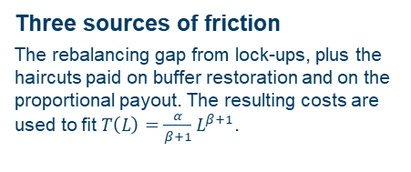
Simulation Design: Lock-ups, Haircuts & Costs
01 02 03 04 05 Calibrating the penalty curve by simulation
Tranche tracking and secondary-market frictions
01
02
03
Lock-up periods
Each illiquid asset class is subject to a specific lock-up period. A tranche-tracking system records the purchase date of each position.
Haircuts on early exit
A locked position sold before expiry, to pay the payout or restore the minimum buffer, incurs an asset-specific haircut hᵢ, held constant over the simulation.
Three sources of friction
The rebalancing gap from lock-ups, plus the haircuts paid on buffer restoration and on the proportional payout. The resulting costs are used to fit $T\left(L\right)=\frac{α}{β+1}L^{β+1}$.
Asset class | Illiquidity index lᵢ | Lock-up (years) | Haircut hᵢ
MM_US | 0.00 | 0 | 0.05%
GLOB_AGG | 0.11 | 0 | 0.10%
GLOB_EQ | 0.13 | 0 | 0.50%
HF_FOF | 0.38 | 2 | 5.0%
GLOB_PD | 0.68 | 5 | 12.0%
GLOB_PE | 1.00 | 8 | 20.0%
Notes:
[Technical]

Slide 18
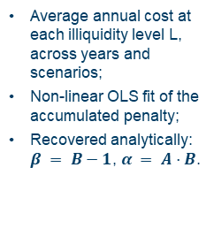


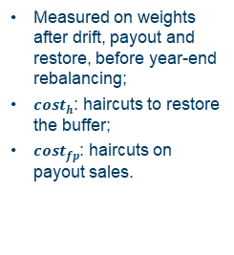

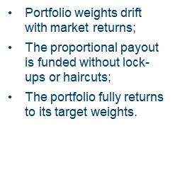
The Annual Simulation Cycle
01 02 03 04 05 Calibrating the penalty curve by simulation
Five steps from market returns to the fitted penalty
A Market returns
B Benchmark
C Real portfolio
D Annual cost
E Fitting
$$r_{t} \sim N(μ, Σ)$$
drift payout at fair value → full rebal.
payout → buffer top-up → constrained rebal.
$$cost_{t}=$$
$$\left(r_{bench}−r_{actual}\right)$$
$$+cost_{h}+cost_{fp}$$
$$\hat{T}= A ·L^{B}$$
Same realization shared by the benchmark and the real portfolio;
Any return difference captures only the illiquidity constraints, not different market outcomes.
Portfolio weights drift with market returns;
The proportional payout is funded without lock-ups or haircuts;
The portfolio fully returns to its target weights.
The same returns and proportional payout are applied;
Sales of locked assets incur asset-specific haircuts;
Rebalancing toward target is subject to lock-up and liquidity-buffer constraints.
Measured on weights after drift, payout and restore, before year-end rebalancing;
$cost_{h}$: haircuts to restore the buffer;
$cost_{fp}$: haircuts on payout sales.
Average annual cost at each illiquidity level L, across years and scenarios;
Non-linear OLS fit of the accumulated penalty;
Recovered analytically: $β = B−1$, $α = A·B$.
Once the loop is complete: one point per L, one curve per archetype
Next year t + 1 · loop over T = 20 years × N = 1,000 scenarios, at every L
Notes:
[Technical]
[Technical]
Section 6.5 of the thesis. Steps A-D form the annual loop; step E runs once on the averaged costs.

Slide 19
Three Institutional Archetypes
01 02 03 04 05 Calibrating the penalty curve by simulation
Different liability structures, different liquidity needs
01
02
03
Pension Fund
University Endowment
Family Office
Most constrained
Intermediate
Least constrained
Mandatory distributions, early withdrawals in market stress, regulatory liquidity reserve.
Stable spending rule that smooths payouts; regular donations; long-duration liabilities.
No contractual obligations; discretionary, idiosyncratic beneficiary needs.
Mean payout rate
10%
Mean payout rate
5%
Mean payout rate
4%
Payout volatility
2.5%
Payout volatility
1.5%
Payout volatility
2.0%
Payout persistence
0.65
Payout persistence
0.55
Payout persistence
0.35
Correlation with equity
−0.60
Correlation with equity
−0.35
Correlation with equity
−0.20
Minimum liquid buffer
40%
Minimum liquid buffer
30%
Minimum liquid buffer
20%
Risk aversion γ
5
Risk aversion γ
3
Risk aversion γ
2
Payout: AR(1) process correlated with equity shocks. Sources: COVIP (2022), NACUBO-TIAA (2023), Ang, Papanikolaou & Westerfield (2014).
Notes:
[Commercial + Technical]
Tables 4 and 5 of the thesis. Negative correlation: payouts rise when equity falls.

Slide 20
Calibration Results
01 02 03 04 05 Calibrating the penalty curve by simulation
The simulation assigns a more convex cost profile than judgement alone
Archetype | A | B | α | β | R² | Subjective α | Subjective β
Pension Fund | 0.0745 | 3.5772 | 0.2666 | 2.5772 | 0.989 | 0.25 | 1.2
Endowment | 0.0353 | 3.7615 | 0.1328 | 2.7615 | 0.982 | 0.12 | 2.0
Family Office | 0.0217 | 3.8767 | 0.0841 | 2.8767 | 0.981 | 0.06 | 2.8
01
02
03
Pension Fund: β 2.58 vs 1.2
Highest cost at any illiquidity level but concentrated at the high end: forced selling and payout shocks compound once illiquidity is large.
Endowment: β 2.76 vs 2.0
Convex profile: costs are negligible below a threshold and then accelerate sharply.
Family Office: α 0.08 vs 0.06
Mild, gradually accumulating cost, consistent with the absence of binding payout obligations.
Notes:
[Commercial + Technical]
Table 6 (simulated) and Section 5.3 (subjective). R² between 0.987 and 0.997.

Slide 21
Implications for portfolio construction
04
What changes in efficient frontiers and allocations
Notes:
[Commercial + Technical]
Chapter divider.

Slide 22
Key Results
01 02 03 04 05 Implications for portfolio construction
What pricing illiquidity changes in practice
>150 bp
≈ 8.5%
1.7 – 4.2
R² ≥ 0.95
Net-return advantage of the penalized portfolio for the pension fund at around 12% volatility
Maximum gross return of the penalized pension fund frontier: PE and PD stop being added where its cost exceeds its benefit
Range of the calibrated curvature β across archetypes: the cost of illiquidity is investor-specific
Fit quality of the power penalty function across all three archetypes
Net-return dominance on a gross basis the penalized frontier sits below the unpenalized one; net of the accumulated penalty it dominates in all archetypes. Targeting a high gross return by concentrating in illiquid assets leads to a lower net return than pricing illiquidity, at the same level of risk.
Notes:
[Commercial]
Sections 6.8 and 7.1-7.2. For the family office the two frontiers are almost identical.

Slide 23
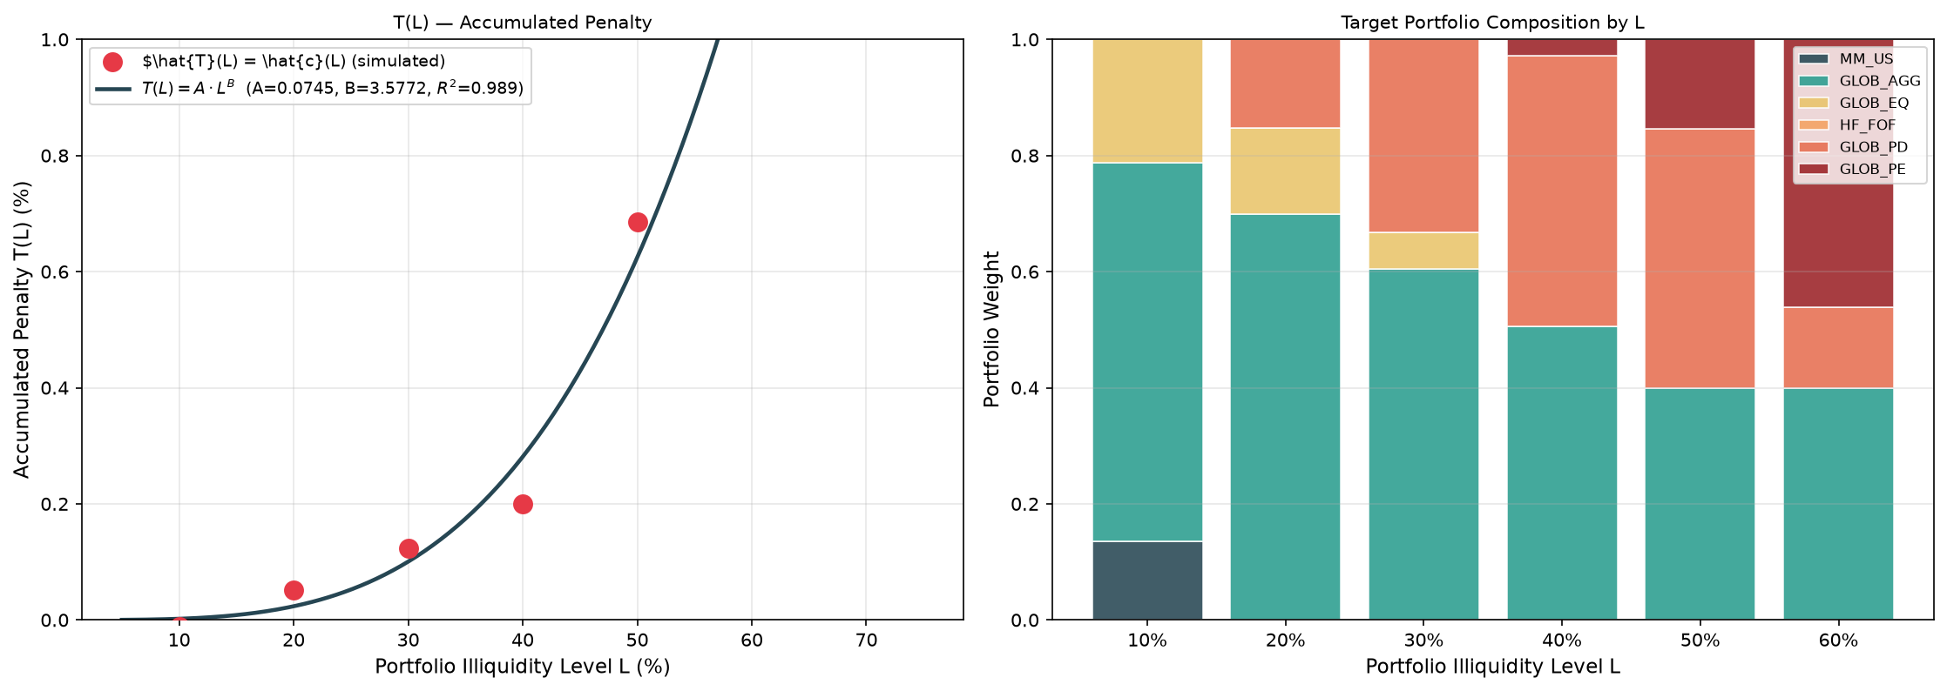
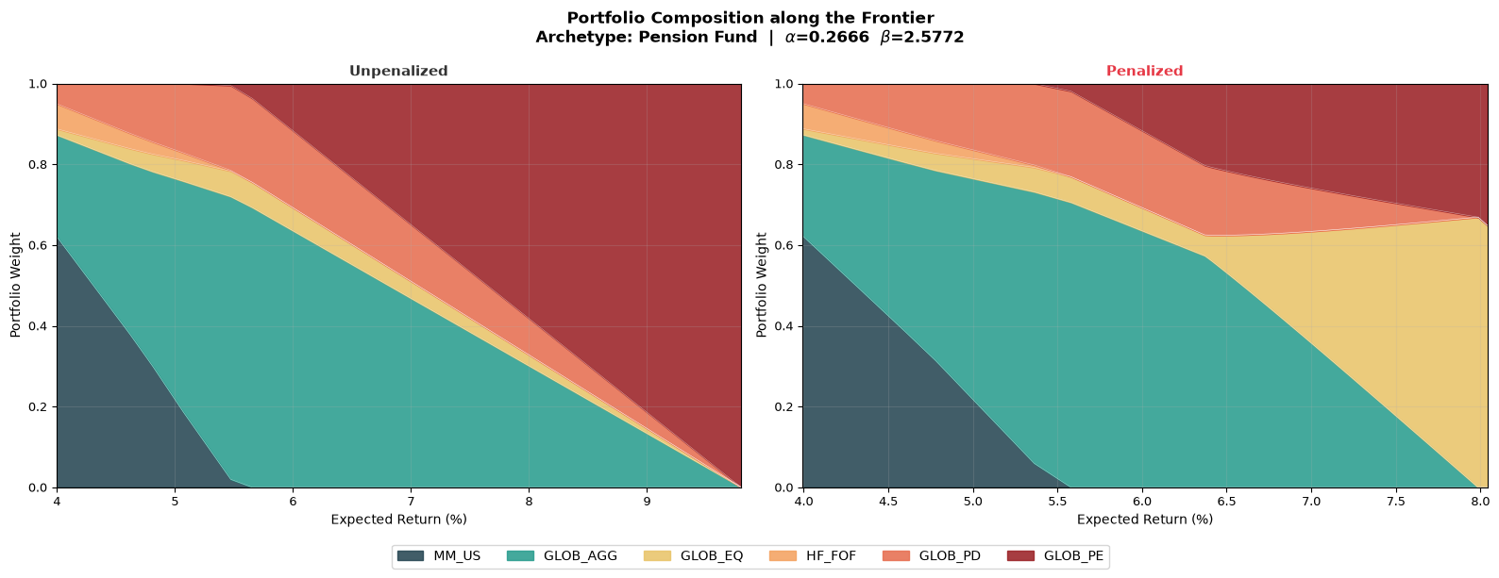
Pension Fund: Calibrated Curve and Allocation
01 02 03 04 05 Implications for portfolio construction
The most liquidity-constrained archetype
α = 0.27
Simulated cost and fitted curve · Target portfolios by illiquidity level
Level of the marginal penalty
β = 2.53
Curvature of the marginal penalty
R² = 0.99
Fit quality
Portfolio composition* along the frontier: unpenalized vs penalized
Highest cost at any illiquidity level.
PD and PE are reduced, with GLOB_EQ absorbing part of the equity exposure at high return levels.
Maximum attainable return capped at about 8%.
* Both frontiers are subject to three relative constraints: private debt capped at 30% of global aggregate, equity at least 30% of private debt, and hedge funds at least 10% of cash
Notes:
[Technical]
Figure 8 and Figure 14 of the thesis.

Slide 24
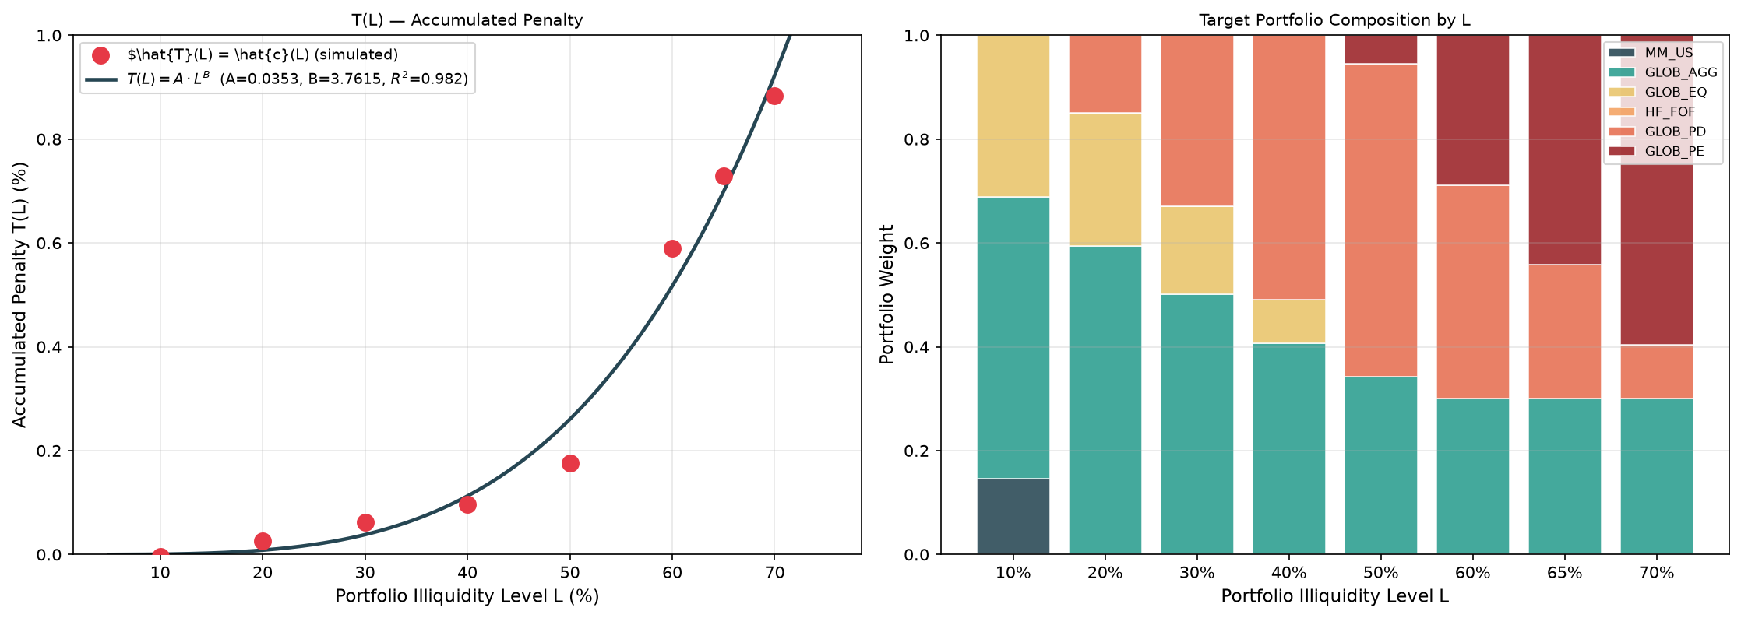
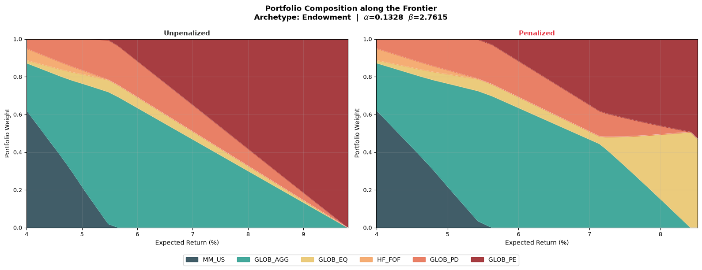
Endowment: Calibrated Curve and Allocation
01 02 03 04 05 Implications for portfolio construction
Intermediate profile with the most convex cost curve
α = 0.13
Simulated cost and fitted curve · Target portfolios by illiquidity level
Level of the marginal penalty
β = 2.76
Curvature of the marginal penalty
R² = 0.98
Fit quality
Portfolio composition* along the frontier: unpenalized vs penalized
Costs negligible at low illiquidity, then accelerating sharply above a threshold.
Below the threshold, penalized and unpenalized allocations are nearly identical.
Above it, GLOB_EQ appears abruptly and displaces GLOB_PD and GLOB_PE.
* Both frontiers are subject to three relative constraints: private debt capped at 30% of global aggregate, equity at least 30% of private debt, and hedge funds at least 10% of cash
Notes:
[Technical]
Figure 9 and Figure 15 of the thesis.

Slide 25
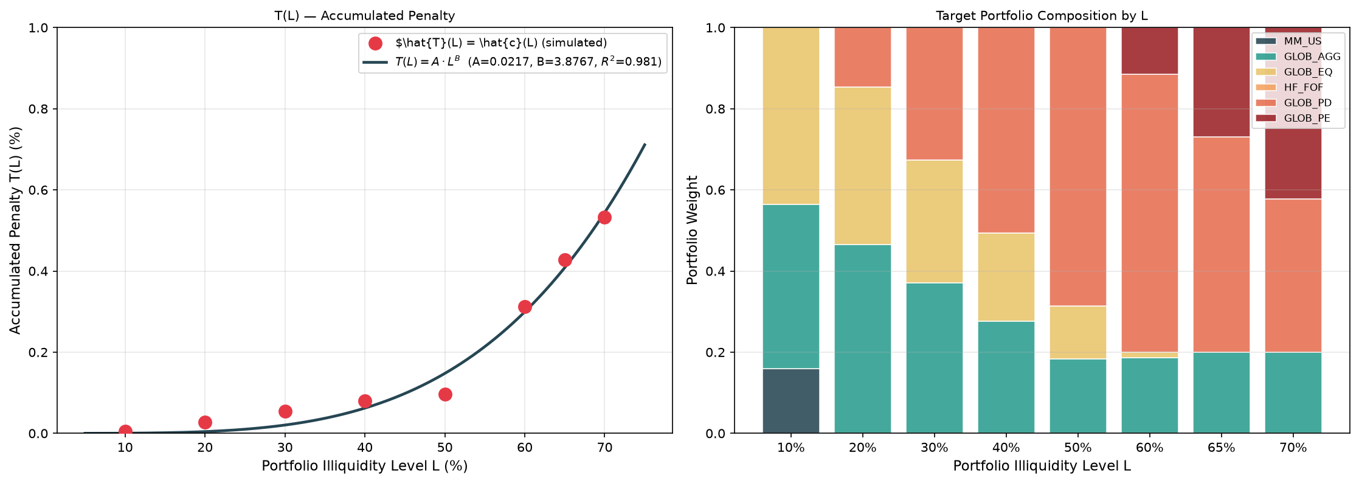
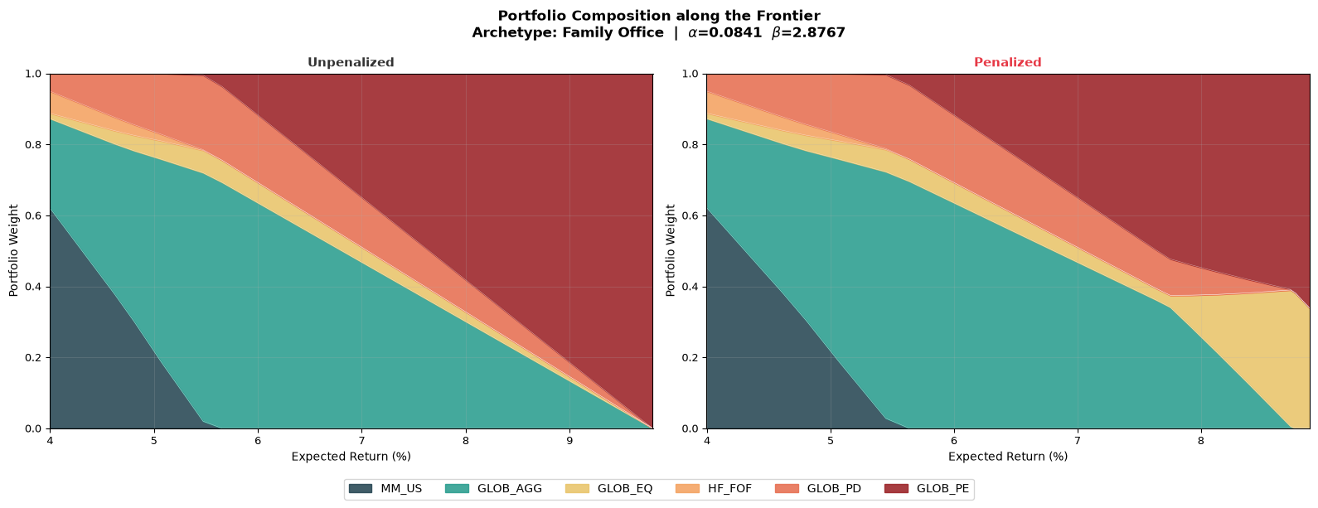
Family Office: Calibrated Curve and Allocation
01 02 03 04 05 Implications for portfolio construction
The least constrained archetype
α = 0.084
Simulated cost and fitted curve · Target portfolios by illiquidity level
Level of the marginal penalty
β = 2.87
Curvature of the marginal penalty
R² = 0.98
Fit quality
Portfolio composition* along the frontier: unpenalized vs penalized
Mildest and most gradually accumulating penalty.
GLOB_PD and GLOB_PE dominates at high return levels in both cases.
For this investor, the unpenalized MVO is a close approximation.
* Both frontiers are subject to three relative constraints: private debt capped at 30% of global aggregate, equity at least 30% of private debt, and hedge funds at least 10% of cash
Notes:
[Technical]
Figure 9 and Figure 15 of the thesis.

Slide 26
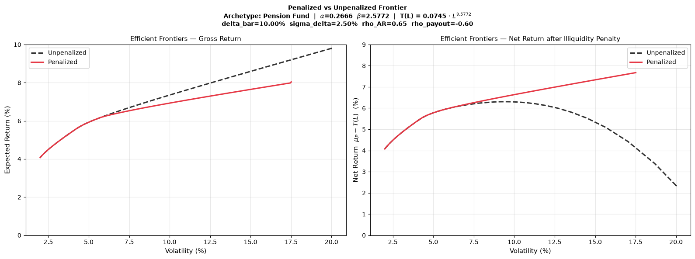
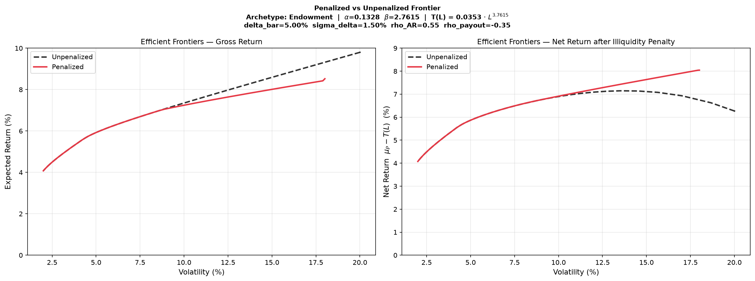
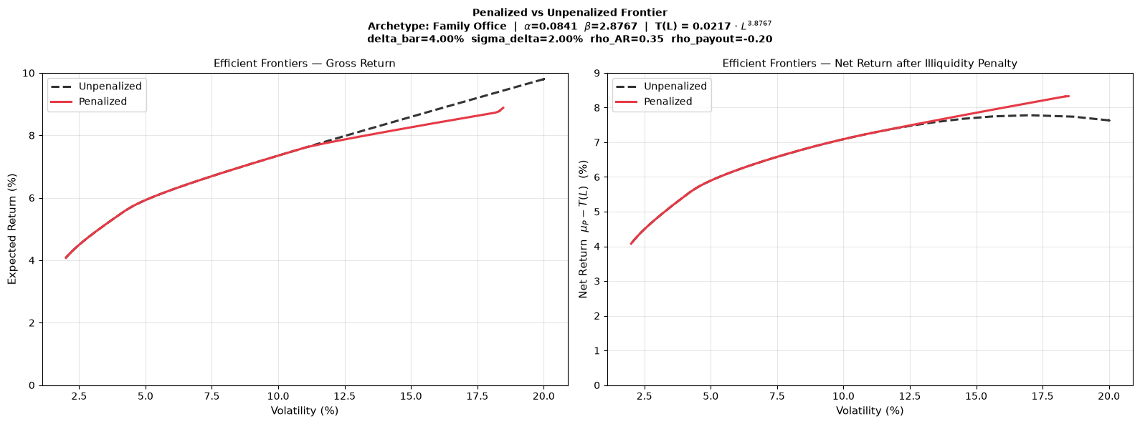
Gross vs Net Frontiers Across Archetypes
01 02 03 04 05 Implications for portfolio construction
Penalized (red) versus unpenalized (dashed) efficient frontier with the calibrated curves
Gross expected return
Pension Fund α = 0.27, β = 2.58
Endowment α = 0.13, β = 2.76
Family Office α = 0.084, β = 2.87
Net expected return
Key takeaway net of the penalty the penalized frontier dominates: >150 bp for the pension fund, a high-volatility gap for the endowment, negligible for the family office.
Notes:
[Commercial + Technical]
Figures 11-13 of the thesis (Section 7.1). Read the bottom row: the unpenalized net return turns hump-shaped for the pension fund and the endowment, while the family office frontiers coincide.

Slide 27
Future developments
05
Using the framework in Amundi's SAA work, and extending it
Notes:
[Commercial + Technical]
Chapter divider.

Slide 28
Putting the Framework to Work at Amundi
01 02 03 04 05 From research to practice
From a research framework to a tool for institutional SAA mandates
01
Built on Amundi's own assumptions
Parametrised entirely on Amundi's CMAs: consistent with our forward-looking views and directly usable in client-facing SAA mandates.
02
Investor-specific
Different penalty curves across archetypes, reflecting payout dynamics and liability structure: one tool for the whole institutional client base.
03
Replicable and updatable
Transparent and auditable calibration, refreshable at every CMA update and ready for integration into the SAA pipeline.
04
A language committees understand
Illiquidity costs expressed as return premiums: accessible to non-quantitative stakeholders without losing analytical rigour.
Notes:
[Commercial]
From the ARA editorial committee note.

Slide 29
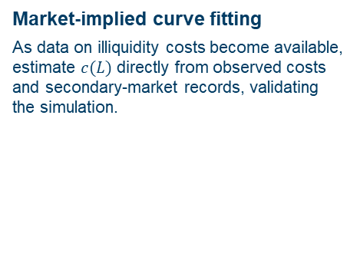
What’s next?
01 02 03 04 05 From research to practice
Towards a More Realistic and Investor-Specific Calibration Framework
01
02
03
Richer return dynamics
Replace the multivariate normal with regime-switching or stochastic-volatility models, to capture fat tails and the stress scenarios where forced selling is most costly.
Liability-aware calibration
Model the asset-liability structure explicitly: payouts driven by liability duration and funding ratio, so the curve depends on the investor's balance sheet.
Market-implied curve fitting
As data on illiquidity costs become available, estimate $c(L)$ directly from observed costs and secondary-market records, validating the simulation.
Towards production integrate the calibration into the SAA pipeline, refresh the curves at each CMA update, and calibrate client-specific parameters for institutional mandates.
Notes:
[Commercial + Technical]
Section 8.2 limitations and future work.

Slide 30
Sources and assumptions​
01 02 03 04 05 From research to practice
Sources of CMA: Amundi Asset Management CASM Model, Amundi Asset Management Quant Solutions and Amundi Investment Institute Teams. Macro figures as of the last release. The starting simulation date is 31 December 2025. Equity returns based on MSCI indices. Reference durations are average figures. Returns on credit assets are comprehensive of default losses. If not otherwise specified, expected returns are geometric annualised average total returns at the specific horizon. EM debt HC, EM-GBI, global infrastructure and hedge funds are in USD, all other indices are in local currency. Returns are nominal and gross of fees, except private and alternative assets which are net of management and admin fees. US direct lending considers leverage on the fund. Real estate refers to all property unlevered real estate. Hedge Funds refer to fund of Hedge funds. The expected returns consider the market beta and the alternative assets risk premium. The alpha return component generated by portfolio management, strategy selection or specific value creation programmes, which can be significant above all for private and alternative assets, is not considered in any form.
The arithmetic average returns are derived using the price generated by our simulation engine. By definition, the arithmetic mean is always greater than or equal to the geometric mean. In particular, the higher volatility of returns and higher frequency of returns and/or a longer time horizon will increase the difference between the two measures. Simulated volatilities are calculated on simulated prices over a 10-year horizon. Simulated volatility for private and alternative assets is derived from unsmoothed return series. Hence, this measure of volatility will be different from the one obtained from realised IRR. Expected returns are calculated using Amundi central scenario assumptions, which include climate transition. Forecast and fair values up to a 3-year horizon are provided by the Amundi Investment Institute Research team (macro, yields, spread and equity). Forecasts for annualised returns are based upon estimates and reflect subjective judgments and assumptions. These results were achieved by means of a mathematical formula and do not reflect the effect of unforeseen economic and market factors on decision-making. The forecast returns are not necessarily indicative of future performance.
Data sources: Bloomberg, Cambridge Associates, Global Financial Data. Edhec Infra, MSCI and MSCI Burgiss, Pitchbook, Preqin.
Indices: Equity indices are MSCI regional indices TR, Credit indices are from BofA Merrill Lynch, Aggregate indices are from Bloomberg Barclays, Govies and EM bonds indices are from JP Morgan.
Notes:
[Commercial + Technical]
Section 8.2 limitations and future work.

