Slide 1
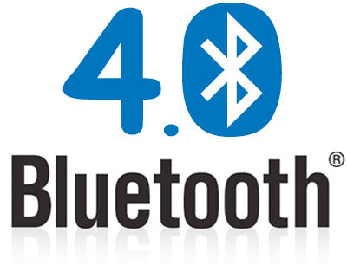
Bluetooth 4.0: Low Energy

Slide 2
Short range wireless application areas
 | Voice | Data | Audio | Video | State
Bluetooth ACL/HS | x | Y | Y | x | x
Bluetooth SCO/eSCO | Y | x | x | x | x
Bluetooth low energy | x | x | x | x | Y
Wi-Fi | (VoIP) | Y | Y | Y | x
Wi-Fi Direct | Y | Y | Y | x | x
ZigBee | x | x | x | x | Y
ANT | x | x | x | x | Y
Low Power
State = low bandwidth, low latency data

Slide 3
How much energy does traditional Bluetooth use?
Traditional Bluetooth is connection oriented. When a device is connected, a link is maintained, even if there is no data flowing.
Sniff modes allow devices to sleep, reducing power consumption to give months of battery life
Peak transmit current is typically around 25mA
Even though it has been independently shown to be lower power than other radio standards, it is still not low enough power for coin cells and energy harvesting applications

Slide 4
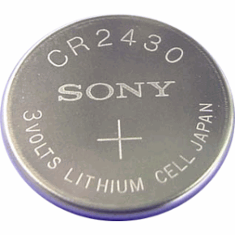
What is Bluetooth Low Energy?
Bluetooth low energy is a NEW, open, short range radio technology
  Blank sheet of paper design
  Different to Bluetooth classic (BR/EDR)
  Optimized for ultra low power
  Enable coin cell battery use cases
    < 20mA peak current
    < 5 uA average current

Slide 5
Basic Concepts of Bluetooth 4.0
Everything is optimized for lowest power consumption
  Short packets reduce TX peak current
  Short packets reduce RX time
  Less RF channels to improve discovery and connection time
  Simple state machine
  Single protocol
  Etc.

Slide 6
Bluetooth low energy factsheet
Range: | ~ 150 meters open field
Output Power: | ~ 10 mW (10dBm)
Max Current: | ~ 15 mA
Latency: | 3 ms
Topology: | Star
Connections: | > 2 billion
Modulation: | GFSK @ 2.4 GHz
Robustness: | Adaptive Frequency Hopping, 24 bit CRC
Security: | 128bit AES CCM
Sleep current: | ~ 1μA
Modes: | Broadcast, Connection, Event Data Models, Reads, Writes

Slide 7
Bluetooth low energy factsheet #2
Data Throughput
  For Bluetooth low energy, data throughput is not a meaningful parameter. It does not support streaming.
  It has a data rate of 1Mbps, but is not optimized for file transfer.
  It is designed for sending small chunks of data (exposing state)

Slide 8
Designed for exposing state
It’s good at small, discrete data transfers.
Data can triggered by local events.
Data can be read at any time by a client.
Interface model is very simple (GATT)
23.2˚C
60.5 km/h
12:23 pm
Gate 10 BOARDING
3.2 kWh
PLAY >>
Network Available

Slide 9
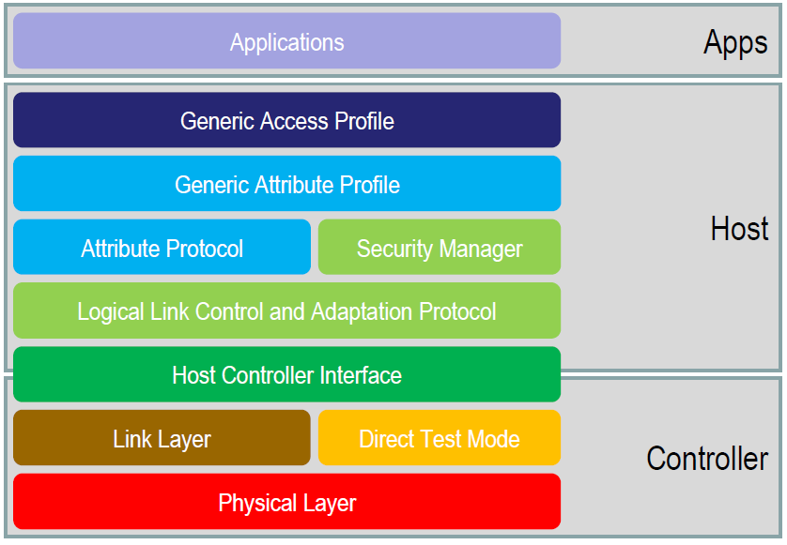
Bluetooth Low Energy Architecture

Slide 10
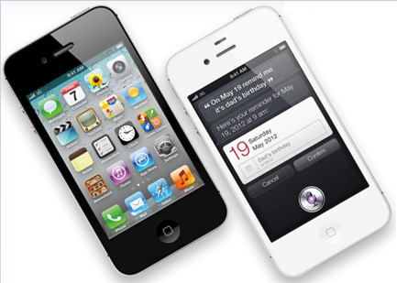
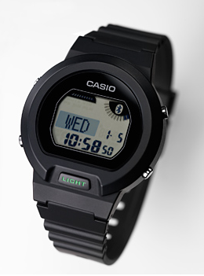
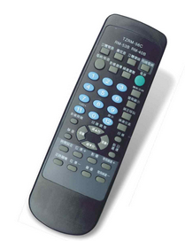
Device Modes
Dual Mode
  Bluetooth BR/EDR and LE
  Used anywhere that BR/EDR
  is used today
Single Mode
  Implements only Bluetooth low energy
  Will be used in
  new devices / applications

Slide 11
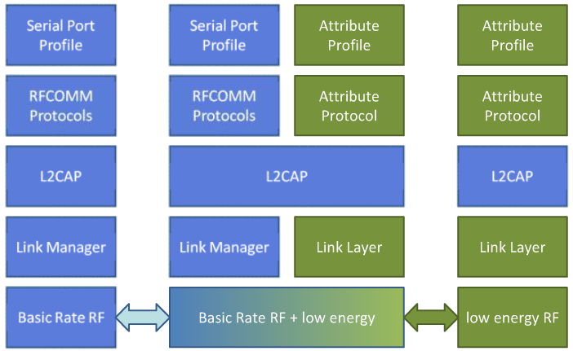
Device Modes
Dual mode + single modes
BR/EDR stack
Dual-mode stack
Single-mode stack

Slide 12
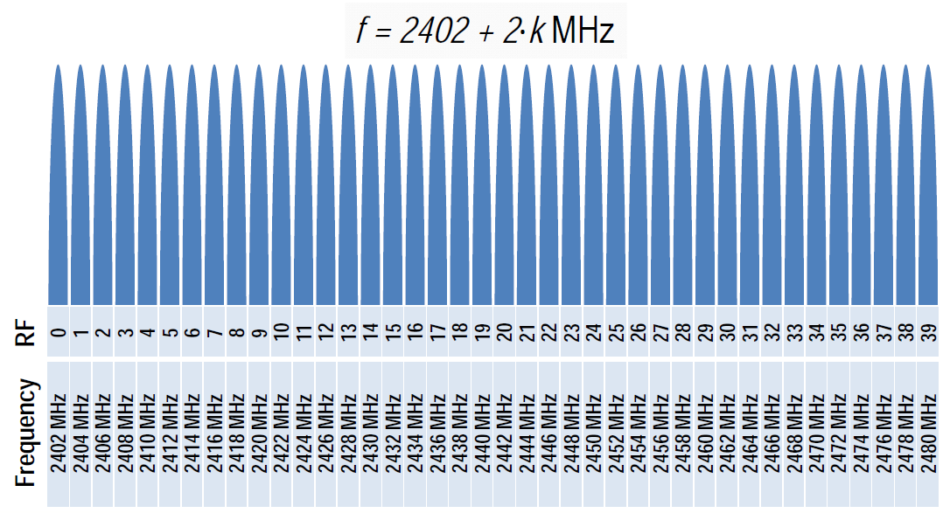
Physical Layer
2.4 GHz ISM band
1Mbps GFSK
  Larger modulation index than Bluetooth BR (which means better range)
40 Channels on 2 MHz spacing

Slide 13
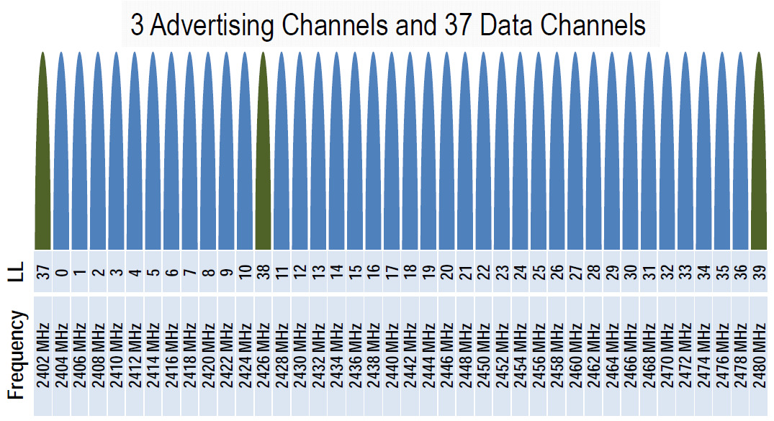
Physical Channels
Two types of channels

Slide 14
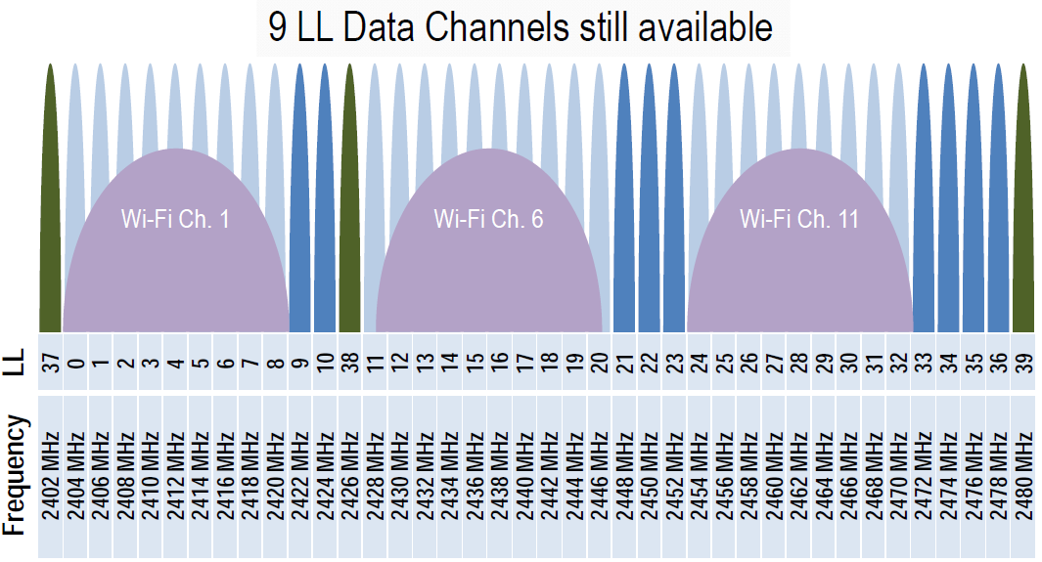
Physical Channels
Advertising channels avoid 802.11

Slide 15
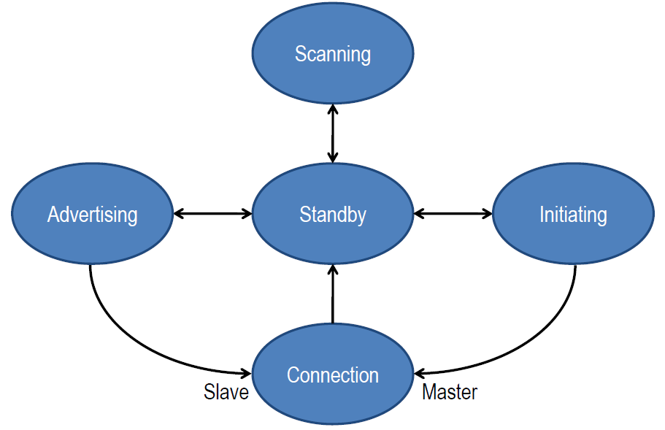
Link Layer
Link Layer state machine

Slide 16
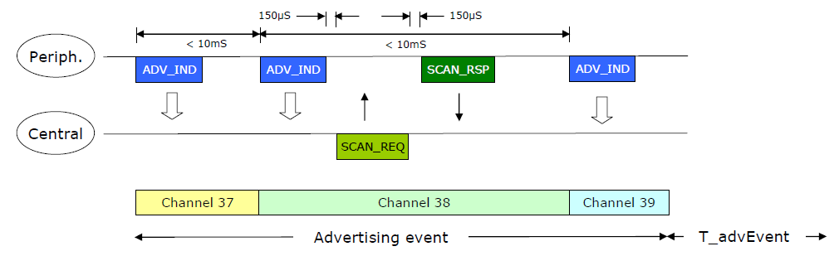
Advertising
Devices can advertise for a variety of reasons:
  To broadcast promiscuously
  To transmit signed data to a previously bonded device
  To advertise their presence to a device wanting to connect
  To reconnect asynchronously due to a local event

Slide 17
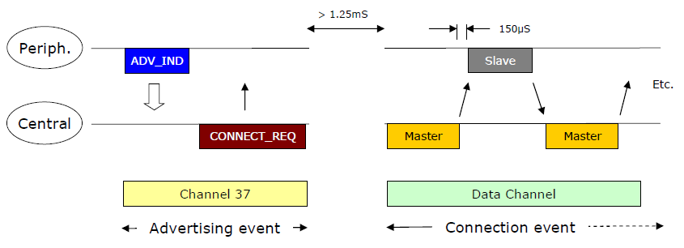
Data transactions
Once a connection is made:
  Master informs slave of hopping sequence and when to wake
  All subsequent transactions are performed in the 37 data channels
  Transactions can be encrypted
  Both devices can go into deep sleep between transactions

Slide 18
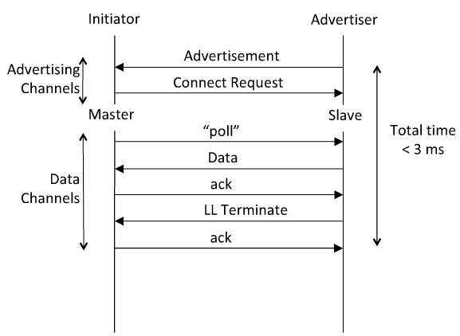
Link Layer Connection
Very low latency connection

Slide 19
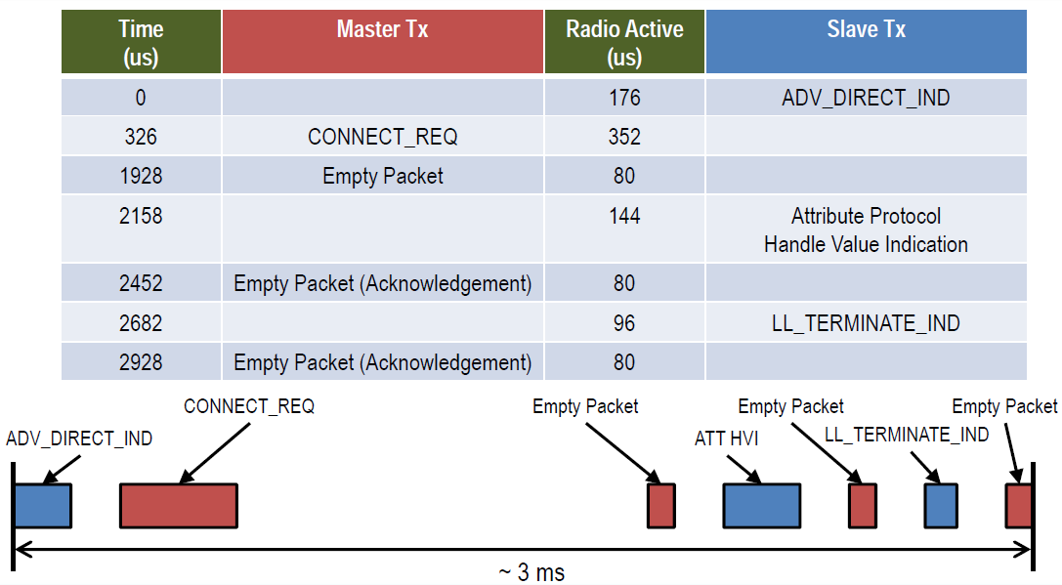
Time From Disconnected to Data ~ 3ms

Slide 20
How low can the energy get?
From the previous slide, calculate energy per transaction
  Assume an upper bound of 3ms per minimal transaction
  Estimated TX power is 15mW (mostly TX power amp for 65nm chips)
  For 1.5v battery, this is 10mA. 0.015W * 0.003 sec = 45 micro Joule
How long could a sensor last on a battery?
  An example battery: Lenmar WC357, 1.55v, 180mAh, $2-5
  180mAh/10mA = 18Hr = 64,800 seconds = 21.6M transactions
  Suppose this sensor sends a report every minute = 1440/day
  For just the BT LE transactions, this is 15,000 days, or > 40 years
  This far exceeds the life of the battery and/or the product
This means that battery will cost more than the electronics
  This sensor could run on scavenged power, e.g. ambient light

Slide 21
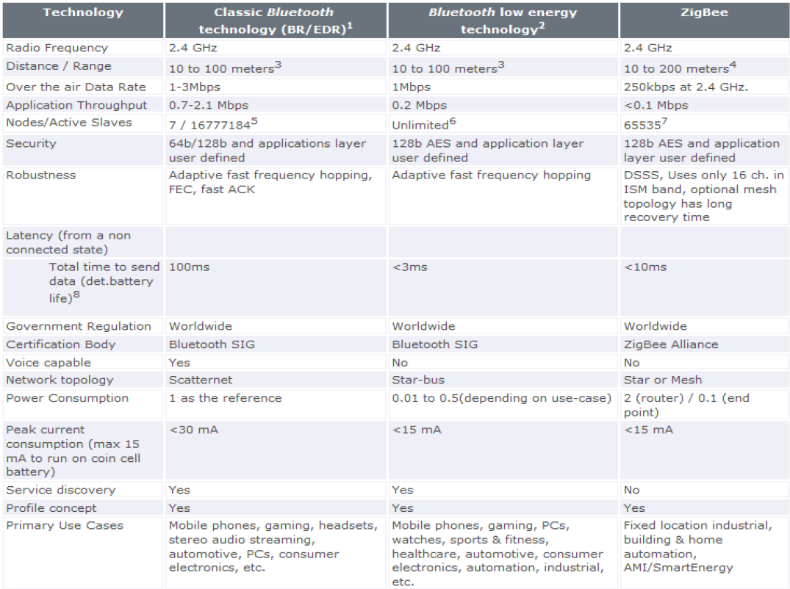
Competitive perspective

Slide 22
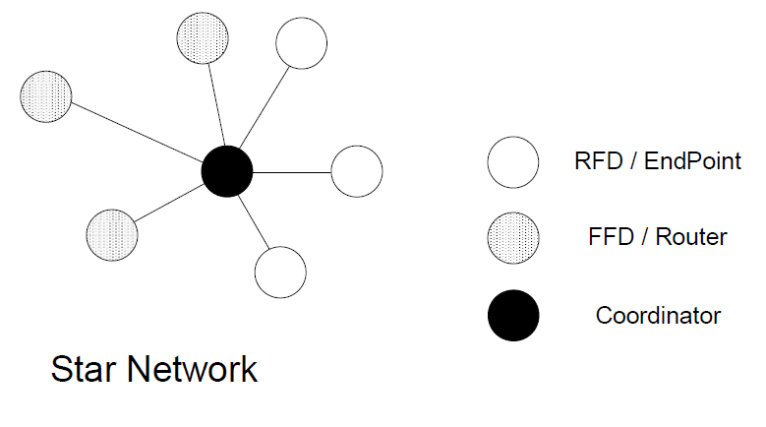
Basic topology of 802.15.4

Slide 23
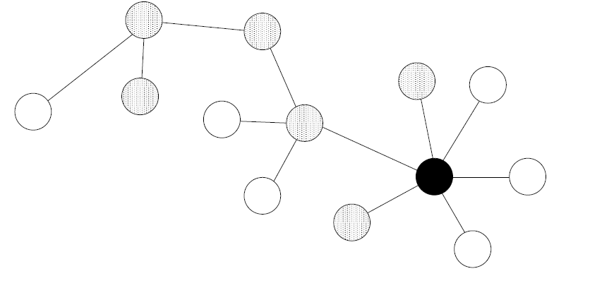
ZigBee: Cluster tree network

Slide 24
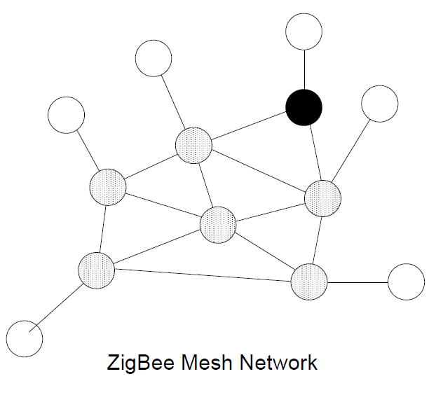
ZigBee PRO: mesh

Slide 25
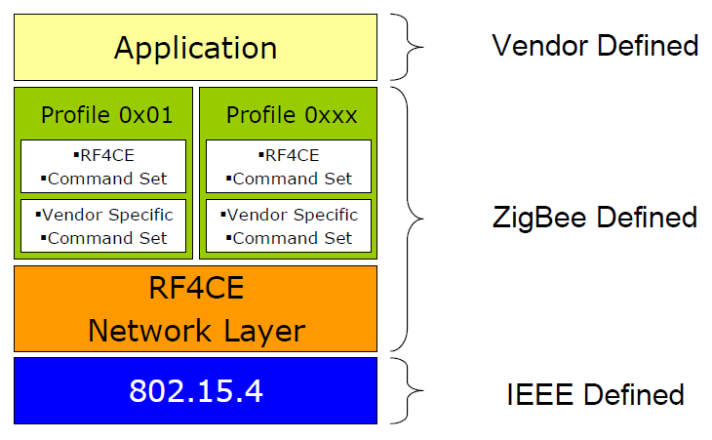
Future ZigBee: RF4CE
Targeted at Remote Control
Uses three channels only – 15,20 and 25

Slide 26
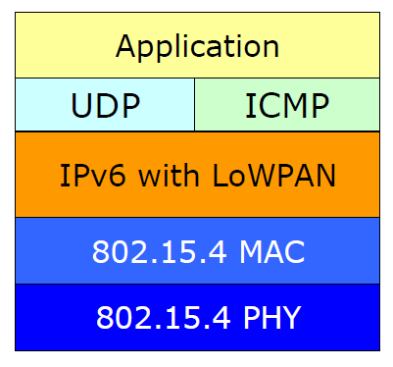
Future ZigBee: 6LoWPAN
An initiative to “squeeze” IPv6 addressing into reasonably sized wireless packets
Being adopted for ZigBee’s Smart Energy Profile 2.0

Slide 27
ZigBee and Bluetooth Low Energy
Business comparison:
  ZigBee is older. It has gone through some iterations
  ZigBee has market mindshare, but not a lot of shipments yet.
  Market barriers: connectivity – ZigBee is not in PCs or mobile phones yet.
Technical comparison:
  Zigbee is low power; Bluetooth LE is even lower. Detailed analysis depends on specific applications and design detail, no to mention chip geometry.
  ZigBee stack is light; the Bluetooth LE/GATT stack is even simpler
Going forward:
  ZigBee has a lead on developing applications and presence
  Bluetooth low energy has improved technology, and a commanding presence in several existing markets: mobile phones, automobiles, consumer electronics, PC industry
  Replacing “classic Bluetooth ” with “dual mode” devices will bootstrap this market quickly

Slide 28
What are the USE CASES planned for BT 4.0?
Proximity
Time
Emergency
Network availability
Personal User Interface
Simple remote control
Browse over Bluetooth
Temperature Sensor
Humidity Sensor
HVAC
Generic I/O (automation)
Battery status
Heart rate monitor
Physical activity monitor
Blood glucose monitor
Cycling sensors
Pulse Oximeter
Body thermometer

Slide 29
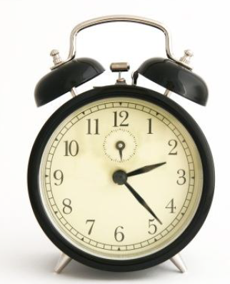
Example use: proximity
It can enable proximity detection
  I’m in the car
  I’m in the office
  I’m in the meeting room
  I’m in the movie theater
It can enable presence detection
  Turn the lights on when I walk around the house
  Automatically locks the door when I leave home
  Turn the alarm off if I’m already awake

Slide 30
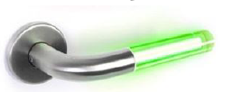
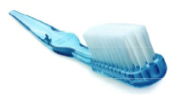
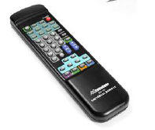
Everyday objects can become sensors
My pulse is …
My blood glucose is …
My temperature is …
… and monitor things unobtrusively

