Slide 1
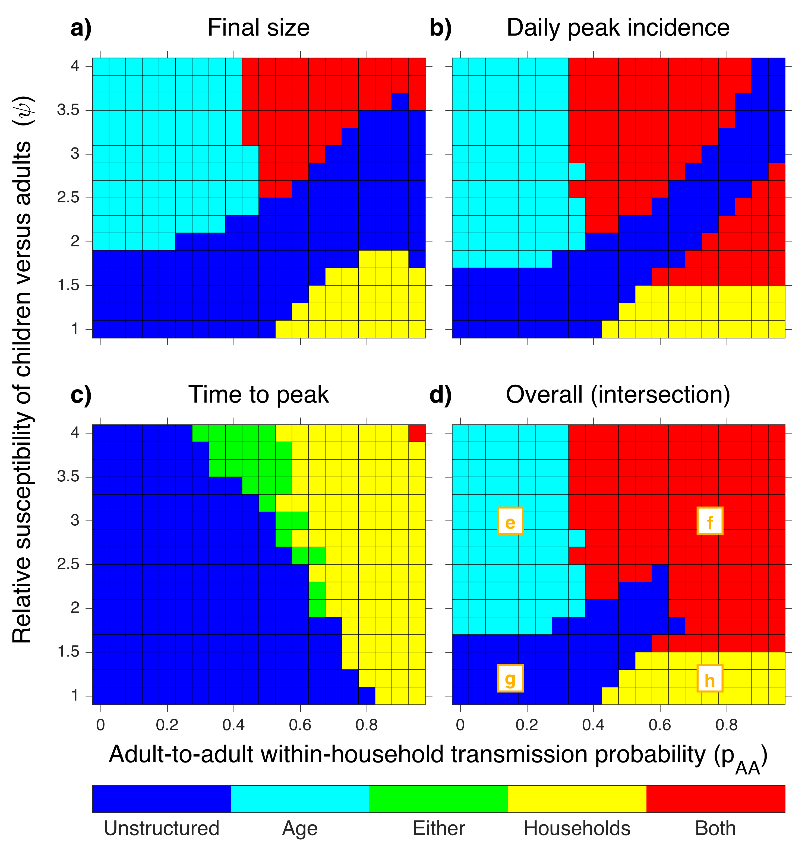
AH
incidence
AH
AH
incidence
incidence
AH
A
A
incidence
incidence
incidence
A
incidence
H
H
incidence
incidence
H
incidence
A
A
A
incidence
incidence
incidence
AH
AH
AH
cumulative
incidence
cumulative
incidence
cumulative
incidence
A
A
cumulative
incidence
A
cumulative
incidence
cumulative
incidence
H
H
cumulative
incidence
cumulative
incidence
H
U
cumulative
incidence
U
cumulative
incidence
cumulative
incidence
U
population
cumulative
incidence
population
size
size
population
size

Slide 2
AH
AH
AH
AH
incidence
AH
AH
incidence
incidence
incidence
incidence
incidence
AH
A
A
A
incidence
incidence
incidence
incidence
A
incidence
A
incidence
A
incidence
H
H
H
H
incidence
incidence
incidence
incidence
A
A
A
A
A
incidence
incidence
incidence
incidence
incidence
AH
AH
AH
cumulative
incidence
AH
AH
cumulative
incidence
AH
cumulative
incidence
cumulative
incidence
cumulative
incidence
cumulative
incidence
A
A
cumulative
incidence
A
A
cumulative
incidence
cumulative
incidence
cumulative
incidence
H
H
cumulative
incidence
cumulative
incidence
H
H
U
cumulative
incidence
cumulative
incidence
U
cumulative
incidence
cumulative
incidence
population
population
U
U
population
size
size
cumulative
incidence
cumulative
incidence
size
population
population
size
size

Slide 3
AH
incidence
A
incidence
H
incidence
A
incidence
AH
cumulative
incidence
A
cumulative
incidence
H
cumulative
incidence
U
cumulative
incidence
population
size

