Slide 1
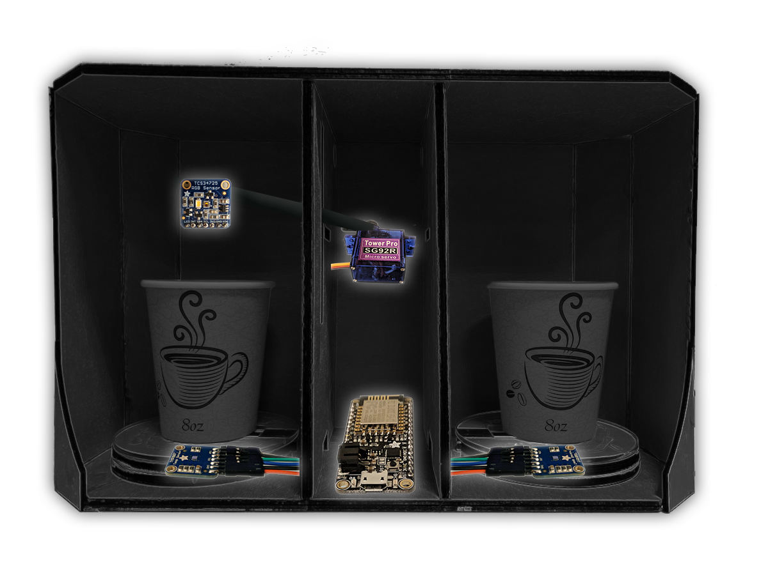
Premium wood finish
TCS34725 colour sensor
Precision servo motor
ESP8266 wireless chip
TMP007 infrared sensors

