Slide 1

Course evaluation
2025-2026
MCS Quality assurance team
Department of Mathematics and Computer Science

Slide 2
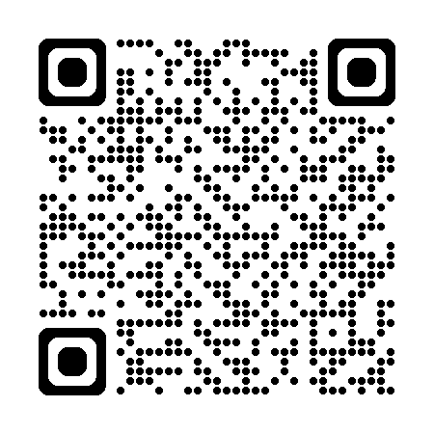

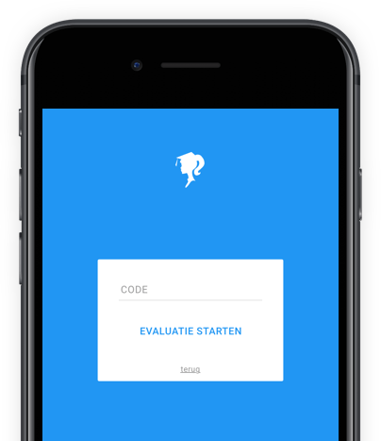
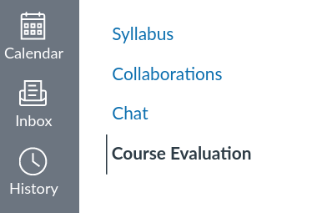
Please complete the survey
https://app.evalytics.nl

Slide 3
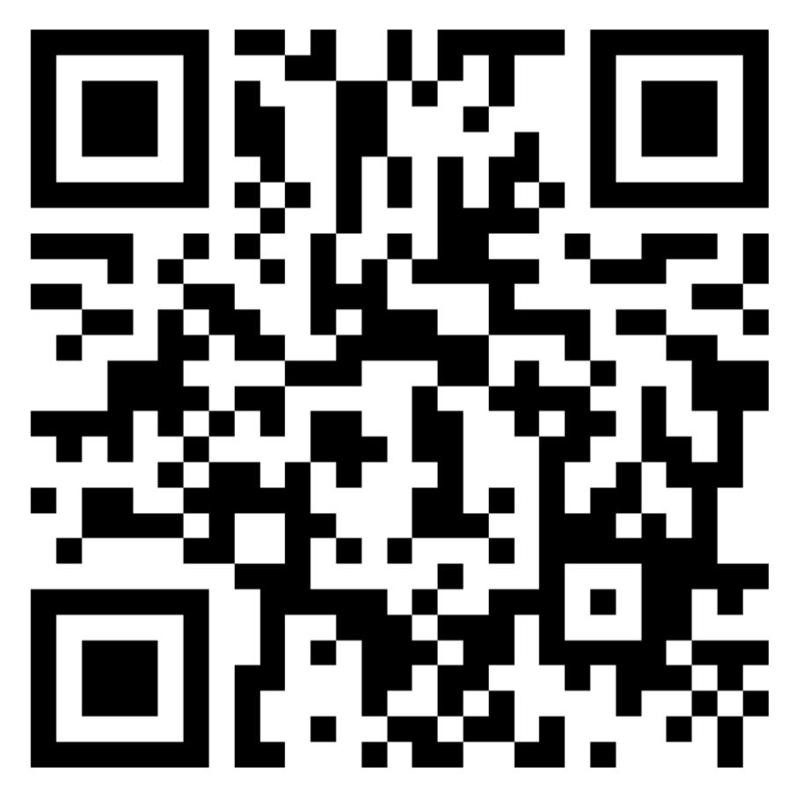
Evaluation of the final exam/assignment
The course evaluation surveys will be closed one day before the final exam; if you want to give feedback about the final exam/assignment, you can use this link or QR code.

Slide 4
What happens to the results of the surveys?
Tips to provide more impactful feedback
Be specific and focused on your feedback. Use examples and suggestions to avoid vague statements.
Always be respectful when giving feedback.
Give positive feedback as well as areas for improvement. Stay solution-oriented.
When giving feedback, focus on the 1 or 2 most important points that apply to you.
The responsible teacher reads the anonymous results and reflects on their course.
Results and reflection are discussed during committee meetings to improve the courses and programs!

