Slide 1

Car Accident Severity
Applied Data Science Capstone
IBM Data Science Professional Certificate
07th October 2020

Slide 2
Preventing car accidents
ADVANTAGES
Citizen Psychological Safety
Less expenditure on road maintenance
Better managing of county/region/state resources
OBJECTIVES
Gather insights on car accidents and road safety
Analyze impact of variables on car accidents
Suggest actions to take

Slide 3
Data Overview
2019 annual report on road traffic collisions and casualties on public roads in Leeds, UK. https://data.gov.uk/dataset/6efe5505-941f-45bf-b576-4c1e09b579a1/road-traffic-accidents
Total of 1907 rows of data and 18 variables
Data cleaning was performed (variables picking, looking for null variables and so on)

Slide 4
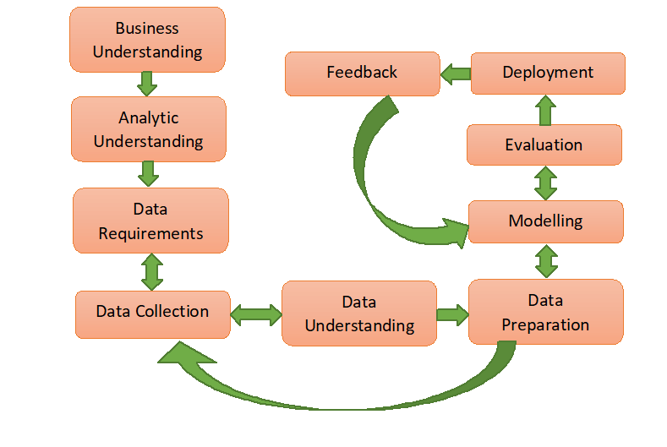
Data Science Methodology

Slide 5
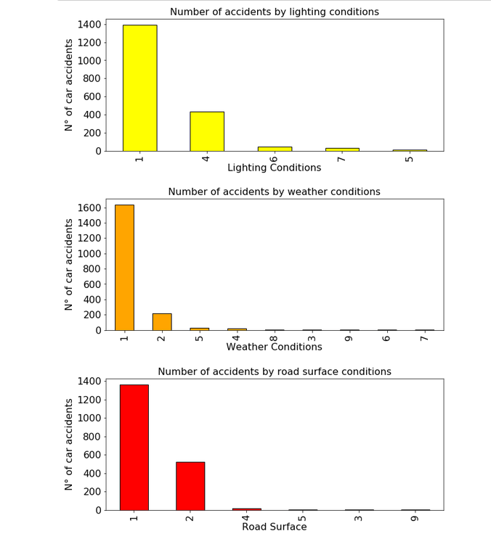
N° of accidents by lighting, weather and road surface conditions
For data type info check the report

Slide 6
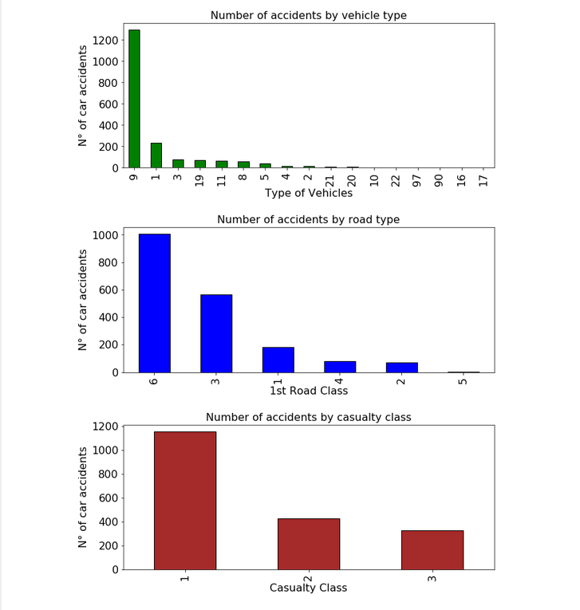
N° of accidents by vehicle type road and casualty class
For data type info check the report

Slide 7
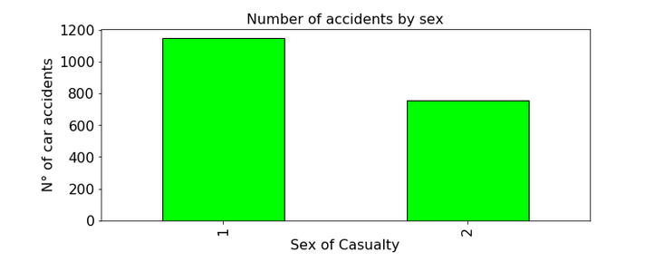
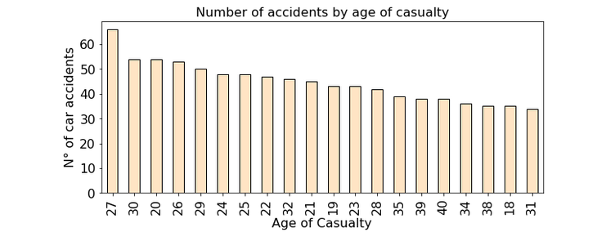
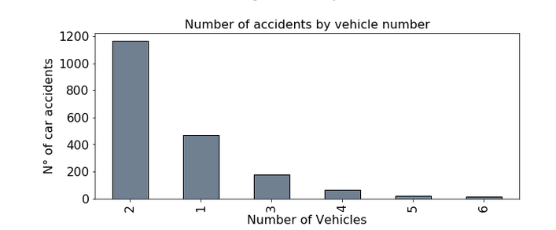
N° of accidents by sex, age of casualty and number of vehicles involved
For data type info check the report

Slide 8
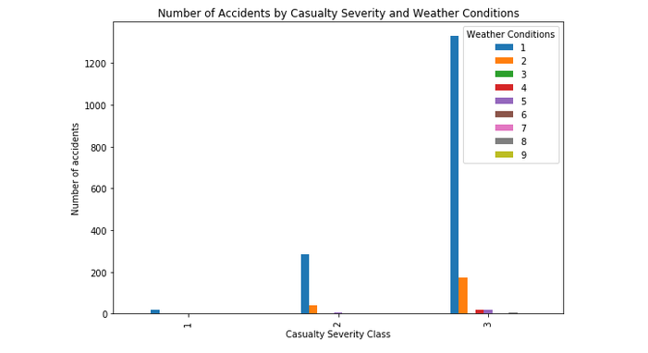
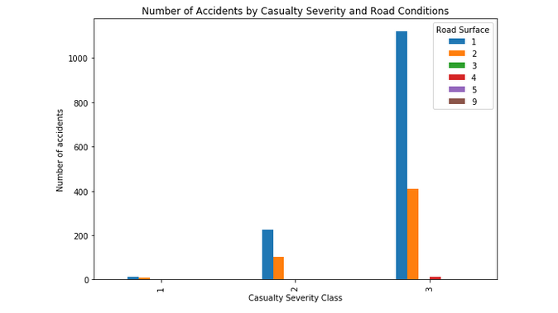
N° of accidents by Casualty Severity and other critical variables
For data type info check the report
Casualty Severity Legend
1. Fatal
2. Serious
3. Slight

Slide 9
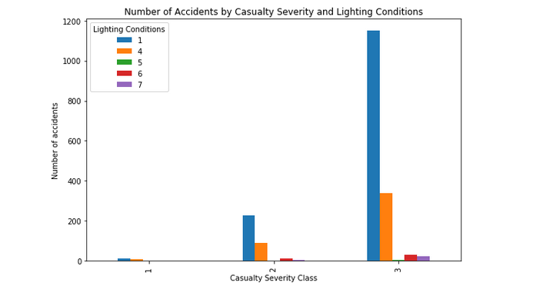
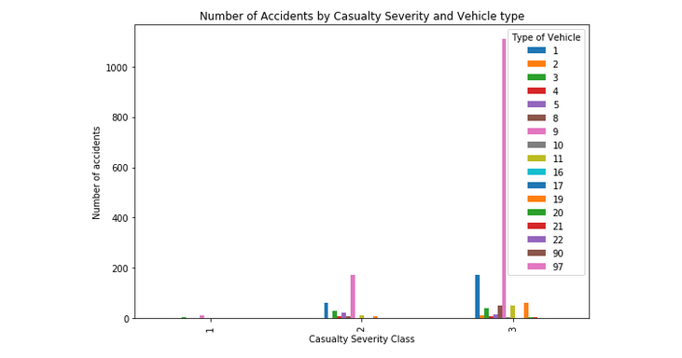
N° of accidents by Casualty Severity and other critical variables
For data type info check the report
Casualty Severity Legend
1. Fatal
2. Serious
3. Slight

Slide 10
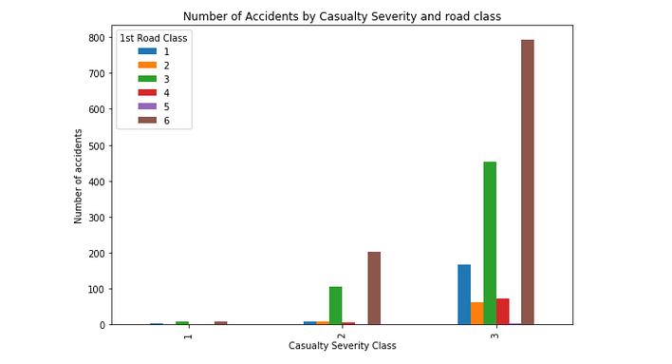
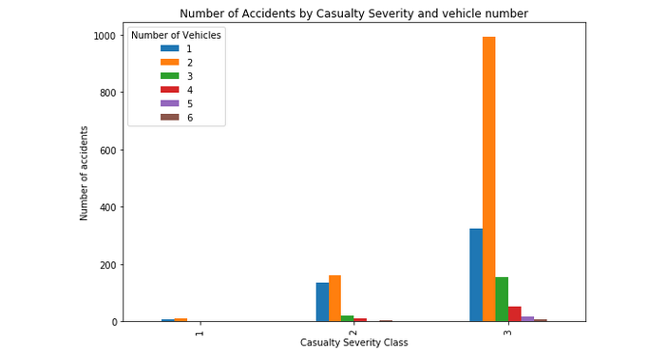
N° of accidents by Casualty Severity and other critical variables
For data type info check the report
Casualty Severity Legend
1. Fatal
2. Serious
3. Slight

Slide 11
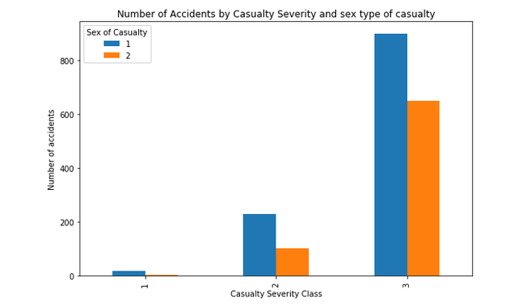
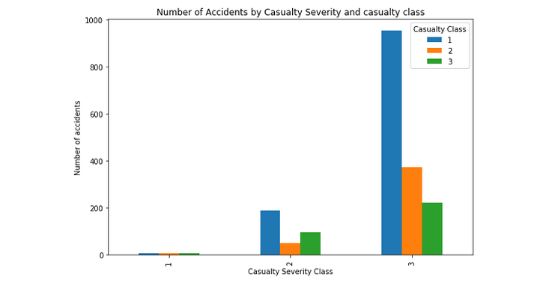
N° of accidents by Casualty Severity and other critical variables
For data type info check the report
Casualty Severity Legend
1. Fatal
2. Serious
3. Slight

Slide 12
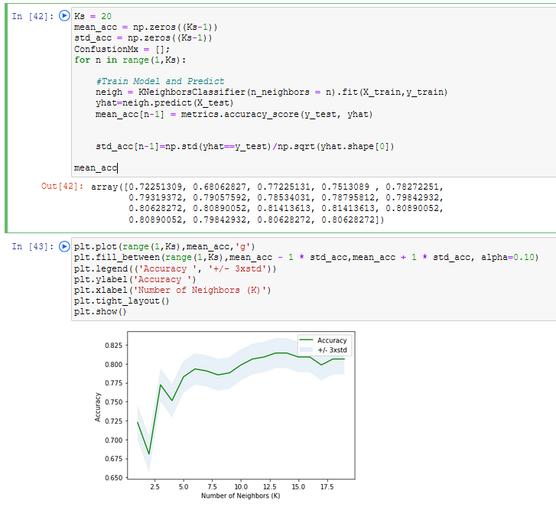
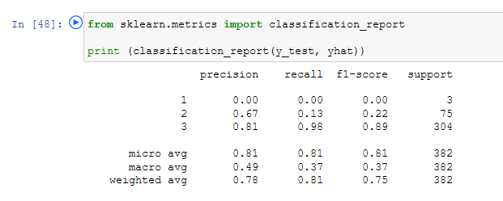
K-nearest neighbor classification model

Slide 13
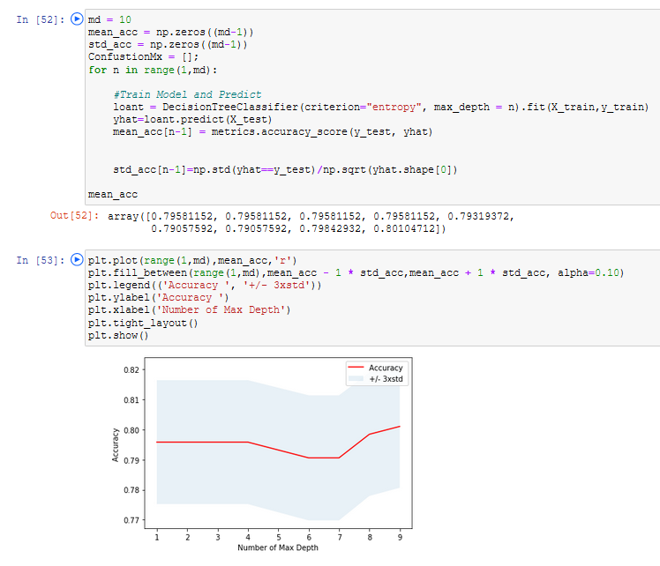
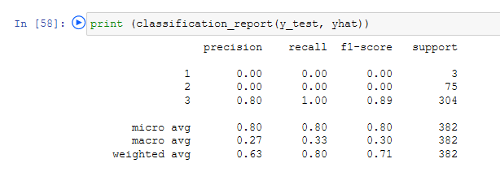
Decision tree classification model

Slide 14
Observations
Recommendations
Most car accidents occurred under “optimal” driving conditions
Dry road conditions
Fine weather, without high winds
Good lighting conditions
Additional attributes could be tracked to better predict car accidents
Traffic conditions in specific road section
Attention level of drivers (hard to measure)
Speed of car at time of crash
Collision and junction type
Expanding severity class

