Slide 1
Childhood exposure to non-persistent endocrine disrupting chemicals and multi-omic markers in a population-based child cohort
Lorenzo Fabbri (@lorenzoF92SM)
BRGE Meeting - 12/01/2022

Slide 2
Outline
Background & Objectives
Methods
Results
Conclusions and Future Work

Slide 3
Background & Objectives
The general population is exposed to a cocktail of chemical exposures
Non-persistent endocrine disruptors (EDCs) are a class of chemicals that interfere with the endocrine system
Multi-omic signatures might provide mechanistic insights into the effect of EDC exposure
We aimed to identify multi-omic signatures associated with non-persistent EDCs using an integrative approach based on Partial Correlation Networks
Notes:
That usually interact in complex ways
Not only the endocrine system, also cardiovascular and central nervous systems, among others
Subtle effects of exposure
Regularized PCCs

Slide 4
Methods
Main idea: move from `single biomarker ~ single exposure` to `all biomarkers ~ all exposures` (i.e., integrative approach)
First attempt: (s)PLS in regression mode
Issues: questionable predictive ability, models explained little variation in the Omics
Second attempt: regularized partial correlation coefficients and GGMs

Slide 5
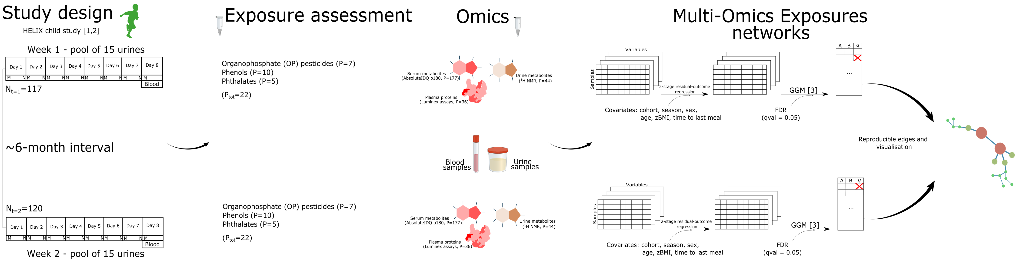
Methods
[1] Vrijheid M, et al. "The human early-life exposome (HELIX): project rationale and design." (2014)
[2] Casas M, et al. "Variability of urinary concentrations of non-persistent chemicals in pregnant women and school-aged children." (2018)
[3] Schafer J, Strimmer K. "A Shrinkage Approach to Large-Scale Covariance Matrix Estimation and Implications for Functional Genomics." (2005)

Slide 6
Methods

Slide 7
Methods
Pipeline (for each time point separately):
Adjustment for covariates (-omics) using 2-stage residual-outcome regression (e.g., `residual(biomarkers ~ covariates)`)
Data transformation: auto-scaling
Merging exposures and -omics into single matrix
Computing correlations using `corpcor` R package (`pcor.shrink` function)
Processing: FDR at 0.05 significance level
Network merging:
Merge by node A, node B and direction (i.e., sign(rho))
Focus on Ccs with exposures and -omics

Slide 8
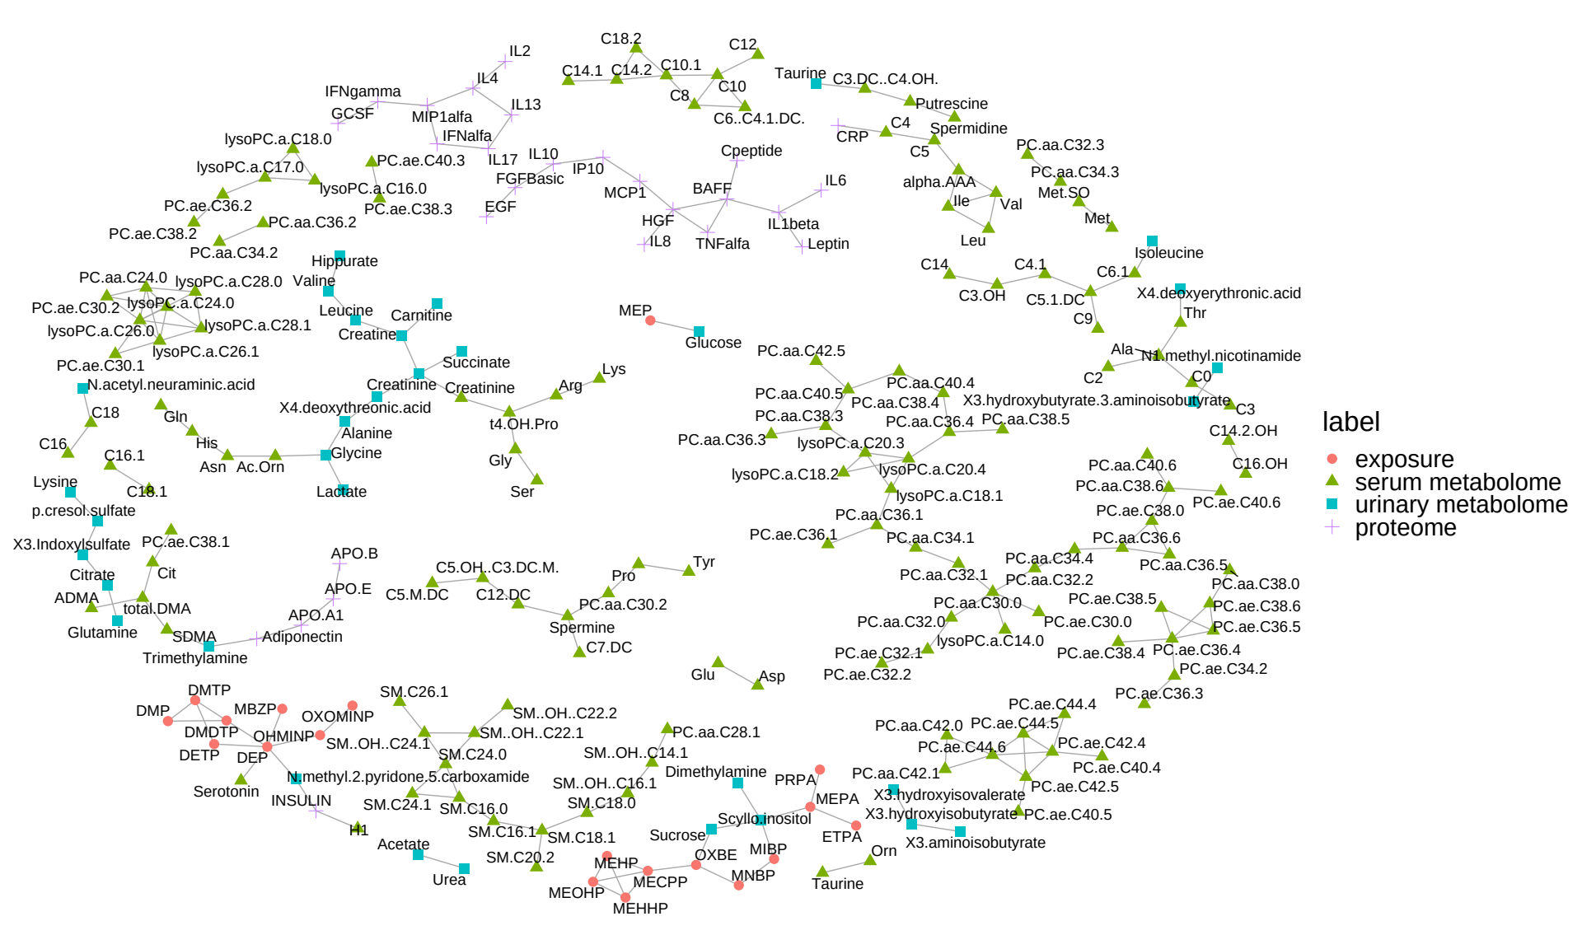
Results
The time-specific networks (Nedges=1,064, Nedges=1,109) included associations of comparable strength (ρ=0.09 (-0.09, 0.11)) and statistical significance (q=0.008 (0.001, 0.025), q=0.01 (0.001, 0.027)). The significant edges represented less than 3% of the possible connections
The merged network consisted of Nedges=229
Notes:
Most of the edges/connections were not reproducible among the two time points
This might be expected also in light of the work of Maribel: most of the exposures have poor to fair between-season reliability

Slide 9
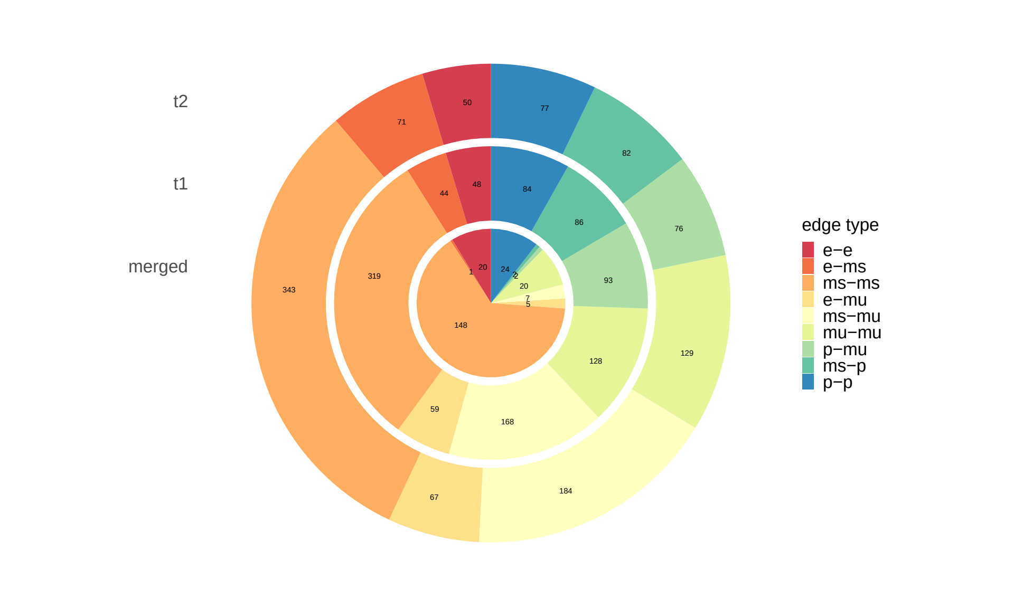
Results
Graph merging led to the exclusion of the majority of exposure-omic connections. Notably, none of the protein-exposure associations were reproducible

Slide 10
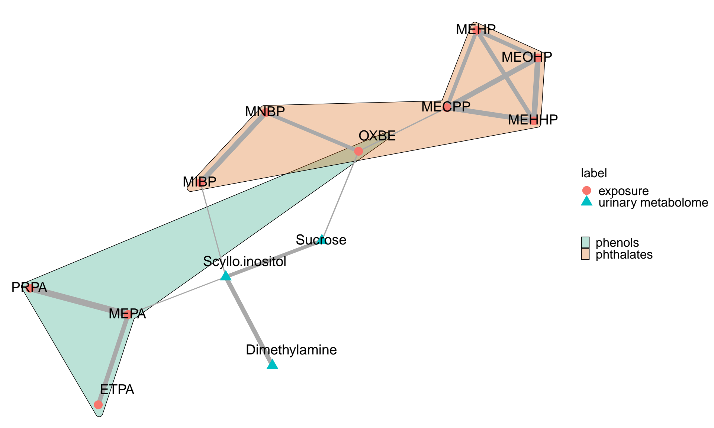
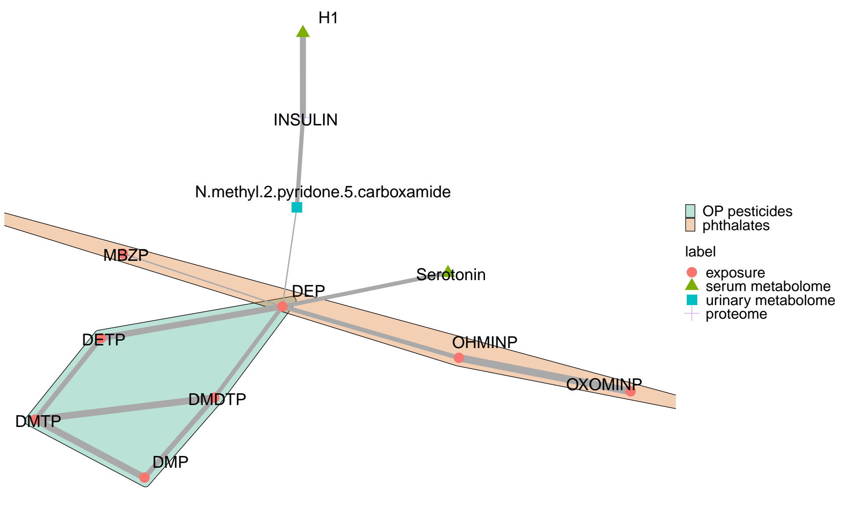
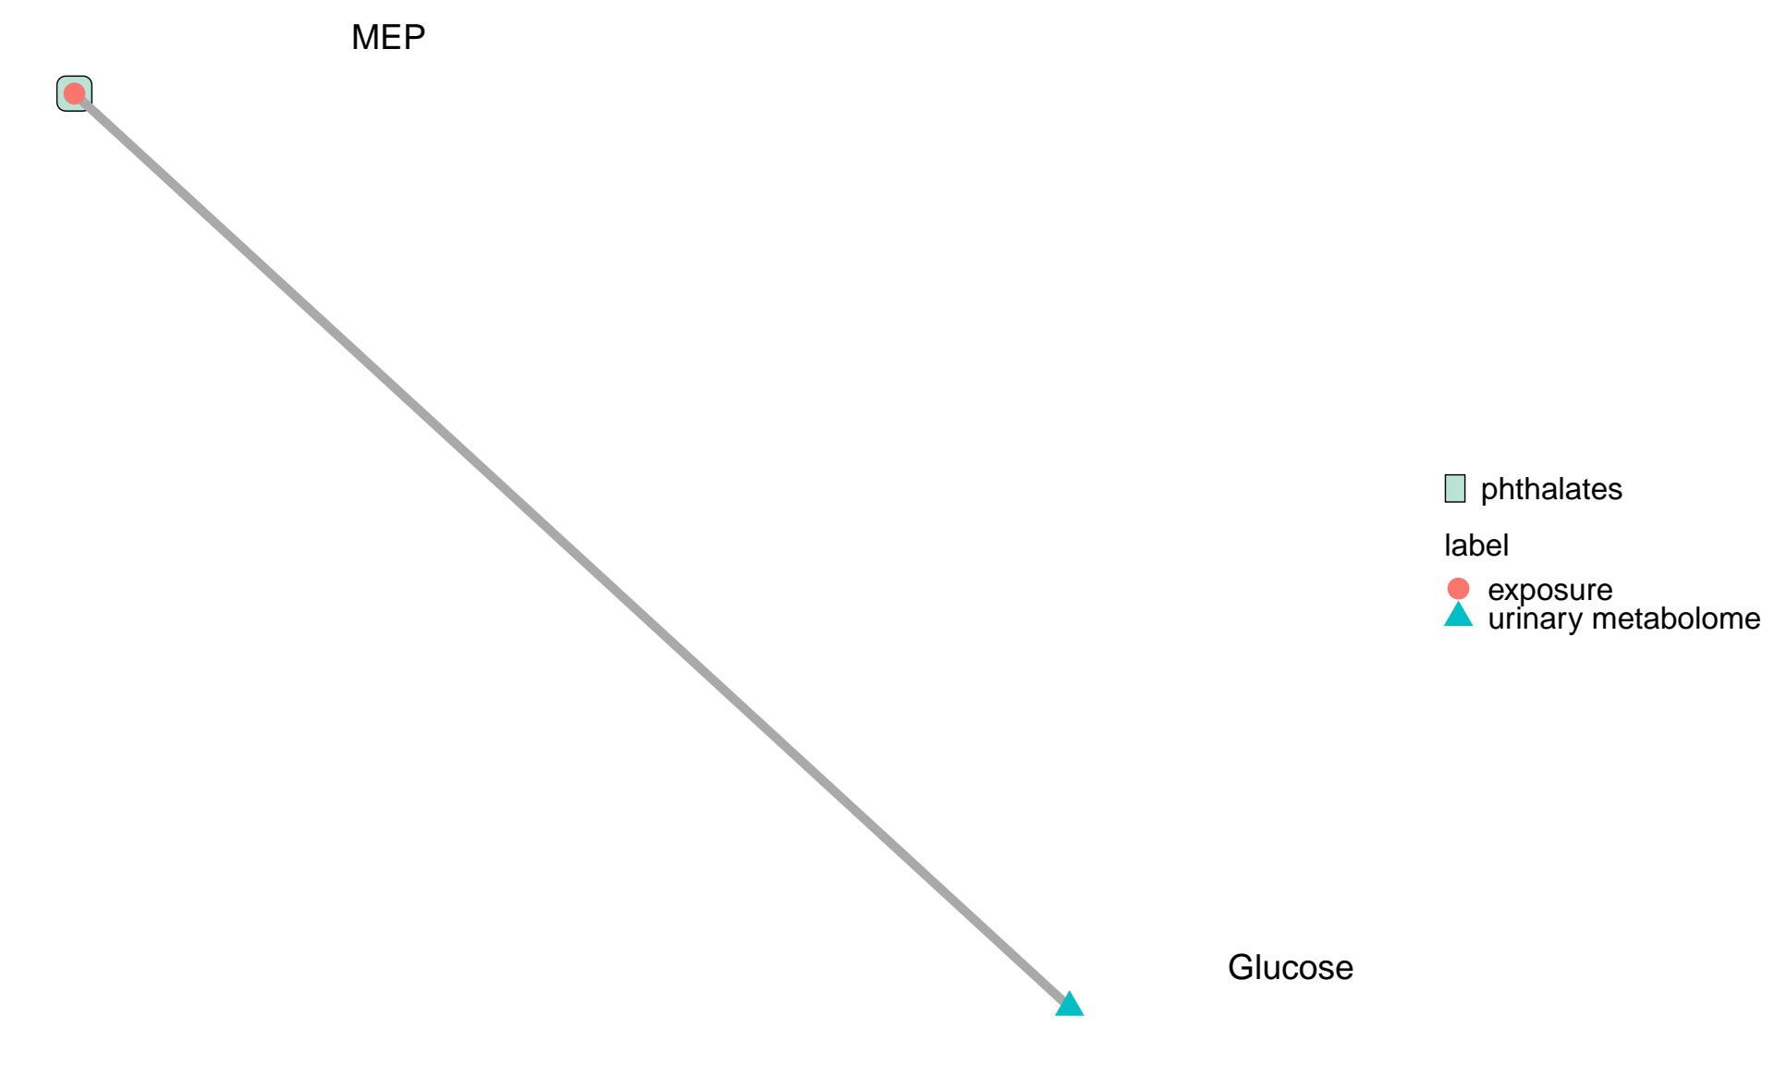
Results
The merged network consisted of 32 connected components, 3 of which included mixed exposure-omic connections
Notes:
CC1: Diabetes mellitus type 2?
See next slide: essentially, associations between OP pesticide metabolites and distruption of the Serotoninergic System

Slide 11
Conclusions
We integrated Multi-Omic and exposure data from a child cohort using an integrative approach, and we identified associations reproducible across time points
The association between DEP and Serotonin (ρ=0.09 for both time points) was reproducible. Exposure to Organophosphate pesticides has been linked to a variety of brain disorders [4], potentially through the serotonergic system
[4] Sarrouilhe D, Defamie N, Mesnil M. "Is the Exposome Involved in Brain Disorders through the Serotoninergic System?" (2021)

Slide 12
Conclusions
In future work we plan to include methylation data
Large number of variables (also compared to dimension of other -omic layers)
Filtering CpG sites using agnostic EWAS: `beta_i ~ exposure_j + covariates` for all i’s and j’s (computationally expensive)
Controlling for multiple testing
Select top features
Perform analysis (i.e., GGMs) again
Interpretation of results

