Slide 1
Laboratory of Data Science
Federica Di Pasquale (493195)
Lorenzo Ferri (607828)
A.A. 2020/2021

Slide 2
Part 1

Slide 3
Part 1: Assignment 0
Creazione DW tramite SQL Server Management Studio.
Valori nulli ammessi solo per attributi diversi dalle chiavi primarie nelle Dimension Tables.
Data type DATE di SQL Server
Vincoli di chiavi primarie e di chiavi esterne -> necessario caricare prima le Dimensioni e poi le Fact tables.

Slide 4
Part 1: Assignment 1 – Fact tables
Connessione al DB tramite protocollo ODBC.
Apertura file fact.csv.
Scan file e identificazione della fact table corretta per ogni riga del file.
Tutte le righe vengono prima memorizzate in tre liste separate (una per ogni fact table).
Infine viene caricato il contenuto con tre chiamate executemany(sql, *params)
Chiusura file, commit e chiusura connessione.

Slide 5
Part 1: Assignment 2 - Dimensions
Unico script python per tutte le dimensioni ad eccezione di Time.
Stesse fasi di connessione al DB e apertura dei file.csv.
Lettura file con funzione reader(). L’header dei file viene utilizzato per ricavare il numero di attributi presenti in modo da poter costruire una query parametrica.
Caricamento di una riga per volta.

Slide 6
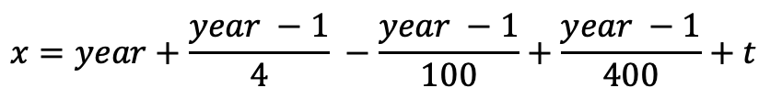
Part 1: Assignment 2 - Time
Si ricava il quarter dato il mese con la funzione getQuarter(month).
Si ricava il giorno della settimana con la funzione getDayOfWeek(day, month, year).
La formula per il calcolo del giorno della settimana è:
Parte intera delle divisioni. Calcolando x%7 si ottiene l’indice del giorno della settimana a partire da Sabato.
La variabile t rappresenta il numero di giorni trascorsi a partire dall’inizio dell’anno fino alla data corrente e viene calcolata con una funzione ricorsiva.
$$x=year+\frac{year −1}{4} −\frac{year −1}{100}+\frac{year −1}{400}+t$$

Slide 7
Part 2

Slide 8
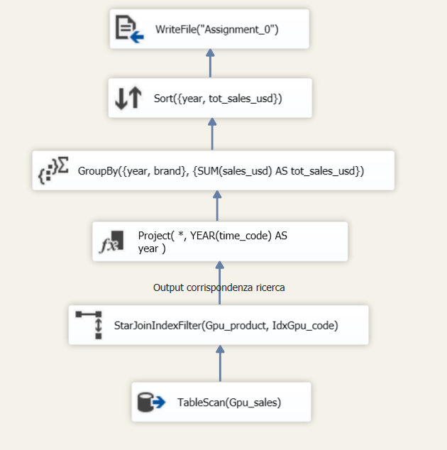
Part 2: Assignment 0
Business Question: For every year, the brand of gpu ordered by sales.

Slide 9
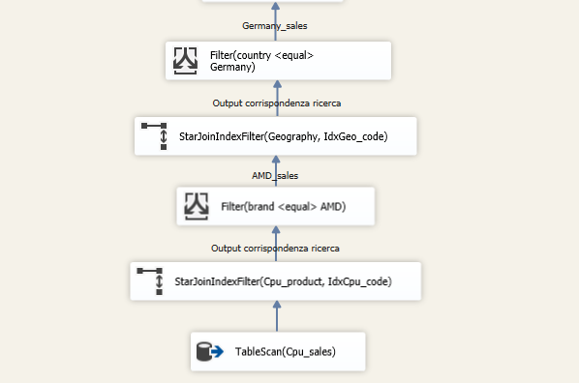
Part 2: Assignment 1.1
Business Question: For any given country, a product is said to have full regionalspread if it was sold in all the regions of that country. List all the AMD brandcpus that do not have full regional spread in Germany.

Slide 10
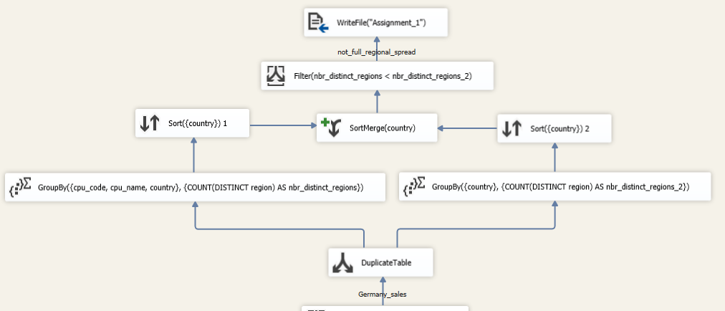
Part 2: Assignment 1.2
Business Question: For any given country, a product is said to have full regionalspread if it was sold in all the regions of that country. List all the AMD brandcpus that do not have full regional spread in Germany.

Slide 11
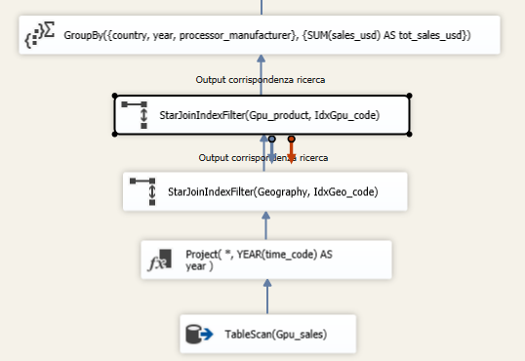
Part 2: Assignment 2.1
Business Question: Calculate which processor manufacturer yields the most sales,for each country and year.

Slide 12
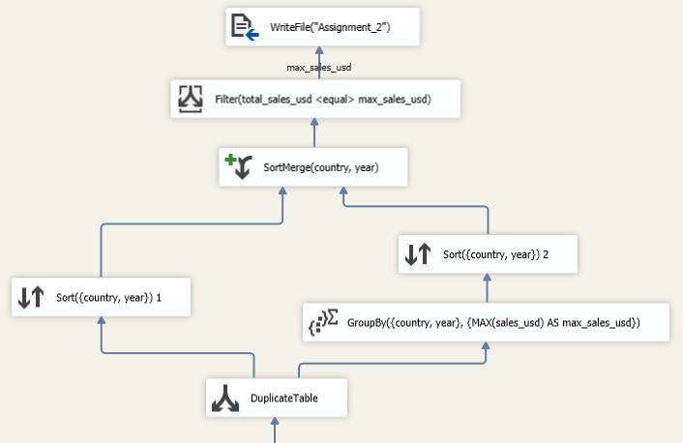
Part 2: Assignment 2.2
Business Question: Calculate which processor manufacturer yields the most sales,for each country and year.

Slide 13
Part 3

Slide 14
Part 3: Assignment 0
Creazione del cubo e definizione delle gerarchie presenti nelle dimensioni Geography e Time.
Geography: Region -> Country -> Continent
Country -> Currency
Time: creazione di nuovi attributi concatenando opportunamente i valori di year-month-week-day per introdurre le dipendenze funzionali necessarie per la gerarchia.

Slide 15
Part 3: Assignment 1
Business Question: Show the total sales for each country and vendor and the grand total with respectto the continent.
SELECT [Measures].[Sales Usd] ON COLUMNS,
{ NONEMPTY(
( [Geography].[Geography_Hierarchy].[Country],
[Vendor].[Name].[Name]) ),
( [Geography].[Geography_Hierarchy].[Continent],
[Vendor].[Name].[All] ) } ON ROWS
FROM [Group5HW Mart]

Slide 16
Part 3: Assignment 2
Business Question: Let diff be the difference between the sales usd and sales currency. Show thetotal sales usd, total sales currency, total diff for each month and the running diffstarting from the same year in Germany.
WITH MEMBER diff AS
[Measures].[Sales Usd] - [Measures].[Sales Currency]
MEMBER running_diff AS
SUM(PERIODSTODATE(
[Time].[Time_Hierarchy].[year], [Time].[Time_Hierarchy].currentmember),
diff), FORMAT_STRING = "Currency"
SELECT {[Measures].[Sales Usd], [Measures].[Sales Currency],
diff, running_diff} ON COLUMNS,
NONEMPTY([Time].[Time_Hierarchy].[Month For The Hierarchy]) ON ROWS
FROM [Group5HW Mart]
WHERE [Geography].[Country].&[Germany]

Slide 17
Part 3: Assignment 3
Business Question: Show the top 5 gpu brands w.r.t the monthly average sales for each region in Europe.
WITH MEMBER monthly_avg_sales AS
AVG([Time].[Time_Hierarchy].[Month For The Hierarchy],
[Measures].[Sales Usd])
SELECT monthly_avg_sales ON COLUMNS,
NONEMPTY(GENERATE(
([Geography].[Region].[Region],
[Gpu Product].[Brand].[Brand]),
TOPCOUNT(([Geography].[Region].currentmember,
[Gpu Product].[Brand].[Brand]), 5,
monthly_avg_sales) ) ) ON ROWS
FROM [Group5HW Mart]
WHERE [Geography].[Continent].&[Europe]

Slide 18
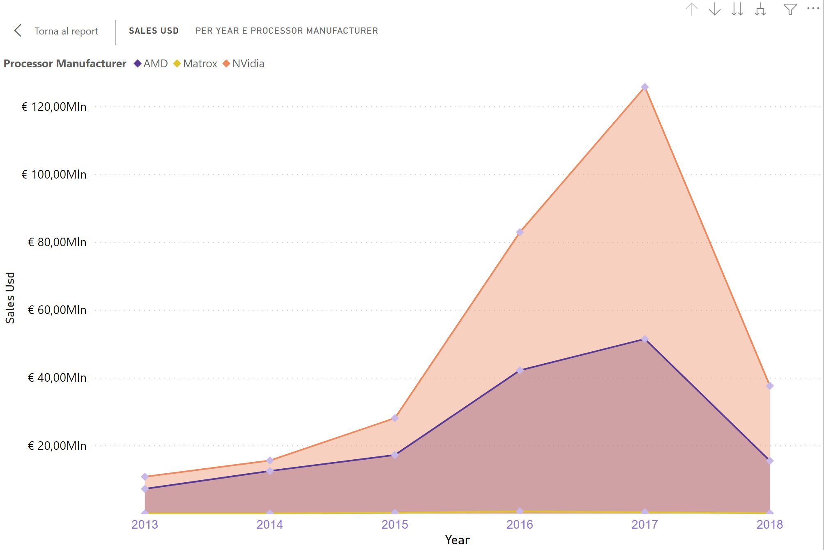
Part 3: Assignment 4

Slide 19
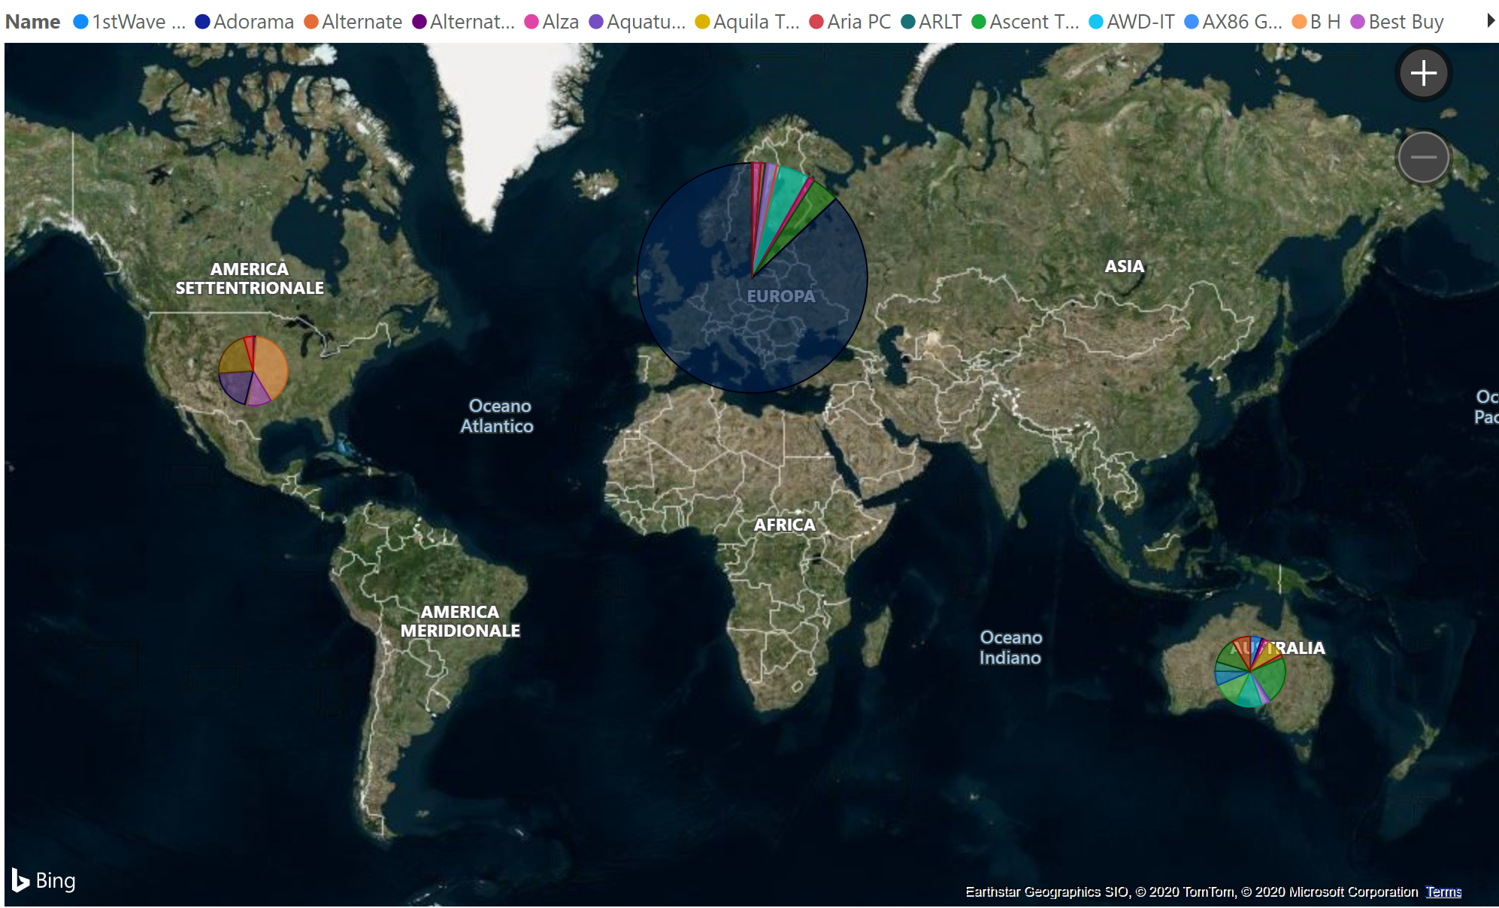
Part 3: Assignment 5

Slide 20
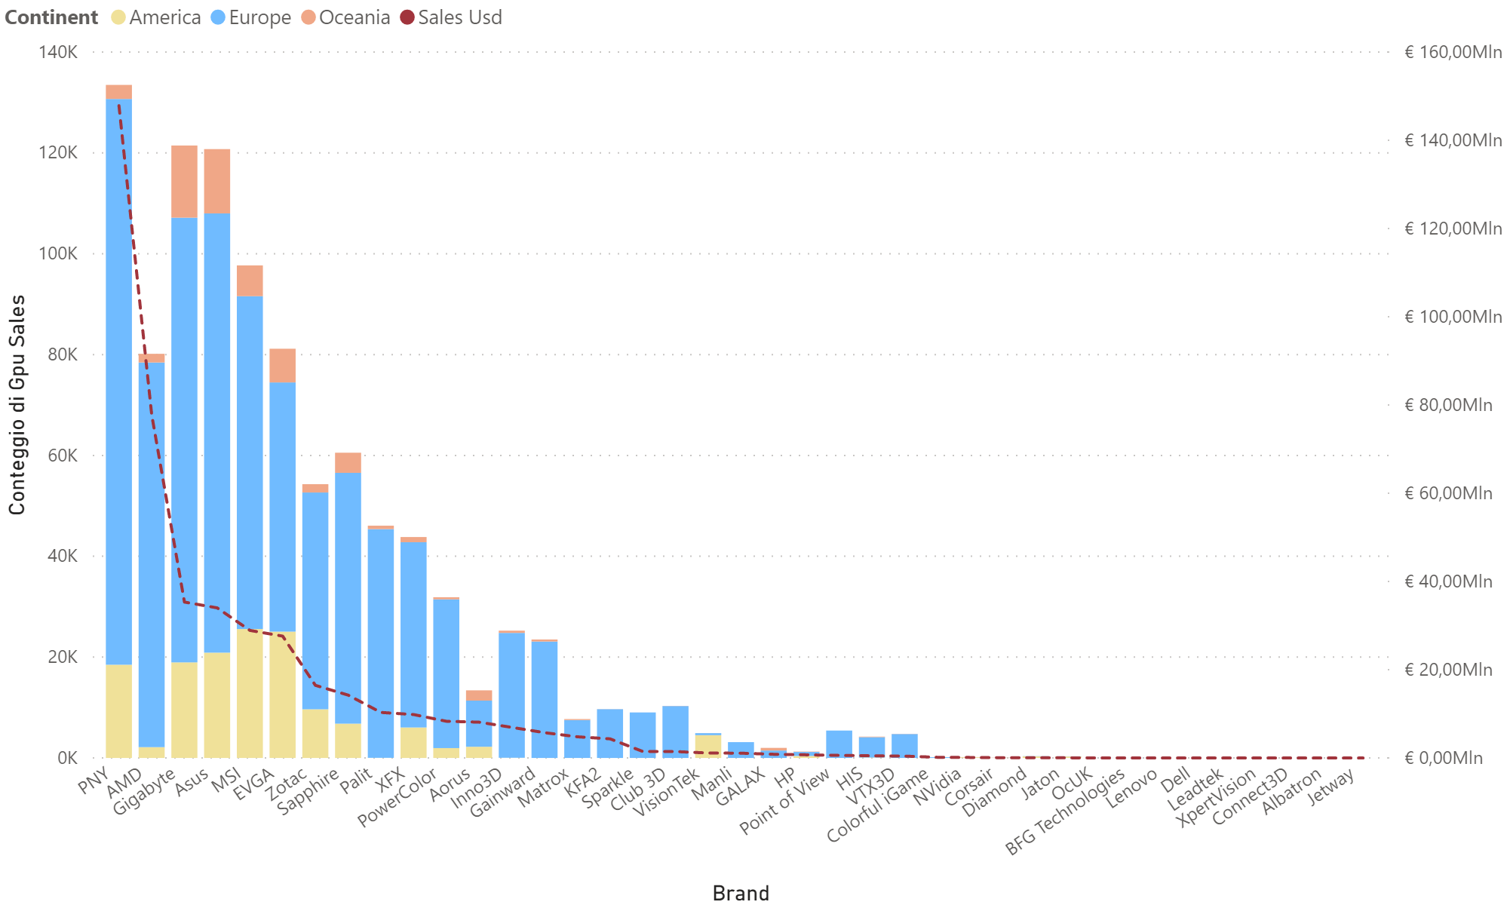
Part 3: Assignment 6.1

Slide 21
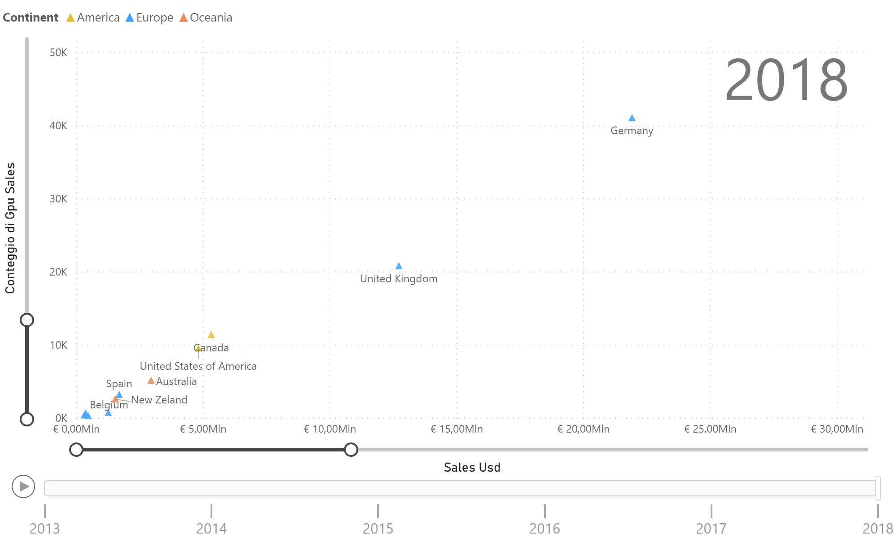
Part 3: Assignment 6.2

