Slide 1
Uncertainty as a Fairness Measure
STATISTICS FOR DATA SCIENCE A.A. 2024/2025
Albani Lorenzo
Ascione Luigi
Del Rosso Filippo

Slide 2
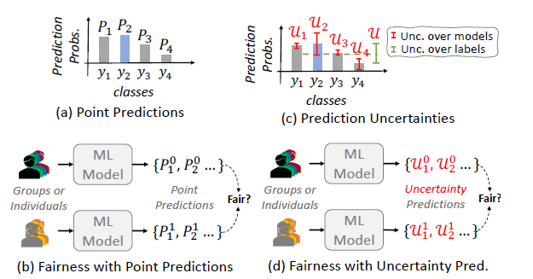
Overview
Fairness is critical in real-world ML applications
A model can be considered fair at a group-level or at levels of individuals
Point-based metrics alone are not sufficient
Ignoring uncertainty may hide structural bias
New perspective: fairness through uncertainty
Motivation
Fairness evaluation in machine learning is often limited to point-based metrics, which may ignore uncertainty. This work aims to highlight how considering predictive, aleatoric and epistemic uncertainty provides a deeper understanding of hidden biases in models

Slide 3
FAIRNESS GERRYMANDERING
Problems to highlight
01
02
03
REAL-WORLD
PROBLEMS
IMBALANCED DISTRIBUTION
Noise data, Missing data and labeling
Fair overall, but unfair for subgroups
Minority groups underrepresented
Goal
Introduce fairness metrics based on uncertainty: this approach complements traditional point-based metrics and provides deeper insights into the sources of bias in machine learning models.

Slide 4
Types of Uncertainty
ALEATORIC
Is measured over classes. Reflects the irreducible noise in the data
EPISTEMIC
Is measured over different models. Reflects the lack of knowledge about the current input
Is measured like the combination of the previous two. Reflects the total uncertainty in model predictions
PREDICTIVE

Slide 5
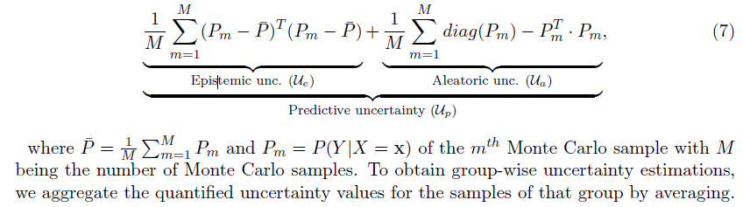
Uncertainty Quantification
Each model produces a probability $P_{m}$ of predicting the positive class
Epistemic Uncertainty (Ue)
Aleatoric Uncertainty (Ua):
Predictive Uncertainty (Up):

Slide 6





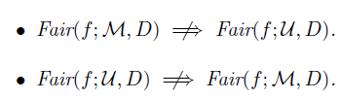
Fairness Metrics
Uncertainty-based fairness
Point-based fairness
Uncertainty fairness
Statistical Parity
Where u can be Alea (Aleatoric), Epis (Epistemic) or Pred (Predictive)
Equal Opportunity
A model is fair if its uncertainties
are the same across different groups:
Equalized Odds
Equal Accuracy
Uncertainty fairness Fair(f; U,D) is independent to the conventional point-measure based fairness Fair(f;M,D)
We will try to prove the two non-implications in the proposition using contradictions

Slide 7
BNN e Montecarlo Sampling
In order to measure uncertainty, we need a model that can provide not just
predictions, but also a measure of confidence. Bayesian Neural Networks allow this
In a Bayesian Neural Network (BNN) operate by placing a prior distribution
over the weights of a neural network. Each weight is treated as a distribution,
not just a single number.
This means the model can represent uncertainty over its parameters
Since weights are distributions, predictions require sampling.
The most common approach is Montecarlo Sampling:
- Run the same input multiple times through the network
- Each time, sample weights → get slightly different outputs
- The variability across outputs reflects the model’s uncertainty
Epistemic Uncertainty:
Multiple models were initialized with different parameters and random seeds
Aleatoric Uncertainty:
Training on a different data sample using bootstrap method

Slide 8
Experiments – Training Setup
Experiments are conducted on synthetic datasets designed to highlight different types of bias
The experiments were carried out using an 80/20 train-test split on the synthetic datasets
We implemented a simple Bayesian Neural Network (BNN) with no hidden layers, trained for 5 epochs
The model was optimized using Stan MCMC(Markov Chain Monte Carlo)
We focused only on synthetic data but in the paper the experiment also continues on real-world datasets

Slide 9
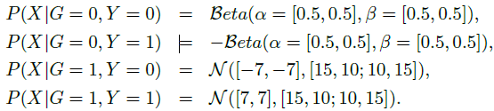
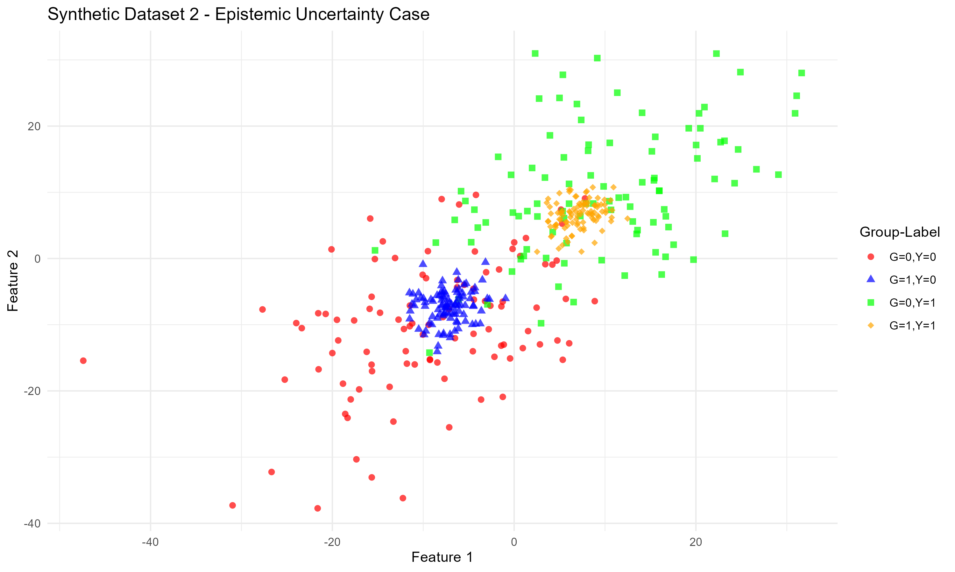
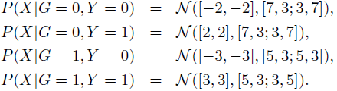
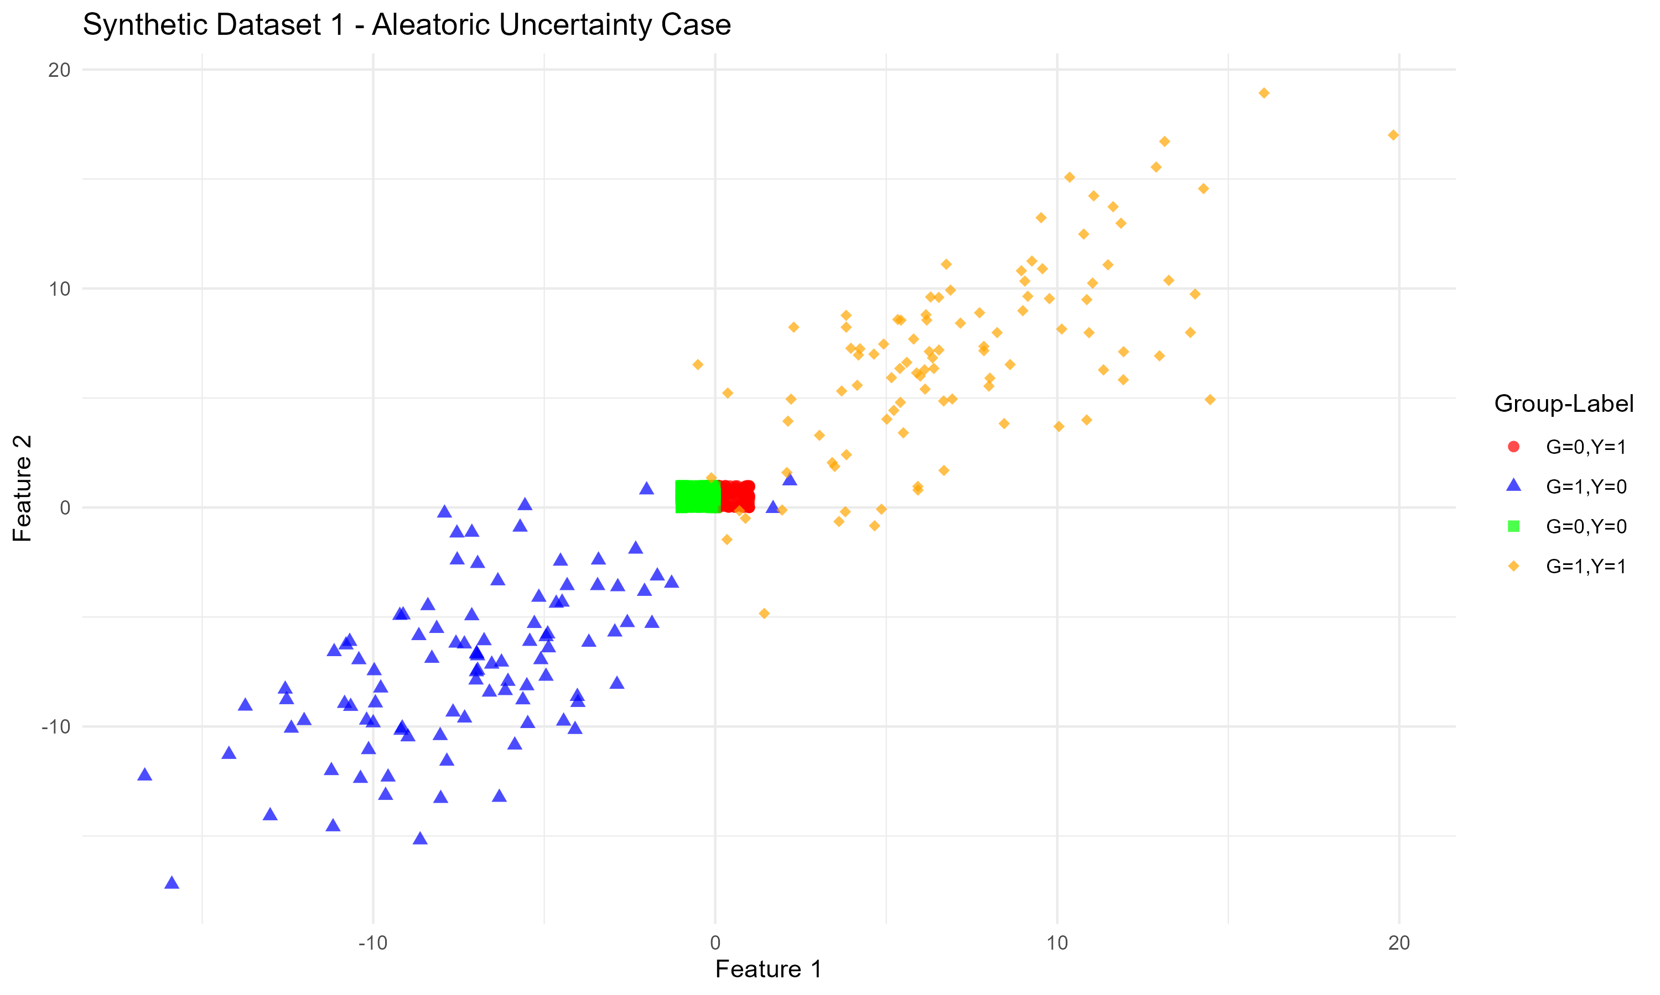
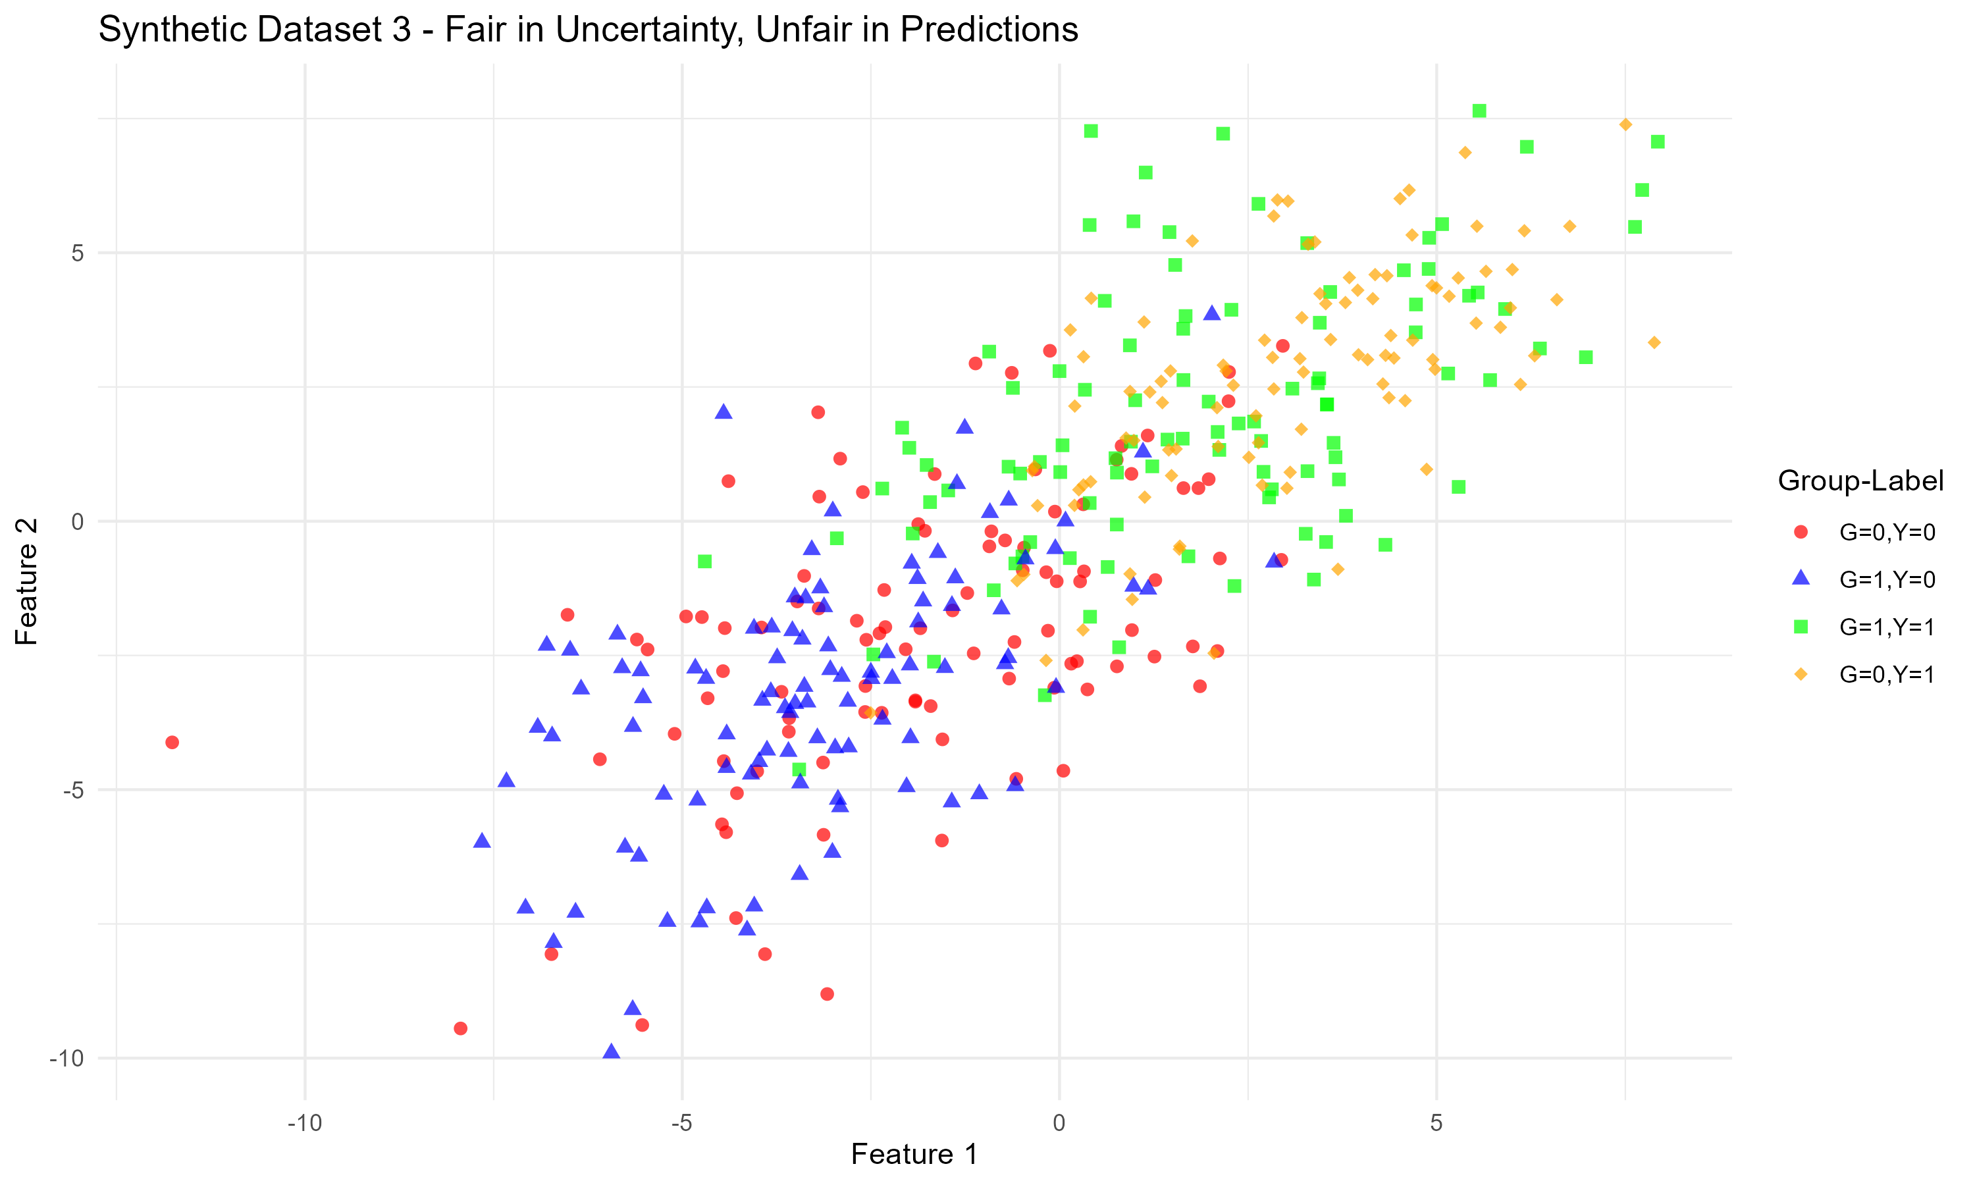
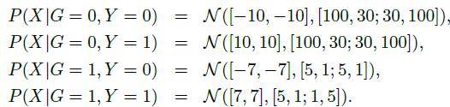
Experiments – Synthetic Data
Synthetic datasets designed to highlight different sources of bias:
Here we report the formula of the distribution and the plot
SD1
SD2
SD3

Slide 10
Expected Results
One of the main point of the paper was to show that even if a model achieves the same high accuracy for two groups, the uncertainty metrics can still differ
SD1 SD2 SD3
Measures | G0 | G1 | G0 | G1 | G0 | G1
Macc | 0,95 | 0,95 | 0,95 | 0,95 | 0,74 | 0,93
Point-based Fairness Measures
Fsp | 1,07 |  | 1,00 |  | 1,17
Fopp | 1,00 |  | 1,00 |  | 1,01
Fodd | 1,05 |  | 0,95 |  | 7,90
Feacc | 1,00 |  | 1,00 |  | 0,79
Uncertainty-based Fairness Measures
Fepis | 1,01 |  | 2,75 |  | 1,05
Falea | 4,68 |  | 0,87 |  | 1,04
Fpred | 4,67 |  | 0,88 |  | 1,04
SD1 is fair in terms of point-based
performance metrics yet unfair in
terms of aleatoric uncertainties
SD2 is fair with point-based fairness measures but unfair in terms of epistemic uncertainties
SD3 is fair according to the proposed
uncertainty-based fairness
measures
but unfair in terms of point-based
fairness measures

Slide 11
Ours Results
Comparison with Original Paper
SD1 SD2 SD3
Measures | G0 | G1 | G0 | G1 | G0 | G1
Macc | 0,74 | 0,93 | 0,90 | 1,00 | 0,80 | 0,90
Point-based Fairness Measures
Fsp | 1,19 |  | 0,86 |  | 1,05
Fopp | 2,20 |  | - |  | 1,47
Fodd | 0,94 |  | 0,85 |  | 0,93
Feacc | 0,80 |  | 0,90 |  | 0,88
Uncertainty-based Fairness Measures
Fepis | 1,90 |  | 4,25 |  | 2,05
Falea | 0,94 |  | 0,88 |  | 0,99
Fpred | 0,93 |  | 0,87 |  | 0,98
BNN architecture used by the authors was implemented in Python, leveraging specialized packages that allow for a high degree of customization. In contrast, our implementation in R relied on simpler models, including ensembles of BNNs and random forests
The synthetic datasets in the paper were tightly coupled with the original network design, which makes the differences between epistemic and aleatoric uncertainty very subtle and difficult to capture without tailored classifiers
As a result, our experiments do not fully highlight these distinctions, leading to differences compared to the original findings.
The classifiers captured epistemic and
aleatoric fairness, but in a very unbalanced
way among classes

Slide 12
Conclusion
An ensemble of Random Forests was tested as an alternative to Bayesian Neural Networks. However, results were less expressive in distinguishing between aleatoric and epistemic uncertainty
This model, which achieved 0.99 accuracy for both groups, struggled to capture differences in epistemic and aleatoric fairness because it classified the data too well
Our results differ from the original paper due to implementation (Python vs R, library maturity), and for the other reasons discussed previously
TakeAway Message:
Traditional point-based fairness metrics are not enough.
Uncertainty-based metrics (epistemic + aleatoric) provide complementary insights

Slide 13
THANK YOU FOR THE ATTENTION
11 September, 2025
STATISTICS FOR DATA SCIENCE

