Slide 1
Lorenzo Collodi
Intelligent systems for pattern recognition
Assignment 2:
CNN for CIFAR-10 dataset

Slide 2
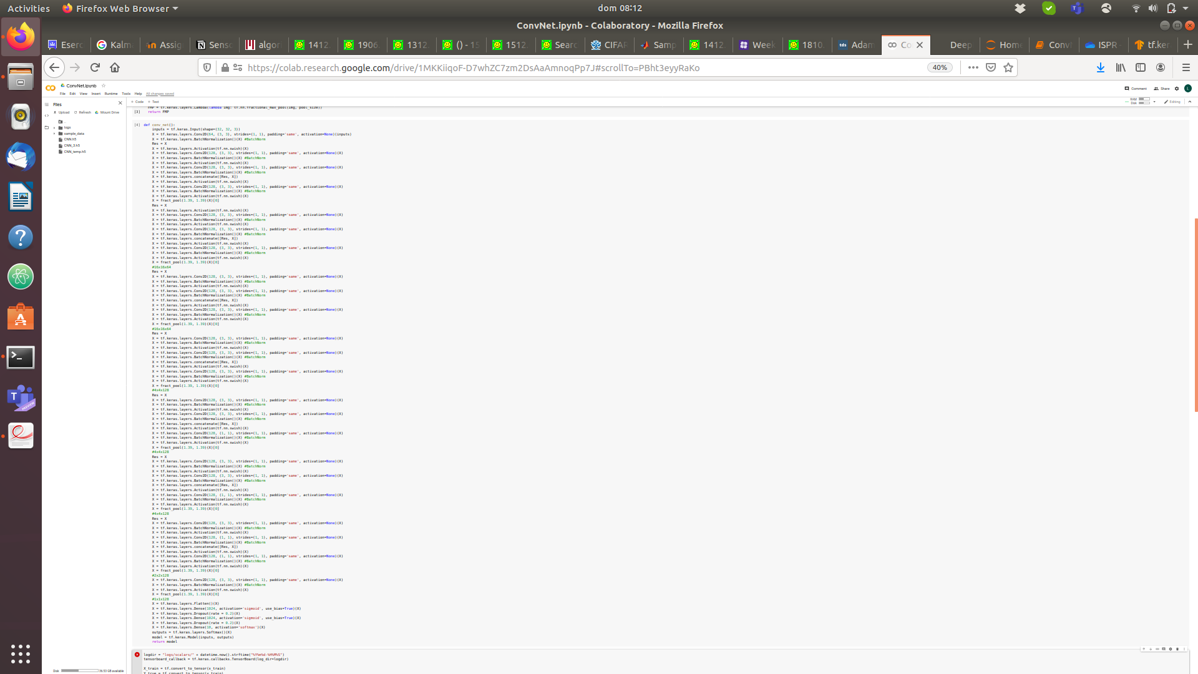
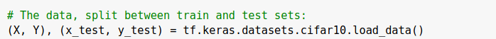
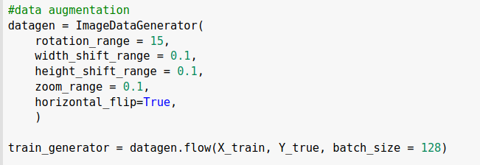
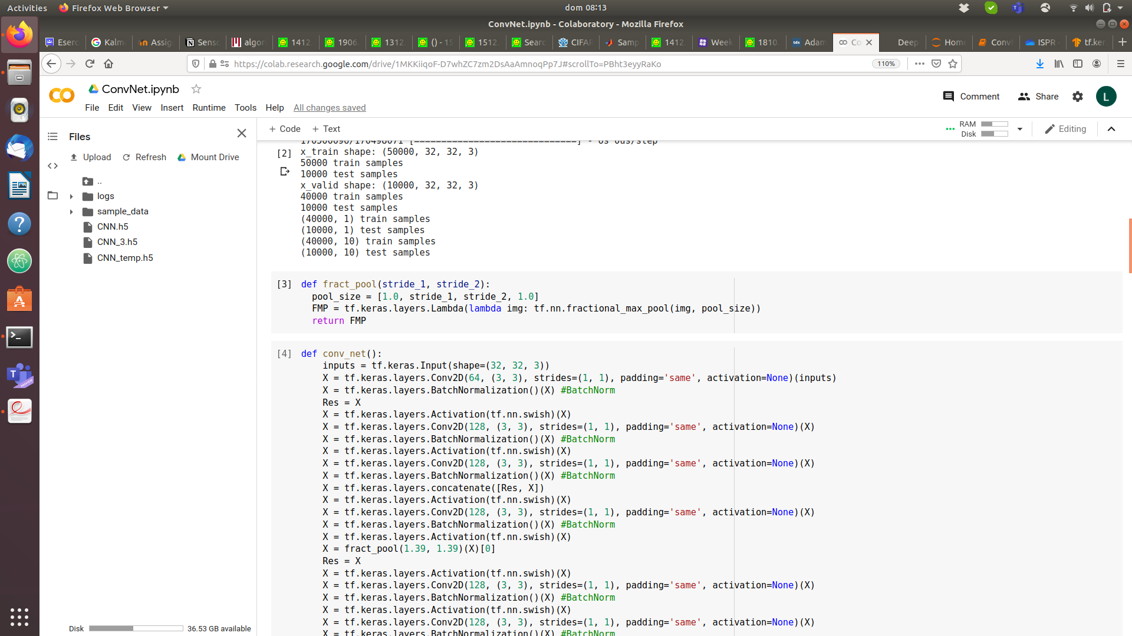
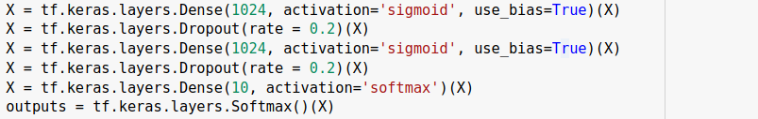
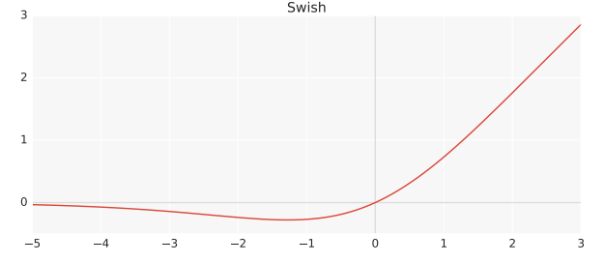
Code
Load dataset
Data augmentation
Fractional pooling [2]
Residual connection [3]
Batch normalization [4]
Swish activation [5]
Base Idea: SimpleNet [1]
Dropout [6]
34 layers, 5M parameters

Slide 3
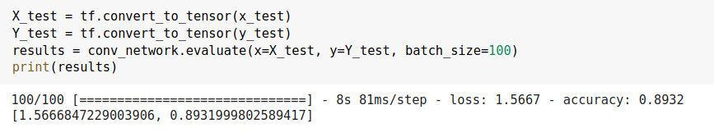
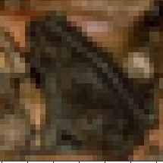
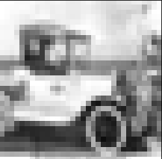
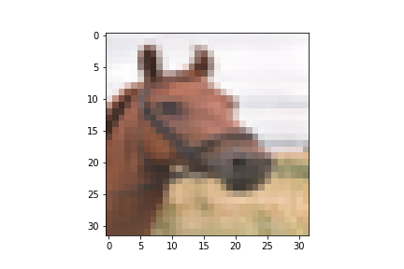
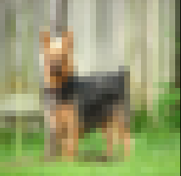
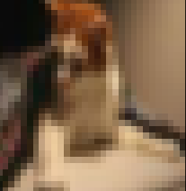
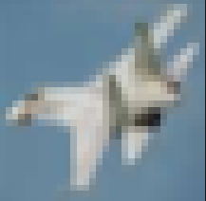
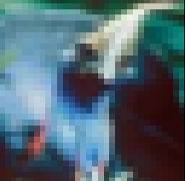
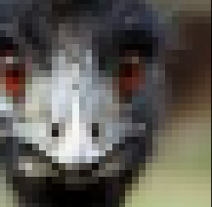
Results
Correctly labelled
Misclassified
Frog
Automobile
True: Dog
Assigned: Deer
True: Cat
Assigned: Dog
Horse
Airplane
True: Bird
Assigned: Cat
True: Bird
Assigned: Automobile

Slide 4
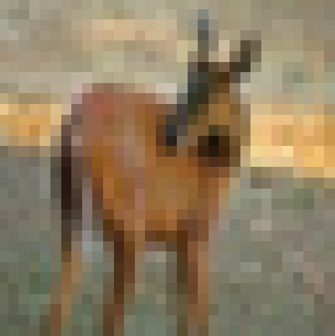
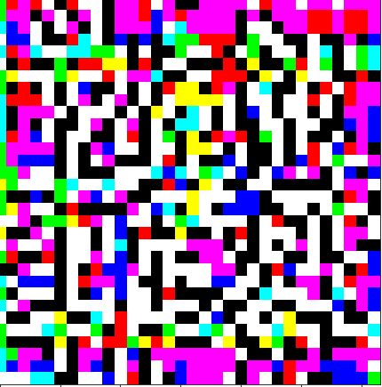

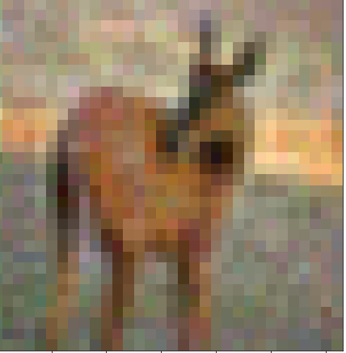
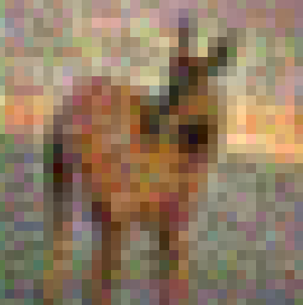
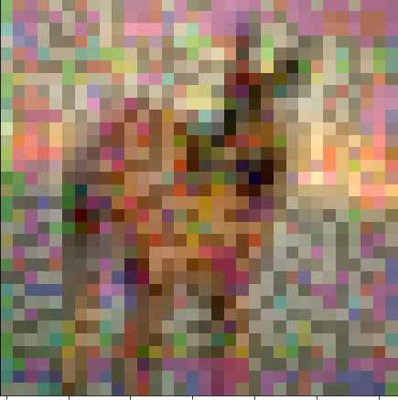
Results: Adversarial attack [7]
Original image, correctly classified
Noise, generated with FGSM (here amplified)
Increasing noise
Amplification: 0.01
Accuracy: 0.86
Image correctly classified
Amplification: 0.03
Accuracy: 0.63
Image correctly classified
Amplification: 0.05
Accuracy: 0.37
Image correctly classified
Amplification: 0.1
Accuracy: 0.17
Image misclassified
Adversarial attack performed on a subset of the original test set (accuracy 0.91)

Slide 5
Conclusions and observations
Many approaches, but not easy to merge them together
More horsepower does not mean better result
Different optimizers should be tried, as the model was still underfitting the training set
Better results were achieved vwith deeper, not wider solutions
Fracional max pooling seems to be the solution with the better impact but should be paired with residual connections to prevent gradient vanishing

Slide 6
Bibliography
[1] Hasanpour, Seyyed Hossein & Rouhani, Mohammad & Fayyaz, Mohsen & Sabokrou, Mohammad. Let's keep it simple: using simple architectures to outperform deeper and more complex architectures, 2016
[2] Graham, Benjamin. Fractional Max-Pooling, 2014
[3] K. He, X. Zhang, S. Ren, and J. Sun. Deep Residual Learning for Image Recognition. CVPR 2016
[4]S. Ioffe, C. Szegedy. Batch Normalization: Accelerating Deep Network Training by Reducing Internal Covariate Shift, ICML 2013
[5] Ramachandran, Prajit et al. Searching for Activation Functions
[6] N. Srivastava et al, Dropout: A Simple Way to Prevent Neural Networks from Overfitting, JLMR 2014
[7] Goodfellow, Ian & Shlens, Jonathon & Szegedy, Christian. Explaining and Harnessing Adversarial Examples. arXiv 1412.6572 2014

Slide 7
THANK YOU

