Slide 1
Java Security: Asymmetric Encryption
Alessandro Marchesano
alessandr.marchesano@unibo.it

Slide 2
Asymmetric Encryption in JCE
In the last lesson, we saw how JCA provides a set of classes, interfaces, and methods for symmetric encryption.
Of course, the framework exposes the same functionality for asymmetric encryption as well.
Some of the classes we saw for symmetric encryption will still be useful...

Slide 3
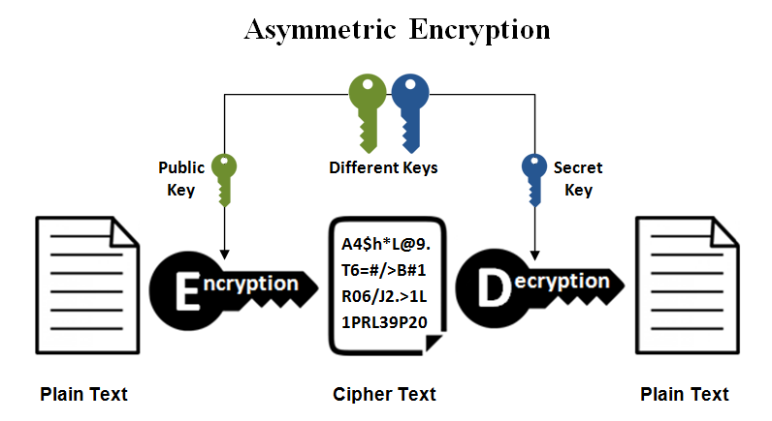
Asymmetric Encryption
Asymmetric encryption uses a pair of mathematically related keys - a public key to encrypt data and a private key to decrypt it.
This method ensures secure communication without sharing secrets, enabling confidentiality and digital signatures.
It is widely used in HTTPS (SSL/TLS) for secure web browsing and in blockchain technology.

Slide 4
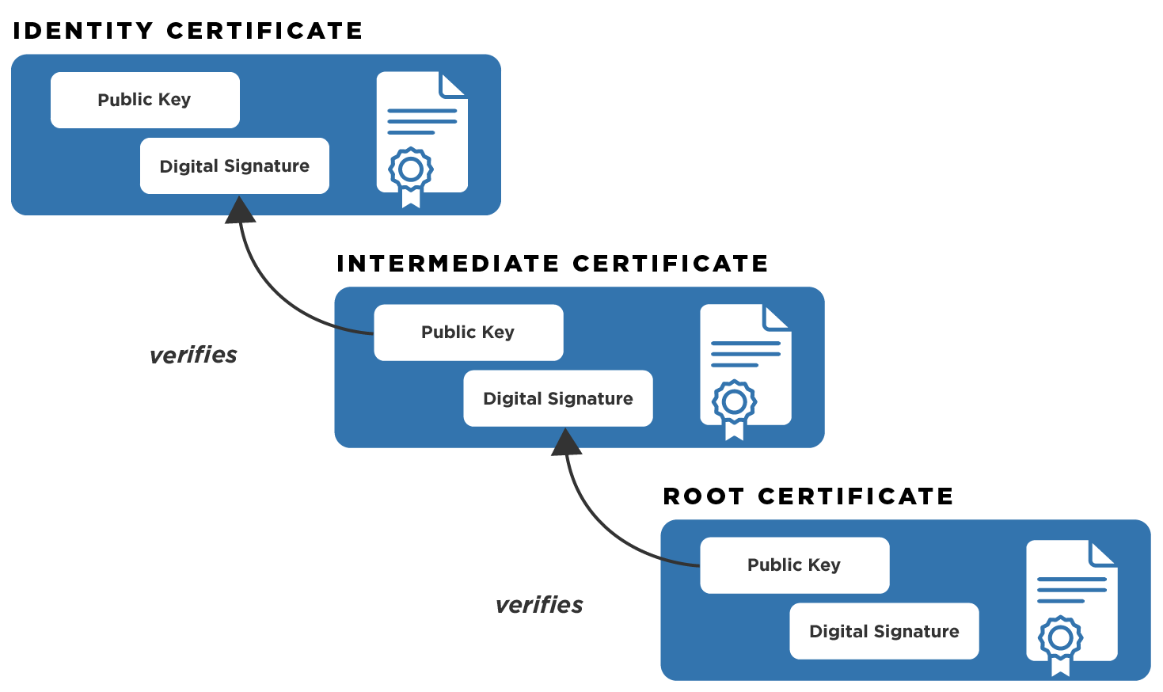
Public Key Infrastructure
Public Key Infrastructure (PKI) is a framework of technology, policies, and procedures used to manage digital certificates and public-key encryption.
It binds public keys to entities (users, devices, or servers) through digital certificates issued by trusted Certificate Authorities (CAs), ensuring secure communication, authentication, and data integrity.

Slide 5
Generating Asymmetric Keys
In order to generate asymmetric keys, we need a KeyPairGenerator object.
It is available via getInstance method: public static KeyPairGenerator getInstance(String algorithm);
KeyPairGenerator kg = KeyPairGenerator.getInstance(“RSA”);
Possible algorithms:
DiffieHellman
DSA
RSA
RSASSA-PSS
EC

Slide 6
Initializing KeyPairGenerator
A key pair generator needs to be initialized before it can generate keys. In most cases, algorithm-independent initialization is sufficient. But in other cases, algorithm-specific initialization can be used.
public void initialize(int keysize);
public void initialize(int keysize, SecureRandom sr);
public void initialize(AlgorithmParameterSpec params);

Slide 7
Obtaining asymmetric keys
The procedure for generating a key pair is always the same, regardless of initialization (and of the algorithm). You always call the following method from KeyPairGenerator:
KeyPair generateKeyPair()
Multiple calls to generateKeyPair will yield different key pairs.
You can get the keys simply with:
KeyPair pair = keyGen.generateKeyPair();
PrivateKey priv = pair.getPrivate();
PublicKey pub = pair.getPublic();

Slide 8
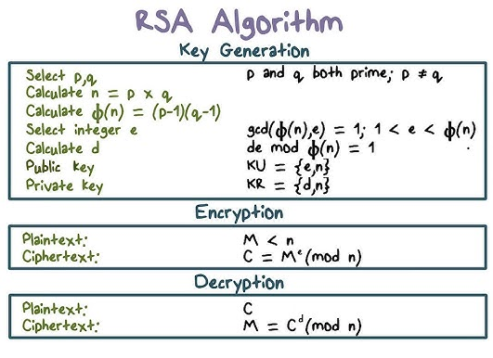
RSA
Used for encryption and signature on the web.
The security of RSA is based on the mathematical difficulty of factoring large prime numbers.
The implementation is optimized to enhance performance (decryption using CRT, e value predefined)

Slide 9
Encrypting with RSA - 1
We use the Cipher in the exact same way as in the symmetric encryption.
We must just be careful using “RSA” algorithm and specifying the right keys.
// Encryption
Cipher cipher = Cipher.getInstance(“RSA”);
c.init(Cipher.ENCRYPT_MODE, receiverPublicKey);
byte[] encryptedMessage = c.doFinal(message);
// Decryption
c.init(Cipher.DECRYPT_MODE, myPrivateKey);
byte[] decryptedMessage = c.doFinal(message);

Slide 10
Encrypting with RSA - 2
Actually, the basic implementation of RSA is susceptible to padding oracle attacks. Therefore, we must use robust versions of these algorithms for greater security (both for encrypting and signing).
// Encryption
Cipher cipher = Cipher.getInstance("RSA/ECB/OAEPWithSHA-256AndMGF1Padding");
c.init(Cipher.ENCRYPT_MODE, receiverPublicKey);
byte[] encryptedMessage = c.doFinal(message);
// Decryption
c.init(Cipher.DECRYPT_MODE, myPrivateKey);
byte[] decryptedMessage = c.doFinal(message);

Slide 11
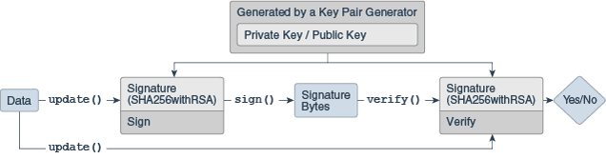
Signature
The Signature class is an engine class designed to provide the functionality of a cryptographic digital signature algorithm that takes arbitrary-sized input and a private key and generates a relatively short string of bytes, called the signature, with the following properties:
Only the owner of a private/public key pair is able to create a signature. It should be computationally infeasible for anyone having only the public key and a number of signatures to recover the private key.
Given the public key corresponding to the private key used to generate the signature, it should be possible to verify the authenticity and integrity of the input.

Slide 12
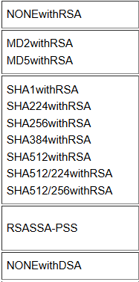
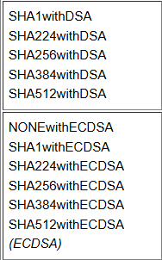
Getting a Signature object
We can get a Signature object through the getInstance method:
public static Signature getInstance(String algorithm);
Possible algorithms:

Slide 13
Choosing the right algorithm for RSA
Java's provider implementation only offers appendix signing mode.
You need to install other providers (e.g. BouncyCastle) to have message recovery signing.
RSASSA-PSS is the most secure implementation of the algorithm.
public final void setParameter(AlgorithmParameterSpec params)
Signature sigSign = Signature.getInstance("RSASSA-PSS");
sigSign.setParameter(new PSSParameterSpec("SHA-256", "MGF1", MGF1ParameterSpec.SHA256, 32, PSSParameterSpec.TRAILER_FIELD_BC));

Slide 14
Initializing a Signature object
A Signature object must be initialized before it is used. The initialization method depends on whether the object is going to be used for signing or for verification.
If it is going to be used for signing, the object must first be initialized with the private key of the entity whose signature is going to be generated.
final void initSign(PrivateKey privateKey)
If instead the Signature object is going to be used for verification, it must first be initialized with the public key of the entity whose signature is going to be verified.
final void initVerify(PublicKey publicKey)
final void initVerify(Certificate certificate)

Slide 15
Using a Signature object
Like other classes, to use the Signature object we must first fill an input array with the update method:
final void update(byte[] data)
Then, we can sign/verify using the ad-hoc methods:
final byte[] sign()
final boolean verify(byte[] signature)

Slide 16
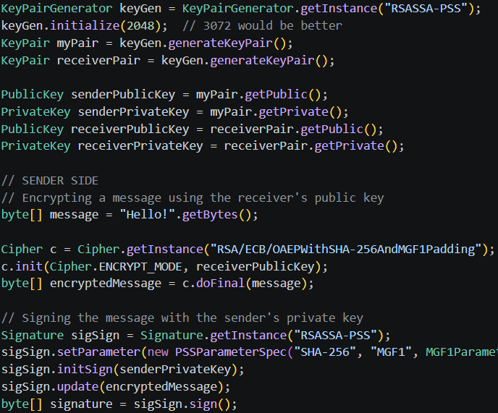
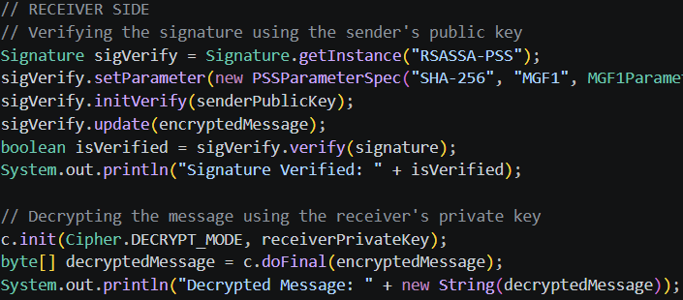

RSA Example

Slide 17
Limitations of RSA
A 2048-bit RSA module can encrypt a maximum of about 245 bytes with PKCS#1 v1.5 padding or only 190 bytes if using the more secure OAEP padding with SHA-256. This makes RSA unusable for documents, images, or large files.
RSA relies on extremely CPU-intensive modular exponentiation operations. Compared to symmetric algorithms like AES, RSA is about 1000 times slower. Encrypting large amounts of data with RSA would quickly saturate system resources.
RSA is not post-quantum secure.

Slide 18
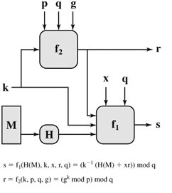
DSA
The Digital Signature Algorithm (DSA) is a standard for digital signatures that uses asymmetric cryptography to ensure message authenticity, integrity, and non-repudiation.
Relies on the difficulty of calculating discrete logarithms.

Slide 19

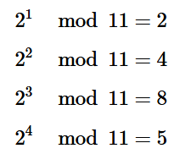
Discrete Logarithm Problem - 1
I consider a cyclic group over a finite field of 11 elements, where the arithmetic is defined modulo 11.
This means that 10 + 1 (mod 11) is equal to 11, but 11 + 1 (mod 11) is equal to 1, because the calculation re-starts from the first position.
In this group, too, I can calculate the powers of the elements:

Slide 20

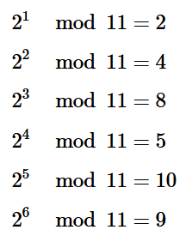
Discrete Logarithm Problem - 2
Let's say I now want to find the discrete logarithm of 9 to base 2 modulo 11, which is the corresponding x such that:
I'm proceeding by trial and error because I'm using very small numbers and this is doable:
Finding the value of x can be a daunting task, especially with much larger numbers, such as those used in cryptography.

Slide 21

Elliptic Curves
In simple terms, an elliptic curve is defined by a cubic equation in two variables. The most common form, known as the Weierstrass form, is:
Sum of two points P+Q: If you draw a line through two points P and Q on the curve, it will intersect the curve at a third point. Reflecting this third point about the x axis, you get the sum P + Q.
The discrete logarithm problem, transposed to elliptic curves, becomes a "multiplication" of points on the curve.

Slide 22
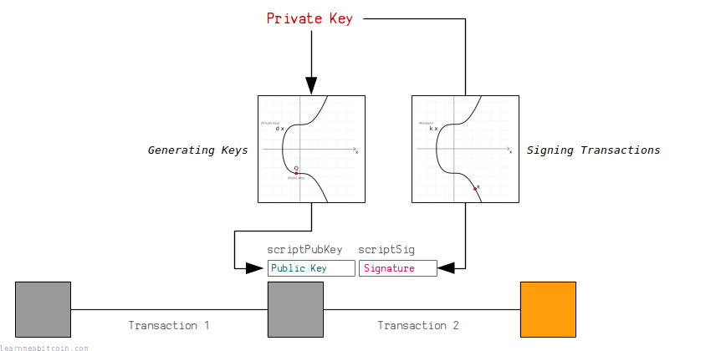
ECDSA
The Elliptic Curve Digital Signature Algorithm (ECDSA) is a public-key cryptographic algorithm used to generate digital signatures.
It is a variant of DSA that uses the mathematics of elliptic curves to offer the same level of security with much smaller keys and faster calculations.
A 256-bit ECDSA key offers security comparable to a 3072-bit RSA key.

Slide 23
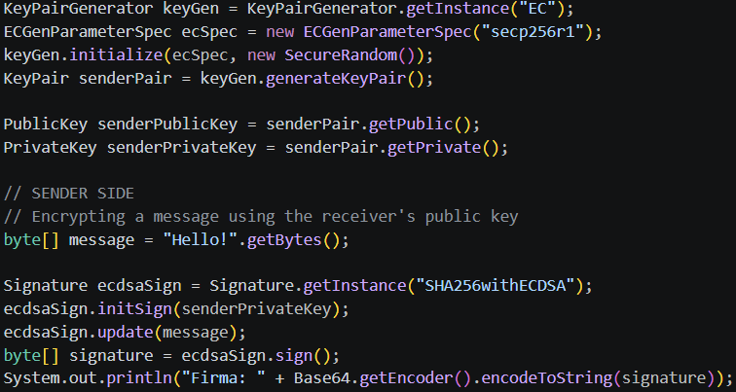
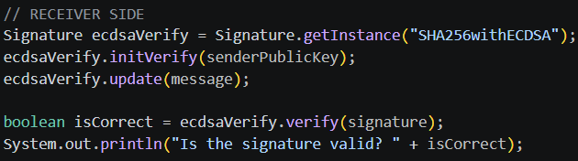
ECDSA Example

Slide 24
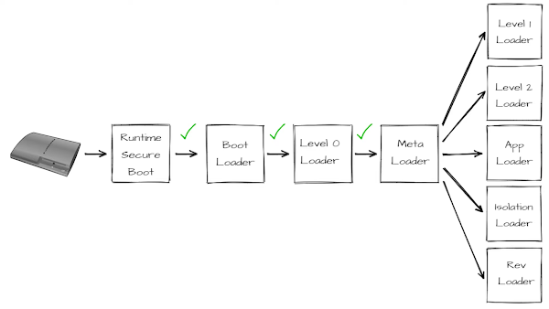
PS3 ECDSA Attack - 1
The PlayStation 3 operates through a sequence of trust between its components. Each step in the process relies on the assumption that the preceding step’s integrity has not been compromised.
This trust is enforced through ECDSA digital signature with Sony’s private key.
ECDSA signature needs a random nonce for each signature. Sony used a constant one.

Slide 25





PS3 ECDSA Attack - 2
When a message is signed, ECDSA produces two components: (r, s)
r depends on the random nonce k. s is calculated as:
d is Sony’s secret key
If two messages m1 and m2 are calculated, we obtain:
m1 -> (r, s1)
m2 -> (r, s2)

Slide 26
Asymmetric Encryption in the real world
Asymmetric Encryption is actually very inefficient. RSA is based on very computationally intensive mathematics. In contrast, symmetric encryption relies on bit substitutions and permutations, which are extremely fast operations, often accelerated directly by the CPU hardware.
An asymmetric algorithm cannot encrypt a message larger than its modulus n. In RSA, if you have a 2048-bit key, your message m must be mathematically smaller than n. However, due to padding, the usable space is drastically reduced.
Better signing algorithm exist, but they need to be integrated in a different scheme.

Slide 27
Hybrid Encryption - 1
Hybrid encryption is a method that combines the strengths of symmetric and asymmetric cryptography to protect data efficiently and securely.
Essentially, it uses the speed of symmetric algorithms (such as AES) to encrypt the actual data and the security of public-key cryptography (such as RSA or ECC) to securely exchange encryption keys.
Standard in TLS.

Slide 28
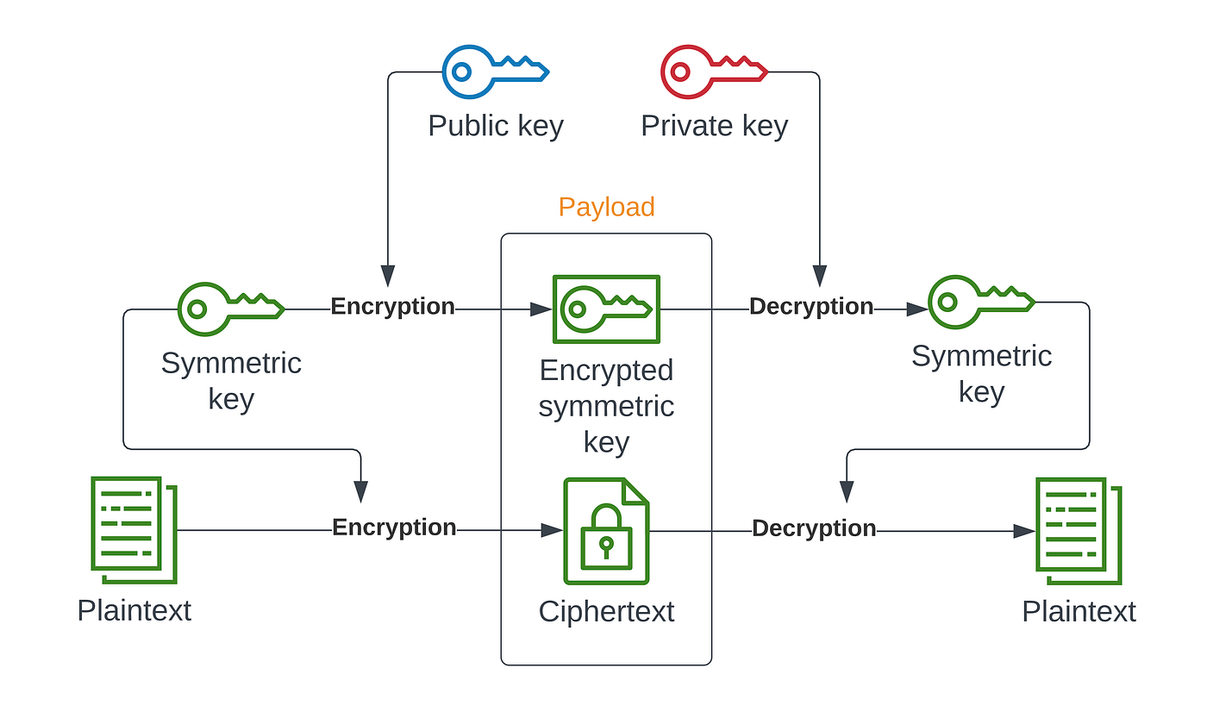
Hybrid Encryption - 2

Slide 29
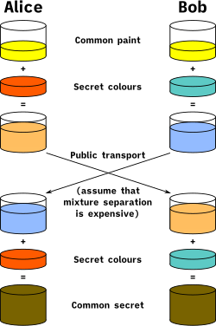
Diffie-Hellmann
Diffie-Hellman (DH) key exchange is a cryptographic protocol that allows two parties to generate a shared secret key over an insecure communication channel (such as the Internet), without the key itself ever being transmitted.
Asymmetric: “Who are you?”
Diffie-Hellman: “How do we talk?”
Symmetric: “Let’s talk!”

Slide 30
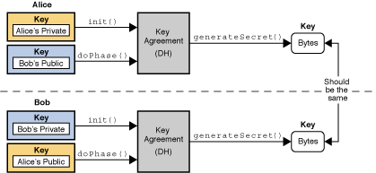
KeyAgreement
Key agreement is a protocol by which 2 or more parties can establish the same cryptographic keys, without having to exchange any secret information.
Each party initializes their key agreement object with their private key and then enters the public keys for each party that will participate in the communication.
When all the public keys have been entered, each KeyAgreement object will generate the same key.

Slide 31
Creating and Initializing a KeyAgreement object
Obtain a KeyAgremeent object with:
public static KeyAgreement getInstance(String algorithm)
Initialize a KeyAgreement object with:
public void init(Key key);
Possible algorithms:
DiffieHellman
ECDH
ECMQV

Slide 32
Using a KeyAgreement object - 1
Every key agreement protocol consists of a number of phases that need to be executed by each party involved in the key agreement.
To execute the next phase in the key agreement, call the doPhase method:
public Key doPhase(Key key, boolean lastPhase);
The key parameter contains the key to be processed by that phase. In most cases, this is the public key of one of the other parties involved in the key agreement, or an intermediate key that was generated by a previous phase.
The lastPhase parameter specifies whether or not the phase to be executed is the last one in the key agreement.

Slide 33
Using a KeyAgreement object - 2
After each party has executed all the required key agreement phases, it can compute the shared secret by calling the generateSecret method:
public final byte[] generateSecret()
public final SecretKey generateSecret(String algorithm)
The generated secret is a point on a curve or a number in a cyclic group. Although it is secret, its bits are not distributed perfectly randomly (that’s why you should not use the second method).
According to modern standards, a shared secret should never be directly used. It must always go through a KDF (a hashing function is good as well).

Slide 34
Obtain the SecretKey object
To obtain the secret key we can use SHA-256 as a KDF.
Then we can use SecretKeySpec class to build a SecretKey object from specifications.
public SecretKeySpec(byte[] key, String algorithm)

Slide 35
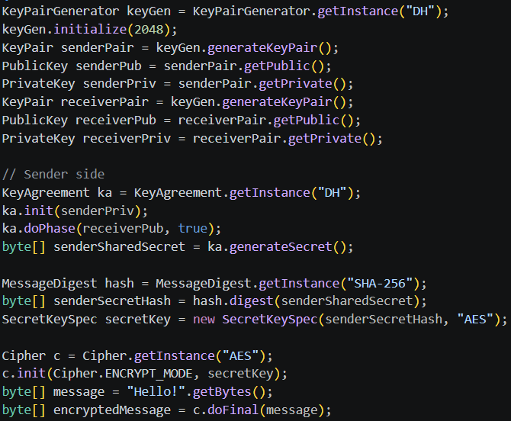
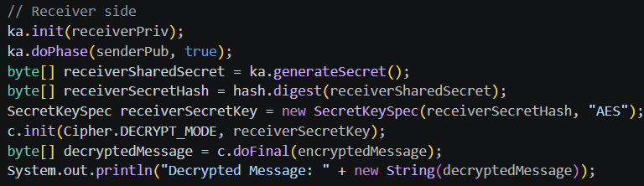
DH Example

Slide 36
Why Hybrid Encryption is better
High Performance/Efficiency: Symmetric algorithms like AES are used to encrypt large data payloads, which is much faster than using asymmetric algorithms (e.g., RSA/ECC) for the entire message.
Secure Key Distribution: Asymmetric encryption is used only to encrypt and transfer the symmetric key (session key) securely, solving the challenge of sharing keys over insecure channels.
Resilience: Using ECDH, the symmetric key exists only for that session. If the server's private key is stolen in the future, the attacker cannot decrypt past traffic because the AES session key has never passed over the network and has been erased from RAM.

Slide 37
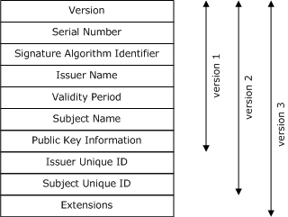
Certificates
An X.509 certificate is a digital document that uses the international X.509 Public Key Infrastructure standard to bind a public key to an identity (user, computer, or service).
It acts as a "digital passport," enabling secure communication, authentication, and encryption for SSL/TLS protocols.
These certificates are issued and signed by trusted Certificate Authorities (CAs).

Slide 38
CertificateFactory
The CertificateFactory class defines the functionality of a certificate factory, which is used to generate certificate and certificate revocation list (CRL) objects from their encoding.
CertificateFactory objects are obtained by using one of the getInstance() static factory methods.
public static final CertificateFactory getInstance(String type)
The only certificate type available by default is “X.509”.

Slide 39
Get a Certificate object
To generate a certificate object and initialize it with the data read from an input stream, use the generateCertificate method:
final Certificate generateCertificate(InputStream inStream)
On a Certificate object, the following methods are available:
- PublicKey getPublicKey() - Gets the public key from this certificate.
- void verify(PublicKey key) - Verifies that this certificate was signed using the private key that corresponds to the specified public key.
- void checkValidity() - Checks that the certificate is currently valid.
- X500Principal getSubjectX500Principal() - Returns the subject value from the certificate.
- and get all the other values from the certificate.

Slide 40
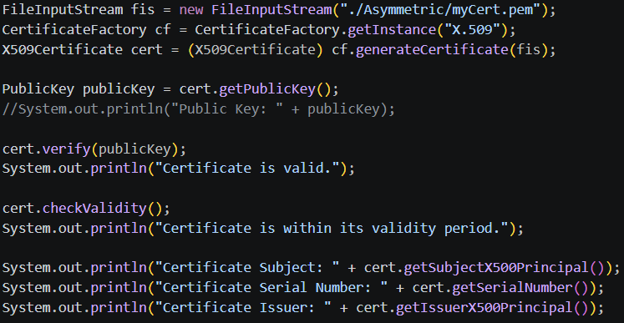
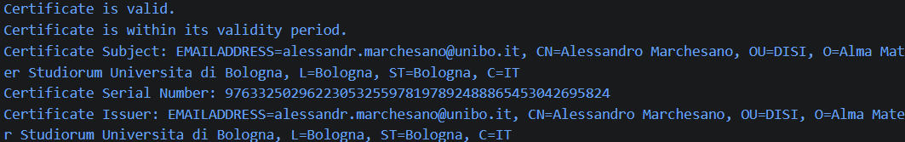
Certificate Example

Slide 41
https://github.com/alexmark22/EsercitazioniUNIBO-SicurezzaDellInformazione

Slide 42
Bibliografia
[1]: JCA Reference Guide - https://docs.oracle.com/en/java/javase/11/security/java-cryptography-architecture-jca-reference-guide.html
[2]: JCA Standard Algorithm Names - https://docs.oracle.com/javase/8/docs/technotes/guides/security/StandardNames.html
[3]: Evolution of Signature Algorithms – https://curity.io/blog/the-evolution-of-signature-algorithms/
[4]: Elliptic Curve Cryptography - https://blog.cloudflare.com/a-relatively-easy-to-understand-primer-on-elliptic-curve-cryptography/
[5]: ECDSA problems – https://blog.trailofbits.com/2020/06/11/ecdsa-handle-with-care/
[6]: Psychic Paper – https://arstechnica.com/information-technology/2022/04/major-crypto-blunder-in-java-enables-psychic-paper-forgeries/
[7]: PS3 Attack - https://deeprnd.medium.com/decoding-the-playstation-3-hack-unraveling-the-ecdsa-random-generator-flaw-e9074a51b831

Slide 43
Alessandro Marchesano
alessandr.marchesano@unibo.it

