Slide 1
Java Security: Architecture, Primitives and Possible Attacks
Alessandro Marchesano
alessandr.marchesano@unibo.it

Slide 2

Java Cryptography Architecture (JCA)
The Java Cryptography Architecture (JCA) framework within the Java platform provides a set of interfaces and implementations for cryptographic services.
It defines a set of APIs for digital signatures, message digests, key management, and encryption/decryption, among other cryptographic operations.
JCA is a core part of the Java Security API and is included in the standard Java Development Kit (JDK).

Slide 3
Safety vs. Security
Safety and Security are two related but distinct concepts:
Safety focuses on preventing accidental failures that could harm the application or the system the program is run on. Examples are garbage collection, static typing, exceptions handling, thread synchronization, impossibility to handle pointers, strong encapsulation (via private, public, protected).
Security, on the other hand, focuses on protecting from intentional attacks by malicious actors.

Slide 4
JCA Principles
Implementation independence: Applications do not need to implement security algorithms. Rather, they can request security services from the Java platform. Security services are implemented in providers, which are plugged into the Java platform via a standard interface.
Implementation interoperability: Providers are interoperable across applications. Specifically, an application is not bound to a specific provider, and a provider is not bound to a specific application.
Algorithm extensibility: The Java platform includes some built-in providers that implement a basic set of security services that are widely used today, but the Java platform supports the installation of custom providers.

Slide 5
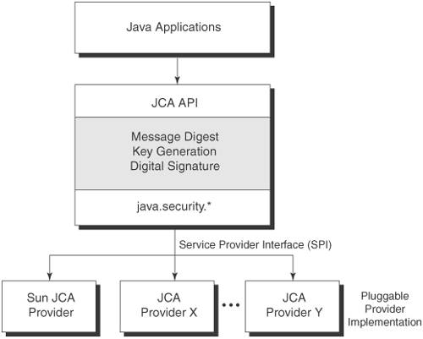
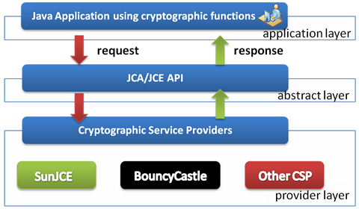
How JCA works
Engine Class
Providers

Slide 6
Cryptographic Service Provider (CSP)
The term Cryptographic Service Provider (CSP) refers to a package or set of packages that implement one or more cryptographic services.
Each JDK installation has one or more providers installed and configured by default. Additional providers may be added statically or dynamically.
Java.security.Provider

Slide 7
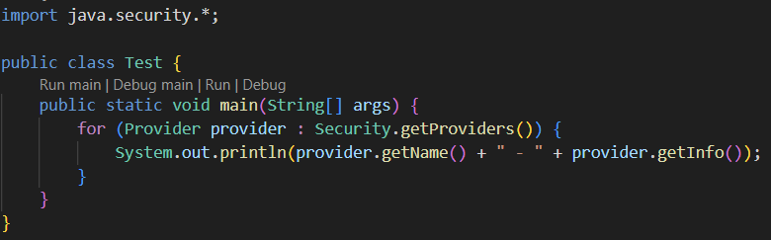
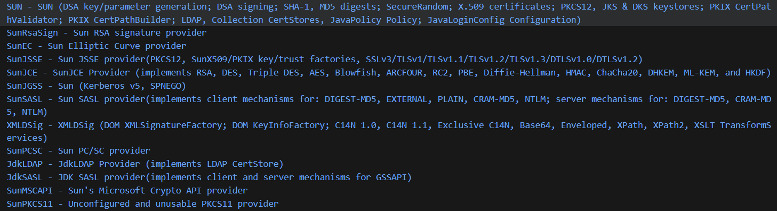
Built-in providers

Slide 8
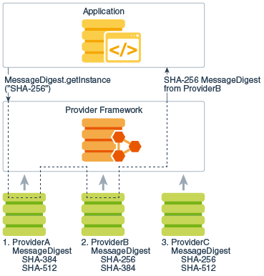
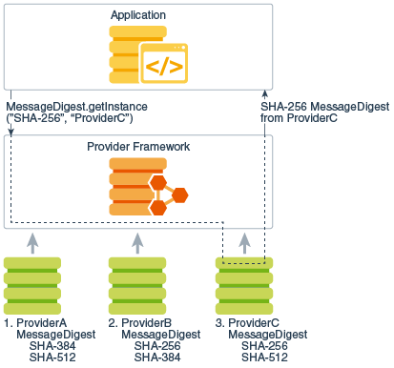
How Providers work

Slide 9
How to request services
static EngineClassName getInstance(String algorithm)
throws NoSuchAlgorithmException
static EngineClassName getInstance(String algorithm, String provider)
throws NoSuchAlgorithmException, NoSuchProviderException
static EngineClassName getInstance(String algorithm, Provider provider)
throws NoSuchAlgorithmException
where EngineClassName is the desired engine type (for example, Signature, MessageDigest, or Cipher). For example:
Signature sig = Signature.getInstance("SHA256withRSA");
MessageDigest md = MessageDigest.getInstance(“SHA-256”)

Slide 10
What services (engine classes) can we request?
SecureRandom
MessageDigest
Signature
Cipher
Mac
KeyFactory
SecretKeyFactory
KeyPairGenerator
KeyGenerator
KeyAgreement
AlgorithmParameters
AlgorithmParameterGenerator
KeyStore
CertificateFactory
CertPathBuilder
CertPathValidator
CertStore

Slide 11
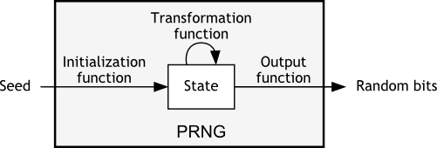
SecureRandom
The SecureRandom class is an engine class that provides cryptographically strong random numbers, using PRNGs, OS-native sources, or a combination of both.
They are used to instantiate ciphers, MACs, algorithm parameters or in application-specific scenarios.

Slide 12
Random vs SecureRandom
The classes defined in Random are NOT cryptographically strong, and the numbers chosen are not completely random because a definite mathematical algorithm is used to select them. Therefore, it is not safe to use this class for tasks that require a high level of security.
Instead, SecureRandom provides a cryptographically strong RNG… if used properly.

Slide 13

Random class algorithm
SecureRandom class algorithm

Slide 14
Getting a SecureRandom object
We can get a SecureRandom object in three ways:
new SecureRandom() - returns a new SecureRandom object from the first provider that supports a SecureRandom RNG algorithm. SHA1PRNG from SUN if none found.
SecureRandom.getInstance(“algorithmName”) - to get a specific implementation of SecureRandom
SecureRandom.getInstanceStrong() - to obtain a strong implementation as defined by the securerandom.strongAlgorithms property of the java.security.Security class.
Possible algorithms:
NativePRNG
NativePRNGBlocking
NativePRNGNonBlocking
PKCS11
DRBG
SHA1PRNG
Windows-PRNG

Slide 15

Using a SecureRandom object
Available methods:
public void setSeed(long seed); - sets the seed in the SecureRandom PRNG.
Overridden java.util.Random methods:
public int nextInt(); Securely generates a random integer.
public int nextBoolean(); Securely generates a random boolean.
public byte[] generateSeed(int numBytes); Returns the given number of seed bytes.
public void nextBytes(byte[] bytes); Securely generates a user-specified number of random bytes

Slide 16
How to deal with seeds
The randomness of the bits produced by the SecureRandom object depends on the randomness of the seed bits.
At the beginning, the objects are not seeded. If, after the instantiation, nextBytes (or whatever operation) is called, then the PRNG is seeded using a secure mechanism provided by the underlying operating system.
If setSeed is called before a call to nextBytes, then the internal seeding mechanism is bypassed, and only the provided seed is used to generate random numbers.
At any time, a SecureRandom object may be re-seeded using one of the setSeed or reseed methods. The given seed for setSeed supplements, rather than replaces, the existing seed; therefore, repeated calls are guaranteed never to reduce randomness.

Slide 17
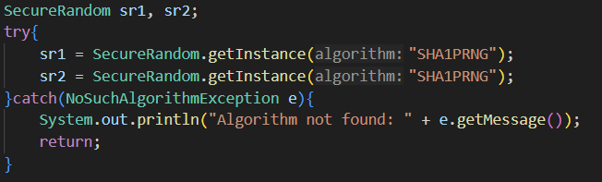

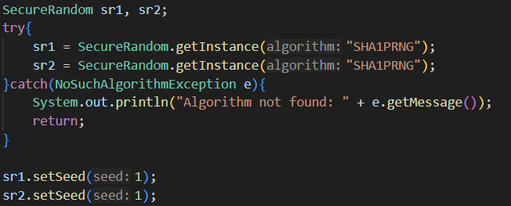

SHA1PRNG with and without seed initialization
Results:
Results:

Slide 18
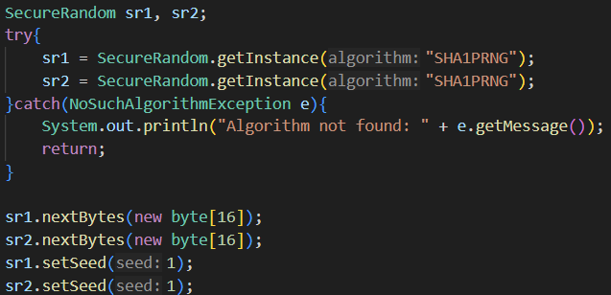

SHA1PRNG with automatic seed initialization
Results:
However, SHA1PRNG is NOT considered secure.

Slide 19
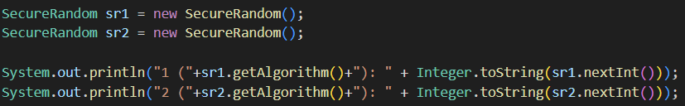

DRBG (1)

Slide 20
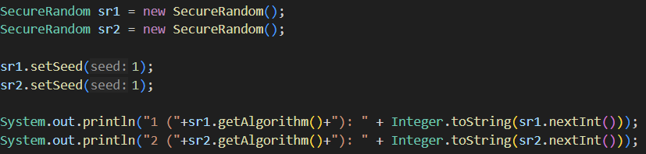


DRBG (2)
First Execution:
Second Execution:

Slide 21
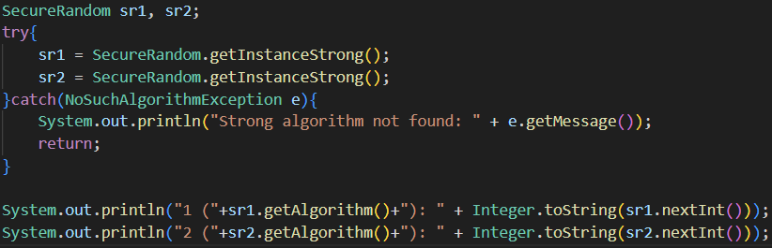

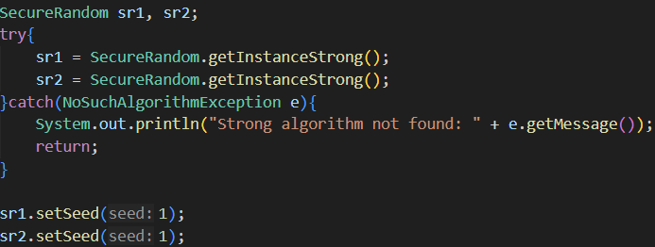


Strong Instance

Slide 22
What did we learn?
Always use SecureRandom. DO NOT use Random class to generate random values.
SHA1PRNG is NOT considered secure and should not be used.
Let the framework auto-initialize the seed. Do not use setSeed or use it only after a nextBytes (or other) call.
If you need to manually set a seed, generate a cryptographically secure one.
Even though getInstanceStrong appears to be the best option, it actually depends.

Slide 23
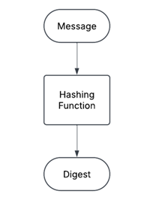
MessageDigest
To avoid modifications of the information in the unsafe channel, we need a hashing function that takes in input a string of information of any length and outputs a unique fingerprint of a fixed length.
Inputting the same string of information into a hashing function always outputs the same fingerprint.
The modification of a single bit must completely change the output fingerprint.

Slide 24
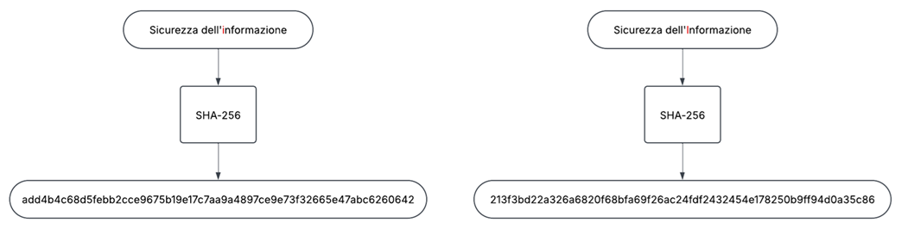
MessageDigest

Slide 25
Getting a MessageDigest object
We can get a MessageDigest object with:
MessageDigest.getInstance(“algorithmName”)
It thus does not need further initialization.
Possible algorithms:
MD2
MD5
SHA-1
SHA-224
SHA-256
SHA-384
SHA-512
SHA-512/224
SHA-512/256

Slide 26

Using a MessageDigest object
The MessageDigest class provides three methods (and many overloading implementations) to manage digest creation:
public final void update(ByteBuffer input); Updates the input buffer by initializing it or appending input to it.
public final void reset(); Resets the input buffer.
public final byte[] digest(); Computes and returns the hash/digest/fingerprint of the input. It automatically resets the input buffer.

Slide 27
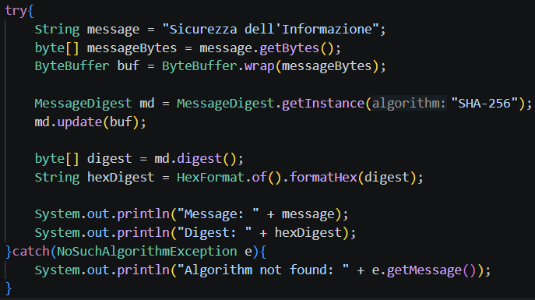
Hashing a message

Slide 28
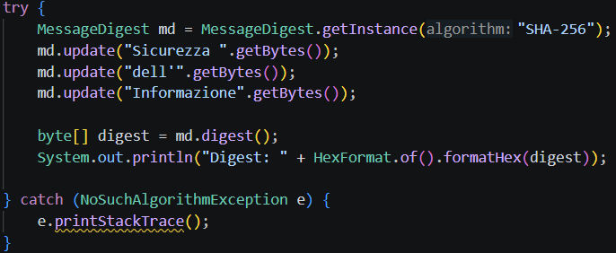
Hashing a message in more steps

Slide 29
Cipher
The Cipher class provides the functionality of a cryptographic cipher used for encryption and decryption.
Symmetric encryption requires that the same key is used both for encrypting and decrypting.
The participants must preemptively agree on the key.
Two types of symmetric ciphers exist:
Block ciphers
Stream ciphers

Slide 30
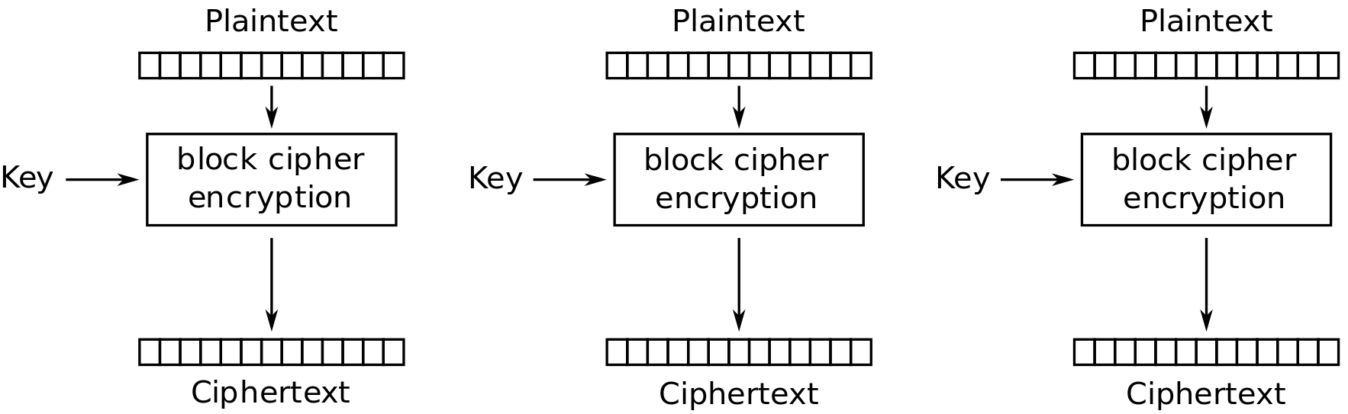
Block Ciphers
Block ciphers process entire blocks at a time, usually many bytes in length.
If there is not enough data to make a complete input block, the data must be padded: that is, before encryption, dummy bytes must be added to make a multiple of the cipher's block size. These bytes are then stripped off during the decryption phase.
Examples of block ciphers are:
AES-EBC (Electronic Code Book)
AES-CBC (Cipher Block Chaining)
AES-CFB (Cipher Feedback Mode)
AES-CTR (Counter Mode)
AES-GCM (Galois Counter Mode)

Slide 31
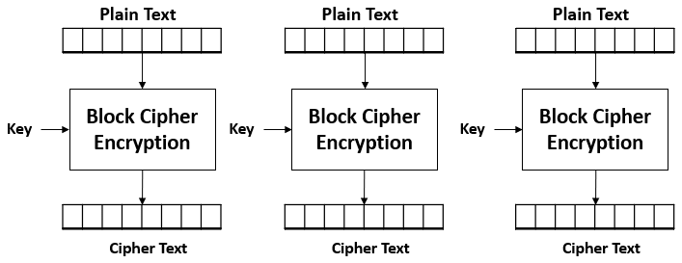
Why we should not use ECB
ECB mode is considered insecure because it encrypts identical plaintext blocks into identical ciphertext blocks, revealing patterns in the data.
Because each block is encrypted independently with the same key, identical plaintext blocks produce identical ciphertext blocks. This means that structured data (like images or formatted text) will still show its structure after encryption.

Slide 32



Slide 33


Slide 34
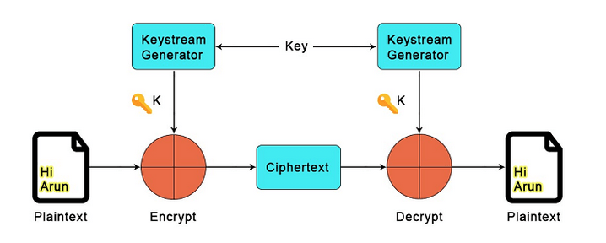
Stream Ciphers
Stream ciphers process incoming data one small unit (typically a byte or even a bit) at a time. This allows for ciphers to process an arbitrary amount of data without padding.
Depending on the particular algorithm, other parameters may be needed (like nonces or counter values).
Examples of Stream Ciphers are:
RC4 (Rivest Cipher 4)
Salsa20
ChaCha20
AES-CTR (Counter Mode)
AES-GCM (Galois Counter Mode)

Slide 35
Getting a Cipher object
An instance of Cipher is obtainable once again through
public static Cipher getInstance(String transformation);
A transformation is of the form “algorithm/mode/padding”
Examples:
//block
Cipher cipher = Cipher.getInstance(“AES”); Cipher cipher = Cipher.getInstance(“AES/ECB/PKCS5Padding");
//stream Cipher cipher = Cipher.getInstance(“ChaCha20”);

Slide 36
Initializing a Cipher object
A Cipher object must be initialized for one of four modes:
ENCRYPT_MODE
DECRYPT_MODE
WRAP_MODE
UNWRAP_MODE
To initialize a Cipher object, call one of the following init methods:
public void init(int opmode, Key key);
public void init(int opmode, Key key, SecureRandom random);
public void init(int opmode, Key key, AlgorithmParameterSpec params);
public void init(int opmode, Key key, AlgorithmParameterSpec params, SecureRandom random);

Slide 37
Generating Keys
Of course, to use ciphers, we need cryptographic key material. To generate keys, we need a KeyGenerator object.
With no one’s surprise, available via: public static KeyGenerator getInstance(String algorithm); KeyGenerator kg = KeyGenerator.getInstance(“AES”);
Initialize the object using: public void init(int keySize); kg.init(256);
Obtain a secret key: public SecretKey generateKey(); SecretKey sk = kg.generateKey();

Slide 38
About Cipher parameters…
If a Cipher object that requires parameters (for example, an IV) is initialized for encryption, and no parameters are supplied to the init method, the underlying cipher implementation is supposed to supply the required parameters itself, generating random parameters or using a default, provider-specific set of parameters.
However, if a Cipher object that requires parameters is initialized for decryption, and no parameters are supplied to the init method, an exception will be raised.
The same parameters that were used for encryption must be used for decryption.
When a Cipher is initialized, it loses all previously acquired state. In other words, initializing a Cipher is equivalent to creating a new instance of that Cipher and initializing it.
When you don’t specify all parameters during initialization, Cipher method getParameters()could be useful.

Slide 39
What parameters do we need?
Depending on the mode of operations, some additional information might be required:
ECB: no additional information.
CBC, OFB, CFB: require an Initialization Vector.
CTR: requires an Initialization Vector and No padding.
GCM: requires an Initialization Vector, the MAC dimension, and No padding.
ChaCha20: requires a nonce and a counter.

Slide 40
How do we generate parameters?
First, create a PRNG and fill a byte array: SecureRandom sr = SecureRandom.getInstanceStrong(); byte[] iv = new byte[16]; sr.nextBytes(iv);
To provide an Initialization Vector: IvParameterSpec spec = new IvParameterSpec(iv);
For GCM specifically, we also need to provide the length in bit of the MAC. int macLen = 128; GCMParameterSpec spec = new GCMParameterSpec(macLen, iv);
In the signature of the init method, AlgorithmParameterSpec is a superclass of both IVParameterSpec and GCMParameterSpec.

Slide 41
Stream Ciphers Parameters
To employ stream ciphers like ChaCha20 we must supply additional parameters exactly as we did for modes of operations.
ChaCha20, for example, must be supplied with a nonce and a counter variable. byte[] nonce = new byte[12]; sr.nextBytes(nonce); int counter = sr.nextInt(); ChaCha20ParameterSpec spec = new ChaCha20ParameterSpec(nonce, counter);

Slide 42
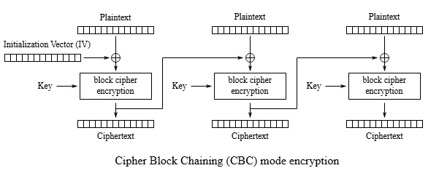

IV mishandling – CBC (1)
What if we use a constant IV?
What if we use a predictable IV (such as a counter)?

Slide 43
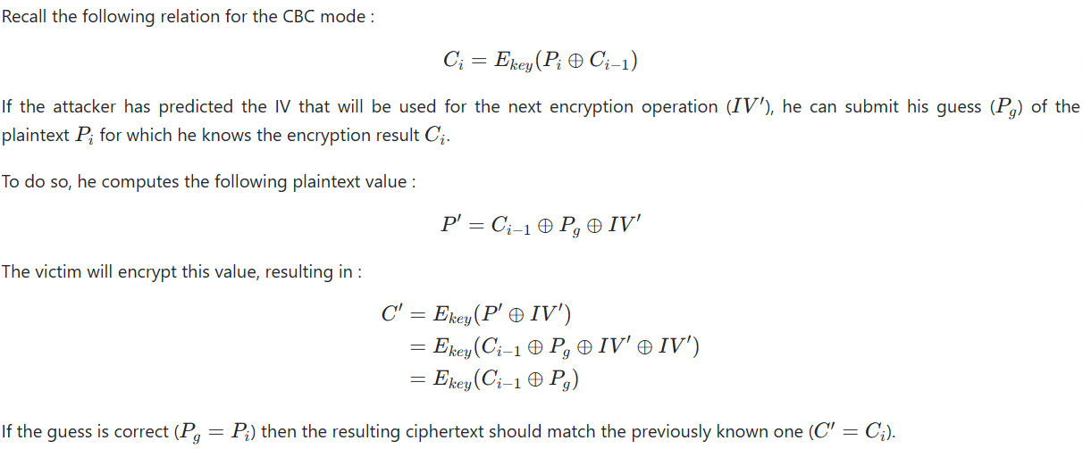
IV mishandling – CBC (2)

Slide 44
IV mishandling – CBC (3)
Imagine a protocol that encrypts each network packet by using the last encrypted block as the new IV. Also suppose that transmitted data is limited to “Yes” or “No”.
An attacker who intercepted the communication might try to guess the message by submitting guesses until the right value is found.
When the guess is right, the encryption result matches the intercepted one.
Although this example might seem far-fetched, this is roughly what is done by the BEAST attack, allowing it to decrypt traffic in TLS 1.0 and below.

Slide 45
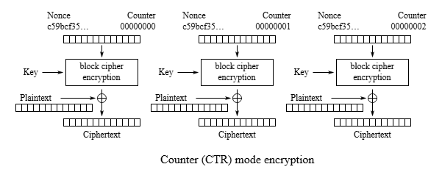
IV mishandling – CTR (1)
What if we use a constant IV?
What if we use a reused IV?

Slide 46
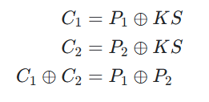
IV mishandling – CTR (2)
Just like for CBC mode, you should not reuse a key/IV pair.
If the same IV is used twice, the same keystream will be produced. The attacker can compute the XOR operation of the two plaintexts, allowing him to decrypt them using crib dragging.

Slide 47
IV mishandling – CTR (3)
The solution could be to generate the IV randomly, but…
The key takeaway is that if you generate an n-bit random value, the probability of obtaining a collision approximates 50% after just 2^(n/2)​ generations, because of the birthday paradox.
If n is sufficiently large, the probability of collision is negligible for a longer time, but keep in mind that a single collision is enough to break confidentiality.
The best solution is to build an IV as a nonce + a counter, ensuring unpredictability and uniqueness.

Slide 48
Using a Cipher Object
Finally, when the cipher object has been initialized, we can start encrypting or decrypting.
For one-shot encryption/decryption we use: public final byte[] doFinal(byte[] input);
For multi-part encryption/decryption, assuming we have n parts: public final byte[] update(byte[] input); // for n-1 parts public final byte[] doFinal(byte[] input);// for last part

Slide 49
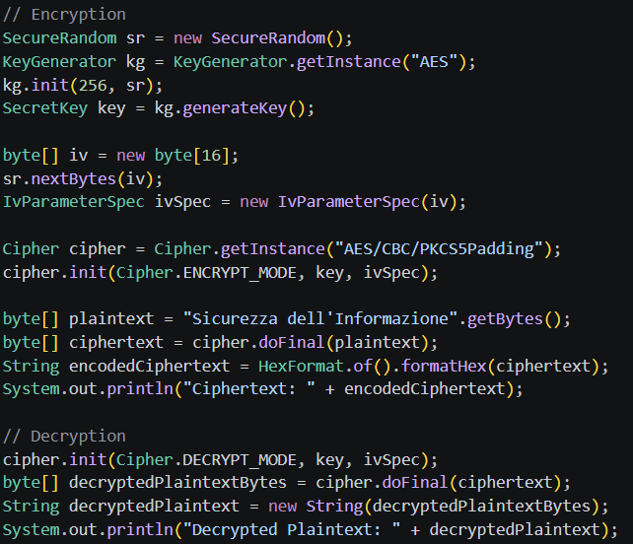
Ciphers Example – Block Ciphers, CBC

Slide 50
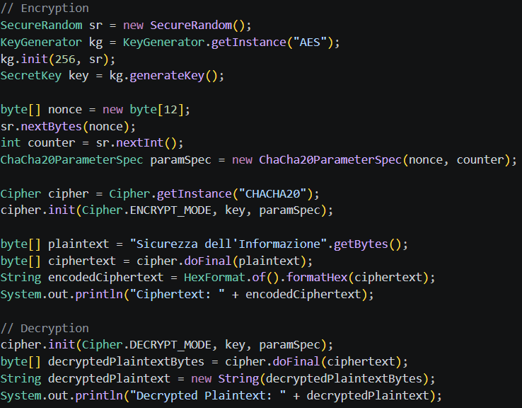
Ciphers Example (2) – Stream Ciphers, ChaCha20

Slide 51
Other Cipher-based classes - CipherInputStream
This class is a FilterInputStream that encrypts or decrypts the data passing through it. It is composed of an InputStream. CipherInputStream represents a secure input stream into which a Cipher object has been interposed. The read methods of CipherInputStream return data that are read from the underlying InputStream but have additionally been processed by the embedded Cipher object.
try (FileInputStream fis = new FileInputStream("/tmp/a.txt");
CipherInputStream cis = new CipherInputStream(fis, cipher1);
FileOutputStream fos = new FileOutputStream("/tmp/b.txt")) {
byte[] b = new byte[8];
int i = cis.read(b);
while (i != -1) {
fos.write(b, 0, i);
i = cis.read(b);
}
}

Slide 52
Other Cipher-based classes - CipherOutputStream
This class is a FilterOutputStream that encrypts or decrypts the data passing through it. It is composed of an OutputStream, or one of its subclasses, and a Cipher. CipherOutputStream represents a secure output stream into which a Cipher object has been interposed. The write methods of CipherOutputStream first process the data with the embedded Cipher object before writing them out to the underlying OutputStream.
try (FileInputStream fis = new FileInputStream("/tmp/a.txt");
FileOutputStream fos = new FileOutputStream("/tmp/b.txt");
CipherOutputStream cos = new CipherOutputStream(fos, cipher1)) {
byte[] b = new byte[8];
int i = fis.read(b);
while (i != -1) {
cos.write(b, 0, i);
i = fis.read(b);
}
}

Slide 53
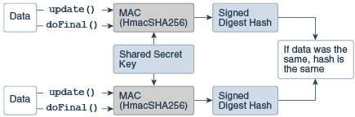
Message Authentication Code (MAC)
Similar to a MessageDigest, a MAC provides a way to check the integrity of information transmitted over or stored in an unreliable medium but includes a secret key in the calculation.
A MAC mechanism that is based on cryptographic hash functions is referred to as HMAC. HMAC can be used with any cryptographic hash function, e.g., SHA-256, in combination with a secret shared key.

Slide 54
Creating a Mac object
Mac objects are obtained by using one of the Mac getInstance() static factory methods.
Mac.getInstance(“algorithmName”);
Examples of Mac algorithms are:
HmacMD5
HmacSHA1
HmacSHA224
HmacSHA256
HmacSHA512

Slide 55
Initializing a Mac object
A Mac object is always initialized with a (secret) key and may optionally be initialized with a set of parameters, depending on the underlying MAC algorithm.
public void init(Key key);
public void init(Key key, AlgorithmParameterSpec params);

Slide 56
Using a Mac object
A MAC can be computed in one step or in multiple. A multiple-part operation is useful if you do not know in advance how long the data is going to be, or if the data is too long to be stored in memory all at once.
For one-shot operations we use: public byte[] doFinal(byte[] input);
For multi-part operations, assuming we have n parts: public void update(byte[] input); // for n-1 parts public byte[] doFinal(byte[] input);// for last part

Slide 57
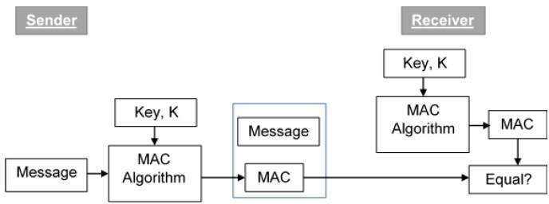
Attach the MAC
JCA does not handle the attachment of the MAC to the message sent on the sender side, nor the verification of the MAC on the recipient side. It must be handled by the developer.
GCM is the only exception (we will see it later).

Slide 58
How to combine Cipher and MAC?
The most common ways to combine Encryption and Mac are:
Encrypt-and-MAC
Mac-then-Encrypt
Encrypt-then-MAC
Encryption and MAC use two different keys.

Slide 59
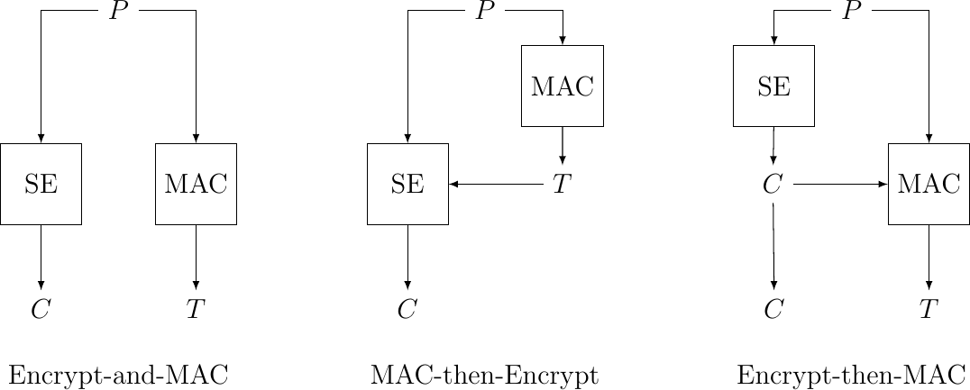
Encrypt-and-MAC
The message is first encrypted, and a MAC is simultaneously calculated on the plaintext. Both are transmitted.
MAC algorithm is not supposed to maintain confidentiality about the message.
The same message sent twice will produce the same MAC and this would be visible.
Encrypt-and-MAC was used in SSH, until version 6.7.
DO NOT USE IT!

Slide 60
MAC-then-Encrypt
A MAC is computed on the plaintext, appended, and then the entire package is encrypted.
Doom principle: if you have to perform any cryptographic operation before verifying the MAC on a message you’ve received, it will somehow inevitably lead to doom.
The receiver must decrypt the data before verifying the MAC, allowing potential attackers to send arbitrary messages and exploit decryption errors (padding oracles).
Historically used in SSL/TLS before 1.2. DO NOT USE IT!

Slide 61
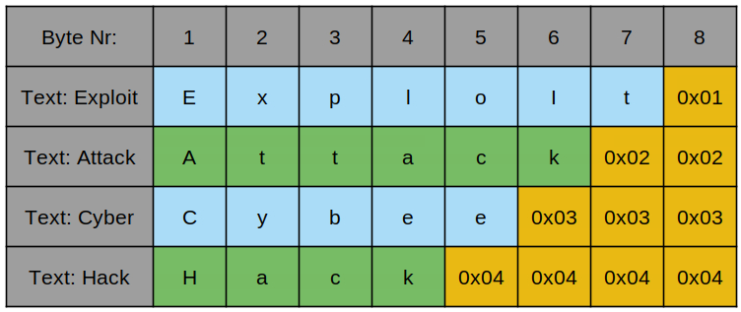
Padding Oracle Attack (1)
TLS used MAC-then-encrypt with AES-CBC. Why is it dangerous?
When the block doesn’t fit the block size, it is padded.
What if an attacker can understand if a packet that has been sent is correctly padded or not? The server acts as an oracle, and the attacker can exploit this to decrypt the plaintext without knowing the key.

Slide 62
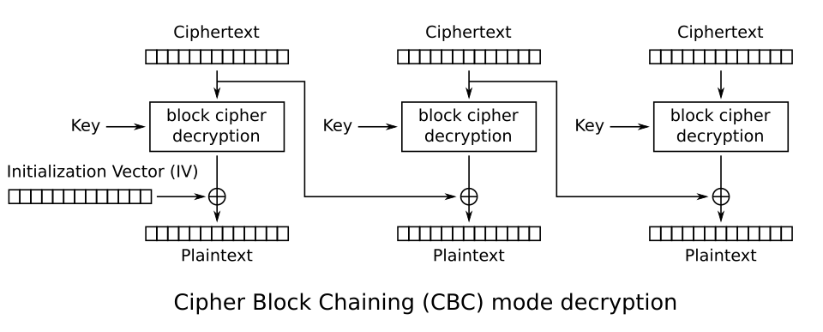


Padding Oracle Attack (2)
and this is true byte by byte.
Suppose the attacker has two ciphertext blocks C1, C2 and wants to decrypt the second block to get plaintext P2.
$$P_{2}= D_{K}\left(C_{2}\right)⨁C_{1}$$

Slide 63

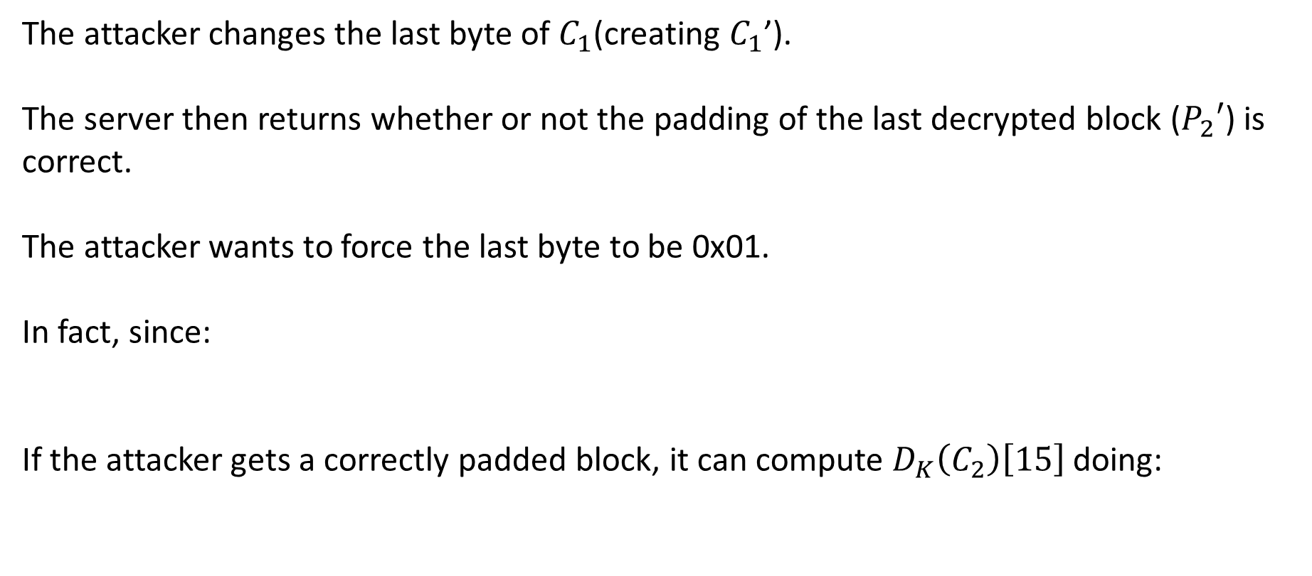

Padding Oracle Attack (3)
The attacker changes the last byte of $C_{1}$(creating $C_{1}$’).
The server then returns whether or not the padding of the last decrypted block ($P_{2}′$) is correct.
The attacker wants to force the last byte to be 0x01.
In fact, since:
If the attacker gets a correctly padded block, it can compute $D_{K}\left(C_{2}\right)\left[15\right]$ doing:
$$P_{2}′[15]= D_{K}\left(C_{2}\right)[15]⨁C_{1}′[15]$$
$$D_{K}\left(C_{2}\right)\left[15\right]=P_{2}′[15]⨁C_{1}′[15]$$
0x01
Decided by the attacker

Slide 64

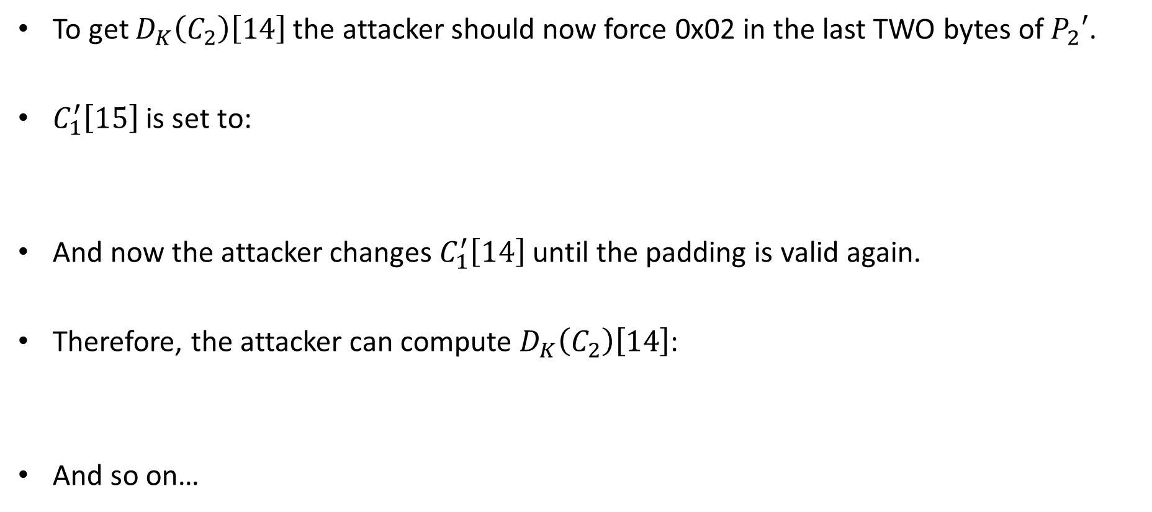

Padding Oracle Attack (4)
To get $D_{K}\left(C_{2}\right)\left[14\right]$ the attacker should now force 0x02 in the last TWO bytes of $P_{2}′$.
$C_{1}^{′}\left[15\right]$ is set to:
And now the attacker changes $C_{1}^{′}\left[14\right]$ until the padding is valid again.
Therefore, the attacker can compute $D_{K}\left(C_{2}\right)\left[14\right]$:
And so on…
$C_{1}^{′}\left[15\right]=D_{K}\left(C_{2}\right)\left[15\right]⨁$ 0x02
$$D_{K}\left(C_{2}\right)\left[14\right]=P_{2}′[14]⨁C_{1}′[14]$$
0x02
Decided by the attacker

Slide 65
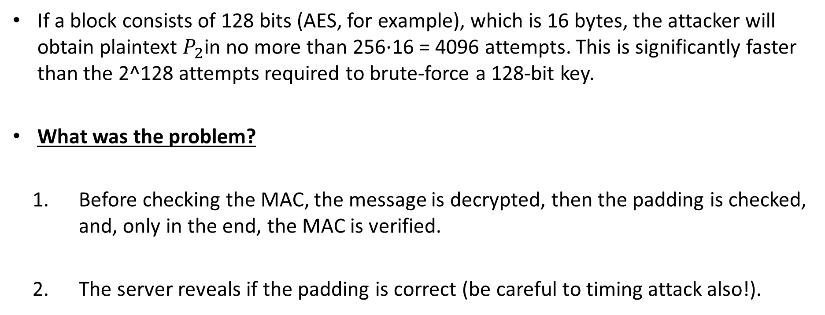
Padding Oracle Attack (5)
If a block consists of 128 bits (AES, for example), which is 16 bytes, the attacker will obtain plaintext $P_{2}$in no more than 256⋅16 = 4096 attempts. This is significantly faster than the 2^128 attempts required to brute-force a 128-bit key.
What was the problem?
1. Before checking the MAC, the message is decrypted, then the padding is checked, and, only in the end, the MAC is verified.
2. The server reveals if the padding is correct (be careful to timing attack also!).

Slide 66
Encrypt than MAC
Encrypts the plaintext and then calculates a MAC on the ciphertext. It is considered the most secure approach to authenticated encryption.
The receiver verifies the MAC before attempting to decrypt the data. If the tag is invalid, the message is discarded, preventing decryption of manipulated data.
Common in modern security protocols like IPsec and available as an extension in TLS 1.2 and 1.3.

Slide 67
How to compare MACs
Before decrypting the message, the receiver MUST recalculate the MAC using the same secret key and algorithm as the sender, then perform a constant-time comparison. If the computed MAC matches the received MAC, the message is deemed authentic and untampered.
Use Constant-Time Comparison: When comparing the MACs, use a cryptographic constant-time string comparison function. This prevents timing attacks, where an attacker deduces the MAC byte-by-byte based on how long the comparison takes.
Avoid Simple Equality Operators: Do not use standard string comparison methods (like == or Arrays.equals()) as they often return immediately upon finding the first differing character, creating timing vulnerabilities. Use MessageDigest.isEqual() .

Slide 68
Xbox360 MAC Timing Attack
Essentially, an older version of the Xbox kernel had a flaw where memcmp was used to check the HMAC value.
Downgrading to the older kernel version allowed an attacker to provide bogus hashes and measure the difference between a valid byte and invalid one.
The implementation of MAC verification had a difference of 2.2 milliseconds between rejection times.
Attackers were able to exploit this and load pirated games onto the hardware.

Slide 69
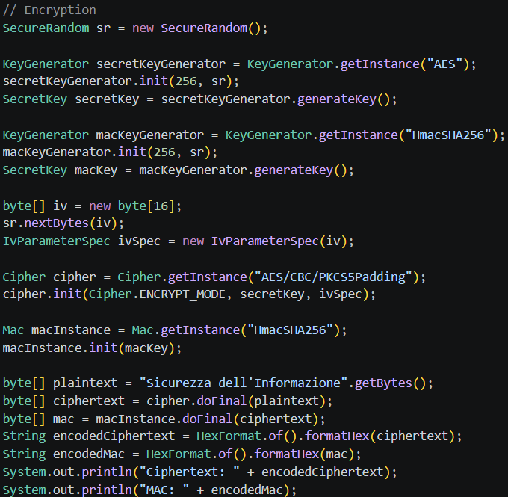
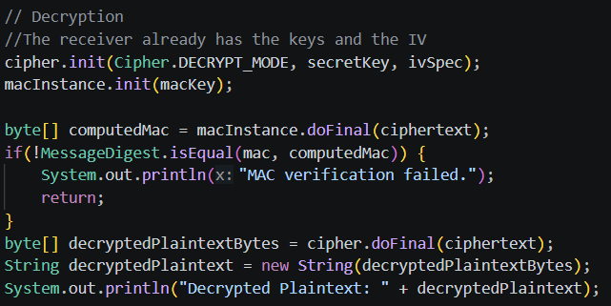

Example

Slide 70
AEAD (GCM)
The GCM operating mode belong to the category of Authenticated Encryption with Additional Data ciphers (AEAD) as it leverages a MAC to grant integrity. This cipher not only grant the authenticity of the ciphertext, but also of some additional plaintext data.
To authenticate additional (non-encrypted) data, we can use the following function: public final void updateAAD(byte[] src);
Of course, this function must be called both when encrypting, and decrypting, in the same order.
Widely used in modern standards

Slide 71
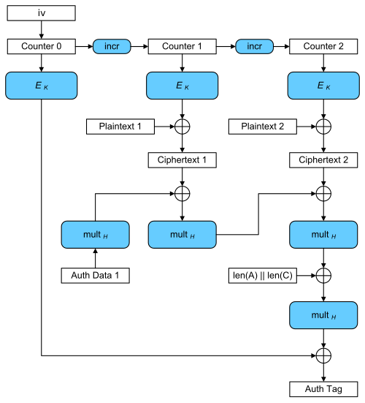
GCM
GCM is encrypt-then-mac .
Cipher.doFinal() automatically encrypts data and generates a MAC on the sender side, verifies the MAC and decrypts data on the receiver side.
Launches AEADBadTagException if Mac verification fails.

Slide 72
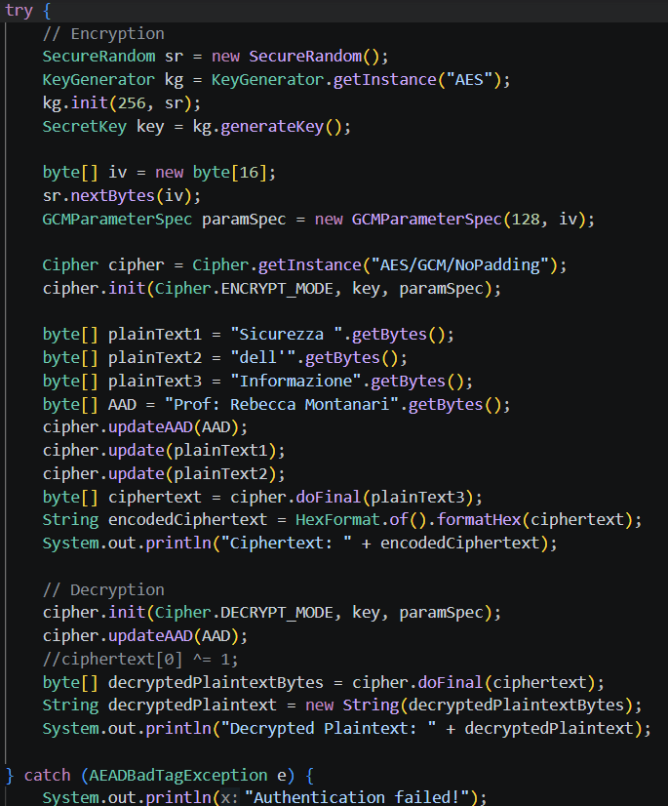
GCM Example

Slide 73
https://github.com/alexmark22/EsercitazioniUNIBO-SicurezzaDellInformazione

Slide 74
Secret Word for the Exercises:
penguin

Slide 75
Bibliografia
[1]: JCA Reference Guide - https://docs.oracle.com/en/java/javase/11/security/java-cryptography-architecture-jca-reference-guide.html
[2]: JCA Standard Algorithm Names - https://docs.oracle.com/javase/8/docs/technotes/guides/security/StandardNames.html
[3]: IV mishandling – https://stackered.com/blog/iv-mishandling/
[4]: Some cryptographic attacks – https://research.checkpoint.com/2024/modern-cryptographic-attacks-a-guide-for-the-perplexed/
[5]: BEAST Attack – https://blog.cryptographyengineering.com/2011/09/21/brief-diversion-beast-attack-on-tlsssl/
[6]: Crib dragging - https://samwho.dev/blog/toying-with-cryptography-crib-dragging/
[7]: Padding Oracle Attack - https://blog.cloudflare.com/padding-oracles-and-the-decline-of-cbc-mode-ciphersuites/

Slide 76
Alessandro Marchesano
alessandr.marchesano@unibo.it

