Slide 1
ASSIGNMENT 1: MODEL
Robert Brünig
Lorenzo Donini
Aurora Terzani

Slide 2
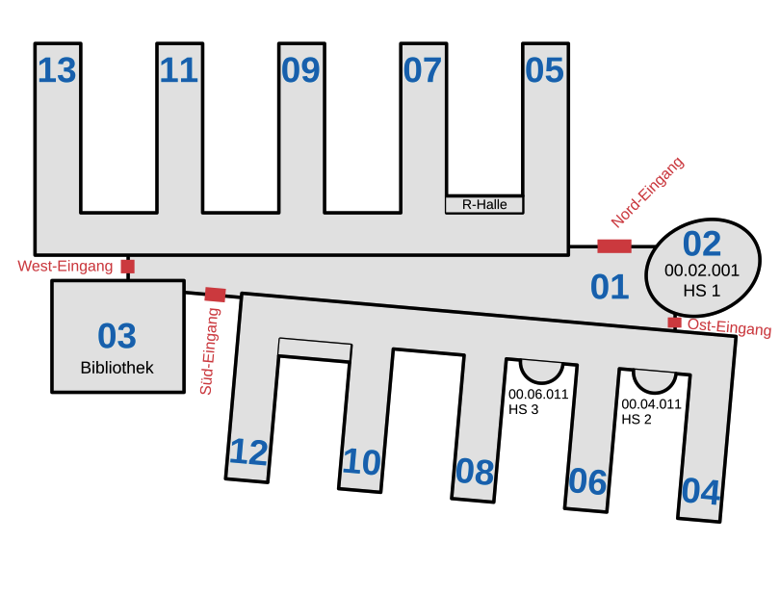
DESCRIPTION OF SCENARIO

Slide 3
GROUPS OF NODES
Students:
Can attend multiple lectures a day
Interact with other students
Study individually or in groups
Non-lecture periods are usually spent inside the main hall
Professors:
Can give 1-2 lectures a day
Have less interaction with other nodes
Non-lecture periods are usually spent in an office

Slide 4
NODE STRATEGY
In order to model different behaviors, nodes need to enter a specific state for each activity
States:
Enter building
Exit building
Attend a lecture
Study
Interact with other students
Eat
…

Slide 5
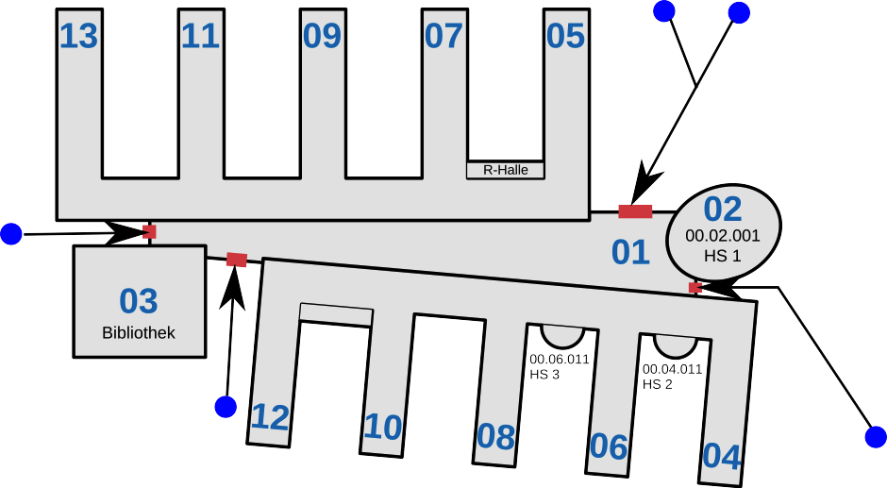
ENTER AND EXIT
Nodes follow a path before entering and exiting the building

Slide 6
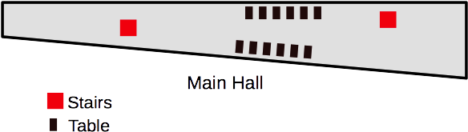
MAIN HALL
Nodes can move freely inside the main hall
When not attending a lecture students behave randomly, based on dynamic probabilities
Nodes may aggregate and form groups (of limited size) through spontaneous decisions of the nodes

Slide 7


LECTURES
In structures outside the main hall, nodes follow a path to a waypoint
Waypoints are associated to an activity

Slide 8
LECTURE SLOTS
Classrooms have a fixed capacity for nodes
Each classroom randomly generates time slots (lectures) in which nodes can occupy them
When nodes decide to go into the lecture-state, they pick a lecture from the list of available ones and move to the associated room

Slide 9

FURTHER DETAILS
Library
Rechnerhalle
Study rooms
Restrooms
Cafeteria

