Slide 1
ASSIGNMENT 1: DEMO
Robert Brünig
Lorenzo Donini
Aurora Terzani

Slide 2
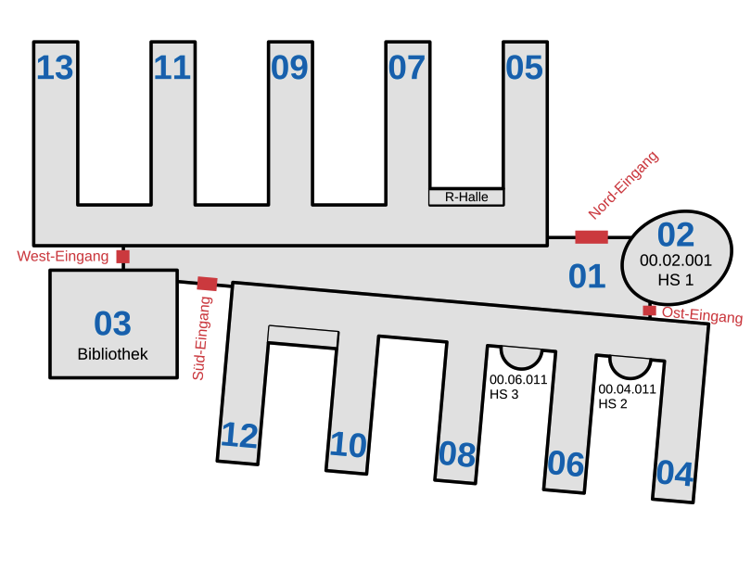
DESCRIPTION OF SCENARIO
Synthetic model
Decisions are based on dynamic probabilities
Movement patterns depend on the state of a node

Slide 3
NODE STATES
Main focus:
Enter building
Exit building
Lectures
Random main hall movements
Individual study
Group study
Social interaction

Slide 4
LECTURES
Specific capacity for each lecture room
Affluence depends on the popularity of a lecture
A random schedule is decided for each node
Lecture have variable duration

Slide 5
TODO
Map implementation
Missing states
Cafeteria/Eating
Bathroom
Library
Fixed paths vs Free roaming
Collision detection

