Slide 1
DESIGNING AND IMPLEMENTING A TUM MOBILITY MODEL
Robert Brünig
Lorenzo Donini
Aurora Terzani

Slide 2
Students & Professors
Students aggregate in main hall

Slide 3
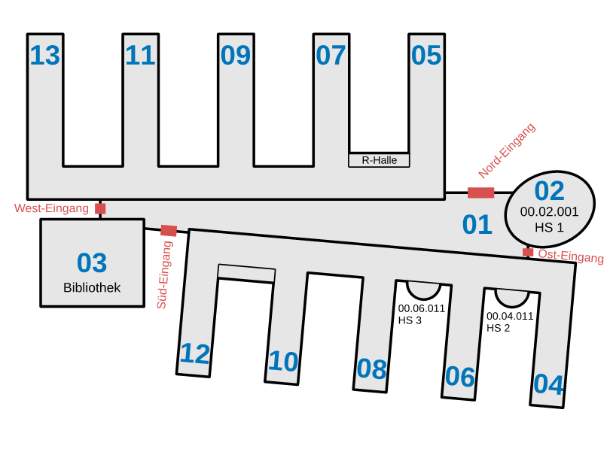
DESCRIPTION OF TUM SCENARIO
Notes:
We are going to consider also a little bit of surronding area
We consider as starting points different entrances , related also to some important meeting point like metro station and canteen

Slide 4
Nodes
Type: Student/Professor
State
  Enter
  Exit
  Main Hall
  Lecture
  ...

Slide 5
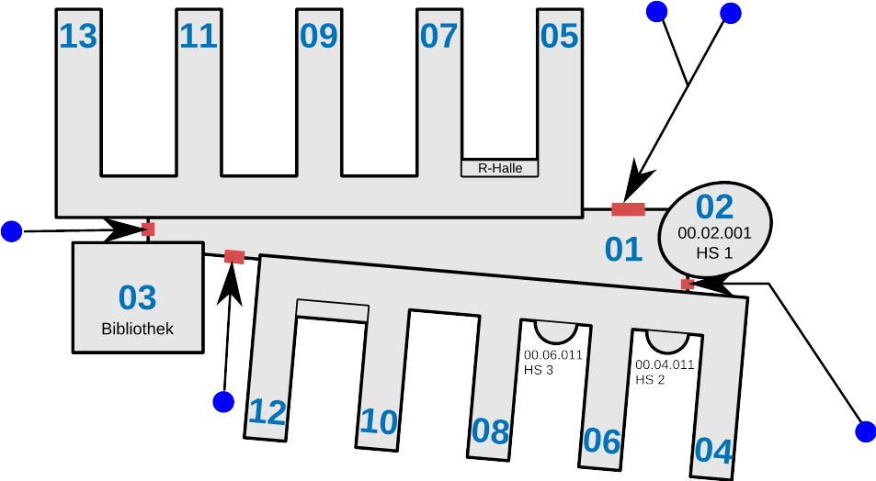
ENTER AND EXIT
Nodes follow paths before entering and after exiting the building
Notes:
We are going to consider also a little bit of surronding area
We consider as starting points different entrances , related also to some important meeting point like metro station and canteen

Slide 6
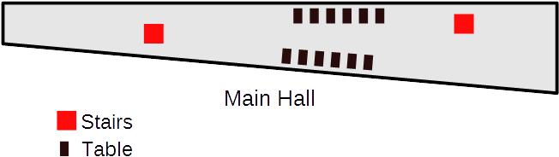
MAIN HALL
Notes:
We are going to consider also a little bit of surronding area
We consider as starting points different entrances , related also to some important meeting point like metro station and canteen

Slide 7
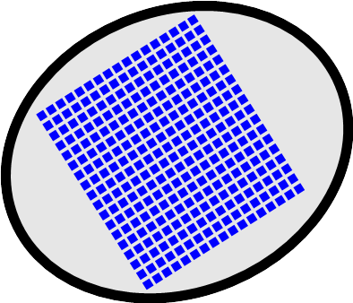
LECTURES
-In structures outside the main hall, nodes follow a path to a waypoint
-Waypoints are associated with an activity
Notes:
We are going to consider also a little bit of surronding area
We consider as starting points different entrances , related also to some important meeting point like metro station and canteen

Slide 8
Lecture slots
Class rooms have a fixed capacity for nodes
They “generate” time slots (lectures) in which nodes can occupie them
When nodes decide to go in the lecture-state they pick a lecture from the list of available ones and go to the associated room

Slide 9
Further Details
Library
Rechnerhalle

Slide 10
ANALYSIS OF THE MOBILITY IN THE SCENARIO
ENTER/EXIT POINTS
entering through different enter/exit areas (ubahn, parking, ...)
outside, nodes move on the lines
inside they move on a free space
MAIN HALL
Free space: random movements
Peolple could aggregate there or stay at their own
Different stay periods
WAYPOINTS
Classes
Library
Cafeteria
Bathrooms
Multiplanes
PEOPLE
professors (hold lectures)
students (listen to lectures)
others (optional)

Slide 11
MODELS IN OUR SCENARIO
LOCATION PREFERENCE
SLAW
Orbital patterns
Periodic event planning
Preferred location map
Heterogeneously bounded mobility areas
Node moves a shortest distance loop through a randomly selected subset of locations every day
SMOOTH
Nodes aggregate to create communities and move near to these
Nodes visit popular waypoints in the network
SOCIAL GRAPH
CMM
The next destination depends on position of user's social ties
HCMM
Spatial attraction
HHW
Communities depends on time of the day and are build synthetically

Slide 12
MODELS IN OUR SCENARIO
MODELING AGENDA
Shortest path routing with collision avoidance
Motion generator: Dijsktra's algorithm
Repeating daily activities in human scheduling
Waypoints in a database associated with an activity
Related to a specific scenario
Population heterogenity
WORKING DAY MOVEMENT
Walking submodel
– Uses Dijkstra’s shortest path algorithm
– Speed defined in settings
Different social patterns
Distinguish between intrabuilding and interbuilding movements
Different kind of activities

