Slide 1

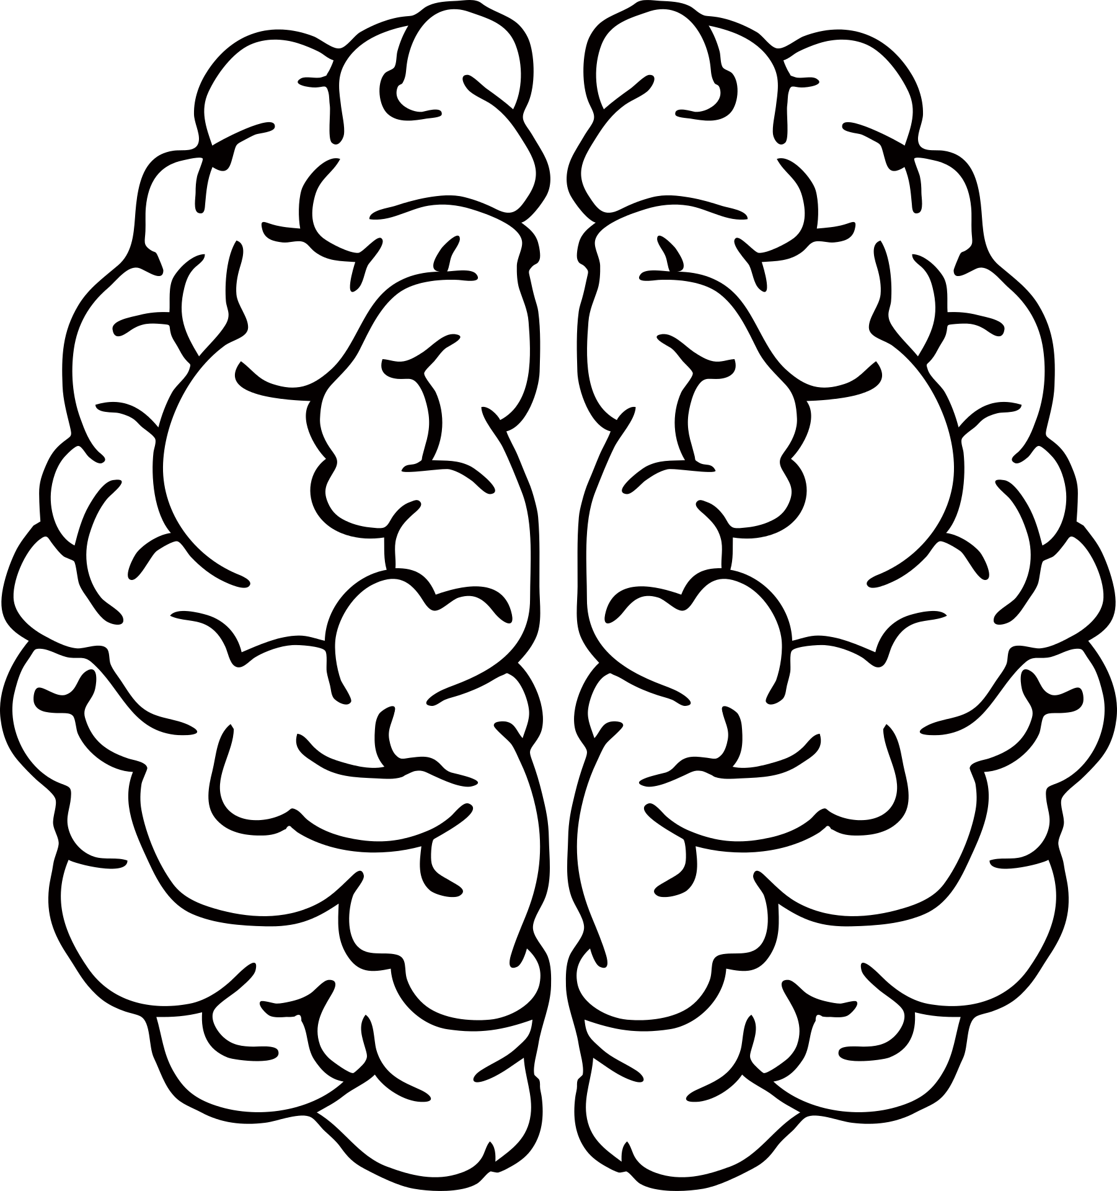
Understanding Human Brain Connectivity
4 DIFFERENT PROJECTS ON
Prof. Laura Sangalli
Dr. Eleonora Arnone
Dr. Letizia Clementi
MOX – Department of Mathematics, Politecnico di Milano

Slide 2
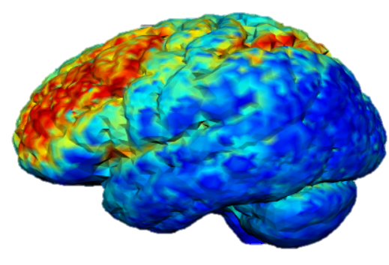
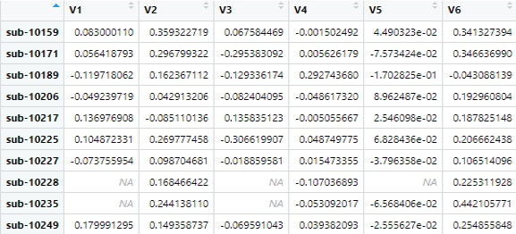
Functional connectivity map
Brains mapped on the same ATLAS
36000 nodes
272 subjects some affected by 3 neuropsychiatric disorders
ADHD
BIPOLARISM
SCHIZOPHRENIA
Notes:
Notes

Slide 3



Medical, demographic and psychological background of subjects
Health conditions
Smoking habits
Comorbidity
Demographic data
Cultural and ethnic identity
Behavioural test results
Barratt Impulsivity Scale (SCHZ)
Dickman Impulsivity Scale (BIP)
California Verbal Learning test (ADHD)
Neuroimaging data shared by the UCLA Consortium for Neuropsychiatric Phenomics
Notes:
We identified three strategies to both, increase the speed of innovation and implementation into the Group
The first strategy, called Complete Integration, would unify all brands into one while simultaneously consolidating central functions.
In the second strategy, called Innovation Center, we would advise you to establish a cross-Traton innovation center to on the one hand incubate external innovation and on the other hand integrate this newly acquired innovation into the Group in a timely manner.
The last strategy, the software platform approach, would result in a controlled opening of the truck operating system to allow complementors and their applications on this OS.

Slide 4
TASK SWITCHING IN SCHIZOPHRENIA
Understanding Human Brain Connectivity
Costanza Cantalini
Erica Bistacchia
Lorenzo Ferarra
Scott Pesenti

Slide 5
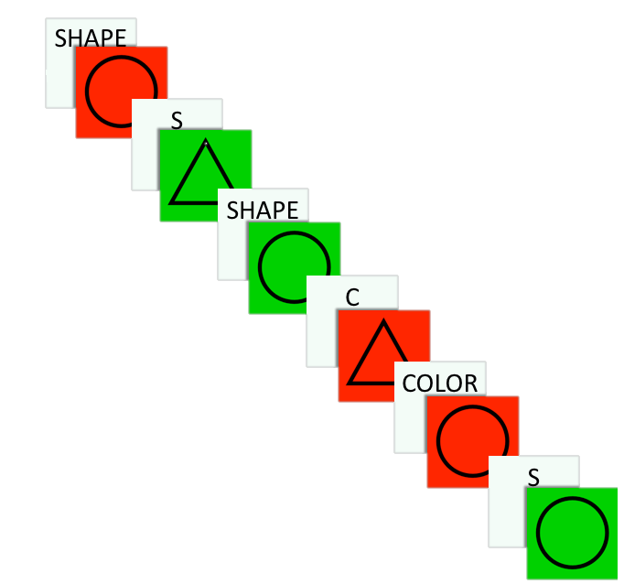

Task-switching test
How does the test work?
It measures the changes in RT between trials requiring vs. not requiring a switch in responding
CSI
Incongruent
Task switch
96 trials for each participant
Goal: Respond as fast and accurate as possible for each trial
4 possible stimuli: red circle, red triangle, green circle, green triangle
Task Cue: respond to the image’s colour or shape
On 33% of trials the instructions switched, while in 67% remains the same but the cue changes
CSI: Long or Short
Incongruent &
switching
Instructions
Red or Circle = Right button
Green or Triangle = Left button

Slide 6
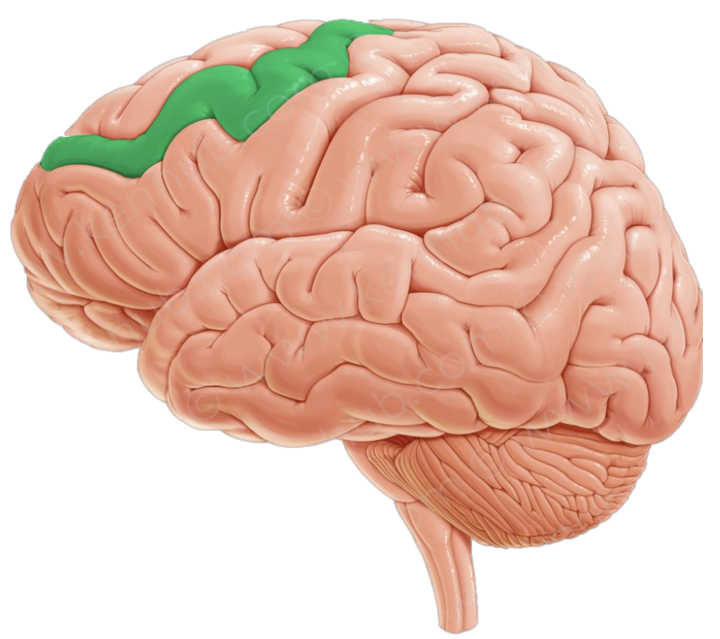
Main goals of our analysis
Dorsolater Prefontal Cortex
Understanding the inner working of a schizophrenic brain analyzing:
Brain connectivity with respect to our Region Of Interest (ROI)
Mean differences in Reaction Time (RT) and outcomes
Explore possible effect of experiment design on results
Switch / No Switch
A longer exposure to the cue (CSI)
Congruency between tests

Slide 7
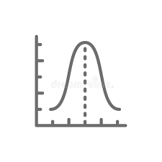


Initial and foreseen problems
DIMENSIONALITY
INTERPRETATION OF HEALTH DATA
NON NORMALITY
Notes:
We identified three strategies to both, increase the speed of innovation and implementation into the Group
The first strategy, called Complete Integration, would unify all brands into one while simultaneously consolidating central functions.
In the second strategy, called Innovation Center, we would advise you to establish a cross-Traton innovation center to on the one hand incubate external innovation and on the other hand integrate this newly acquired innovation into the Group in a timely manner.
The last strategy, the software platform approach, would result in a controlled opening of the truck operating system to allow complementors and their applications on this OS.

Slide 8
Non-normality of RT
In order to perform test on reaction time we first need to:
visualize data
test their normality

Slide 9
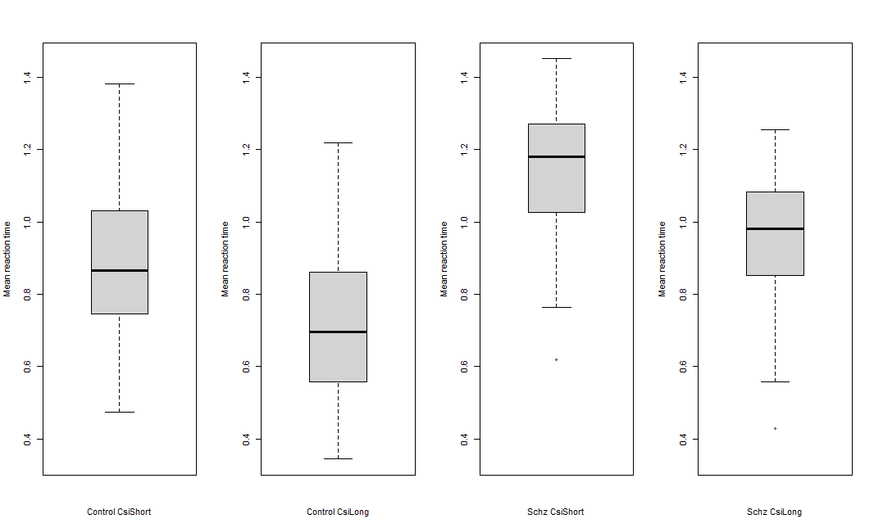
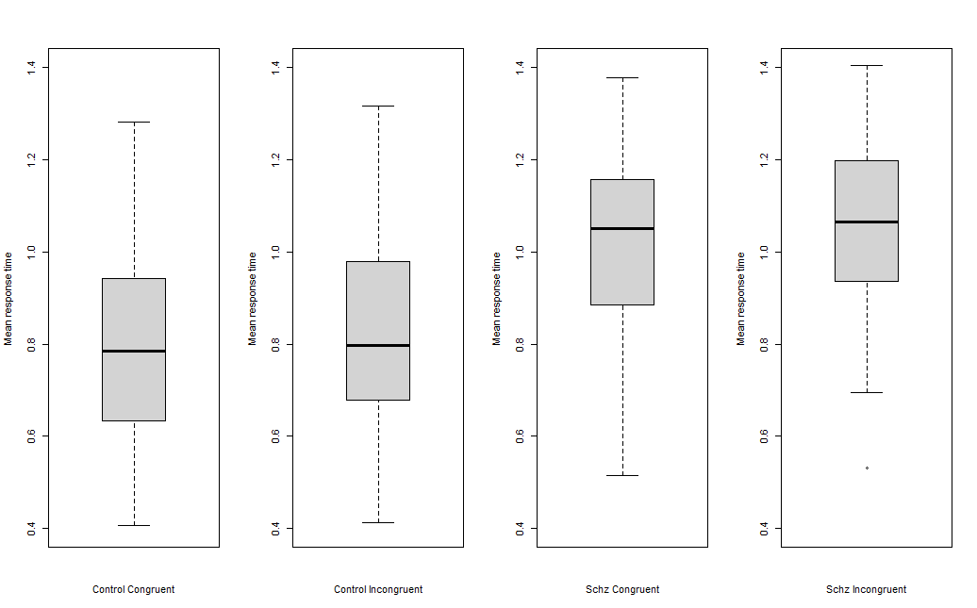
Non-normality of RT
In order to perform tests on Reaction Time we first need to:
visualize data
test their normality
Representation of Reaction Time

Slide 10
Dimensionality
Reduction to a 83-features dataset by aggregating nodes into regions

Slide 11
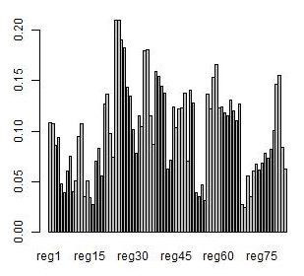
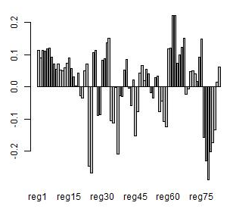
Dimensionality
Reduction to a 83-features dataset by aggregating nodes into regions
Perform PCA on the reduced dataset

Slide 12
Dimensionality
Reduction to a 83-features dataset by aggregating nodes into regions
Perform PCA on the reduced dataset
Possible incompatibility of PCA with clustering:
performing clustering separately

Slide 13
Interpretation of health data
Excessive demographic information
e.g. race, education and general information
Some incoherent/missing data on health/demographics
e.g. smoking habits
Excessively specific data on health covariates

Slide 14
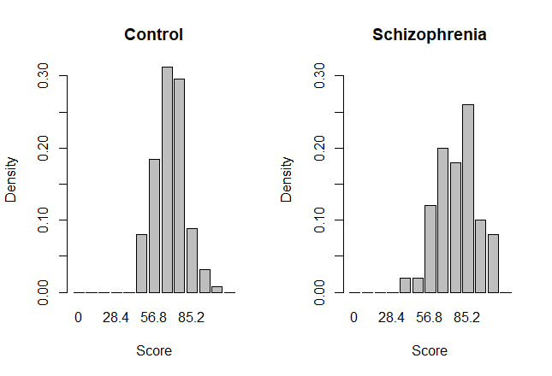
Interpretation of health data
Excessive demographic information
e.g. race, education and general information
Some incoherent/missing data on health/demographics
e.g. smoking habits
Excessively specific data on health covariates
Detailed personal result on Barratt test
impulsiveness measure

Slide 15
In the next episode …
TECHNIQUES TO BE IMPLEMENTED
PCA
Reducing dimensionality of Z-maps
Clustering (on Z-maps)
In order to identify different “shades” of schizophrenia
Three-way ANOVA
In order to identify differences between groups:
RT control vs. schizophrenic
RT Switch vs. No Switch
RT congruency vs. incongruency

Slide 16
In the next episode …
TECHNIQUES TO BE IMPLEMENTED
PCA
Reducing dimensionality of Z-maps
Clustering (on Z-maps)
In order to identify different “shades” of schizophrenia
Three-way ANOVA
In order to identify differences between groups:
RT control vs. schizophrenic
RT Switch vs. No Switch
RT congruency vs. incongruency
POTENTIAL FUTURE DEVELOPMENTS
Mixed effect models
Spatial Analysis

Slide 17
THANK YOU FOR YOUR ATTENTION

