Slide 1
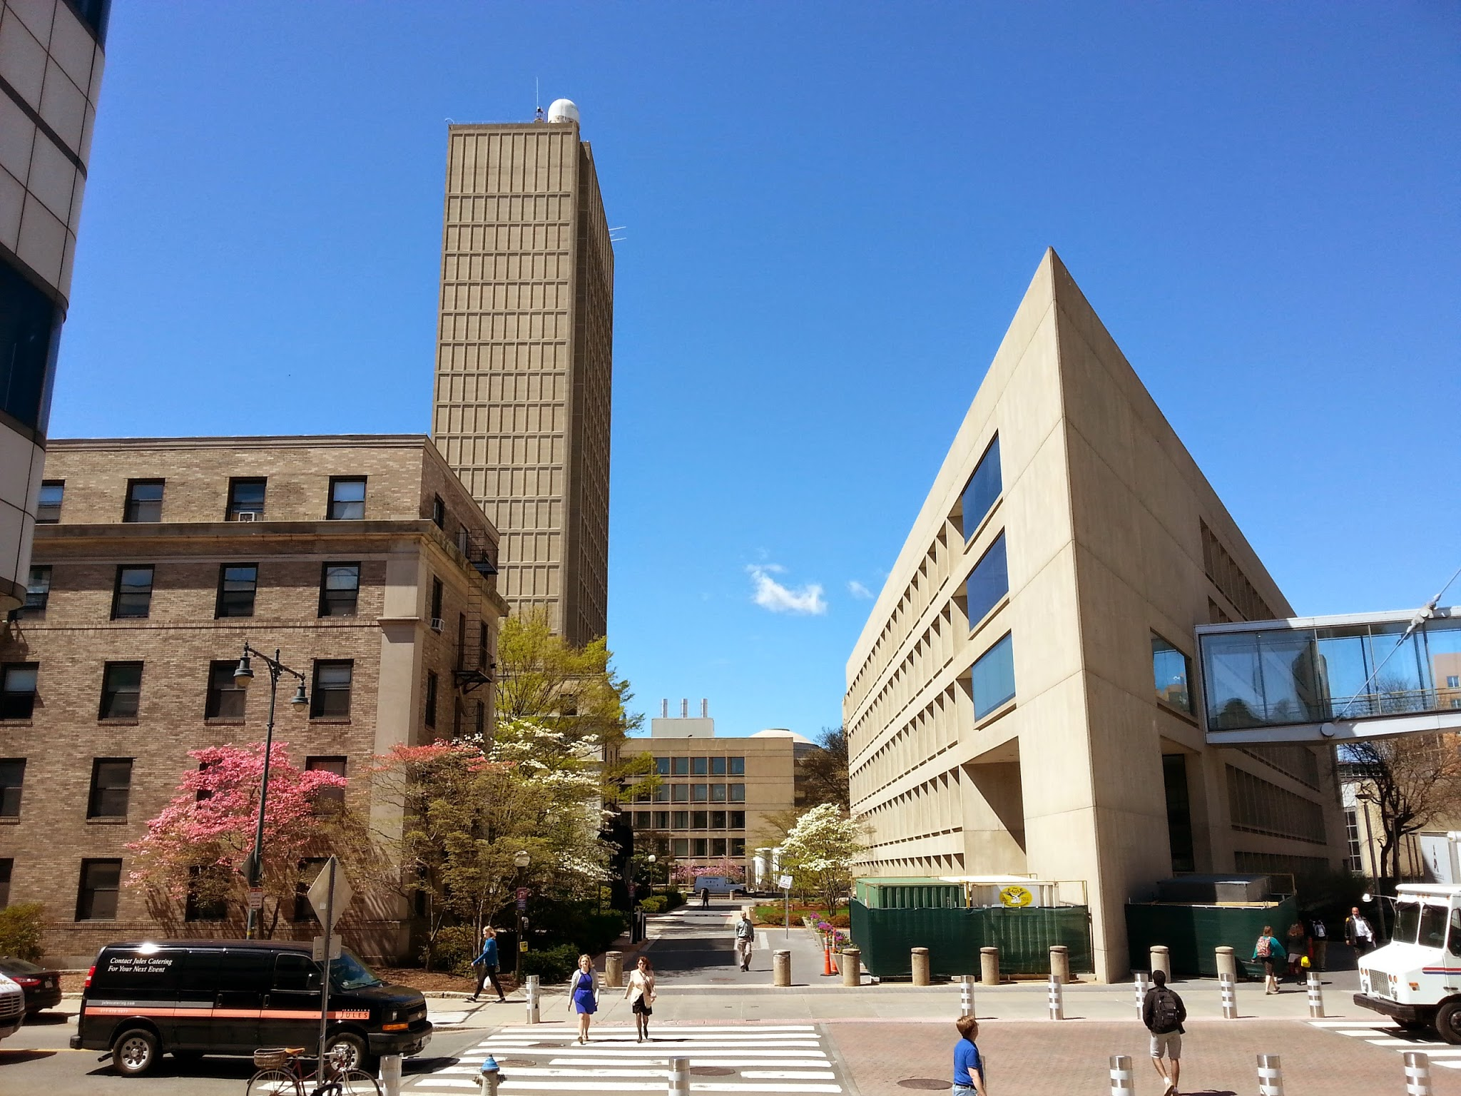
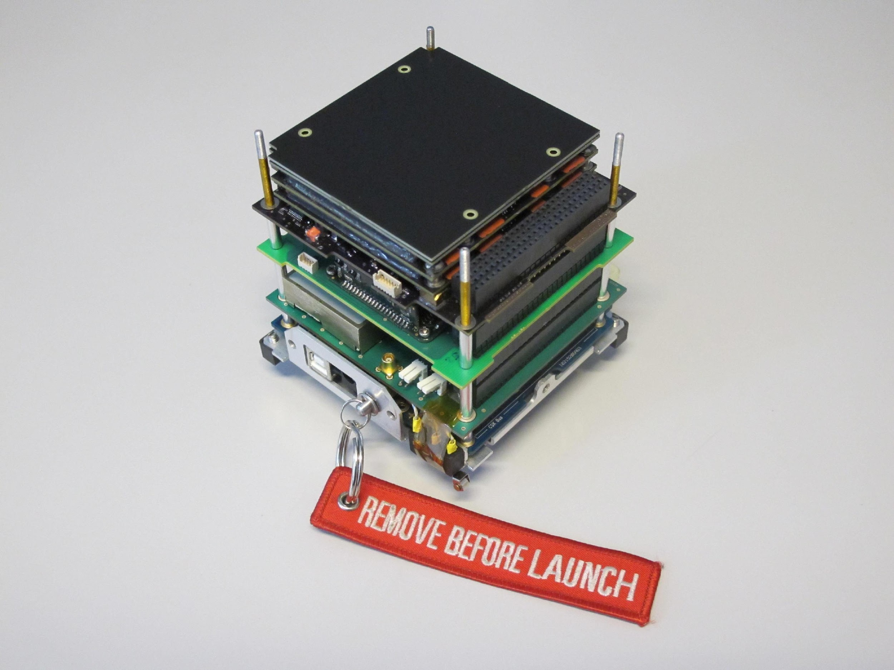

My two months at MIT
What I did, thoughts and future plans
PhD Student: Lorenzo Feruglio, lorenzo.feruglio@polito.it
Dottorato di ricerca in Ingegneria Aerospaziale XXIX ciclo – 11st July 2014

Slide 2
Outline
What I did:
Project work paper study
Seminaries and meetings
CubeSat Team
Thoughts:
The research
Our way Vs their way
Future plans:
My path
First year (second semestre)
Second year and beyond!
Collaborations

Slide 3
What I did during my two months there
(and what I can say I have done during my first six months of PhD)

Slide 4
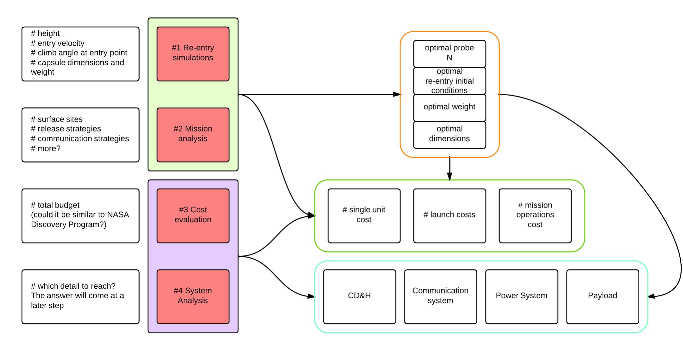
Project work paper study
Notes:
input dal team C, con fabio abbiamo pensato a cosa si poteva fare per fare un paper sull’argomento Penetrators on Mars

Slide 5
Seminaries and meetings
We followed a good number of seminaries, thesis dissertations and meetings during our stay there.
As a recap, here are a few interesting ones we’ve listened to:
C. Pong thesis on ADCS for ExoplanetSat
J. De Wit thesis on estimating exoplanet properties from observations
Exploring Mars with the Curiosity Rover: The Search for Ancient Habitable Environments by Curiosity Rover Chief Scientist
more
Weekly meeting with the Asteroid Drilling Team:
drilling asteroids: where, how and why
presentations by the various team members on different topics, all (possibly) related to the main research
Twice per month, we were presenting our progresses on the paper study to Sara and the rest of the team
positive feedback almost from everyone
negative feedback from one post doc, which has and will prove to be very useful

Slide 6
CubeSat Team
This slide recaps the work done during the first six months of PhD (most of which is still on-going)
ADCS software: from simulations to the flight code
re-check and review of the simulations
flight code complete overhaul
testing
OBC software e-st@r-II
flight code debugging and rewriting
testing
...and 3STAR
on the way to the design of the scheduler
and the main code structure
GCS software
re-design of all the software
partial (funcitonal) implementation in order to guide the students (due to the tight schedule)
more?

Slide 7
My thoughts

Slide 8
Comparing our way to MIT’s way
During my stay at MIT (and later, talking with Mary) I had the chance to notice the following:
They tend to buy everything which is not related to the research a team is performing
This brings drawbacks:
Hard to get developer skills on the satellite in general - they get specific knowledge on the research they are carrying on
Very bad understanding of the general status of a project
Not used to flexibility?
But also positive things:
Many things which are usually an obstacle can be seen as trivial, as someone else will do them
Time and freeness to concentrate on the research topic
What do I like more?
→ OUR WAY.
What gives better international visibility, as a team / university?
→ Probably their way.

Slide 9
The research
I want to do something that nobody has done before in Italy, and possibly to get close, if not improving, what other teams are starting to do in a few other universities
Which are the topics i would like to research?
Autonomous operations, AI, ADCS, OBC, formation flying, more?
More.
All these fields are really interesting to me, and I would love to increase my knowledge on those.
But:
I aim to finish my PhD and to become an expert in a certain field, which could be anything related to satellite design / development or mission design (from the system point of view thought!) ← does it make any sense? It should!

Slide 10
The research (II)
Here are a few ideas that are floating in my mind, and that I will explore in the following months:
Artificial intelligence
what can be done on small satellites?
how can it help in a small satellite mission?
LEO Vs interplanetary: examine the differences
Normal CD&H vs AI: differences?
Autonomous operations (satellite)
define a set of tasks that we can automate and implement/test for 3STAR
performance comparison, analysis of operations?
Autonomous operations (constellations)
same thing
Neural networks
Learn the theory
Can we implement them for the CD&H, for the ADCS, or for both (3STAR)? Explore.

Slide 11
Future plans

Slide 12
My intended path?
I had multiple occasions, speaking with different people, to record the following sentences (which made me happy!)
one of the limiting factors we were finding is the lack of autonomy (speaking both for a Mars CubeSat mission and for LunarCube)
In which way do we want to taylor my research?
I would like to keep gaining experience in the system design/development phase
I am interested in the mission analysis, not really from a

Slide 13
First year (second semester)
Second year and beyond..
I have already collected a good number of papers concerning all the topics I presented here.
I need to proceed with literature review phase
By the end of the year, and after increasing the knowledge on the subject, a few options might have already been removed thanks to the new information
Parallel way? (hoping to have time)
Performance analysis, studies and similar on my research topic, in order to gain knowledge from the system engineer point of view
Design and development, in order to gain specific and specialistic knowledge on the subsystem and the related technologies
This could fit well in the idea of developing 3STAR

Slide 14
Collaborations
As Fabio said, multiple chances of collaboration might rise thanks to this PoliTo - MIT joint effort.
During the end of the first year:
I will try to keep the new connections made during my stay there, strengthening the bonds
I will try to search new connections, as soon as I progress through my literature review and I will have more things to say related to my research topic
During my second year:
I will activate (hopefully during the second semester) to organize - get fundings if needed, to perform a 3-6 months period abroad, which I will try to spend during my 3rd year

