Slide 1



A tool for nano­satellite functional verification: comparison between different in­-the-­loop simulation configurations
sponsored by
L. Feruglio (speaker), R. Mozzillo, S. Corpino, F. Stesina Department of Mechanical and Aerospace Engineering

Slide 2
OUTLINE
e-st@r-II CubeSat
StarSim
Key features
GUI brief description
AIL, SIL, CIL, HIL
Presentation of a few key examples
Comparison
Results of intermediate simulation sessions
Results on Hardware-in-the-Loop simulations
1/25

Slide 3
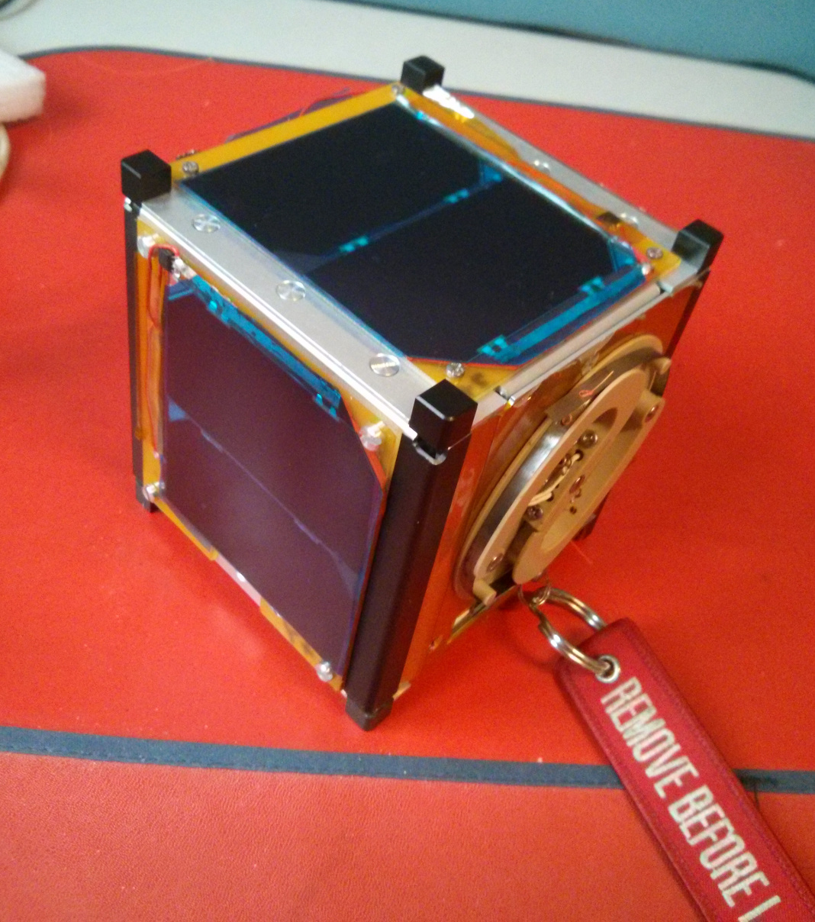
e-st@r-II CubeSat
StarSim
AIL, SIL, CIL, HIL
Comparison
2/25

Slide 4
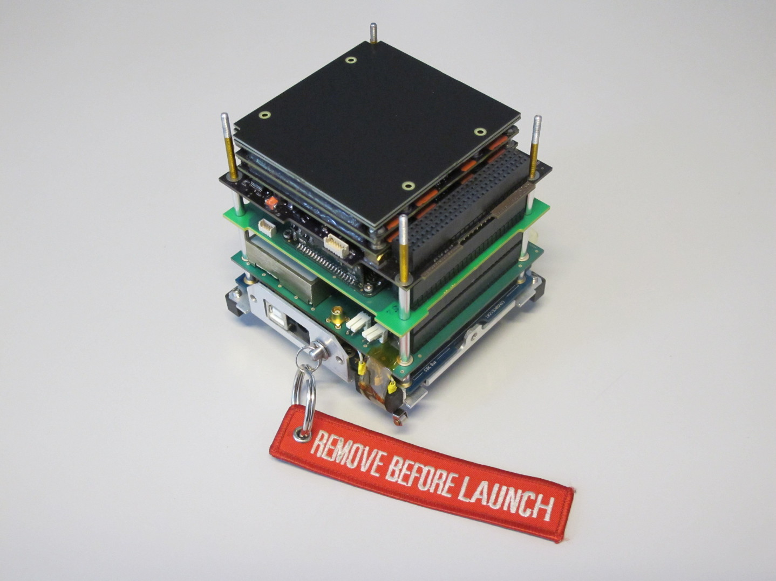
e-st@r-II CubeSat
StarSim
AIL, SIL, CIL, HIL
Comparison
EPS
COMSYS
A-ADCS
C&DH
3/25

Slide 5
e-st@r-II CubeSat
StarSim
AIL, SIL, CIL, HIL
Comparison
EPS
COMSYS
A-ADCS
Payload
In-house design
3 magnetic torquers
ARM v7
IMU with magnetometers
C&DH
4/25

Slide 6
e-st@r-II CubeSat
StarSim
AIL, SIL, CIL, HIL
Comparison
EPS
COMSYS
A-ADCS
C&DH
Commercial
MSP430
Salvo RTOS
5/25

Slide 7
e-st@r-II CubeSat
StarSim
AIL, SIL, CIL, HIL
Comparison
COMSYS
In-house design
1200 bit/s data rate
437.485 MHz transmission
CW in case of loss of C&DH
EPS
A-ADCS
C&DH
6/25

Slide 8
e-st@r-II CubeSat
StarSim
AIL, SIL, CIL, HIL
Comparison
EPS
Commercial
20Wh battery capacity
5V, 3.3V, Unregulated Bus
COMSYS
A-ADCS
C&DH
7/25

Slide 9
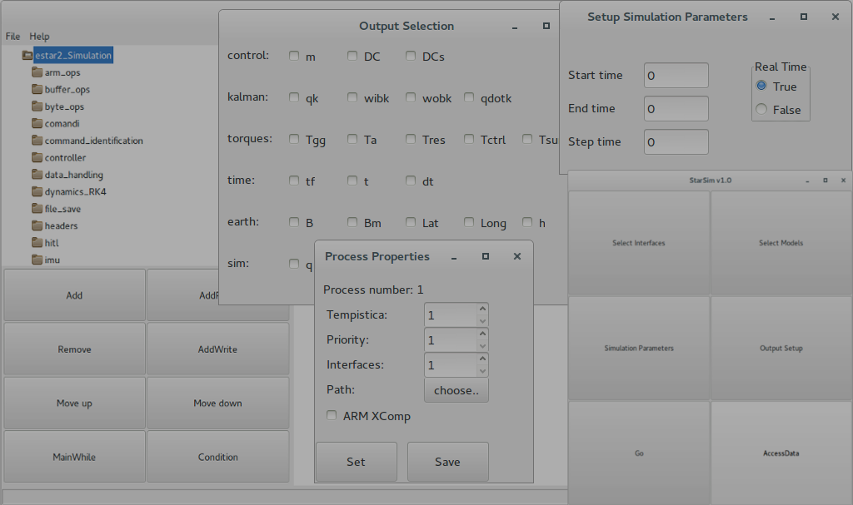
e-st@r-II CubeSat
StarSim
AIL, SIL, CIL, HIL
Comparison
StarSim
8/25

Slide 10
e-st@r-II CubeSat
StarSim
AIL, SIL, CIL, HIL
Comparison
Need of a single “infrastructure” independent of the complexity of the test and from the development stage of the project
Real time and
accelerated mode
Natively supports
C, C++
Flexibility
& modularity
Adaptable to
different projects
STARSIM
Multi-sessions
User coding limited to models
Same functionality through
all tests phases
Automatic
code generation
and cross-compiling
9/25

Slide 11
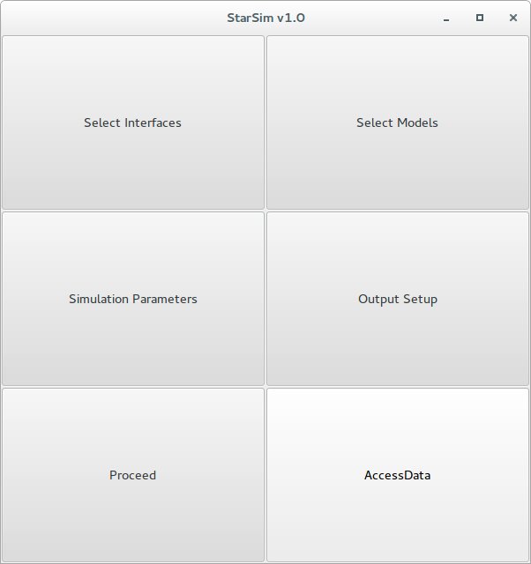
e-st@r-II CubeSat
StarSim
AIL, SIL, CIL, HIL
Comparison
10/25

Slide 12
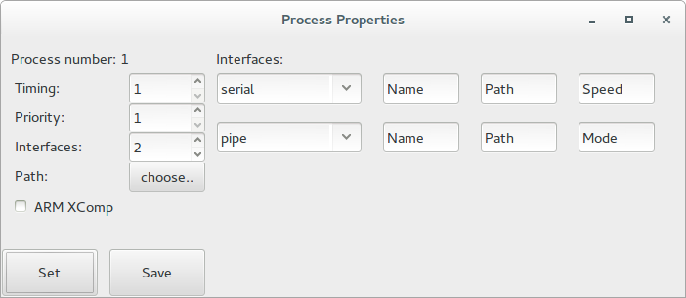
e-st@r-II CubeSat
StarSim
AIL, SIL, CIL, HIL
Comparison
Simulation properties setup
Scheduling and priorities definition
Interfaces for each process with connection parameters setup
Cross-compile flag
11/25

Slide 13
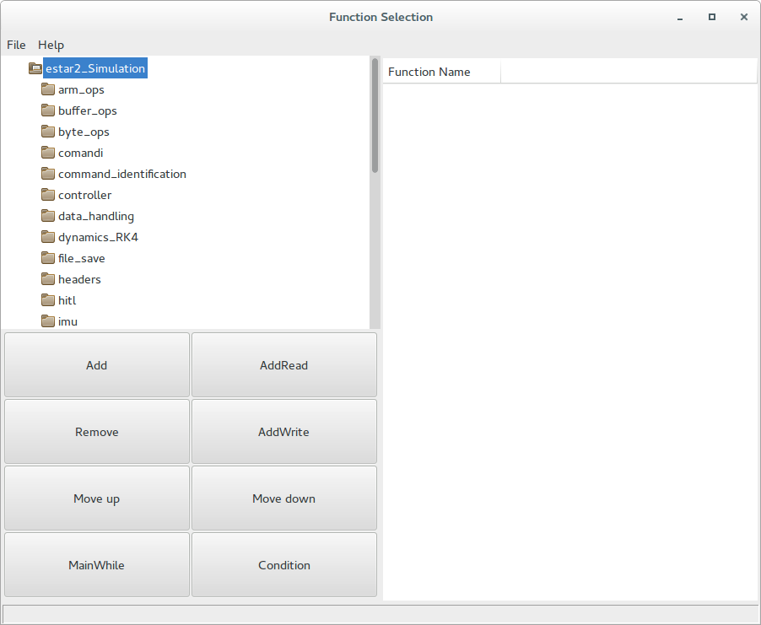
e-st@r-II CubeSat
StarSim
AIL, SIL, CIL, HIL
Comparison
Simulation flow setup – model selection
Database explorer
Drag & drop action, or command buttons
Simulation flow definition
Open/Save functions
Model
Database
Models
flow
12/25

Slide 14
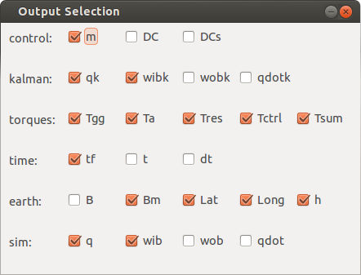
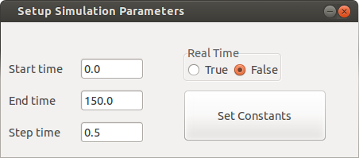
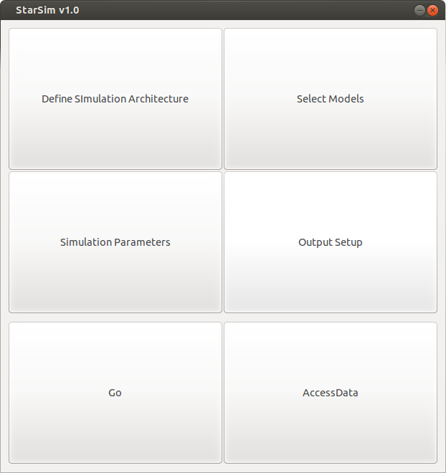
e-st@r-II CubeSat
StarSim
AIL, SIL, CIL, HIL
Comparison
Link to data repository where the files with the results/ data/ configurations are saved
Start/Stop the simulation
13/25

Slide 15
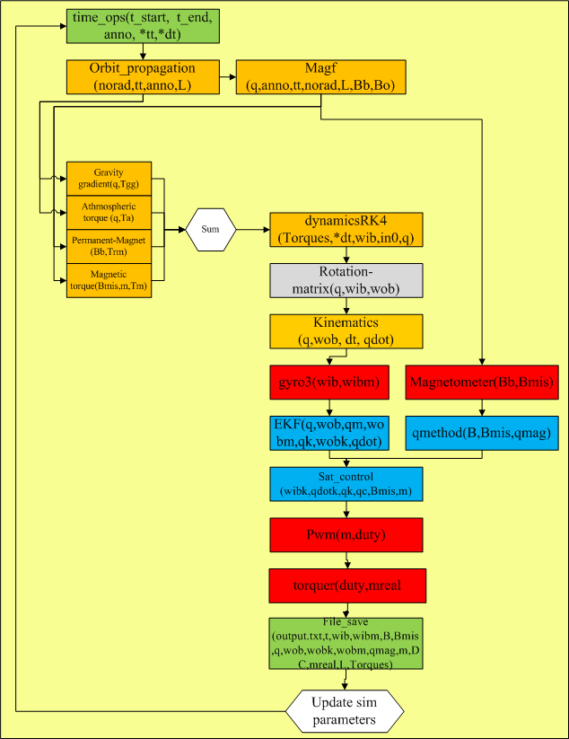
AIL simulations (ADCS)
e-st@r-II CubeSat
StarSim
AIL, SIL, CIL, HIL
Comparison
Only one process runs on the Simulation Unit;
Neither SW nor HW interfaces are required.
14/25

Slide 16
SIL simulations (ADCS)
e-st@r-II CubeSat
StarSim
AIL, SIL, CIL, HIL
Comparison
IMU communication
2 processes, 2 pipes
OBC/ADCS communication:
3 processes, 2 pipes
Integrated subsystem verification:
3 processes, 3 pipes
15/25

Slide 17
e-st@r-II CubeSat
StarSim
AIL, SIL, CIL, HIL
Comparison
Simulation
process
16/25

Slide 18
CIL simulations
e-st@r-II CubeSat
StarSim
AIL, SIL, CIL, HIL
Comparison
OBC/ADCS verification:
2 processes, 2 serial communications, 1 process on embedded system, 2 GSE
IMU communication verification:
1 process, 1 serial communication, 1 process on embedded system, 2 GSE
RT and synchronization verification:
2 processes, 3 serial communications, 1 process on embedded system, 2 GSE
17/25

Slide 19
e-st@r-II CubeSat
StarSim
AIL, SIL, CIL, HIL
Comparison
18/25

Slide 20
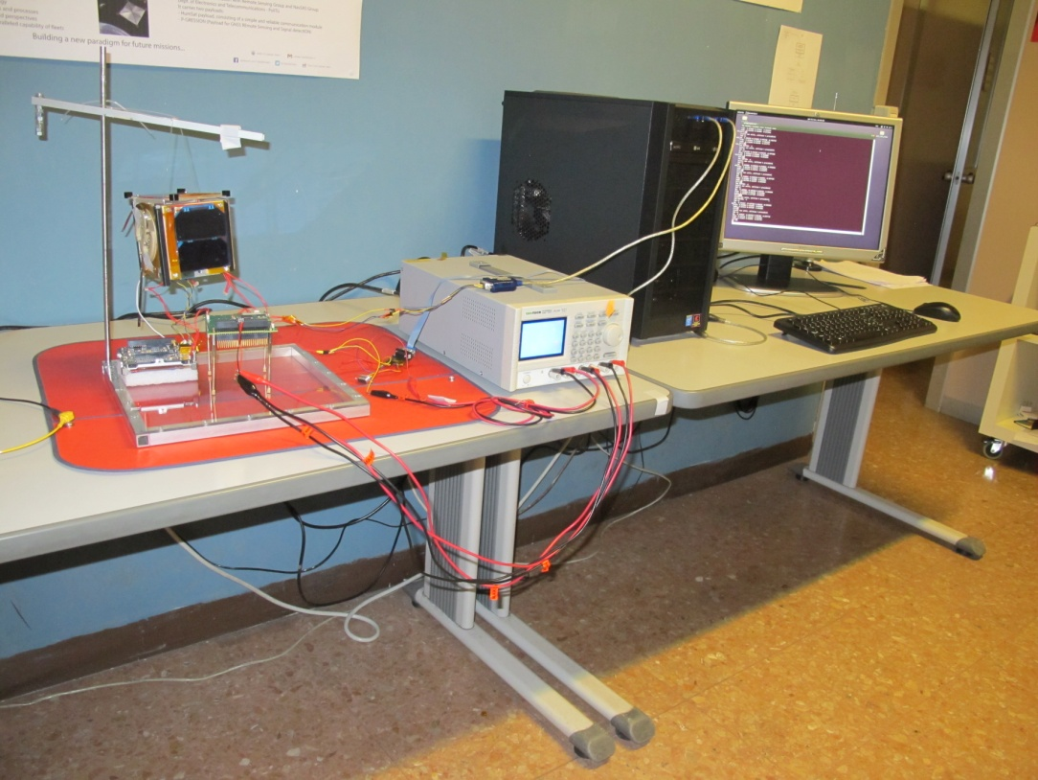
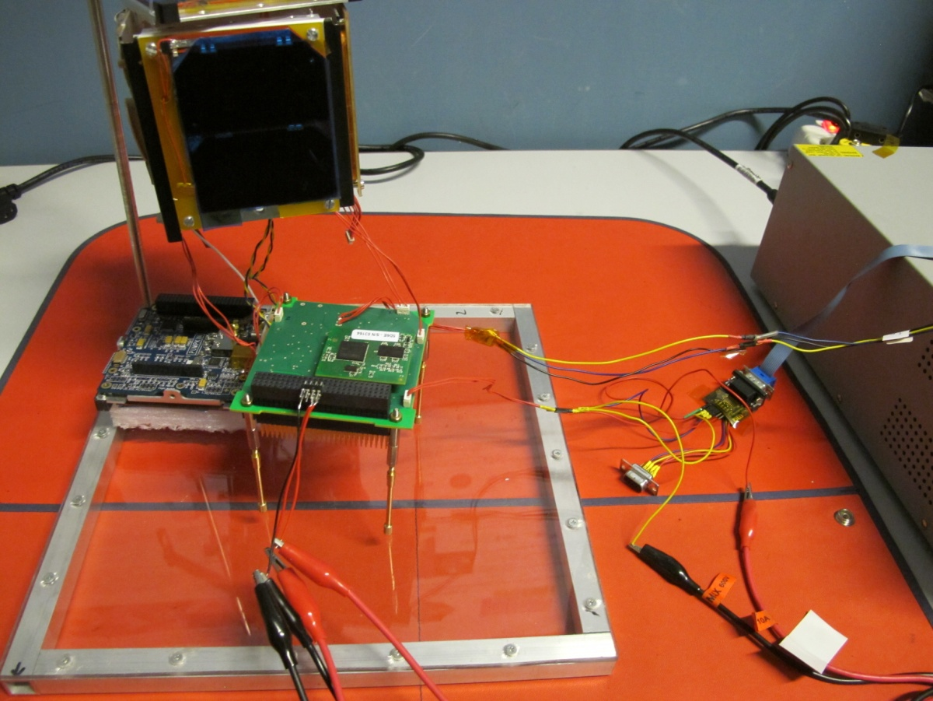
ADCS full verification
e-st@r-II CubeSat
StarSim
AIL, SIL, CIL, HIL
Comparison
19/25

Slide 21
e-st@r-II CubeSat
StarSim
AIL, SIL, CIL, HIL
Comparison
Software in the Loop
No errors in IMU-ADCS board communications
No errors in OBC-ADCS communications
Controller in the Loop
No packet is lost in ADCS-OBC but about 1.2% of packets are corrupted
No packet is lost in IMU-ADCS board communications but about 2% of packets are corrupted
3% of IMU packets are lost. No error arises after the data extraction, thanks to IMU sampling of high enough frequency
20/25

Slide 22
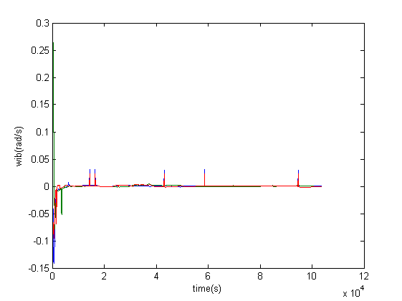
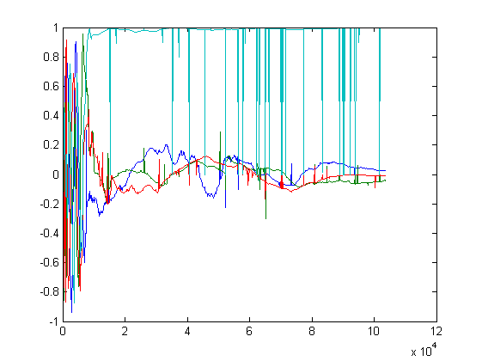
e-st@r-II CubeSat
StarSim
AIL, SIL, CIL, HIL
Comparison
Controller in the Loop early results
Angular velocity
Attitude
21/25

Slide 23
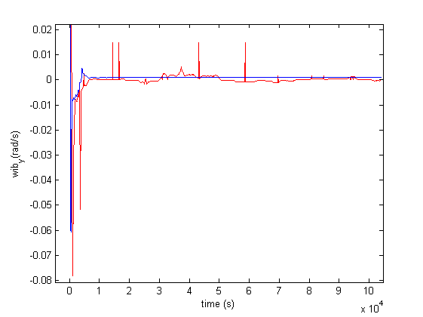
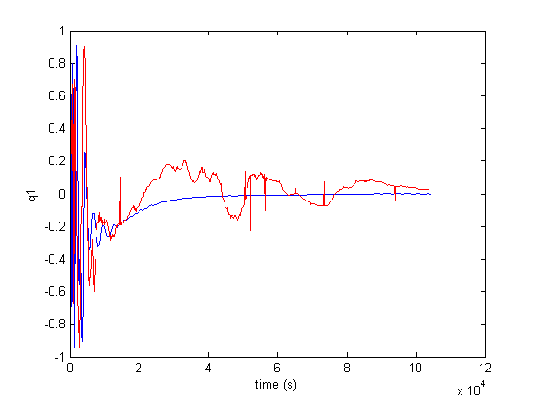
Comparison HIL vs AIL
e-st@r-II CubeSat
StarSim
AIL, SIL, CIL, HIL
Comparison
AIL
HIL
AIL
HIL
Angular velocity (wx) comparison
q1
comparison
Power consumption for detumbling and acquisition phases:
AIL: 1750 mW
HIL: 2540 mW
22/25

Slide 24
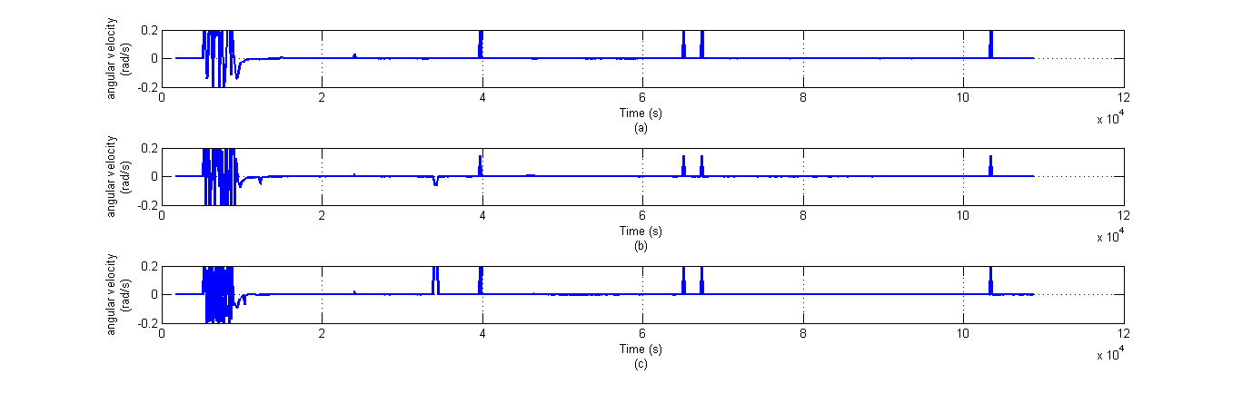
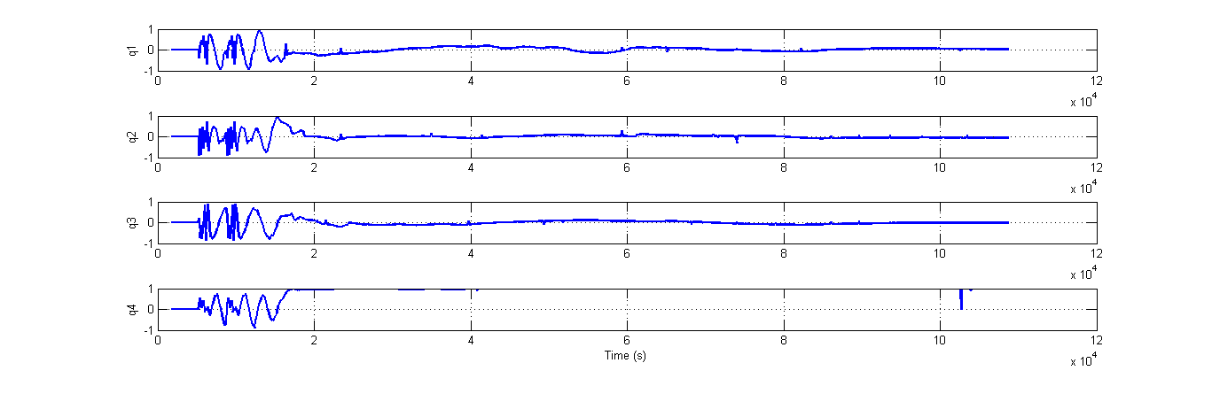
HIL simulation for integrated system: results (I)
e-st@r-II CubeSat
StarSim
AIL, SIL, CIL, HIL
Comparison
23/25

Slide 25
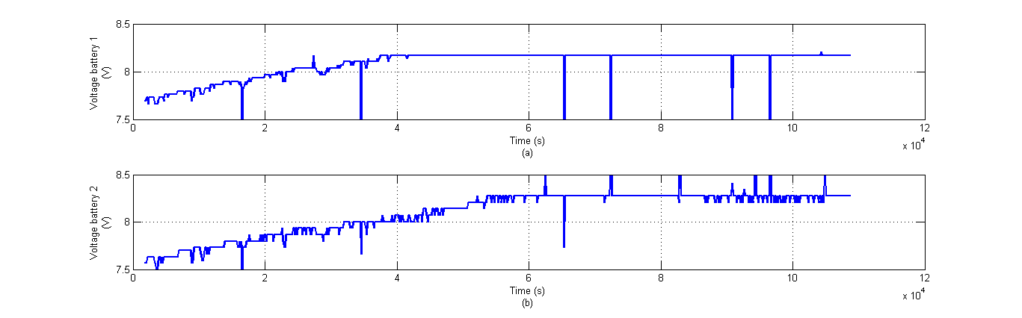
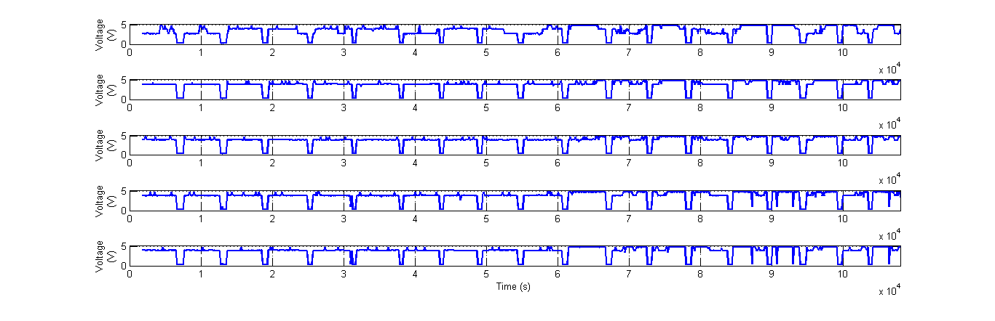
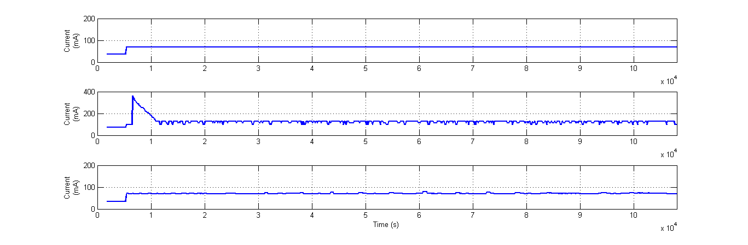
HIL simulation for integrated system: results (II)
e-st@r-II CubeSat
StarSim
AIL, SIL, CIL, HIL
Comparison
Solar panels behavior along the orbits
3.3 V bus current consumption
5 V bus current consumption
battery bus current consumption
24/25

Slide 26
THANK YOU FOR YOUR ATTENTION QUESTIONS AND COMMENTS ARE WELCOME!
Lorenzo Feruglio
lorenzo.feruglio@polito.it
+39 011 090 8657
CubeSat Team at Politecnico di Torino:
www.polito.it/cubesat-team
cubesat.team@polito.it
25/25

