Slide 1
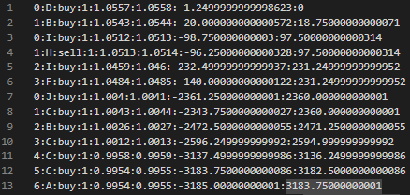


Towards More Efficient Trading: Integration of Deep Q-Network and Algorithmic Trading Techniques
Lorenzo David Gutierrez Vesga
Juan Esteb an Albis
Universidad del Norte

Slide 2

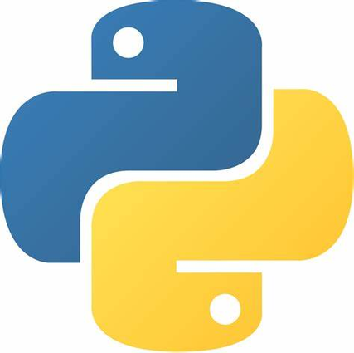

Introduction
BACKTESTING

Slide 3


FIRST PART

Slide 4
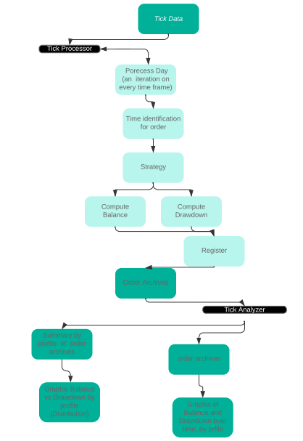
Backtesting
Module

Slide 5
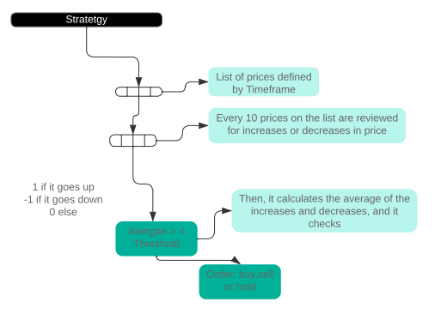
Strategy

Slide 6
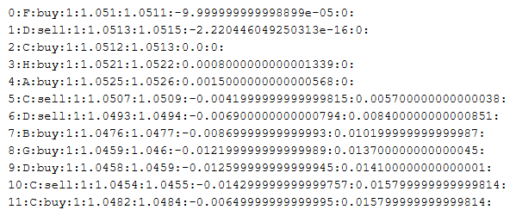
Example

Slide 7
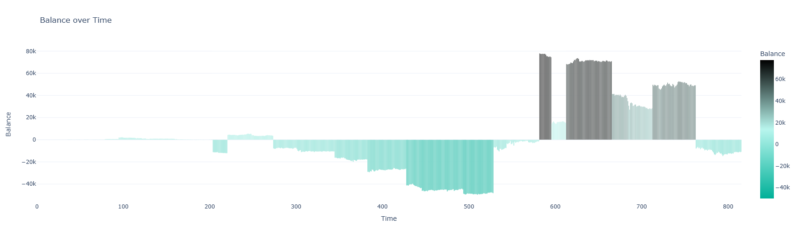
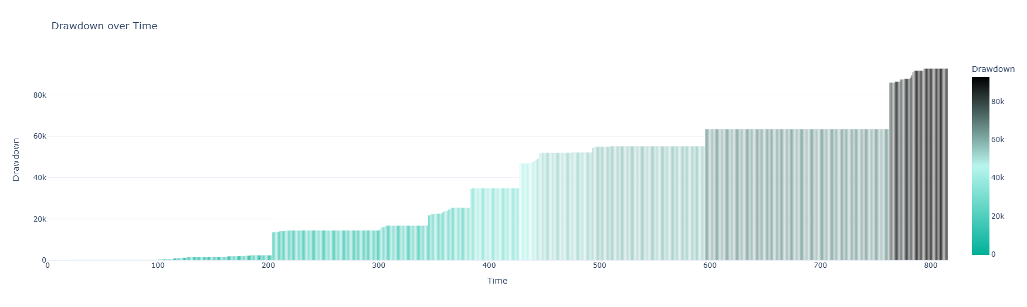

Slide 8
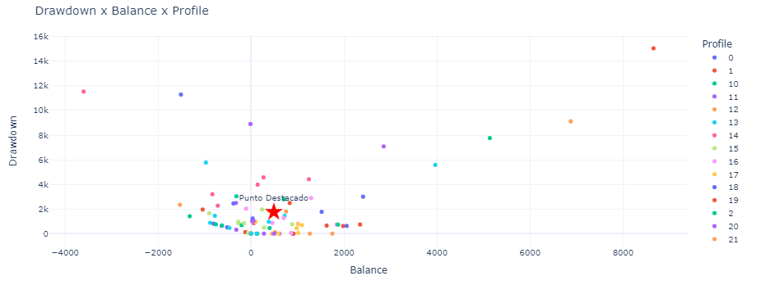
Backtesting results
Profit factor = 0.125

Slide 9
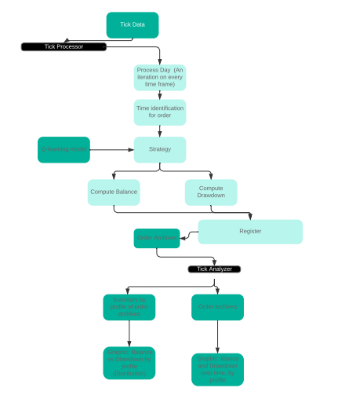
Q-Learning

Slide 10
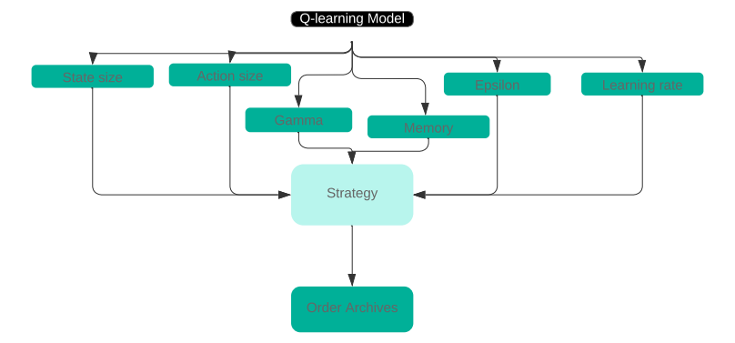
Q-learnign implementation

Slide 11


SECOND PART

Slide 12
EXPLANATION

Slide 13
Backtesting
Module

Slide 14
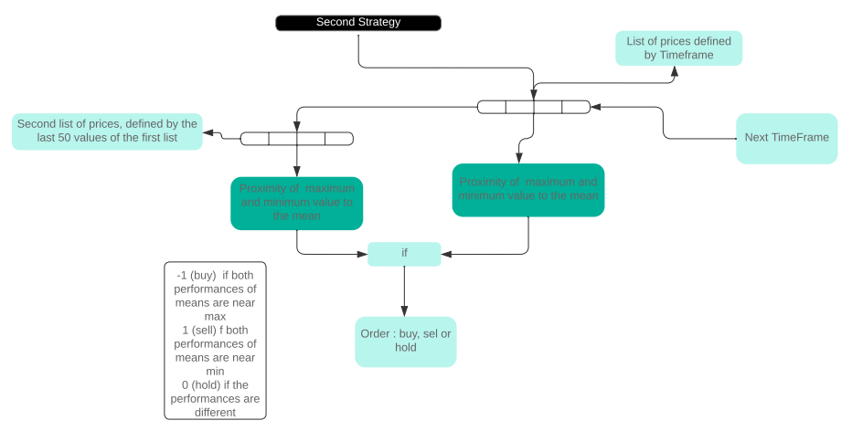
STRATEGY
STRATEGIES

Slide 15
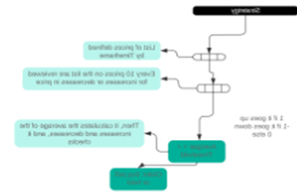
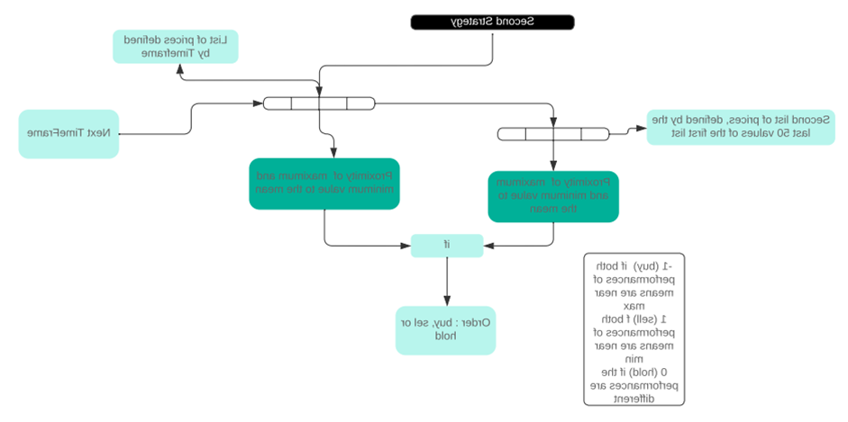
SEIGETARTS

Slide 16
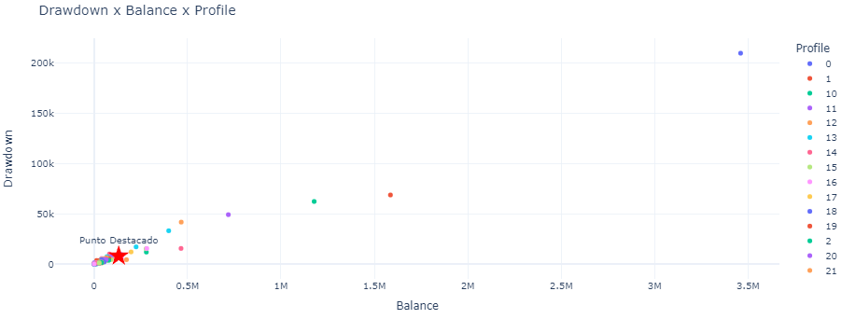
STRATEGY : MEAN PROXIMITY
Profit factor = 16.03

Slide 17
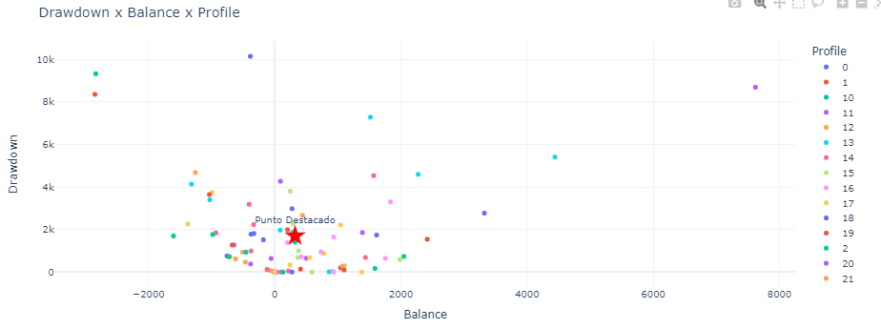
Ygetarts : Von neuman
Profit factor = 0.18
0.18

Slide 18
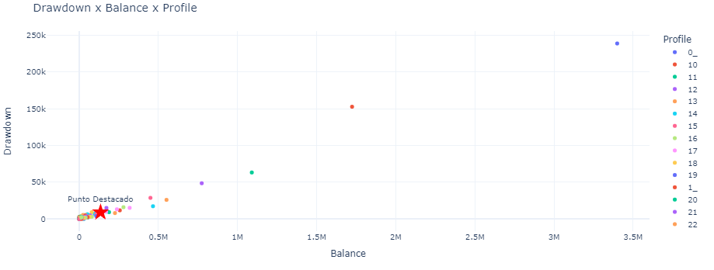
Ygetarts : Mean Proximity
Profit factor = 14.77

Slide 19
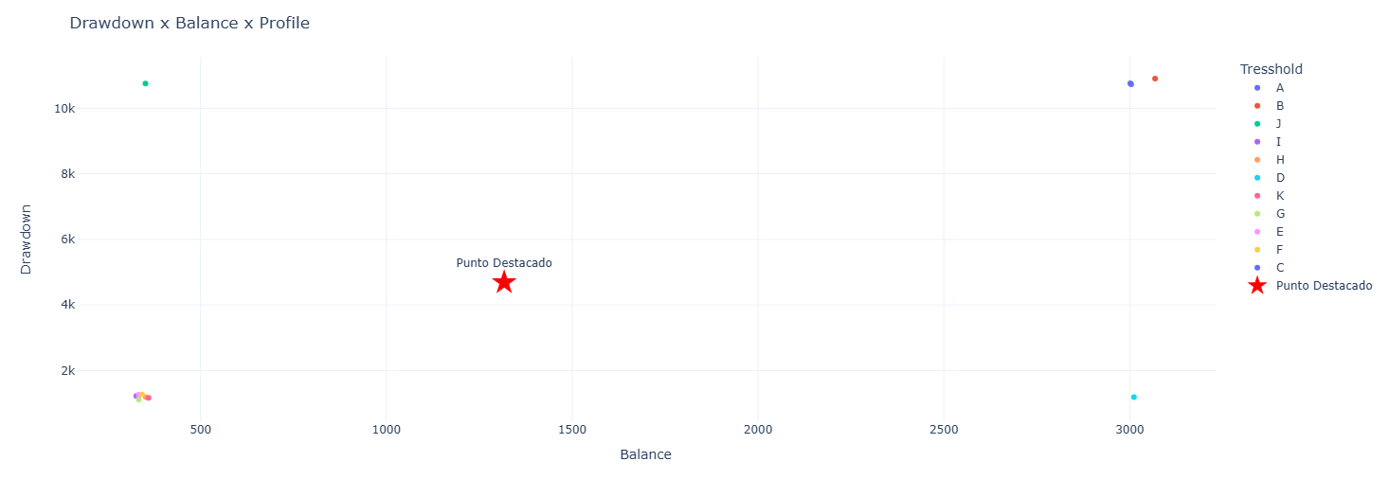
Q-learning
Profit factor = 0.28

Slide 20
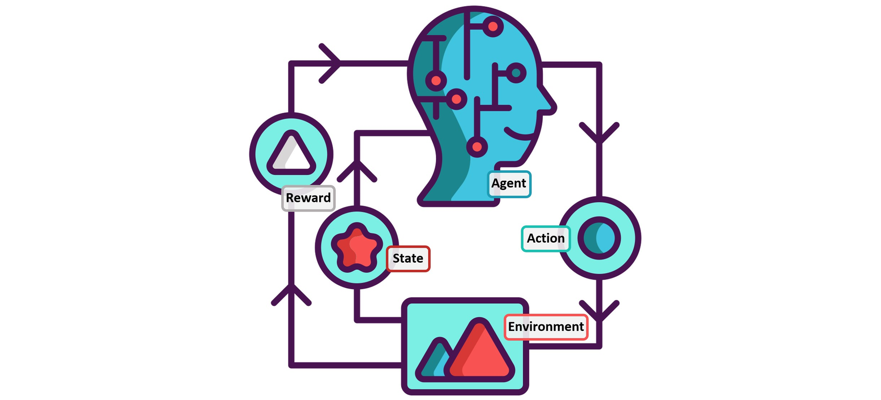
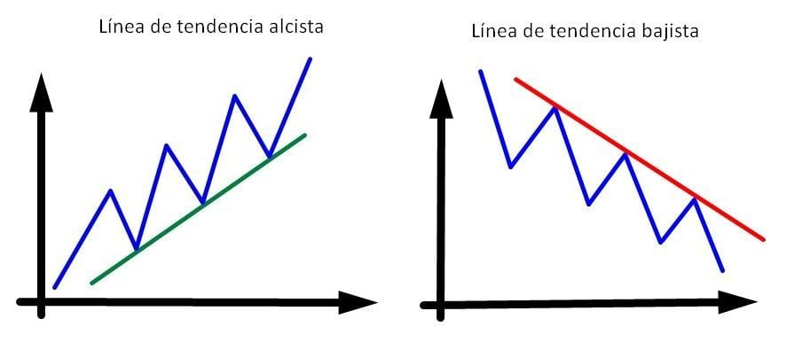
Conclusions and Horizon
Versatility

Slide 21
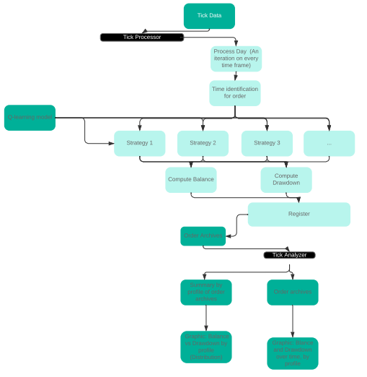

Slide 22
Thanks
This project wouldn`t have been capable without the help of 'TRADING SOLUTIONS COMPANY S A S' and specifically with the guide of Kevin Omar Dávila Castellar that provided a great guide for the costruction of the algoritm and gave the idea of the Strategy.

