Slide 1

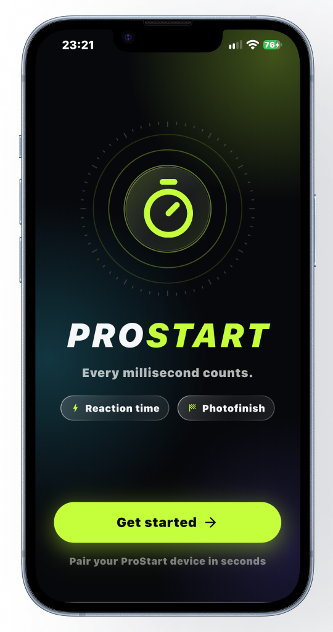

TECHNOLOGY & HEALTH · KTH · HT26
PROSTART
A portable reaction-time and photo-finish system for track & field
1.2 ms
≈ 8 ms
10 ms
One sample: our resolution
Reaction vs 240 fps video
Photo finish vs 60 fps video
Arianna Bartocci · Duarte Chambel · Lorenzo Galli · Loke Enlund Östangård · Ninad Purekar
Notes:
COVER – shown while the group gets ready. No speech needed.

Slide 2
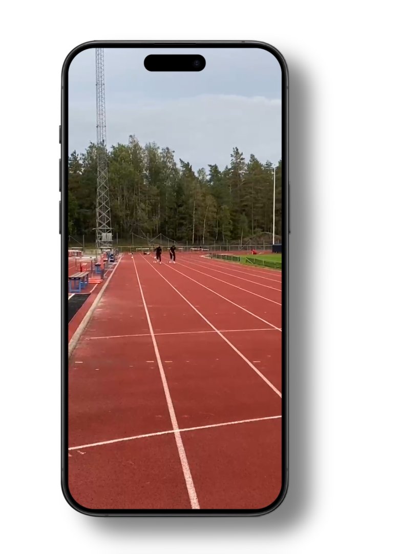
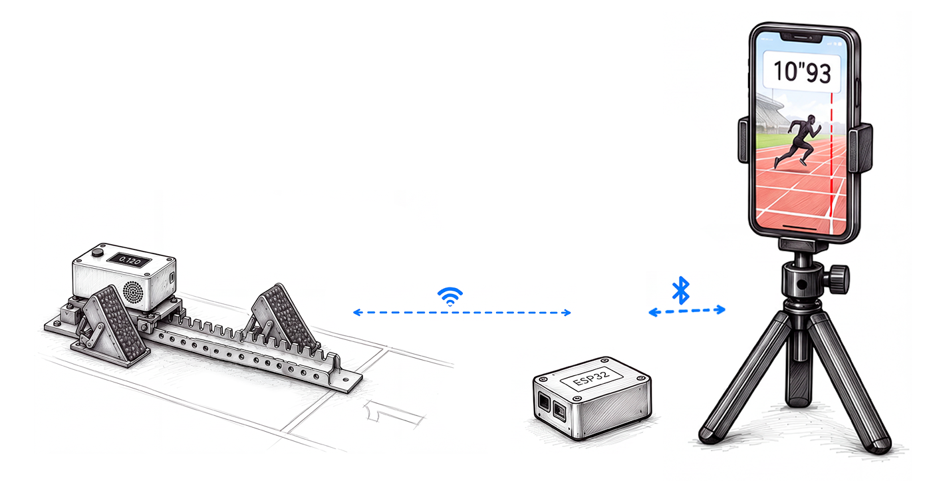
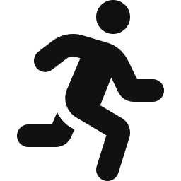
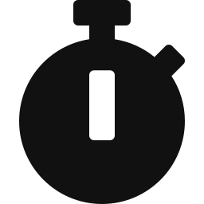

01
PROJECT INTRODUCTION
A small, affordable box that mounts on any existing starting block, gives the start signal and times the reaction, linked to a phone photofinish.
INTENDED USERS
Athletes training alone
no starter, no timer needed
Coaches
today: hand timing only
Clubs & academies
no budget for certified systems
Notes:
Hi everyone! We are Arianna, Duarte, Lorenzo, Loke and Ninad, and our project is called Prostart. Our idea is simple: we designed a small, low-cost box that mounts on any existing starting block. The box gives the start signal, "on your marks", "set", "go", and measures the athlete's reaction time with an accelerometer. A phone at the finish line records the finish, like a photo finish. It's built for club coaches and solo athletes who today have to rely on stopwatches. It bridges the gap between professional timing and everyday training.

Slide 3
02
PROBLEM STATEMENT
Non-elite athletes and coaches can rarely measure block-start reaction time with millisecond accuracy.
0.005 s
< 0.100 s
- 0.24 s
≈ US$1,600
Noah Lyles’ winning margin in the 100 m at the 2024 Paris Olympic Games
Reaction time counted as a false start
Hand timing reads faster than electronic timing
Price of a single-block ReacTime system
EXISTING SOLUTIONS
FinishLynx ReacTime
Photocells
Omega (Olympics official timekeeper)
Student load-cell block
Threshold on acceleration reads the onset late
Costly
Start at the torso crossing a beam, missing the reaction to the gun
Force sensors built into the blocks, 4,000 Hz
Force sensors are not portable
No timing-accuracy check
GAP: a low-cost, portable solution with a documented timing error.
Notes:
In competitive sprinting, measuring block-start reaction time with millisecond accuracy is a luxury non-elite athletes and coaches can rarely afford. Yet, fractions of a second change everything, let’s think for example at Noah Lyles, who won the Paris Olympic 100-metre final by a mere five thousandths of a second, a margin where a fast and well-measured start plays a critical role. Any reaction under 0.100 seconds is flagged as a false start, and elite sprinters sit only slightly above that mark.. So what do most clubs use today? Hand timing. But a manual stopwatch introduces an error of about 0.24 seconds compared to electronic systems, rendering times completely unreliable for the tiny gains an athlete trains for. Other solutions exist. Photocells start timing when the body crosses a beam, so they miss the reaction. FinishLynx ReacTime measures reaction time with a threshold on acceleration, but even the training version for one block costs about 1,600 dollars. At the Olympics, Omega uses force sensors built into the blocks. So there is a clear gap: a low-cost, portable system with a documented timing error.

Slide 4
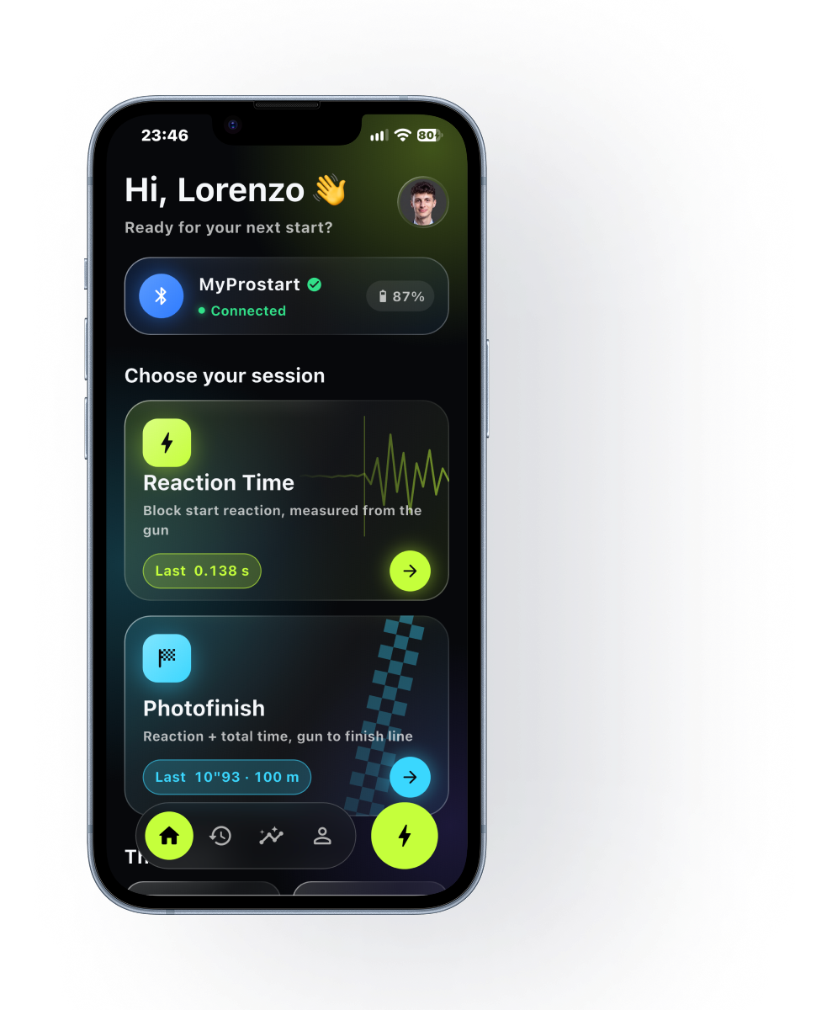
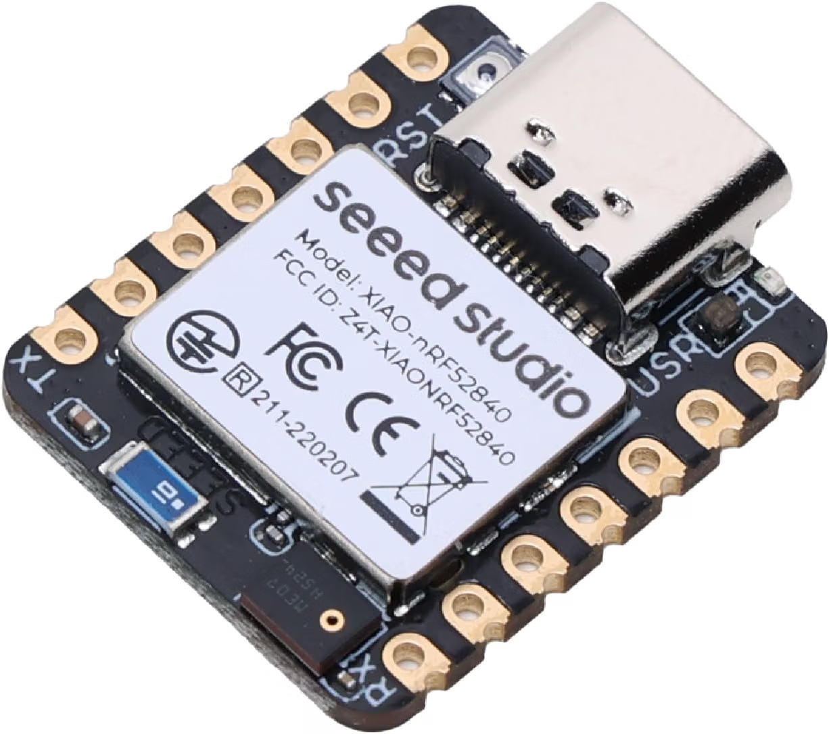



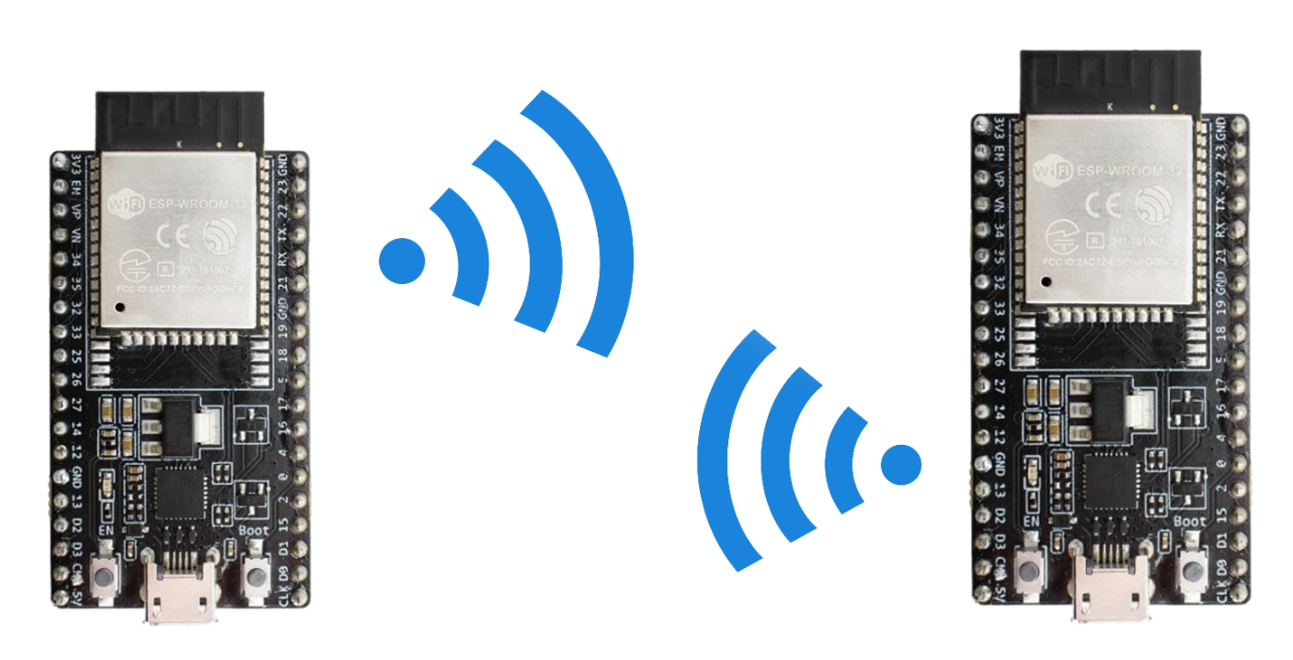


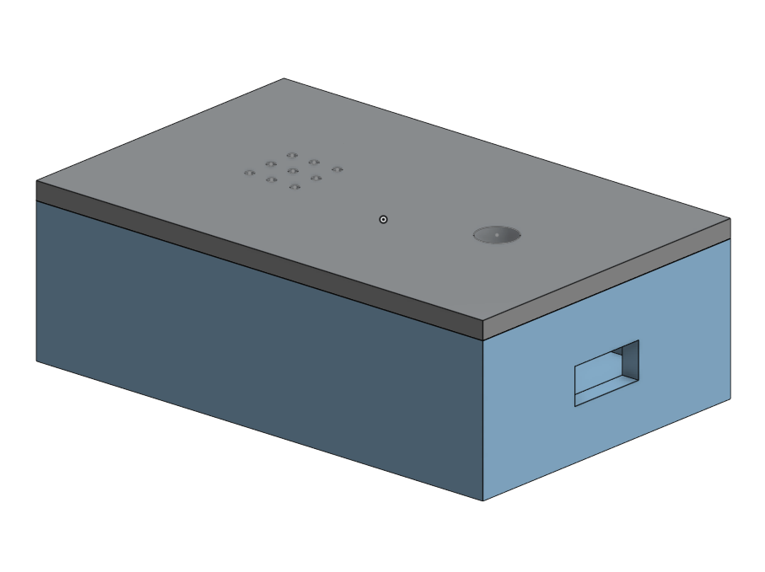


03
TECHNICAL APPROACH
Start unit
ESP32-C3 + BMI270 at 804 Hz: 1 sample = 1.2 ms, each one stamped in an interrupt
Two-stage onset detector
STA/LTA trigger decides that a movement occurred
AIC picker finds the exact sample: threshold-free
Link to the finish
Start unit → BLE → phone (≈ 30 m); for 100 m, a second ESP32-C3 on long-range ESP-NOW
Photo finish
Synced clocks + on-device AI find the
chest crossing: t(finish) – t(go)
Notes:
Our system has two parts: a start unit on the block, and a phone at the finish line. The start unit is built on one small board, an ESP32-C3, with a BMI270 accelerometer. It reads the accelerometer about 800 times per second, so one sample every 1.2 milliseconds, and every reading is stamped the moment it arrives.
To find the exact moment the athlete starts to push, we use two steps. First, an STA/LTA trigger decides that a movement happened. Then an AIC picker looks around that moment and finds the sample where the signal changes from quiet to active. This second step does not depend on any threshold.
The start unit talks to the phone directly over Bluetooth, which covers about 30 metres. For a full 100 metres we plan a second ESP32-C3 at the finish, linked by long-range radio. At the finish, the phone's clock is synced to the board, and on-device AI finds the chest crossing the line. We write the firmware in Arduino, the app in Flutter, and the analysis in Python.

Slide 5
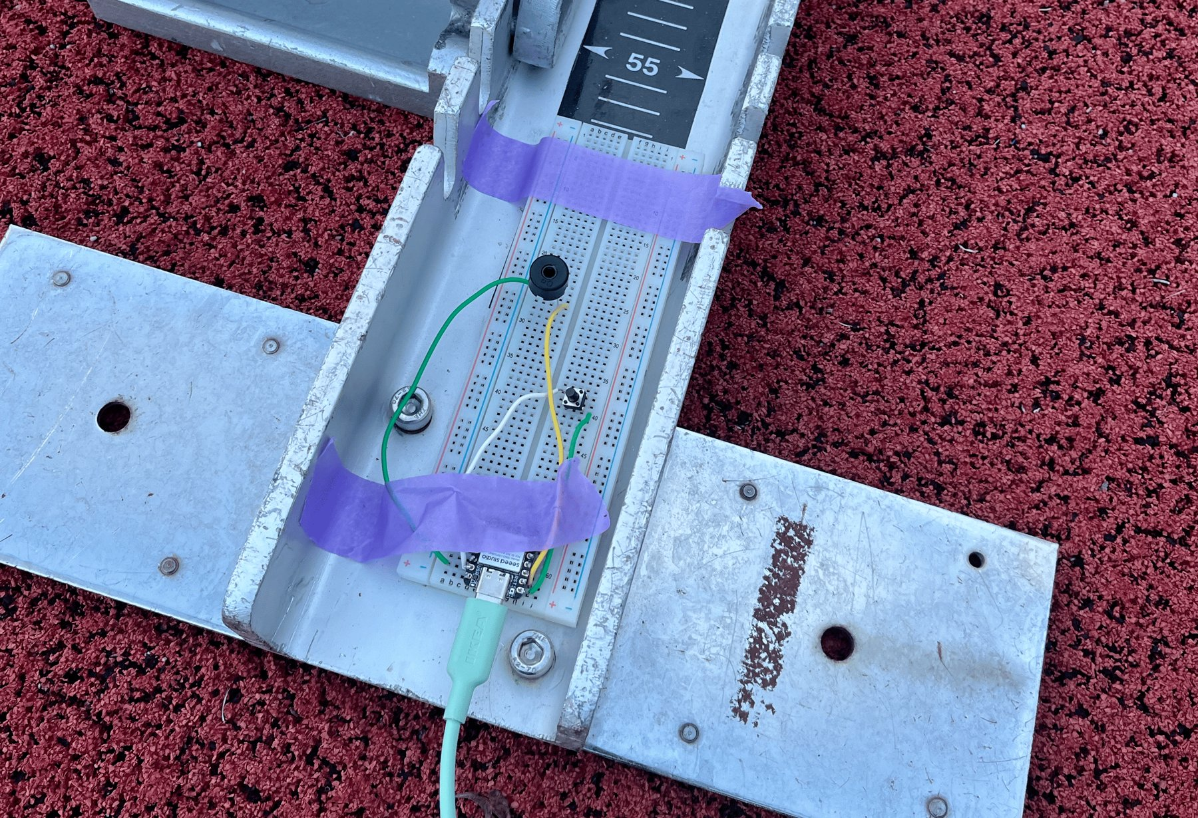
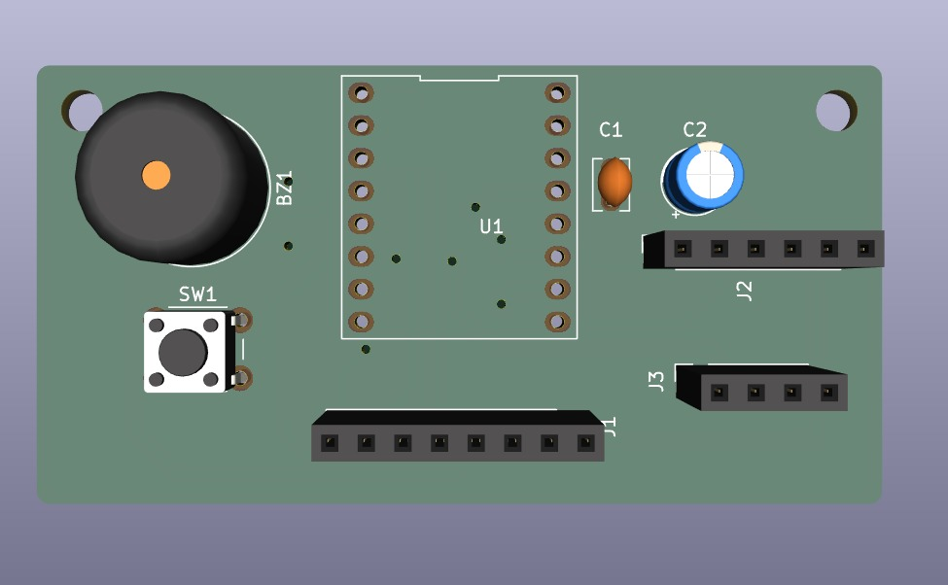
04
HARDWARE: FROM PROTOTYPE TO PCB
First prototype: breadboard on the back of a block
Now: two-layer PCB, 65.5 × 34 mm, one ESP32-C3
From three microcontrollers to one: the ESP32-C3 samples, judges the start and talks to the phone.
Notes:
This is where we started: our first prototype on a breadboard, mounted on the back of a real block. It worked, but it needed three microcontrollers: one on the block, and two more to carry the start signal to the finish.
Now everything runs on one ESP32-C3, on our own two-layer PCB: the accelerometer, the display, the button and the buzzer. The same chip samples the sensor, judges the start and talks to the phone over Bluetooth.

Slide 6
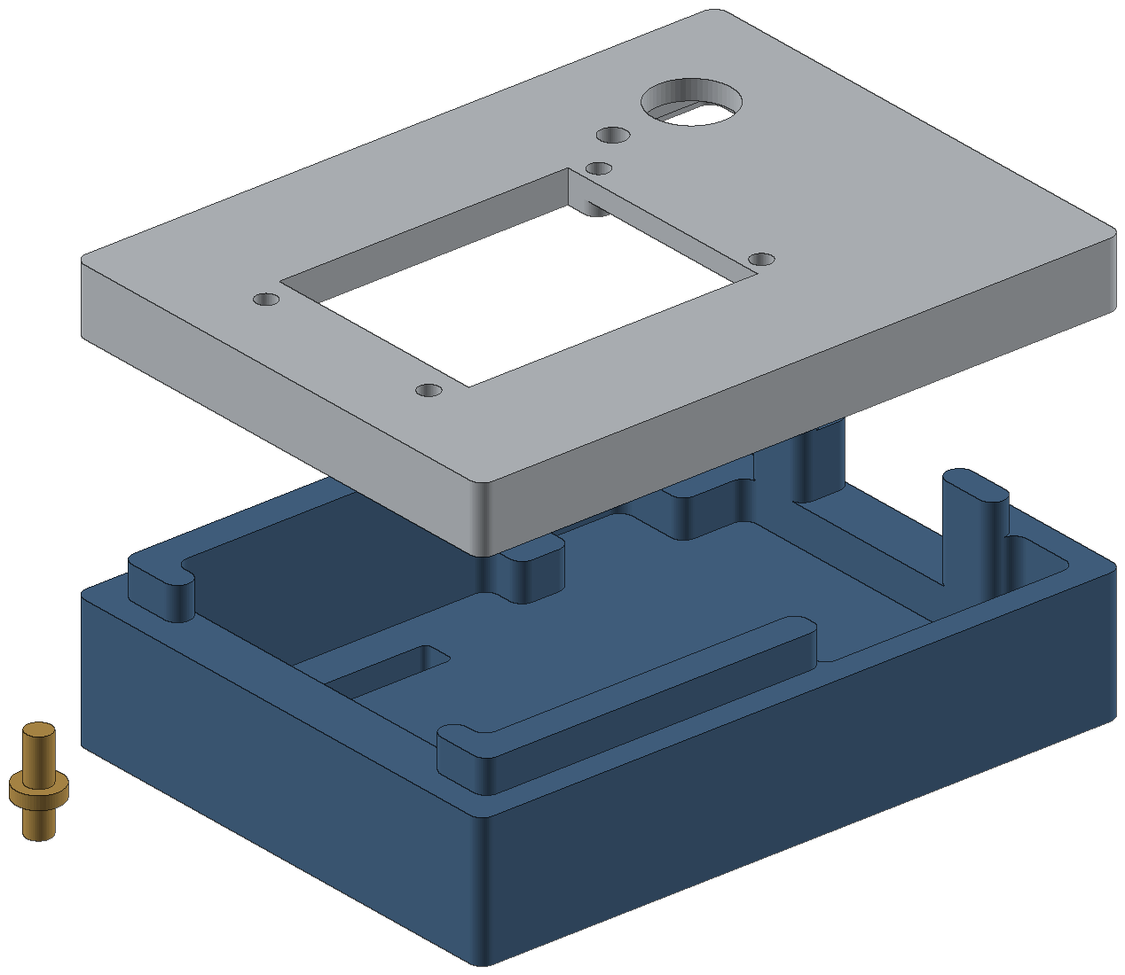

04
HARDWARE: THE BOX
3D-printed box, 75 × 99.5 × 25 mm: box, lid and button cap
The finished unit on the block
Designed around the PCB: display window, buzzer opening and button on the lid.
Notes:
We designed the box around the board and printed it in three parts: the box, the lid and the button cap. The lid has a window for the display and openings for the buzzer and the button. This is the finished unit, mounted on the block.

Slide 7
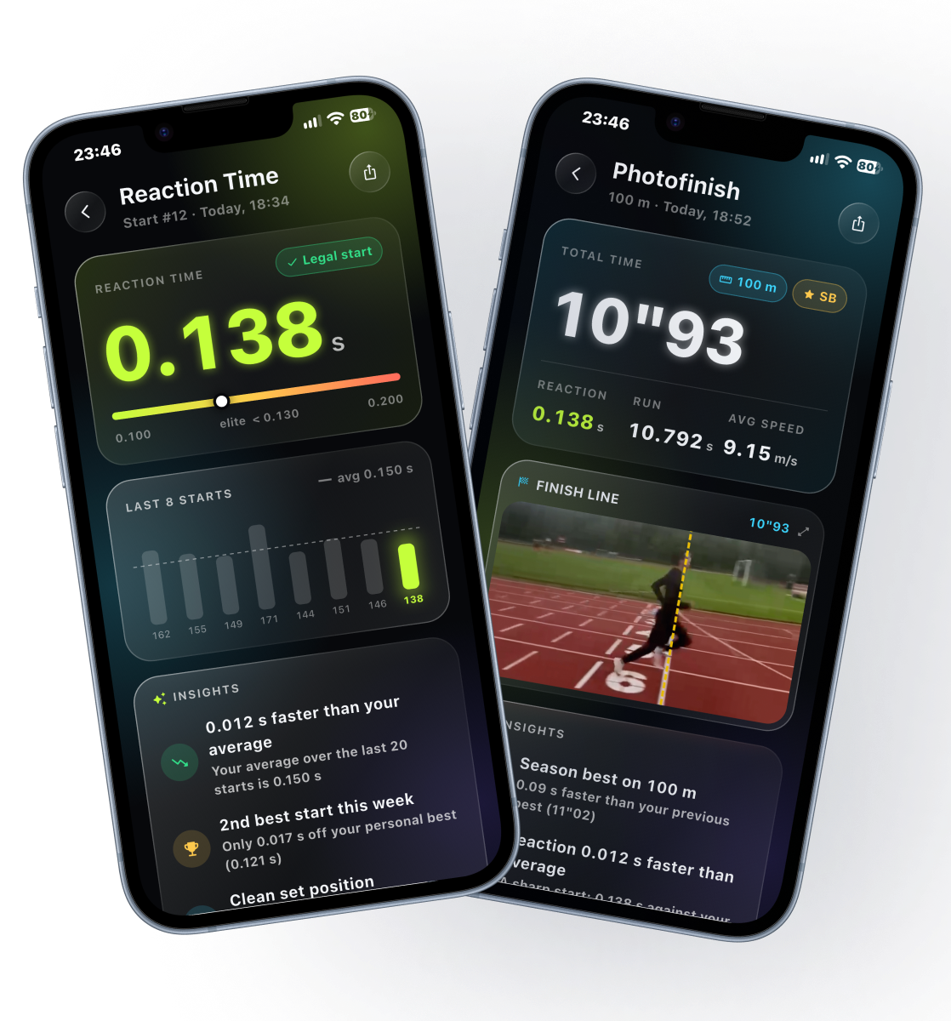
05
USER INTERACTION
1
Mount
Clip the box on the back of any starting block
2
Press
One button starts the sequence
3
“On your marks”, “Set”
Two beeps, like a real starter
4
“Go”
Fired at random 0.7–1.5 s after the athlete is still
5
Reaction time
Shown in the app. Moving within 100 ms of “go” is a false start
6
Finish
Phone films the line, AI finds the torso crossing
Notes:
Now, how does an athlete use it? First, the coach or athlete securely straps the box onto the back of the starting block. Then they press one button. The box plays three beeps: "on your marks", "set" and "go". After "set", the box waits until the athlete is completely still, and then it fires "go" at a random time, between 0.7 and 1.5 seconds later. When the athlete pushes off, the box measures the reaction time. If the athlete moves less than 100 milliseconds after "go", it is a false start. At the finish line, the phone app films all the time. When it receives the start time from the block, AI on the phone finds the moment the athlete's torso crosses the line. The finish time is simply the finish moment minus the start moment. Here you can see the design of our app.

Slide 8



LIVE DEMO
Video here: Insert → Video, then stretch it over the whole slide
Notes:
Let us show you how it works on the track. [Play the video.]

Slide 9
06
PHOTO FINISH: HOW IT WORKS
The board knows when “go” was, the phone knows when the chest crossed: four steps put both on one clock.
STEP 1 · SYNC
STEP 2 · FILM
STEP 3 · FIND
STEP 4 · TIME
Sync the clocks
Film the line
Find the chest
Time the crossing
Before “set”, the phone pings the board and keeps the fastest message each way
240 fps, 1/1000 s exposure, every frame stamped on the synced clock
On-device AI: body silhouette, arms removed, chest front
Interpolate between the two frames around the line: t(finish) – t(go)
Notes:
How does the photo finish work? The board knows when "go" was, and the phone knows when the chest crossed the line, but on two different clocks. So, first, before "set", the phone pings the board many times and keeps the fastest message in each direction: that tells us the offset between the two clocks within a few milliseconds.
Second, the phone films the line at 240 frames per second, with a very short exposure, and every frame keeps the time it was taken. Third, on-device AI finds the body; the rules time the chest, so we take the front of the chest from the body's silhouette, with the arms removed. Fourth, the chest is before the line in one frame and past it in the next: interpolating between the two gives the crossing time, finer than one frame.

Slide 10
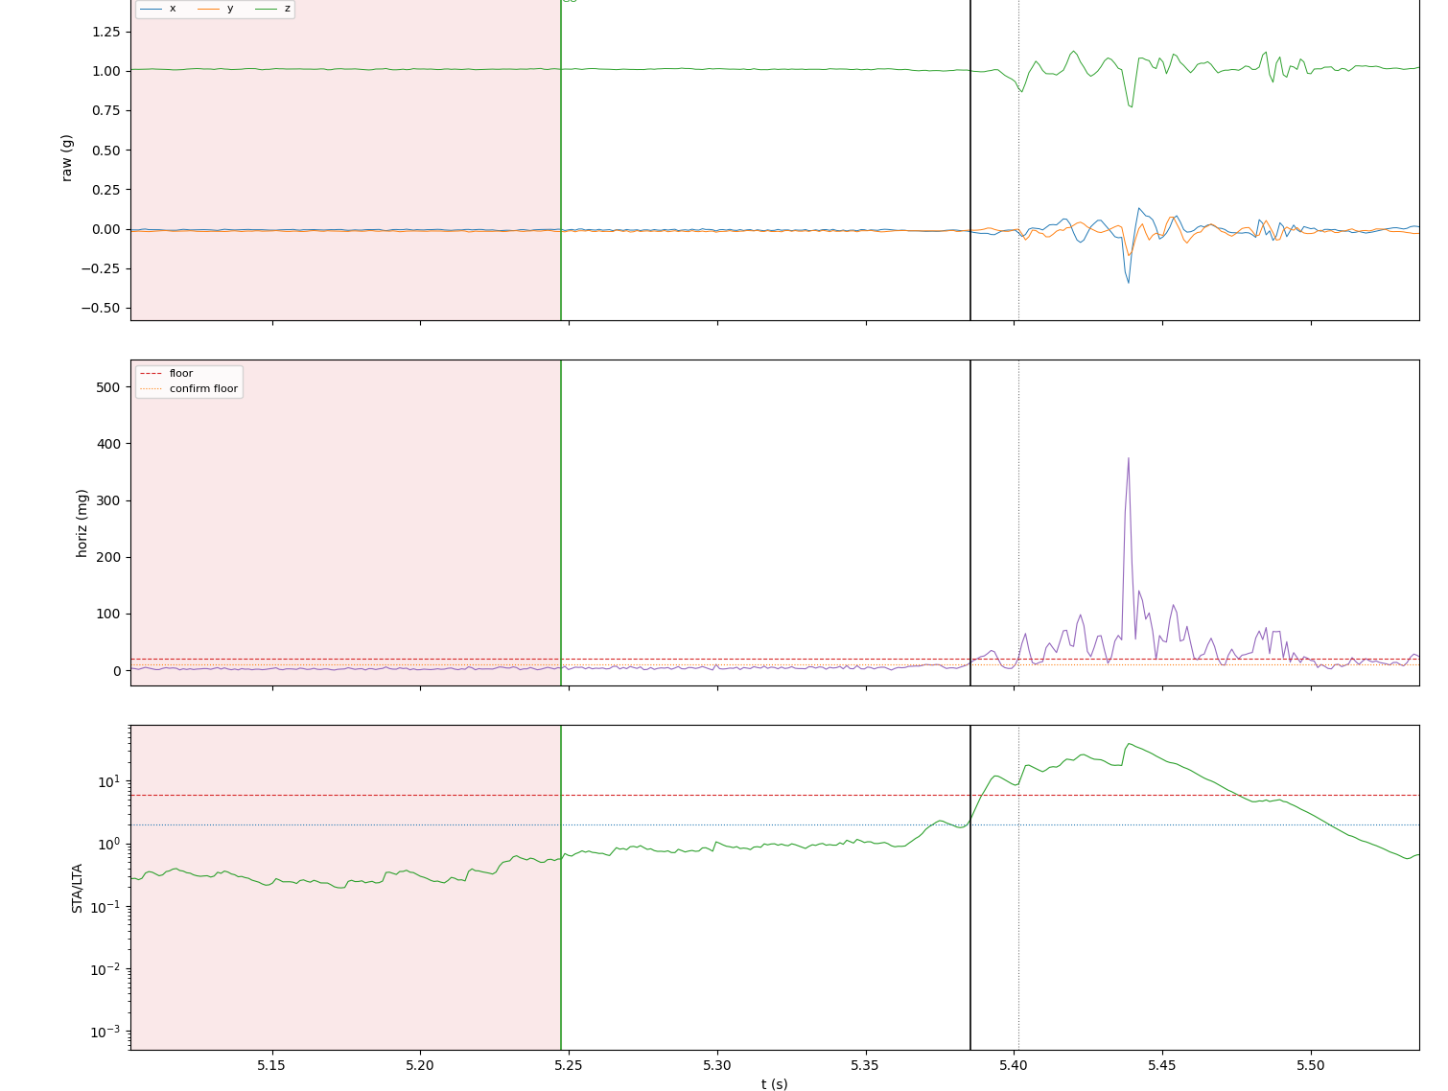
07
RESULTS: ONE REAL START
GO
Green line: the “go” beep, stamped by the 8 µs clock
138 ms
Black line: AIC onset, the reaction time we report
+16.2 ms
Dotted line: where a threshold alone would place it
First prototype · raw acceleration · horizontal magnitude · STA/LTA ratio
Notes:
This is one real start. The green line is “go”. The black line is where our detector finds the push: 138 milliseconds later. A simple threshold would place it 16 milliseconds later. [Next Slide]

Slide 11
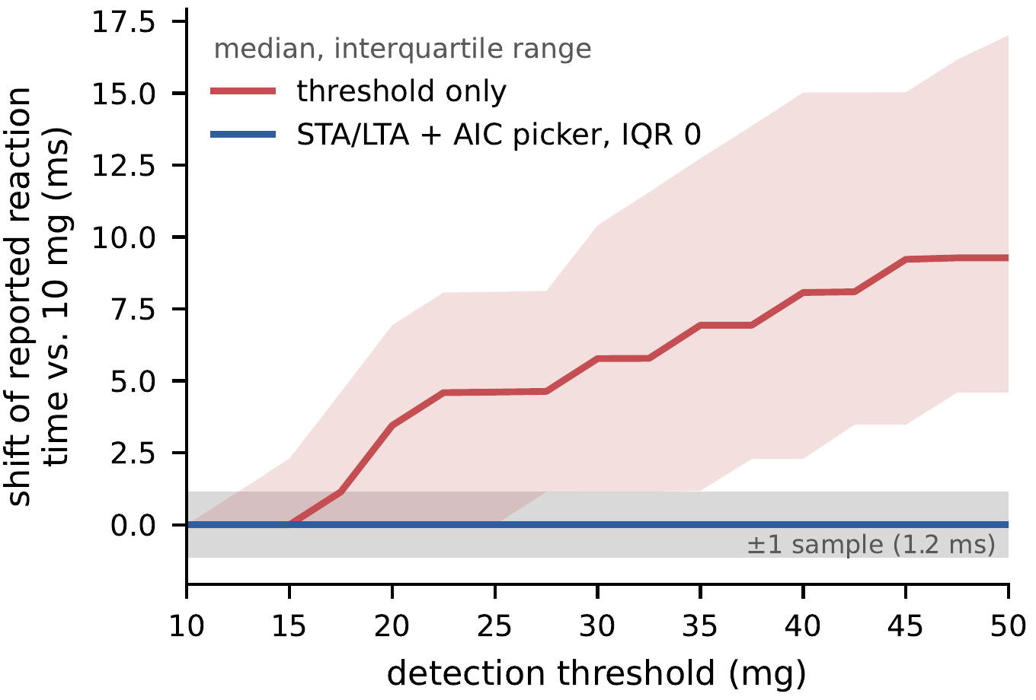
07
RESULTS · MEASUREMENTS
0.0 ms vs 9.3 ms
median shift: our detector vs threshold only (10 → 50 mg)
70 / 79
starts with identical AIC onset (74 within 1 sample)
72 + 7
valid starts + false starts (5 sprinters, 4 sessions)
154.0 ms
median reaction time (range 111.3 – 476.5 ms)
Threshold sweep over 79 starts: the AIC onset stays fixed; threshold-only drifts up to 9.3 ms (median)
Notes:
Our main result is shown in this graph. We swept the detection threshold from 10 to 50 milli-g. With a simple threshold—the red line—the reported reaction time drifts, with a median shift of 9.3 milliseconds. With our two-step detector, the blue line remains completely stable: in 70 of 79 starts the result did not change at all, and in 74 it stayed within a single sample. We estimate the random error at 1 to 2 milliseconds. However, a stable number is not yet a guaranteed correct number, so our next step will be to validate it against a mechanical ground truth.

Slide 12
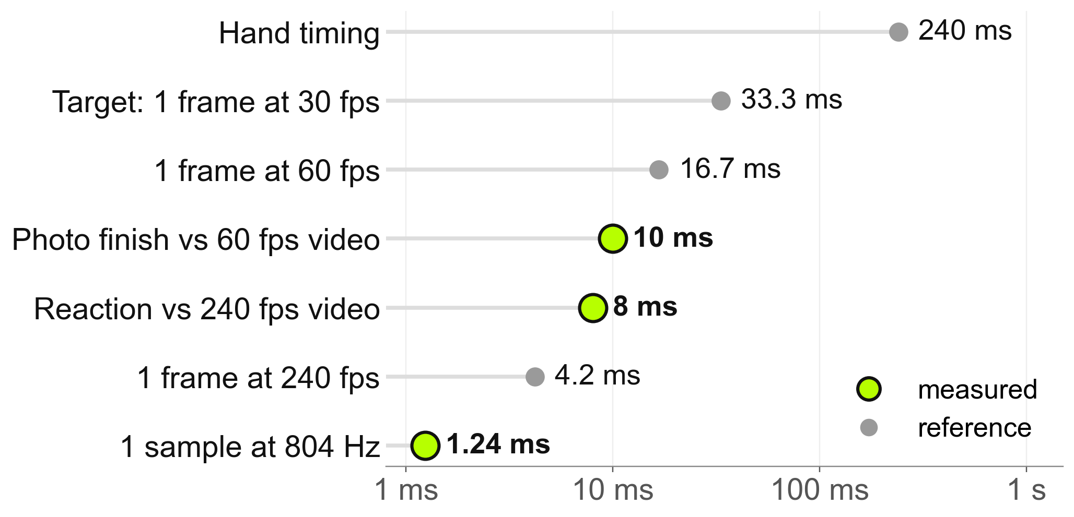
07
RESULTS · VALIDATION
≈ 8 ms
reaction time vs 240 fps video, LED marking “go”
10 ms
photo finish vs 60 fps video (1 frame = 16.7 ms)
33 ms
our target at half-time: one frame at 30 fps
0.24 s
hand timing reads fast, as the literature reports
Every timing error on one log scale: what we measured, against frame intervals and hand timing
Notes:
Then we validated both measurements against high-speed video. For the reaction time, we added an LED that the board lights exactly at "go", and filmed the block at 240 frames per second. The LED gives us the "go" frame exactly; the push is the first frame where the athlete moves, picked by eye. Board and video agree within about 8 milliseconds. One frame alone is 4.2 milliseconds, and the eye sees the body move after the first force on the block, so this is the limit of the video, not of our unit: the unit's own resolution is one sample, 1.2 milliseconds.
For the photo finish, against a 60 frames-per-second reference video, our time differs by 10 milliseconds: less than one frame, and a third of the 33 milliseconds we set as our target at half-time, thanks to the interpolation between frames. Hand timing on the same runs read about a quarter of a second fast, as the literature says.

Slide 13
08
FUTURE WORK
Reaction time and photo finish are validated. Next, we prove the 1.2 ms and reach 100 m.
STEP 1 · START UNIT
STEP 2 · START UNIT
STEP 3 · LINK
STEP 4 · APP
Confirm the 1.2 ms
Measure fixed delays
Reach 100 m
Photo finish on Android
A 1000 fps camera checks one-sample accuracy directly
The sensor's filter and the sound's travel to the athlete (2.9 ms per metre)
A second ESP32-C3 at the finish: long-range ESP-NOW, then BLE to the phone
Same detector on Android's camera; iOS works today
Notes:
Looking ahead. Both measurements are validated, so the next steps make them sharper and longer. First, a 1000 frames-per-second camera, to check the unit's one-sample accuracy, 1.2 milliseconds, directly. Second, measure the two fixed delays we have not measured yet: the accelerometer's internal filter, and the time the sound takes to reach the athlete, about 3 milliseconds per metre.
Third, reach 100 metres: a second ESP32-C3 at the finish, linked to the start unit by long-range radio, which we already tested beyond 100 metres, and to the phone by Bluetooth. Fourth, bring the photo finish to Android; today it runs on the iPhone.

Slide 14

09
HOW WE WORKED
WHAT WENT WELL
WHAT WE WOULD CHANGE
Test with real sprinters
Test radio range earlier
Real blocks and athletes, then 240 fps video as ground truth
ESP32-C3 Wi-Fi reached 60–70 m; a track needs 150–200 m
Measure before trusting
Plan ground truth from day one
Serial link capped us at 232 Hz → on-board buffer, 865 Hz without gaps
The LED + 240 fps check came at the end; it should come first
Let data drive the design
Choose the final microcontroller early
Threshold sweep showed drift → added the AIC step
Bluetooth on the first board cost timing → one ESP32-C3 for everything
Notes:
Finally, a few words on how we worked. We built the system step by step, and we always tested with real sprinters on real blocks, and in the end against 240 frames-per-second video. What went well? First, we measured before trusting: for example, sending data over the serial cable limited us to about 232 samples per second, so we buffered the data on the board and sampled without gaps. Second, we let the data guide the design: the threshold sweep showed that a simple threshold was not stable, so we added the AIC step.
What would we do differently? We would test the radio range earlier: a Wi-Fi test reached only 60 to 70 metres, and a track needs more. We would plan the ground truth from day one: the LED and high-speed video check came at the end. And we would choose the final microcontroller early: adding Bluetooth to our first board cost timing, so we moved everything to one ESP32-C3.

Slide 15
THANK YOU
Questions?
PROSTART
Arianna Bartocci · Duarte Chambel · Lorenzo Galli · Loke Enlund Östangård · Ninad Purekar
Notes:
Closing slide. PROSTART measures reaction time and finish time within the limits of high-speed video, with a box that fits on any block and a phone. Olympic-style timing, accessible to every club. Thank you!

