Slide 1
t
The Space Cost of Shor's Algorithm
How much does the Quantum Phase Estimation register weigh
n
Lorenzo Luchesini · 881345 · AI4ST a.a. 2025-6

Slide 2
Shor's Algorithm: the Full Pipeline
1
Order-finding reduction
Factoring N reduces to finding the order r of a random a coprime to N : gcd(a^{r⁄2} ± 1, N) yields a non-trivial factor with probability ≥ 1 − 1⁄2ᵏ⁻¹.
2
Quantum Phase Estimation
A QPE circuit estimates the eigenphase θ = k⁄r of the operator U_{a} on a counting register of t qubits.
3
Continued fractions
The measured phase y⁄2^{t} is expanded as a continued fraction to recover the best approximation k⁄r, with denominator < N.
4
Euclidean algorithm
Once r is known, gcd(a^{r⁄2} − 1, N) is computed classically in polynomial time to extract the factors of N.

Slide 3
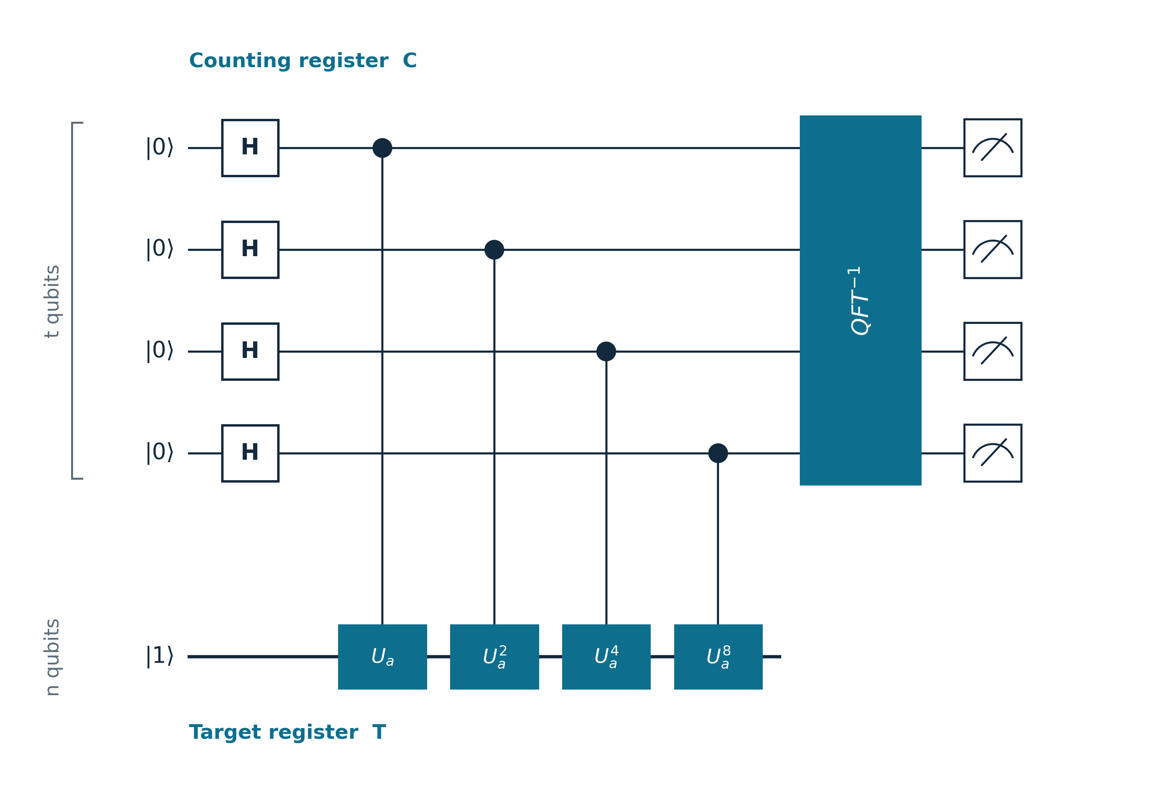
Inside the QPE Circuit
The operator U_{a}
U_{a} |x⟩ = |ax mod N⟩
is a permutation, hence unitary.
Its eigenvectors are
|u_{j}⟩ = (1⁄√r) Σ_{k} w_{r}^{−jk} |a^{k} mod N⟩,
j = 0, ..., r−1,
with eigenvalue w_{r}^{j} = e^{2πij⁄r}.
Why start from |1⟩
|1⟩ = (1⁄√r) Σ_{j} |u_{j}⟩
is an equal superposition of all r
eigenvectors of U_{a}—
we cannot prepare a single |u_{j}⟩
without already knowing r,
but |1⟩ needs no such knowledge.

Slide 4
Order finding uses two registers
Target register T — n = ⌈log₂ N⌉ qubits, holds the state
|a^{k} mod N⟩
Counting register C — t qubits, reads the phase θ = k⁄r and nothing else
Register C · t qubits
H
H
H
H
QFT†
How large must C be?
Register T · n qubits
|1⟩
M_{b}
M_{b}
M_{b}
total width = t + n

Slide 5
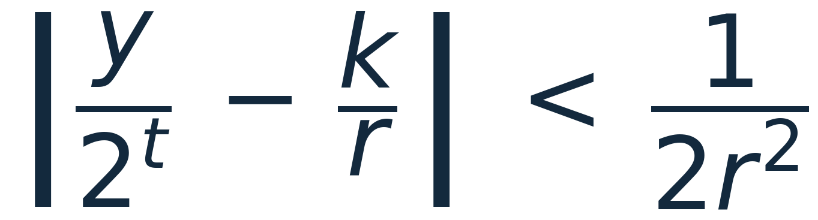
From phase to order: continued fractions
Measuring C returns y⁄2^{t} ≈ k⁄r with k uniform in {0, ..., r−1}.
Continued fractions reconstruct k⁄r exactly — but only if the estimate is precise enough:
The phase must be resolved with error < 1⁄(2r²).
Register C sets the resolution: grid spacing 2⁻ᵗ.
With too few bits, multiple phases k⁄r land on the same measured value and continued fractions get it wrong.
Example (N = 21, t = 6)
measured y/2ᵗ = 11/64 ≈ 0.172
convergents: 0, 1/5, 1/6 → r = 6
the first denominator < N is chosen.

Slide 6
The space cost: t ≈ 2n
Since r < N, it suffices to require
| y⁄2^{t} − k⁄r | < 1⁄(2N²)
which requires t ≳ 2 log₂ N + 1 ≈ 2n
The register that only reads the phase is twice as large as the one holding the number.
Total width ≈ 3n versus log₂ N bits of useful information.
register | size | role
target T | n | holds the number
counting C | ≈ 2n | phase precision
TOTAL | ≈ 3n
T : n
C : ≈ 2n
two-thirds of the width is just phase precision
2×
C versus T
3n
total width

Slide 7
The experiment
Only t is varied, and from the exact distribution of register C two probabilities are measured:
P_{resolve} (t)
phase measured within 1⁄(2r²) of a true k⁄r.
purely spatial metric: «did the register have enough bits?»
P_{factor} (t)
a single shot yields a non-trivial factor of N.
includes the numerical overhead: k = 0, r odd, gcd(k, r) > 1.
The gap P_{resolve} − P_{factor} is fixed (theorem: success ≥ 1 − 1⁄2ᵏ⁻¹, k = number of distinct primes);
while the point where P_{resolve} rises is the space requirement.
Target: N = 15, 21, 35, 105 with base a = 2. Simulator: PennyLane default.qubit, analytic mode.

Slide 8
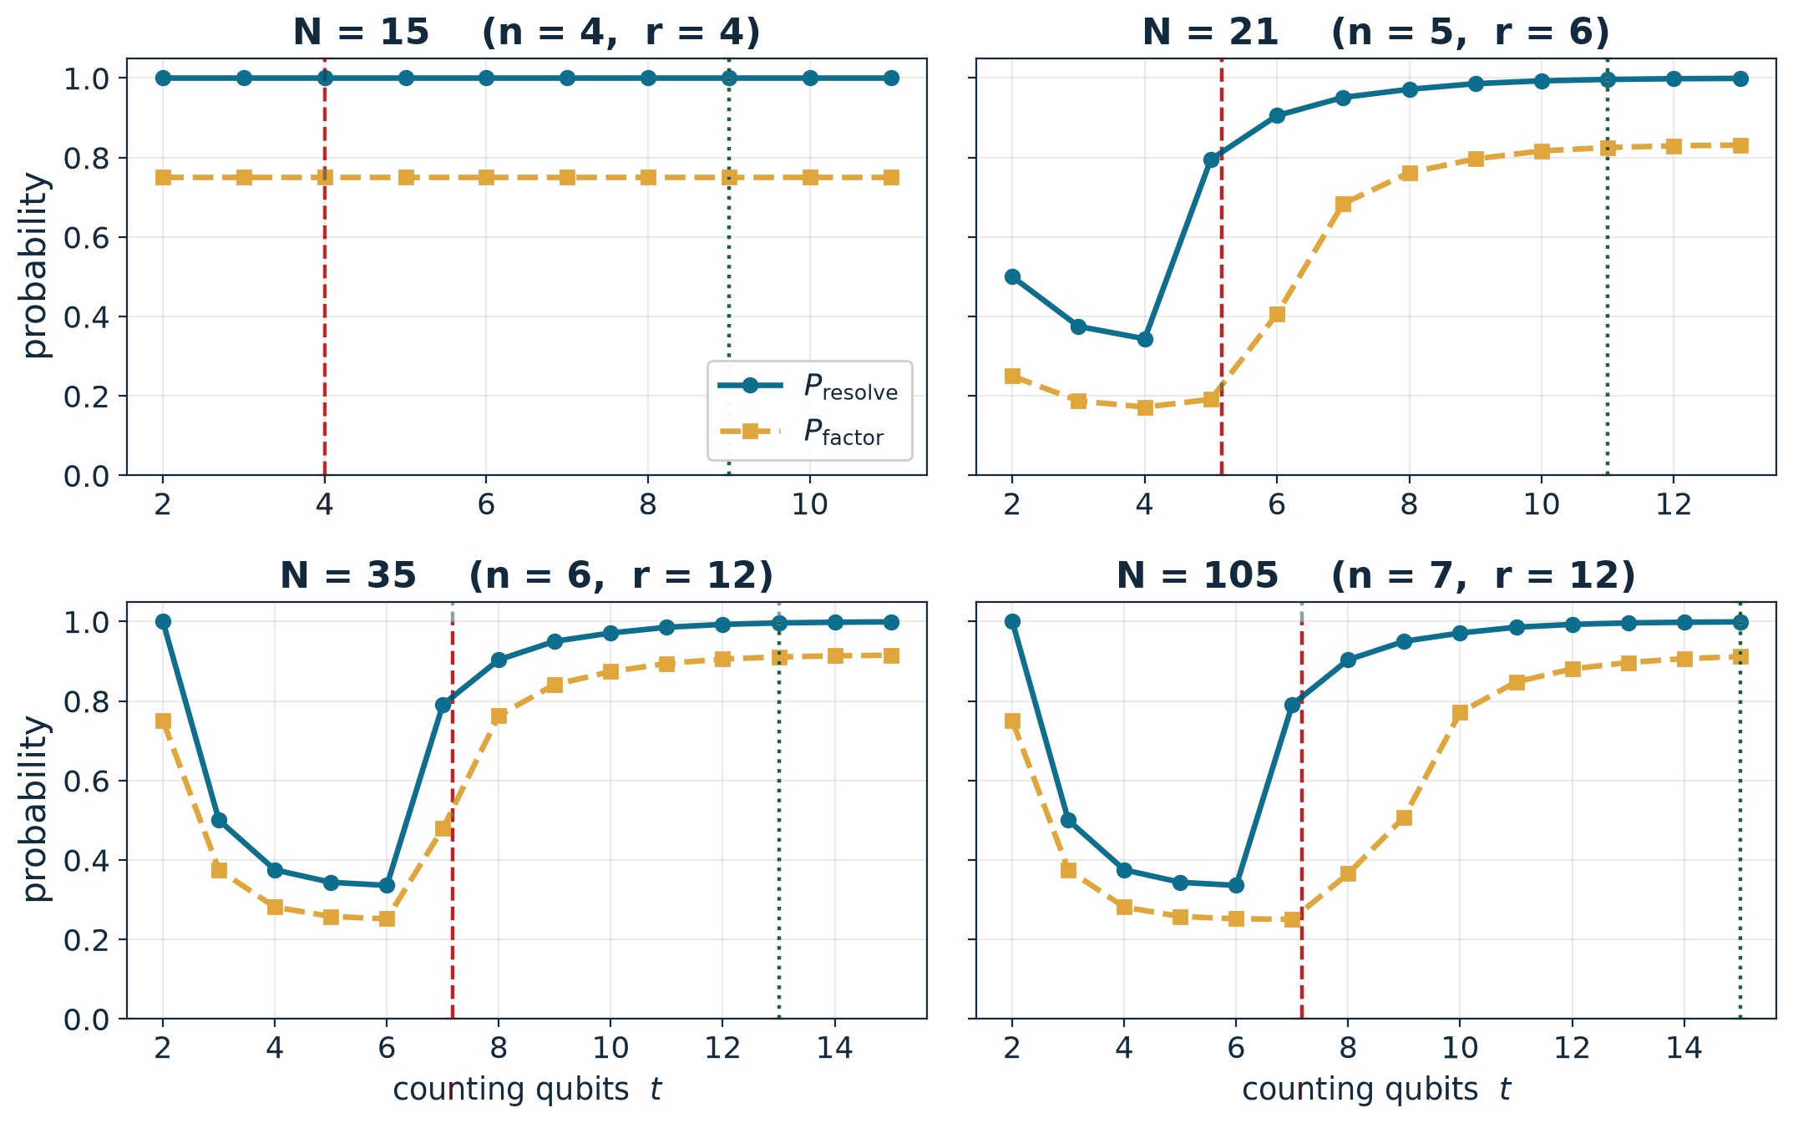
Success vs. register size
The «knee»
P_{resolve} rises around t ≈ 2 log₂ r, well inside the worst-case bound 2n+1.
Plateau
P_{factor} plateaus below 1: this is the numerical overhead, independent of t.
N = 15
flat curves: r = 4 is a power of 2.
red dashed t = 2log₂r (instance)
dark green dotted t = 2n + 1 (worst-case bound)

Slide 9
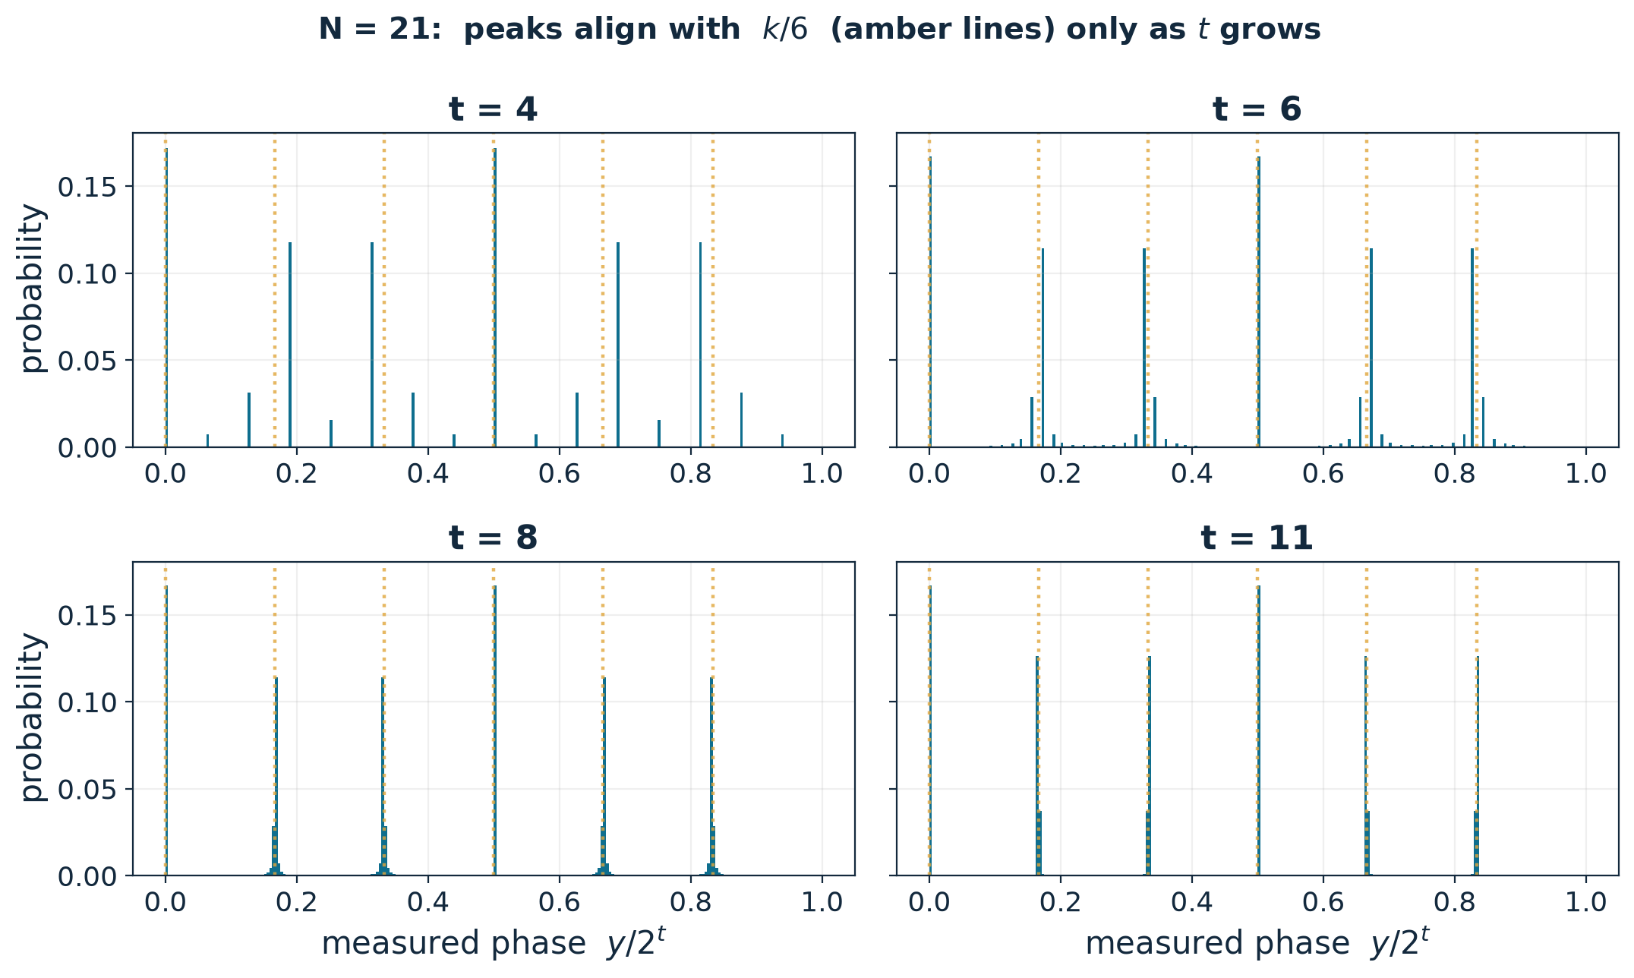
N = 15 is deceptive — the non-monotonic dip
N = 15 has r = 4 = 2²: the phases k⁄4 are exact in 2 bits → success already at t = 2.
With t tiny, the only representable values y⁄2^{t} coincide by aliasing with true k⁄r values.
As soon as t is enough to sample phases that are NOT k⁄r but not enough to resolve them, success collapses (minimum at t ≈ n).

Slide 10
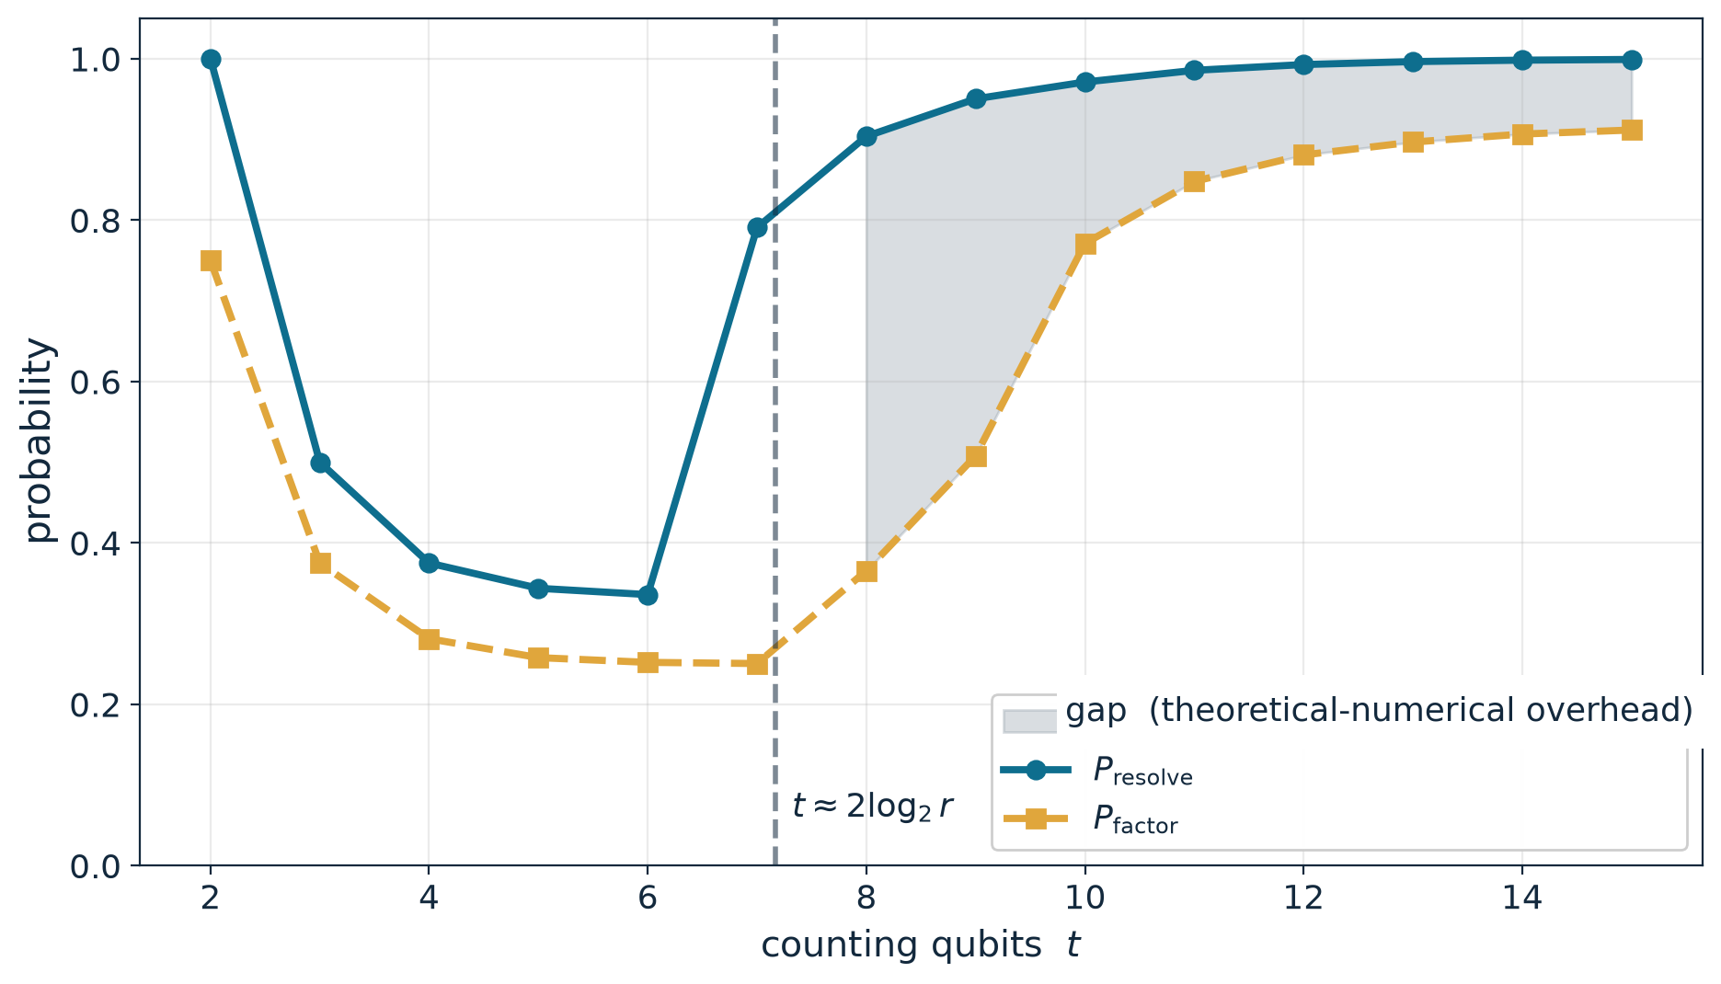
Space requirement vs. numerical overhead
Rise of P_{resolve}
= the register has reached ≈ 2 log₂ r bits. This is the SPACE cost.
Residual gap
= k = 0, r odd, gcd(k,r) > 1. Constant in t, reduced by repeating (or changing a).
Separating the two is the point of the experiment.
Let’s define t* as the smallest amount of counting qubits for which P_{factor}(t) reaches 90% of its plateau value.

Slide 11
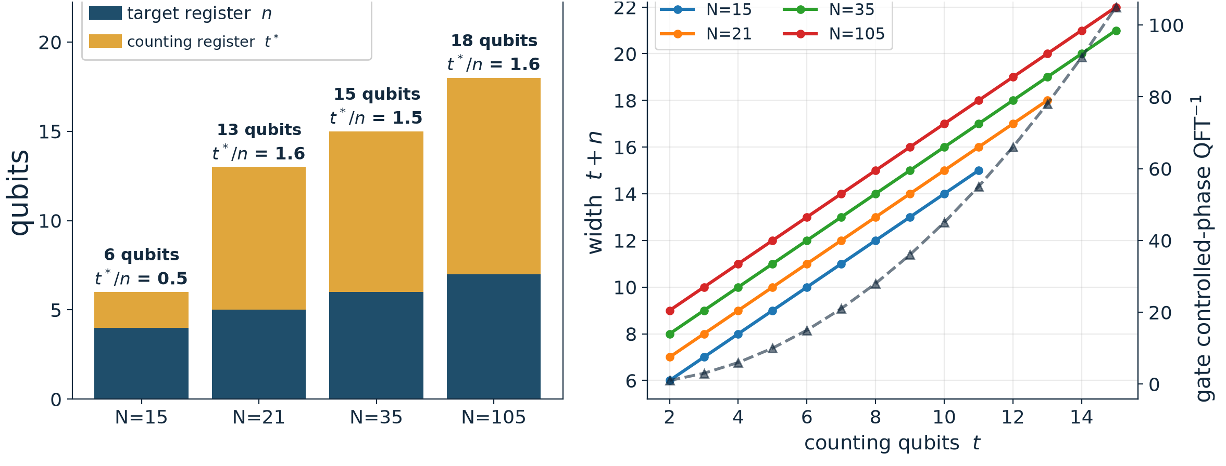
Width and circuit cost
Circuit width at t*
Linear in width, quadratic in QFT⁻¹
t* ≈ 1.5–1.6 n
(N = 15: 0.5, the lucky case)
width t + n: linear
QFT⁻¹ t(t−1)⁄2: quadratic
only 2–4 distinct M_{b} operators

Slide 12
Conclusions
N | n | t* | width | t*⁄n
21 | 5 | 8 | 13 | 1.6
35 | 6 | 9 | 15 | 1.5
105 | 7 | 11 | 18 | 1.57
The phase-only register is ~1.5× the one holding the number.
Shor’s theorem: asymptotically t* ~ n + m, with P_{factor} ≥ 1 − 1⁄2ᵐ (m = extra qubits beyond n).
Within the same circuit: linear width, quadratic QFT⁻¹, modular arithmetic with few distinct M_{b}.

Slide 13
References
[1] P. W. Shor, Polynomial-Time Algorithms for Prime Factorization and Discrete Logarithms on a Quantum Computer. SIAM J. Comput. 26(5), 1997 (arXiv: quant-ph/9508027).
[2] IBM Quantum, Shor's algorithm — tutorial. quantum.cloud.ibm.com/docs/en/tutorials/shors-algorithm

