Slide 1
Machine Learning Applications to Semiconductor Manufacturing Process Control
Enzo Mangubat
NYCDSA Capstone Project
January x, 2021
code:
Online article:

Slide 2
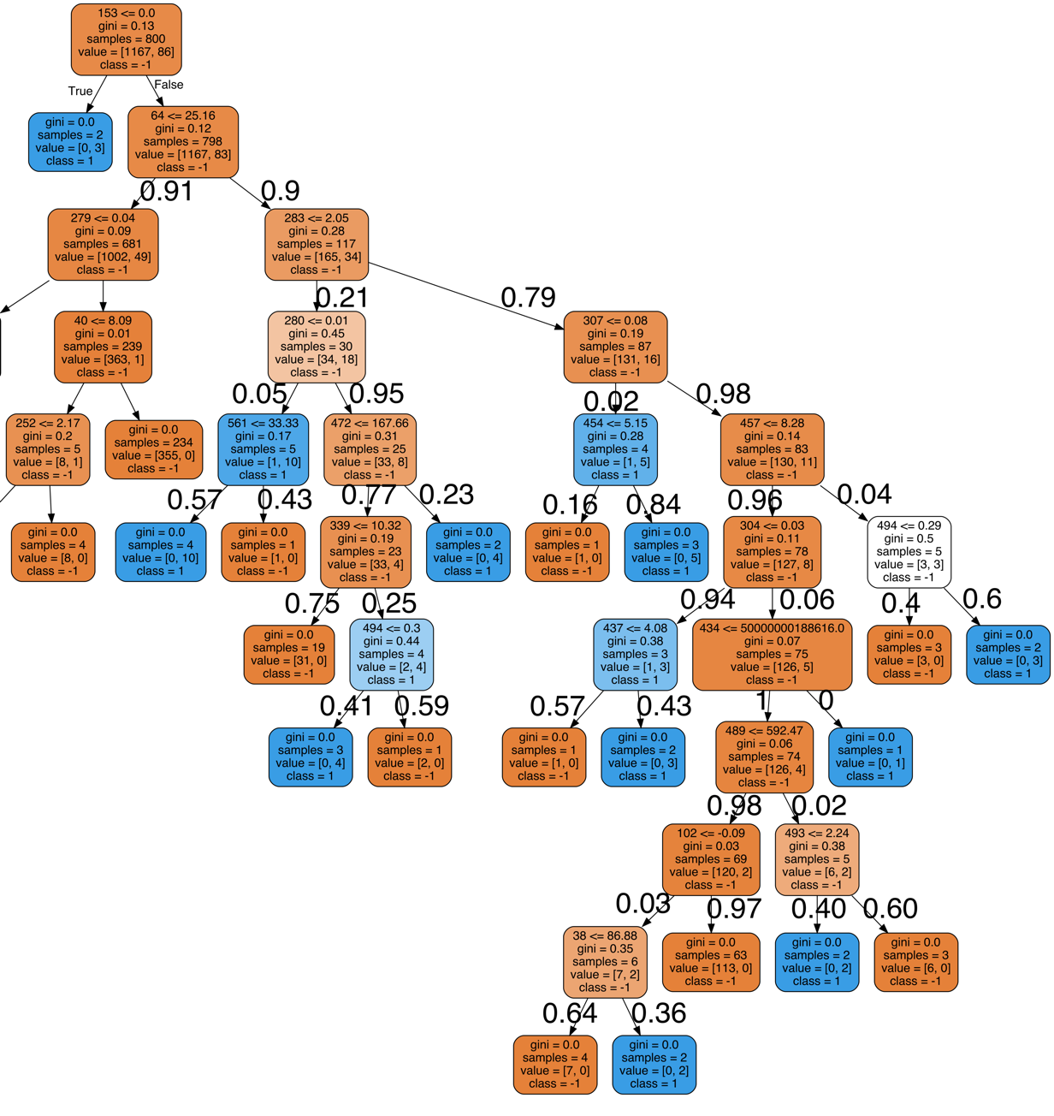
How can this influence what values to control for?
module making decision
Assume we are the module controlling parameter 283.
Do we keep it above or below 2.05?
outcome | chance of passing
below | 15.1%
above | 55%
0.029
0.024
0.046
0.046
0.017
0.55
0.016
0.024
Thankfully, this parameter is already 79% likely to be above.
These was done by:
Calculate the probabilities at each split based on the distribution of data at that node.
Multiply all the probabilities leading to an endpoint to get the probability of that endpoint.
Sum all the probabilities of the passing outcomes for below and above.
0.076
0.110
0.51
0.51
0
if param 283 <=2.05
0.054
0.005
0.005
0.001
0.0006
if param 283 > 2.05

