Slide 1
Laboratory of Advanced Programming
Distributed Fault-Tolerant Seismic Analysis Platform
Distributed Fault-Tolerant Seismic Analysis Platform
1

Slide 2
Problem and Motivation
Raw seismic streams are not directly useful for operational monitoring.
Suspicious activity must be detected quickly, classified consistently, and retained for later investigation.
The platform must continue to provide value even when one or more processing nodes become unavailable.
Distributed Fault-Tolerant Seismic Analysis Platform
2

Slide 3
Project Goal
Ingest live measurements from an external seismic simulator.
Redistribute a normalized stream to replicated processing nodes.
Classify events through FFT-based frequency analysis.
Persist consolidated results in PostgreSQL.
Expose live and historical visibility through a single dashboard.
Distributed Fault-Tolerant Seismic Analysis Platform
3

Slide 4
System Overview
External
Simulator
Fan-out
Broker
Processing
Replicas x5
Gateway +
PostgreSQL
React
Dashboard
Distributed Fault-Tolerant Seismic Analysis Platform
4

Slide 5
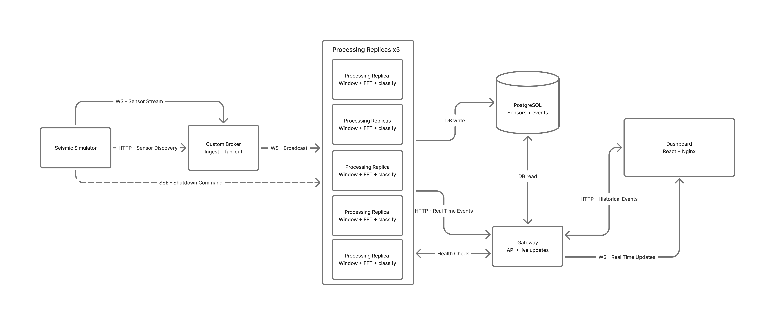
Implemented Architecture
Distributed Fault-Tolerant Seismic Analysis Platform
5

Slide 6
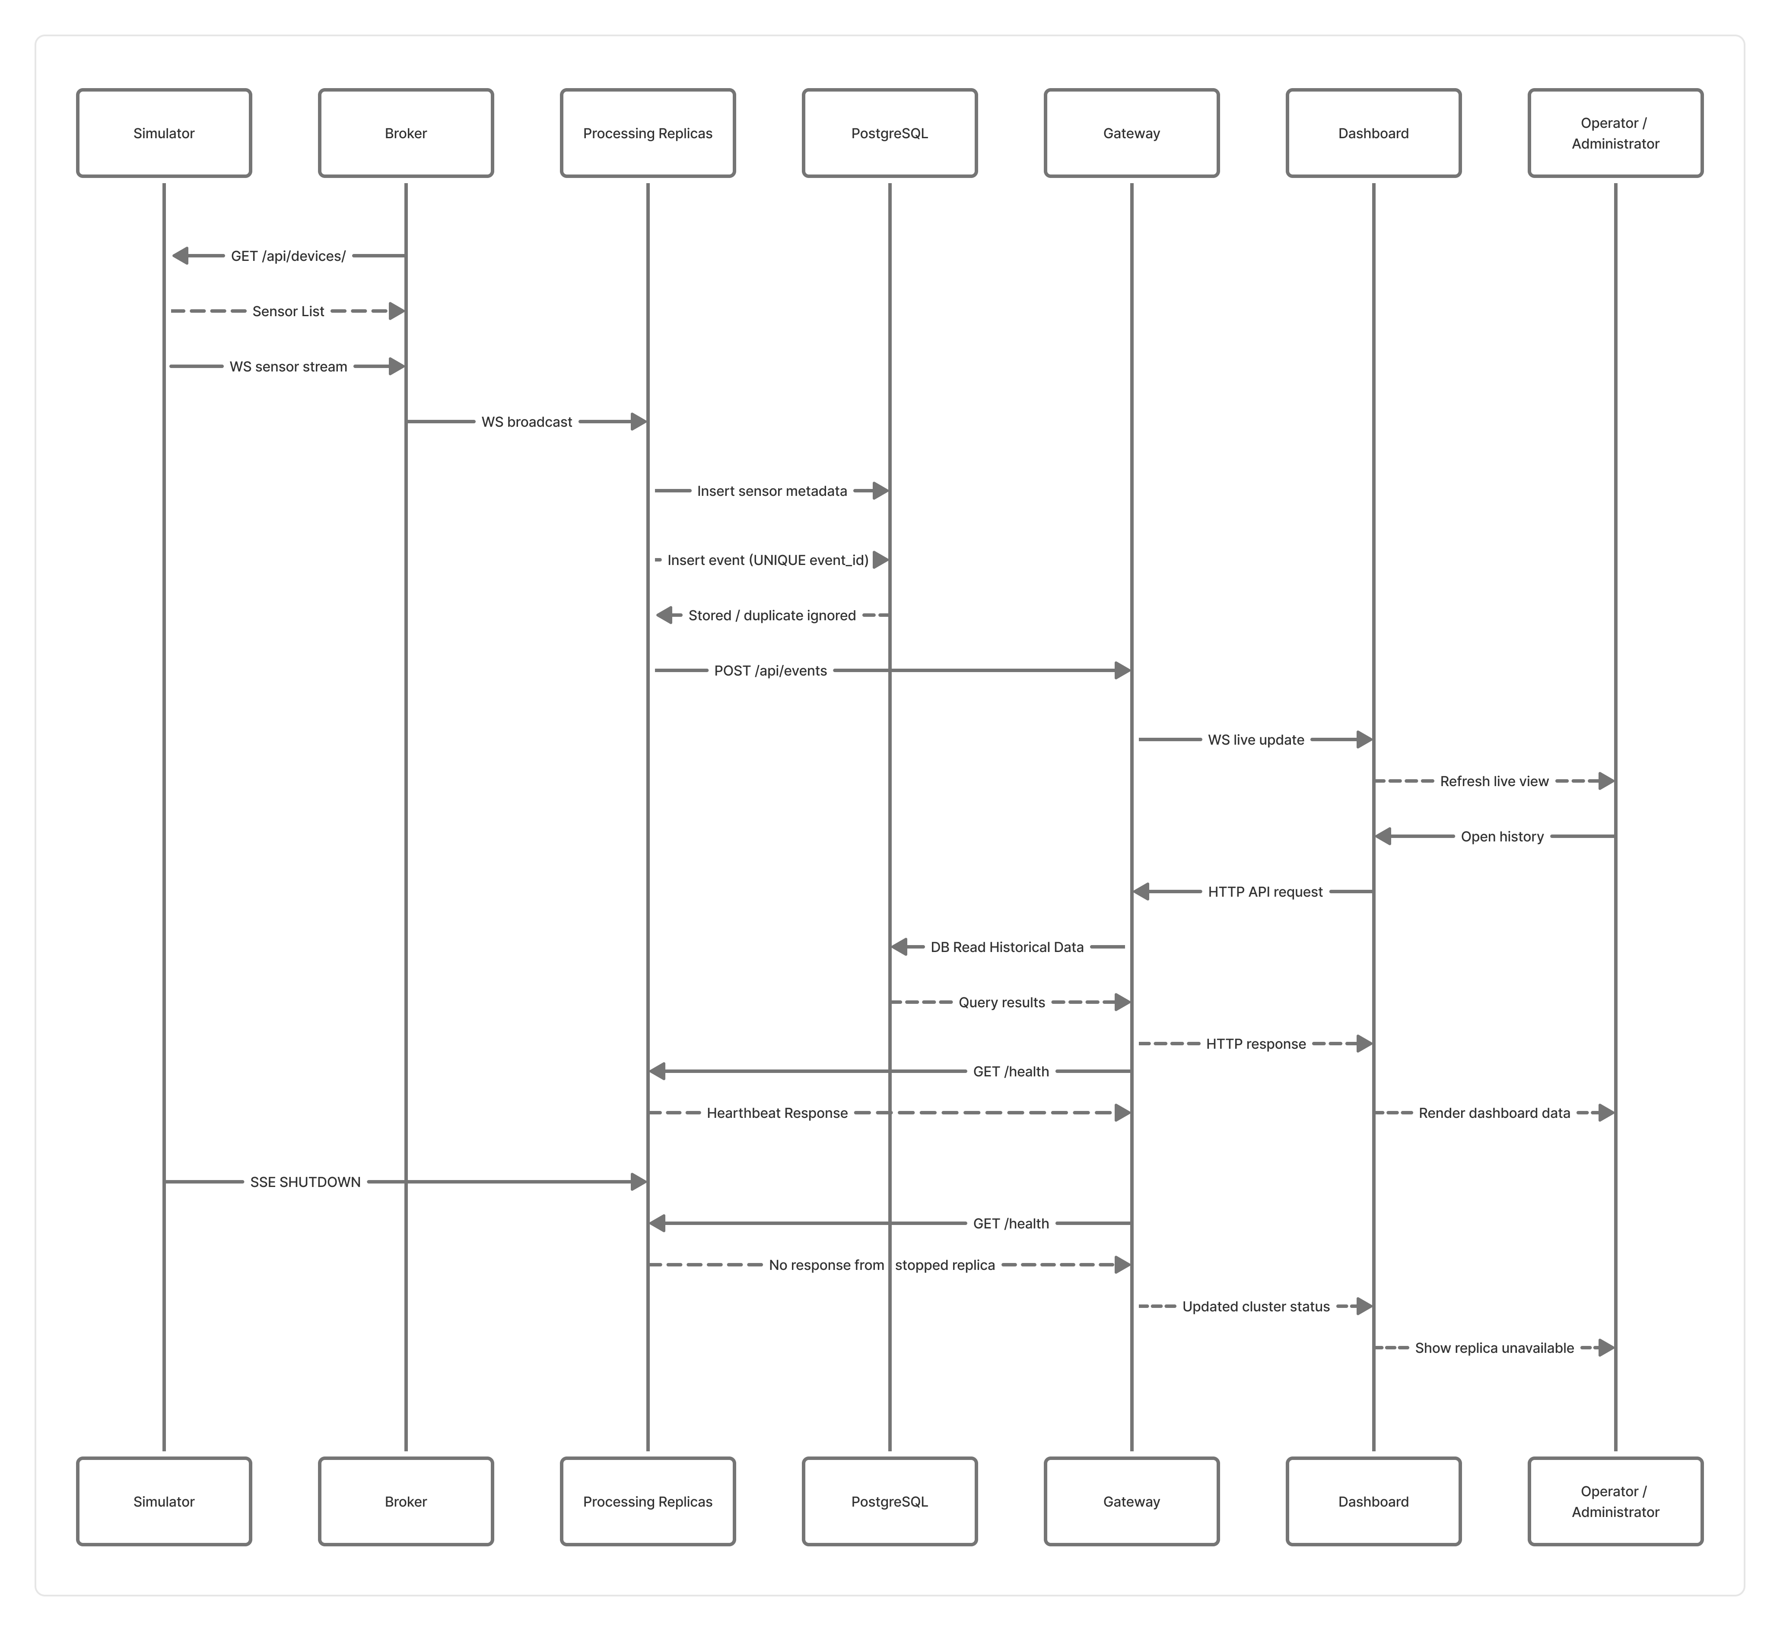
End-to-End Runtime Data Flow
Distributed Fault-Tolerant Seismic Analysis Platform
6

Slide 7
Services and Communication Protocols
Simulator → Broker
HTTP sensor discovery + per-sensor WebSocket streams
Simulator → Replicas
SSE control stream for graceful shutdown
Broker → Replicas
WebSocket fan-out on /ws/ingest
Replicas → PostgreSQL
SQL writes for sensors and events
Replicas → Gateway
HTTP POST /api/events
Gateway → Frontend
REST APIs + WebSocket /ws/live
Gateway → Replicas
Periodic GET /health polling
Distributed Fault-Tolerant Seismic Analysis Platform
7

Slide 8
Internal Event Model
Measurement envelope
Detected event envelope
{
"sensor_id": "sensor-08",
"category": "datacenter",
"region": "Replica Datacenter",
"sampling_rate_hz": 20.0,
"timestamp": "2026-03-25T00:00:00Z",
"value": 0.123456
}
{
"event_id": "sha256(sensor|ts|type)",
"sensor_id": "sensor-08",
"event_type": "earthquake",
"last_sample_timestamp": "2026-03-25T00:00:09.95Z",
"peak_frequency": 1.6,
"peak_amplitude": 4.0
}
Distributed Fault-Tolerant Seismic Analysis Platform
8

Slide 9
Custom Broker Role
Step 1
Step 2
Step 3
Step 4
Discovers sensors dynamically through GET /api/devices/
Opens one upstream WebSocket stream for each sensor
Wraps raw samples into a normalized measurement envelope
Broadcasts the same stream to every connected replica
Distributed Fault-Tolerant Seismic Analysis Platform
10

Slide 10
Detection and Classification Logic
200
20
100
Noise threshold
Ignore frequencies below 0.5 Hz and amplitudes below 0.01
samples per sliding window
new samples between analyses
cooldown samples after a detection
0.5 - 3.0 Hz
Earthquake
3.0 - 8.0 Hz
Conventional explosion
>= 8.0 Hz
Nuclear-like
Distributed Fault-Tolerant Seismic Analysis Platform
9

Slide 11
Replicated Processing and Fault Tolerance
Five identical processing services receive the same measurement stream.
Each replica keeps independent per-sensor windows and can classify the same event autonomously.
If one replica fails after startup, the remaining replicas continue processing and forwarding detections.
Graceful shutdown is supported through the simulator control SSE stream.
Replica 2
Replica 1
Broker
Replica 3
Replica 5
Replica 4
Distributed Fault-Tolerant Seismic Analysis Platform
11

Slide 12
Persistence and Duplicate-Safe Consolidation
Sensors are inserted once with ON CONFLICT DO NOTHING.
Events use a deterministic event_id = sha256(sensor_id|timestamp|event_type).
The events table enforces UNIQUE(event_id), consolidating identical detections from multiple replicas.
The gateway adds a second deduplication layer for live notifications through a recent-event cache.
sha256(sensor_id | timestamp | event_type)
Sensors table
sensor_id as primary key; static metadata inserted once.
Events table
event_id is UNIQUE; duplicate writes are ignored safely.
Distributed Fault-Tolerant Seismic Analysis Platform
12

Slide 13
SINGLE ENTRY POINT
Gateway and API Layer
Live ingest
POST /api/events
Monitoring
GET /api/system/status
History
Gateway
GET /api/history
Sensors
GET /api/sensors
Event details
GET /api/events/{event_id}
Live updates
WS /ws/live
Distributed Fault-Tolerant Seismic Analysis Platform
13

Slide 14
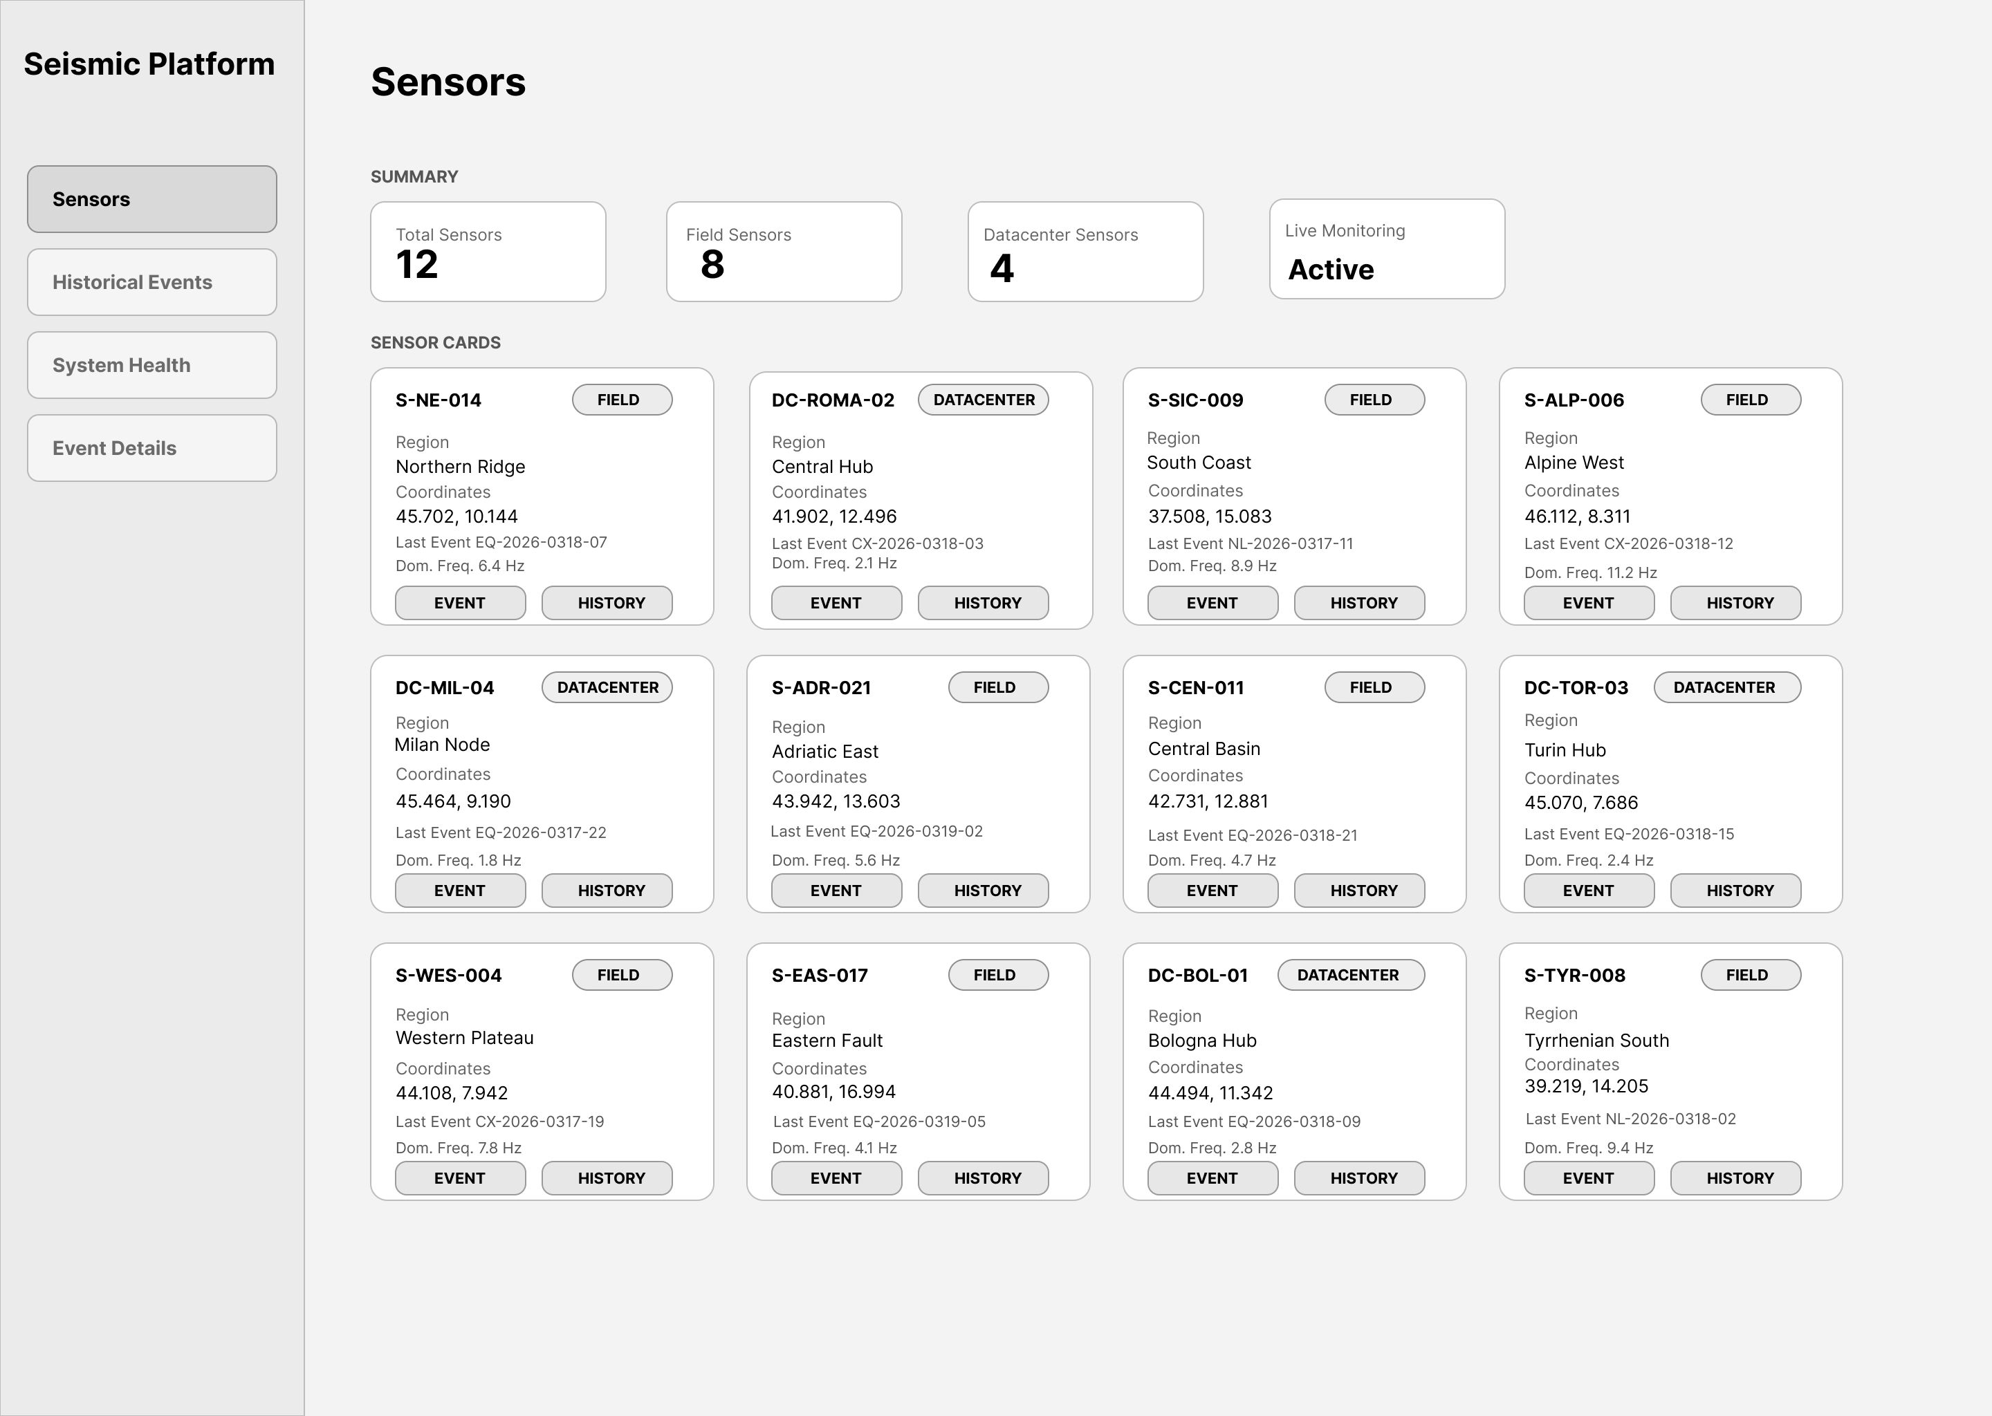
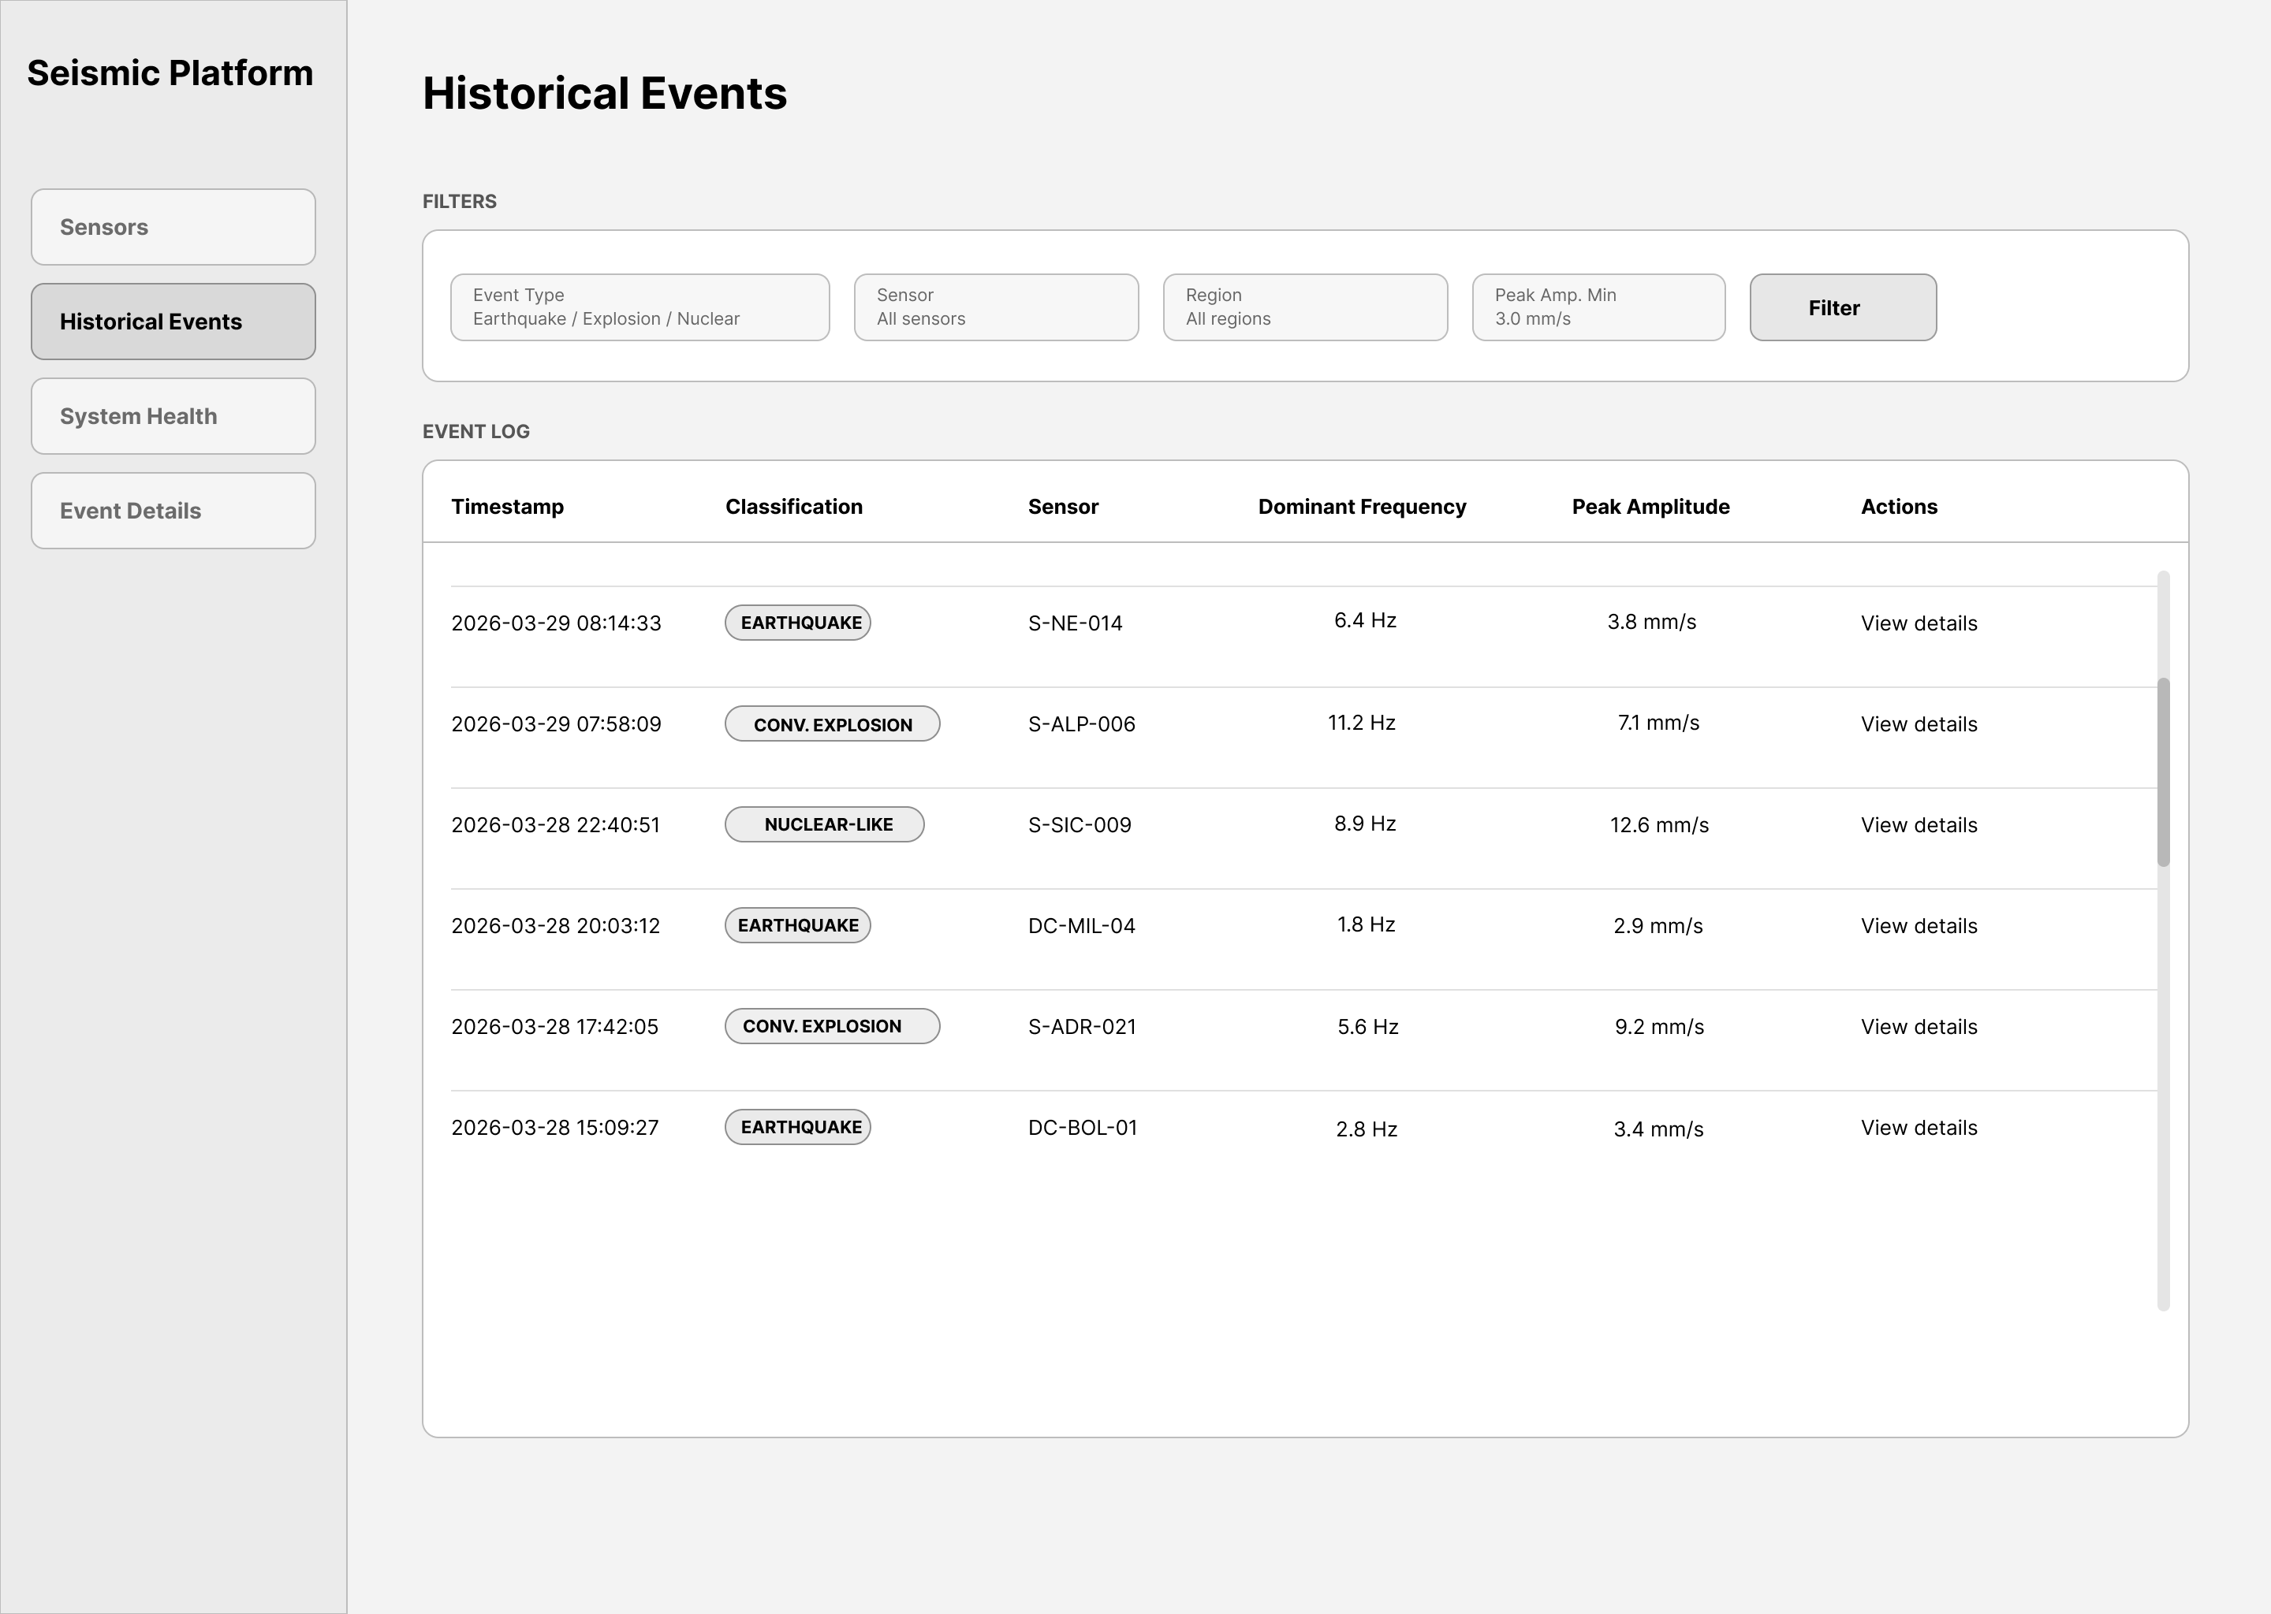
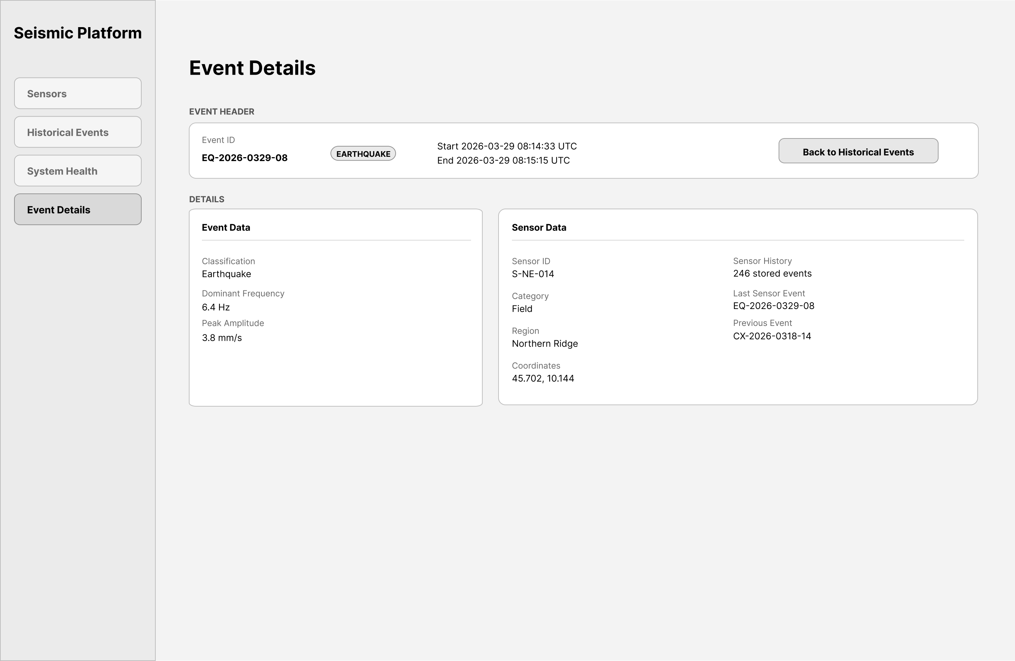
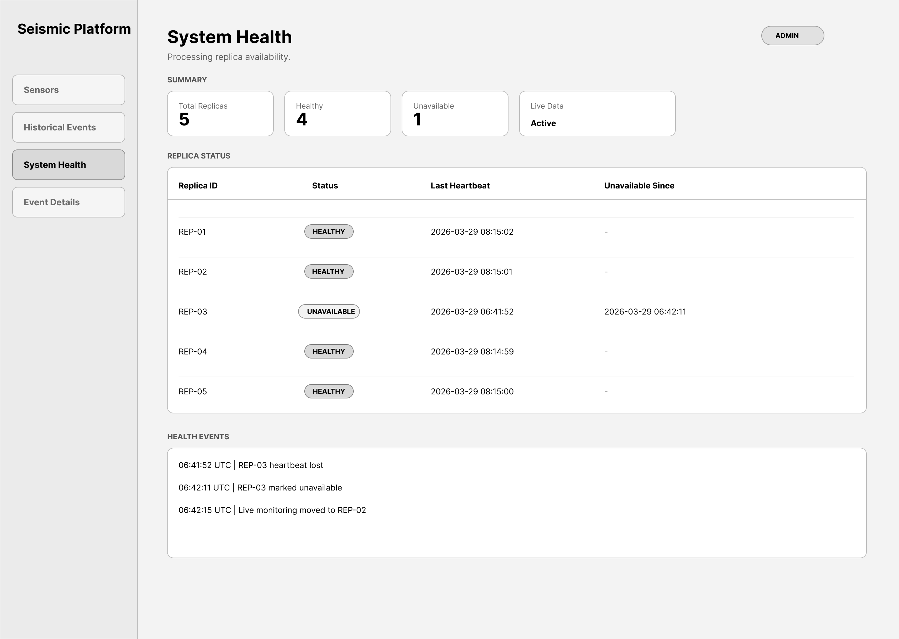
FRONTEND
Dashboard Overview
Sensors
Historical Events
Event Details
System Health
Distributed Fault-Tolerant Seismic Analysis Platform
14

Slide 15
OPERATOR WORKFLOW
Historical Investigation and Event Details
Historical view
Detailed view
Historical Events combines persisted detections with compatible live updates and supports filtering by event type, sensor, region, and minimum peak amplitude.
Event Details enriches one event with classification, dominant frequency, amplitude, coordinates, category, and related sensor details.
Distributed Fault-Tolerant Seismic Analysis Platform
15

Slide 16
OBSERVABILITY
System Health and Degraded Operation
The gateway request all replica /health endpoints every 5 seconds.
The UI reports total, healthy, and unavailable replicas, plus last heartbeat and unavailable-since timestamps.
A short health-event log keeps node failures visible over time.
The system remains usable with replica loss after startup because healthy replicas continue processing.
Distributed Fault-Tolerant Seismic Analysis Platform
16

Slide 17
OPERATIONS
Docker Compose Deployment
Service
Port
Role
simulator
8080
External source: discovery, streams, control
custom-broker
9000
Ingestion and fan-out
gateway
8001
Single API and live-update entry point
postgres
5432
Persistent storage for sensors and events
frontend
3000 → 80
React dashboard served by Nginx
replica-1 → ... → replica-5
Internal (8000)
Replicated FFT processing layer
Distributed Fault-Tolerant Seismic Analysis Platform
17

Slide 18
CLOSING
Conclusion
The project implements a coherent distributed seismic analysis platform from ingestion to operator-facing monitoring.
Its main value lies in the alignment between runtime flow, duplicate-safe persistence, API design, and dashboard usability.
The result is technically solid because the implemented codebase matches the architectural narrative.
Distributed Fault-Tolerant Seismic Analysis Platform
19

