Slide 1

FlightRadar24 Monitoring
The following project has been developed with the goal of implementing current leading technologies in both batch and real-time data management and analysis. The data source is FlightRadar24, a website that offers real-time flight tracking services. Through an API it is possible to obtain information, in real time, regarding flights around the globe. The developed dashboard allows the user to obtain general information about past days flights, in addition to real-time analytics regarding live air traffic in each zone of interest.
_________________________________________________________
LorenzoTarcinale | InformationSystemsforBigData | UniSa 2022

Slide 2
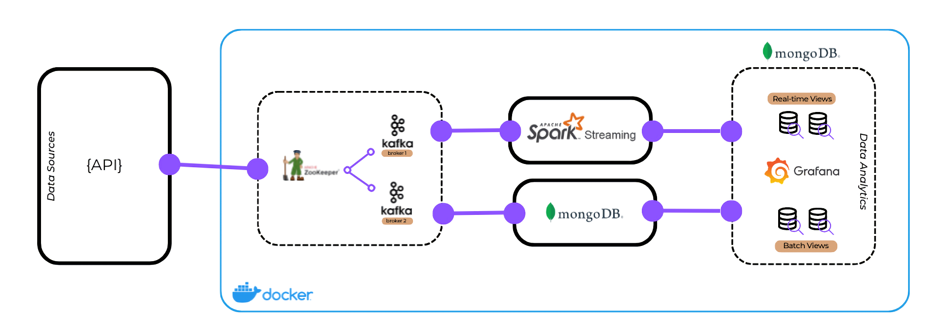
Pipeline
The real-time characteristic of the chosen data source motivates the need to set up an architecture that can cope with the large number of data arriving in a short period of time. The pipeline consists of several stages, which use current technologies for Real-Time Data Processing: it resemble a Lambda Architecture which make possible store data and at the same time analyze it in real time.
All of this has been developed in a Docker environment to enable future testing and a total replication of the project.

Slide 3
Let’s breakdown each stage of the pipeline.

Slide 4

Data source
The API returns a wide variety of information about flights, airports, and airlines. Some of these may be for example: aircraft model, origin and destination airport, latitude and longitude, ground and vertical speed, altitude and more.
airports.json
airlines.json
flight_details.json
zones.json
flights.json

Slide 5

Data source
It has been chosen to refer only to air activity in the skies of: italy, france, germany, england and spain.
Kafka Cluster

Slide 6

Data ingestion |
The cluster is based on 2 brokers and 1 topic. The main data traversing the cluster are those related to flights at time t. The remainder are stored directly in the db and will be used as static tables for joins.
Calls to the API and the sending of messages in the kafka cluster are done in such a way as to simulate as much real-world simultaenity and randomization as possible.
The messages are then both consumed by Spark Structured Streaming and stored in MongoDB.
API
Broker 1, Broker 2
flights.json
topic = apicall | 2 partitions | replication-factor = 2
Spark Streaming
airports.json
airlines.json
MongoDB
zones.json
producer
kafka
consumers

Slide 7

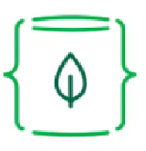
Storaging |
Starting from the storage: through the use of Kafka Connect and an official MongoDB connector enabled as a sink it is possible to store data from Kafka to Mongo. This facilitates and optimizes the process as it leverages the reliability of the cluster.
Spark Streaming
SINK
Batch views | Grafana
flightsDB

Slide 8


Real-Time
Data Processing |
Spark Structured Streaming natively supports reading data streams from kafka. After processing the data appropriately, through the use of an official Mongo Spark package it is possible to write the data stream to the database and make the data ready for the visualization.
MongoDB
writeStream
readStream
Real-time views | Grafana

Slide 9
Data Visualization | Dashboard Schema
This is the main idea of the final dashboard. It combines the two types of views, and attempts to encapsulate the most informative analyses for the user.
60sec updates
60sec updates
Average
flight distance per zone
Active
flights
per zone
Real-time views
1d updates
7d updates
7d updates
Flights
yesterday
Most departures from
Aircraft
most flew
1d updates
Flights count per
airline
Batch views

Slide 10

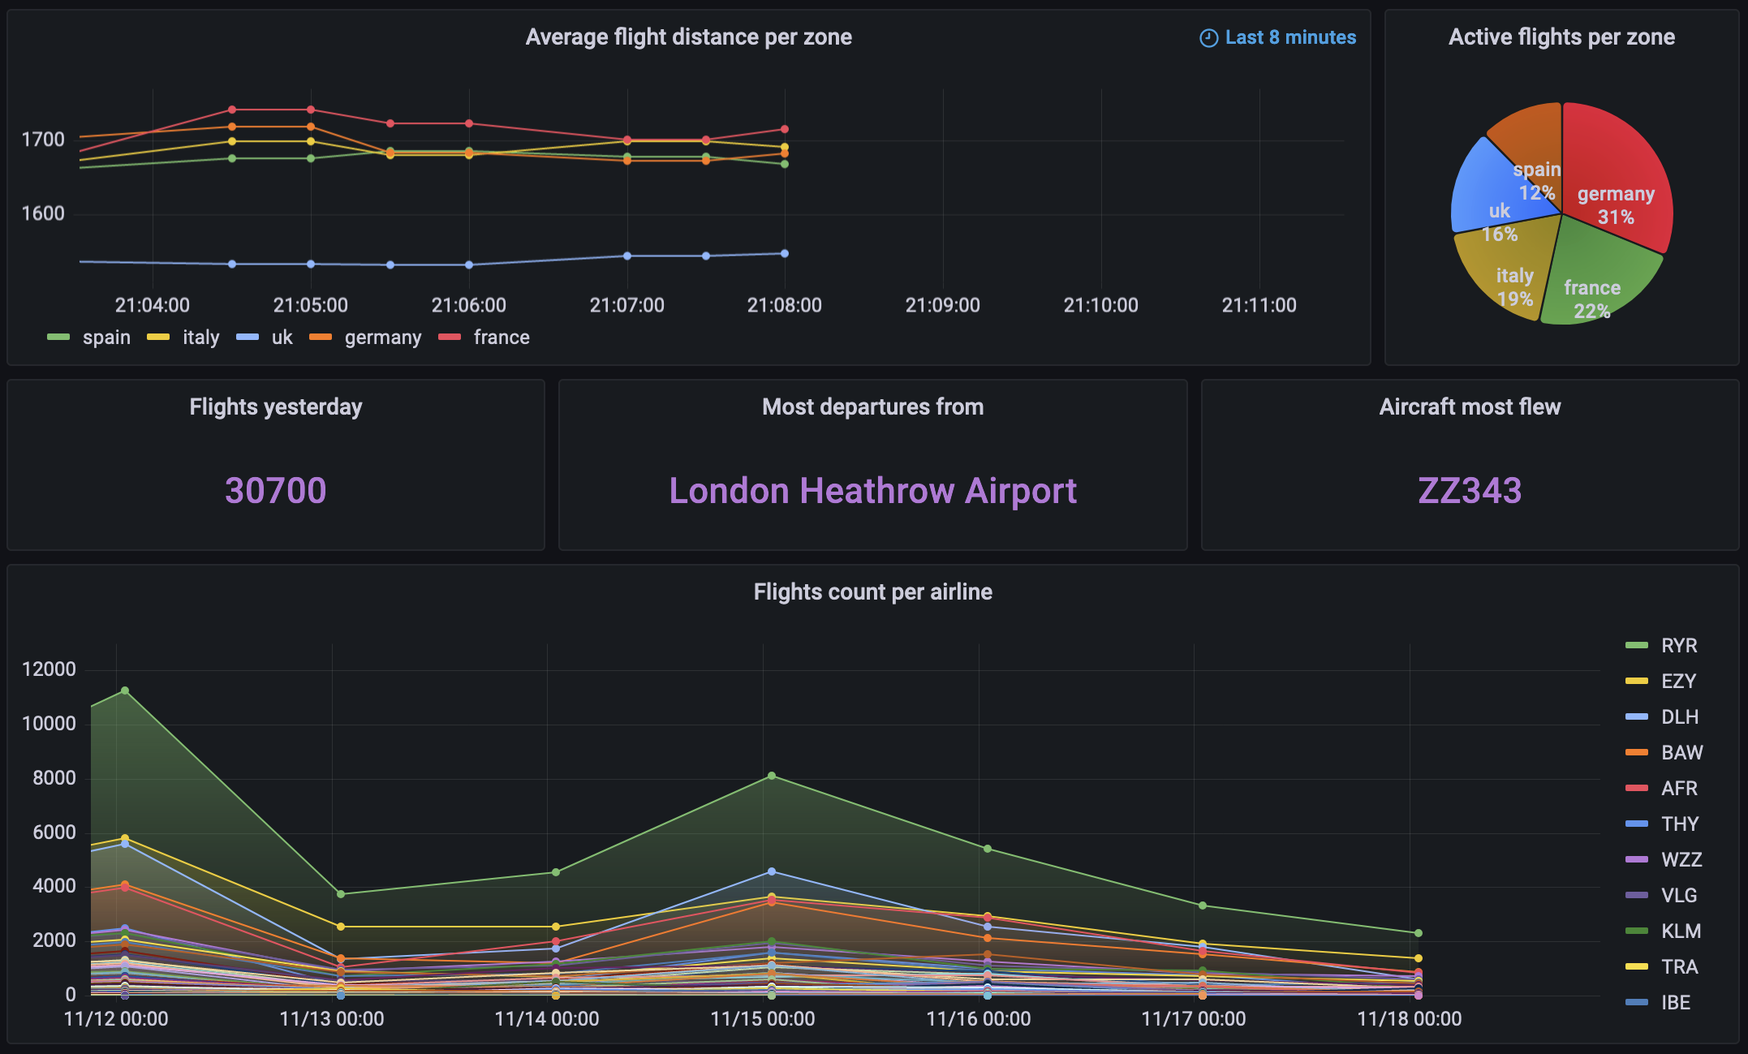
Data Visualization |

Slide 11
See README.md for documentation and quickstart.
See QUERY.md for more information about the queries performed.

Slide 12
LorenzoTarcinaleInformationSystemsforBigData
UniSa2022

