Slide 1
Meridian AI Platform
Meridian Advisors

Slide 2
The Challenge
Commercial real estate advisors spend excessive time on repetitive tasks.
Drafting standard emails and deal memos
Searching through past interactions for precedent
Formatting presentations to strict brand standards
Solution: An AI co-pilot embedded directly into the firm's M365 workflow.

Slide 3
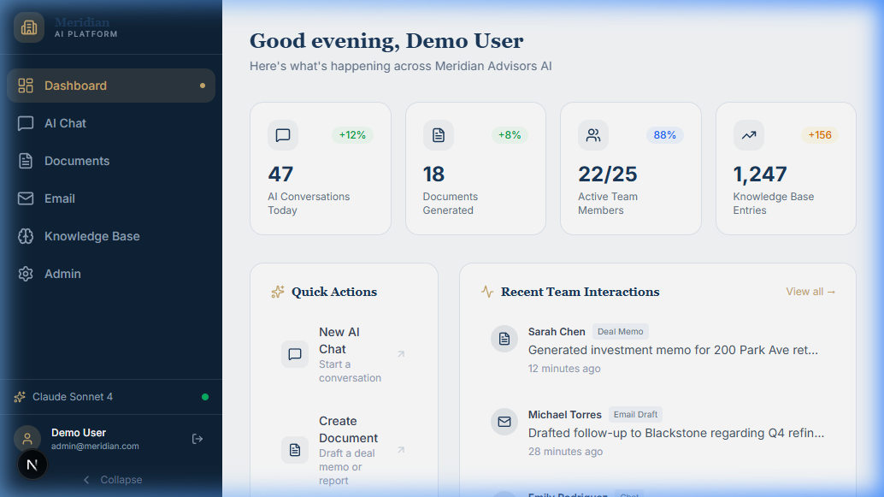
Phase 1: Foundation
Built a secure, LLM-agnostic architecture integrated with Microsoft 365.
Entra ID Single Sign-On (SSO) for security
Microsoft Graph API integration for Word and Outlook
Agnostic Router: Swap between Claude 3.5 Sonnet and OpenAI instantly
Version-controlled, locked system prompt to ensure professional tone

Slide 4
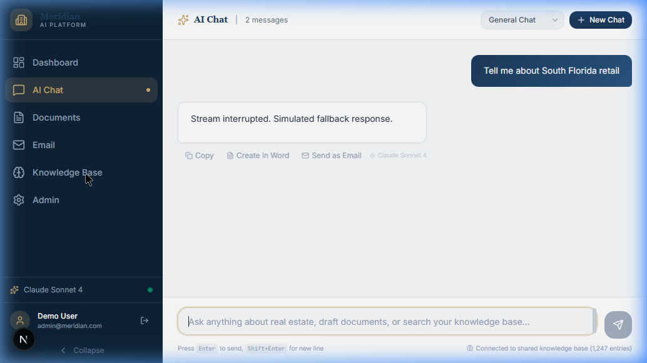
Phase 2: The Memory Layer
Transformed isolated AI chats into a shared organizational brain.
Interaction Logging: All AI chats automatically saved to Cosmos DB
Vectorization: Content embedded using OpenAI text-embedding-3-small
Retrieval-Augmented Generation (RAG): Azure AI Search retrieves past knowledge
Result: The AI gets smarter and learns firm conventions over time

Slide 5
Phase 3: Production Lock-in
Expanded capabilities while locking down security and brand identity.
Advanced M365: Automated generation of PowerPoint decks and Excel models
Branded Output: Hardcoded firm templates (colors, fonts, logos) into exports
Role-Based Access Control (RBAC): Admin panels restricted via JWT claims
Data Loss Prevention (DLP): Strict guardrails against hallucinating or leaking PII

Slide 6
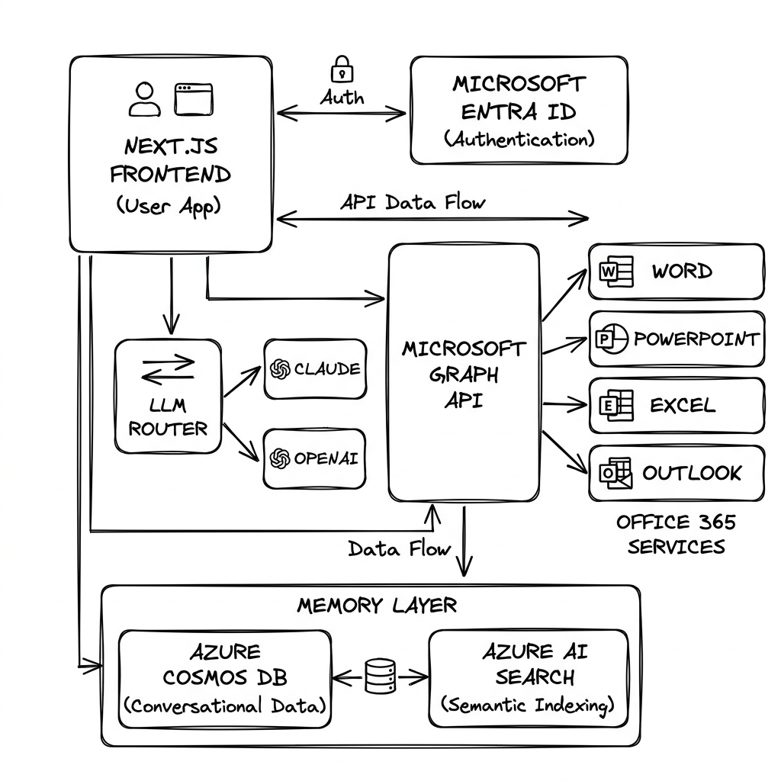
Technical Architecture
Built on modern, enterprise-grade cloud technologies.
Frontend: Next.js 15, React 19, Tailwind CSS 4
Backend: Node.js Edge runtime, Azure AI Search, Cosmos DB
Security: Microsoft Entra ID (OBO flow), strict CORS, RBAC
Infrastructure: Fully automated deployment via Azure Bicep templates

Slide 7
Source Code
Review the full architecture and implementation details on GitHub:
https://github.com/lorenzouriel/m365-ai-ecosystem.git

