Slide 1
DISTRIBUTED SYSTEMS
OMNeT
C++
FAULT-TOLERANT DATAFLOW PLATFORM

Slide 2
OUR GROUP
Lorenzo Torri 10682199
Giorgio Vergona 10933247
Valentina Villa 10705748

Slide 3
TABLE OF CONTENTS
01
About the Project
04
Failure Management
02
Assumptions
05
Data Analysis
03
Algorithm
General functioning, main goals and constraints
Deeper dive in case of failures and how to handle them
Examining the underlying assumptions of the system
Study of performance and results generated by the platform
Implementation of the distributed dataflow platform

Slide 4
ABOUT THE PROJECT
Platform for processing <key,value> pairs
Operators:
map(f: int→int): input <k,v>, output <k,f(v)>
changeKey(f: int→int): input <k,v>, output <f(v),v>
reduce(f: list<int>→int): input list<v> of a single k, output <k,f(v)>
JSON format provided as input to the Coordinator, specifying a long sequence of operators and the number of partitions
Input data stored in CSV file
Operators executed in parallel over multiple partitions of input data
Fault-tolerance mechanisms
Implementation and simulation through OMNeT++

Slide 5
INPUT FORMAT
{
"partitions": 9,
"instructions":
["map(ADD(5))",
"change(MUL(2))",
"map(SUB(3))",
"reduce()"]
}
The sequence of operations is expressed in a JSON format alongside the number of partitions in which the input data must be splitted into.
The map and change operators must have one of the following parameters, which represents the operation to be executed:
ADD(int)
MUL(int)
SUB(int)
DIV(int)
KEY
VALUE
5
23
2
15
The input data is stored inside a CSV file where each line represents a <k,v> tuple
7
9
9
66

Slide 6
ASSUMPTIONS
Workers may fail, Coordinator is reliable
Links reliable
Scheduling approach
Workers rely on local durable storages only for input data whereas intermediate results are lost if the Worker fails
System relies on a durable non-faulty storage where the latest version of data is stored
Workers may fail only after receiving an heartbeat from the Coordinator and before replying with an ACK
Coordinator stops sending heartbeats to the Workers, until the recovery of a failed Worker has finished
Final operator of the sequence must always be a reduce

Slide 7

GLOBAL DURABLE STORAGE
Since one of our assumptions was to have a global durable storage to store intermediate results at the end of each operator, we opted, instead of using the local memory of the Coordinator, for an external node used as a datastore
This is a design choice in order to reduce the number of messages flowing to the Coordinator and the workload on this node. The drawback is the increase of the number of messages in the overall network
This implementation is quite useful since the links are reliable and the increase of the number of messages is not a heavy burden, given our assumptions. This choice turns out to be effective for a faster computation on the Coordinator

Slide 8

THE NETWORK

Slide 9
ALGORITHM
DATA SETUP
Coordinator receives in input a CSV and a JSON file
Based on the number of partitions and on the size of the CSV file the Coordinator equally splits input data in the given number of partitions
Coordinator sends partitions to the data storage
Data storage saves partitions in different portions of memory each with a progressive index.

Slide 10
ALGORITHM
INDEX SPLIT & DATA RETRIEVAL
Based on the number of partitions and on the number of available Workers, the Coordinator assigns one or more indexes to each worker
Coordinator sends to each Worker the indexes associated to them, and also the operator to apply
Each Worker retrieves from the data storage the partitions associated with the indexes received at the previous step
op
op
idx1
idx2

Slide 11
ALGORITHM
DATA PROCESSING
Each Worker applies the operator received from the Coordinator to every single tuple of all the partitions
When a partition is completely processed, then the Worker sends:
An ACK to the Coordinator
The processed partition to the data storage, in order to overwrite the old version
Once a partition is sent to the data storage, the new partition is durable, and in case of a Worker failure, it is not rescheduled
ACK
ACK
op
op

Slide 12
ALGORITHM
FOLLOWING OPERATORS
When the Coordinator receives a number of ACK equals to the number of partitions, the operator has finished its execution on all data so the Coordinator starts again the operations of INDEX SPLIT & DATA RETRIEVAL for the next operator since some of the previous active nodes may have failed
This cycle continues until the last operator, which is, for our assumptions, always a reduce

Slide 13
ALGORITHM
REDUCE
Coordinator, based on the number of active Workers N, sends out to each one of them a progressive index, from 0 to N-1 and the reduce operator
Each Worker retrieves from the data storage all the tuples such that
key%N==i
When a partition is completely processed, then the Worker sends:
An ACK to the Coordinator
The processed partition to be saved on the data storage
Once a partition is sent to the data storage, the new partition is durable, and in case of a Worker failure, it is not rescheduled
reduce
reduce
i1
i2
ACK
ACK

Slide 14



FAILURE MANAGEMENT
HEARTBEATS
Start Recovery
Coordinator sends periodically to each Worker an heartbeat
Each Worker can reply to the heartbeat with an ACK, or can lose the packet, simulating a failure
After a certain timeout, the Coordinator checks if the number of ACK received is equal to the number of heartbeat sent, if so it starts again from point 1. Otherwise a failure recovery procedure starts
heartbeat
heartbeat
Message
Lost
ACK

Slide 15
FAILURE MANAGEMENT
RECOVERY
Coordinator stops sending heartbeats until the recovery process has finished (one of the assumptions)
Coordinator sends to the failed Workers a failure operation message, in order to retrieve the partitions not yet processed by the Worker with the corresponding index
Each failed Worker:
If it already has the partitions, it sends them back to the Coordinator with a failed partitions message
Otherwise, it waits for its partitions from the data storage, and then it sends the failed partitions message to the Coordinator
failure operation
idx

Slide 16
FAILURE MANAGEMENT
RESCHEDULING
Once the Coordinator has received all the failed partitions, the rescheduling operation starts
Coordinator sends to an active node (one of the nodes that has replied to the heartbeat message) an additional partitions message, with all the failed partitions with the corresponding indexes
When this recovery operation finishes, the Coordinator starts again sending heartbeats, only to the active Workers
idx

Slide 17
FAILURE MANAGEMENT
RESTARTING
Once the recovery phase has finished, and the normal flow of operations started again, each failed Worker starts a recovery phase
When a failed Worker is alive again, it sends to the Coordinator an alive message
The Coordinator adds to the list of active Workers also the one from which has received the alive message
From the next cycle, the Coordinator will send also to this Worker a heartbeat message
alive

Slide 18
FAILURE MANAGEMENT
LIMIT CASE
Sometimes it might happen that all the Workers in the network fail during the same heartbeat cycle
In this situation the Coordinator retrieves, as shown before, all the failed partitions
When the Coordinator must decide who to send the failed partitions, since no Worker is still alive, it keeps them and waits
As soon as one of the failed Worker send to the Coordinator the alive message, then the Coordinator will send to it all the failed partitions of previous cycle
alive

Slide 19
DATA ANALYSIS
For the Data Analysis we decided to gather different performance indices of the network by varying the number of Workers and the probability of failure

Slide 20
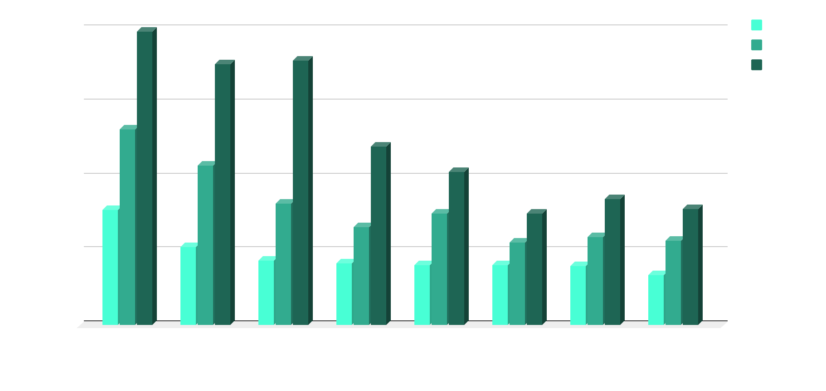
DATA ANALYSIS
We look at the total execution time of each simulation, varying the number of Workers and the probability of failure of each node (0%, 0.05%, 0.15%)

Slide 21
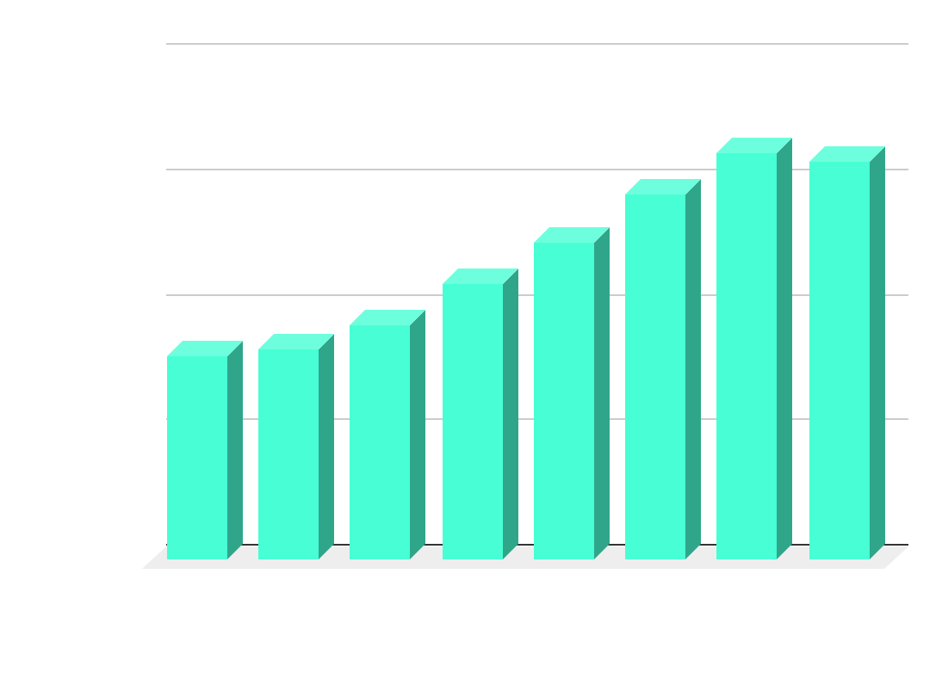
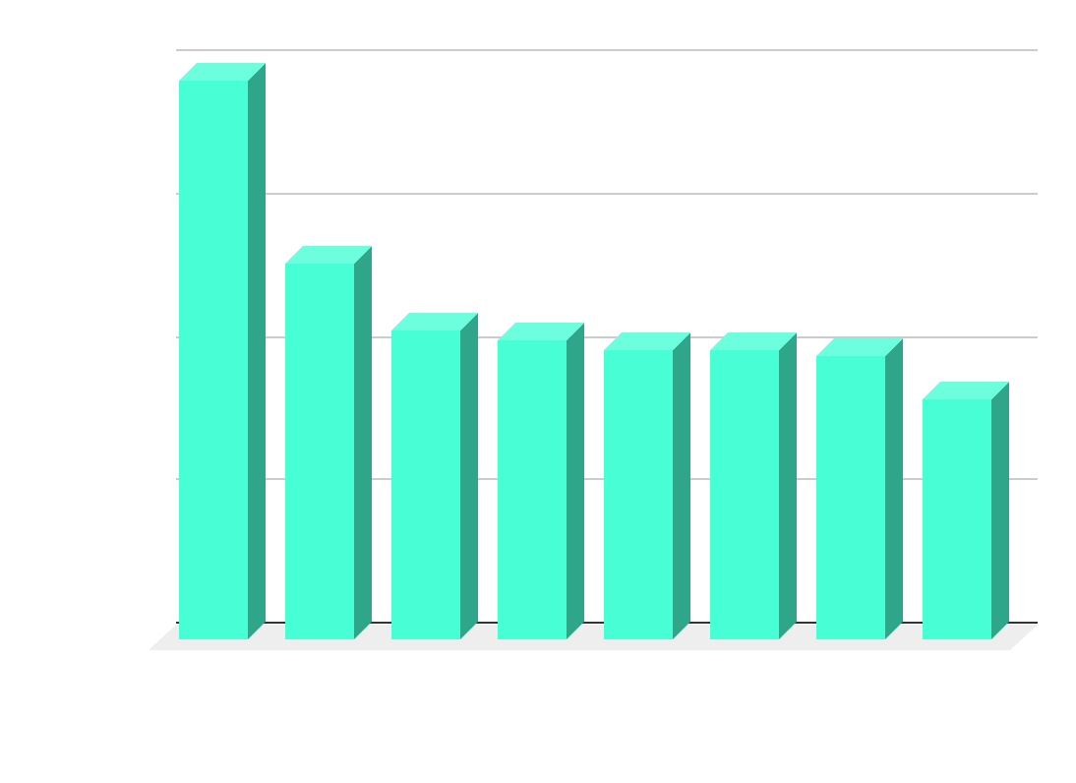
DATA ANALYSIS
When there are no failures in the network, even if the total number of messages increases, still the execution time decreases

Slide 22
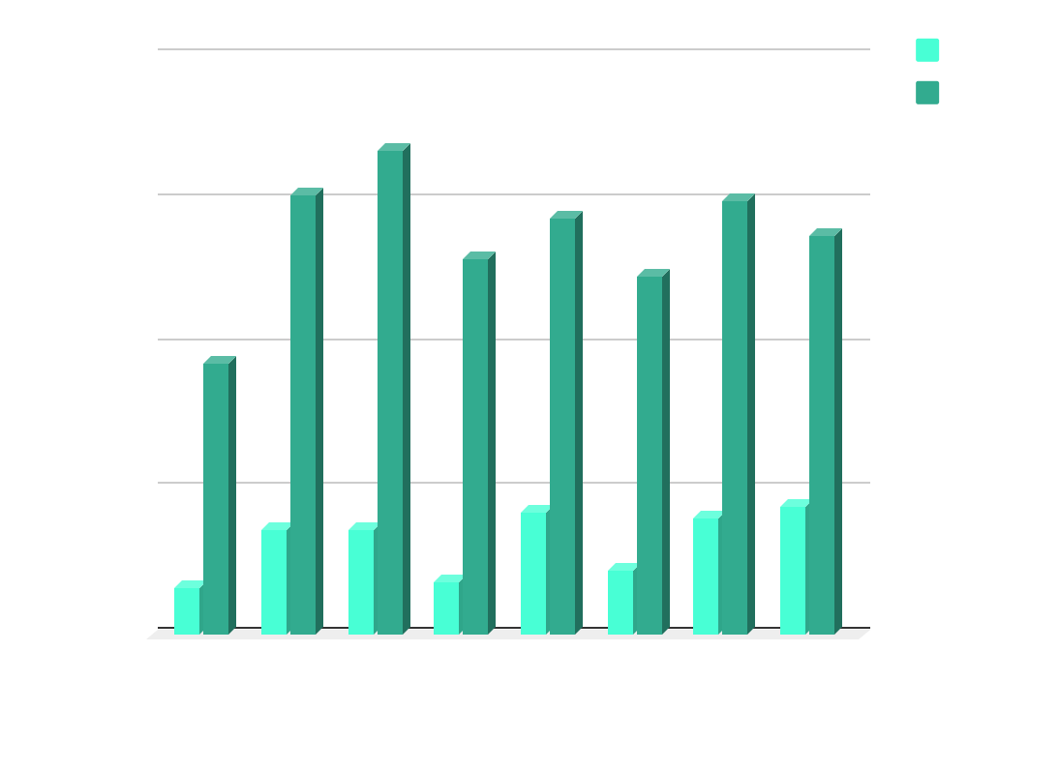
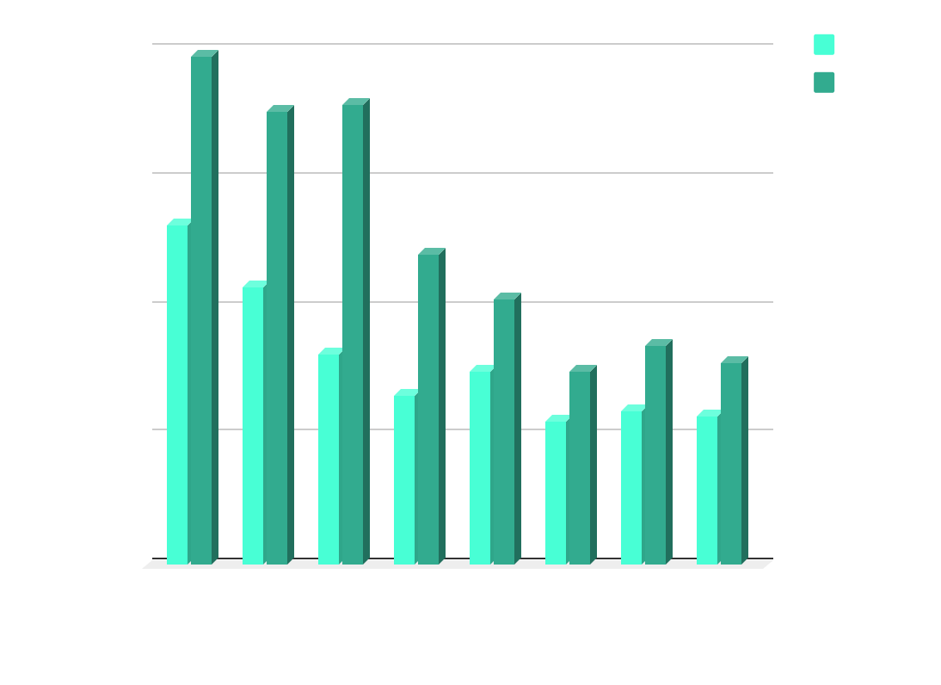
DATA ANALYSIS
In the presence of failures, we can focus on the execution time of each simulation, looking at the total number of failures that occurred

Slide 23

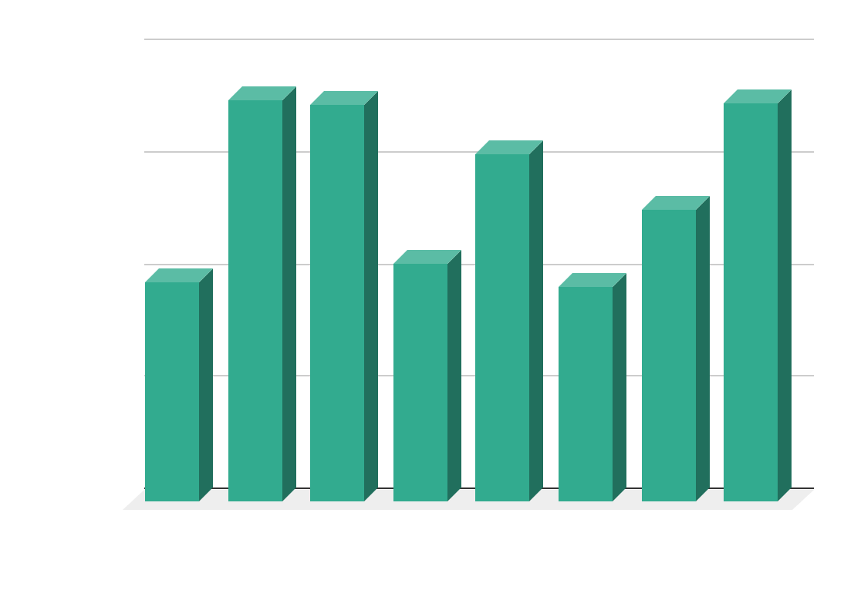
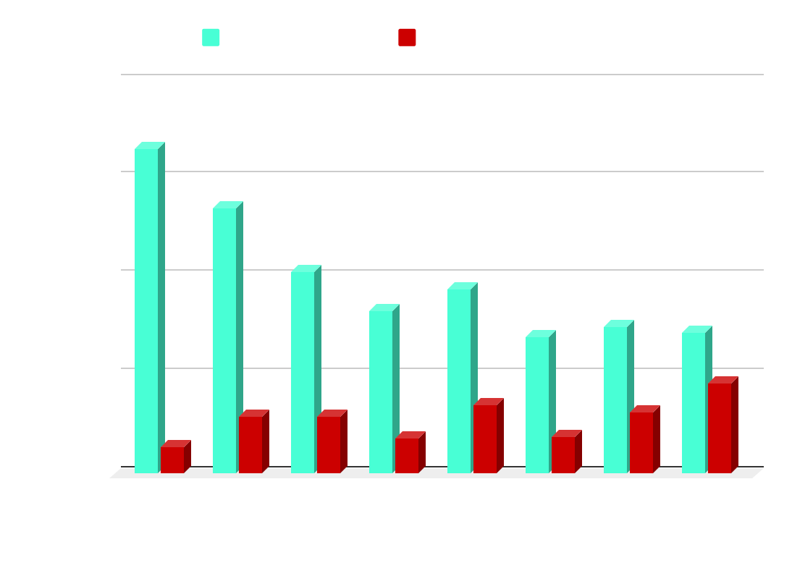
DATA ANALYSIS
We consider the case of 0.05% of failure: looking at the total time that nodes stay down (total failure time), and the mean percentage of time that each node spends in a failed state with regards to the overall execution time

Slide 24
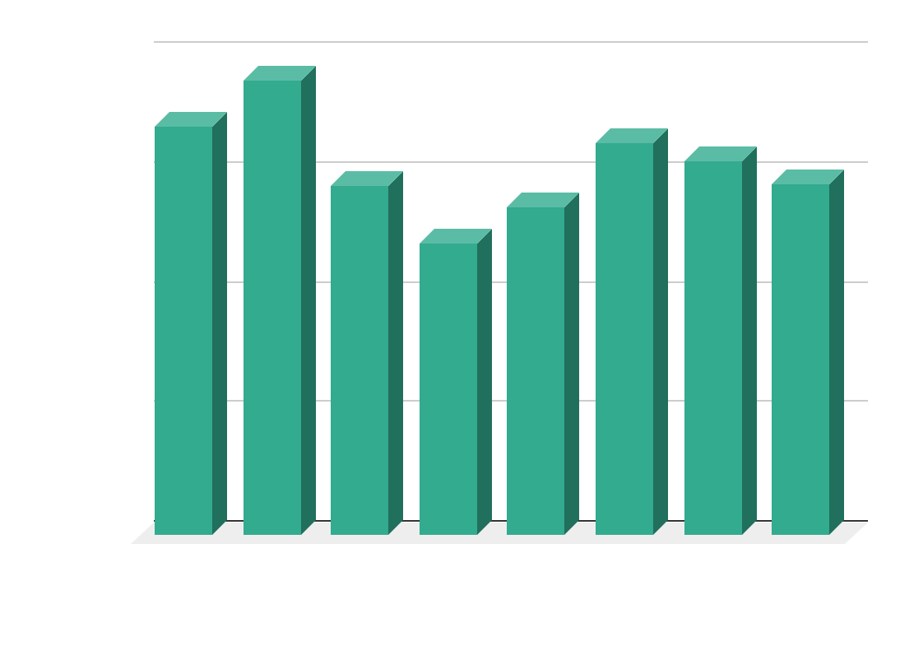
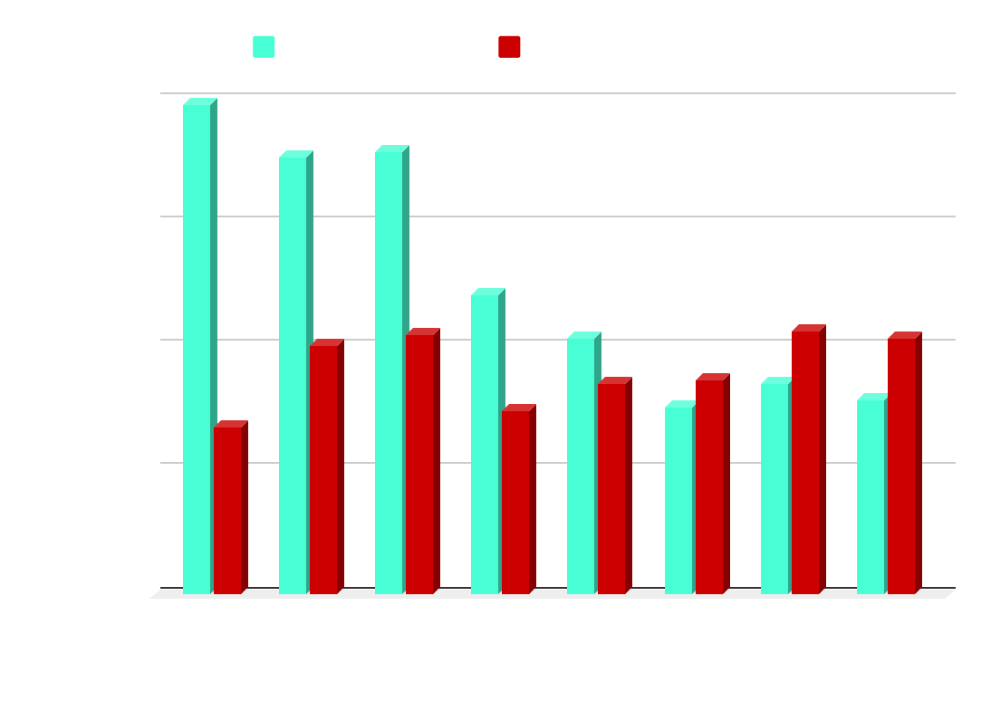
DATA ANALYSIS
Same situation as before, but looking at a 0.15% failure probability

Slide 25

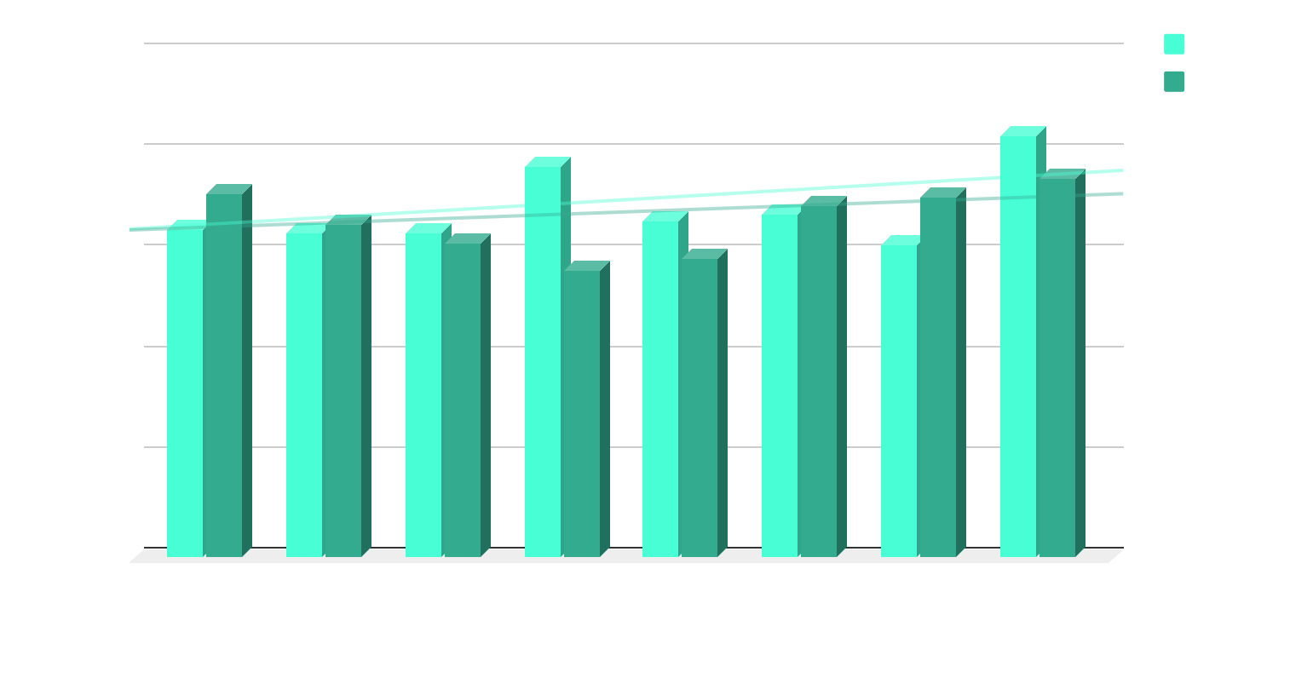
DATA ANALYSIS
We decided also to look at the mean recovery time workers take to get back to life, both for 0.05% case and 0.15% case. As it is shown by the graph, this metric seems not to be influenced by the probability of failure and the number of workers, thus in both cases is around 7s

Slide 26
THANKS!
OMNeT
C++
If there is any question please (don’t) ask!
https://github.com/valentinavilla/progettoDS
lorenzo1.torri@mail.polimi.it
giorgio.vergona@mail.polimi.it
valentina5.villa@mail.polimi.it

