Slide 1
Capstone Project
Machine Learning Fundamentals
Lori R Bard
4 March 2019

Slide 2
Table of Contents
Exploration of the Dataset
Question to Answer
Augmenting the Dataset
Classification Approaches
Regression Approaches
Conclusions – Next Steps

Slide 3
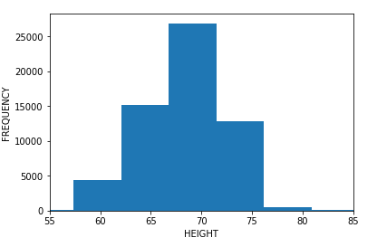
Exploration of the Dataset
Graph of Height vs Frequency in the Population
There is a clear average around 68
Used this graph to categorize the population on a scale of 1 to 5

Slide 4
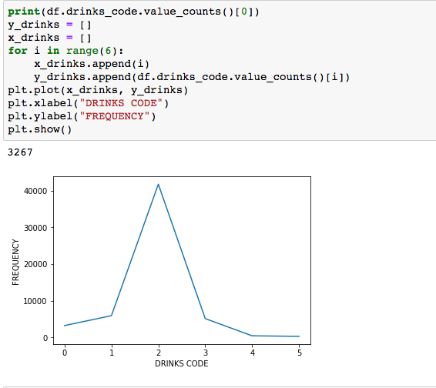
Exploration of the Dataset
Looking at the frequency of drinking for the population.
Used the code “drink_mapping = {"not at all":0, "rarely":1, "socially":2,
"often":3, "very often":4, "desperately":5}”
To quantify the qualitative data. Clearly, most drink socially.

Slide 5
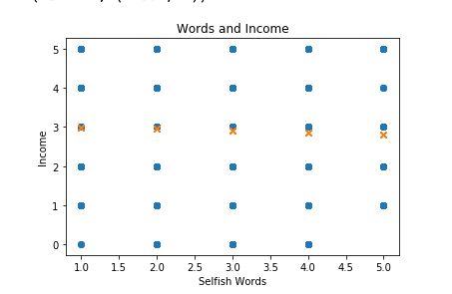
Exploration of the Dataset
Graph of Self Asserting Words vs Income
Self Asserting Words refer to the frequency that the words I, I’m , Me, My and Have are used in the persons essays. I used all the essays for each person.
Income was categorized in levels, 1 being low income and 5 being high income
There doesn’t seem to be much of a relationship between the two but let’s explore further.

Slide 6
Question to Answer
Can I predict the income of a person based on their height, perceived body type, and self image (use of “self” words)?
We tend to think that tall people with good self images, who think highly of themselves, will have higher income. Is this true?

Slide 7
Augmenting the Data
This was BY FAR the most difficult part of the project.
First of all, I had to eliminate almost all the participants that didn’t answer the “income” question, so my data went from 59,943 participants to 11,504.
I kept getting key errors and had to use a bunch of try/except in my code
I got rid of all NaN’s
I converted the height, body, self assurance and income numbers to scales between 1 and 5.

Slide 8
“Self” words mapped to values in the code above
count = 0
self_words = []
chosen_words = ["i'm", 'i','me','my','have']
data_range = len(df)
j = 0
while j < data_range:
try:
all_essays_j = all_essays[j]
all_essays_j.split()
essay_len = len(all_essays_j)
if essay_len > 0:
for word in all_essays_j:
if word.lower() in chosen_words:
count += 1
percent_self = (count * 100)/essay_len
else:
percent_self = 0 self_words.append(percent_self)
count = 0
j += 1
except KeyError:
self_words.append(0)
count = 0
j += 1
count = 0
for j in range(len(self_words)):
if self_words[j] > 13:
count += 1
self_words[j] = 13

Slide 9
“Height” mapped to values in the code above
tall = [73,74,75,76,77,78,79,80,81,82,83,84,85,86,87,88,89,90,91,92,93,94,95]
pretty_tall = [69,70,71,72]
average = [64,65,66,67,68]
short = list(range(64))
print(df.height.head())
print(len(df.height))
height_range = len(df.height)
print(height_range)
height_mapping = []
for i in range(height_range):
try:
height = int(df.height[i])
if height in tall:
height_mapping.append(5)
elif height in pretty_tall:
height_mapping.append(4)
elif height in average:
height_mapping.append(2)
else:
height_mapping.append(1)
except KeyError:
height_mapping.append(0)
df["height_code"] = height_mapping
print("DF HEIGHT HEAD",df.height.head(),"DF HEIGHT MAPPING CODE HEAD", df.height_code.head())
# print("HEIGHT MAPPING CODE HEAD",df.height_mapping_code.head())

Slide 10
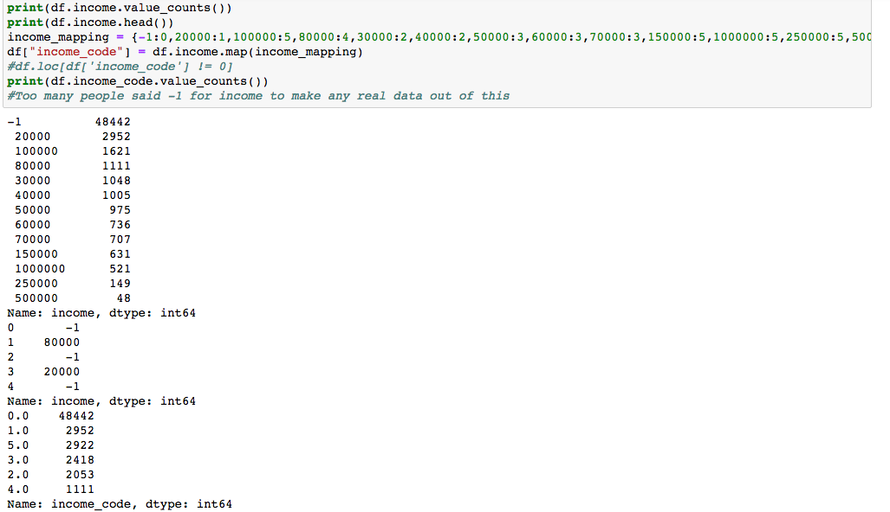
Income mapped to values. If the income value was -1, I gave it a value of 0. I did not use any of the points where income_code is 0.

Slide 11
Classification Approaches
1. K- Nearest Neighbor Classificaiton
2. Support Vector Machine (SVC)

Slide 12
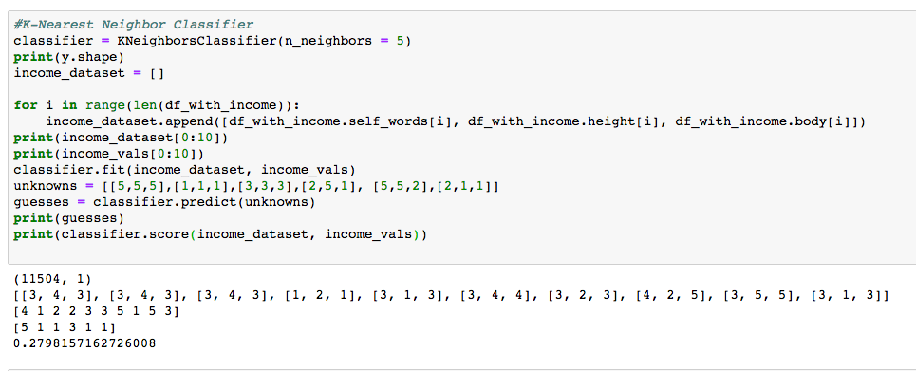
K-Nearest Neighbor Classification
Well, the score came out pretty low. It doesn’t seem like it’s possible to
predict someone’s income dependent on how they talk, how tall they
are, and their body image.

Slide 13
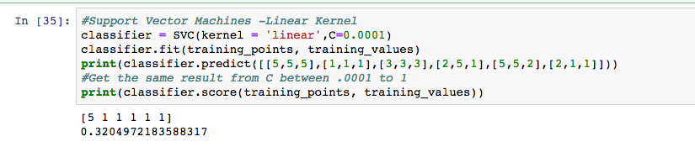
Support Vector Machine
Well, the score came out pretty low, although slightly higher than using
K-Nearest Neighbor. Again, it doesn’t seem like it’s possible to predict
someone’s income dependent on how they talk, how tall they are,
and their body image.

Slide 14
Regression Approaches
Multiple Linear Regression
K Nearest Neighbor Regressor

Slide 15
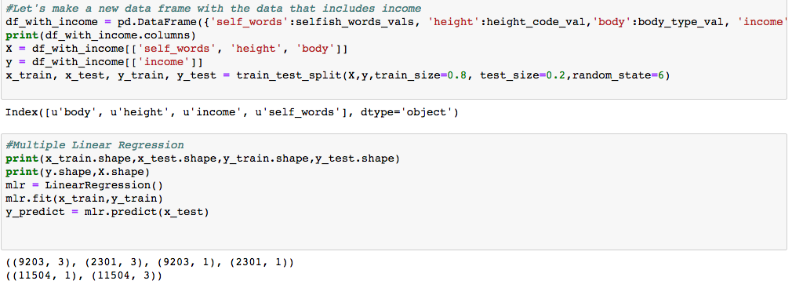
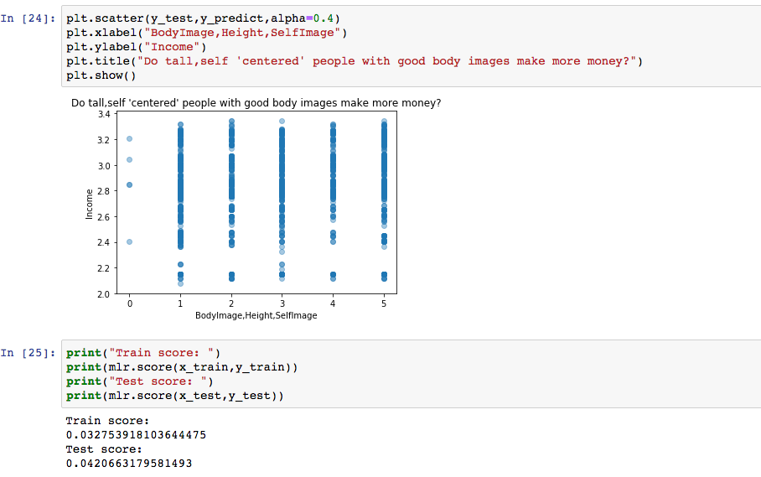
Multiple Linear Regression
The score for Multiple Linear Regression is also very low. Again, it
Doesn’t seem possible to predict income based on body image, words used,
Height.

Slide 16
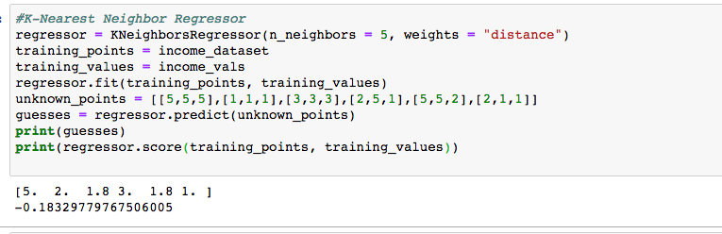
K-Nearest Neighbour Regressor
The only thing that’s consistent, is that we don’t seem to be able to
Predict a person’s income by their body image, height or vocabulary.

Slide 17
Conclusions
I tried to answer the question, “If a person is tall, has a good body image, and uses certain words usually associated with people with a good self image, will they earn more money?”
The answer seems to be “NO”
I could not predict the income better than random alone.
When mapping categorical data to numerical data, the way categories are organized can have a big influence on the result. For example, for body image, I had to choose numbers for good and bad body image based on my own biases.
My question was basically a classification question, and classification methods resulted in slightly better results.
It would be interesting to look at different words used. For instance, if someone uses longer words, are they more likely to earn more money?
Making the data clean was a huge undertaking. Removing all the NaN’s, key errors, and only using the data with income values was a big job. I ended up using only about 20% of the data, because I wanted to track to income numbers, and not many respondents answered that question.

Slide 18
My Code
My code, in it’s entirety, resides at https://github.com/loribard/MachineLearningFundamentals

