Slide 1
Aqua Mundo Behaviours
Product Intelligence

Slide 2
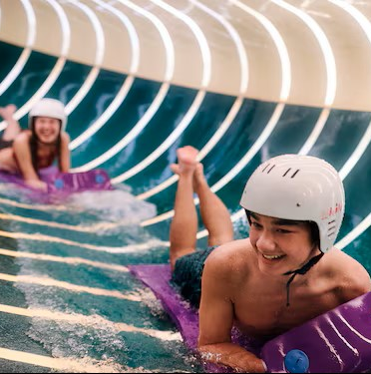
Objectives, scope and methodology of the survey
Objectives of the study
Identify the strengths and irritants of the Aqua Mundo experience according to customers to improve their satisfaction.
Survey Methodology
Integration into the EQS of a structured mini-questionnaire with open and closed questions for quantitative and qualitative analysis.
Geographical scope and sample
Study covering the five countries (BNGFD) with more than 10,500 respondents for a diversified and reliable analysis. Analysis time period : Nov 2025 – April 2026.
Customer Data Analytics
Fine reading of customer behaviors and verbatims to understand emotions, frustrations and expectations expressed.

Slide 3
Survey Questions
How many times did you visit Aqua Mundo during your stay?
I haven't visited it
Once during the stay
Once a day
Several times a day
Why didn't you go to Aqua Mundo?
You have visited Aqua Mundo :
In group
Individaully
What do you like most about Aqua Mundo?
What did you miss or could be improved at Aqua Mundo?

Slide 4
General Observations
Only 3% of respondents do not visit the Aqua mundo for FR VS 10% BE, 13% NL, 7% DE and 1% DK
Senior 75> and Senior active 55-74 have the highest % of respondents who do not visit the Aqua mundo for all BNGFD
Familes with Children 12-17 and 5-11 visit more the aqua mundo than Familes with Children 0-2 and 3-4, no matter how often (once during the stay, once a day or several times a day.)
Repeaters and trialist are aligned : there’s not really a big difference between the frequency of visit for the two (< 5% diff)
FR parcs have the highest % of respondents who visit the Aqua Mundo several times a day no matter the family structure or if they are trialists or repeaters (33% FR vs 6% DE, 10% BE, 7% NL & 13% DK)
Parc Sandur has the highest % of respondents who do not visit the Aqua mundo during thier stay (40.2%)
The higher the offer on the parc’s aqua mundo, the more the aqua mundo is visited

Slide 5
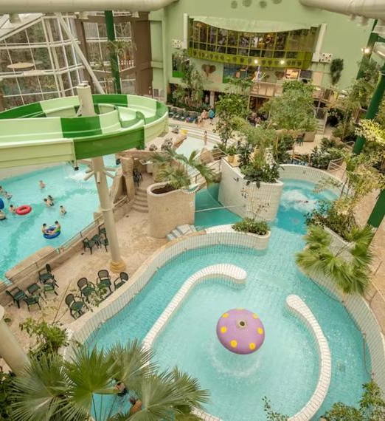
Frequency of visits and central role of the Aqua Mundo
Frequency of visits
73.2% visit Aqua Mundo every day or +
59.5%: visit 1 time/day 13.7%: visit several times a day
18.6%: visit 1 time during the stay 8.2%: do not visit Aqua Mundo
Mode of visit
81.6% in groups (mostly family) 18.4% alone
Key Insights : The Aqua Mundo is a pillar of the Center Parcs experience 91.8 % visit the aqua mundo atleast once during the stay

Slide 6
Frequency of visits (Country analysis)
92% (19% + 60% + 14%) visit the the Aqua Mundo atleast once during the stay
Country CP | I haven't visited it | Once during the stay | Once a day | Several times a day | Total
Belgium | 10% | 19% | 61% | 10% | 1842
Denmark | 1% | 18% | 68% | 13% | 171
France | 3% | 11% | 54% | 33% | 2584
Netherlands | 13% | 22% | 58% | 7% | 3085
Germany | 7% | 22% | 64% | 6% | 2833
Total | 8% | 19% | 60% | 14% | 10515
FR has the highest % of guests who visit the aqua mundo several times a day (33%)
NL has the highest % of guests who do not visit the aqua mundo during their stay (13%)
NL has the highest number of respondents

Slide 7
Frequency of visits (Parcs Analysis)
Site | I haven't visited it | Once during the stay | Once a day | Several times a day | Total
Bispinger Heide | 6,7% | 18,1% | 68,4% | 6,8% | 586
De Eemhof | 8,2% | 17,0% | 62,9% | 11,8% | 364
De Huttenheugte | 9,3% | 19,7% | 62,5% | 8,6% | 421
De Kempervennen | 10,2% | 17,9% | 64,8% | 7,1% | 420
De Vossemeren | 6,0% | 12,8% | 67,8% | 13,4% | 367
Erperheide | 5,8% | 12,9% | 70,1% | 11,1% | 395
Het Heijderbos | 6,0% | 19,1% | 67,5% | 7,3% | 465
Het Meerdal | 13,6% | 22,6% | 57,5% | 6,3% | 367
Kempense Meren | 5,5% | 16,9% | 62,3% | 15,3% | 183
Le Bois aux Daims | 1,4% | 5,0% | 47,5% | 46,1% | 436
Le Lac d'Ailette | 2,7% | 8,2% | 60,3% | 28,8% | 330
Les Ardennes | 5,5% | 27,2% | 60,4% | 6,9% | 217
Les Bois-Francs | 2,0% | 7,5% | 49,7% | 40,8% | 441
Les Hauts de Bruyères | 2,6% | 8,5% | 53,1% | 35,8% | 388
Les Landes de Gascogne | 1,7% | 8,5% | 51,9% | 37,9% | 235
Les Trois Forêts | 3,4% | 14,9% | 63,0% | 18,7% | 443
Limburgse Peel | 16,0% | 30,7% | 49,5% | 3,8% | 212
Nordborg Resort | 1,2% | 17,5% | 68,4% | 12,9% | 171
Oostduinkerke aan zee | 14,9% | 21,4% | 53,2% | 10,4% | 154
Parc Sandur | 40,2% | 38,5% | 20,5% | 0,9% | 117
Park Allgäu | 4,9% | 18,6% | 69,1% | 7,4% | 834
Park Bostalsee | 9,2% | 17,5% | 63,7% | 9,5% | 325
Park De Haan | 12,0% | 18,3% | 59,4% | 10,3% | 350
Park Eifel | 9,8% | 36,9% | 50,0% | 3,3% | 336
Park Hochsauerland | 7,0% | 24,5% | 66,0% | 2,5% | 473
Park Nordseeküste | 9,3% | 26,5% | 58,1% | 6,1% | 279
Park Zandvoort | 24,7% | 27,7% | 44,6% | 3,0% | 336
Port Zélande | 13,6% | 21,1% | 59,5% | 5,7% | 383
Terhills Resort | 26,7% | 31,8% | 39,2% | 2,3% | 176
Villages Nature Paris | 5,5% | 25,4% | 51,4% | 17,7% | 311
Total | 8,2% | 18,6% | 59,5% | 13,7% | 10515
Majority of guests visit the aqua mundo once a day (6261 repondents which represents 59,54 % of total respondents)
EP has the highest % of respondents who visit the aqua mundo once a day (70.1)
BD receives the highest % of respondents who visit the Aqua Mundo several times a day (46.1%)
BD’s Aqua Mundo experience is very appreciated
SR receives the highest % of respondents who did not visit the Aqua Mundo (40.2%)

Slide 8
Frequency of visits (Household Structure (01/03/2026 – 30/04/2026))
Majority of guests visit the aqua mundo once a day (1415 repondents which represents 61.1 % of total respondents)
Household structure | I haven't visited it | Once during the stay | Once a day | Several times a day | Total
Adults 35-54 | 15,9% | 25,9% | 47,1% | 11,2% | 170
Family with Children 0-2 | 7,7% | 26,9% | 61,5% | 3,8% | 52
Family with Children 12-17 | 3,1% | 12,3% | 66,7% | 17,9% | 357
Family with Children 3-4 | 4,4% | 14,0% | 71,1% | 10,5% | 114
Family with Children 5-11 | 0,7% | 15,4% | 72,7% | 11,1% | 557
Not registered | 6,1% | 18,6% | 60,3% | 15,0% | 521
Seniors Active 55-74 | 18,0% | 22,8% | 49,5% | 9,6% | 438
Seniors>75 | 31,0% | 14,3% | 52,4% | 2,4% | 42
Young Adults 18-34 | 9,4% | 37,5% | 40,6% | 12,5% | 64
Total | 7,8% | 18,6% | 61,1% | 12,4% | 2315
Seniors >75 have the highest number of respondents who do not visit the Aqua Mundo (31%)
Young adults 18-34 have the highest % of respondents who visit the Aqua Mundo once during the stay (37.5%)
Families with Children of 5-11 have the highest % of respondents who visit the Aqua Mundo once a day (72.7%)
Families with Children of 12-17 have the highest % of respondents who visit the Aqua Mundo several times a day (17.9%)

Slide 9
Frequency of visits (Trialist / Repeater)
Majority of guests visit the aqua mundo once a day (6261 repondents which represents 59,5 % of total respondents)
Repeaters have the highest % of respondents who visit the aqua mundo once a day (62% VS 56% for trialists)
New Customer (T) | I haven't visited it | Once during the stay | Once a day | Several times a day | Total
A | 8,0% | 16,9% | 58,1% | 17,1% | 539
R | 8,7% | 17,2% | 61,5% | 12,6% | 6502
T | 7,1% | 21,5% | 56,2% | 15,2% | 3474
Total | 8,2% | 18,6% | 59,5% | 13,7% | 10515
Trialists visit more several times in a day the Aqua mundo than Repeaters (15.2% >12.6%)
There’s not a huge gap between the Trialists and repeaters (1 – 2% difference)
91% of guests visit the aqua mundo atleast once, no matter if they Trialists ou Repeaters

Slide 10
Household Structure / Trialist-Repeater (Germany)
Household structure | I haven't visited it | Once during the stay | Once a day | Several times a day | Total
Adults 35-54 | 21% | 30% | 45% | 4% | 213
Family with Children 0-2 | 7% | 30% | 59% | 4% | 46
Family with Children 12-17 | 5% | 18% | 73% | 4% | 95
Family with Children 3-4 | 4% | 20% | 70% | 6% | 104
Family with Children 5-11 | 0% | 16% | 78% | 6% | 295
Not registered | 3% | 21% | 69% | 7% | 1559
Seniors Active 55-74 | 19% | 26% | 50% | 4% | 390
Seniors>75 | 36% | 8% | 52% | 4% | 25
Young Adults 18-34 | 12% | 36% | 44% | 8% | 89
Total | 7% | 22% | 64% | 6% | 2833
Seniors >75 are those who visit the least the Aqua mundo (36%) followed by seniors active 55-74 (19%)
Families with children 5-11 have the highest % who visit the aqua mundo once a day (78%)
Repeaters tend to visit more the Aqua mudo once a day than Trialists (67% vs 59%), while Trailists tend to visit more once during the stay (28% vs 20%)
New Customer (T) | I haven't visited it | Once during the stay | Once a day | Several times a day | Total
A | 12% | 17% | 65% | 6% | 104
R | 7% | 20% | 67% | 6% | 1808
T | 7% | 28% | 59% | 6% | 921
Total | 7% | 22% | 64% | 6% | 2833
AG’s aqua mundo is the most visited (at least once) as well as the highest number of respondents who do not visit the aqua mundo during their stay

Slide 11
Household Structure / Trialist-Repeater (Belgium)
Seniors >75 are those who visit the least the Aqua mundo (31%) followed by seniors active 55-74 (19%)
Household structure | I haven't visited it | Once during the stay | Once a day | Several times a day | Total
Adults 35-54 | 15% | 29% | 48% | 9% | 160
Family with Children 0-2 | 4% | 17% | 79% | 0% | 24
Family with Children 12-17 | 5% | 15% | 68% | 13% | 62
Family with Children 3-4 | 3% | 10% | 83% | 5% | 40
Family with Children 5-11 | 1% | 7% | 85% | 7% | 111
Not registered | 5% | 16% | 65% | 13% | 913
Seniors Active 55-74 | 19% | 22% | 52% | 7% | 401
Seniors>75 | 31% | 19% | 44% | 6% | 32
Young Adults 18-34 | 14% | 32% | 46% | 8% | 74
Total | 10% | 19% | 61% | 10% | 1842
Families with Children of 0-2 visite the aqua mundo just once (Once during the stay & one a day) or do not visit at all
Repeaters visit more several time the aqua mundo than trialists as well as once a day
While Trialists visit more the aqua mundo once during the stay or not at all than repaeters
New Customer (T) | I haven't visited it | Once during the stay | Once a day | Several times a day | Total
A | 15% | 22% | 56% | 7% | 72
R | 9% | 17% | 63% | 11% | 1265
T | 11% | 21% | 58% | 9% | 505
Total | 10% | 19% | 61% | 10% | 1842
EP’s aqua mundo is the most visited (at least once) and TH’s aqua mundo has the highest number of respondents who do not visit the aqua mundo during their stay

Slide 12
Household Structure / Trialist-Repeater (France)
Family with Children 12-17 visit more the Aqua mundo several times a day (45%) followed BY Young Adults 18-34 (35%)
Household structure | I haven't visited it | Once during the stay | Once a day | Several times a day | Total
Adults 35-54 | 4% | 15% | 49% | 32% | 225
Family with Children 0-2 | 0% | 20% | 58% | 22% | 45
Family with Children 12-17 | 1% | 6% | 48% | 45% | 150
Family with Children 3-4 | 2% | 14% | 63% | 21% | 43
Family with Children 5-11 | 1% | 8% | 58% | 34% | 194
Not registered | 2% | 10% | 55% | 33% | 1355
Seniors Active 55-74 | 5% | 13% | 53% | 29% | 381
Seniors>75 | 6% | 16% | 53% | 25% | 32
Young Adults 18-34 | 3% | 16% | 46% | 35% | 127
Total | 3% | 11% | 54% | 33% | 2584
Families with Children of 0-2 visit the aqua mundo atleast once during the stay
There’s a significant difference between the frequency of visit (several times a day) of trialists and Repeaters for FR vs others : 33% FR vs 6% DE, 10% BE, 7% NL & 13% DK
BF’s aqua mundo is the most visited (at least once) and VN’s aqua mundo has the highest number of respondents who do not visit the aqua mundo during their stay
New Customer (T) | I haven't visited it | Once during the stay | Once a day | Several times a day | Total
A | 2% | 9% | 54% | 35% | 183
R | 3% | 9% | 56% | 32% | 1319
T | 3% | 13% | 51% | 33% | 1082
Total | 3% | 11% | 54% | 33% | 2584
BD’s aqua mundo is the highest visited several times a day

Slide 13
Household Structure / Trialist-Repeater (Netherlands)
Seniors >75 are those who visit the least the Aqua mundo (45%) followed by seniors active 55-74 (29%)
Household structure | I haven't visited it | Once during the stay | Once a day | Several times a day | Total
Adults 35-54 | 21% | 27% | 48% | 3% | 287
Family with Children 0-2 | 7% | 26% | 62% | 5% | 42
Family with Children 12-17 | 3% | 18% | 71% | 7% | 152
Family with Children 3-4 | 6% | 20% | 68% | 6% | 50
Family with Children 5-11 | 3% | 23% | 68% | 7% | 183
Not registered | 5% | 19% | 66% | 10% | 1430
Seniors Active 55-74 | 29% | 25% | 43% | 3% | 705
Seniors>75 | 45% | 12% | 42% | 2% | 65
Young Adults 18-34 | 12% | 29% | 55% | 4% | 135
Total | 13% | 22% | 58% | 7% | 3085
Young adults 18-34 are the more present here than in other countries
There are significantly more Repeaters than Trialists (66% VS 28%)
HB’s aqua mundo is the most visited (at least once) and ZV’s aqua mundo has the highest number of respondents who do not visit the aqua mundo during their stay
New Customer (T) | I haven't visited it | Once during the stay | Once a day | Several times a day | Total
A | 10% | 23% | 59% | 9% | 177
R | 14% | 20% | 59% | 7% | 2046
T | 11% | 26% | 57% | 6% | 862
Total | 13% | 22% | 58% | 7% | 3085
HB’s aqua mundo is the highest visited several times a day

Slide 14
Household Structure / Trialist-Repeater (Denmark)
Household structure | I haven't visited it | Once during the stay | Once a day | Several times a day | Total
Adults 35-54 | 0% | 44% | 56% | 0% | 9
Family with Children 0-2 | 0 | 0 | 0 | 0 | 0
Family with Children 12-17 | 0% | 0% | 50% | 50% | 4
Family with Children 3-4 | 0% | 33% | 67% | 0% | 3
Family with Children 5-11 | 0% | 17% | 83% | 0% | 12
Not registered | 1% | 13% | 69% | 17% | 109
Seniors Active 55-74 | 0% | 33% | 67% | 0% | 9
Seniors>75 | 0 | 0 | 0 | 0 | 0
Young Adults 18-34 | 0% | 33% | 67% | 0% | 6
Total | 1% | 18% | 68% | 13% | 171
Family with Children 5-11 visit the most the Aqua mundo (7% of the total)
Family with Children 12-17 visit several times the aqua mundo than any other household structure
There is no significant difference between Repeaters and Trialists
NO has the lowest number of quests who visit the aqua mundo (all countries combined)
New Customer (T) | I haven't visited it | Once during the stay | Once a day | Several times a day | Total
A | 0% | 0% | 67% | 33% | 3
R | 0% | 23% | 66% | 11% | 64
T | 2% | 14% | 70% | 13% | 104
Total | 1% | 18% | 68% | 13% | 171

Slide 15
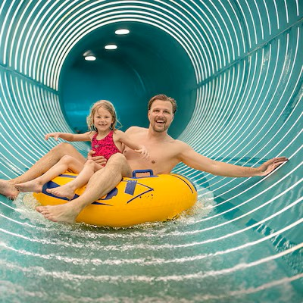
Why some guests don't visit Aqua Mundo
576 Reviews
1. Customer profile and disinterest (32%)
Disinterest in swimming The perception of Aqua Mundo as a child's activity "Not swimmers", "not for us", "too old" Adults without children less concerned
2. External constraints (34%)
Lack of time, short stays or favourable weather favour outdoor activities to the detriment of a visit to Aqua Mundo.
3. Health limitations and personal circumstances (12%)
Illness, disability, age or the presence of young sick children often prevent access to Aqua Mundo.
4. Problems with the Aqua Mundo experience (13%)
Overcrowding, noise, cold water, closed facilities, pool cleanliness, aqua mundo perceived as too small…
5. Personal & family-related contraints (10%)
Families with pets, adults with very young children (0-2)
relative weight by category (%)

Slide 16

Why some guests don't visit the Aqua Mundo at Parc Sandur
35 Reviews
1. Lack of time / other priorities
“Busy with other activitie” “had short stays”
2. Aqua Mundo perceived as too small or not attractive enough
Several respondents described the facility as “small”, “like a regular swimming pool”, or lacking attractions
3. Health limitations and personal circumstances
Illness, sick children, skin conditions, or needing to care for children prevented some guests from visiting
4. Preference for staying in accommodation
Some guests preferred relaxing in their cottage or spending time elsewhere in the park.
5. Limited opening hours

Slide 17

What customers love
1. Attractions (48%)
Wildwaterbaan (rivière sauvage)
Slides
Wave pool Children's games
2. Family orientation (28%)
Children's areas, baby equipment (vests, dedicated areas) "For all ages"
3. The overall experience (19%)
Tropical atmosphere, Vegetation, cleanliness, Immersion / "change of scenery"
4. Relaxation & Wellness (3%)
Relaxation, jacuzzi, well-being
5. Security/personnel (2%)
Numerous lifeguards, vigilance, safety

Slide 18
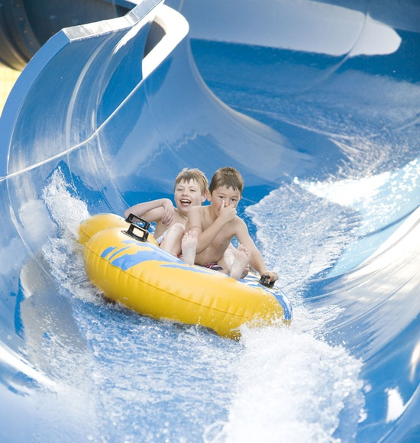
Main irritants impacting the customer experience
1. Temperature issues
The water and air temperature is often too cold, especially for children, which creates frustration.
2. Overcrowding and queues
Overcrowding during peak periods leads to noise, long queues and a lack of seats.
3. Lack of comfort
The quiet areas and relaxation areas are insufficient, and the changing rooms are often saturated, affecting comfort.
4. Maintenance and cleanliness
The dilapidated and closed equipment degrades the experience, while the cleanliness of the showers and toilets is sometimes criticized.
5. Insufficient adult supply
lack of facilities (spa / jacuzzisauna / hammam), quiet areas, not suitable without children

Slide 19
Strengths and Weaknesses
Immersive tropical atmosphere Essential activity of the stay Strong family experience Slides and fun activities appreciated Popular wave pool Activity adapted for all weathers Moments of relaxation and relaxation Activities popular with children A good complement to the Center Parcs experience Very strong "holiday" atmosphere Varied offer for different ages Generally appreciated staff Positive emotional experience High perceived value to families
Overcrowding / too many people
Queues at attractions
Water sometimes considered too cold
Inconvenient locker rooms
Lack of lockers/hooks
Difficulty finding quiet spaces
Insufficient size of some areas
Feeling of limited space during peak periods
Visitor flow management could be improved
Some infrastructure perceived as aging
Opening hours or accessibility sometimes considered limited
Varying level of cleanliness at different times
Noise and agitation in some areas

Slide 20
Thank you

Slide 22
Fonction icons

