Slide 1
NPS PROGRAM FINAL RESULTS FY25 REVIEW (post stay satisfaction survey)
Product Intelligence

Slide 2
Executive Summary
Survey health check :
985 715 invitation sent (+ 30 364 vs ly).
Email opening rate ↗ 6pts (69%), Click-through rate ↘ 2,8pts (34%).
Survey return rate ↘ 2,5pts (30%), = 296K respondents, -3% vs ly.
Survey abandonment rate is flat with 11,7%.
NPS CPSP FY25= 20,5, and improved +6 pts vs ly
↗ in all countries, all parks and all guest segmentation (trialist, origin, villa type…) vs ly.
Some exception on guest segmentation can be investigated on park level.
Continuous improvement of monthly NPS vs. N-1.
Only Sunparks decreased vs ly and NPS is still <0.
Country ranking:
Denmark (NPS=30,3)
Belgium (NPS=30,2 ; +5,3 pts vs ly)
France (NPS=22 ; +6,6 pts vs ly)
Germany (NPS=20,7 ; +6 pts vs ly)
Netherlands (NPS=18,1 ; +6,8 pts vs ly)
Contributions to NPS
Net Satisfaction Scores of village, staff, cottage, Aqua Mundo, leisure and catering experiences are the highest contributors to NPS.
Important attributes of these CX pillars are : village safety, cottage maintenance and cleanliness, offer and value for money.
Guest feedbacks: text analytics and Impact Score:
Weaknesses impacting negatively the NPS:
26% of all records includes at least one negative (from mixed to strongly) feedbacks on accommodation with focus on issues around cleanliness, maintenance, upkeep, inventory or comfort; which represents the highest share of guest feedbacks.
This share decreased -6 pts compared to FY24 (32%), impacting positively the NPS.
Strengths impacting positively the NPS:
60 to 80% of comments are positive regarding staff (including restaurants), reception, check-in process, check-out process, village location, design, decoration and convenience, spa and Aqua Mundo categories. Accommodation decoration and size are also mentioned as more positive than negative, impacting positively the NPS.
There are differences in weaknesses and strengths per park.
Special attention to continue improvement:
Denmark : Trialist and ReActivated guest, 3-4 and 12-17 yo, French and Dutch origin, quality and diversity of things to do (leisure and catering), cottage °C and Bugs summer
Belgium: Trialist and ReActivated guest, 0-2 and 12-17 yo, French, Swiss and Dutch, VIP cottages AR-HA-VM-EH, Cottage cleanliness, Les Ardennes and Parc De Haan.
France: June-July, ReActivated guest, Teens 12-17 yo, foreign origin, VIP cottages, Catering, Value for money, Lac d’Ailette and Villages Nature Paris.
Germany: Trialist and ReActivated guest, 0-2 and 12-17 yo, Austrian, Dutch, Swiss and Danish, VIP and Exclusive wellness cottages (Park Allgäu), Eden VIP (Bispinder Heide), Apartments (Nordseeküste), Park Nordseeküste, cottage cleanliness.
Netherlands: Trialist and ReActivated guest, 0-2 and 12-17 yo, Dutch and Swiss origin, VIP cottages, Kids cottages, cottage cleanliness and maintenance, Limburgse Peel and Port Zélande.

Slide 3
Table of content
Executive Summary
Health check of the post stay survey and email
NPS FY25 Results and learnings : Center Parcs & Sunparks Europe
NPS FY25 Results and learnings : Center Parcs & Sunparks BELGIUM
NPS FY25 Results and learnings : Center Parcs NETHERLANDS
NPS FY25 Results and learnings : Center Parcs GERMANY
NPS FY25 Results and learnings : Center Parcs France
NPS FY25 Results and learnings : Center Parcs Denmark
Nomenclature

Slide 4
Survey Health check
We collected 285 849 answers (-3% vs ly)
Email opening rate is 69%, increased + 6pts vs ly thanks to improvement in design.
Response rate is 30%, decreased -2,5pts vs ly. Only VN, OD and ZV increased.
Return rate is higher on short survey, vs very short survey was higher last years.
We don’t notice a significant difference in NPS between the surveys, only +1pt on very short survey vs total.
% Survey response rate | FY24 | FY25 | Evol vs ly
Bispinger Heide | 34 | 32 | -2,0
De Eemhof | 29 | 26 | -3,0
De Huttenheugte | 31 | 29 | -2,0
De Kempervennen | 30 | 28 | -2,0
De Vossemeren | 29 | 28 | -1,0
Erperheide | 29 | 27 | -2,0
Het Heijderbos | 30 | 28 | -2,0
Het Meerdal | 31 | 30 | -1,0
Kempense Meren | 32 | 31 | -1,0
Le Bois aux Daims | 33 | 29 | -4,0
Le Lac d'Ailette | 32 | 30 | -2,0
Les Ardennes | 30 | 28 | -2,0
Les Bois-Francs | 31 | 28 | -3,0
Les Hauts de Bruyères | 34 | 30 | -4,0
Les Landes de Gascogne | 35 | 31 | -4,0
Les Trois Forêts | 32 | 29 | -3,0
Limburgse Peel | 32 | 30 | -2,0
Oostduinkerke aan zee | 32 | 35 | 3,0
Parc Sandur | 35 | 33 | -2,0
Park Allgäu | 38 | 34 | -4,0
Park Bostalsee | 33 | 35 | 2,0
Park De Haan | 33 | 31 | -2,0
Park Eifel | 35 | 29 | -6,0
Park Hochsauerland | 33 | 32 | -1,0
Park Nordseeküste | 35 | 31 | -4,0
Park Zandvoort | 31 | 34 | 3,0
Port Zélande | 31 | 30 | -1,0
Terhills Resort | 31 | 30 | -1,0
Villages Nature Paris | 27 | 32 | 5,0
Analysis
%Email openning rate | FY24 | FY25 | Evol vs ly
Belgium | 56 | 64 | 8,0
Denmark |  | 76
France | 65 | 71 | 6,0
Netherlands | 63 | 70 | 7,0
Germany | 68 | 70 | 2,0
Total | 63 | 69 | 6,0
% Survey response rate | FY24 | FY25 | Evol vs ly
Belgium | 30,9 | 29,2 | -1,7
Denmark |  | 35,4
France | 32,2 | 28,9 | -3,4
Netherlands | 31,1 | 29,0 | -2,1
Germany | 35,7 | 33,0 | -2,7
Total | 32,4 | 29,9 | -2,5
%Survey response rate | FY23 | FY24 | FY25 | Evol vs ly
very short | 36,4 | 32,9 | 28 | -3,4
short | 34,7 | 32,7 | 30,7 | -2,1
long | 32,6 | 32 | 30,4 | -2,7
total | 33,8 | 32,4 | 29,9 | -2,5
NPS per survey lenght | Belgium | Denmark | France | Netherlands | Germany | Total
very short | 21 | 32,2 | 24,2 | 18,7 | 22,4 | 21,5
short | 21,3 | 29,5 | 21,7 | 17,7 | 20,6 | 20,2
long | 22,2 | 30,6 | 21,9 | 18,3 | 20,5 | 20,6
total | 21,7 | 30,3 | 22 | 18,1 | 20,7 | 20,5

Slide 5
NPS Evolution
NPS CPSP = 20,5, and improved +6 pts vs ly with, all countries and all parks improved vs ly.
Only Sunparks decreased 1,4 pt vs ly, due to -6pts at OD; NPS SP=-12,3.
Top parks per country are Terhills – BE (57,4), Les Landes de Gascogne – FR (48,5), Park Hochsauerland – GE (35,6), and Het Meerdal – NL (31,7).
Highest increase vs ly in NPS are Park Bostalsee (+11,7pts) and Bispinger Heide (+10,2pts) in GE, Le Bois aux Daims (+10,7pts) and Les Bois-Francs in FR (+10,3pts), Parc Sandur (+9,6pts) and Limburgse Peel (+9,3pts) in NL, and Park de Haan (+8,6pts) and Les Ardennes (+5,4pts) in BE.
FINAL NPS |  | Evol vs n-1
De Vossemeren | 34,0 | 0,0
Erperheide | 42,1 | 4,8
Les Ardennes | 9,5 | 5,4
Park De Haan | 7,7 | 8,6
CP Belgium | 26,6 | 5,1
Sunparks Kempense Meren | -14,0 | 1,8
Sunparks Oostduinkerke aan zee | -10,1 | -6,0
SP Belgium | -12,3 | -1,4
TH Belgium | 57,4 | 6,0
CP SP TH Belgium | 21,7 | 3,7
Analysis
FINAL NPS |  | Evol vs n-1
CP | 21,1 | 6,3
SP | -12,3 | -1,4
CP SP | 19,8 | 6,0
TH | 57,4 | 6,0
CP SP TH | 20,5 | 6,0
NO | 30,3
CP SP TH NO | 20,5 | 6,0
FINAL NPS |  | Evol vs n-1
Bispinger Heide | 21,1 | 10,2
Park Allgäu | 17,5 | 3,7
Park Bostalsee | 24,3 | 11,7
Park Eifel | 22,4 | 8,5
Park Hochsauerland | 35,6 | 3,5
Park Nordseeküste | 0,3 | 0,2
CP GERMANY | 20,7 | 6,1
FINAL NPS |  | Evol vs n-1
De Eemhof | 13,3 | 6,8
De Huttenheugte | 19,6 | 4,8
De Kempervennen | 22,7 | 6,3
Het Heijderbos | 16,6 | 6,5
Het Meerdal | 31,7 | 6,9
Limburgse Peel | 2,5 | 9,3
Parc Sandur | 19,3 | 9,6
Park Zandvoort | 22,6 | 4,7
Port Zélande | 11,7 | 6,8
CP Netherlands | 18,1 | 6,8
FINAL NPS |  | Evol vs n-1
Le Bois aux Daims | 33,7 | 10,7
Le Lac d'Ailette | 6,9 | 2,7
Les Bois-Francs | 18,3 | 10,3
Les Hauts de Bruyères | 15,2 | 6,2
Les Landes de Gascogne | 48,5 | 7,5
Les Trois Forêts | 27,2 | 8,3
Villages Nature Paris | 8,8 | 3,9
CP France | 22,0 | 6,6
FINAL NPS
Nordborg Resort | 30,3
CP DENMARK | 30,3

Slide 6
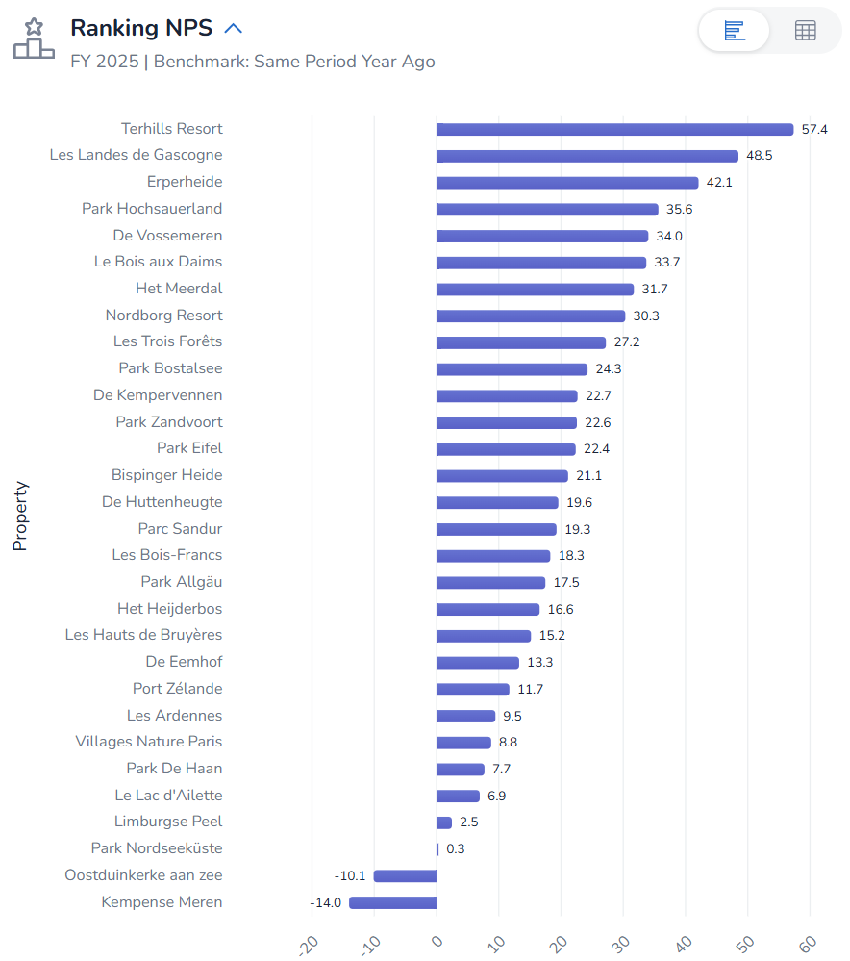
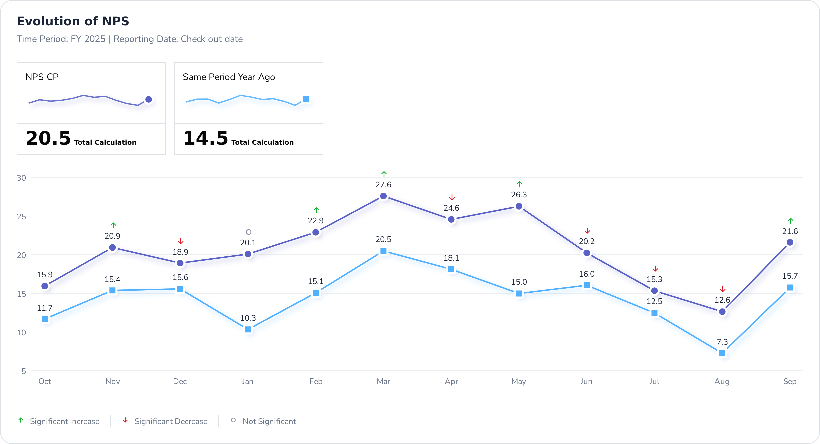
NPS Evolution and distribution
Continuous improvement of monthly NPS vs. N-1
Clear upgrade in January and May 2025 vs ly, the trend has reversed.
14 villages above the CPE NPS and 14 villages below (vs 10 parks above CP average of 15,5 ly and 17 villages below)
Analysis
Average CP
21,1

Slide 7
Return intention
Positive % return intention ↗ in all countries for Center Parcs.
Analysis

Slide 8
Belgium
NPS Review

Slide 9
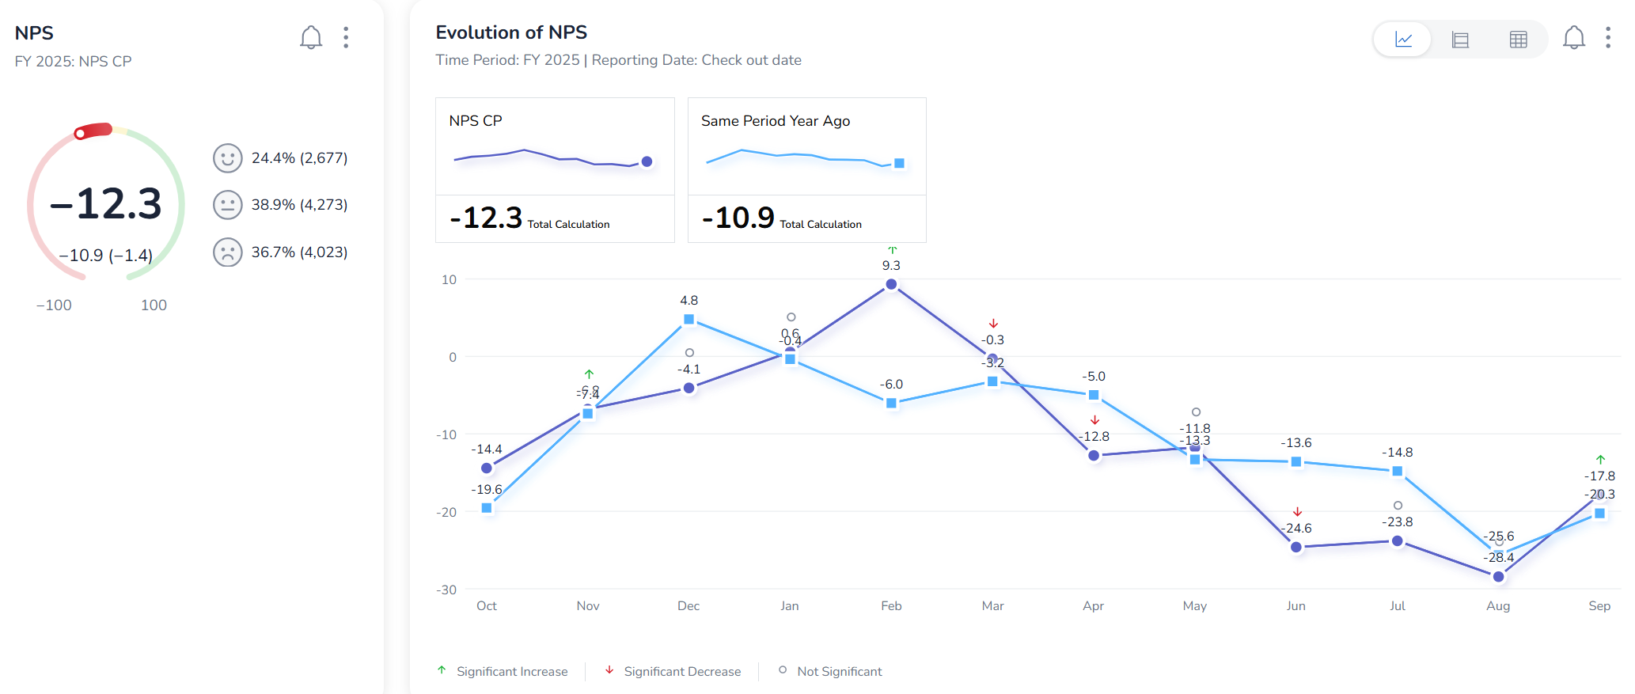
Belgium – highest contribution to NPS (Sunparks only)
Only February is positive this year, whereas December ly.
Analysis

Slide 10
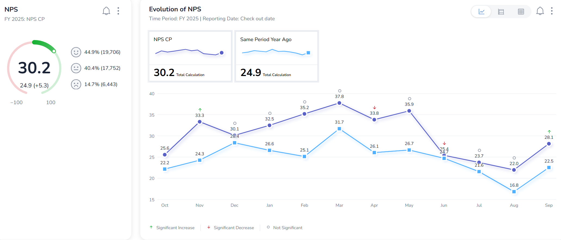
Belgium – highest contribution to NPS (Center Parcs only)
Continuous improvement of monthly NPS vs. N-1
Analysis

Slide 11
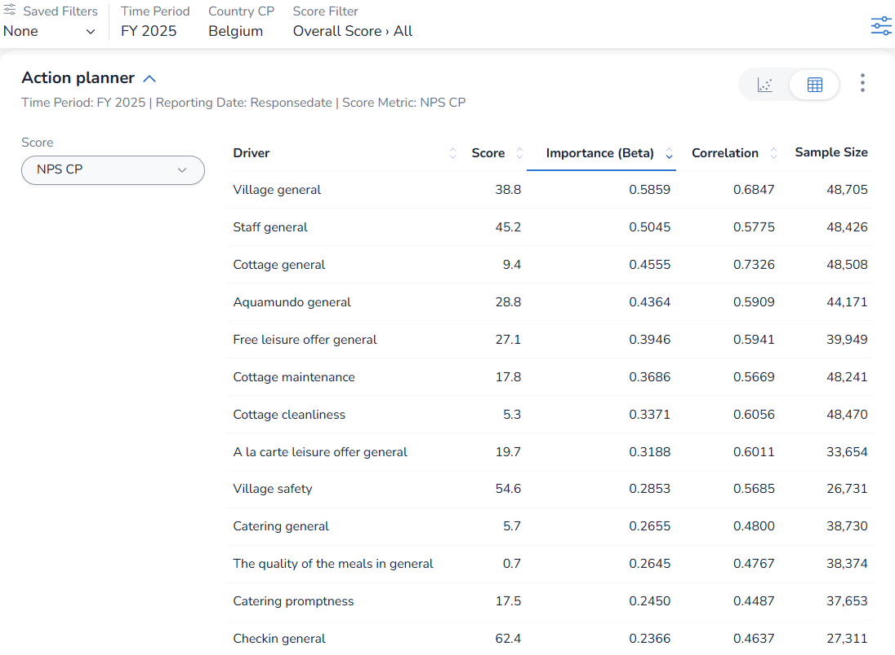
Belgium – highest contribution to NPS
Main pillars are key on Net Promoter Score.
Secondary pillars “Village safety”, “quality of the meals” and “catering promptness” are also key to impact Net Promoter Score
Analysis

Slide 12
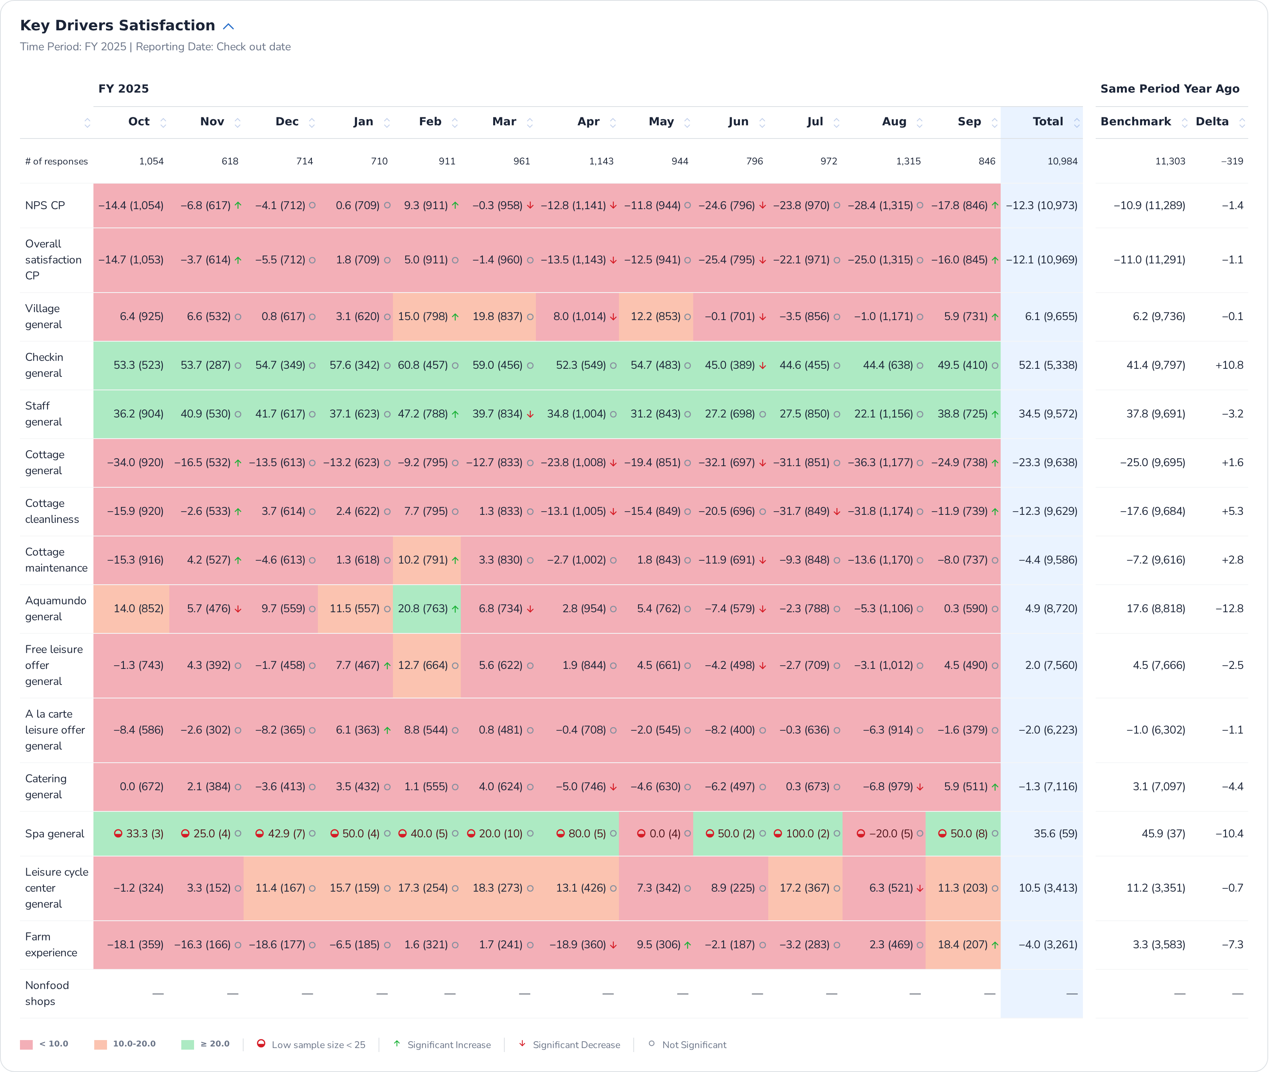
Belgium – main pillars over months (Sunparks only)
Direct impact between cottage general and its main attributes cleanliness and maintenance, with NPS and Overall satisfaction of the stay.
Improvement of all pillars compared to ly, excepted on staff and village.
Analysis

Slide 13
Belgium – main pillars over months (Sunparks only)
Decrease of all pillars compared to ly.
Analysis

Slide 14
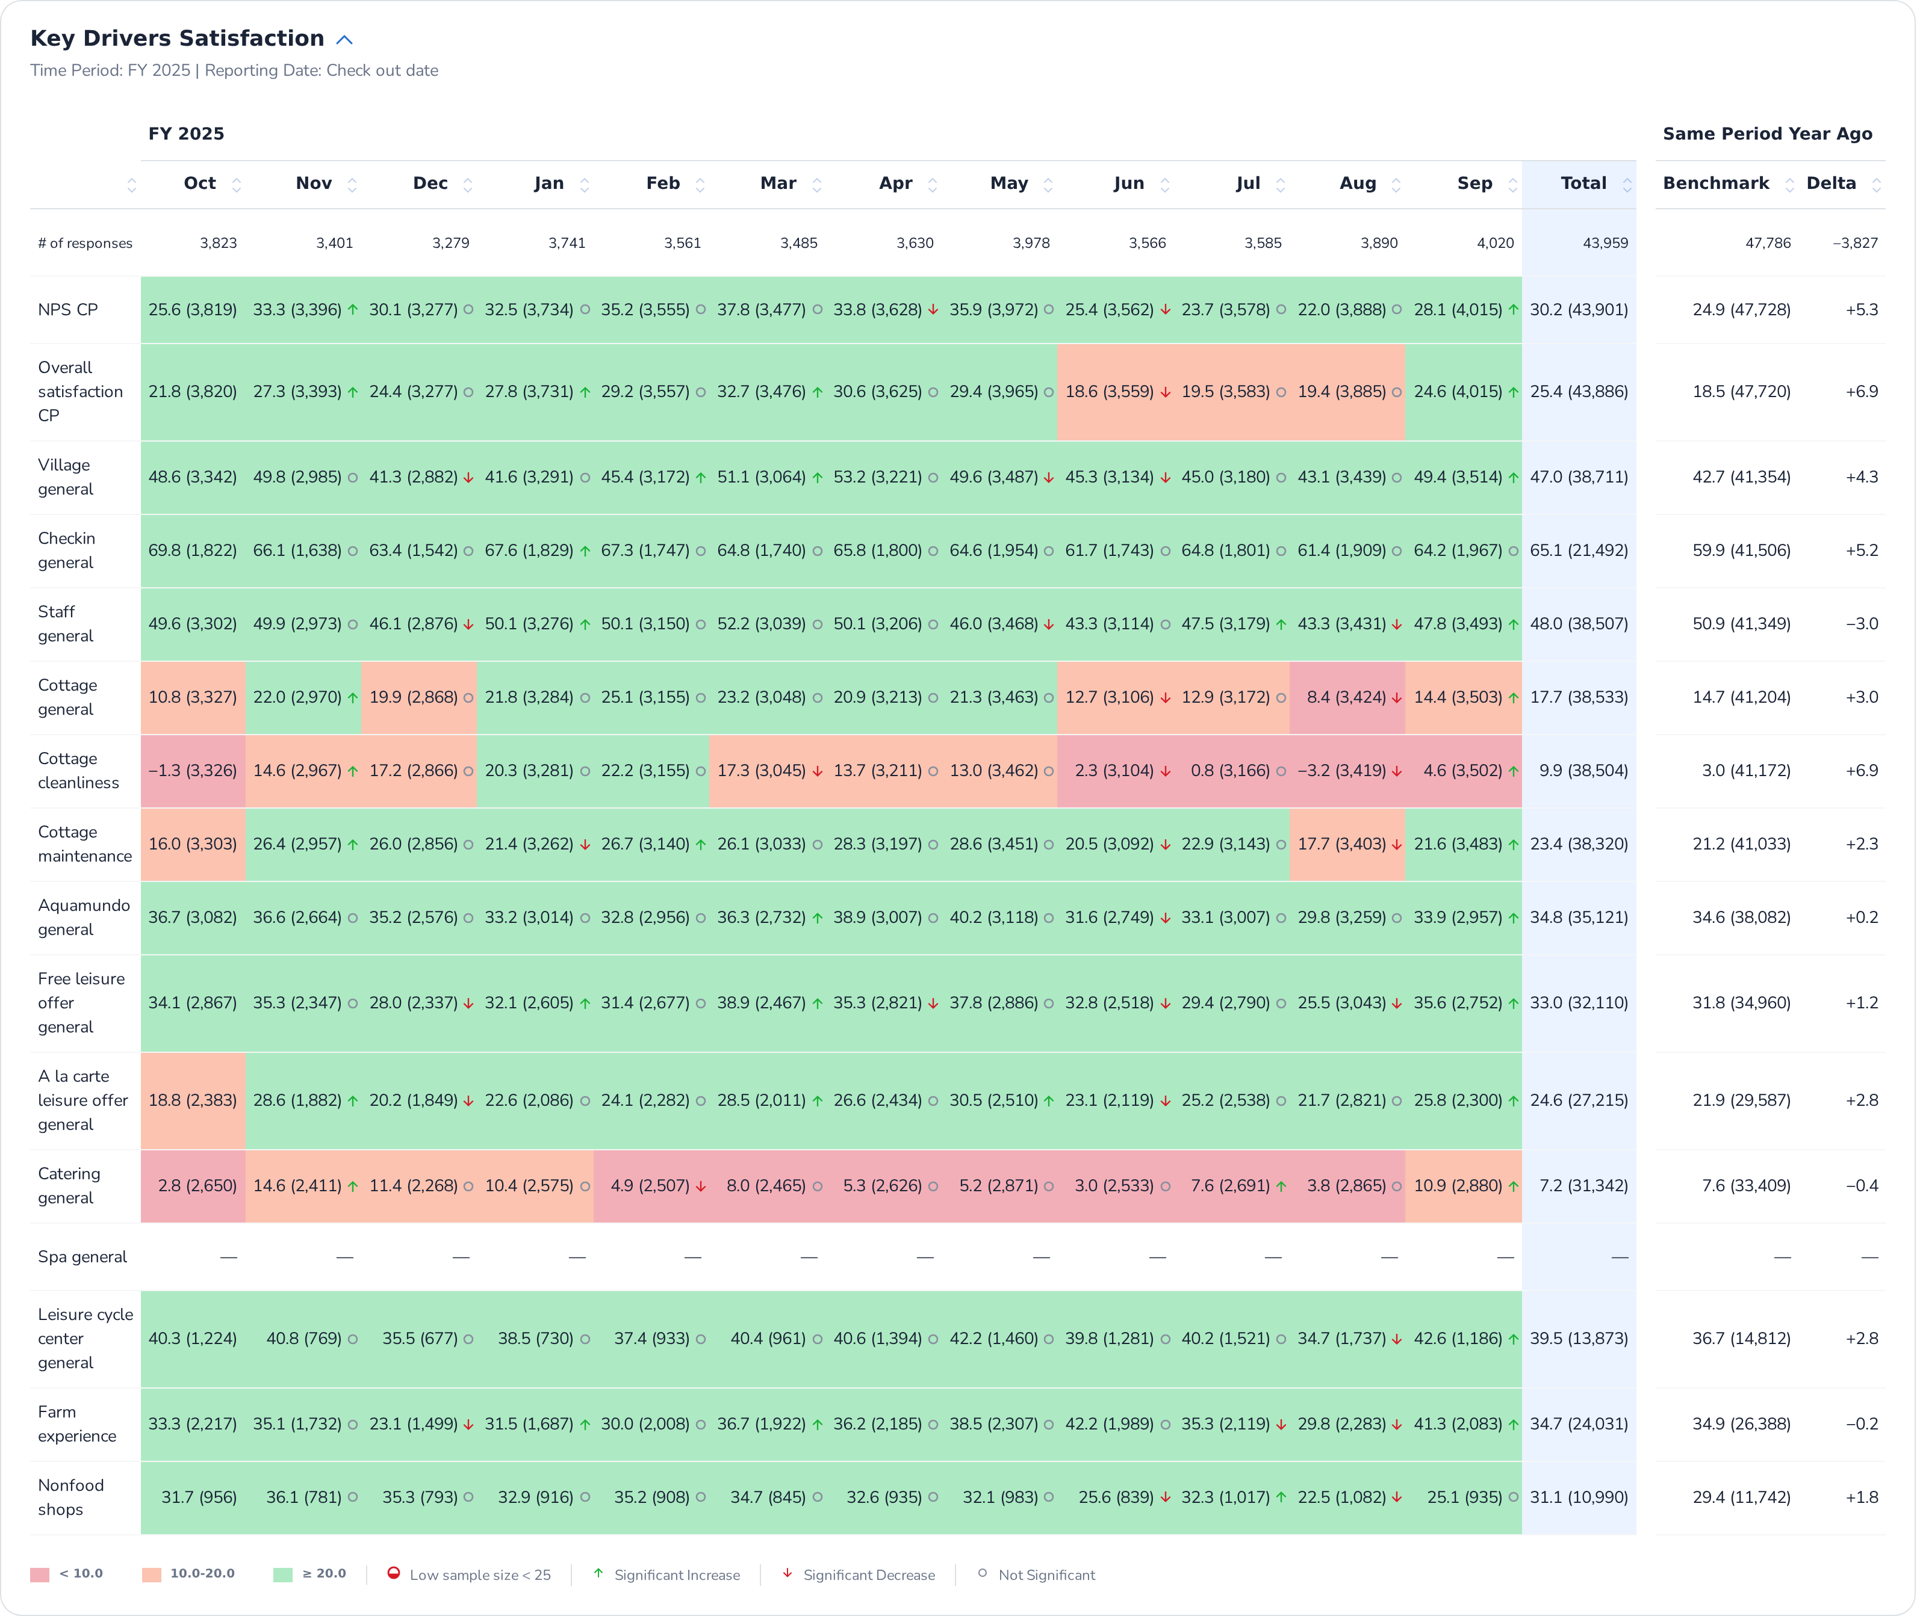
Belgium – main pillars over months (Center Parcs only)
Impact between cottage general and its main attributes cleanliness and maintenance with NPS is less visible than with Overall satisfaction of the stay.
Improvement of all pillars compared to ly, excepted on staff.
Analysis

Slide 15
Belgium – main pillars over months (Center Parcs only)
Increased of all pillars compared to ly.
Analysis

Slide 16
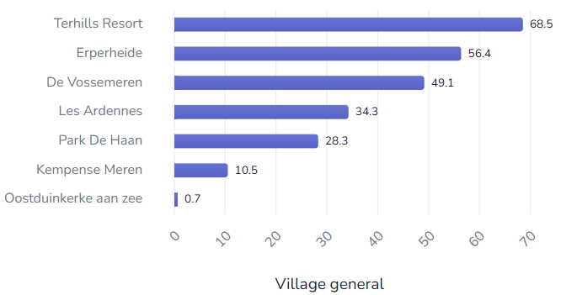
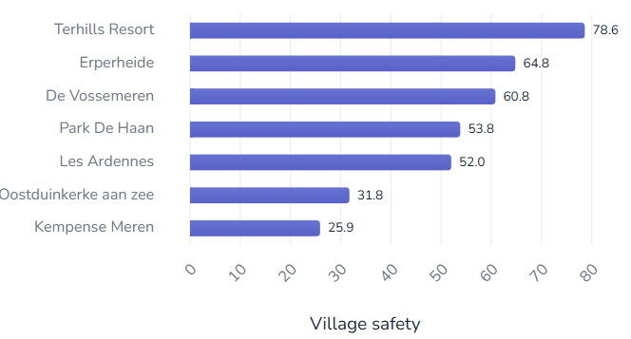
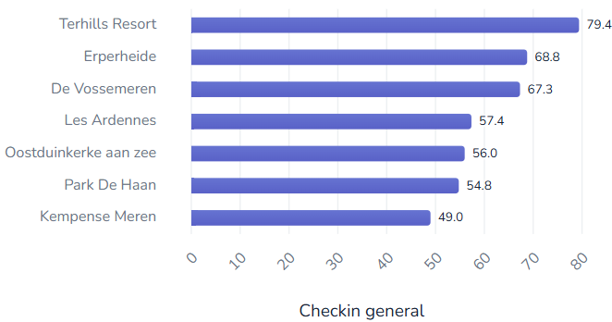
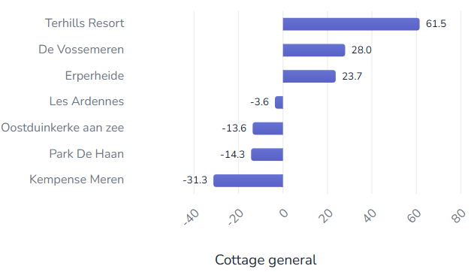
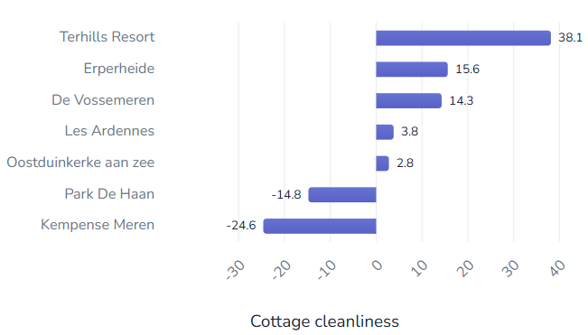
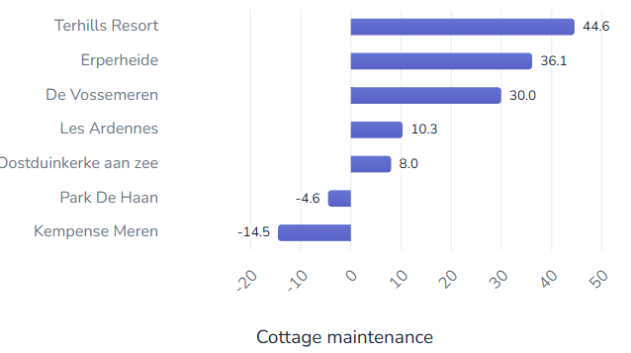
Belgium – ranking parks on main pillars
Terhills Resort is TOP village and cottage experience.
Then, Erperheide and De Vossemeren have the same trend on main pillars.
Finally, Les Ardennes and Park De Haan have the same trend on main pillars, but Les Ardennes is better than De Haan in cottage experiences.
Analysis

Slide 17
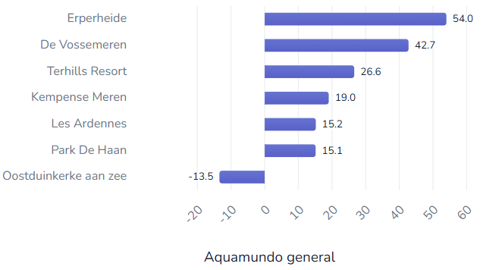
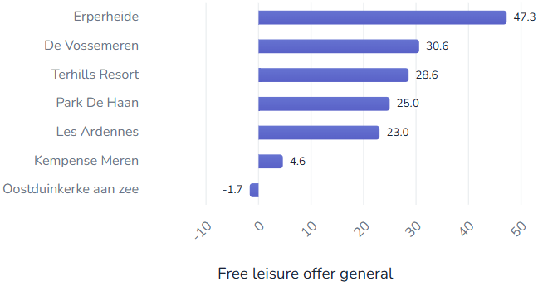
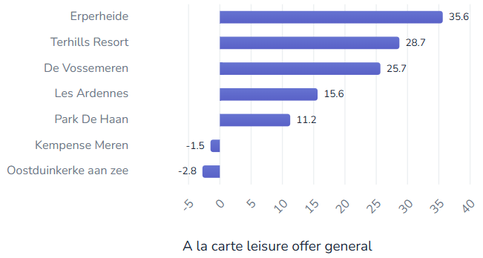
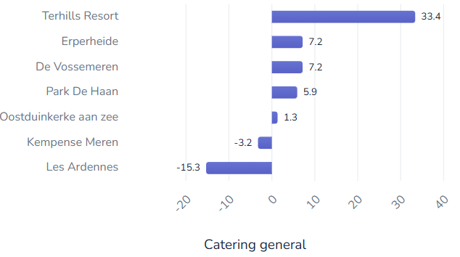
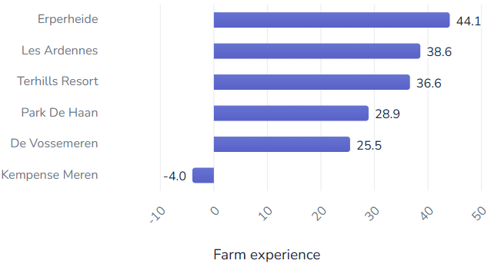
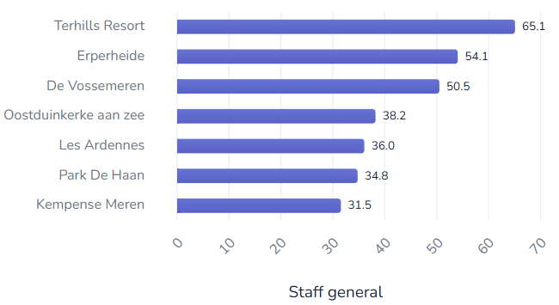
Belgium – ranking parks on main pillars
Erperheide is top village for leisure experiences., above De Vossemeren, but comparable for catering experience.
Terhilss is top village for staff and catering experiences
Les Ardennes and Park De Haan have the same trend on all pillars, but De Haan is better than Ardennes in catering and farm experiences.
Analysis

Slide 18
Belgium – NPS per trialist/repeaters/reactivated
NPS Repeaters > NPS Trialist and ReActivated guest.
All segments improved in all parks of Belgium.
Only ReActivated and Repeaters guest of De Vossemeren decreased.
All segments decreased at Sunparks Oostduinkerke aan zee.
 | FY25 | FY24 | Evol
R | 28,2 | 24,3 | 3,9
Total | 21,7 | 18 | 3,7
A | 14,6 | 12,3 | 2,3
T | 13,1 | 10,2 | 2,9
Analysis
NPS | FY25 | FY24 | Evol
De Vossemeren, Subtotal | 34 | 34,1 | 0
De Vossemeren, A | 28,7 | 34,6 | -6,0
De Vossemeren, R | 35,8 | 36,2 | -0,4
De Vossemeren, T | 30,9 | 29,4 | 1,5
Erperheide, Subtotal | 42,1 | 37,4 | 4,7
Erperheide, A | 33,8 | 30,8 | 3,0
Erperheide, R | 43,5 | 39,4 | 4,1
Erperheide, T | 39,8 | 34,2 | 5,6
Kempense Meren, Subtotal | -14,0 | -15,9 | 1,8
Kempense Meren, A | -11,2 | -19,7 | 8,6
Kempense Meren, R | -1,0 | -1,7 | 0,7
Kempense Meren, T | -22,8 | -24,2 | 1,3
Les Ardennes, Subtotal | 9,5 | 4,1 | 5,4
Les Ardennes, A | 6,0 | -6,8 | 12,8
Les Ardennes, R | 11,2 | 6,0 | 5,2
Les Ardennes, T | 7,6 | 3,5 | 4,2
Terhills Resort, A | 56,2 | 42,7 | 13,5
Terhills Resort, R | 55,5 | 50,9 | 4,6
Terhills Resort, T | 60,1 | 52,7 | 7,3
NPS | FY25 | FY24 | Evol
Oostduinkerke aan zee, Subtotal | -10,1 | -4,0 | -6,1
Oostduinkerke aan zee, A | -16,8 | 1,1 | -17,8
Oostduinkerke aan zee, R | 5,4 | 8,7 | -3,3
Oostduinkerke aan zee, T | -20,2 | -12,4 | -7,8
Park De Haan, Subtotal | 7,7 | -1,0 | 8,7
Park De Haan, A | 1,3 | -5,6 | 6,9
Park De Haan, R | 9,2 | -0,1 | 9,3
Park De Haan, T | 6,1 | -1,7 | 7,8
Terhills Resort, Subtotal | 57,4 | 51,3 | 6,1
Terhills Resort, A | 56,2 | 42,7 | 13,5
Terhills Resort, R | 55,5 | 50,9 | 4,6
Terhills Resort, T | 60,1 | 52,7 | 7,3

Slide 19
Belgium – NPS per household structure
Data are slightly different because a part of total booking don’t get household structure information.
Belgium parks increased on all household structure.
Only De Vossemeren lost few points on 5-17 years old.
Seniors and family with 3;11 are the highest NPS.
0;2 and 12;17 are the lowest NPS.
 | FY25 | FY24 | Evol
Seniors>75 | 39,8 | 31,1 | 8,7
Seniors active 55-74 | 35,9 | 31,5 | 4,4
Family with Children 3-4 | 31,6 | 24,5 | 7,2
Family with Children 5-11 | 31,2 | 27,1 | 4,1
Total | 30,5 | 25,6 | 4,9
Adults 35-54 | 30,3 | 24,4 | 5,9
Young Adults 18-34 | 29,6 | 22,7 | 6,8
Family with Children 0-2 | 27,1 | 21,7 | 5,4
Family with Children 12-17 | 22,3 | 19,4 | 2,8
Analysis
NPS | FY25 | FY24 | Evol
De Vossemeren, Subtotal | 34,0 | 34,3 | -0,3
De Vossemeren, Adults 35-54 | 35,9 | 33,6 | 2,3
De Vossemeren, Family with Children 0-2 | 27,9 | 27,8 | 0,1
De Vossemeren, Family with Children 12-17 | 31,3 | 33,0 | -1,6
De Vossemeren, Family with Children 3-4 | 30,3 | 28,9 | 1,4
De Vossemeren, Family with Children 5-11 | 36,0 | 36,2 | -0,2
De Vossemeren, Seniors active 55-74 | 35,1 | 37,8 | -2,7
De Vossemeren, Seniors>75 | 41,7 | 38,5 | 3,2
De Vossemeren, Young Adults 18-34 | 34,3 | 30,7 | 3,6
Erperheide, Subtotal | 42,2 | 38,1 | 4,1
Erperheide, Adults 35-54 | 39,1 | 32,4 | 6,8
Erperheide, Family with Children 0-2 | 39,3 | 34,0 | 5,3
Erperheide, Family with Children 12-17 | 34,6 | 31,3 | 3,3
Erperheide, Family with Children 3-4 | 44,9 | 40,9 | 4,0
Erperheide, Family with Children 5-11 | 44,4 | 41,5 | 2,8
Erperheide, Seniors active 55-74 | 45,0 | 41,9 | 3,1
Erperheide, Seniors>75 | 43,9 | 38,2 | 5,6
Erperheide, Young Adults 18-34 | 43,0 | 33,7 | 9,4
NPS | FY25 | FY24 | Evol
Les Ardennes, Subtotal | 9,4 | 4,1 | 5,3
Les Ardennes, Adults 35-54 | 5,7 | 2,9 | 2,8
Les Ardennes, Family with Children 0-2 | 11,5 | -4,2 | 15,7
Les Ardennes, Family with Children 12-17 | 2,4 | -1,2 | 3,6
Les Ardennes, Family with Children 3-4 | 12,8 | 7,0 | 5,7
Les Ardennes, Family with Children 5-11 | 14,6 | 7,0 | 7,7
Les Ardennes, Seniors active 55-74 | 12,9 | 9,5 | 3,4
Les Ardennes, Seniors>75 | -4,1 | -7,7 | 3,6
Les Ardennes, Young Adults 18-34 | -1,4 | -1,4 | 0,0
Park De Haan, Subtotal | 7,5 | -0,4 | 8,0
Park De Haan, Adults 35-54 | 6,0 | -3,0 | 9,0
Park De Haan, Family with Children 0-2 | -3,2 | -5,5 | 2,3
Park De Haan, Family with Children 12-17 | -1,2 | -3,9 | 2,7
Park De Haan, Family with Children 3-4 | 10,1 | -5,6 | 15,7
Park De Haan, Family with Children 5-11 | 9,0 | 0,3 | 8,7
Park De Haan, Seniors active 55-74 | 15,3 | 7,0 | 8,3
Park De Haan, Seniors>75 | 20,0 | 5,3 | 14,7
Park De Haan, Young Adults 18-34 | 6,1 | -3,5 | 9,6
NPS | FY25 | FY24 | Evol
Terhills Resort, Subtotal | 57,2 | 51,8 | 5,4
Terhills Resort, Adults 35-54 | 57,1 | 52,6 | 4,5
Terhills Resort, Family with Children 0-2 | 54,3 | 48,1 | 6,2
Terhills Resort, Family with Children 12-17 | 49,3 | 42,7 | 6,6
Terhills Resort, Family with Children 3-4 | 53,2 | 50,2 | 3,0
Terhills Resort, Family with Children 5-11 | 50,9 | 51,9 | -1,0
Terhills Resort, Seniors active 55-74 | 61,8 | 57,1 | 4,8
Terhills Resort, Seniors>75 | 67,6 | 57,2 | 10,4
Terhills Resort, Young Adults 18-34 | 58,1 | 46,3 | 11,9
No household structure info on Sunparks.8

Slide 20
Belgium – NPS per customer country
GB and BE origin are the highest NPS.
FR, CH and NL are the lowest NPS below average.
Increase of all origin in all parks in Belgium.
Excepted at Oostduinkerke with decrease on all main origin BNGF.
 | FY25 | FY24 | Evol
GB | 41,2 | 39,5 | 1,7
BE | 36,0 | 30,2 | 5,8
DE | 31,8 | 26,6 | 5,2
LU | 30,4 | 17,5 | 12,9
Total | 30,2 | 24,9 | 5,3
FR | 27,0 | 21,8 | 5,2
CH | 25,8 | 11,2 | 14,5
NL | 16,4 | 12,1 | 4,3
Analysis
NPS | FY25 | FY24 | Evol
De Vossemeren, Subtotal | 34,0 | 34,1 | -0,1
De Vossemeren, BE | 38,3 | 37,3 | 1,1
De Vossemeren, DE | 34,1 | 34,5 | -0,4
De Vossemeren, FR | 44,3 | 43,1 | 1,2
De Vossemeren, GB | 58,2 | 58,7 | -0,5
De Vossemeren, LU | 27,7 | 36,3 | -8,6
De Vossemeren, NL | 21,4 | 22,4 | -1,0
NPS | FY25 | FY24 | Evol
Les Ardennes, Subtotal | 9,5 | 4,2 | 5,3
Les Ardennes, BE | 21,2 | 15,9 | 5,2
Les Ardennes, DE | 7,6 | 3,6 | 4,0
Les Ardennes, FR | 16,5 | 5,5 | 11,0
Les Ardennes, GB | 11,1 | 14,3 | -3,2
Les Ardennes, LU | 28,0 | 12,6 | 15,4
Les Ardennes, NL | -12,9 | -17,1 | 4,2
NPS | FY25 | FY24 | Evol
Kempense Meren, Subtotal | -14,0 | -15,9 | 1,8
Kempense Meren, BE | -10,7 | -11,2 | 0,5
Kempense Meren, DE | -26,2 | -28,4 | 2,2
Kempense Meren, FR | -0,1 | -3,3 | 3,2
Kempense Meren, GB | 8,5 | -6,7 | 15,2
Kempense Meren, NL | -33,9 | -36,1 | 2,2
NPS | FY25 | FY24 | Evol
Erperheide, Subtotal | 42,1 | 37,3 | 4,8
Erperheide, BE | 44,6 | 41,4 | 3,2
Erperheide, DE | 46,9 | 41,9 | 5,0
Erperheide, FR | 48,3 | 48,3 | -0,1
Erperheide, GB | 61,7 | 54,6 | 7,1
Erperheide, LU | 50,0 | 29,9 | 20,1
Erperheide, NL | 29,3 | 21,2 | 8,0
NPS | FY25 | FY24 | Evol
Park De Haan, Subtotal | 7,7 | -1,0 | 8,7
Park De Haan, BE | 13,1 | 2,9 | 10,2
Park De Haan, DE | -2,5 | -8,2 | 5,8
Park De Haan, FR | 12,0 | 3,8 | 8,2
Park De Haan, GB | 24,8 | 20,2 | 4,6
Park De Haan, LU | 0,0 | -25,6 | 25,6
Park De Haan, NL | -18,2 | -23,9 | 5,7
NPS | FY25 | FY24 | Evol
Oostduinkerke aan zee, Subtotal | -10,1 | -4,0 | -6,1
Oostduinkerke aan zee, BE | -10,8 | -2,4 | -8,4
Oostduinkerke aan zee, DE | -25,2 | -21,7 | -3,5
Oostduinkerke aan zee, FR | 0,7 | 5,1 | -4,3
Oostduinkerke aan zee, GB | 6,7 | 6,3 | 0,5
Oostduinkerke aan zee, NL | -49,7 | -48,2 | -1,5
NPS | FY25 | FY24 | Evol
Terhills Resort, Subtotal | 57,4 | 51,3 | 6,0
Terhills Resort, BE | 61,9 | 54,6 | 7,3
Terhills Resort, DE | 60,6 | 53,0 | 7,6
Terhills Resort, FR | 53,4 | 48,9 | 4,5
Terhills Resort, GB | 81,8 | 52,9 | 28,9
Terhills Resort, LU | 60,6 | 51,2 | 9,4
Terhills Resort, NL | 44,4 | 42,0 | 2,3

Slide 21
Belgium – NPS per villa category (comfort level)
NPS of all villa types increased vs ly.
Overall, the NPS increase with the increase of range from Comfort as lowest NPS to VIP and Exclusive in top NPS.
Top villa categories are VIP and Exclusive (Terhills), Lakeside (Terhills).
NPS of both Exclusive and Select are negative at Sunparks.
 | FY25 | FY24 | Evol
Vip Lake side | 66,9 | 64,0 | 2,9
Exclusive Lakeside cottage | 57,6 | 48,8 | 8,8
Disabled VIP | 55,2 | 51,9 | 3,3
Premium Apartment | 49,4 | 47,4 | 2,0
Exclusive cottage | 47,3 | 45,7 | 1,6
Premium Hotel | 44,0 | 41,0 | 3,0
Kids cottage, new generation | 36,4 | 31,7 | 4,6
VIP cottage | 32,6 | 27,0 | 5,6
Premium cottage Wheelchair | 31,9 | 39,8 | -7,9
Premium cottage | 26,8 | 20,5 | 6,3
Comfort cottage | 25,1 | 20,9 | 4,3
Total | 21,7 | 18,0 | 3,7
Hotelroom | 19,7 | 17,7 | 2,0
Exclusive | -4,0 | -2,2 | -1,8
Select | -15,4 | -14,2 | -1,2
Analysis
 | FY25 | FY24 | Evol
De Vossemeren | 34,0 | 34,1 | 0,0
Comfort cottage | 32,9 | 33,8 | -0,9
Kids cottage new generation | 36,4 | 31,7 | 4,6
Premium Hotel | 44,0 | 41,0 | 3,0
Premium cottage | 34,3 | 33,4 | 0,9
Premium cottage Wheelchair | 16,3 | 44,7 | -28,5
VIP cottage | 31,3 | 32,9 | -1,6
 | FY25 | FY24 | Evol
Les Ardennes | 9,5 | 4,1 | 5,4
Comfort cottage | 6,5 | 4,7 | 1,8
Premium cottage | 13,1 | 4,5 | 8,5
VIP cottage | 5,4 | 0,7 | 4,8
 | FY25 | FY24 | Evol
Kempense Meren | -14,0 | -15,9 | 1,8
Exclusive | -6,2 | -6,3 | 0,1
Hotelroom | 19,7 | 17,7 | 2,0
Select | -17,6 | -20,3 | 2,7
 | FY25 | FY24 | Evol
Erperheide | 42,1 | 37,4 | 4,7
Comfort cottage | 43,8 | 40,4 | 3,4
Premium Apartment | 49,4 | 47,4 | 2,0
Premium cottage | 41,5 | 35,2 | 6,3
Premium cottage Wheelchair | 41,4 | 36,7 | 4,8
VIP cottage | 36,2 | 28,5 | 7,6
 | FY25 | FY24 | Evol
Park De Haan | 7,7 | -1,0 | 8,7
Comfort cottage | 6,6 | -1,2 | 7,8
Premium cottage | 10,6 | 1,7 | 8,8
VIP cottage | 5,2 | -4,4 | 9,6
 | FY25 | FY24 | Evol
Oostduinkerke aan zee | -10,1 | -4,0 | -6,1
Exclusive | -2,5 | 1,0 | -3,5
Select | -12,6 | -5,5 | -7,1
 | FY25 | FY24 | Evol
Terhills Resort | 57,4 | 51,3 | 6,1
Disabled VIP | 55,2 | 51,9 | 3,3
Exclusive Lakeside cottage | 57,6 | 48,8 | 8,8
Exclusive cottage | 47,3 | 45,7 | 1,6
VIP cottage | 58,0 | 51,9 | 6,1
Vip Lake side | 66,9 | 64,0 | 2,9

Slide 22
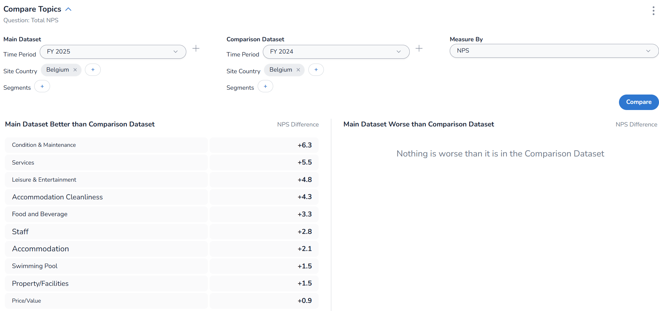
Belgium – text analytics, topics comparision vs N-1
All categories of topics from open comments improved compared to N-1, which means a decrease in the share of negative comments, and/or an increase in the share of positive comment volumes, explaining the overall improvement in the total NPS.
Analysis
CPSP

Slide 23
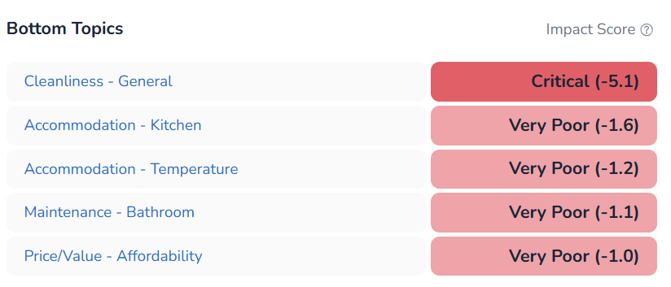
Belgium – text analytics, bottom topics with higher negative impact score on NPS
Cottage cleanliness and maintenance issues have the highest negative impact score on NPS, before price and value for money.
Analysis
CP

Slide 24
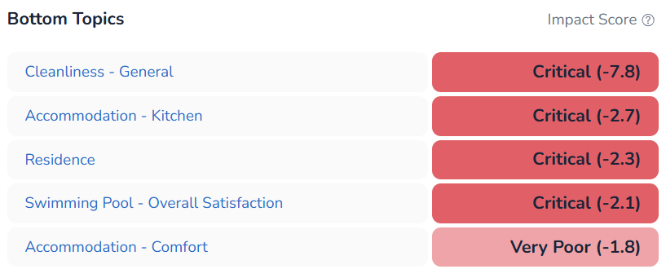
Belgium – text analytics, bottom topics with higher negative impact score on NPS
Cottage cleanliness and maintenance issues have the highest negative impact score on NPS, before central facilities and swimming pool.
Analysis
SP

Slide 25
Netherlands
NPS Review

Slide 26
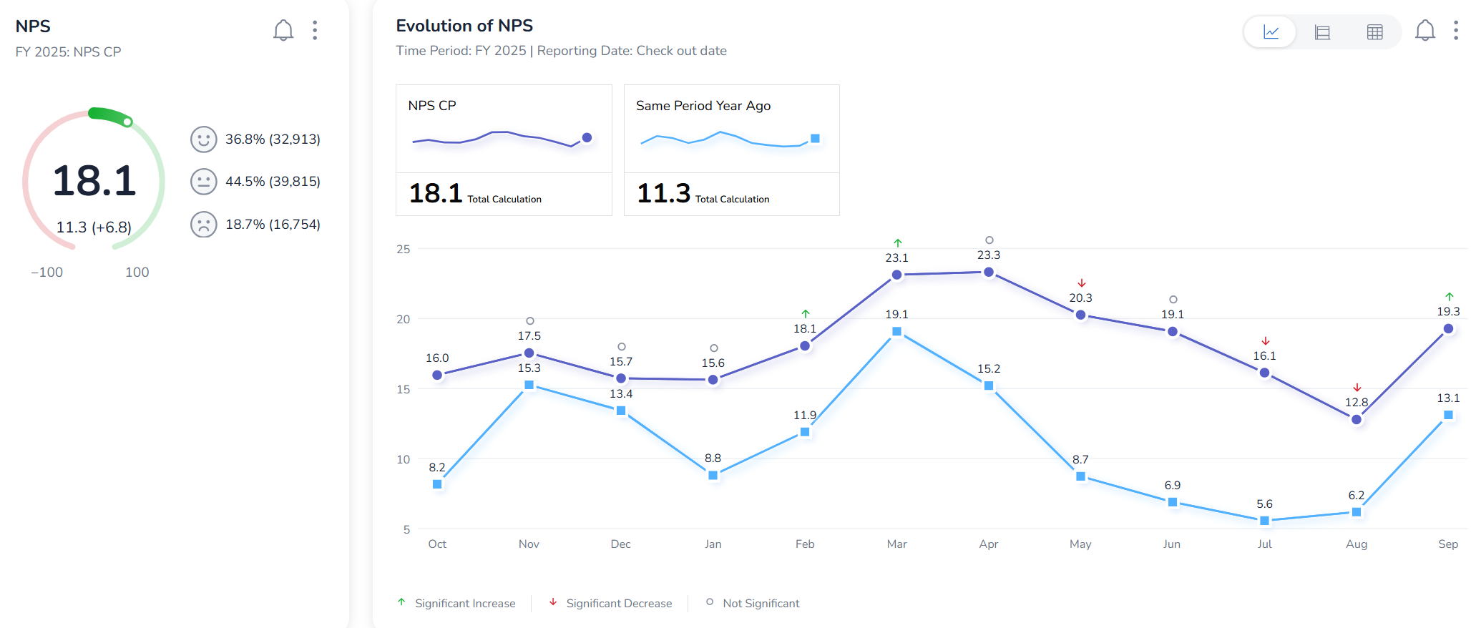
Netherlands – highest contribution to NPS
Continuous improvement of monthly NPS vs. N-1.
Analysis

Slide 27
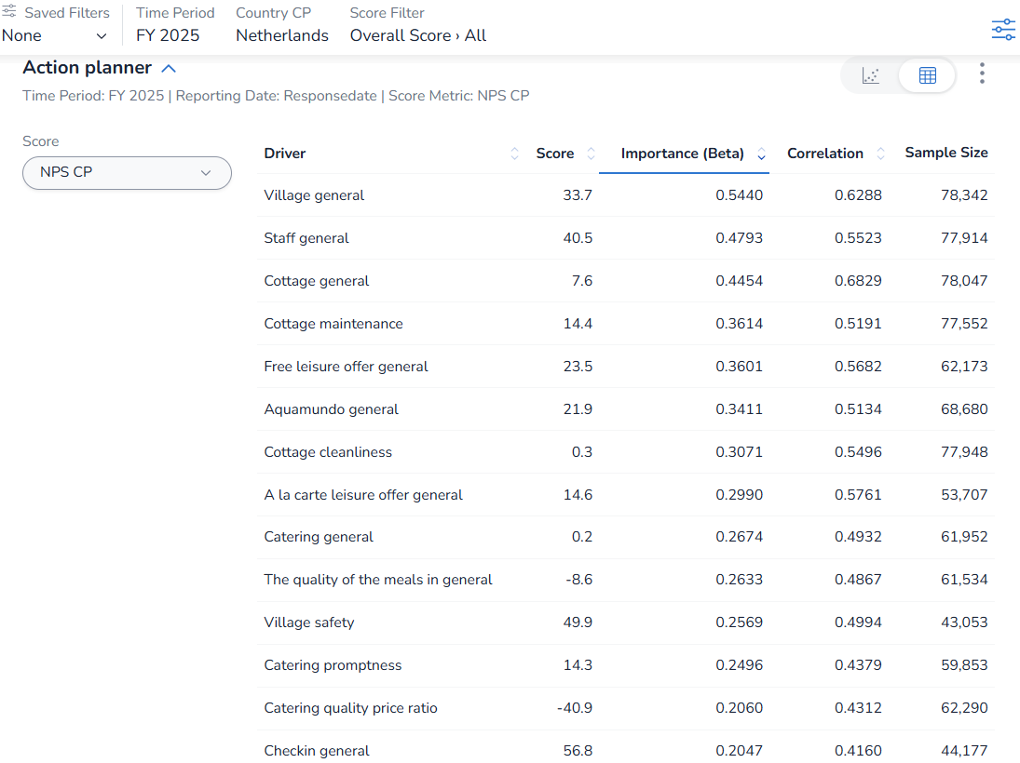
Netherlands – highest contribution to NPS
Main pillars are key on Net Promoter Score.
Secondary pillars “Village safety”, “quality of the meals” and “catering promptness” are also key to impact Net Promoter Score
Analysis

Slide 28
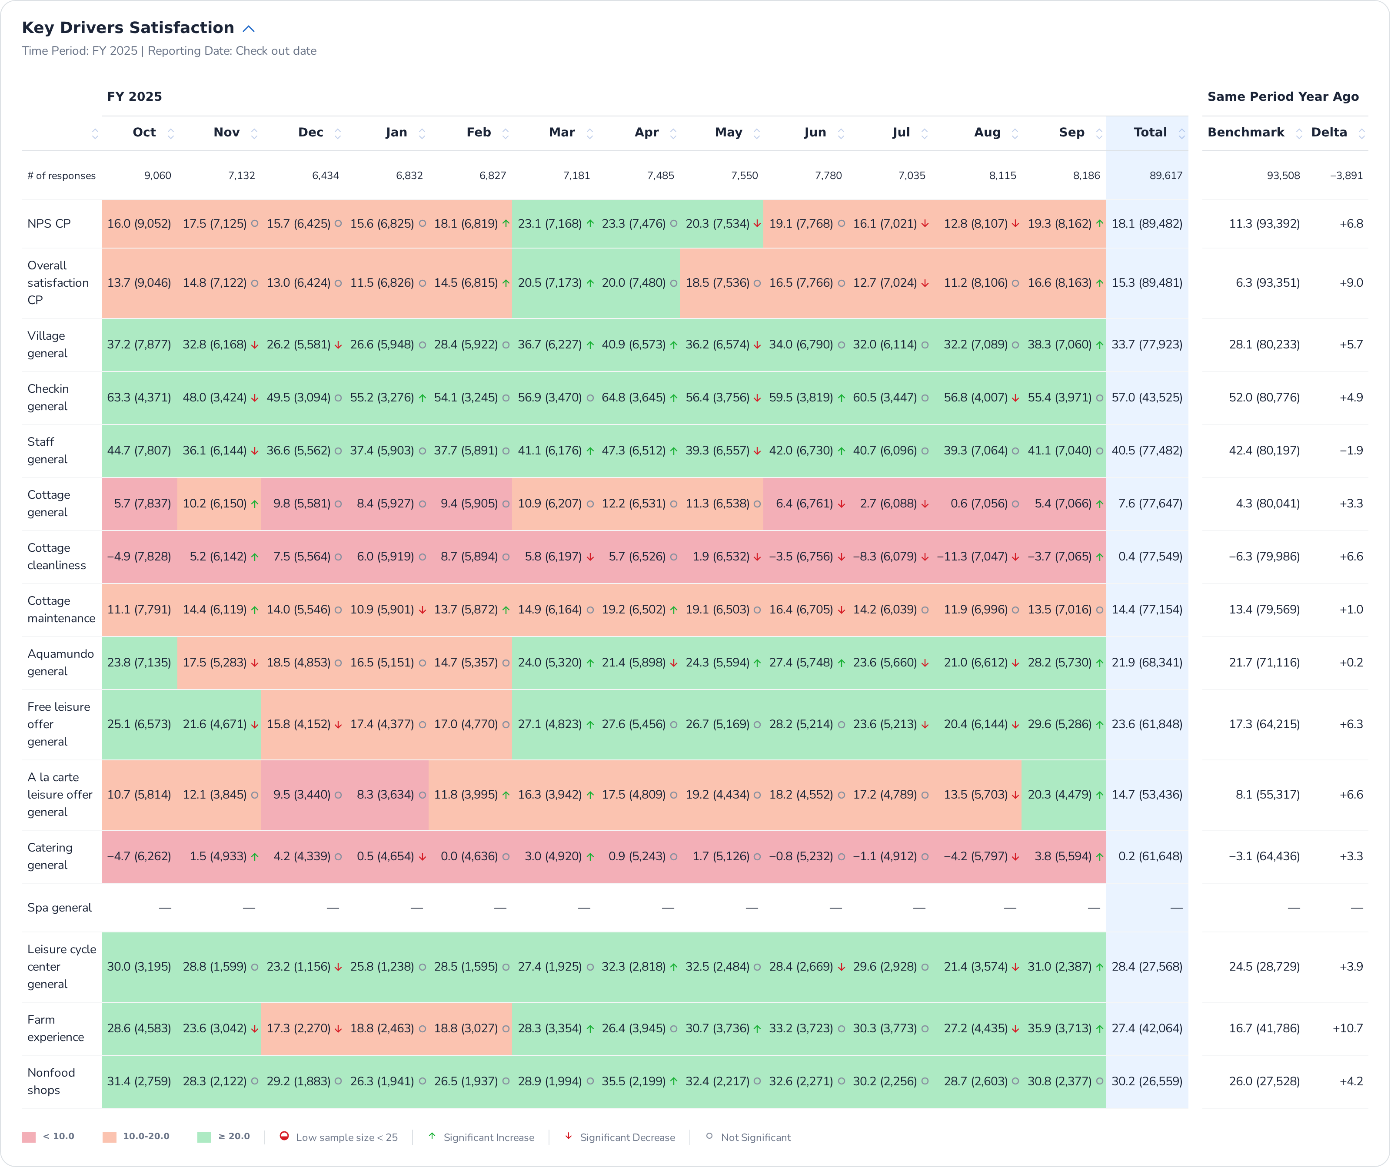
Netherlands – main pillars over months
Direct impact between cottage general and its main attributes cleanliness and maintenance, with NPS and Overall satisfaction of the stay.
Improvement of all pillars compared to ly.
Analysis

Slide 29
Netherlands – main pillars over months
Improvement of all pillars compared to ly.
NSS of catering offer is still very low.
Analysis

Slide 30
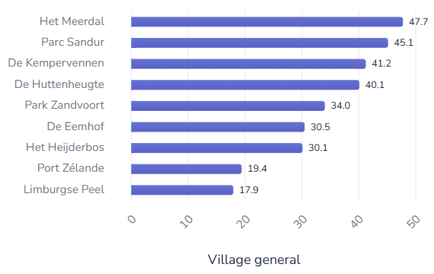
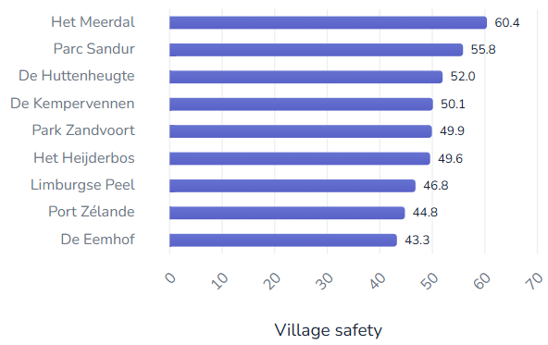
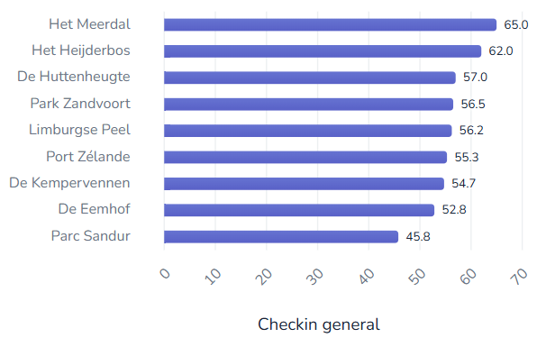
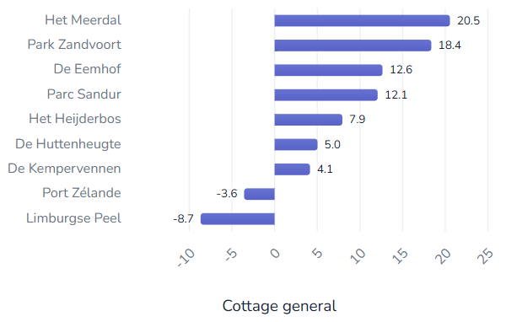
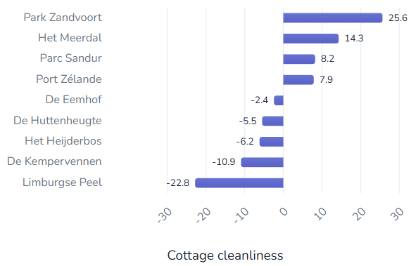
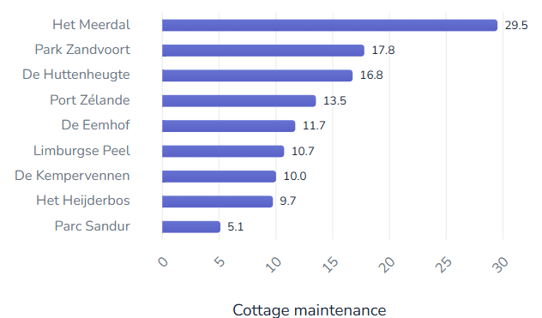
Netherlands – ranking parks on main pillars
Het Meerdal is TOP village and cottage experiences.
Park Sandur is also TOP village for village experience.
Park Zandvoort is also TOP village for cottage experience.
Analysis

Slide 31
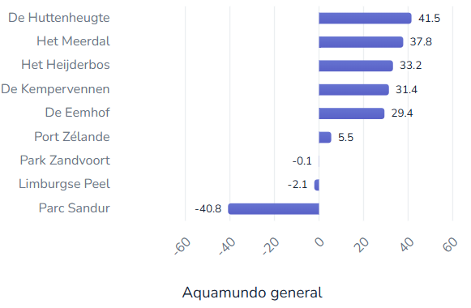
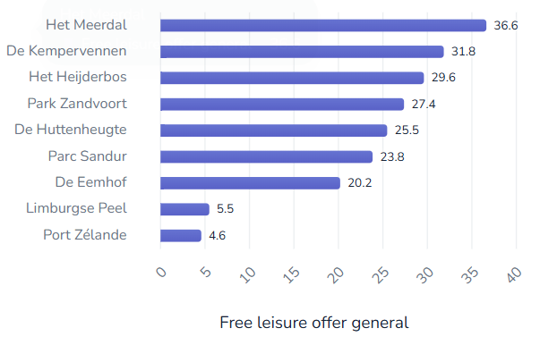
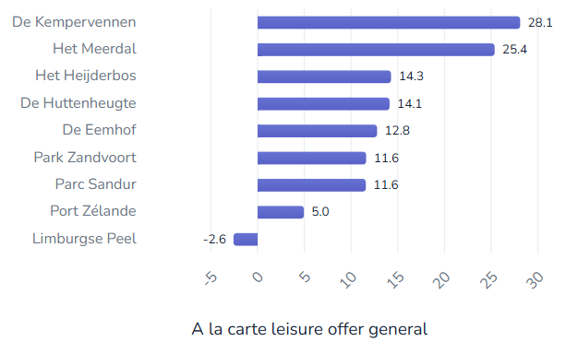
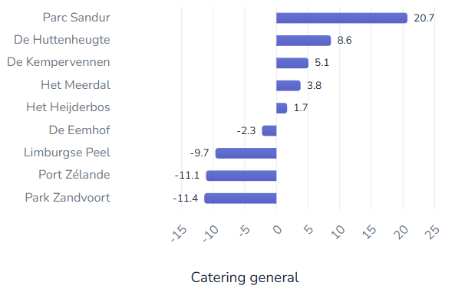
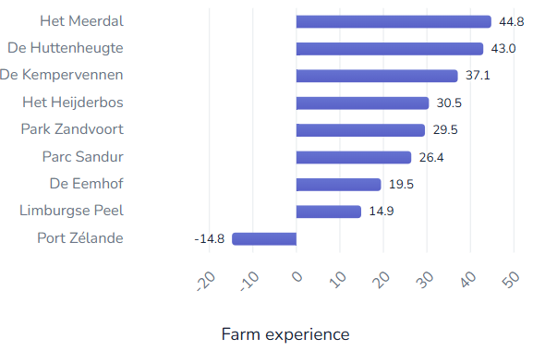
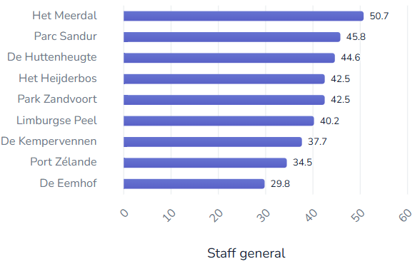
Netherlands – ranking parks on main pillars
De Huttenheugte is TOP village for Aqua Mundo and Farm experience.
Het Meerdal and De Kempervenen are top villages for Leisure and Farm experiences, whereas Limburgse Peel and Port Zélande are at bottom.
Parc Sandur is clearly above other parks in catering experience but is not in TOP villages for Aqua Mundo and leisure experiences.
Analysis

Slide 32
Netherlands – NPS per trialist/repeaters/reactivated
NPS Repeaters > NPS Trialist and ReActivated guest.
All segments improved in all parks of Netherlands.
 | FY25 | FY24 | Evol
R | 23,4 | 17,4 | 6,0
Total | 18,1 | 11,3 | 6,8
A | 11,2 | 6,5 | 4,7
T | 9,9 | 1,9 | 8,0
Analysis
 | FY25 | FY24 | Evol
 | 18,1 | 11,3 | 6,8
De Eemhof | 13,3 | 6,5 | 6,8
A | 6,1 | 3,2 | 3,0
R | 17,0 | 12,6 | 4,5
T | 8,6 | -2,2 | 10,7
De Huttenheugte | 19,6 | 14,8 | 4,7
A | 9,5 | 10,1 | -0,7
R | 26,7 | 20,8 | 5,9
T | 9,1 | 5,0 | 4,0
De Kempervennen | 22,7 | 16,3 | 6,4
A | 12,9 | 7,7 | 5,1
R | 25,4 | 20,2 | 5,1
T | 18,3 | 9,7 | 8,6
 | FY25 | FY24 | Evol
Het Heijderbos | 16,6 | 10,1 | 6,5
A | 13,1 | 6,2 | 6,9
R | 21,6 | 16,4 | 5,2
T | 8,8 | 0,4 | 8,3
Het Meerdal | 31,7 | 24,9 | 6,8
A | 22,8 | 21,7 | 1,1
R | 34,8 | 30,0 | 4,8
T | 25,7 | 14,3 | 11,4
Limburgse Peel | 2,5 | -6,8 | 9,3
A | -6,7 | -10,8 | 4,1
R | 9,8 | 0,7 | 9,1
T | -6,5 | -15,5 | 9,0
 | FY25 | FY24 | Evol
Parc Sandur | 19,3 | 9,7 | 9,6
A | 11,1 | 1,6 | 9,5
R | 25,7 | 14,4 | 11,3
T | 11,0 | 4,0 | 7,0
Park Zandvoort | 22,6 | 17,8 | 4,7
A | 20,5 | 14,2 | 6,3
R | 29,6 | 24,4 | 5,2
T | 11,8 | 9,5 | 2,4
Port Zélande | 11,7 | 4,9 | 6,8
A | 10,4 | 1,9 | 8,5
R | 16,7 | 11,0 | 5,6
T | 3,6 | -3,9 | 7,5

Slide 33
Netherlands – NPS per household structure
Data are slightly different because a part of total booking don’t get household structure information.
Dutch parks increased on all household structures.
Seniors, Adults 35-54 and 3;4 are the highest NPS.
0;2 and 12;17 are the lowest NPS, below average.
 | FY25 | FY24 | Evol
Seniors>75 | 23,0 | 16,7 | 6,3
Seniors active 55-74 | 22,2 | 16,5 | 5,7
Adults 35-54 | 19,1 | 11,7 | 7,4
Family with Children 3-4 | 19,0 | 11,9 | 7,1
Total | 18,4 | 11,8 | 6,6
Family with Children 5-11 | 18,1 | 11,9 | 6,2
Young Adults 18-34 | 17,6 | 8,7 | 8,9
Family with Children 12-17 | 15,1 | 9,4 | 5,7
Family with Children 0-2 | 12,8 | 4,2 | 8,6
Analysis
 | FY25 | FY24 | Evol
 | 18,4 | 11,8 | 6,6
De Eemhof | 13,5 | 7,2 | 6,3
Adults 35-54 | 12,9 | 5,6 | 7,3
Family with Children 0-2 | 8,4 | -6,6 | 15,0
Family with Children 12-17 | 13,5 | 7,4 | 6,0
Family with Children 3-4 | 12,0 | 2,2 | 9,8
Family with Children 5-11 | 12,7 | 8,9 | 3,8
Seniors active 55-74 | 17,4 | 11,1 | 6,4
Seniors>75 | 10,2 | 9,4 | 0,8
Young Adults 18-34 | 12,0 | 7,8 | 4,2
De Huttenheugte | 19,9 | 15,1 | 4,8
Adults 35-54 | 17,3 | 8,0 | 9,3
Family with Children 0-2 | 17,1 | 12,8 | 4,3
Family with Children 12-17 | 16,3 | 15,1 | 1,2
Family with Children 3-4 | 16,5 | 13,2 | 3,3
Family with Children 5-11 | 22,3 | 15,7 | 6,6
Seniors active 55-74 | 22,6 | 19,6 | 3,0
Seniors>75 | 21,6 | 13,7 | 7,9
Young Adults 18-34 | 21,5 | 14,8 | 6,8
 | FY25 | FY24 | Evol
De Kempervennen | 23,3 | 16,9 | 6,3
Adults 35-54 | 19,4 | 12,2 | 7,3
Family with Children 0-2 | 14,9 | 11,3 | 3,6
Family with Children 12-17 | 23,5 | 17,6 | 5,9
Family with Children 3-4 | 21,9 | 15,2 | 6,6
Family with Children 5-11 | 26,3 | 20,7 | 5,6
Seniors active 55-74 | 23,3 | 17,8 | 5,5
Seniors>75 | 23,6 | 14,0 | 9,6
Young Adults 18-34 | 24,3 | 13,5 | 10,8
Het Heijderbos | 16,8 | 10,5 | 6,4
Adults 35-54 | 14,9 | 14,3 | 0,6
Family with Children 0-2 | 17,3 | 3,9 | 13,4
Family with Children 12-17 | 12,5 | 6,1 | 6,4
Family with Children 3-4 | 14,6 | 10,5 | 4,1
Family with Children 5-11 | 16,5 | 12,1 | 4,5
Seniors active 55-74 | 21,0 | 13,6 | 7,4
Seniors>75 | 25,0 | 7,4 | 17,6
Young Adults 18-34 | 21,4 | 9,4 | 12,0
 | FY25 | FY24 | Evol
Het Meerdal | 31,9 | 25,4 | 6,5
Adults 35-54 | 32,3 | 23,9 | 8,4
Family with Children 0-2 | 30,6 | 22,0 | 8,7
Family with Children 12-17 | 28,9 | 17,3 | 11,6
Family with Children 3-4 | 37,5 | 30,8 | 6,7
Family with Children 5-11 | 32,5 | 26,2 | 6,4
Seniors active 55-74 | 31,0 | 29,2 | 1,8
Seniors>75 | 31,3 | 26,1 | 5,2
Young Adults 18-34 | 29,4 | 23,3 | 6,1
Limburgse Peel | 3,0 | -6,0 | 8,9
Adults 35-54 | 10,5 | -2,0 | 12,5
Family with Children 0-2 | -7,9 | -17,9 | 10,0
Family with Children 12-17 | 0,0 | -8,9 | 8,9
Family with Children 3-4 | -3,3 | -8,2 | 4,9
Family with Children 5-11 | -2,9 | -9,7 | 6,7
Seniors active 55-74 | 16,4 | 7,6 | 8,8
Seniors>75 | 18,5 | 8,6 | 9,9
Young Adults 18-34 | -12,8 | -23,0 | 10,2
 | FY25 | FY24 | Evol
Parc Sandur | 19,1 | 9,6 | 9,5
Adults 35-54 | 27,8 | 13,3 | 14,5
Family with Children 0-2 | 1,8 | 1,0 | 0,7
Family with Children 12-17 | 14,8 | 6,7 | 8,1
Family with Children 3-4 | 19,5 | -2,3 | 21,8
Family with Children 5-11 | 16,0 | 8,2 | 7,9
Seniors active 55-74 | 24,5 | 15,7 | 8,7
Seniors>75 | 25,7 | 26,8 | -1,1
Young Adults 18-34 | 9,7 | -2,3 | 12,0
Park Zandvoort | 22,2 | 18,2 | 3,9
Adults 35-54 | 27,5 | 22,1 | 5,4
Family with Children 0-2 | 15,0 | 13,6 | 1,4
Family with Children 12-17 | 13,8 | 11,6 | 2,2
Family with Children 3-4 | 20,3 | 18,5 | 1,8
Family with Children 5-11 | 19,4 | 15,4 | 4,0
Seniors active 55-74 | 28,1 | 24,0 | 4,1
Seniors>75 | 33,2 | 32,2 | 1,0
Young Adults 18-34 | 18,7 | 10,6 | 8,0
Port Zélande | 11,9 | 5,3 | 6,7
Adults 35-54 | 10,8 | 4,3 | 6,5
Family with Children 0-2 | 5,1 | -0,7 | 5,7
Family with Children 12-17 | 9,8 | 7,4 | 2,5
Family with Children 3-4 | 15,3 | 3,6 | 11,7
Family with Children 5-11 | 12,0 | 2,9 | 9,1
Seniors active 55-74 | 14,5 | 8,3 | 6,2
Seniors>75 | 16,2 | 17,1 | -0,9
Young Adults 18-34 | 12,9 | 2,4 | 10,4

Slide 34
Netherlands – NPS per customer country
GB, US, IL, IE, FR, BE, DE and LU origins are the highest NPS.
NL, CH and DK are the lowest NPS below average.
Increase of all origin except IL and CH.
NPS FR decreased on Park Sandur, De Huttenheugte, De Eemhof and Het Meerdal.
NPS CH mainly decreased on Port Zélande and Park Zandvoort.
 | FY25 | FY24 | Evol
US | 56,7
GB | 48,3 | 41,7 | 6,6
IL | 47,4 | 48,6 | -1,2
IE | 31,4 | 21,9 | 9,5
FR | 28,1 | 27,9 | 0,2
BE | 27,6 | 22,1 | 5,5
DE | 23,8 | 14,2 | 9,6
LU | 19,7 | 8,1 | 11,6
Total | 18,1 | 11,3 | 6,8
DK | 11,5 | 3,1 | 8,4
NL | 9,8 | 4,1 | 5,7
CH | 8,5 | 15,9 | -7,4
Analysis
 | FY25 | FY24 | Evol
De Eemhof | 13,3 | 6,5 | 6,8
BE | 27,6 | 25,9 | 1,7
DE | 18,4 | 8,1 | 10,3
FR | 32,3 | 33,0 | -0,6
GB | 37,3 | 37,1 | 0,2
IL | 44,0 | 46,0 | -1,9
LU | 24,3 | 3,1 | 21,2
NL | 7,1 | -0,3 | 7,5
De Huttenheugte | 19,6 | 14,8 | 4,8
BE | 33,0 | 28,4 | 4,6
DE | 28,6 | 20,9 | 7,7
DK | 17,1 | 25,0 | -7,9
FR | 25,0 | 30,8 | -5,8
GB | 42,4 | 61,3 | -18,9
NL | 13,5 | 9,3 | 4,2
De Kempervennen | 22,7 | 16,3 | 6,3
BE | 33,5 | 27,6 | 6,0
DE | 30,6 | 20,7 | 9,9
FR | 42,0 | 38,5 | 3,5
GB | 56,3 | 48,1 | 8,2
IE | 44,1 | 19,4 | 24,8
LU | 37,3 | 5,3 | 32,0
NL | 11,3 | 6,1 | 5,2
 | FY25 | FY24 | Evol
Het Heijderbos | 16,6 | 10,1 | 6,5
BE | 26,2 | 20,7 | 5,5
DE | 20,4 | 13,1 | 7,3
FR | 42,3 | 29,9 | 12,4
GB | 47,2 | 41,4 | 5,7
LU | 10,4 | 0,0 | 10,4
NL | 10,3 | 4,3 | 6,0
Het Meerdal | 31,7 | 24,9 | 6,8
BE | 41,1 | 34,9 | 6,2
DE | 40,3 | 29,9 | 10,4
FR | 40,3 | 43,3 | -3,0
GB | 57,8 | 53,4 | 4,4
LU | 42,5 | 31,1 | 11,4
NL | 19,3 | 14,4 | 4,8
Limburgse Peel | 2,5 | -6,8 | 9,3
BE | 10,9 | 2,1 | 8,8
DE | 4,2 | -6,0 | 10,2
FR | -1,8 | 1,7 | -3,5
GB | 40,3 | 22,0 | 18,4
NL | -2,9 | -11,4 | 8,5
 | FY25 | FY24 | Evol
Parc Sandur | 19,3 | 9,6 | 9,6
BE | 21,2 | 18,9 | 2,3
DE | 25,2 | 13,7 | 11,5
FR | 7,1 | 13,8 | -6,7
NL | 12,5 | 3,8 | 8,8
Park Zandvoort | 22,6 | 17,9 | 4,7
BE | 25,2 | 26,5 | -1,3
CH | 3,6 | 18,2 | -14,6
DE | 28,9 | 20,3 | 8,6
FR | 22,4 | 20,9 | 1,5
GB | 27,8 | 31,4 | -3,6
LU | 27,6 | 8,8 | 18,8
NL | 13,6 | 12,3 | 1,3
Port Zélande | 11,7 | 4,9 | 6,8
BE | 20,6 | 14,8 | 5,8
CH | 15,9 | 19,4 | -3,5
DE | 15,4 | 5,2 | 10,2
FR | 26,8 | 21,6 | 5,2
GB | 35,7 | 17,7 | 17,9
LU | 6,1 | 14,5 | -8,4
NL | 0,1 | -4,1 | 4,2

Slide 35
Netherlands – NPS per villa category (comfort level)
NPS of all villa types increased vs ly.
Overall, the NPS is higher on special cottages than regular cottages, excepted Waterfront Suite (below average) and Kids cottage new generation (lower NPS of specials, decreased at HH and KV but increased at PZ and HB).
Within regulars, Premium are the highest NPS vs VIP and Comfort are the lowest NPS.
In other categories, Hotel and Appartments are doing great.
 | FY25 | FY24 | Evol
Premium Kids cottage | 40,6 | 28,7 | 11,9
Safari Lodge | 40,0 | 8,1 | 31,9
Jungle Cabana | 37,7 | 31,7 | 6,0
Boathouse | 37,3 | 22,6 | 14,6
Hotel Honeymoon-suite | 35,4 | 10,4 | 25,0
Premium Hotel | 31,0 | 26,8 | 4,2
Eden Premium cottage | 23,9 | 16,7 | 7,1
Premium Apartment | 23,3 | 13,2 | 10,1
Premium cottage | 20,6 | 13,1 | 7,6
Comfort Kids cottage | 18,5 | 4,7 | 13,8
Total | 18,1 | 11,3 | 6,8
Waterfront Suite | 18,0 | 12,2 | 5,7
Eden VIP cottage | 17,4 | 9,5 | 7,9
VIP cottage | 16,5 | 10,2 | 6,3
Comfort cottage | 14,5 | 8,7 | 5,9
Kids cottage, new generation | 14,5 | 7,0 | 7,5
Premium cottage Wheelchair | 6,0 | -2,1 | 8,1
Analysis
 | FY25 | FY24 | Evol
 | 18,1 | 11,3 | 6,8
De Eemhof | 13,3 | 6,5 | 6,8
Boathouse | 32,2 | 14,1 | 18,1
Comfort cottage | 13,5 | 5,6 | 7,9
Kids cottage new generation | 6,8 | -9,1 | 15,9
Premium Hotel | 23,4 | 21,5 | 1,9
Premium cottage | 12,2 | 2,9 | 9,4
Premium cottage Wheelchair | 0,0 | 3,8 | -3,8
VIP cottage | 8,9 | 5,5 | 3,3
Waterfront Suite | 18,0 | 12,2 | 5,7
De Huttenheugte | 19,6 | 14,8 | 4,7
Comfort cottage | 18,9 | 20,6 | -1,7
Kids cottage new generation | 12,9 | 16,7 | -3,7
Premium cottage | 20,6 | 14,3 | 6,3
VIP cottage | 18,2 | 9,6 | 8,6
De Kempervennen | 22,7 | 16,3 | 6,4
Boathouse | 39,4 | 28,2 | 11,3
Comfort cottage | 18,7 | 15,8 | 2,9
Eden Premium cottage | 23,9 | 16,7 | 7,1
Eden VIP cottage | 7,4 | -2,1 | 9,5
Kids cottage new generation | 35,9 | 42,9 | -7,0
Premium cottage | 26,4 | 18,9 | 7,5
VIP cottage | 18,8 | 12,7 | 6,1
 | FY25 | FY24 | Evol
Het Heijderbos | 16,6 | 10,1 | 6,5
Comfort cottage | 14,9 | 9,1 | 5,7
Eden VIP cottage | 20,6 | 12,7 | 7,8
Jungle Cabana | 37,7 | 31,7 | 6,0
Kids cottage new generation | 10,1 | 6,8 | 3,3
Premium Hotel | 32,6 | 29,7 | 2,9
Premium cottage | 16,8 | 9,2 | 7,6
VIP cottage | 12,9 | 7,5 | 5,4
Het Meerdal | 31,7 | 24,9 | 6,8
Comfort cottage | 34,9 | 28,9 | 6,0
Premium Kids cottage | 40,6 | 28,7 | 11,9
Premium cottage | 32,0 | 26,2 | 5,8
VIP cottage | 27,4 | 18,5 | 8,9
Limburgse Peel | 2,5 | -6,8 | 9,3
Comfort cottage | 2,7 | -6,6 | 9,3
VIP cottage | 1,1 | -8,2 | 9,4
 | FY25 | FY24 | Evol
Park Zandvoort | 22,6 | 17,8 | 4,7
Comfort cottage | 18,8 | 12,5 | 6,2
Hotel Honeymoon-suite | 35,4 | 10,4 | 25,0
Premium Hotel | 35,1 | 28,2 | 6,9
Premium cottage | 20,5 | 15,1 | 5,3
Premium cottage Wheelchair | 18,9 | 5,7 | 13,2
VIP cottage | 22,3 | 23,1 | -0,7
Port Zélande | 11,7 | 4,9 | 6,8
Comfort cottage | 8,9 | 4,6 | 4,3
Kids cottage new generation | 18,6 | -2,9 | 21,5
Premium Apartment | 23,3 | 13,2 | 10,1
Premium cottage | 10,6 | 1,8 | 8,9
Premium cottage Wheelchair | 2,0 | -13,2 | 15,2
Safari Lodge | 40,0 | 8,1 | 31,9
VIP cottage | 10,2 | 6,3 | 4,0

Slide 36
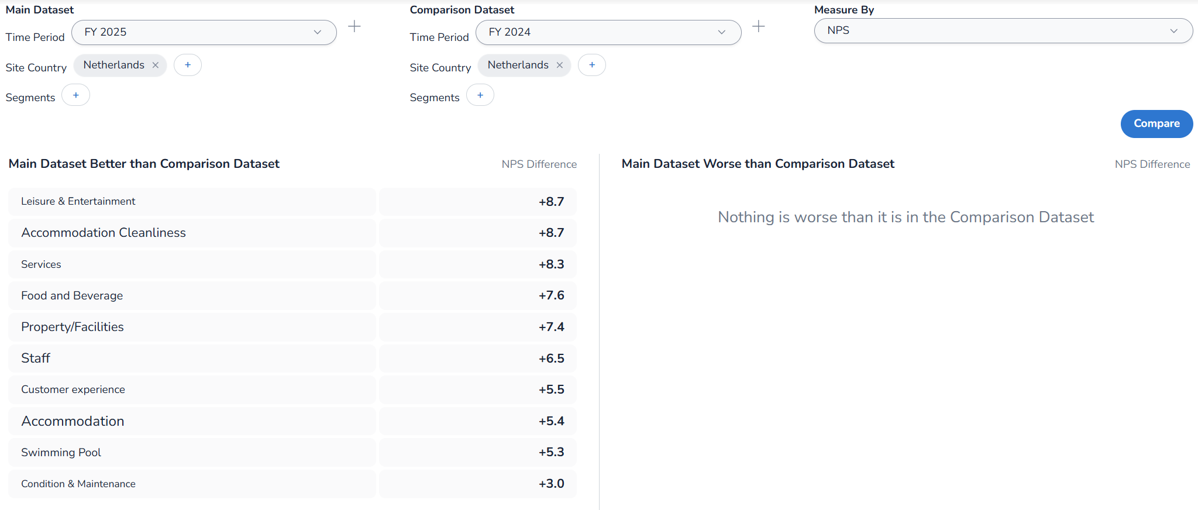
Netherlands – text analytics, topics comparision vs N-1
All categories of topics from open comments improved compared to N-1, which means a decrease in the share of negative comments, and/or an increase in the share of positive comment volumes, explaining the overall improvement in the total NPS.
Analysis

Slide 37
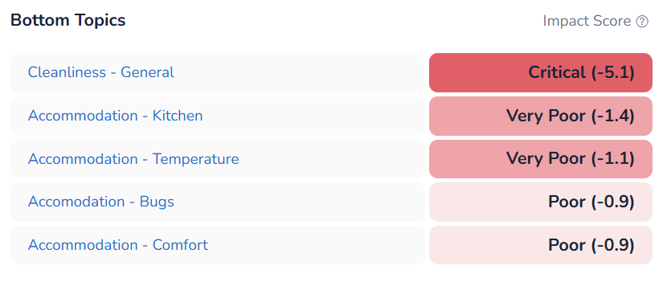
Netherlands – text analytics, bottom topics with higher negative impact score on NPS
Cottage cleanliness and maintenance issues have the highest negative impact score on NPS.
Analysis

Slide 38
Germany
NPS Review

Slide 39
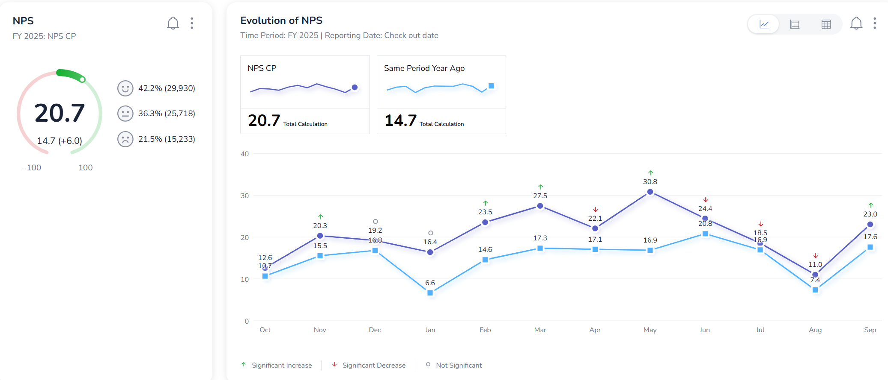
Germany – highest contribution to NPS
Continuous improvement of monthly NPS vs. N-1
Analysis

Slide 40
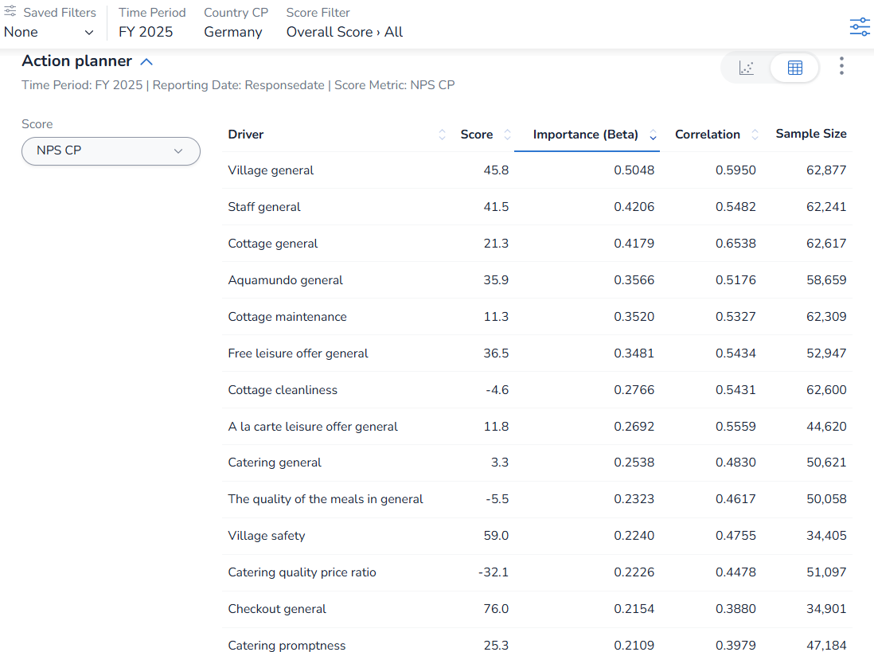
Germany – highest contribution to NPS
Main pillars are key on Net Promoter Score.
Secondary pillars “Village safety”, “quality of the meals” and “catering promptness” are also key to impact Net Promoter Score.
Analysis

Slide 41
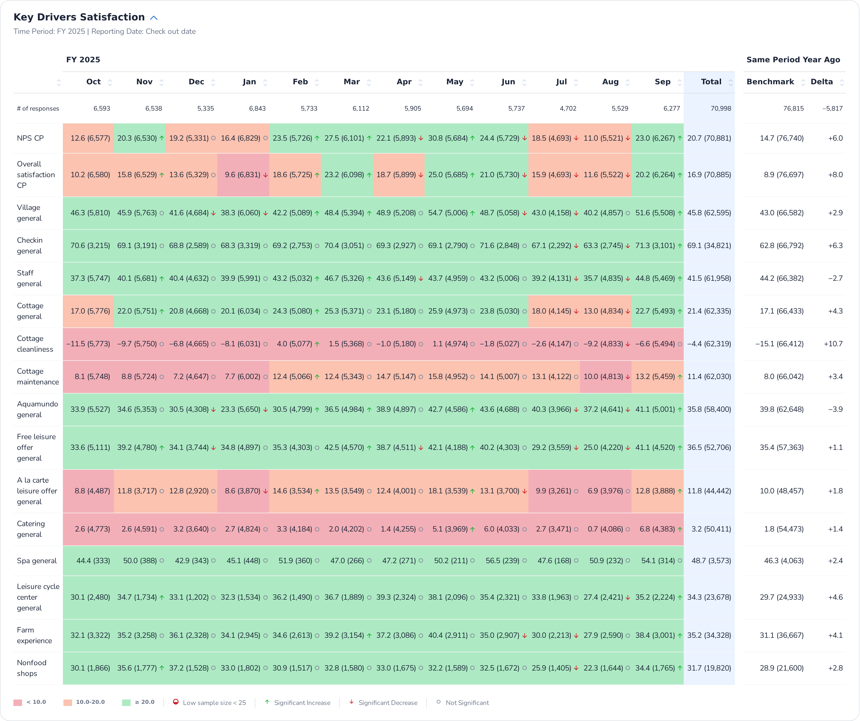
Germany – main pillars over months
Direct impact between cottage general and its main attributes cleanliness and maintenance, with NPS and Overall satisfaction of the stay.
Improvement of all pillars compared to ly, excepted on staff.
Analysis

Slide 42
Germany – main pillars over months
Improvement of all pillars compared to ly
NSS à la carte leisure offer continues to increase.
NSS catering general offer continues to increase, but it’s still low.
Analysis

Slide 43
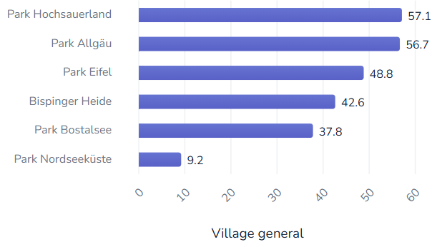
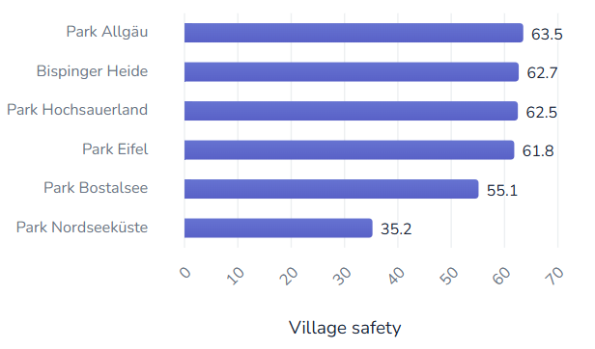
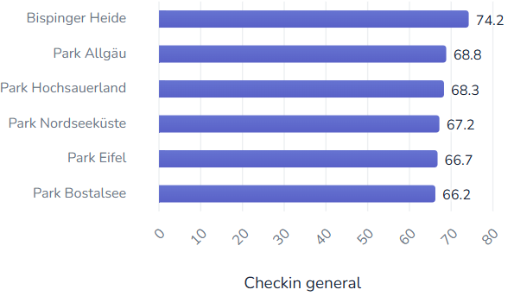
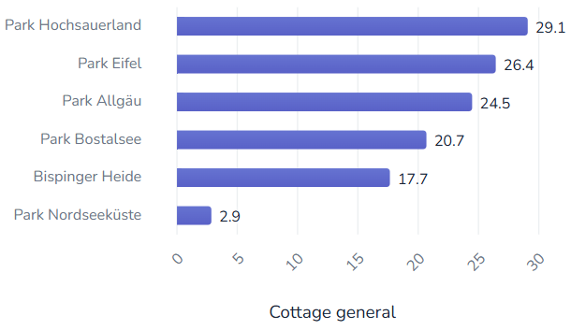
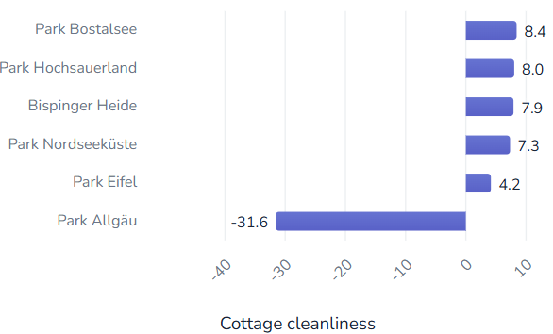
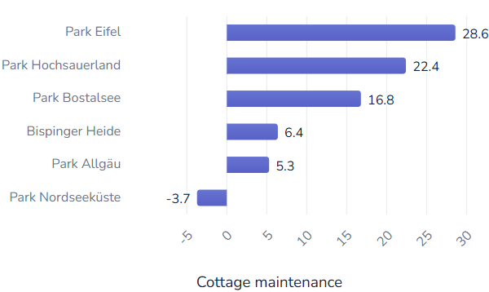
Germany – ranking parks on main pillars
Park Hochsauerland, Park Allgäu and Park Eifel are top village and cottage experience.
Nevertheless, Park Allgäu is still underperforming in cottage cleanliness and maintenance.
Park Nordseeküste is clearly below in both cottage and village experience.
Analysis

Slide 44
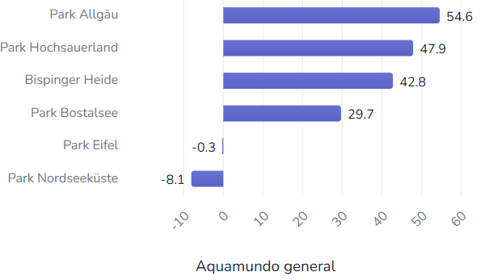
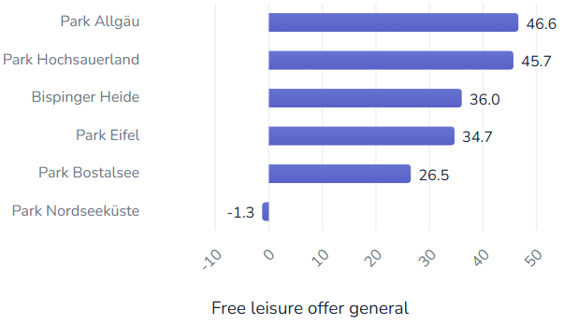




Germany – ranking parks on main pillars
Park Allgäu and Park Hochsauerland are TOP villages for Aqua Mundo and Leisure experience, before Bispinger Heide and Park Bostalsee.
Park Hochsauerland is also top village for catering, before Bispinger Heide and Park Bostalsee.
Park Eifel and Park Nordseeküste are clearly underperforming in Aqua Mundo experience. Park Eifel better performs in free leisure such as farm experience.
Analysis

Slide 45
Germany – NPS per trialist/repeaters/reactivated
NPS Repeaters > NPS Trialist and ReActivated guest.
All segments improved in all parks of Germany.
Only Trialists and Repeaters guest of Park Nordseeküste decreased.
 | FY25 | FY24 | Evol
R | 27 | 22,6 | 4,4
Total | 20,7 | 14,7 | 6,0
A | 16,1 | 8,5 | 7,6
T | 12,5 | 6 | 6,5
Analysis
 | FY25 | FY24 | Evol
Bispinger Heide | 21,1 | 11,0 | 10,2
A | 18,5 | 8,8 | 9,7
R | 27,1 | 19,3 | 7,8
T | 13,6 | 2,2 | 11,3
Park Allgäu | 17,5 | 13,8 | 3,7
A | 10,1 | 5,4 | 4,7
R | 22,9 | 21,5 | 1,3
T | 11,0 | 5,8 | 5,2
Park Bostalsee | 24,3 | 12,6 | 11,7
A | 22,7 | 6,4 | 16,2
R | 31,2 | 21,2 | 10,0
T | 15,2 | 3,8 | 11,5
Park Eifel | 22,4 | 13,9 | 8,5
A | 13,7 | 3,9 | 9,9
R | 29,3 | 18,1 | 11,2
T | 12,8 | 8,3 | 4,5
 | FY25 | FY24 | Evol
Park Hochsauerland | 35,6 | 32,2 | 3,5
A | 30,4 | 26,8 | 3,6
R | 40,7 | 39,2 | 1,5
T | 28,2 | 22,9 | 5,3
Park Nordseeküste | 0,3 | 0,1 | 0,2
A | 0,6 | -5,8 | 6,4
R | 8,6 | 9,5 | -0,8
T | -10,9 | -9,2 | -1,6

Slide 46
Germany – NPS per household structure
Data are slightly different because a part of total booking don’t get household structure information.
Seniors and family with 3;4 are the highest NPS.
Young Adults, 0;2 and 12;17 are the lowest NPS.
German parks increased on all household structure.
Only Park Nordseeküste lost few points on 0;2, 5;11 and seniors.
 | FY25 | FY24 | Evol
Seniors active 55-74 | 29,4 | 26,2 | 3,2
Seniors>75 | 29 | 22,5 | 6,5
Family with Children 3-4 | 22,6 | 14,9 | 7,7
Total | 20,8 | 15 | 5,8
Adults 35-54 | 19,9 | 15,6 | 4,3
Family with Children 5-11 | 19,9 | 14,2 | 5,7
Family with Children 12-17 | 17 | 11,2 | 5,8
Family with Children 0-2 | 16,5 | 10,7 | 5,8
Young Adults 18-34 | 14,9 | 7,9 | 7,0
Analysis
 | FY25 | FY24 | Evol
 | 20,8 | 15,0 | 5,8
Bispinger Heide | 21,2 | 11,1 | 10,1
Adults 35-54 | 17,5 | 10,4 | 7,1
Family with Children 0-2 | 14,5 | 7,0 | 7,6
Family with Children 12-17 | 17,4 | 6,8 | 10,6
Family with Children 3-4 | 21,2 | 10,3 | 10,9
Family with Children 5-11 | 21,5 | 10,3 | 11,1
Seniors active 55-74 | 29,7 | 22,6 | 7,1
Seniors>75 | 30,0 | 14,1 | 15,9
Young Adults 18-34 | 17,5 | 8,0 | 9,5
Park Allgäu | 17,7 | 14,2 | 3,5
Adults 35-54 | 17,1 | 14,4 | 2,7
Family with Children 0-2 | 15,5 | 9,6 | 5,9
Family with Children 12-17 | 17,2 | 13,0 | 4,2
Family with Children 3-4 | 20,1 | 17,5 | 2,6
Family with Children 5-11 | 15,3 | 13,4 | 1,8
Seniors active 55-74 | 28,8 | 21,3 | 7,5
Seniors>75 | 31,5 | 19,0 | 12,5
Young Adults 18-34 | 14,9 | 10,1 | 4,8
 | FY25 | FY24 | Evol
Park Bostalsee | 24,6 | 12,2 | 12,3
Adults 35-54 | 20,4 | 16,3 | 4,1
Family with Children 0-2 | 24,0 | 9,6 | 14,4
Family with Children 12-17 | 23,0 | 12,3 | 10,7
Family with Children 3-4 | 22,5 | 8,9 | 13,6
Family with Children 5-11 | 26,1 | 11,4 | 14,7
Seniors active 55-74 | 27,7 | 19,8 | 7,9
Seniors>75 | 20,2 | 17,9 | 2,3
Young Adults 18-34 | 22,4 | 3,7 | 18,6
Park Eifel | 22,4 | 14,3 | 8,0
Adults 35-54 | 22,5 | 14,1 | 8,4
Family with Children 0-2 | 19,0 | 12,0 | 7,0
Family with Children 12-17 | 11,6 | 1,1 | 10,6
Family with Children 3-4 | 28,9 | 15,7 | 13,3
Family with Children 5-11 | 23,4 | 13,5 | 10,0
Seniors active 55-74 | 26,3 | 26,1 | 0,2
Seniors>75 | 32,7 | 22,2 | 10,5
Young Adults 18-34 | 9,9 | 13,3 | -3,4
 | FY25 | FY24 | Evol
Park Hochsauerland | 35,7 | 32,5 | 3,2
Adults 35-54 | 36,5 | 31,3 | 5,2
Family with Children 0-2 | 35,4 | 30,2 | 5,2
Family with Children 12-17 | 28,3 | 26,7 | 1,7
Family with Children 3-4 | 33,9 | 29,2 | 4,7
Family with Children 5-11 | 35,5 | 32,3 | 3,2
Seniors active 55-74 | 42,2 | 43,1 | -1,0
Seniors>75 | 44,7 | 41,5 | 3,2
Young Adults 18-34 | 32,0 | 22,3 | 9,8
Park Nordseeküste | -0,5 | 0,5 | -1,0
Adults 35-54 | 3,9 | 7,2 | -3,3
Family with Children 0-2 | -18,4 | -10,8 | -7,6
Family with Children 12-17 | -3,2 | -3,2 | 0,1
Family with Children 3-4 | 1,7 | -5,4 | 7,1
Family with Children 5-11 | -3,8 | -2,2 | -1,6
Seniors active 55-74 | 12,7 | 17,0 | -4,3
Seniors>75 | 4,8 | 13,9 | -9,2
Young Adults 18-34 | -9,0 | -15,3 | 6,3

Slide 47
Germany – NPS per customer country
GB, IL, FR, BE origin are the highest NPS.
AT, NL, CH and DK are the lowest NPS below average.
Increase of all origin except IL, AT and DK.
NPS Park Allgaü increased mainly on local origin, and BE / NL origin (most of the volumes) whereas it decreased on other origin like FR, BE, GB, AT.
 | FY25 | FY24 | Evol
GB | 43,7 | 42,7 | 1,0
IL | 38,6 | 48,3 | -9,7
FR | 31,5 | 29,9 | 1,6
BE | 30,1 | 26,3 | 3,8
LU | 27,1 | 9,6 | 17,5
DE | 21,4 | 14,7 | 6,7
Total | 20,7 | 14,7 | 6,0
AT | 16,4 | 28,4 | -12,0
NL | 12,8 | 9 | 3,8
CH | 12 | 11,6 | 0,4
DK | 7,3 | 12,4 | -5,1
Analysis
 | FY25 | FY24 | Evol
 | 20,7 | 14,7 | 6,0
Bispinger Heide | 21,1 | 11,0 | 10,2
BE | 26,5 | 4,3 | 22,3
DE | 21,9 | 11,5 | 10,4
DK | 6,6 | 12,7 | -6,1
NL | 3,8 | -6,9 | 10,8
Park Allgäu | 17,5 | 13,8 | 3,7
AT | 17,5 | 30,5 | -13,0
BE | 22,9 | 30,7 | -7,8
CH | 12,0 | 12,1 | -0,1
DE | 17,5 | 12,9 | 4,6
DK | 3,3 | 9,1 | -5,8
FR | 39,5 | 43,9 | -4,4
GB | 38,9 | 56,1 | -17,2
IL | 44,4 | 45,2 | -0,7
LU | 29,5 | 18,4 | 11,1
NL | 17,8 | 12,3 | 5,6
BE | 2,8 | -10,7 | 13,5
DE | 1,0 | 1,1 | -0,1
NL | -10,3 | -21,7 | 11,3
 | FY25 | FY24 | Evol
Park Bostalsee | 24,3 | 12,6 | 11,7
BE | 33,7 | 26,9 | 6,8
CH | 14,9 | -1,0 | 15,9
DE | 24,5 | 12,1 | 12,4
FR | 32,3 | 28,0 | 4,3
LU | 25,0 | 9,3 | 15,7
NL | 11,5 | 2,6 | 8,9
Park Eifel | 22,4 | 13,9 | 8,4
BE | 28,1 | 25,5 | 2,6
CH | 28,6 | 10,5 | 18,0
DE | 24,7 | 14,4 | 10,3
FR | 17,3 | 1,6 | 15,7
GB | 27,6 | 23,8 | 3,8
LU | 25,9 | 10,5 | 15,4
NL | 10,9 | 8,9 | 2,0
 | FY25 | FY24 | Evol
Park Hochsauerland | 35,6 | 32,2 | 3,4
BE | 42,9 | 30,8 | 12,1
DE | 38,6 | 34,3 | 4,3
DK | 22,6 | 9,1 | 13,5
FR | 23,5 | 29,2 | -5,6
NL | 19,5 | 20,4 | -0,8
Park Nordseeküste | 0,3 | 0,1 | 0,2
BE | 2,8 | -10,7 | 13,5
DE | 1,0 | 1,1 | -0,1
NL | -10,3 | -21,7 | 11,3

Slide 48
Germany – NPS per villa category (comfort level)
NPS of all villa types increased vs ly.
Overall, the NPS is higher on special cottages than regular with TOP Villa type on Treehouse and Boathouse.
Within regulars (Eden) VIP and Exclusive Wellness are the lowest NPS.
In other categories, Hotel (Hochsauerland) is the highest NPS whereas Apartments (Nordseeküste) are the most critical.
 | FY25 | FY24 | Evol
Hotel Premium Wheelchair | 57,8 | 25,8 | 32,0
Treehouse | 34,7 | 30,6 | 4,1
Boathouse | 33,5 | 17,7 | 15,8
Premium Kids cottage | 30,9 | 24,4 | 6,5
Premium Hotel | 30,7 | 28,6 | 2,1
Exclusive | 23,9 | 18,1 | 5,8
Premium cottage | 22,6 | 16,4 | 6,2
Comfort cottage | 22,5 | 15,0 | 7,6
Premium cottage Wheelchair | 21,1 | 11,0 | 10,1
Total | 20,7 | 14,7 | 6,0
Eden Premium cottage | 16,4 | 1,9 | 14,5
VIP cottage | 13,9 | 10,1 | 3,8
Exclusive Wellness | 11,3 | 9,0 | 2,3
Apartment Comfort | 1,9 | 1,3 | 0,6
Appartement VIP | 1,3 | -3,1 | 4,4
Eden VIP cottage | -0,6 | -6,1 | 5,5
Analysis
 | FY25 | FY24 | Evol
 | 20,7 | 14,7 | 6,0
Bispinger Heide | 21,1 | 11,0 | 10,2
Boathouse | 33,5 | 17,7 | 15,8
Comfort cottage | 22,6 | 9,0 | 13,5
Eden Premium cottage | 16,4 | 1,9 | 14,5
Eden VIP cottage | -0,6 | -6,1 | 5,5
Premium Hotel | 31,7 | 32,2 | -0,5
Premium Kids cottage | 35,0 | 17,0 | 18,0
Premium cottage | 24,0 | 13,0 | 11,1
Premium cottage Wheelchair | 26,1 | 1,4 | 24,7
Treehouse | 34,7 | 30,6 | 4,1
VIP cottage | 15,6 | 8,5 | 7,1
Park Allgäu | 17,5 | 13,8 | 3,7
Comfort cottage | 20,4 | 14,8 | 5,6
Exclusive | 23,9 | 18,1 | 5,8
Exclusive Wellness | 11,3 | 9,0 | 2,3
Premium cottage | 17,2 | 13,8 | 3,4
Premium cottage Wheelchair | 16,0 | 1,8 | 14,3
VIP cottage | 9,7 | 9,9 | -0,2
 | FY25 | FY24 | Evol
Park Bostalsee | 24,3 | 12,6 | 11,7
Comfort cottage | 24,0 | 13,0 | 11,0
Premium cottage | 27,9 | 14,8 | 13,1
VIP cottage | 17,3 | 5,8 | 11,6
Park Eifel | 22,4 | 13,9 | 8,5
Comfort cottage | 24,3 | 15,2 | 9,1
Premium Kids cottage | 19,2 | 17,2 | 1,9
Premium cottage | 22,4 | 16,9 | 5,6
VIP cottage | 19,5 | 5,1 | 14,4
 | FY25 | FY24 | Evol
Park Hochsauerland | 35,6 | 32,2 | 3,5
Comfort cottage | 37,2 | 33,4 | 3,7
Hotel Premium Wheelchair | 57,8 | 25,8 | 32,0
Premium Hotel | 45,5 | 37,2 | 8,3
Premium Kids cottage | 37,4 | 34,7 | 2,7
Premium cottage | 34,1 | 31,7 | 2,4
Premium cottage Wheelchair | 24,6 | 38,1 | -13,5
VIP cottage | 27,8 | 27,2 | 0,6
Park Nordseeküste | 0,3 | 0,1 | 0,2
Apartment Comfort | 1,9 | 1,3 | 0,6
Appartement VIP | 1,3 | -3,1 | 4,4
Comfort cottage | -3,5 | -6,4 | 2,8
Premium Hotel | 14,1 | 16,3 | -2,2
Premium cottage | -3,4 | -5,5 | 2,1
VIP cottage | -8,6 | -3,4 | -5,2

Slide 49

Germany – text analytics, topics comparision vs N-1
All categories of topics from open comments improved compared to N-1, which means a decrease in the share of negative comments, and/or an increase in the share of positive comment volumes, explaining the overall improvement in the total NPS, except for value for money.
Analysis

Slide 50

Germany – text analytics, bottom topics with higher negative impact score on NPS
Cottage cleanliness and maintenance issues have the highest negative impact score on NPS, before staff attitude and helpfulness, central facilities and spa (mainly maintenance condition in accommodation).
Analysis

Slide 51
France
NPS Review

Slide 52

France – highest contribution to NPS
Continuous improvement vs N-1 for NPS
Despite in June and July (due to decrease in cottage, weather condition, catering and leisure)
Analysis

Slide 53

France – highest contribution to NPS
Main pillars are key on Net Promoter Score.
Secondary pillars “Village safety”, “quality of the meals” are also key to impact Net Promoter Score.
Analysis

Slide 54

France – main pillars over months
Direct impact between cottage general and its main attributes cleanliness and maintenance, with NPS and Overall satisfaction of the stay.
Improvement of all pillars compared to ly.
Analysis

Slide 55
France – main pillars over months
Improvement of all pillars compared to ly.
NSS catering offer increased and turned positive, but still low.
Analysis

Slide 56






France – ranking parks on main pillars
Les Landes de Gascogne is TOP Villages for village and cottage experiences, before Le Bois aux Daims and Les Trois Forêts.
Whereas Le Lac d’Ailette is at the bottom on both experiences.
Analysis

Slide 57






France – ranking parks on main pillars
Le Bois aux Daims and Les Landes de Gascogne are TOP village for Aqua Mundo and leisure experiences.
Le Bois aux Daims is TOP village on catering experience, despite low NSS.
Les Landes de Gascogne, Villages Nature Paris and Les Trois Forêts are TOP village for Farm experience, before Le Bois aux Daims.
Le Lac d’Ailette is also at the bottom for catering, leisure and farm experiences.
Les Bois-Francs and Les Hauts de Bruyères are also at the bottom for farm experience.
Analysis

Slide 58
France – NPS per trialist/repeaters/reactivated
NPS Trialist > NPS Repeaters and ReActivated guest.
All segments improved in all parks of France.
+12,7 pts on Reactivated guest at Les Hauts de Bruyères (newly refurbished).
High improvement also on ReActivated guest at les Bois-Francs, Le Bois-aux-Daims and Les Trois-Forêts.
 | FY25 | FY24 | Evol
T | 23,9 | 16,4 | 7,5
R | 21,1 | 16 | 5,1
Total | 18,1 | 11,3 | 6,8
A | 14,2 | 5,2 | 9,0
Analysis
 | FY25 | FY24 | Evol
 | 22,0 | 15,4 | 6,6
Le Bois aux Daims | 33,7 | 23,0 | 10,7
A | 27,7 | 12,5 | 15,2
R | 33,2 | 23,6 | 9,7
T | 34,7 | 24,2 | 10,6
Le Lac d'Ailette | 6,9 | 4,2 | 2,7
A | 1,8 | -5,1 | 6,9
R | 6,8 | 6,8 | 0,0
T | 7,9 | 2,5 | 5,3
Les Bois-Francs | 18,3 | 8,0 | 10,3
A | 10,9 | -1,4 | 12,3
R | 17,5 | 9,7 | 7,8
T | 19,8 | 7,9 | 11,9
 | FY25 | FY24 | Evol
Les Hauts de Bruyères | 15,2 | 9,0 | 6,2
A | 13,8 | 1,0 | 12,7
R | 14,7 | 11,3 | 3,4
T | 15,8 | 8,2 | 7,6
Les Landes de Gascogne | 48,5 | 41,1 | 7,4
A | 29,2 | 23,8 | 5,4
R | 46,5 | 39,8 | 6,7
T | 51,0 | 43,5 | 7,6
Les Trois Forêts | 27,2 | 18,9 | 8,3
A | 19,9 | 10,7 | 9,2
R | 29,4 | 21,5 | 7,9
T | 25,4 | 17,4 | 8,0
Villages Nature Paris | 8,8 | 4,9 | 3,9
A | -3,5 | -5,8 | 2,3
R | 7,5 | 4,4 | 3,2
T | 11,5 | 7,0 | 4,4

Slide 59
France – NPS per household structure
Data are slightly different because a part of total booking don’t get household structure information.
French parks increased on all household structures. Only 12;17 decreased at le Lac d’Ailette
Seniors, Young Adults 18;34 and 0;2 and 3;4 are the highest NPS.
12;17 are the lowest NPS, below average.
 | FY25 | FY24 | Evol
Seniors>75 | 36,5 | 27,2 | 9,3
Seniors active 55-74 | 30,8 | 23,8 | 7,0
Family with Children 3-4 | 25,8 | 19,2 | 6,6
Young Adults 18-34 | 25,3 | 17,9 | 7,4
Family with Children 0-2 | 22,7 | 18,7 | 4,0
Total | 22,7 | 16,0 | 6,7
Family with Children 5-11 | 22,5 | 16,4 | 6,1
Adults 35-54 | 21,3 | 15,1 | 6,2
Family with Children 12-17 | 16,4 | 9,1 | 7,3
Analysis
 | FY25 | FY24 | Evol
Le Bois aux Daims | 34,2 | 23,4 | 10,8
Adults 35-54 | 32,0 | 22,8 | 9,2
Family with Children 0-2 | 31,7 | 27,7 | 4,0
Family with Children 12-17 | 30,7 | 17,1 | 13,6
Family with Children 3-4 | 36,5 | 27,5 | 9,0
Family with Children 5-11 | 32,8 | 23,3 | 9,4
Seniors active 55-74 | 41,0 | 27,9 | 13,0
Seniors>75 | 47,1 | 34,8 | 12,3
Young Adults 18-34 | 38,5 | 29,7 | 8,7
Le Lac d'Ailette | 7,6 | 4,9 | 2,7
Adults 35-54 | 3,8 | 1,0 | 2,8
Family with Children 0-2 | 0,7 | 3,2 | -2,6
Family with Children 12-17 | 3,7 | 0,2 | 3,6
Family with Children 3-4 | 6,6 | 3,9 | 2,6
Family with Children 5-11 | 9,6 | 6,5 | 3,1
Seniors active 55-74 | 17,4 | 13,8 | 3,6
Seniors>75 | 28,9 | 21,0 | 7,9
Young Adults 18-34 | 5,0 | 5,6 | -0,6
 | FY25 | FY24 | Evol
Les Bois-Francs | 19,1 | 8,3 | 10,8
Adults 35-54 | 18,1 | 7,6 | 10,6
Family with Children 0-2 | 16,2 | 11,4 | 4,8
Family with Children 12-17 | 13,5 | 0,6 | 12,9
Family with Children 3-4 | 21,2 | 7,8 | 13,5
Family with Children 5-11 | 18,2 | 7,9 | 10,3
Seniors active 55-74 | 27,1 | 17,4 | 9,7
Seniors>75 | 30,3 | 13,7 | 16,6
Young Adults 18-34 | 26,0 | 17,1 | 8,9
Les Hauts de Bruyères | 15,9 | 9,9 | 6,0
Adults 35-54 | 14,4 | 9,1 | 5,3
Family with Children 0-2 | 14,0 | 1,9 | 12,1
Family with Children 12-17 | 10,6 | 2,0 | 8,6
Family with Children 3-4 | 15,2 | 8,3 | 7,0
Family with Children 5-11 | 16,2 | 11,3 | 4,9
Seniors active 55-74 | 22,3 | 19,2 | 3,0
Seniors>75 | 34,0 | 28,2 | 5,8
Young Adults 18-34 | 15,8 | 15,3 | 0,4
Les Landes de Gascogne | 49,5 | 41,9 | 7,7
Adults 35-54 | 42,0 | 37,1 | 5,0
Family with Children 0-2 | 56,7 | 52,1 | 4,5
Family with Children 12-17 | 37,9 | 30,2 | 7,7
Family with Children 3-4 | 58,8 | 50,5 | 8,3
Family with Children 5-11 | 52,5 | 45,3 | 7,3
Seniors active 55-74 | 51,4 | 46,4 | 5,0
Seniors>75 | 49,3 | 34,7 | 14,6
Young Adults 18-34 | 56,2 | 31,1 | 25,2
 | FY25 | FY24 | Evol
Les Trois Forêts | 27,2 | 19,3 | 7,9
Adults 35-54 | 30,7 | 22,3 | 8,4
Family with Children 0-2 | 33,8 | 23,3 | 10,5
Family with Children 12-17 | 21,1 | 13,7 | 7,4
Family with Children 3-4 | 29,3 | 21,5 | 7,8
Family with Children 5-11 | 24,4 | 17,6 | 6,8
Seniors active 55-74 | 38,1 | 28,8 | 9,2
Seniors>75 | 41,3 | 33,8 | 7,5
Young Adults 18-34 | 32,1 | 22,3 | 9,8
Villages Nature Paris | 9,7 | 5,1 | 4,7
Adults 35-54 | 8,1 | 4,0 | 4,1
Family with Children 0-2 | 2,7 | 1,1 | 1,6
Family with Children 12-17 | 3,2 | 1,2 | 2,1
Family with Children 3-4 | 15,8 | 6,0 | 9,8
Family with Children 5-11 | 11,4 | 7,0 | 4,5
Seniors active 55-74 | 14,6 | 9,4 | 5,2
Seniors>75 | 26,4 | 17,6 | 8,8
Young Adults 18-34 | 14,5 | 5,3 | 9,2

Slide 60
France – NPS per customer country
French guest are the highest NPS for most of the volumes on all parks.
NL, BE and DK are the lowest NPS below average.
Increase of all origin except IL, ES, CH, IE (very low % of total respondents).
NPS French guest increased on all parks which impact the total FR country results.
 | FY25 | FY24 | Evol
ES | 45,5 | 45,8 | -0,4
IL | 43,8 | 55,9 | -12,2
FR | 24,4 | 16,9 | 7,5
Total | 22,0 | 15,5 | 6,6
LU | 21,5 | 10,8 | 10,7
CH | 20,9 | 16,0 | 4,9
DE | 20,7 | 13,6 | 7,1
GB | 17,9 | 20,1 | -2,2
US | 17,6 | 0,0 | 17,6
BE | 16,6 | 14,0 | 2,6
IE | 0,0 | 22,0 | -22,0
DK | -7,5 | -11,5 | 4,0
NL | -9,9 | -11,8 | 1,9
Analysis
 | FY25 | FY24 | Evol
 | 22,0 | 15,5 | 6,6
Le Bois aux Daims | 33,7 | 23,1 | 10,6
BE | 43,5 | 27,6 | 15,9
CH | 55,2 | 34,7 | 20,5
DE | 33,3 | 44,7 | -11,4
FR | 33,5 | 22,7 | 10,8
GB | 50,0 | 41,8 | 8,2
NL | 19,5 | 7,0 | 12,4
Le Lac d'Ailette | 6,9 | 4,4 | 2,6
BE | 8,7 | 4,8 | 3,9
CH | 1,8 | 2,1 | -0,3
DE | -22,0 | -6,2 | -15,8
FR | 11,3 | 7,3 | 4,0
GB | 4,8 | 8,1 | -3,3
LU | -7,7 | -19,2 | 11,5
NL | -33,3 | -26,8 | -6,6
LU | 0,0 | 12,2 | -12,2
 | FY25 | FY24 | Evol
Les Bois-Francs | 18,3 | 8,0 | 10,3
BE | 2,6 | 4,6 | -2,0
DE | 3,4 | -21,2 | 24,6
FR | 19,7 | 9,1 | 10,6
GB | 15,0 | 13,7 | 1,2
NL | -27,7 | -26,6 | -1,1
Les Hauts de Bruyères | 15,2 | 8,9 | 6,2
BE | 1,3 | -4,8 | 6,0
CH | 6,7 | 18,0 | -11,3
DE | -2,7 | -2,8 | 0,1
FR | 16,0 | 9,6 | 6,3
GB | 30,8 | 1,4 | 29,4
NL | -8,6 | -24,5 | 15,9
Les Landes de Gascogne | 48,5 | 41,1 | 7,4
BE | 38,7 | 48,1 | -9,4
CH | 36,1 | 42,5 | -6,4
DE | 33,3 | 43,3 | -10,0
ES | 67,6 | 60,9 | 6,7
FR | 48,9 | 41,0 | 7,9
GB | 39,5 | 53,0 | -13,6
NL | 21,6 | 9,1 | 12,5
 | FY25 | FY24 | Evol
Les Trois Forêts | 27,2 | 18,9 | 8,3
BE | 31,8 | 25,6 | 6,2
CH | 22,4 | 16,0 | 6,4
DE | 28,3 | 17,4 | 10,9
FR | 28,8 | 20,6 | 8,2
GB | 8,6 | 18,3 | -9,7
LU | 29,3 | 16,8 | 12,5
NL | 2,6 | -0,7 | 3,3
Villages Nature Paris | 8,8 | 4,9 | 3,8
BE | 10,4 | 7,8 | 2,6
CH | 1,9 | 8,0 | -6,1
DE | 11,0 | 10,0 | 0,9
FR | 9,9 | 2,6 | 7,3
GB | 19,0 | 22,0 | -3,0
IE | -1,8 | 20,5 | -22,3
IL | 27,3 | 65,4 | -38,1
LU | 0,0 | 12,2 | -12,2
NL | -3,8 | -8,4 | 4,6

Slide 61
France – NPS per villa category (comfort level)
NPS of all villa types increased vs ly, excluding VN Premium apt and LA Premium lakeside.
Overall, the NPS is higher on special cottages (treehouses) than regular.
Within regulars (Eden) VIP and Exclusive Wellness are the highest NPS.
In other categories, Hotelroom (BF) is the #2 of top villa types
TOP villa types are Treehouses (LG/BD), Hotel room (BF), Exclusive (TF, CH) and Themed (TF).
 | FY25 | FY24 | Evol
Treehouse | 52,6 | 31,8 | 20,8
Premium Hotel | 42,2 | 29,3 | 12,9
Exclusive Cottages | 36,3 | 34,8 | 1,5
Eden Premium cottage | 33,9 | 20,9 | 13,0
Themed Cottages | 33,1 | 32,1 | 1,0
Eden VIP cottage | 32,5 | 21,2 | 11,3
Eden Comfort cottage | 31,8 | 22,8 | 8,9
VIP cottage | 25,0 | 18,4 | 6,5
Comfort cottage | 24,4 | 17,5 | 6,9
Total | 22,0 | 15,4 | 6,6
Premium cottage | 15,3 | 9,0 | 6,4
VIP Cottage | 12,9 | 7,6 | 5,3
VIP cottage (lake) | 10,8 | 7,6 | 3,2
VIP Appartment | 7,9 | 1,2 | 6,8
Premium Appartment | 7,7 | 9,2 | -1,4
Premium Cottage | 7,6 | 7,6 | 0,0
Comfort Cottage | 6,9 | 0,9 | 6,0
Premium cottage (lake) | 0,9 | 4,5 | -3,5
Analysis
 | FY25 | FY24 | Evol
 | 22,0 | 15,4 | 6,6
Le Bois aux Daims | 33,7 | 23,0 | 10,7
Eden Comfort cottage | 32,6 | 24,9 | 7,7
Eden Premium cottage | 34,2 | 20,6 | 13,6
Eden VIP cottage | 33,5 | 23,0 | 10,5
Treehouse | 52,6 | 31,8 | 20,8
Le Lac d'Ailette | 6,9 | 4,2 | 2,7
Comfort cottage | 11,8 | 7,2 | 4,6
Premium cottage | 4,3 | -0,4 | 4,7
Premium cottage (lake) | 0,9 | 4,5 | -3,5
VIP cottage | 6,6 | 5,7 | 0,9
VIP cottage (lake) | 10,8 | 7,6 | 3,2
Les Bois-Francs | 18,3 | 8,0 | 10,3
Comfort cottage | 18,4 | 5,6 | 12,8
Premium Hotel | 42,2 | 29,3 | 12,9
Premium cottage | 15,4 | 8,6 | 6,8
VIP cottage | 13,5 | -0,6 | 14,1
 | FY25 | FY24 | Evol
Les Hauts de Bruyères | 15,2 | 9,0 | 6,2
Comfort cottage | 18,2 | 9,6 | 8,6
Exclusive Cottages | 29,8 | 7,1 | 22,6
Premium cottage | 11,8 | 6,7 | 5,1
Themed Cottages | 19,4 | 11,9 | 7,5
VIP cottage | 14,9 | 13,9 | 0,9
Les Landes de Gascogne | 48,5 | 41,1 | 7,4
Comfort cottage | 48,6 | 41,7 | 6,9
Treehouse Cottages | 55,6 | 49,2 | 6,4
VIP cottage | 47,3 | 39,1 | 8,1
 | FY25 | FY24 | Evol
Les Trois Forêts | 27,2 | 18,9 | 8,3
Comfort cottage | 23,3 | 16,6 | 6,8
Eden Comfort cottage | 25,3 | 8,6 | 16,8
Eden Premium cottage | 30,4 | 23,1 | 7,3
Eden VIP cottage | 26,7 | 21,9 | 4,8
Exclusive Cottages | 36,8 | 35,0 | 1,8
Premium cottage | 26,0 | 17,2 | 8,8
Themed Cottages | 34,7 | 26,8 | 7,9
VIP cottage | 27,0 | 16,6 | 10,3
Villages Nature Paris | 8,8 | 4,9 | 3,9
Comfort Cottage | 6,9 | 0,9 | 6,0
Premium Appartment | 7,7 | 9,2 | -1,4
Premium Cottage | 7,6 | 7,6 | 0,0
VIP Appartment | 7,9 | 1,2 | 6,8
VIP Cottage | 12,9 | 7,6 | 5,3

Slide 62

France – text analytics, topics comparision vs N-1
All categories of topics from open comments improved compared to N-1, which means a decrease in the share of negative comments, and/or an increase in the share of positive comment volumes, explaining the overall improvement in the total NPS,
Analysis

Slide 63

France – text analytics, bottom topics with higher negative impact score on NPS
All Cottage cleanliness and Price/Value affordabilibity have the highest negative impact score on NPS, before issues in central facilities and in Aqua Mundo.
Analysis

Slide 64
Denmark
NPS Review

Slide 65

Denmark – highest contribution to NPS
Main pillars are key on Net Promoter Score.
Secondary pillars “Village safety”, “Farm”, “quality of the meals”, “catering promptness” are also key to impact Net Promoter Score.
Analysis

Slide 66

Denmark – main pillars over months
Very positive results at Nordborg.
Direct impact between cottage general and its main attributes cleanliness with NPS.
Analysis

Slide 67
Denmark – main pillars over months
Leisure improved after Summer holiday (both free and paid).
Catering offer is negative.
Analysis

Slide 68
Denmark – NPS per segment
Household structure: TOP NPS are Adults and Seniors active whereas LOW NPS are on 3;4 and 12;17 years old.
Villa category: NPS increases with the level of comfort, from Comfort to Premium to VIP.
NPS Repeaters > NPS Trialist and ReActivated guest.
Origin customer: higher NPS on BE and GB (4% of volumes), DK and DE are in the average (85%), NL and FR are below the average (10%).
Analysis
 | FY25
Nordborg Resort | 31,0
Adults 35-54 | 40,4
Family with Children 0-2 | 32,8
Family with Children 12-17 | 21,5
Family with Children 3-4 | 25,4
Family with Children 5-11 | 34,0
Seniors active 55-74 | 40,1
Seniors>75
Young Adults 18-34 | 32,0
 | FY25
Nordborg Resort | 30,3
Comfort cottage | 27,6
Premium cottage | 30,4
Premium cottage Wheelchair | 22,2
VIP (disabled)
VIP cottage | 33,4
 | FY25
Nordborg Resort | 30,3
A | 22,5
R | 33,8
T | 27,2
 | FY25
Nordborg Resort | 30,3
BE | 37,7
DE | 30,2
DK | 31,9
FR | 27,8
GB | 58,3
NL | 22,3

Slide 69

Denmark – text analytics, bottom topics with higher negative impact score on NPS
F&B cost, accommodation issues (temperature and bugs) and Aqua Mundo issues have the highest negative impact score on NPS.
Analysis

Slide 70
Thank you
Product Intelligence

Slide 71
Understanding the nomenclature used in our NPS program with Medallia
Product Intelligence

Slide 72



NPS (Net Promoter Score)
Definition
The NPS is an index ranging from -100 to 100 that measures the willingness of customers to recommend a company’s products or services to others. It is used as a proxy for gauging the customer’s overall satisfaction with a company’s product or service and the customer’s loyalty to the brand.
Calculation
Customers are asked to rate on a 0-10 scale the likelihood of recommending the company or brand to others.
For example, “On a scale of 0 to 10, how likely are you to recommend this company’s product or service to a friend?”
Based on their rating, respondents are then classified in 3 categories:
“Detractors”: score lower or equal to 6
“Passives”: score of 7 or 8
“Promoters”: score of 9 or 10
The NPS is finally determined by subtracting the percentage of customers who are detractors from the percentage who are promoters.
NPS = % - %

Slide 73
NSS (Net Satisfaction Score)
Definition
The NSS is an index ranging from -100 to 100 that measures the customer’s satisfaction after their experience with a brand, brand’s products or services. It is the equivalent of the CSAT (Customer Satisfaction Score).
Calculation
Customers are asked to rate on a 1-10 scale (or 1-5 scale) their satisfaction with a certain service, product, or interaction with a brand.
For example, “How would you rate your overall satisfaction with [product/service]?”
The NSS is determined by subtracting the percentage of ‘satisfied’ respondents (9-10) from the number of ‘unsatisfied’ respondents (1-6).
UNSATISFIED
SATISFIED
NSS = % of [9-10] - % of [1-6]

Slide 74
Action planner
The Action Planner Admin Suite module helps you identify what matters most to your customers, and what drives excellent experiences. It uses statistical analysis to help prioritize which areas for performance improvement (drivers) will have the greatest impact on key metric (outcome) scores. Action Planners are recommended as strategic insight tools appropriate for corporate level prioritization, and are not intended for use at the frontline.
Correlation
Correlation analysis helps you understand how predictive one variable is of another variable, independent of the size of the effect. It helps you answer the question: How reliable is the relationship between X and Y? This is entirely in relative terms. (For example, how much of the overall variance in Y can X be used to predict?)
To help you understand a limitation with correlation, consider the following example using measurements of leg length and skull size from a population of elephants. It is reasonable to suggest that these two variables are associated in some way, since elephants with short legs tend to have small heads and elephants with long legs tend to have big heads. We could, therefore, demonstrate that an association exists by performing a correlation analysis. However, it is meaningless to apply a causal regression analysis to these variables because they are interdependent. One is not wholly dependent on the other.
With this type of analysis in general, there could be a high correlation because both variables measure the same thing, one actually causes the other, a third variable causes both of them, or some other reason.

Slide 75

Action planner
Table visualization
The List visualization of the Action Planner module displays a list of drivers and their likely effect on the outcome, based on improving the drivers by the listed goal. It helps users prioritize improvement plans and estimate the potential impact of improvements.
The table includes the following columns:
Driver — Fields that have an impact on the outcome.
Score — The current score for each driver.
Importance (Beta) — The impact predictor (regression) of a change in a driver score on the outcome.
Correlation — The correlation of a change in the driver score to the outcome.
Sample Size — The number of responses used in the calculation.

Slide 76

Impact score (text analytics)
The impact score displayed in Medallia Text Analytics reports shows the influence of each individual topic on overall customer satisfaction, and is indicative of the topics people discuss when they give high or low scores. Topics with higher impact scores have more impact on customer satisfaction than topics with lower impact scores. Comparing the impact scores of your topics can help you decide which areas you need to prioritize improving.
Note: Impact score is not an average or percentage score. Rather, it is a statistical figure based on a Medallia formula, expressing the difference between two scores while also considering the number of records used for each score.
Typically, an impact score is calculated for every topic with 100 or more comment matches.
The following example shows how to calculate the impact score for the topic "price" among a total of 10,000 surveys with a total NPS of 75. Since price was not mentioned in 9,000 of 10,000 surveys, the NPS of 78 (for "price" not mentioned) is subtracted from the NPS of 75 (for all surveys) for an impact score of "price" on NPS as -3. This negative score indicates that "price" is driving down overall customer satisfaction.

Slide 77

Impact score (text analytics)
The importance of impact score
The impact score shows the relationship between a score (such as NPS) and survey comments. A positive impact score indicates that customers who comment about the topic are, in general, more satisfied than the average survey population—these customers are pulling up survey scores. A negative impact score indicates that these customers are less satisfied—these customers are pushing down survey scores.
In the following image, the Selection - Size topic has the lowest impact score, revealing that customers commenting about that topic are the least satisfied with their experience. Reading the comments related to Selection - Size and resolving the issues you discover could improve the impact score and, ultimately, increase your satisfaction scores.
Although the impact score quantifies how much the surveys associated with a topic are raising or lowering the key metric score, it is intended to provide directional guidance only. Survey takers give a particular score for any number of reasons. For example, they might not explain all those reasons in the comment field. Alternatively, survey takers might comment about multiple topics that impacted their experience, rather than just one topic. Consequently, there is no guarantee that focusing on improving one particular topic will increase your overall score by the exact number indicated by the impact score

