Slide 1

6. Quality Performance

Slide 2
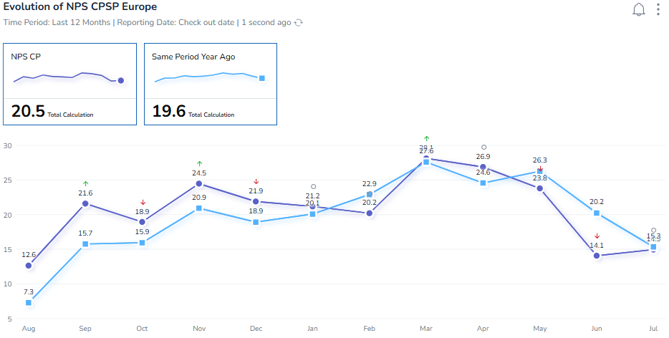
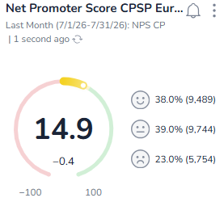
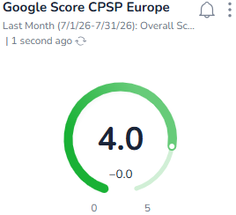
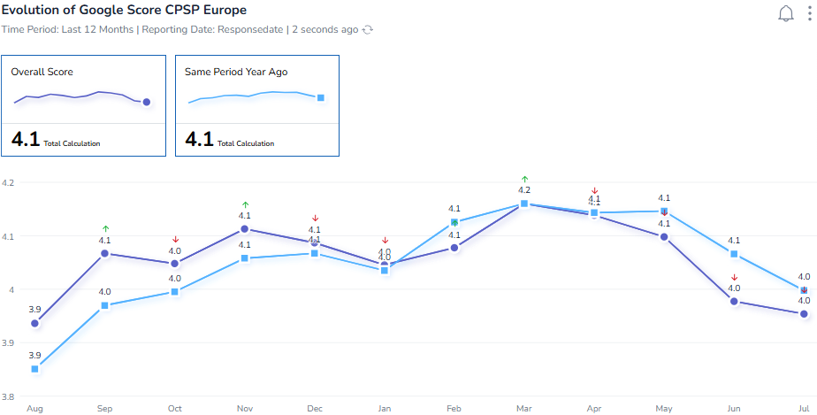
6. Quality Performance / destination BNGF
Updated 10/08 by S&M team
Group BR
July 26 vs July 25
Last 12 month
Internal BR
BNGFD including TH ,VN & NO Including SP

Slide 3
6. Quality Performance / destination CPSP BNGF
Updated 10/08 by S&M team
Group BR
Net Promoter Score
At CPSP E level, the NPS of Jlye 26 is decreasing (-0,4pts) compared to n-1 with NPS of 14,9 and +0,8pts vs previous month (June 26).
Decreasing NPS for all countries compared to n-1. Except BE and GE
CPSP BE= 14,5 +0,9 pts vs ly and -1,8 pts vs last month.
CP NL= 13,9 -2,2 pts vs ly and +2,7 pts vs last month.
CP GE= 21,9 +3,3pts vs ly and +1,1 pts vs last month.
CP FR= 8,9 -3,5 pts vs ly and +3,5 pts vs last month.
CP DK= 33,2 +3,3pts vs ly and -17,7pts vs last month.
Guests' comments (TOP/FLOP impact on Net Satisfaction Score and NPS)
The Cottage Cleanliness and Bathroom and Kitchen at cottage are the main critical points of attention: and is the main negative contributors to NPS in July 26 from open comment.
The F&B (Brewery) and Aqua Mundo are the main positive contributors to NPS from open comments
RETURN INTENTION
At CP E level, the Ret Int of July 26 +0,1pts compared to n-1 with Ret Int of 82,6
Decreasing for NL and FR vs n-1.
SOCIAL SCORE (GOOGLE)
On Social Review Google average score is flat by compared to n-1, with a score of 4,1/5
CCC Requests
With 3542 Requests on July 2026, the number of Requests increased by +12% vs last year but -13% vs previous month
Internal BR
*Including TH and NO
Including SP

Slide 4
6. Quality Performance / destination BNGF
Updated 10/08 by S&M team
Group BR
Internal BR
Return intention
Total FR including VN

Slide 5
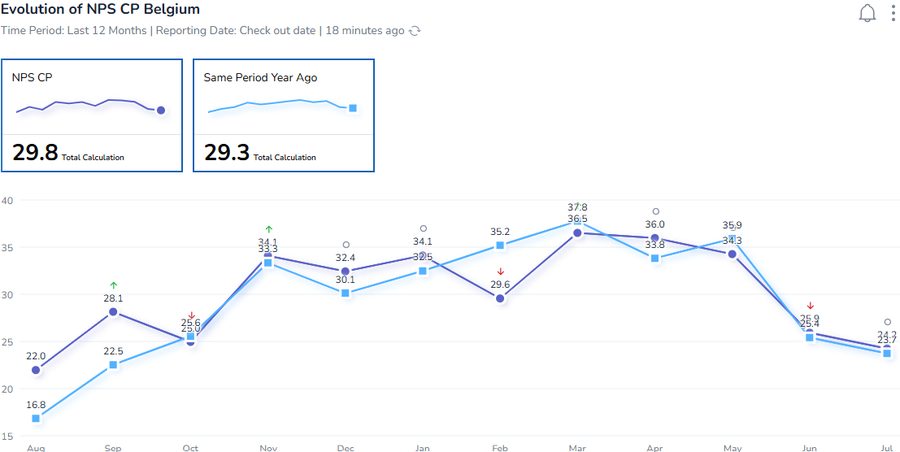
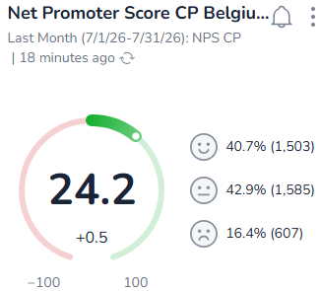
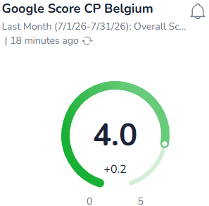
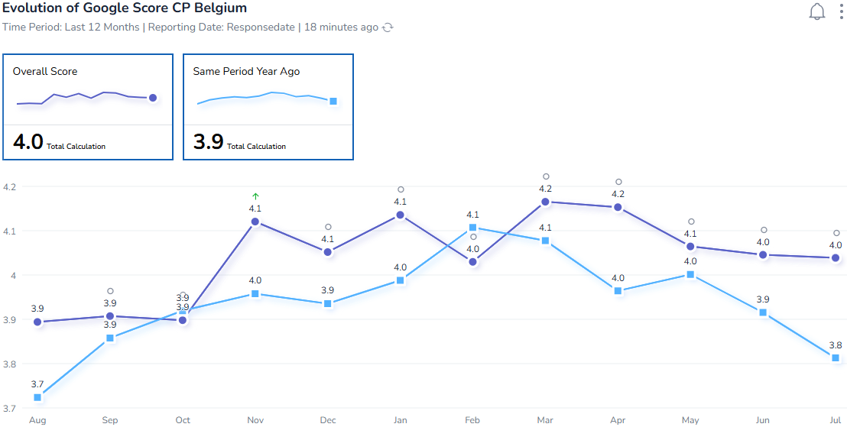
6. Quality Performance / destination CP BELGIUM
Updated 10/08 by S&M team
Group BR
July 26 vs July 25
Last 12 month
Internal BR
Including TH

Slide 6
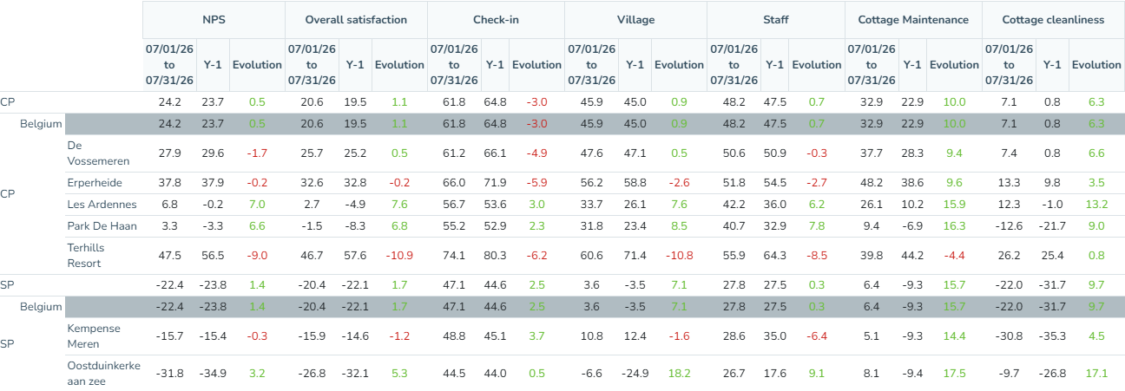
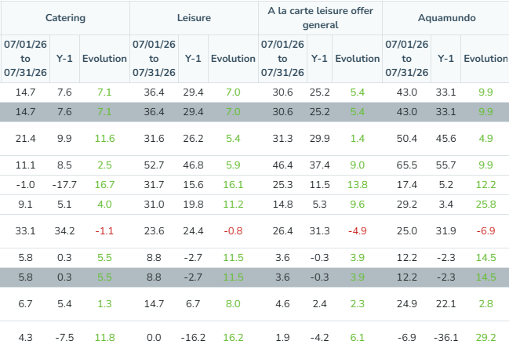
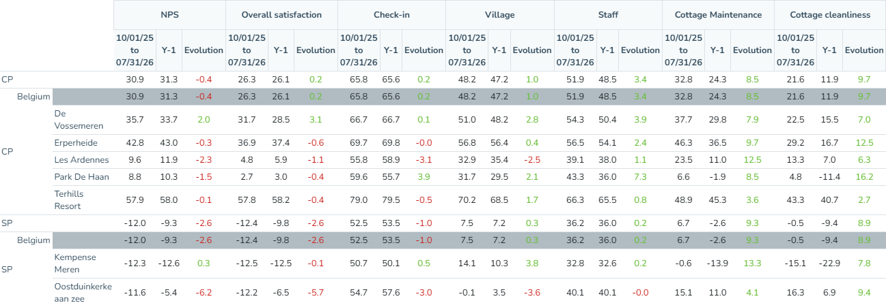
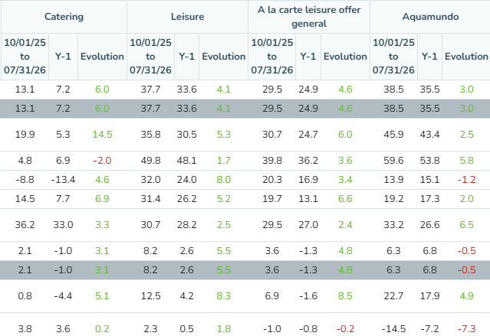
6. Quality Performance / destination CP Belgium
Updated 10/08 by S&M team
Extra input for internal BR in case needed
July 26
vs
July 25
YTD
July 26
Vs LY
In July 26 for CP BE, positive evolution for, Staff (+0,7pts), Cottage Maintenance (+10,0pts), Cottage Cleanliness (+6,3pts), Catering (+7,1pts) Leisure (+7,0pts) A la carte leisure offer general (+5,4pts), Aqua Mundo (+9,9pts). Decrease for Check-in (-3,0pts),
Decrease of NPS vs ly for VM (-1,7pts), EP (-0,2pts), TH (-9,0pts) and KM (-0,3pts)

Slide 7
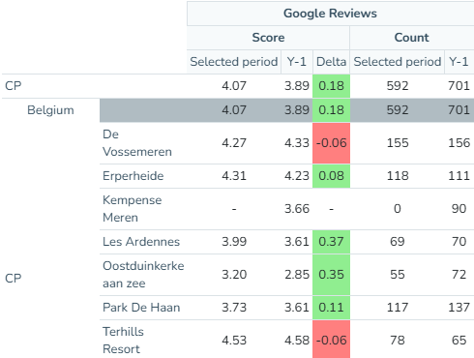
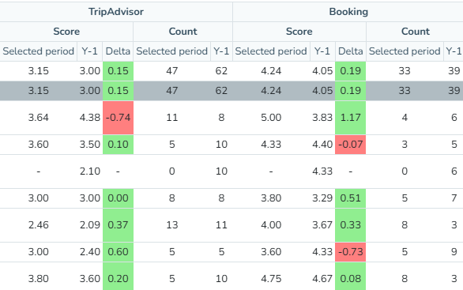
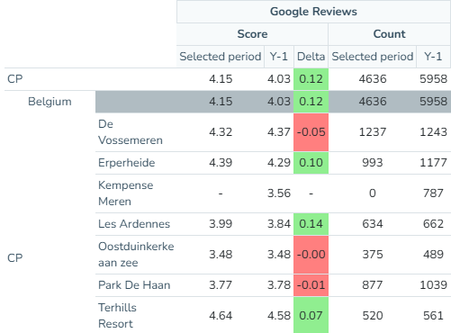
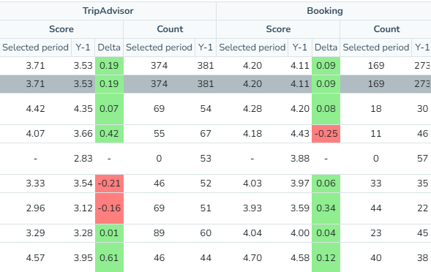
6. Quality Performance / destination CP Belgium
Updated 10/08 by S&M team
Extra input for internal BR in case needed
July 26
vs
July 25
YTD
July 26
Vs LY

Slide 8
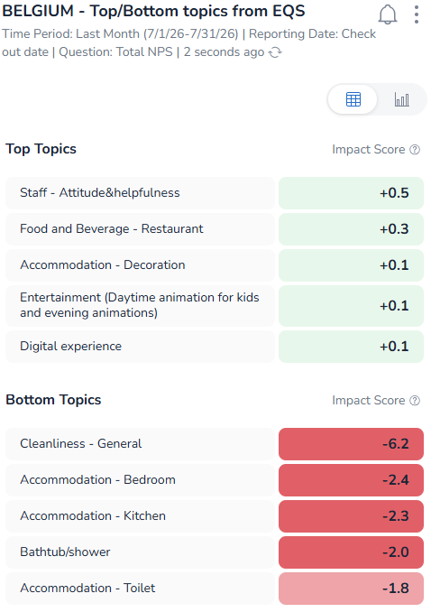
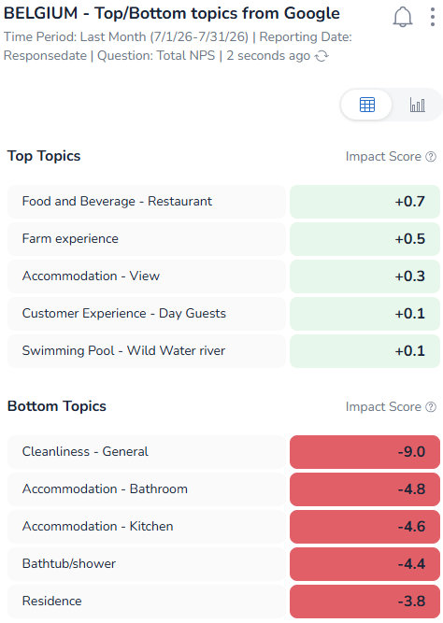
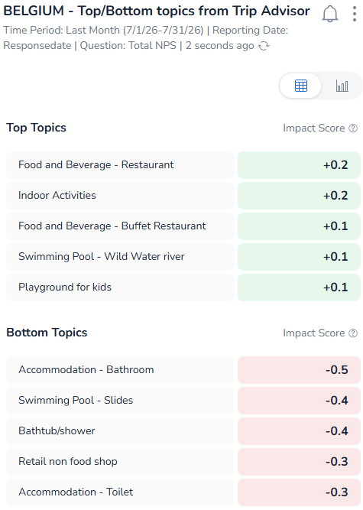
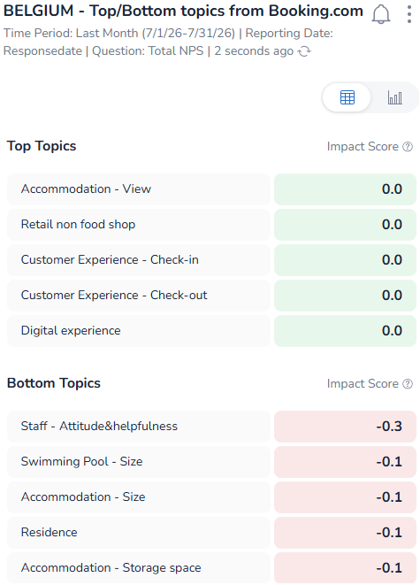
6. Quality Performance / destination CP Belgium
Updated 10/08 by S&M team
TOPS/FLOPS CONCEPTS CP BE FROM OPEN COMMENT

Slide 9
Quality Performance / destination CP Belgium: input

Slide 10
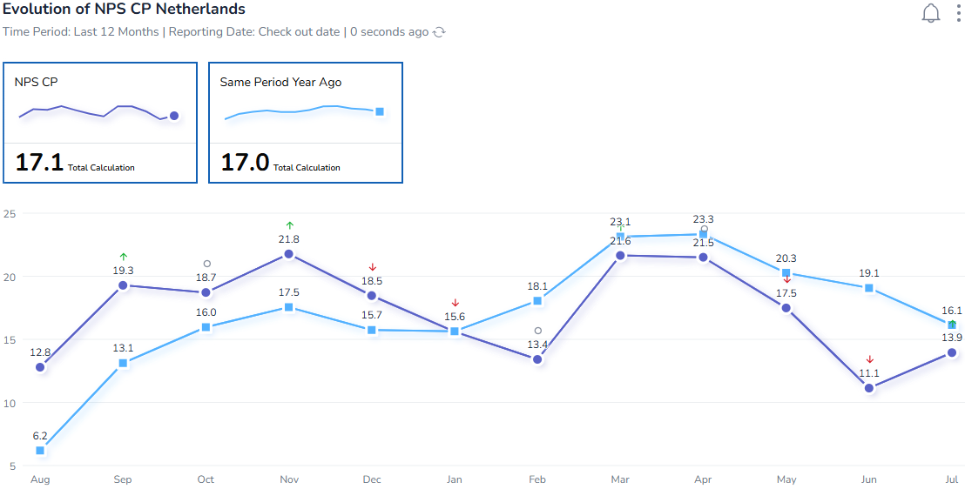
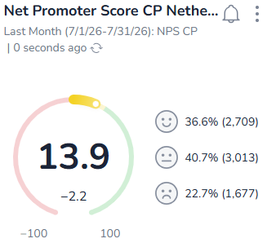
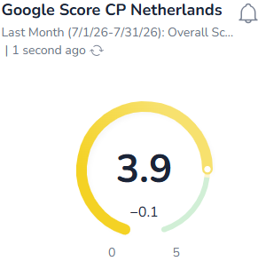
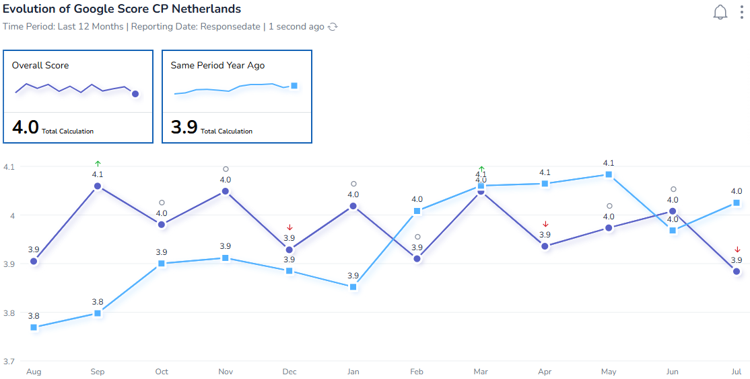
6. Quality Performance / destination CP NETHERLANDS
Updated 10/08 by S&M team
Group BR
July 26 vs July 25
Last 12 month
Internal BR

Slide 11
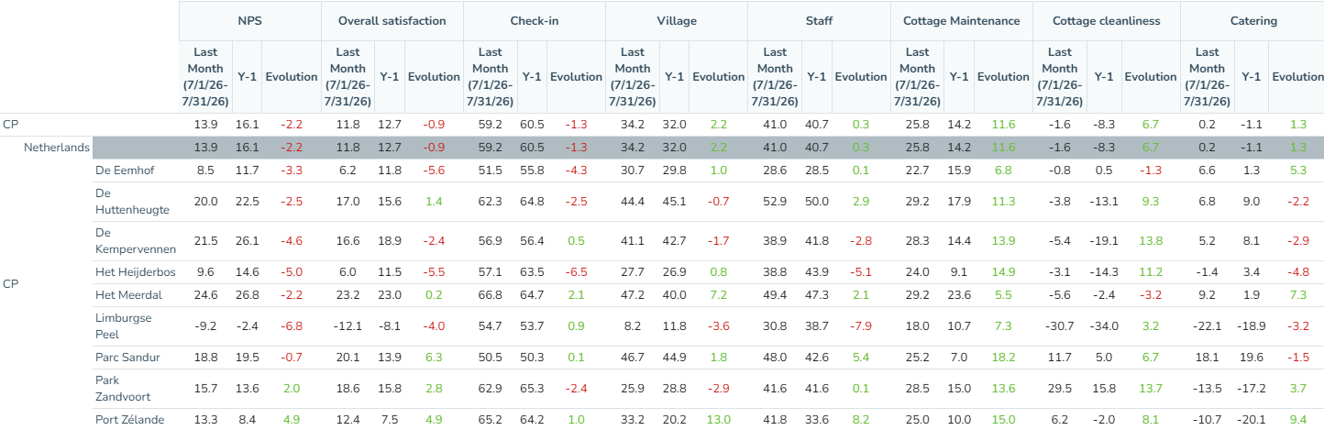
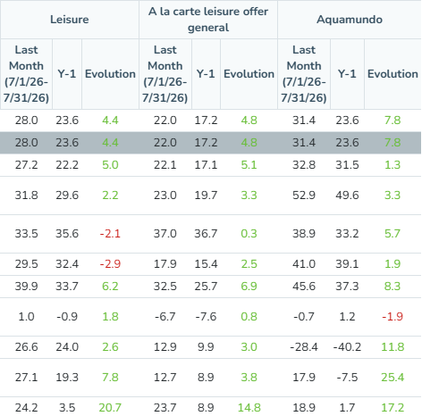
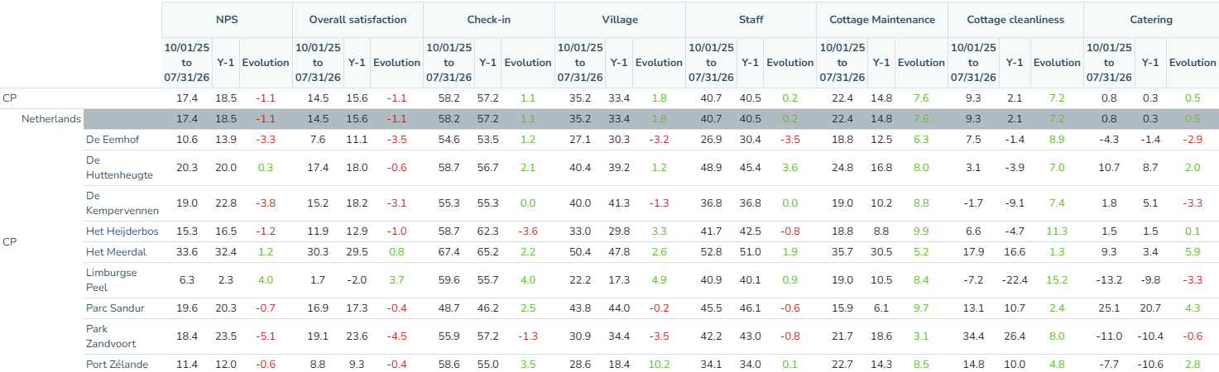
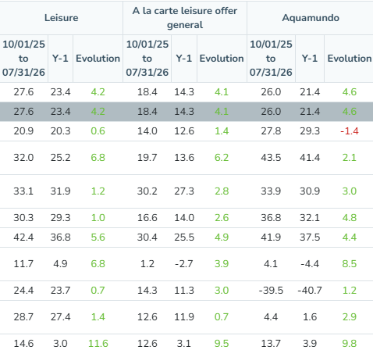
6. Quality Performance / destination CP Netherlands
Updated 09/07 by S&M team
Extra input for internal BR in case needed
Internal BR
July 26
vs
July 25
YTD
July 26
Vs LY
In July 26 for CP NL, positive evolution for Village (+2,2 pts), Staff (+0,3 pts), Cottage Maintenance (+11,6 pts), Cottage Cleanliness (+6,7pts), Catering (+1,3 pts) Free Leisure (+4,4 pts) Paid Leisure (+4,8 pts) and Aqua Mundo (+7,8 pts). NSS decrease for Check-in (-1,3pts),
Decrease of NPS for all villages and increased only for ZV (+2,0 pts) and PZ (+4,6 pts), .

Slide 12
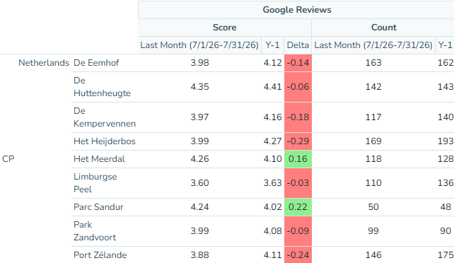
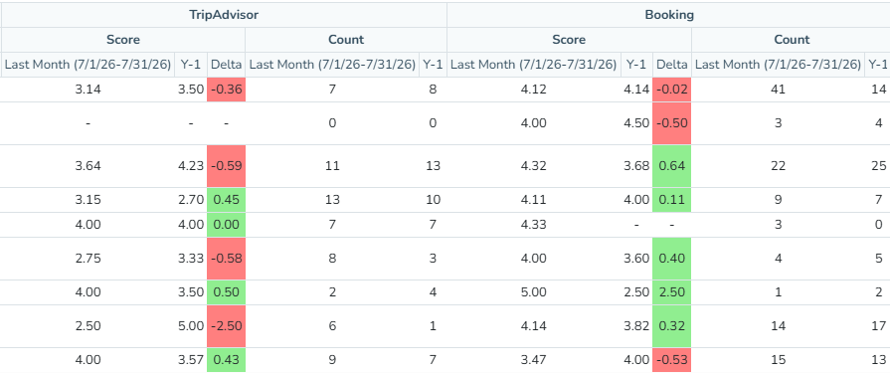
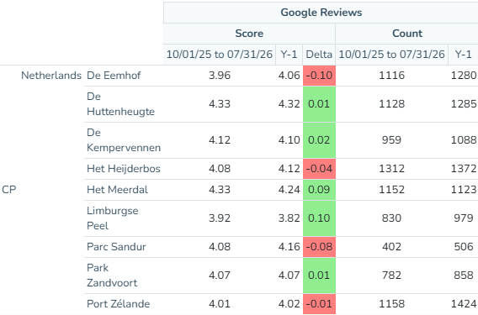
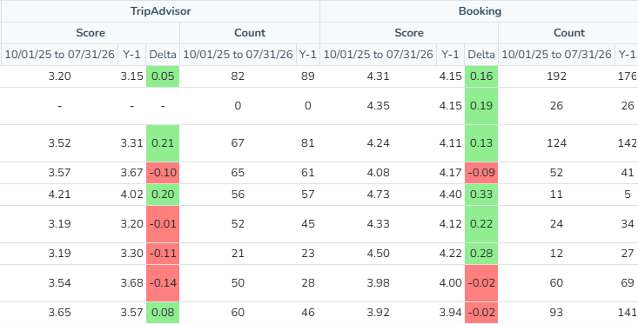
6. Quality Performance / destination CP Netherlands
Updated 10/08 by S&M team
Extra input for internal BR in case needed
July 26
vs
July 25
YTD
July 26
Vs LY

Slide 13
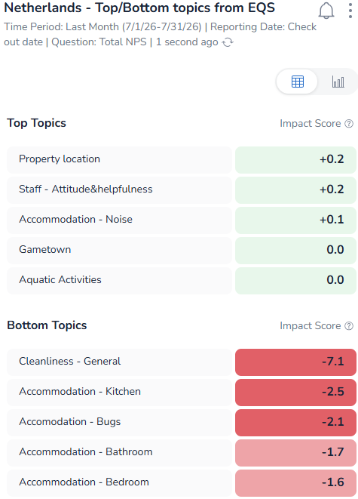
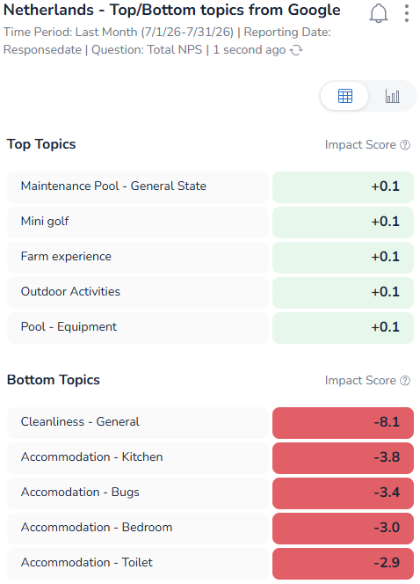
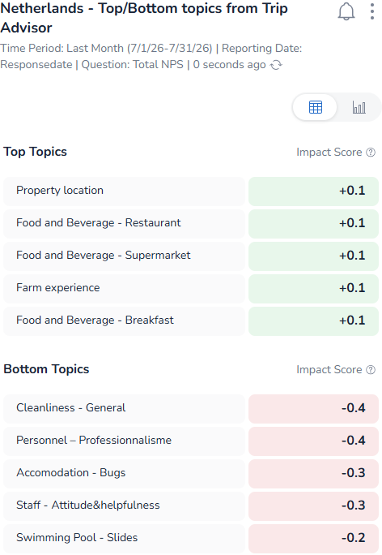
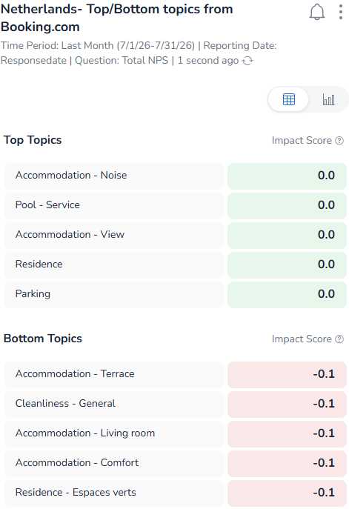
6. Quality Performance / destination CP Netherlands
Updated 10/08 by S&M team
TOPS/FLOPS CONCEPTS CP NL FROM OPEN COMMENT

Slide 14

6. Quality Performance / destination CP Netherlands: input

Slide 15
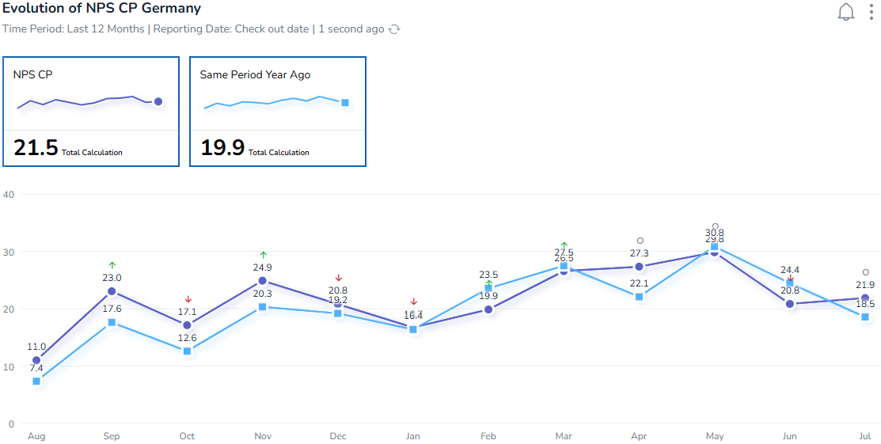
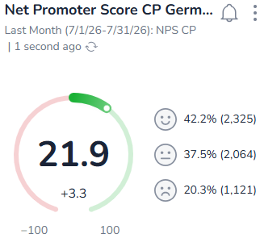
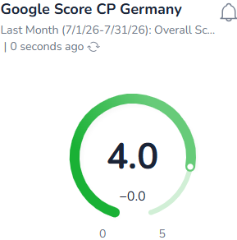
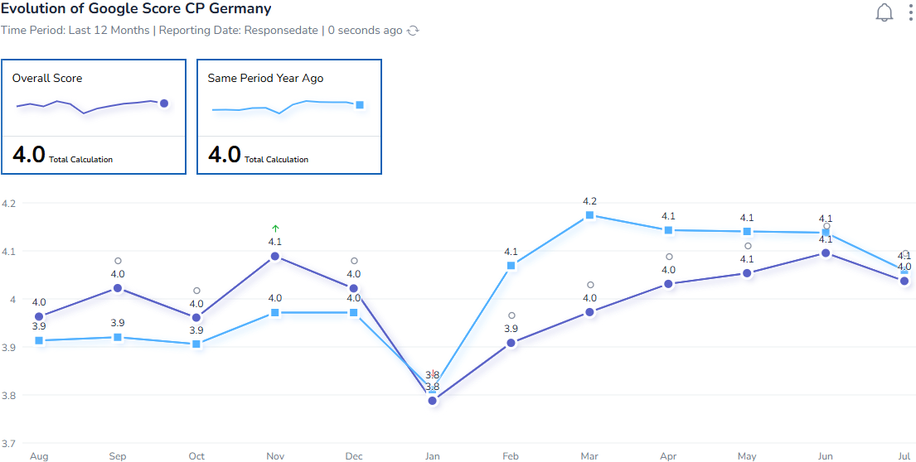
6. Quality Performance / destination CP GERMANY
Updated 10/08 by S&M team
Group BR
July 26 vs July 25
Last 12 month
Internal BR

Slide 16
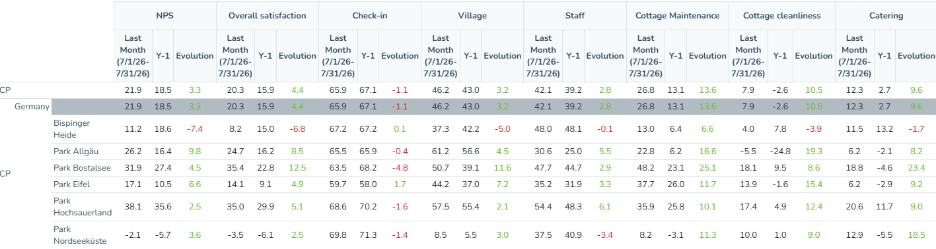
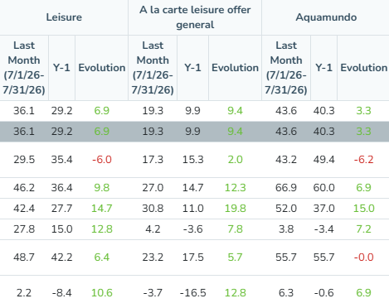
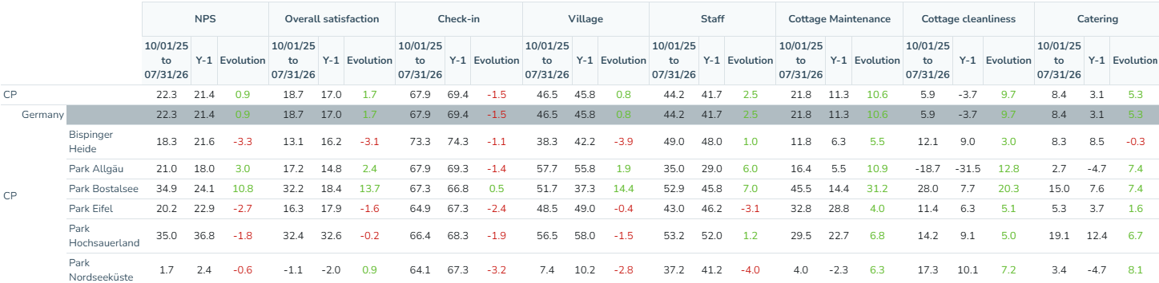
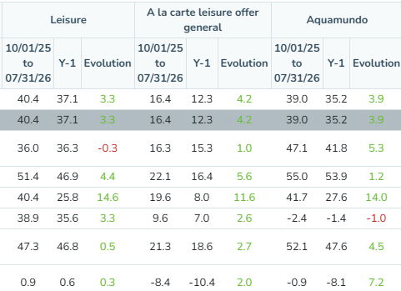
6. Quality Performance / destination CP Germany
Updated 10/08 by S&M team
Extra input for internal BR in case needed
Group BR
Internal BR
July 26
vs
July 25
YTD
July 26
Vs LY
In July 26 for CP GE, pillars increased vs ly with Village (+3,2 pts) Staff (+2,8 pts) Cottage Maintenance (+13,6 pts), Cottage Cleanliness (+10,5 pts), Catering (+9,6 pts) Free Leisure (+6,9 pts) Paid Leisure (+9,4pts) and Aqua Mundo (+3,3pts). NSS decrease for Check-in (-1,1pts),
NPS increases for all parcs except or BS (-7,4pts)

Slide 17
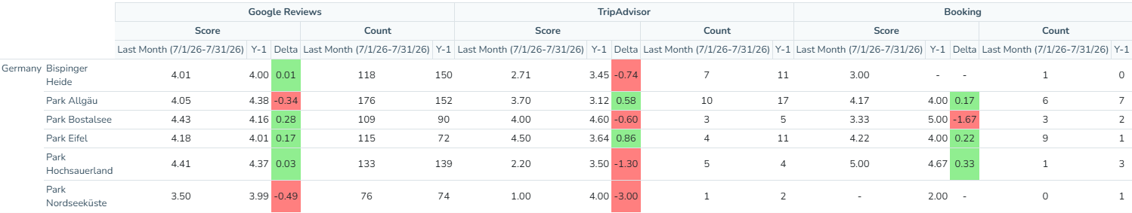
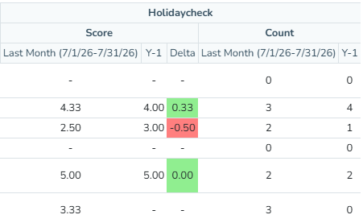
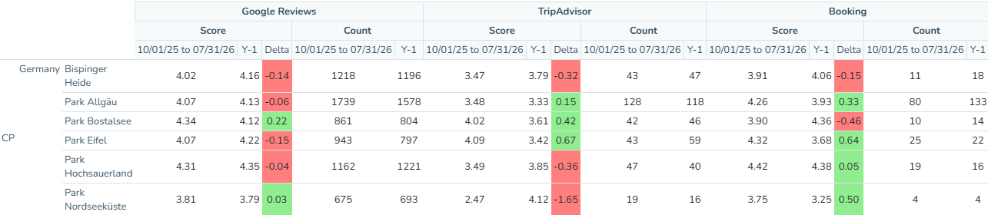
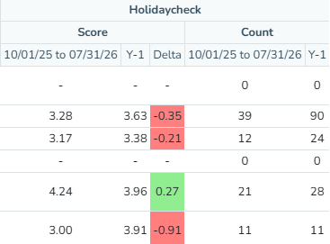
6. Quality Performance / destination CP Germany
Updated 10/08 by S&M team
Extra input for internal BR in case needed
July 26
vs
July 25
YTD
July 26
Vs LY

Slide 18
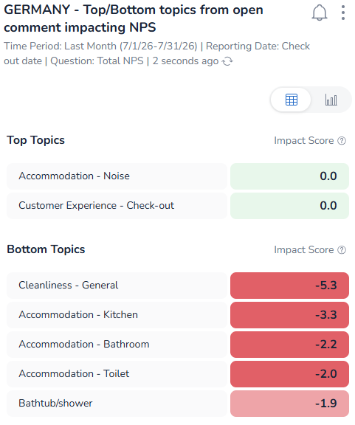
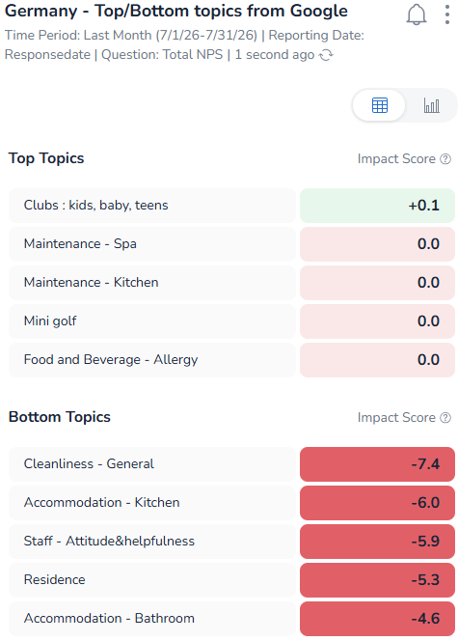


6. Quality Performance / destination CP Germany
Updated 10/08 by S&M team
TOPS/FLOPS CONCEPTS FROM OPEN COMMENT

Slide 19
6. Quality Performance / destination CP Germany: input

Slide 20




6. Quality Performance / destination CP France
Updated 10/08 by S&M team
Group BR
July 26 vs July 25
Last 12 month
Internal BR

Slide 21




6. Quality Performance / destination CP France
Updated 10/08 by S&M team
Extra input for internal BR in case needed
Internal BR
July 26
vs
July 25
YTD
July 26
Vs LY
In July 2026 for CP FR, positive evolution for Check-in (+2,2 pts), Cottage Maintenance (+6,8 pts), Cottage Cleanliness (+4,2 pts), Catering (+4,2 pts)Free Leisure (+5,4 pts), Paid Leisure (+1,8pts pts), Aqua Mundo (+0,5 pts), NSS decrease for Village (-1,7ptspts), Staff (-1,0pts),
Critical NPS decrease for all parcs BD (-11,5 pts), BF (-2,2 pts), LG (-9,3 pts), VN (-20,7 pts)
Total FR including VN

Slide 22


6. Quality Performance / destination CP France
Updated 10/08 by S&M team
Extra input for internal BR in case needed
July 26
vs
July 25
YTD
July 26
Vs LY

Slide 23




6. Quality Performance / destination CP France
Updated 10/08 by S&M team
TOPS/FLOPS CONCEPTS FROM OPEN COMMENT

Slide 24
6. Quality Performance / destination CP France: input

Slide 25




6. Quality Performance / destination CP Denmark
Updated 10/08 by S&M team
Group BR
July 26 vs July 25
Last 12 month
Internal BR

Slide 26



6. Quality Performance / destination CP Denmark
Updated 10/08 by S&M team
Extra input for internal BR in case needed
Internal BR
July 26
Vs
July 25
YTD
July 26
In July 26 improving NPS vs last year
But decreasing NSS for Check-in (-8,5pts), Village (-2,0pts), Staff (-1,8pts), Cottage Maintenance (-15,0pts)
Total FR including VN

Slide 27
6. Quality Performance / destination CP France
Updated 10/08 by S&M team
Extra input for internal BR in case needed
July 26
vs
July 25
YTD
July 26
Vs LY

Slide 28


6. Quality Performance / destination CP Denmark
Updated 10/08 by S&M team
TOPS/FLOPS CONCEPTS FROM OPEN COMMENT

Slide 29

Cottage interventions monitoring – July 26
Updated 10/08 by S&M team
Group BR
Datas from the EQS based on check out date
Internal BR

Slide 30

CCC Requests– July 26
Updated 10/08 by S&M team
Group BR
Internal BR
Datas based on
Check-out dates
Nbr Requests : Number of customer requests for stays that ended the selected period
Nbr Bookings : Number of confirmed bookings
YoY : Same period last year
MoM : same period last month

Slide 31






TOP Bottom topic from EQS per parc
Updated 10/08 by S&M team
Group BR

Slide 32






TOP Bottom topic from EQS per parc
Updated 10/08 by S&M team
Group BR
Internal BR

Slide 33






TOP Bottom topic from EQS per parc
Updated 10/08 by S&M team
Group BR
Internal BR

Slide 34






TOP Bottom topic from EQS per parc
Updated 10/08 by S&M team
Group BR
Internal BR

Slide 35





TOP Bottom topic from EQS per parc
Updated 10/08 by S&M team
Group BR
Internal BR

