Slide 1
Type inference as constraint solving
Simon Peyton Jones
Microsoft Research
Lambdale Sept 2019

Slide 2
The task of type inference
Reject bad programs
Accept good programs

Slide 3
The task of type inference
Reject bad programs, with a decent error message
Accept Elaborate good programs

Slide 4
Elaboration
sort :: ∀a. Ord a => [a] -> [a]
reverse :: ∀a. [a] -> [a]
foo :: [Int] -> [Int]
foo = \xs. sort (reverse xs)
$fOrdInt comes from
instance Ord Int where …
$fOrdInt :: Ord Int
foo :: [Int] -> [Int]
foo = \(xs:[Int]). sort @Int $fOrdInt (reverse @Int xs)
Elaboration
Decorate every binder with its type
Add type applications
Add dictionary applications

Slide 5
Elaboration
sort :: ∀a. Ord a => [a] -> [a]
reverse :: ∀a. [a] -> [a]
foo :: ∀a. Ord a => [a] -> [a]
foo = \xs. sort (reverse xs)
foo :: ∀a. Ord a => [a] -> [a]
foo = /\a. \(d:Ord a). \(xs:a).
sort @a d (reverse @a xs)
Elaboration
Decorate every binder with its type
Add type applications and abstractions
Add dictionary applications and abstractions

Slide 6
Elaboration
sort :: ∀a. Ord a => [a] -> [a]
concat :: ∀a. [[a]] -> [a]
foo :: ∀a. Ord a => [[a]] -> [a]
foo = \xs. concat (sort xs)
$fOrdList :: ∀a. Ord a -> Ord [a]
foo :: ∀a. Ord a => [a] -> [a]
foo = /\a. \(d:Ord a). \(xs:a).
let d2:Ord [a]
d2 = $fOrdList @a d
in concat @a (sort @[a] d2 xs)
Elaboration
Decorate every binder with its type
Add type applications and abstractions
Add dictionary applications and abstractions, and local bindings
$fOrdList comes from
instance Ord a => Ord [a] where …

Slide 7
Classic Damas-Milner
reverse :: ∀a. [a] -> [a]
and :: [Bool] -> Bool
foo = \xs. (reverse xs, and xs)
Start with (xs:α), where α is a unification variable, standing for an as-yet-unknown type
Typecheck (reverse xs)
Instantiate ‘reverse’ with a unification variable β, standing for another as-yet-unknown type. So this occurrence of reverse has type [β] -> [β].
Constrain expected arg type [β] equal to actual arg type α, thus α ~ [β].

Slide 8
Classic Damas-Milner
reverse :: ∀a. [a] -> [a]
and :: [Bool] -> Bool
foo = \xs. (reverse xs, and xs)
Start with (xs:α), where α is a unification variable, standing for an as-yet-unknown type
Typecheck (reverse xs)
Instantiate ‘reverse’ with a unification variable β, standing for another as-yet-unknown type. So this occurrence of reverse has type [β] -> [β].
Constrain expected arg type [β] equal to actual arg type α, thus α ~ [β].
Typecheck (and xs)
Constrain expected arg type [Bool] equal to actual arg type α, thus α ~ [Bool].
So we need (α ~ [β], α ~ [Bool])
Solve by unification, yielding a substitution: α := [Bool], β := Bool

Slide 9
Elaboration and unification variables
reverse :: ∀a. [a] -> [a]
and :: [Bool] -> Bool
foo = \xs. (reverse xs, and xs)
foo = \(xs:α). (reverse @β xs, and xs)
Elaborate
Apply the substitution
(zonking)
Constraints
α ~ [β], α ~ [Bool]
foo = \(xs:[Bool]). (reverse @Bool xs, and xs)
Solve, by unification
to produce a substitution
α := [Bool], β := Bool
Main point: solving the constraints “fills in” the elaborated program

Slide 10
Unification variables
A unification variable stands for a type; it’s a type that we don’t yet know
GHC sometimes calls it a “meta type variable”
By the time type inference is finished, we should know what every meta-tyvar stands for.
The “global substitution” maps each meta-tyvar to the type it stands for.
A meta-tyvar stands only for a monotype; a type with no foralls in it.

Slide 11
Same thing, but for type classes
sort :: ∀a. Ord a => [a] -> [a]
reverse :: ∀a. [a] -> [a]
foo :: [Int] -> [Int]
foo = \xs. sort (reverse xs)
foo = \(xs:[Int]). sort @β d (reverse @δ xs)
Elaborate
Constraints
Apply the substitution
[β] ~ [δ], [δ] ~ [Int], d:Ord β
foo = \(xs:[Int]). sort @Int $fOrdInt (reverse @Int xs)
Solve, by unification
β := Int, δ := Int, d := $fOrdInt
Main point: solving the constraints “fills in” the elaborated program

Slide 12
Deferring solving
Main point
The order in which we encounter constraints
≠
The order in which we solve them
Old school: “on the fly solving”
Encounter a unification problem
Solve it
If fails, report error
Otherwise, proceed
This will not work any more
We have to solve β := Int, before we can solve d:Ord β
[β] ~ [δ], [δ] ~ [Int], d:Ord β

Slide 13
Deferring solving
g :: F a -> a -> Int
type instance F Bool = Bool
f x = (g True x, ...., not x)
x::β
Instantiate g at α
g True
F α ~ Bool,
α ~ β,
β ~ Bool
Order of encounter
g True x
not x
We have to solve this first

Slide 14
Deferring solving
op :: C a x => a -> x -> Int
instance Eq a => C a Bool
f x = let g :: ∀a Eq a => a -> a
g a = op a x
in g (not x)
x : β
Constraint: C a β
Cannot solve constraint (C a β) until we “later” discover that (β ~ Bool)
Again, need to defer constraint solving, rather than doing it all “on the fly”

Slide 15
The French approach to type inference
Apply substitution
Haskell source program
Large syntax, with many many constructors
Elaborated program with “holes”
Elaborated source program
Constraint generation
Constraints
Small syntax, with few constructors
Solve
Substitution
Residual constraint
Report
errors
The essence of ML type inference, Pottier & Remy, In ATAPL, Pierce, 2005.

Slide 16
The language of constraints
Haskell source program
Large syntax, with many many constructors
Constraints
Small syntax, with few constructors
What exactly is this?
Constraint generation
How does solving work?
Solve
Residual constraint
Report errors

Slide 17
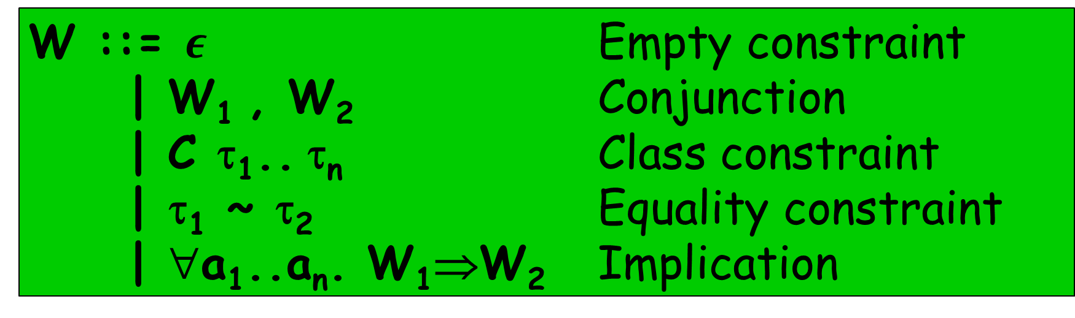
The language of constraints
W ::= $ε$ Empty constraint
| W₁ , W₂ Conjunction
| C τ₁.. τ_{n} Class constraint
| τ₁ ~ τ₂ Equality constraint
| ∀a₁..a_{n}. W₁⇒W₂ Implication

Slide 18
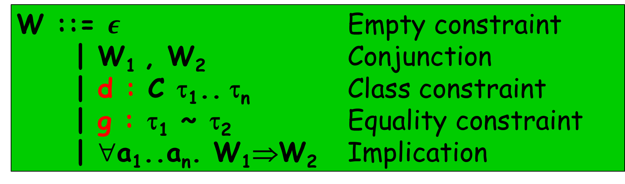
The language of constraints
W ::= $ε$ Empty constraint
| W₁ , W₂ Conjunction
| d : C τ₁.. τ_{n} Class constraint
| g : τ₁ ~ τ₂ Equality constraint
| ∀a₁..a_{n}. W₁⇒W₂ Implication
Evidence

Slide 19


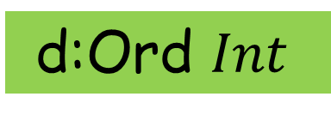
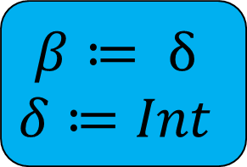


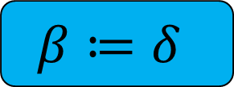




How solving works
[β] ~ [δ], [δ] ~ [Int], d:Ord β
Decompose $\left[β\right]\sim [δ]$
β ~ δ, [δ] ~ [Int], d:Ord β
Take the constraints
Do one rewrite
Repeat from 1
Each step takes a set of constraints and returns a logically-equivalent set of constraints.
When you can’t do any more, that’s the “residual constraint”
Substitute $β≔δ$
[δ] ~ [Int], d:Ord $δ$
$$β≔δ$$
Decompose $\left[δ\right]\sim [Int]$
δ ~ Int, d:Ord $δ$
Substitute $δ≔Int$
$$β≔ δ$$
$$δ≔Int$$
d:Ord $Int$
Solve $d:Ord Int$from instance declaration
$$ε$$

Slide 20
Things to notice
Constraint solving takes place by successive rewrites of the constraint
Each rewrite generates a binding, for
a type variable (fixing a unification variable)
a dictionary (class constraints)
a coercion (equality constraint)
as we go
Bindings record the proof steps
Bindings get injected back into the term

Slide 21
Implication constraints

Slide 22
Existentials
data T where
MkT :: ∀a. Show a => a -> T
ts :: [T]
ts = [MkT 3, MkT True]
ts = [ MkT @Int $fShowInt 3
, MkT @Bool $fShowBool True
]

Slide 23
Existentials
MkT :: ∀a. Show a => a -> T
show :: ∀a. Show a => a -> String
ts :: [T]
ts = [MkT 3, MkT True]
ts = [ MkT @Int $fShowInt 3
, MkT @Bool $fShowBool True
]
f :: T -> String
f = \t. case t of
MkT x -> show x
f = \(t:T). case t of
MkT a (gd:Show a) (x:a)
-> show @a gd x

Slide 24
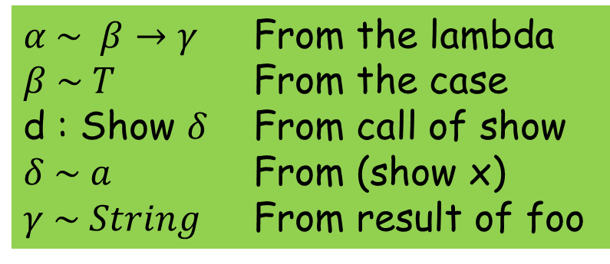

Generate constraints
MkT :: ∀a. Show a => a -> T
show :: ∀a. Show a => a -> String
f : $α$
t : $β$
x : a
Instantiate show with $δ$
f = \t. case t of { MkT x -> show x }
Generate constraints
$α \sim β→γ$ From the lambda
$β \sim T$ From the case
d : Show $δ$ From call of show
$δ \sim a$ From (show x)
$γ \sim String$ From result of foo

Slide 25
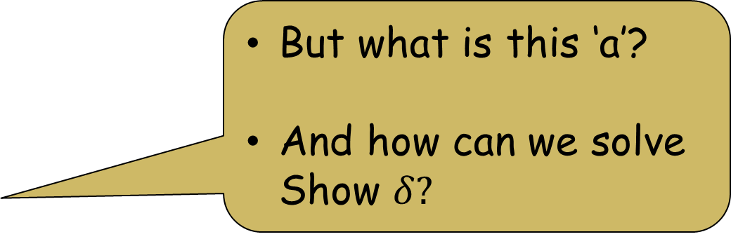
Generate constraints
MkT :: ∀a. Show a => a -> T
show :: ∀a. Show a => a -> String
f = \t. case t of { MkT x -> show x }
Generate constraints
But what is this ‘a’?
And how can we solve Show $δ?$
$α \sim β→γ$ From the lambda
$β \sim T$ From the case
d : Show $δ$ From call of show
$δ \sim a$ From (show x)
$γ \sim String$ From result of foo

Slide 26
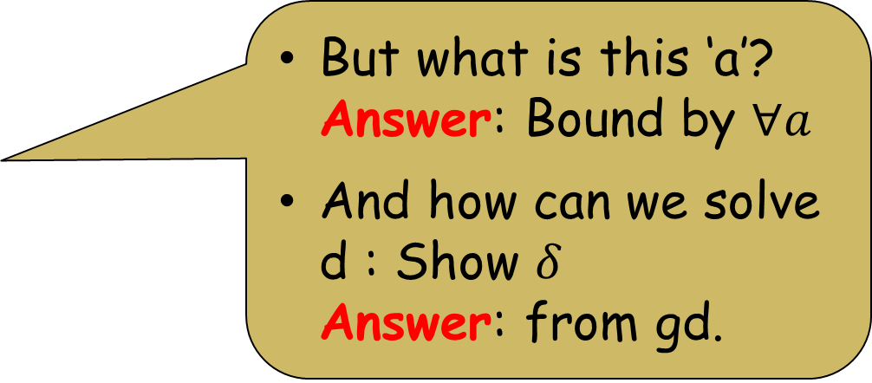
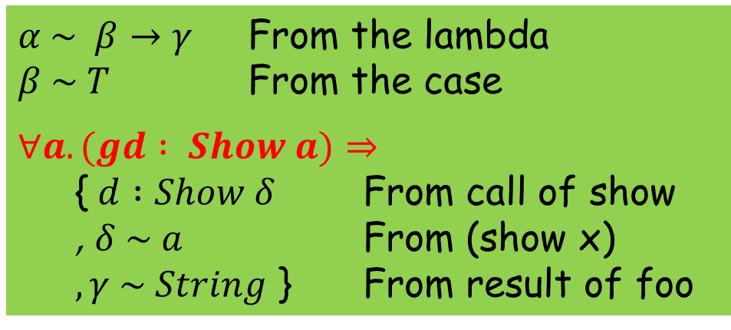
The Right Way: implication constraints
f = \t. case t of { MkT x -> show x }
Generate constraints
MkT :: ∀a. Show a => a -> T
show :: ∀a. Show a => a -> String
$α \sim β→γ$ From the lambda
$β \sim T$ From the case
$$∀a. (gd : Show a)⇒$$
{$d :Show δ$ From call of show
, $δ \sim a$ From (show x)
$, γ \sim String$ } From result of foo
But what is this ‘a’? Answer: Bound by $∀a$
And how can we solve d : Show $δ$ Answer: from gd.

Slide 27
Reminder
W ::= $ε$ Empty constraint
| W₁ , W₂ Conjunction
| d : C τ₁.. τ_{n} Class constraint
| g : τ₁ ~ τ₂ Equality constraint
| ∀a₁..a_{n}. W₁⇒W₂ Implication
Implication constraint
Given
Wanted

Slide 28

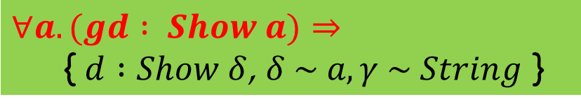






$α \sim β→γ$ From the lambda
$β \sim T$ From the case
$$∀a. (gd : Show a)⇒$$
{$d :Show δ$ From call of show
, $δ \sim a$ From (show x)
$, γ \sim String$ } From result of foo
$$∀a. (gd : Show a)⇒$$
{$d :Show δ$, $δ \sim a, γ \sim String$ }
Substitute $δ≔a$
$$∀a. (gd : Show a)⇒$$
{$d :Show a$, $γ \sim String$ }
Solve (d:Show a), substitute d:=gd $δ≔a$
$$∀a. \left(gd : Show a\right)⇒ γ \sim String$$
Solving
Substitute $γ≔String$
$$ε$$
Elaborated program with holes
Elaborated program after filling holes
f = \(t:β). case t of
MkT a (gd:Show a) (x:a)
-> show @δ d x
f = \(t:T). case t of
MkT a (gd:Show a) (x:a)
-> show @a gd x

Slide 29
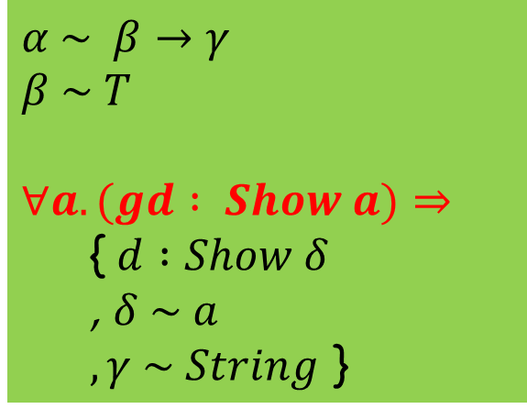

What is ‘a’?
f = \(t:T). case t of
MkT a (gd:Show a) (x:a)
-> show @a gd x
f = \t. case t of
MkT x -> show x
Generate constraints
$α$ is a unification variable, standing for an as-yet-unknown type.
Constraint solving produces a substitution for the unification variables
$\text{When} \text{typechecking} \text{is} \text{done}\text{, }$ $\text{all} \text{unification} \text{variables} \text{are} \text{gone}\text{ (}\text{substituted} \text{away}\text{)}$
$a$ is a skolem constant, the type variable $a$ bound by the MkT pattern match in the elaborated program.
Each pattern match on MkT binds a fresh, distinct ‘a’.
Every skolem in the constraints should be bound by a $∀$
$α \sim β→γ$
$β \sim T$
$$∀a. (gd : Show a)⇒$$
{$d :Show δ$
, $δ \sim a$
$, γ \sim String$ }

Slide 30
Level numbers and constraint floating

Slide 31
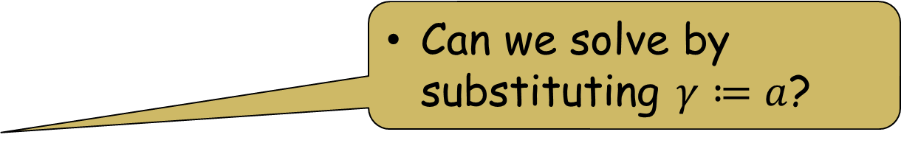
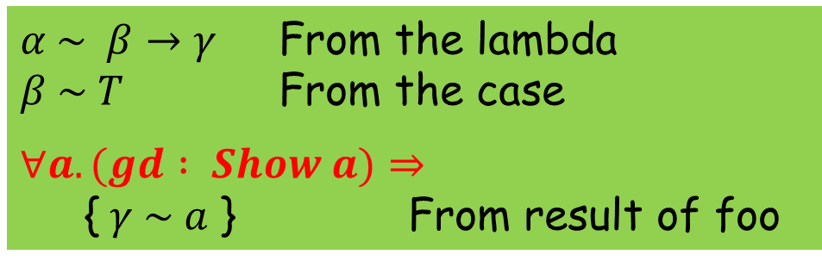
Existential escape
f2 = \t. case t of { MkT x -> x } -- Ill-typed
Generate constraints
MkT :: ∀a. Show a => a -> T
$α \sim β→γ$ From the lambda
$β \sim T$ From the case
$$∀a. (gd : Show a)⇒$$
{$γ \sim a$ } From result of foo
Can we solve by substituting $γ≔a$?

Slide 32
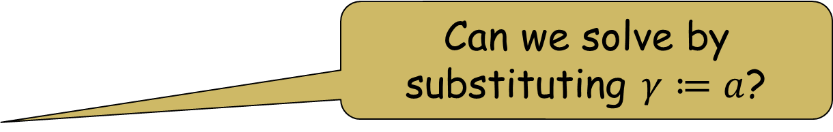

Existential escape
f2 = \t. case t of { MkT x -> x } -- Ill-typed
Generate constraints
MkT :: ∀a. Show a => a -> T
$α \sim β→γ$ From the lambda
$β \sim T$ From the case
$$∀a. (gd : Show a)⇒$$
{$γ \sim a$ } From result of foo
Can we solve by substituting $γ≔a$?
No! No! Noooo! $γ$ comes from an “outer scope”

Slide 33

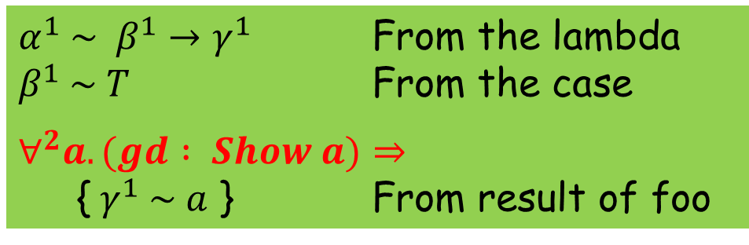
Level numbers
f2 = \t. case t of { MkT x -> x } -- Ill-typed
Generate constraints
Every unification variable has a level number
Every implication has a level number
We say $γ^{1}$ is untouchable under the $∀^{2}$
The untouchability rule: you cannot solve $γ^{n}\sim ty$ under a $∀^{k}$, if n<k
$α^{1} \sim β^{1}→γ^{1}$ From the lambda
$β^{1} \sim T$ From the case
$$∀^{2}a. (gd : Show a)⇒$$
{$γ^{1} \sim a$ } From result of foo

Slide 34
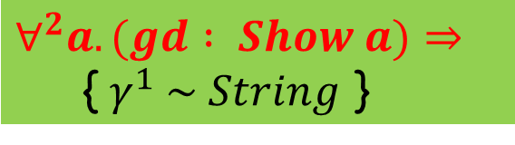
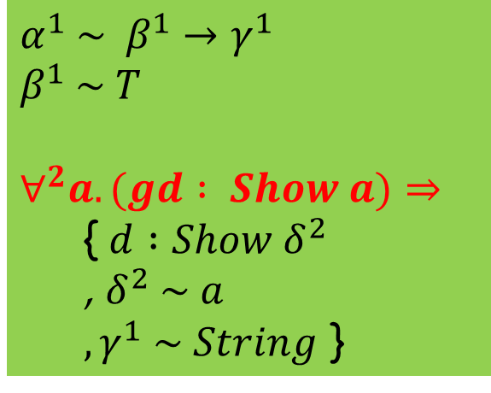
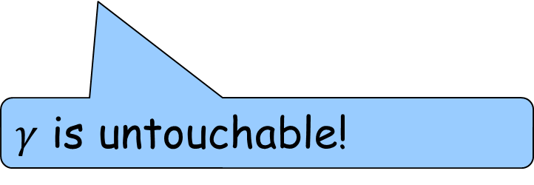

Back to our earlier example
f = \t. case t of
MkT x -> show x
Now what????
Generate constraints
$α^{1} \sim β^{1}→γ^{1}$
$β^{1} \sim T$
$$∀^{2}a. (gd : Show a)⇒$$
{$d :Show δ^{2}$
, $δ^{2} \sim a$
$, γ^{1} \sim String$ }
$$∀^{2}a. (gd : Show a)⇒$$
{$γ^{1} \sim String$ }
$$α≔T →γ^{1}$$
$$β≔T$$
$$δ≔a$$
$γ$ is untouchable!

Slide 35
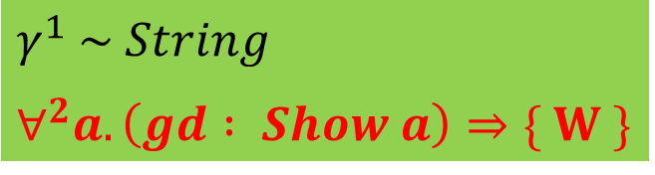
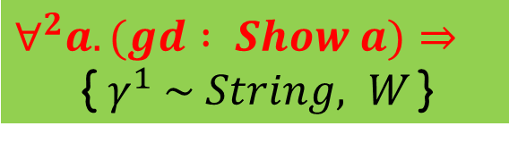

Floating constraints
$$∀^{2}a. (gd : Show a)⇒$$
{$γ^{1} \sim String, W$ }
$$γ^{1} \sim String$$
$$∀^{2}a. \left(gd : Show a\right)⇒\{ W \}$$
Float $(γ^{1} \sim String)$ outside the $∀$
Now $γ^{1}$ is not untouchable any more
So we can substitute $γ^{1}≔String$

Slide 36

Our ill-typed example again
f2 = \t. case t of { MkT x -> x } -- Ill-typed
Generate constraints
Cannot float $\left(γ^{1} \sim a\right)$ outside the $∀a$, obviously, because it mentions $a$!
$α^{1} \sim β^{1}→γ^{1}$ From the lambda
$β^{1} \sim T$ From the case
$$∀^{2}a. (gd : Show a)⇒$$
{$γ^{1} \sim a$ } From result of foo

Slide 37
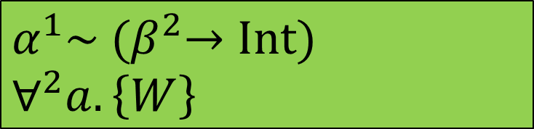

Promotion
$$∀^{2}a. \left\{α^{1}\sim {(β}^{2}→Int), W\right\}$$
Can we float this to?
$$α^{1}\sim {(β}^{2}→Int)$$
$$∀^{2}a. \left\{W\right\}$$

Slide 38

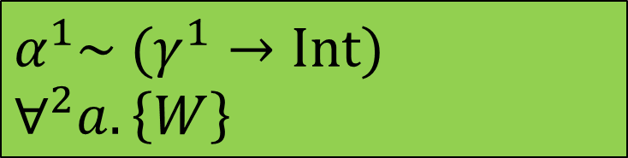
Promotion
$$∀^{2}a. \left\{α^{1}\sim {(β}^{2}→Int), W\right\}$$
When floating an equality, promote all its free unification variables
NO!
Can we float this to?
Instead “promote” $β^{2} ≔ γ^{1}$, so we get
$$α^{1}\sim {(β}^{2}→Int)$$
$$∀^{2}a. \left\{W\right\}$$
$$α^{1}\sim (γ^{1}→Int)$$
$$∀^{2}a. \left\{W\right\}$$

Slide 39

Levels and floating: story so far
Ever unification variable and implication constraint has a level
Unification variable $α^{n}$ is untouchable under a $∀^{k}$ if $n<k$
Float an equality $(s\sim t)$ out of an implication $∀a. blah$, if $a$ does not appear free in $s$ or $t$.
When floating out, promote the free unification variables of the floated constraint
F ::= d : C τ₁.. τ_{n}
| g : τ₁ ~ τ₂
| F₁ , F₂
| True
W ::= F
| W₁ , W₂
| ∀^{k} a₁..a_{n}. F ⇒ W

Slide 40
Constraint generation and level numbers

Slide 41
The “ambient” level
When generating constraints for a term, the generator has an “ambient” level
Fresh unification variables are born at this level
At a pattern match e.g. case x of { K x y -> rhs }
Increment the ambient level
Generate constraints for the rhs
Wrap them in an implication constraint binding the existentials and constraints of K
No need for this wrapping if no existentials or constraints e.g. case x of { Just y -> rhs; … }

Slide 42

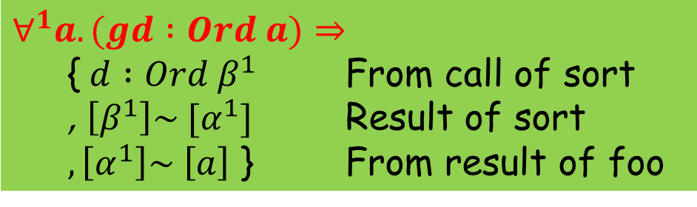
Type signatures
reverse :: ∀a. [a] -> [a]
sort :: ∀a. Ord a => [a] -> [a]
f :: ∀a. Ord a => [a] -> [a]
f = \xs -> reverse (sort xs)
xs : $[a]$
Instantiate reverse with $α$
Instantiate sort with $β$
Type signature gives rise to an implication constraint
Constraints of the signature become “givens” of the implication
Increment the ambient level before generating constraints for the RHS
$$∀^{1}a. (gd :Ord a)⇒$$
{$d :Ord β^{1}$ From call of sort
, $\left[β^{1}\right]\sim [α^{1}]$ Result of sort
$, \left[α^{1}\right]\sim \left[a\right]$ } From result of foo

Slide 43
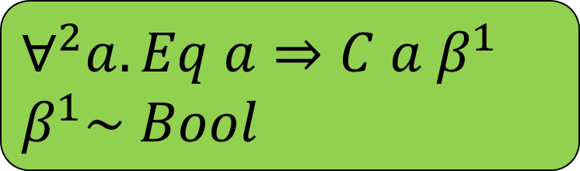
Works equally well for nested signatures
op :: C a x => a -> x -> Int
instance Eq a => C a Bool
f x = let g :: ∀a Eq a => a -> a
g a = op a x
in g (not x)
x : β
Constraint: C a β
And then this
$$∀^{2}a. Eq a⇒C a β^{1}$$
$$β^{1}\sim Bool$$
Solve this first

Slide 44
Constraint solving: hither and yon

Slide 45
Story so far
Perform repeated rewrites on the constraints
Each rewrite preserves logical meaning
Each rewrite is recorded by adding an evidence binding, in the elaborated program
The constraint language is very small
But solving is quite subtle
F ::= d : C τ₁.. τ_{n}
| g : τ₁ ~ τ₂
| F₁ , F₂
| True
W ::= F
| W₁ , W₂
| ∀^{k} a₁..a_{n}. F ⇒ W

Slide 46
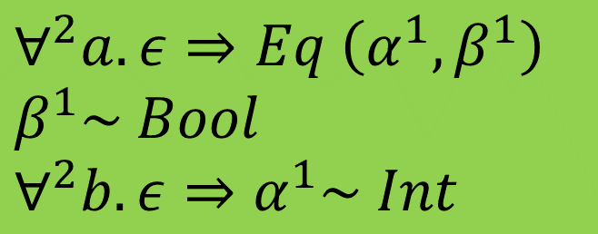






Solving hither and yon
$$∀^{2}a. ε⇒Eq \left(α^{1},β^{1}\right)$$
$$β^{1}\sim Bool$$
$$∀^{2}b. ε⇒α^{1}\sim Int$$
$$Root^{1}$$
$$∀^{2}a$$
$$β^{1}\sim Bool$$
$$∀^{2}b$$
$$Eq {(α}^{1},β^{1})$$
$$α^{1}\sim Int$$
Touchable
A tree of constraints to solve
Untouchable

Slide 47

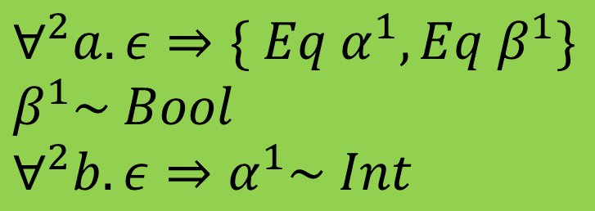

Solving hither and yon
$$∀^{2}a. ε⇒\{ Eq α^{1}, Eq β^{1}\}$$
$$β^{1}\sim Bool$$
$$∀^{2}b. ε⇒α^{1}\sim Int$$
$$Root^{1}$$
$$∀^{2}a$$
$$β^{1}\sim Bool$$
$$∀^{2}b$$
$$Eq α^{1}$$
$$α^{1}\sim Int$$
$$Eq β^{1}$$
Use instance (Eq a, Eq b) => Eq (a,b)

Slide 48
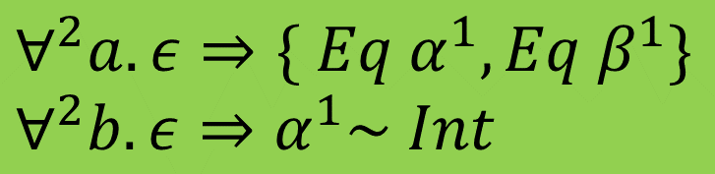
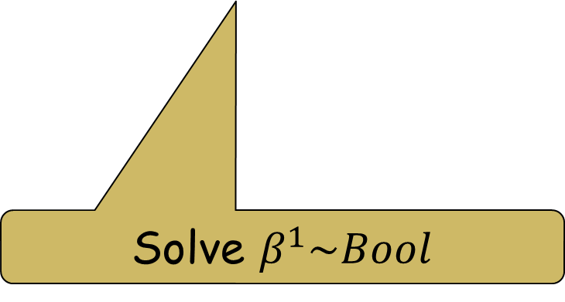

Solving hither and yon
$$β≔Bool$$
$$∀^{2}a. ε⇒\{ Eq α^{1}, Eq β^{1}\}$$
$$∀^{2}b. ε⇒α^{1}\sim Int$$
$$Root^{1}$$
$$∀^{2}a$$
$$∀^{2}b$$
$$Eq α^{1}$$
$$α^{1}\sim Int$$
$$Eq β^{1}$$
Solve $β^{1}\sim Bool$

Slide 49

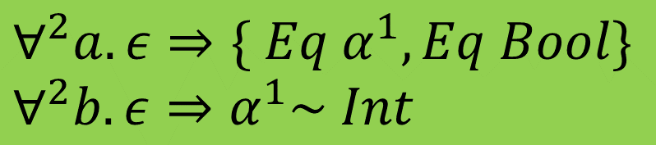
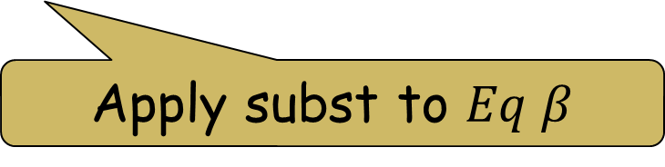
Solving hither and yon
$$β≔Bool$$
$$∀^{2}a. ε⇒\{ Eq α^{1}, Eq Bool\}$$
$$∀^{2}b. ε⇒α^{1}\sim Int$$
$$Root^{1}$$
$$∀^{2}a$$
$$∀^{2}b$$
$$Eq α^{1}$$
$$α^{1}\sim Int$$
$$Eq Bool$$
Apply subst to $Eq β$

Slide 50
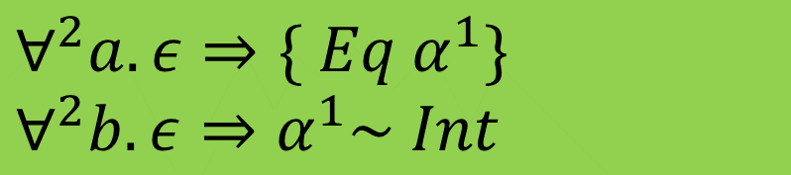
Solving hither and yon
$$β≔Bool$$
$$∀^{2}a. ε⇒\{ Eq α^{1}\}$$
$$∀^{2}b. ε⇒α^{1}\sim Int$$
$$Root^{1}$$
$$∀^{2}a$$
$$∀^{2}b$$
$$Eq α^{1}$$
$$α^{1}\sim Int$$
Use instance Eq Bool

Slide 51
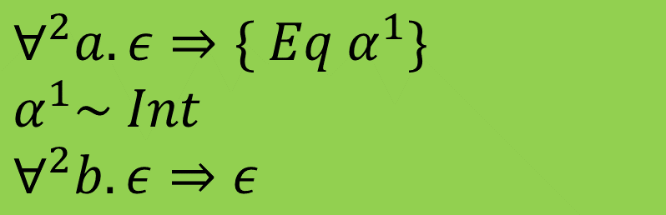

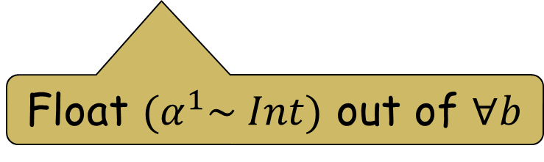
Solving hither and yon
$$β≔Bool$$
$$∀^{2}a. ε⇒\{ Eq α^{1}\}$$
$$α^{1}\sim Int$$
$$∀^{2}b. ε⇒ε$$
$$Root^{1}$$
$$∀^{2}a$$
$$∀^{2}b$$
$$α^{1}\sim Int$$
$$Eq α^{1}$$
Float ${(α}^{1}\sim Int)$ out of $∀b$

Slide 52
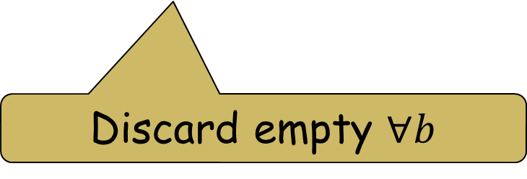
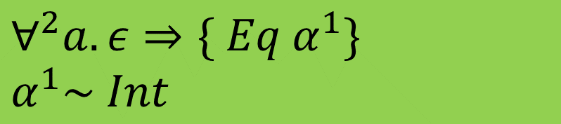
Solving hither and yon
$$β≔Bool$$
$$∀^{2}a. ε⇒\{ Eq α^{1}\}$$
$$α^{1}\sim Int$$
$$Root^{1}$$
$$∀^{2}a$$
$$α^{1}\sim Int$$
$$Eq α^{1}$$
Discard empty $∀b$

Slide 53
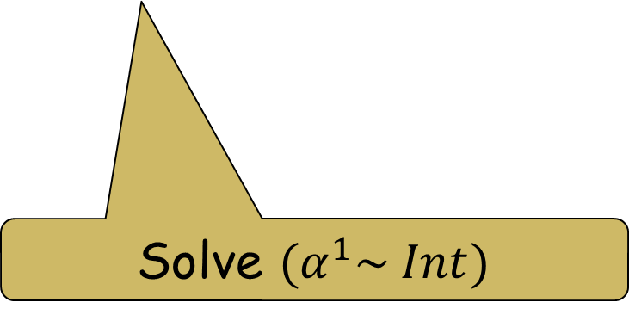


Solving hither and yon
$$β≔Bool$$
$$α≔Int$$
$$∀^{2}a. ε⇒\{ Eq α^{1}\}$$
$$Root^{1}$$
$$∀^{2}a$$
$$Eq α^{1}$$
Solve $(α^{1}\sim Int)$

Slide 54
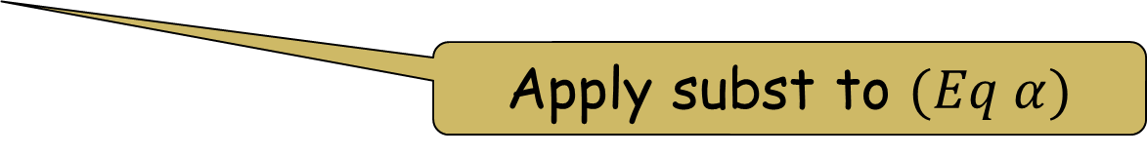


Solving hither and yon
$$β≔Bool$$
$$α≔Int$$
$$∀^{2}a. ε⇒\{ Eq Int\}$$
$$Root^{1}$$
$$∀^{2}a$$
$$Eq Int$$
Apply subst to $(Eq α)$

Slide 55

Solving hither and yon
$$β≔Bool$$
$$α≔Int$$
$$∀^{2}a. ε⇒ε$$
$$Root^{1}$$
$$∀^{2}a$$
Use instance Eq Int

Slide 56

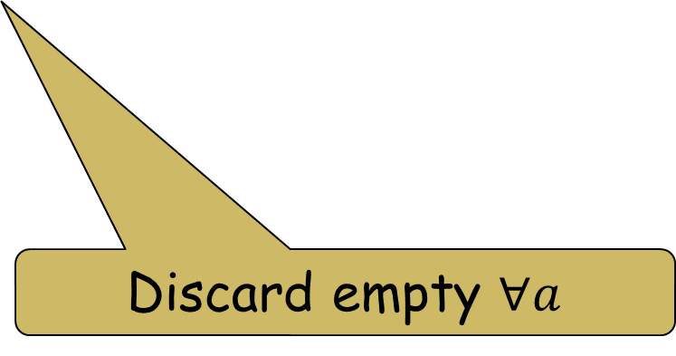
Solving hither and yon
$$β≔Bool$$
$$α≔Int$$
$$ε$$
Main message
Constraint solving may involve going to and fro over the tree
No problem!
$$Root^{1}$$
Discard empty $∀a$

Slide 57
Back to the big picture

Slide 58
The French approach to type inference
Apply substitution
Haskell source program
Large syntax, with many many constructors
Elaborated program with “holes”
Elaborated source program
Constraint generation
Constraints
Small syntax, with few constructors
Solve
Substitution
Residual constraint
Report
errors
The essence of ML type inference, Pottier & Remy, In ATAPL, Pierce, 2005.

Slide 59
The advantages of being French
Constraint generation has a lot of cases (Haskell has a big syntax) but is rather easy.
Constraint solving is tricky! But it only has to deal with a very small constraint language.
Generating an elaborated program is easy: constraint solving “fills the holes” of the elaborated program

Slide 60
Robustness
Constraint solver can work in whatever order it likes (incl iteratively), unaffected by of the order in which you traverse the source program.
A much more common approach: solve typechecking problems in the order you encounter them
Result: small (even syntactic) changes to the program can affect whether it is accepted ☹
TL;DR: generate-then-solve is much more robust

Slide 61
Error messages
All type error messages are generated from the final, residual unsolved constraint.
Hence type errors incorporate results of all solved constraints. Eg “Can’t match [Int] with Bool”, rather than “Can’t match [a] with Bool”
Much more modular: error message generation is in one place (TcErrors) instead of scattered all over the type checker.
Constraints carry “provenance” information to say whence they came

Slide 62
Practical benefits
Highly modular
constraint generation (7 modules, 3000 loc)
constraint solving (5 modules, 3000 loc)
error message generation (1 module, 800 loc)
Efficient: constraint generator does a bit of “on the fly” unification to solve simple cases, but generates a constraint whenever anything looks tricky
Provides a great “sanity check” for the type system: is it easy to generate constraints, or do we need a new form of constraint?

Slide 63
Things I have sadly not talked about
Coercions: the evidence for equality
Type families, and “flattening”
Functional dependencies, injectivity, and “Derived” constraints
Deferred type errors and typed holes
Unboxed vs boxed equalities
Nominal vs representational equality (Coercible etc)
Kind polymorphism, levity polymorphism, matchabilty polymorphism
… and quite a bit more

Slide 64
Things I have sadly not talked about
Coercions: the evidence for equality
Type families, and “flattening”
Functional dependencies, injectivity, and “Derived” constraints
Deferred type errors and typed holes
Unboxed vs boxed equalities
Nominal vs representational equality (Coercible etc)
… and quite a bit more
The good news
All of these crazy things are (reasonably) easily handled within the generate-and-solve framework

Slide 65
Conclusion
Generate constraints then solve, is THE way to do type inference.
Background reading
OutsideIn(X): modular type inference with local assumptions (JFP 2011). Covers implication constraints but not floating or level numbers.
Practical type inference for arbitrary-rank types (JFP 2007). Full executable code; but does not use the Glorious French Approach
Vive la France

Slide 66
Extra slides
There is lots more to say.
Far too much to fit in a 1-hr talk.
Some of these extra topics are in the following slides.

Slide 67
Evidence of equality

Slide 68
Equality constraints generate evidence too!
data T a where
K1 :: Bool -> T Bool
K2 :: T a
f :: T a -> Maybe a
f x = case x of
K1 z -> Just z
K2 -> Nothing
K1 :: ∀a. (a~Bool) =>
Bool -> T a

Slide 69
Equality constraints generate evidence too!
f :: T a -> Maybe a
f = Λ(a:*) λ(x:T a).
case x of
K1 (c:a~Bool) (z:Bool)
-> Just z  c2
K2 -> False
K1 :: ∀a. (a~Bool) =>
Bool -> T a
Plus constraint to solve
$$∀. \left(c :a\sim Bool\right)⇒(c2 :Maybe Bool \sim Maybe a)$$

Slide 70
Equality constraints generate evidence too!
$$∀^{2}. \left(c :a\sim Bool\right)⇒(c2 :Maybe Bool \sim Maybe a)$$
Decompose
c2 := Maybe c3
$$∀^{2}. \left(c :a\sim Bool\right)⇒(c3 :Bool \sim a)$$
Use given to substitute for a
Use given to substitute for a
c3 := c4 ; Sym c
$$∀^{2}. \left(c :a\sim Bool\right)⇒(c3 :Bool \sim Bool)$$
Proving Bool~Bool is easy
c4 := Refl Bool
$$∀^{2}. \left(c :a\sim Bool\right)⇒ ε$$

Slide 71
Plug the evidence back into the term
f :: T a -> Maybe a
f = Λ(a:*) λ(x:T a)
case x of
K1 (c:a~Bool) (z:Bool)
-> Just z  (Maybe (Refl Bool ; Sym c))
K2 -> False

Slide 72
Floating with GADTs
data T a where
K :: Bool -> T Bool
f x = case x of
K z -> True
What type should we infer for f?
f :: ∀b. T b -> b
f :: ∀b. T b -> Bool
Neither is more general than (a substitution instance of) the other!

Slide 73
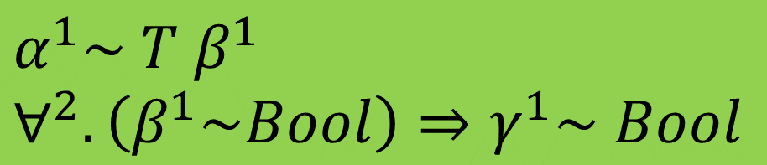


Floating with GADTs
data T a where
T1 :: Bool -> T Bool
f x = case x of
T1 z -> True
Float, and solve? $γ^{1}≔Bool$
Get f :: ∀b. T b -> Bool
Rewrite $γ^{1}\sim Bool$ to $γ^{1}\sim β^{1}$ using the given $β^{1} \sim Bool$; then float and solve $γ^{1}≔β^{1}$
Get ∀b. T b -> b
f : $α→γ$
x : $α$
$$α^{1}\sim T β^{1}$$
$$∀^{2}. \left(β^{1}\sim Bool\right)⇒γ^{1}\sim Bool$$

Slide 74

Floating with GADTs
data T a where
T1 :: Bool -> T Bool
f x = case x of
T1 z -> True
Solution
Do not float anything out of an implication that has “given” equalities
f : $α→γ$
x : $α$
$$α^{1}\sim T β^{1}$$
$$∀^{2}. \left(β^{1}\sim Bool\right)⇒γ^{1}\sim Bool$$
Result (in this case):
“cannot unify untouchable $γ$ with Bool”

Slide 75
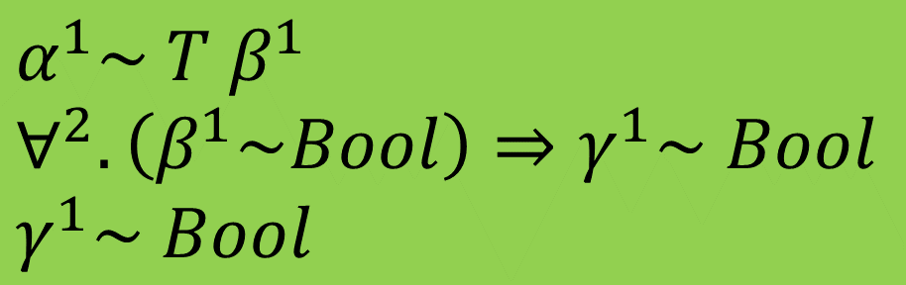
Floating with GADTs
data T a where
K1 :: Bool -> T Bool
K2 :: T a
f2 x = case x of
K1 z -> True
K2 -> False
Another branch, with no given equalities, may resolve the ambiguity
f : $α→γ$
x : $α$
$$α^{1}\sim T β^{1}$$
$$∀^{2}. \left(β^{1}\sim Bool\right)⇒γ^{1}\sim Bool$$
$$γ^{1}\sim Bool$$
From the K2 branch, no implication needed

Slide 76
Deferred type errors andtyped holes

Slide 77
Type errors considered harmful
The rise of dynamic languages
“The type errors are getting in my way”
Feedback to programmer
Static: type system
Dynamic: run tests
“Programmer is denied dynamic feedback in the periods when the program is not globally type correct” [DuctileJ, ICSE’11]

Slide 78
Type errors considered harmful
Underlying problem: forces programmer to fix all type errors before running any code.
Goal: Damn the torpedos
Compile even type-incorrect programs to executable code, without losing type soundness

Slide 79
How it looks
bash$ ghci –fdefer-type-errors
ghci> let foo = (True, ‘a’ && False)
Warning: can’t match Char with Bool
gici> fst foo
True
ghci> snd foo
Error: can’t match Char with Bool
Not just the command line: can load modules with type errors --- and run them
Type errors occur at run-time if (and only if) they are actually encountered

Slide 80
Type holes: incomplete programs
{-# LANGUAGE TypeHoles #-}
module Holes where
f x = (reverse . _) x
Quick, what type does the “_” have?
Agda does this, via Emacs IDE
Holes.hs:2:18:
Found hole ‘_’ with type: a -> [a1]
Relevant bindings include
f :: a -> [a1] (bound at Holes.hs:2:1)
x :: a (bound at Holes.hs:2:3)
In the second argument of (.), namely ‘_’
In the expression: reverse . _
In the expression: (reverse . _) x

Slide 81
Multiple, named holes
f x = [_a, x::[Char], _b:_c ]
Holes:2:12:
Found hole `_a' with type: [Char]
In the expression: _a
In the expression: [_a, x :: [Char], _b : _c]
In an equation for `f': f x = [_a, x :: [Char], _b : _c]
Holes:2:27:
Found hole `_b' with type: Char
In the first argument of `(:)', namely `_b'
In the expression: _b : _c
In the expression: [_a, x :: [Char], _b : _c]
Holes:2:30:
Found hole `_c' with type: [Char]
In the second argument of `(:)', namely `_c'
In the expression: _b : _c
In the expression: [_a, x :: [Char], _b : _c]

Slide 82
Combining the two
-XTypeHoles and –fdefer-type-errors work together
With both,
you get warnings for holes,
but you can still run the program
If you evaluate a hole you get a runtime error.

Slide 83
Just a hack?
Presumably, we generate a program with suitable run-time checks.
How can we be sure that the run-time checks are in the right place, and stay in the right places after optimisation?
Answer: not a hack at all, but a thing of beauty!
Zero runtime cost

Slide 84
When equality is insoluble...
(True, ‘a’ && False)
Haskell term
Generate constraints
elaborated program
c7 : Int ~ Bool
(True, (‘a’  c7) && False)
Constraints
Elaborated program
(mentioning constraint variables)

Slide 85
Step 2: solve constraints
Use lazily evaluated “error” evidence
Cast evaluates its evidence
Error triggered when (and only when) ‘a’ must have type Bool
let c7: Int~Bool
= error “Can’t match ...”
Solve
c7 : Int ~ Bool
(True, (‘a’  c7) && False)
Constraints
Elaborated program
(mentioning constraint variables)

Slide 86
Step 2: solve constraints
Uh oh! What became of coercion erasure?
Use lazily evaluated “error” evidence
Cast evaluates its evidence
Error triggered when (and only when) ‘a’ must have type Bool
let c7: Int~Bool
= error “Can’t match ...”
Solve
c7 : Int ~ Bool
(True, (‘a’  c7) && False)
Constraints
Elaborated program
(mentioning constraint variables)

Slide 87
Hole constraints (a new form of constraint)
True && _
Haskell term
Generate constraints
elaborated program
h7 : Hole β
β ~ Bool
(True && h7)
Elaborated program
(mentioning constraint variables)
Constraints

Slide 88
Hole constraints...
Again use lazily evaluated “error” evidence
Error triggered when (and only when) the hole is evaluated
let h7: Bool = error “Evaluated hole”
Solve
h7 : Hole Bool
(True && h7)
Elaborated program
(mentioning constraint variables)
Constraints

Slide 89
Generalisation

Slide 90
Generalisation (Hindley-Milner)
f :: Int -> Float -> (Int,Float)
f x y = let g v = v+v
in (g x, g y)
We need to infer the most general type for g :: ∀a. Num a => a -> a so that it can be called at Int and Float
Generate constraints for g’s RHS, simplify them, quantify over variables not free in the environment
BUT: what happened to “generate then solve”?

Slide 91
A more extreme example
data T a where
C :: T Bool
D :: a -> T a
f :: T a -> a -> Bool
f v x = case v of
C -> let y = not x
in y
D x -> True
Should this typecheck?
In the C alternative, we know a~Bool

Slide 92
A more extreme example
data T a where
C :: T Bool
D :: a -> T a
f :: T a -> a -> Bool
f v x = let y = not x
in case v of
C -> y
D x -> True
What about this?
Constraint a~Bool arises from match on C

Slide 93
A more extreme example
data T a where
C :: T Bool
D :: a -> T a
f :: T a -> a -> Bool
f v x = let y () = not x
in case v of
C -> y ()
D x -> True
Or this?

Slide 94
A more extreme example
Here we abstract over the a~Bool constraint
data T a where
C :: T Bool
D :: a -> T a
f :: T a -> a -> Bool
f v x = let y :: (a~Bool) => () -> Bool
y () = not x
in case v of
C -> y ()
D x -> True
But this surely should!

Slide 95
A possible path [Pottier et al]
Abstract over all unsolved constraints from RHS
Big types, unexpected to programmer
Errors postponed to usage sites
(Serious) Sharing loss for thunks
(Killer) Can’t abstract over implications f :: (forall a. (a~[b]) => b~Int) => blah

Slide 96
A much easier path
Do not generalise local let-bindings at all!
Simple, straightforward, efficient
Polymorphism is almost never used in local bindings (see “Modular type inference with local constraints”, JFP)
GHC actually generalises local bindings that could have been top-level, so there is no penalty for localising a definition.

Slide 97
Efficient Equalities

Slide 98
Questions you might like to ask
Is this all this coercion faff efficient?
ML typechecking has zero runtime cost; so anything involving these casts and coercions looks inefficient, doesn’t it?

Slide 99
Making it efficient
let c7: Bool~Bool = refl Bool
in (x  c7) && False)
Remember deferred type errors: cast must evaluate its coercion argument.
What became of erasure?

Slide 100
Take a clue from unboxed values
data Int = I# Int#
plusInt :: Int -> Int -> Int
plusInt x y
= case x of I# a ->
case y of I# b ->
I# (a +# b)
x `plusInt` x
= case x of I# a ->
case x of I# b ->
I# (a +# b)
= case x of I# a ->
I# (a +# a)
Library code
Inline + optimise
Expose evaluation to optimiser

Slide 101
Take a clue from unboxed values
data a ~ b = Eq# (a ~# b)
() :: (a~b) -> a -> b
x  c = case c of
Eq# d -> x # d
refl :: t~t
refl = /\t. Eq# (refl# t)
let c7 = refl Bool
in (x  c7) && False
...inline refl, 
= (x # (refl# Bool))
&& False
Inline + optimise
Library code
So (~#) is the primitive type constructor
(#) is the primitive language construct
And (#) is erasable

Slide 102
Implementing ~#
data T where
T1 :: ∀a. (a~#Bool) -> Double# -> Bool -> T a
A T1 value allocated in the heap looks like this
Question: what is the representation for (a~#Bool)?
64 bits
32 bits
T1
???
3.8
True

Slide 103
Implementing ~#
data T where
T1 :: ∀a. (a~#Bool) -> Double# -> Bool -> T a
A T1 value allocated in the heap looks like this
Question: what is the representation for (a~#Bool)?
Answer: a 0-bit value
0 bits
64 bits
32 bits
T1
3.8
True

Slide 104
Boxed and primitive equality
data a ~ b = Eq# (a ~# b)
User API and type inference deal exclusively in boxed equality (a~b)
Hence all evidence (equalities, type classes, implicit parameters...) is uniformly boxed
Ordinary, already-implemented optimisation unwrap almost all boxed equalities.
Unboxed equality (a~#b) is represented by 0-bit values. Casts are erased.
Possibility of residual computations to check termination

