Slide 1
Week 14 Homework Javascript
Lorie Grant

Slide 2
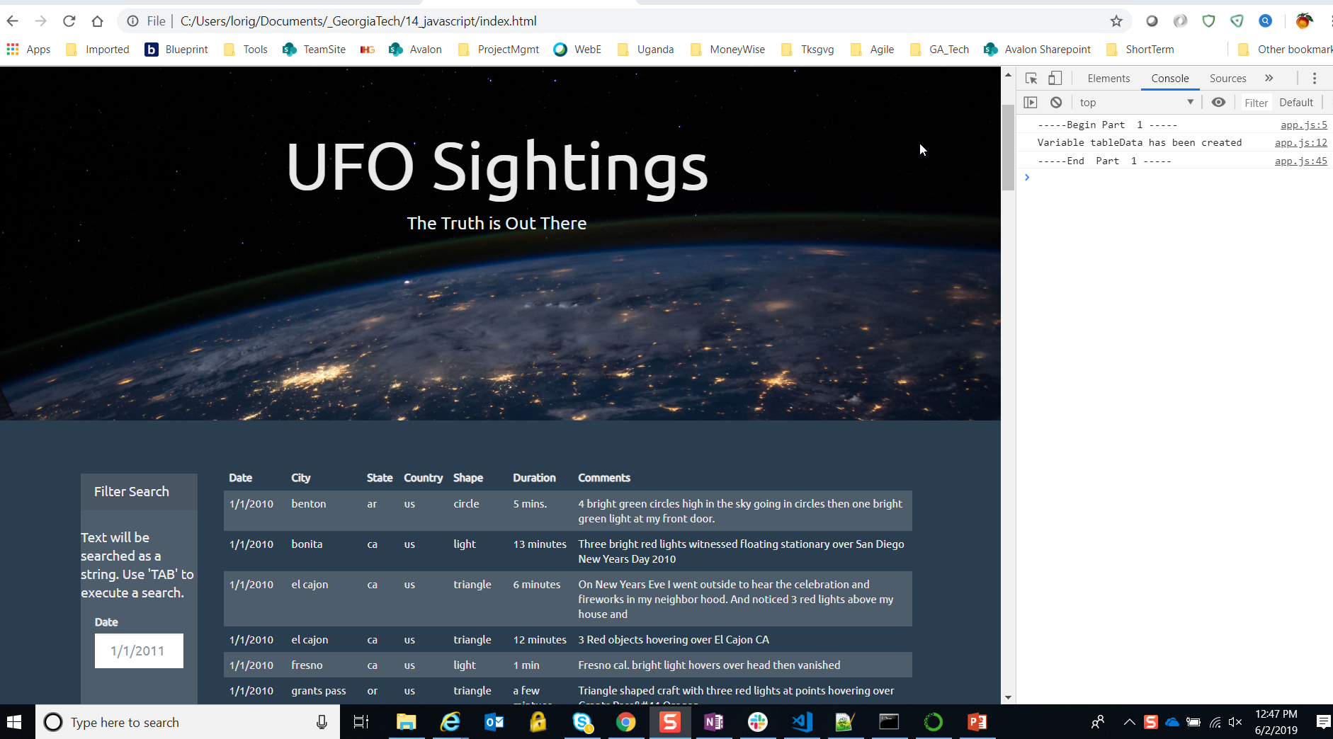
Initial Load

Slide 3
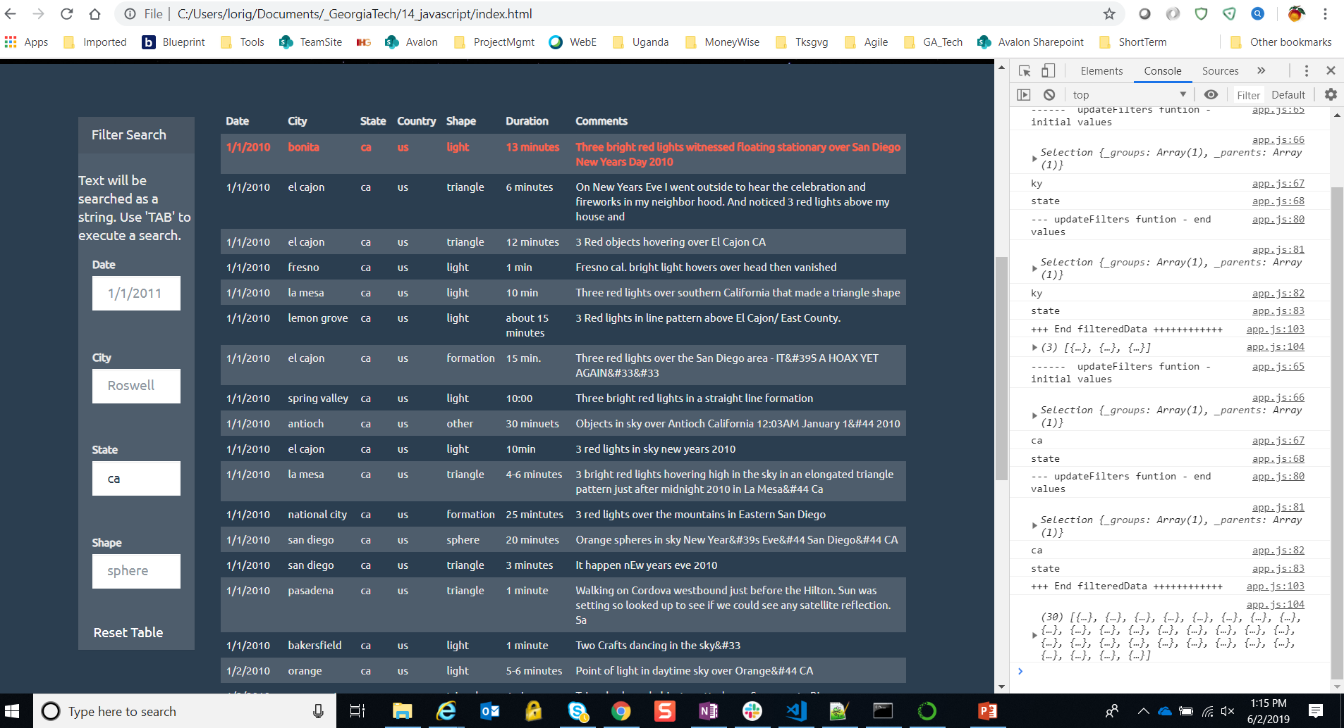
Filter for Data – 1 filter applied

Slide 4
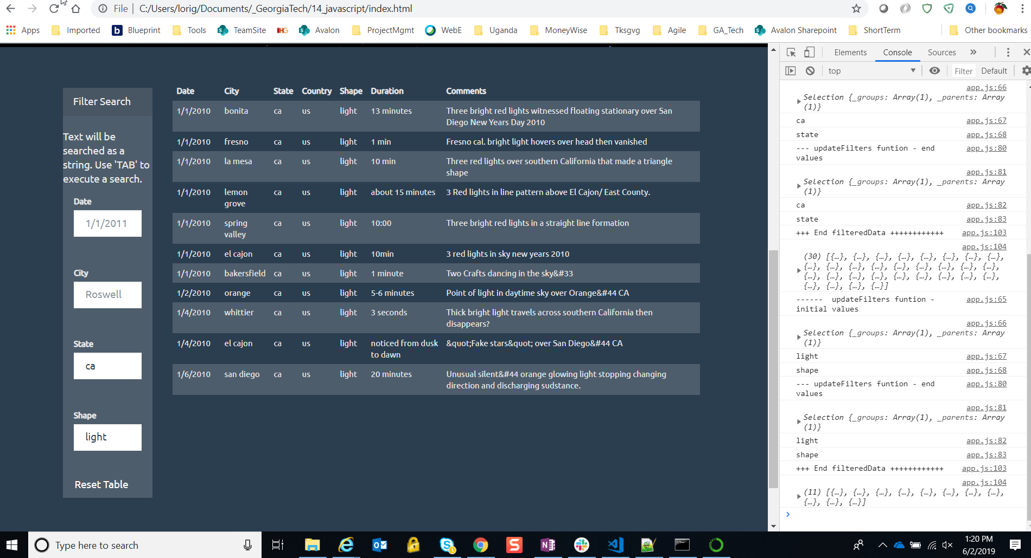
Filter for Data – 2 filters applied

Slide 5
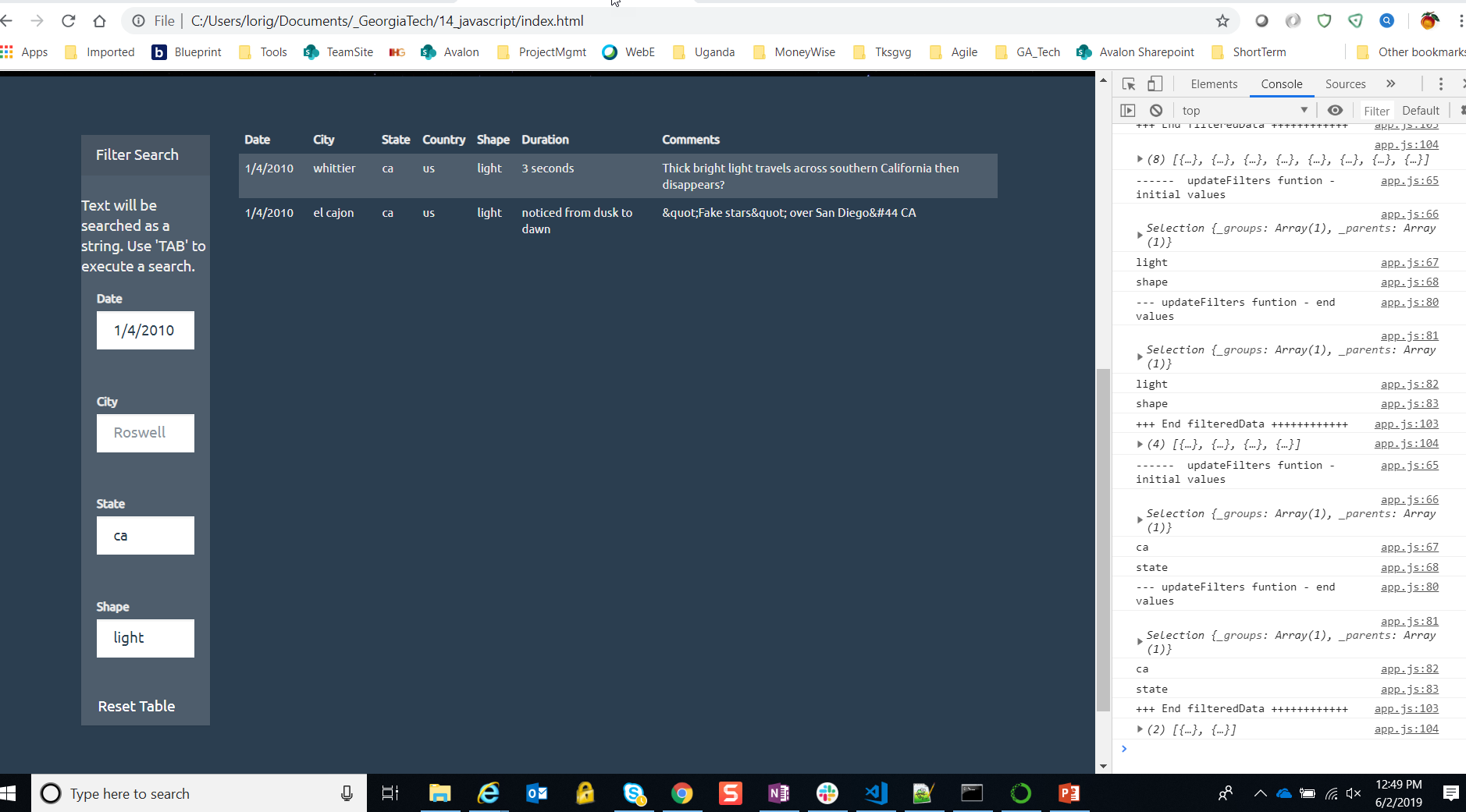
Filter for Data – 3 filters applied

Slide 6
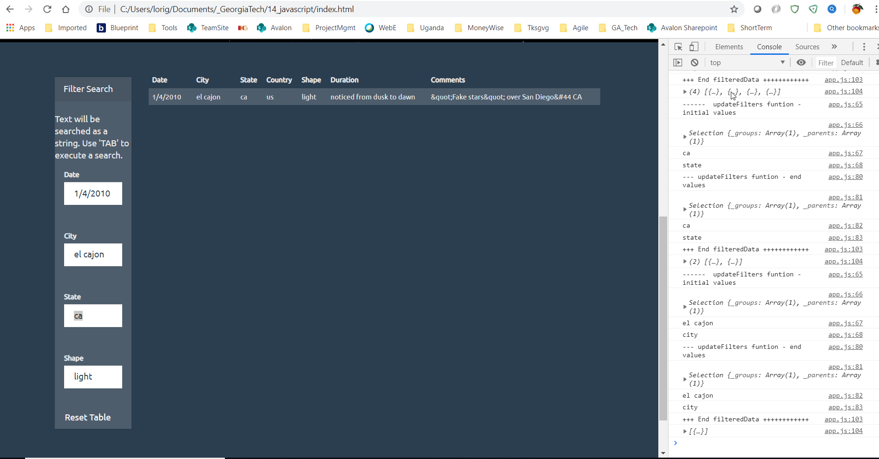
Filter for Data – 4 filters applied

Slide 7
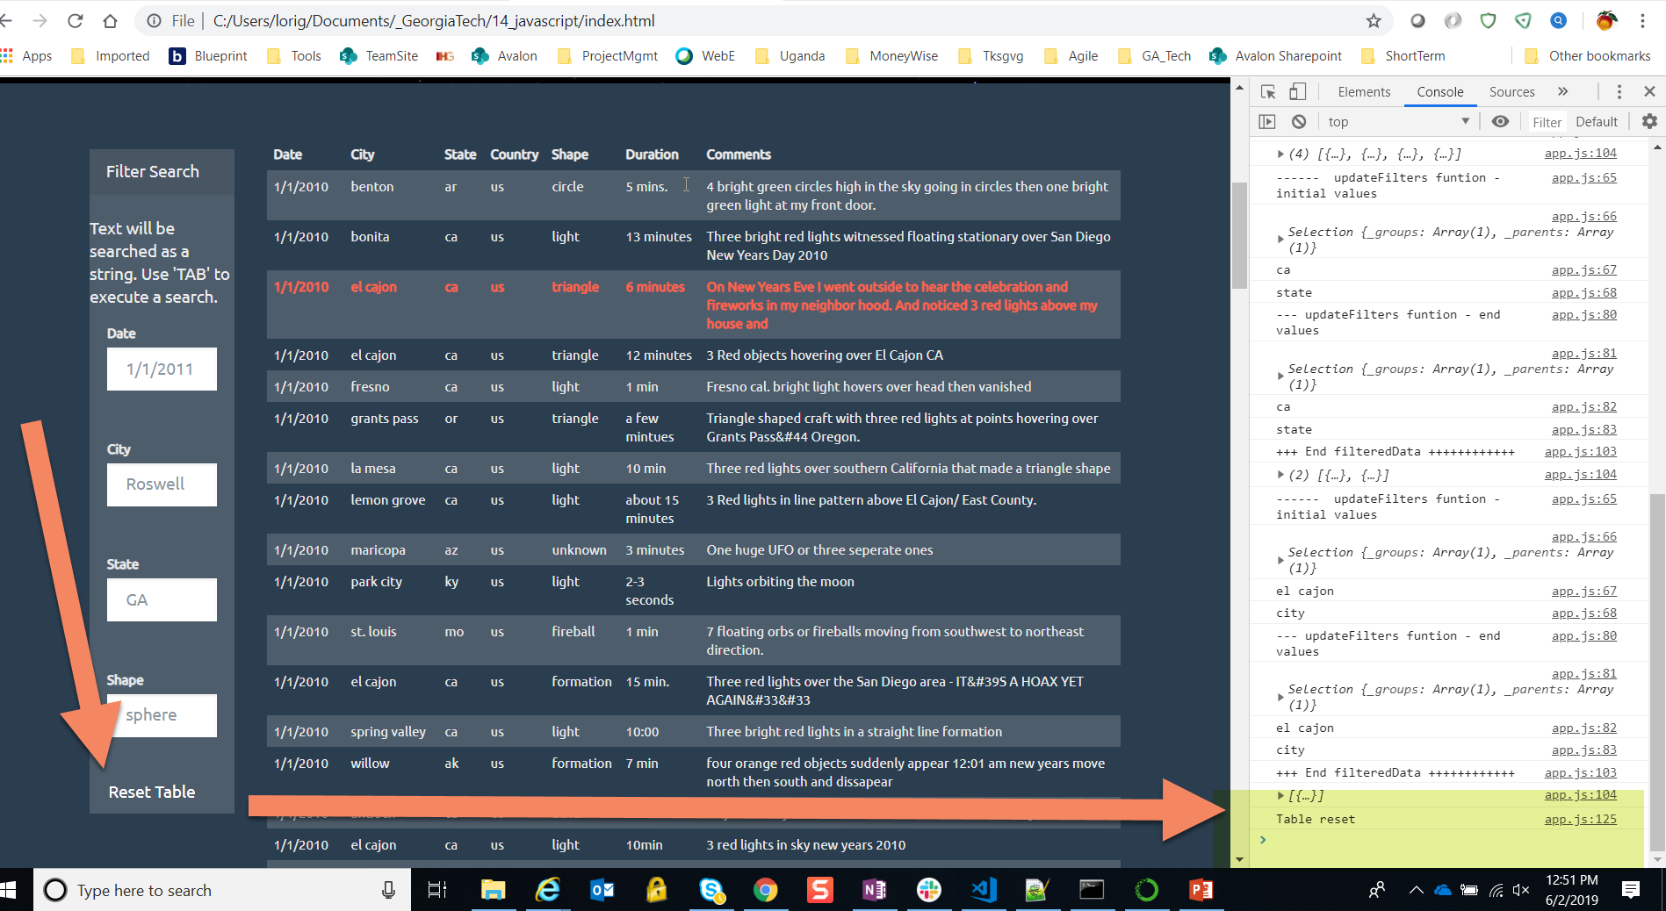
Reset Table

Slide 8
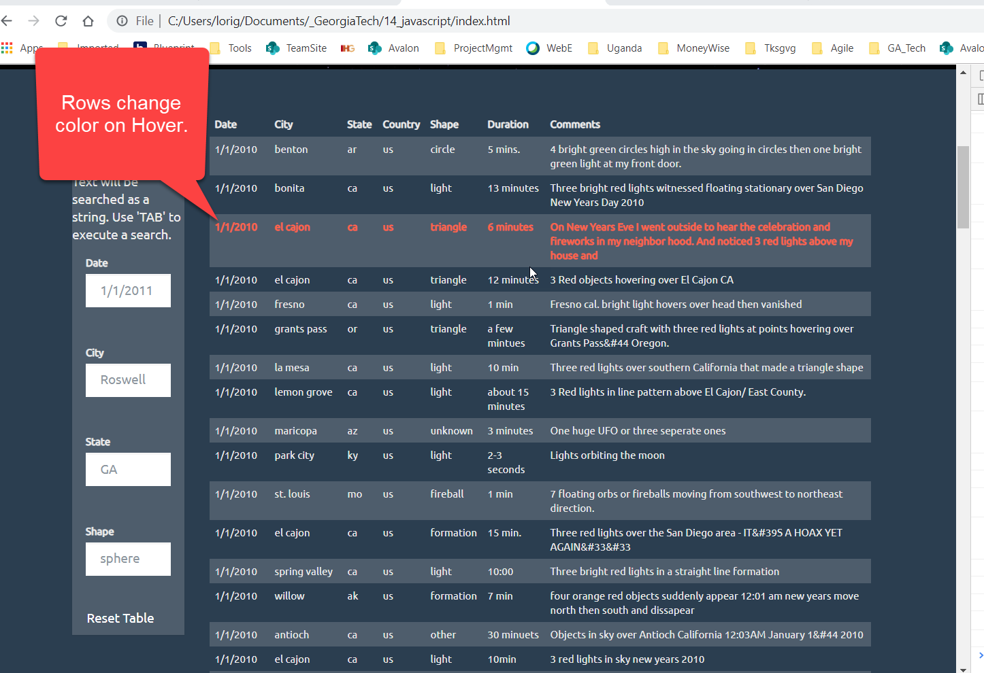
For easier reading – Rows change color on hover

