Slide 1
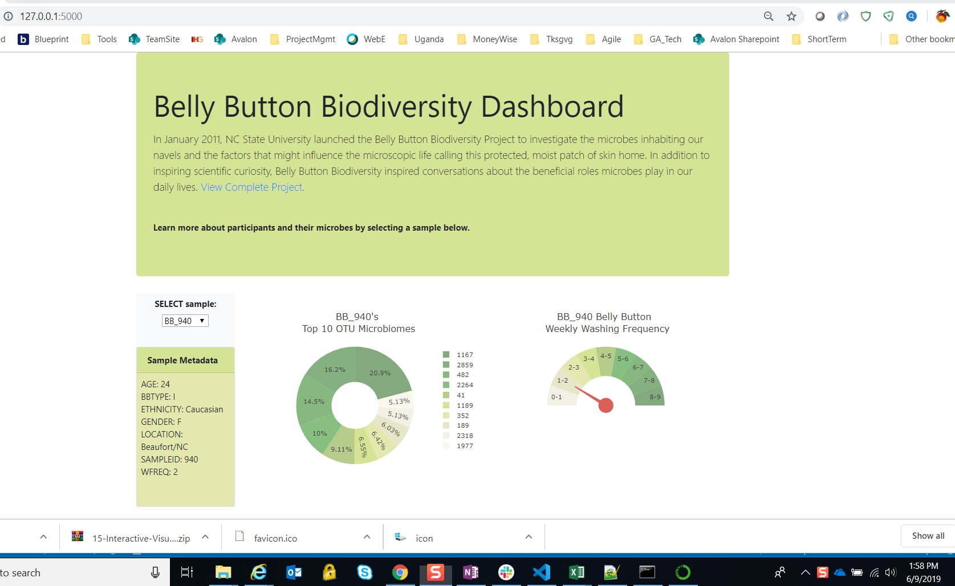
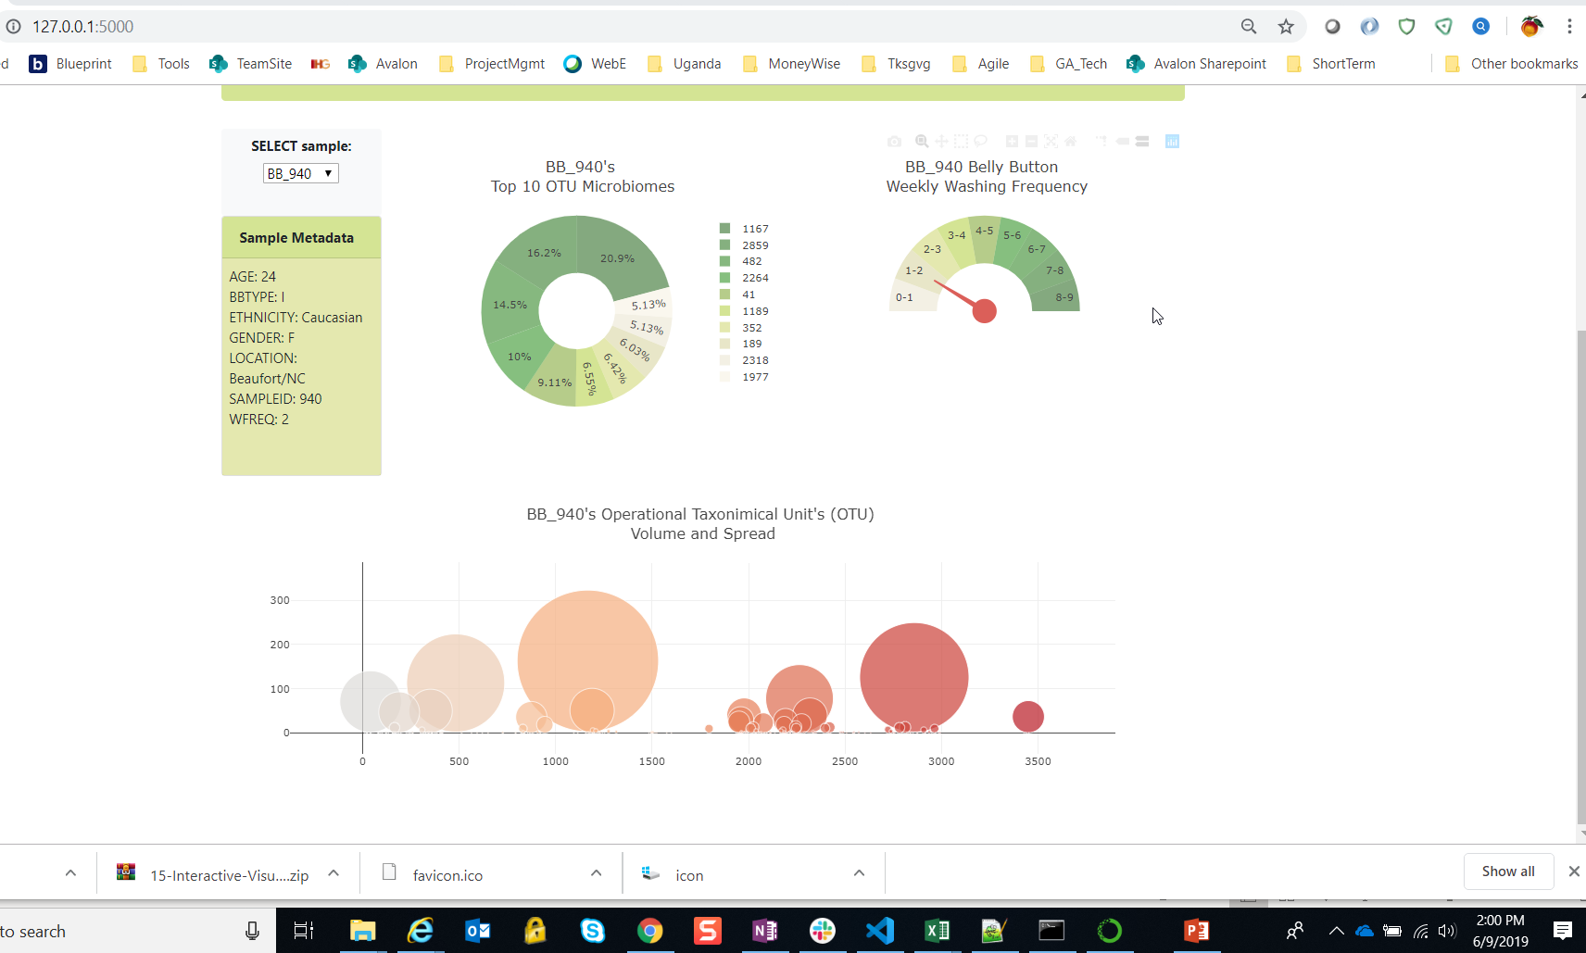
Screen At Initial Launch - localhost

Slide 2
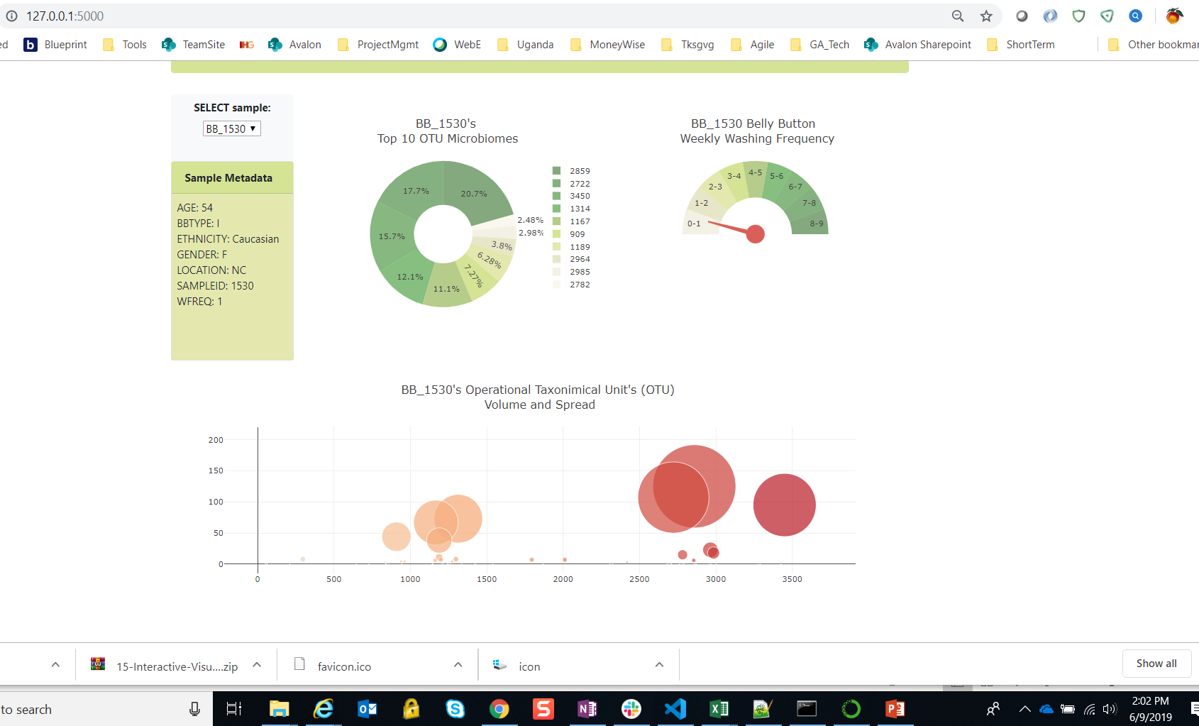
Search via the ‘Select Sample’ dropdown - localhost

Slide 3
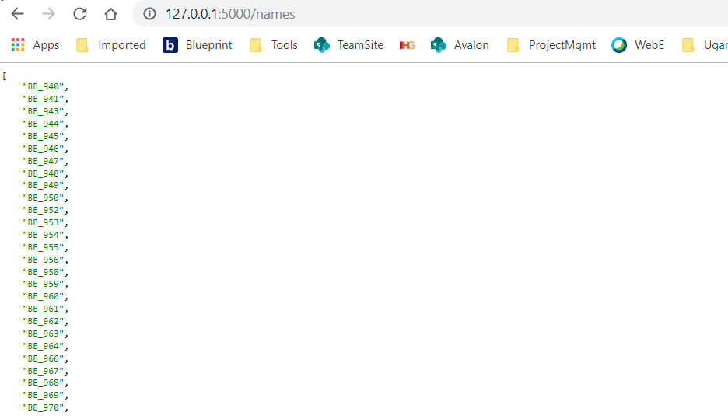
Localhost - @app.route("/names")

Slide 4
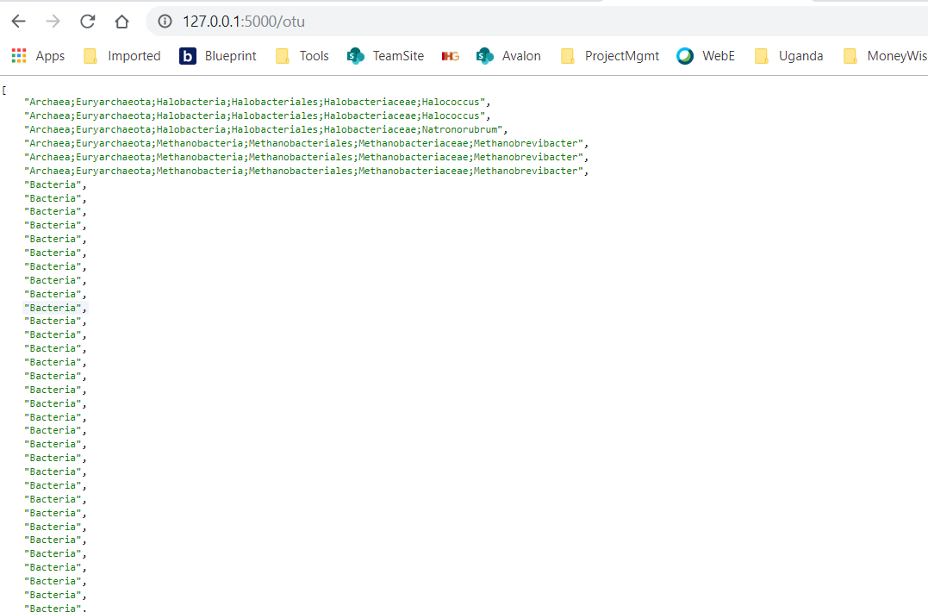
Localhost - @app.route("/otu")

Slide 5
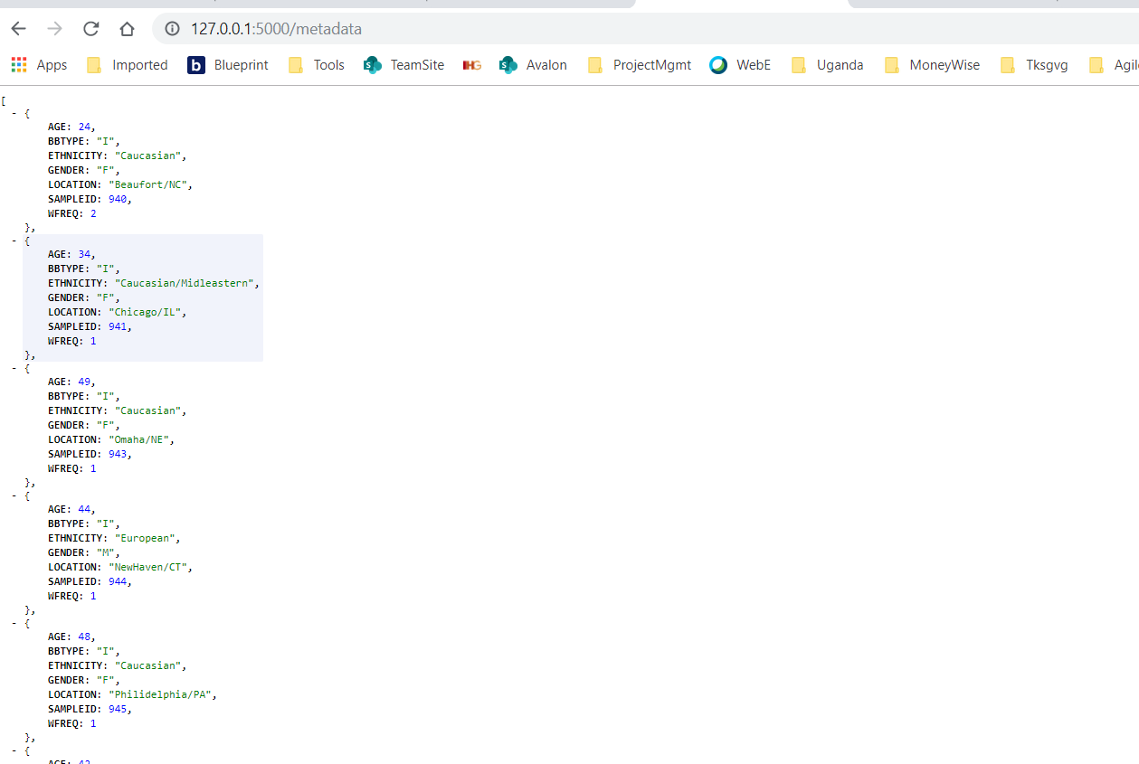
Localhost - @app.route("/metadata")

Slide 6
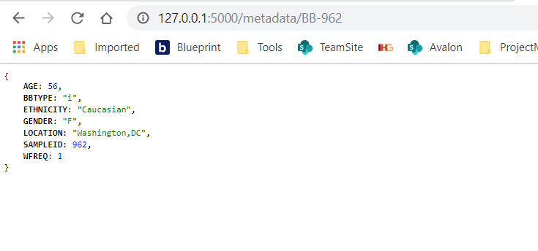
Localhost - @app.route("/metadata/<sample>")

Slide 7
Heroku Deployment appears successful
I did not take a screen image; however, there were no errors.

Slide 8
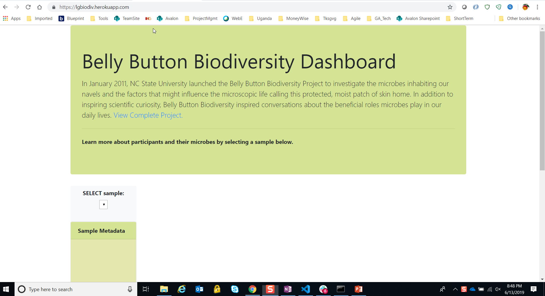
Issues with viewing on Heroku – no data.
URL = https://lgbiodiv.herokuapp.com/

Slide 9
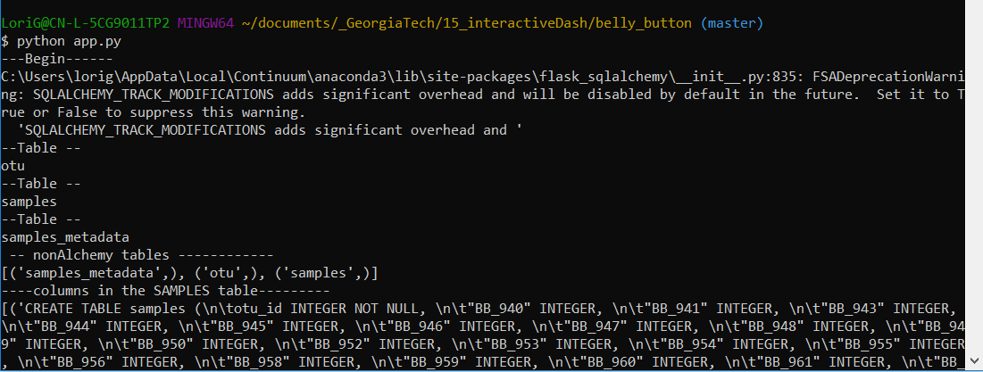
Confirmed the ‘samples’ table exists (Part of app.py)
# Heroku cannot find the samples table (see following screens for the detailed error). This article looks like my issue, but I do not understand this part:
  You'll have to commit your database file on your local development machine and push that commit to Heroku.
# https://stackoverflow.com/questions/56158266/sqlite3-operationalerror-no-such-table-on-heroku

Slide 10
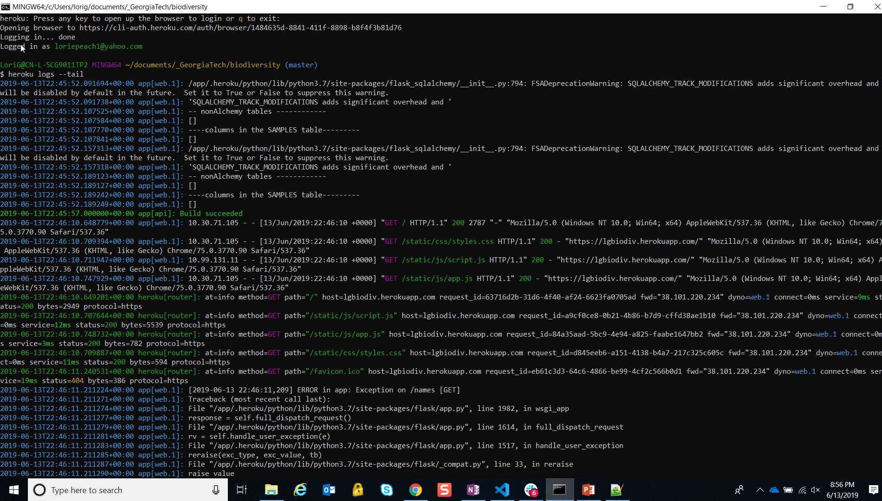
Page 1 of 3 – Heroku error logs indicate the ‘samples’ table does not exist: $ heroku logs --tail

Slide 11
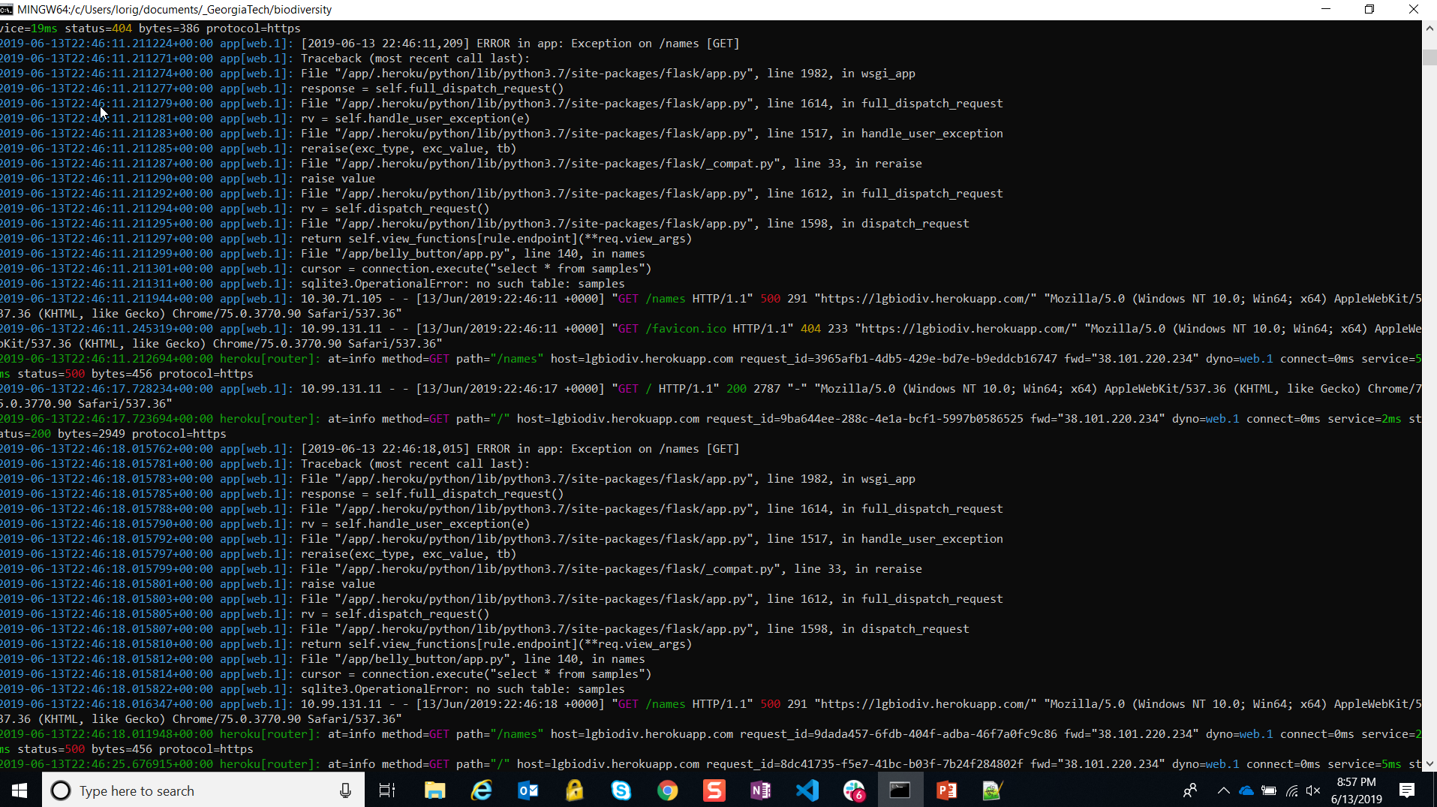
Page 2 of 3 - View the issues via this command entry: $ heroku logs --tail

Slide 12
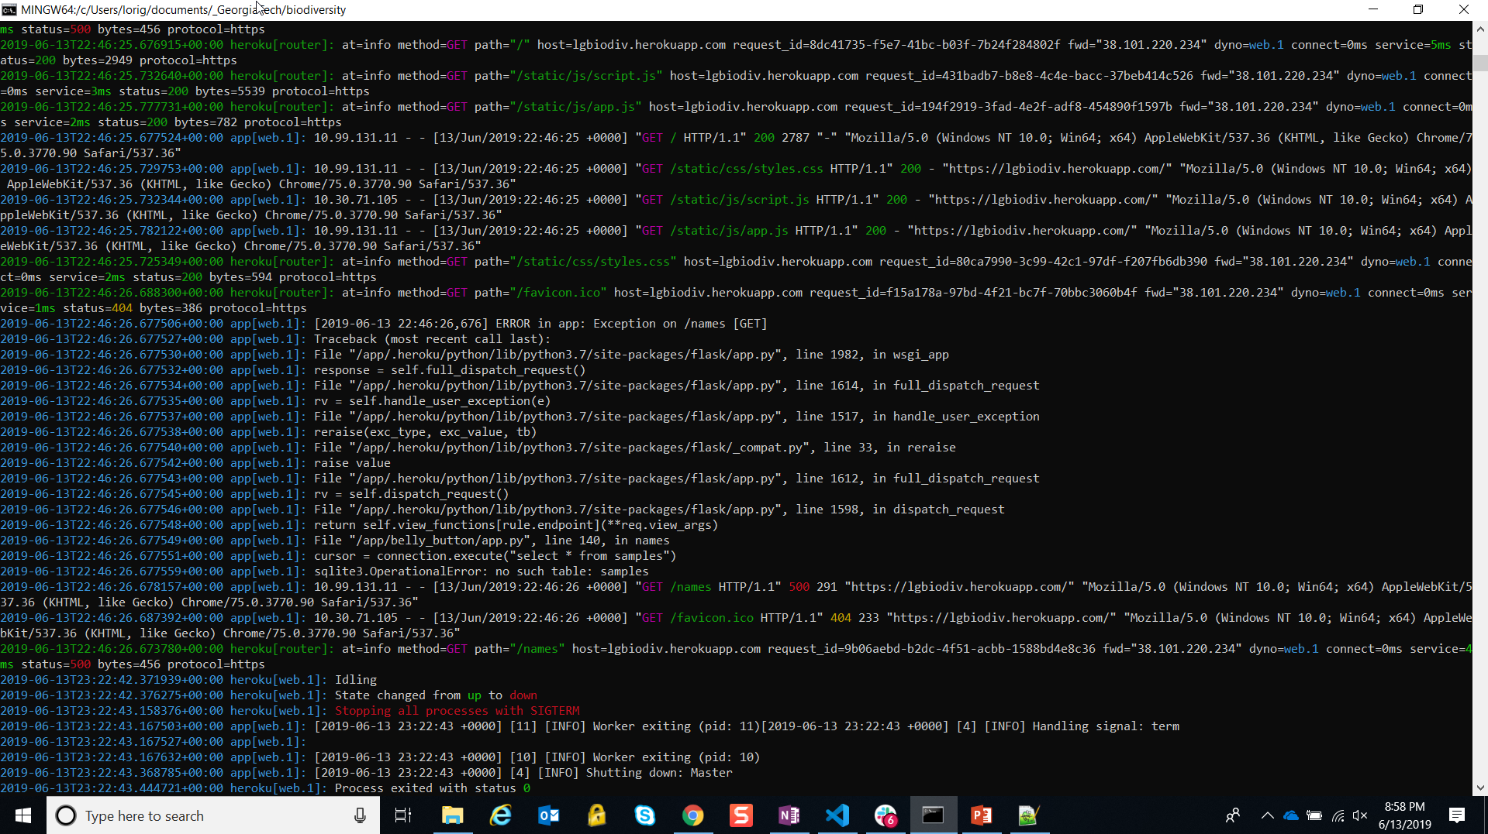
Page 3 of 3 - View the issues via this command entry: $ heroku logs --tail

Slide 13
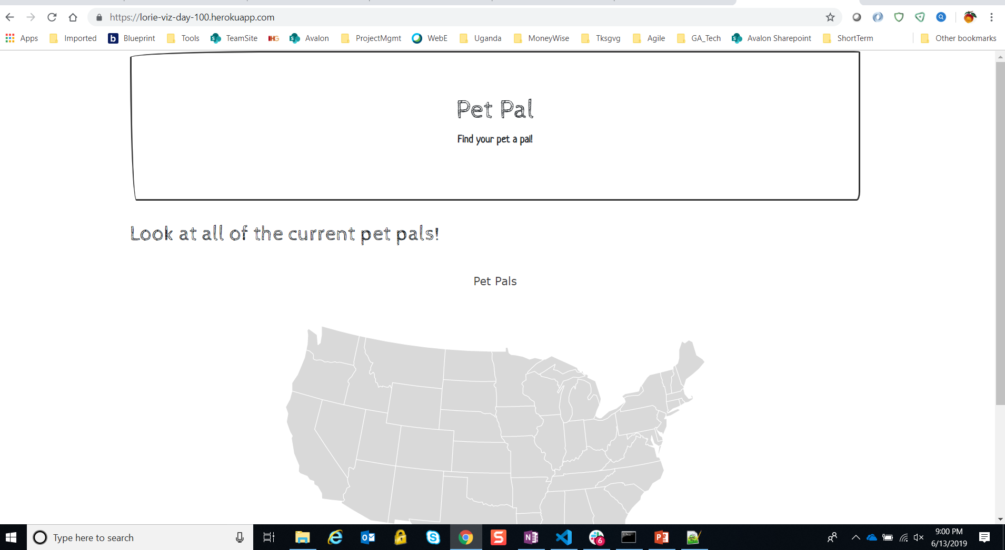
Successful Deployment of Pet Pal, page 1 of 3
https://lorie-viz-day-100.herokuapp.com/

Slide 14
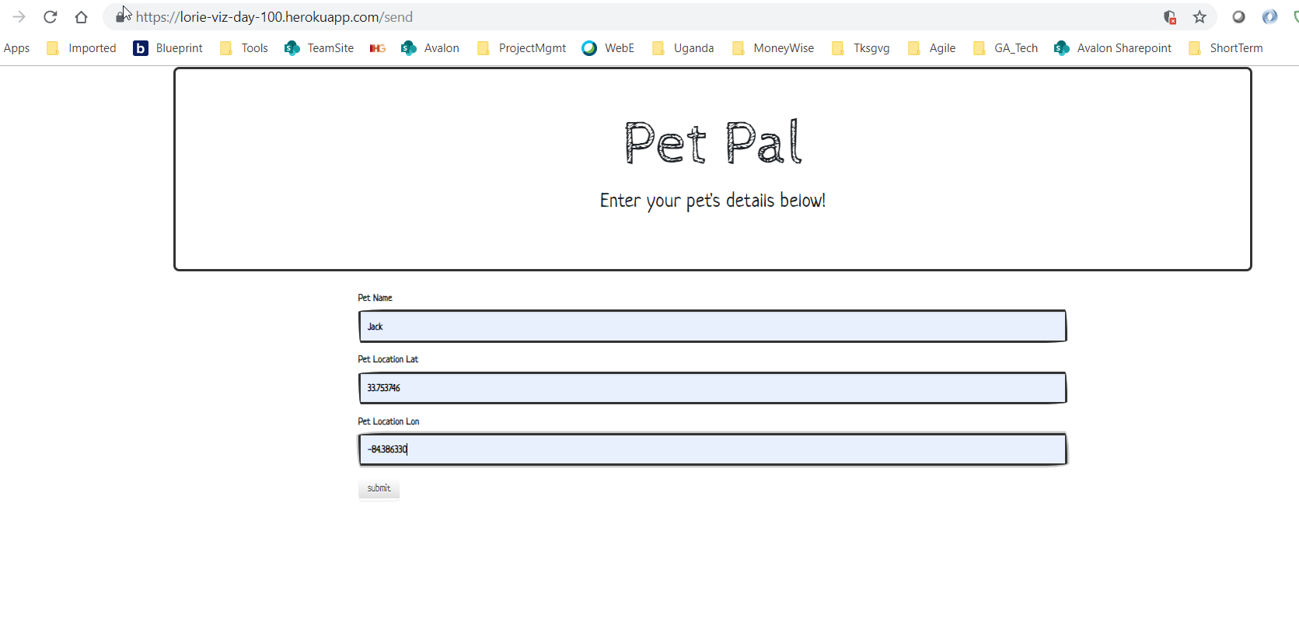
Successful Deployment of Pet Pal, page 2 of 3 -- Enter Data

Slide 15
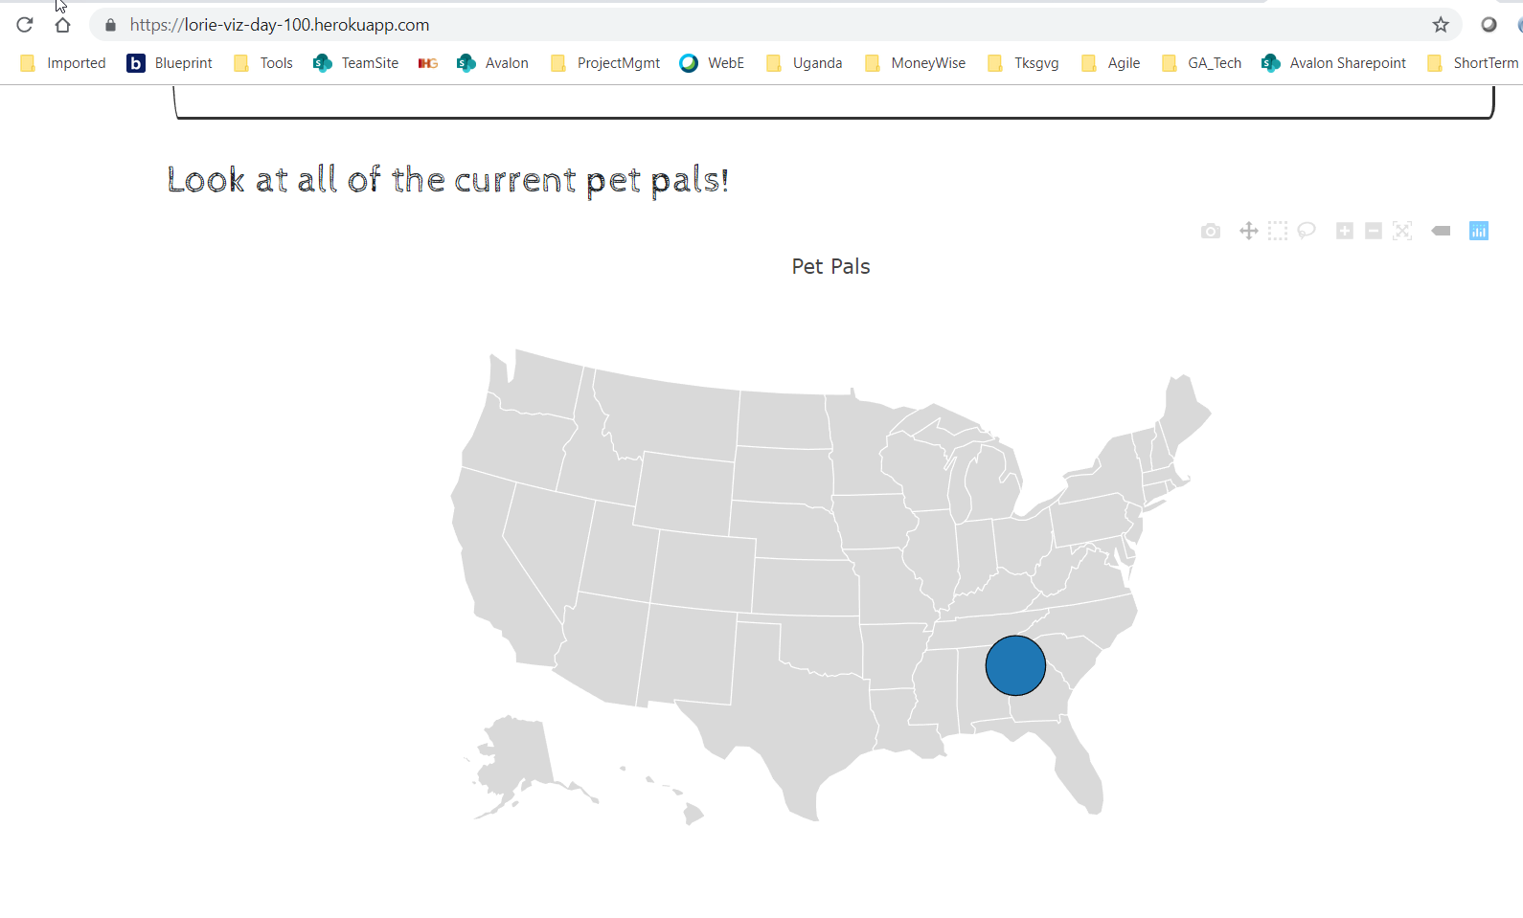
Successful Deployment of Pet Pal, page 3 of 3 -- View Data

