Slide 1
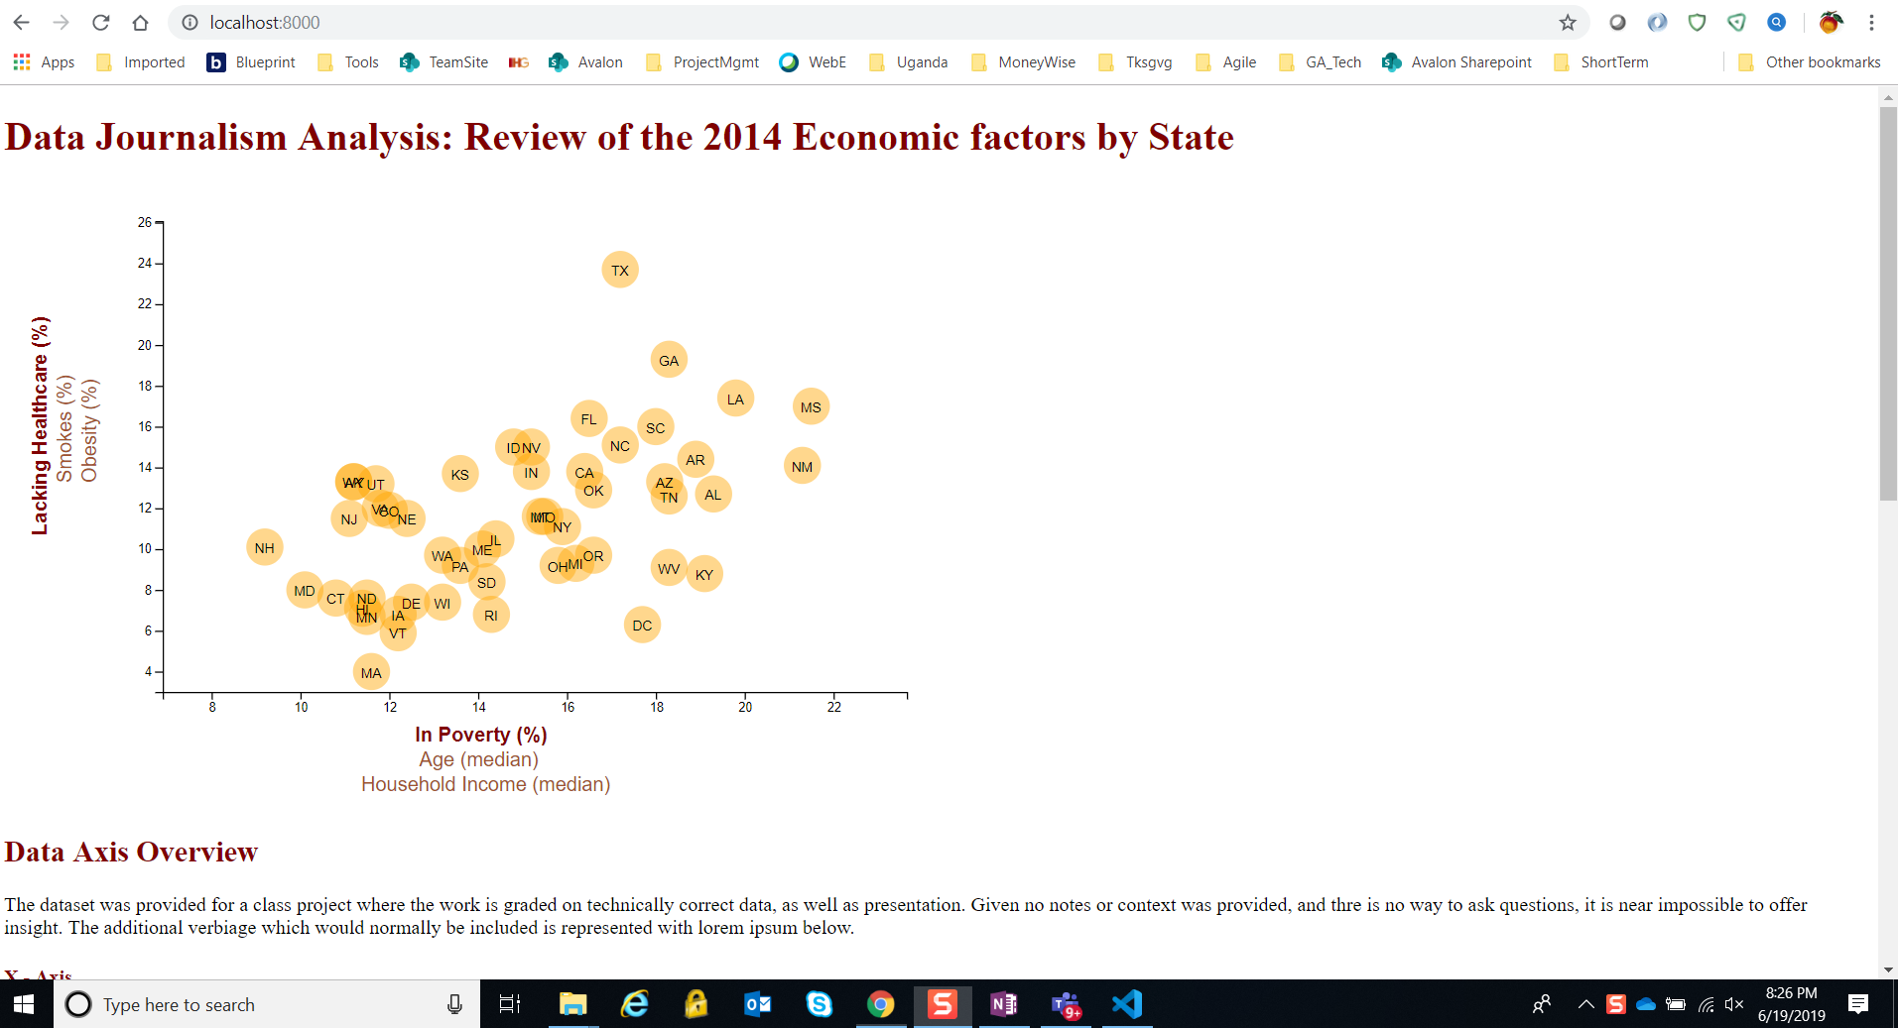
Screen At Initial Launch – localhost (1 of 2)

Slide 2
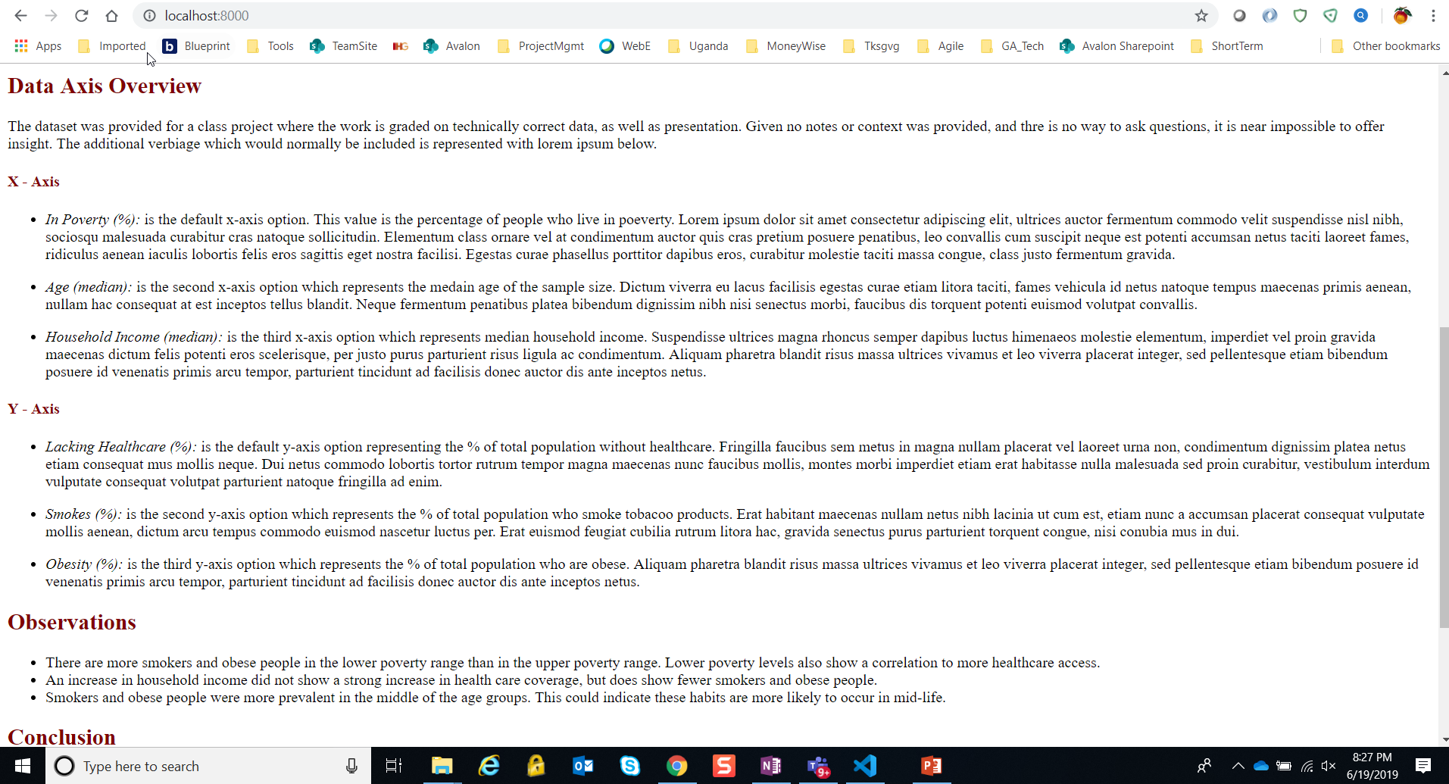
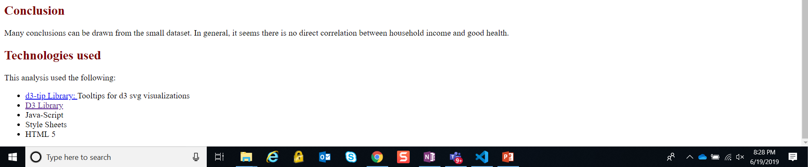
Screen At Initial Launch – localhost (2 of 2)

Slide 3
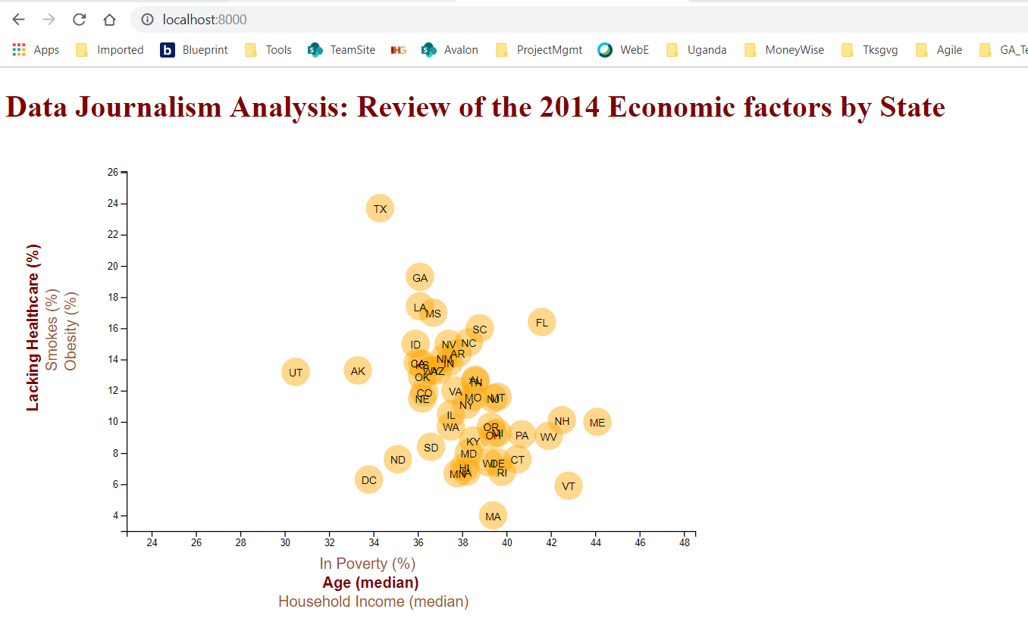
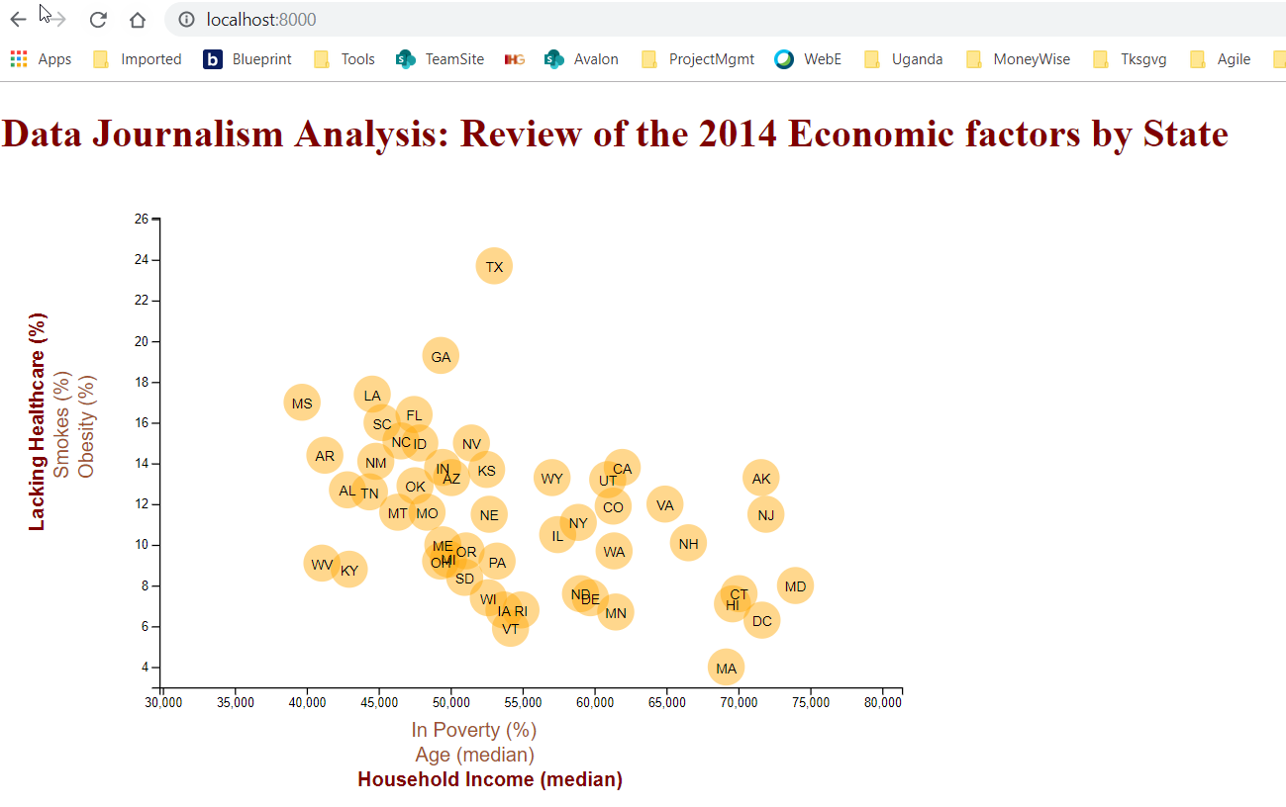
Localhost - Change X Axis

Slide 4
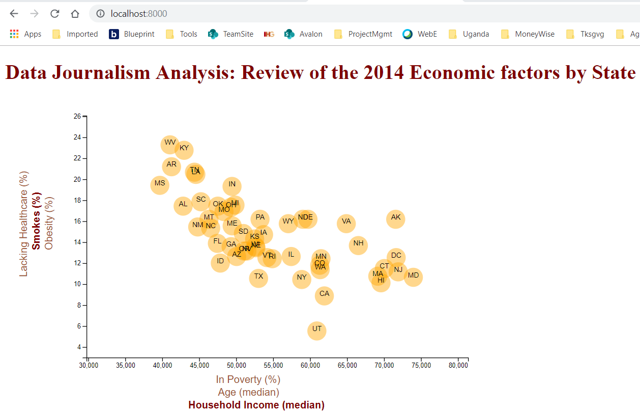
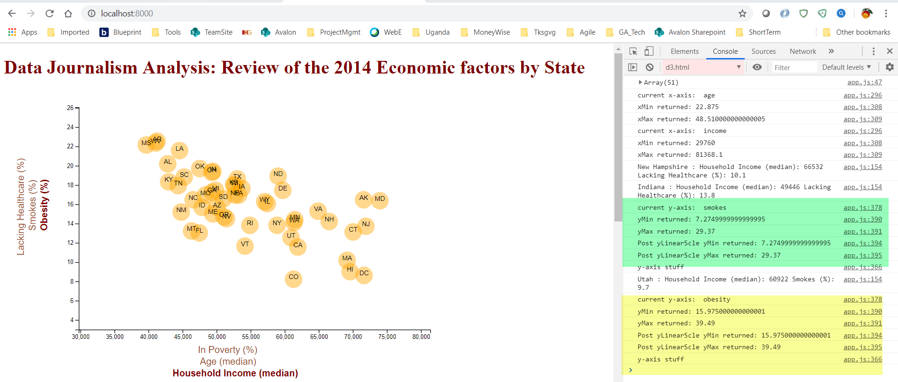
Localhost - Change Y Axis
NOTE: confirmed the y axis values are changing. See the green and yellow highlights for smokes and obesity.
Worked with Ruchi for assistance. We are not able to see why the y axis is not updating with the correct scale.

Slide 5
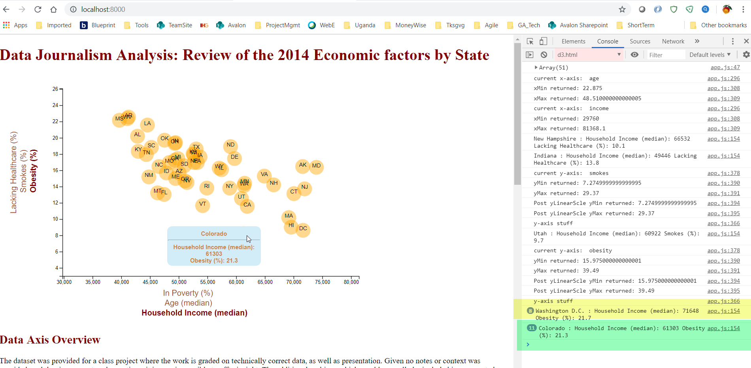
Localhost - Mouseover a Circle and the details display.

