Slide 1
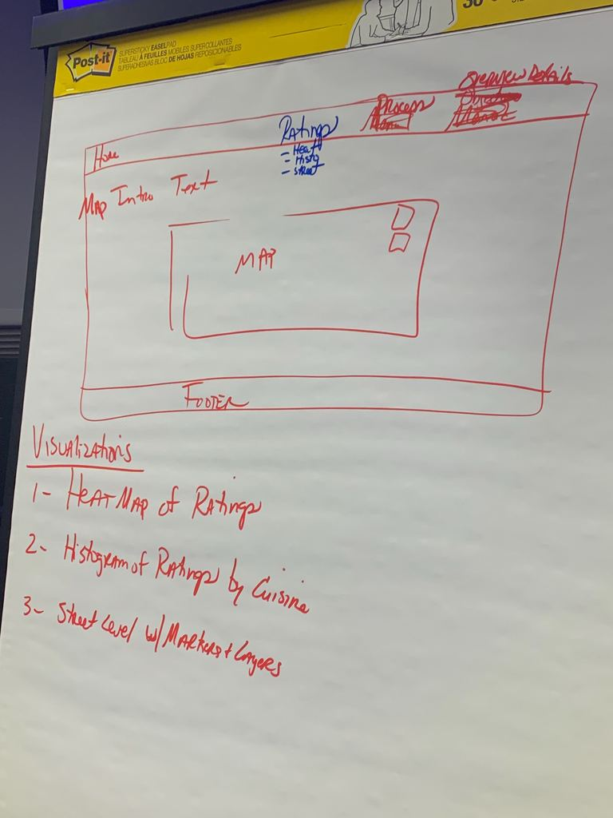
Analysis of NY City Restaurant Health Scores
Final Design
Menu options which allow the user to select different visualizations. The selected visualization will appear in the center of the screen.
Group 1: Data on Rye
Motivation for Topic
We love to travel, to eat when we travel, and to visit New York! This dataset is current, has many variables for visualization, and was interesting to the team.
The dataset
is from NYC OpenData
is provided by the New York City Department of Health and Mental Hygiene (DOHMH)
contains information on New York City restaurant inspection results
was captured using an API call
Link to GitHub Repository: https://github.com/tisfarah/VizProj

Slide 2
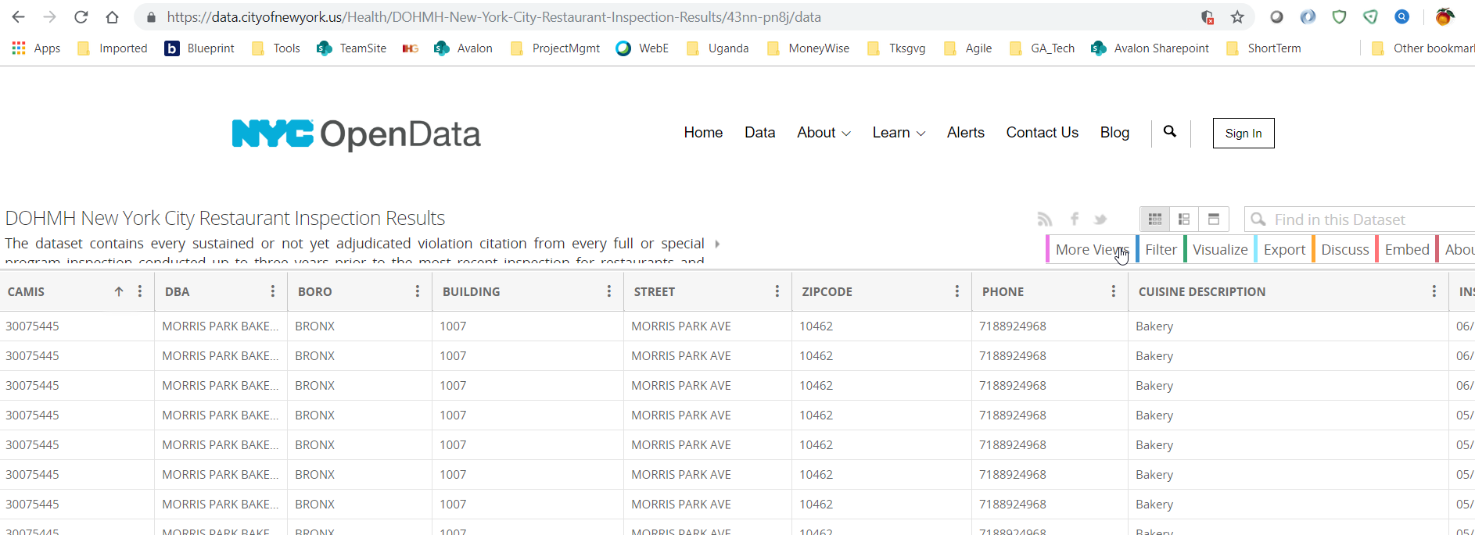
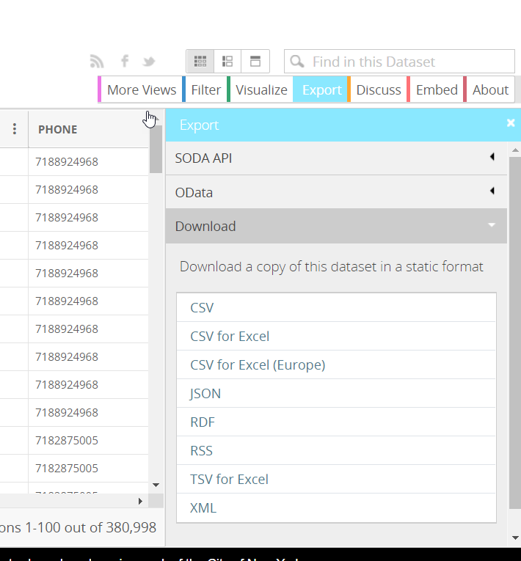
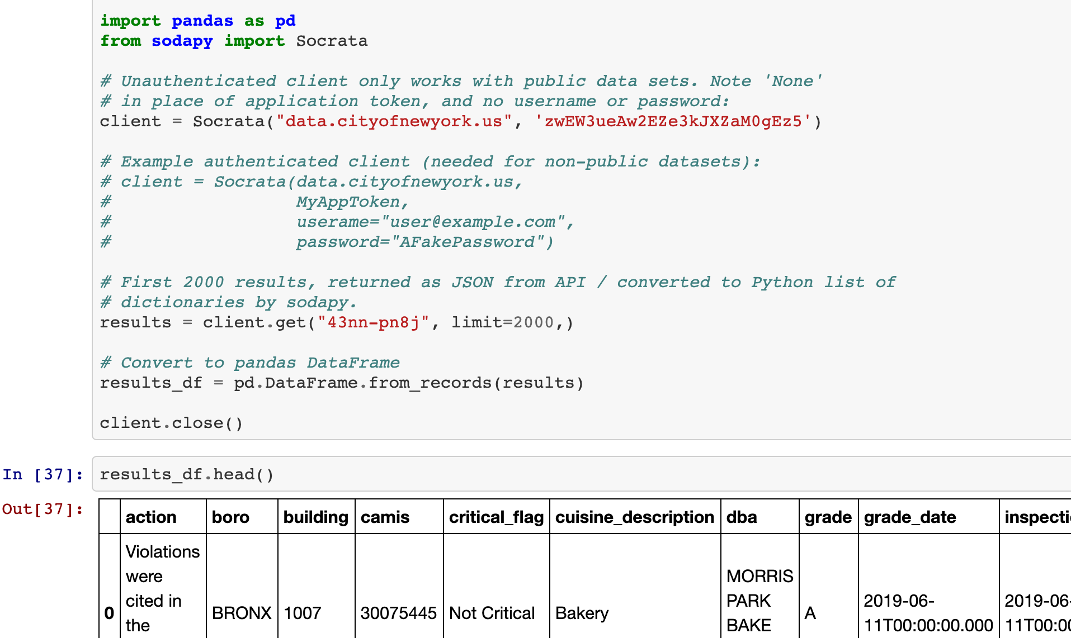
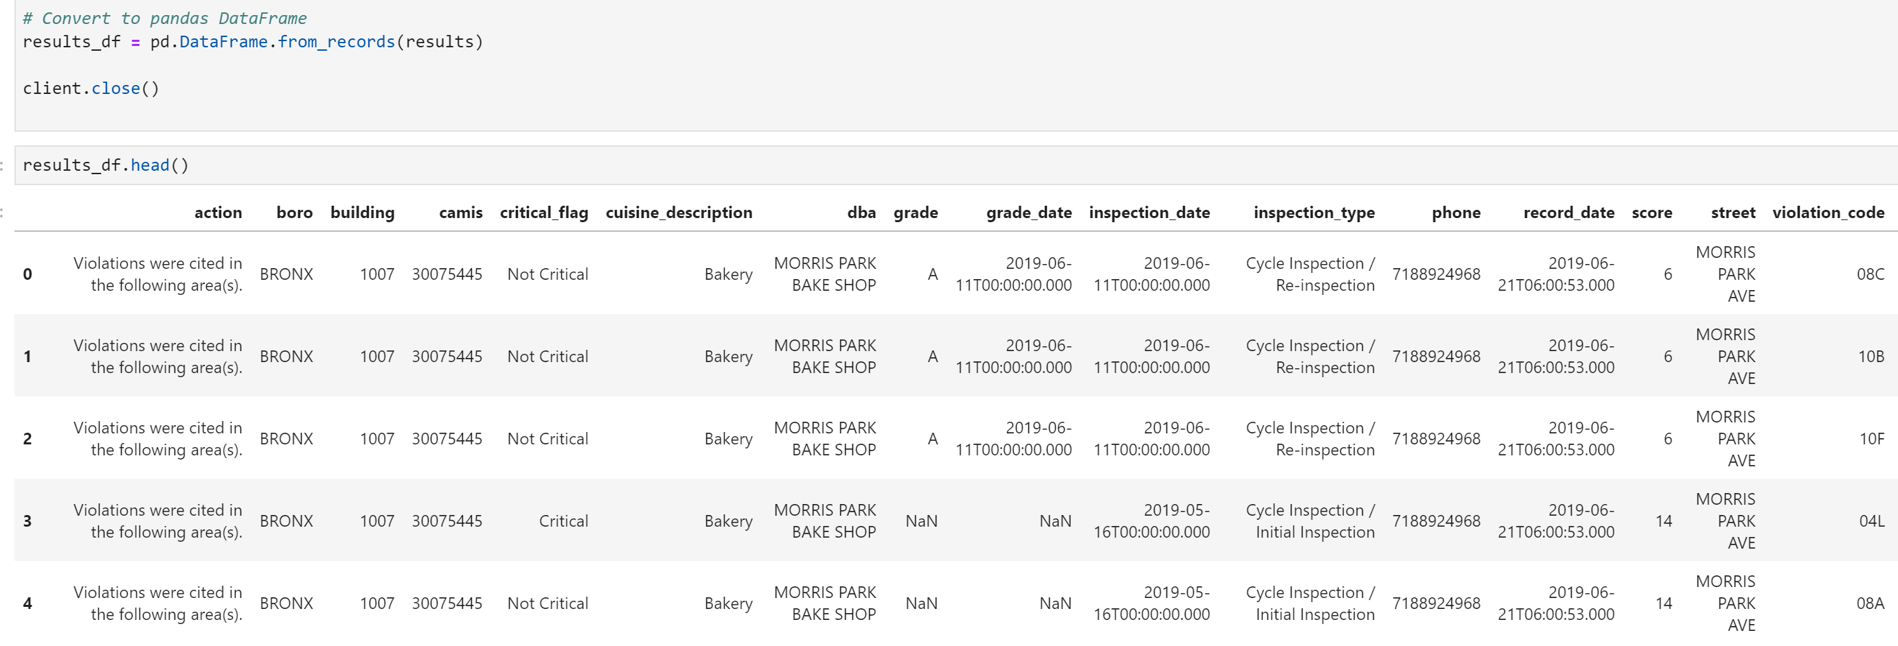
Screen Images of Metadata
Locate Data
Download CSV
Obtain via API Call
From City Of New York
To Jupyter
Notebook
Link to Dataset: https://data.cityofnewyork.us/Health/DOHMH-New-York-City-Restaurant-Inspection-Results/43nn-pn8j;

Slide 3
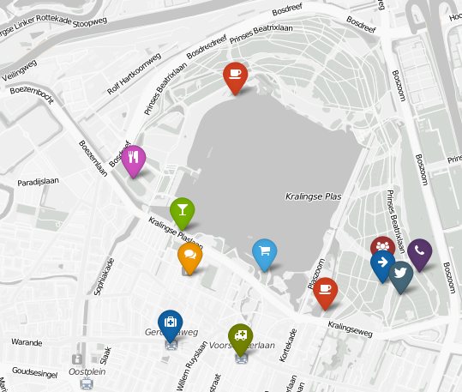

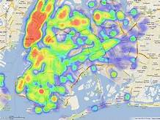
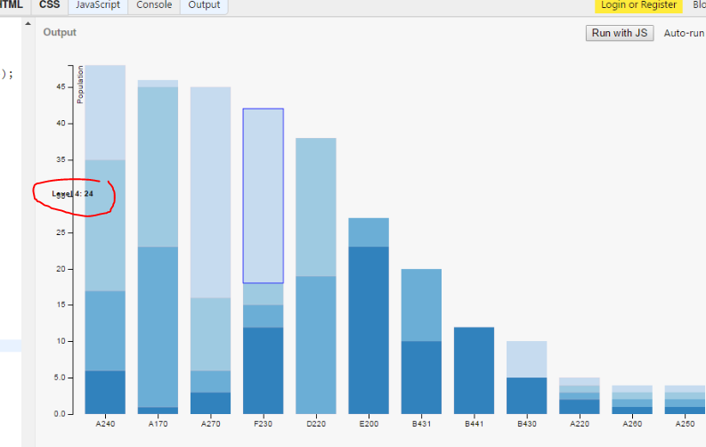
“Inspiring” visualizations that frame our creative fodder

Slide 4
