Slide 1


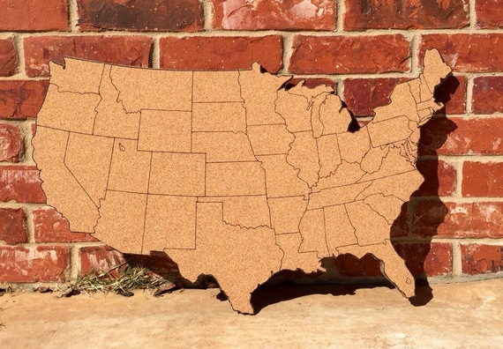
Liquor in Iowa
Forecasting Consumption
Prepared by Data Distilleries Group
Adrian Jackson, Francis Kabongo,
Farah Clerveau, & Lorie Grant
08 August 2019
Data Science & Analytics Bootcamp
Project 3

Slide 2




Toolbox
Jupyter Notebook
Google Cloud Platform (GCP)
Applications
R Studio
Tableau
Languages
Python
R
SQL
Libraries
Seaborn
Pandas
JSON
Numpy
Statsmodel
Sklearn
Matplotlib
Google Cloud
Forecast
TSeries

Slide 3

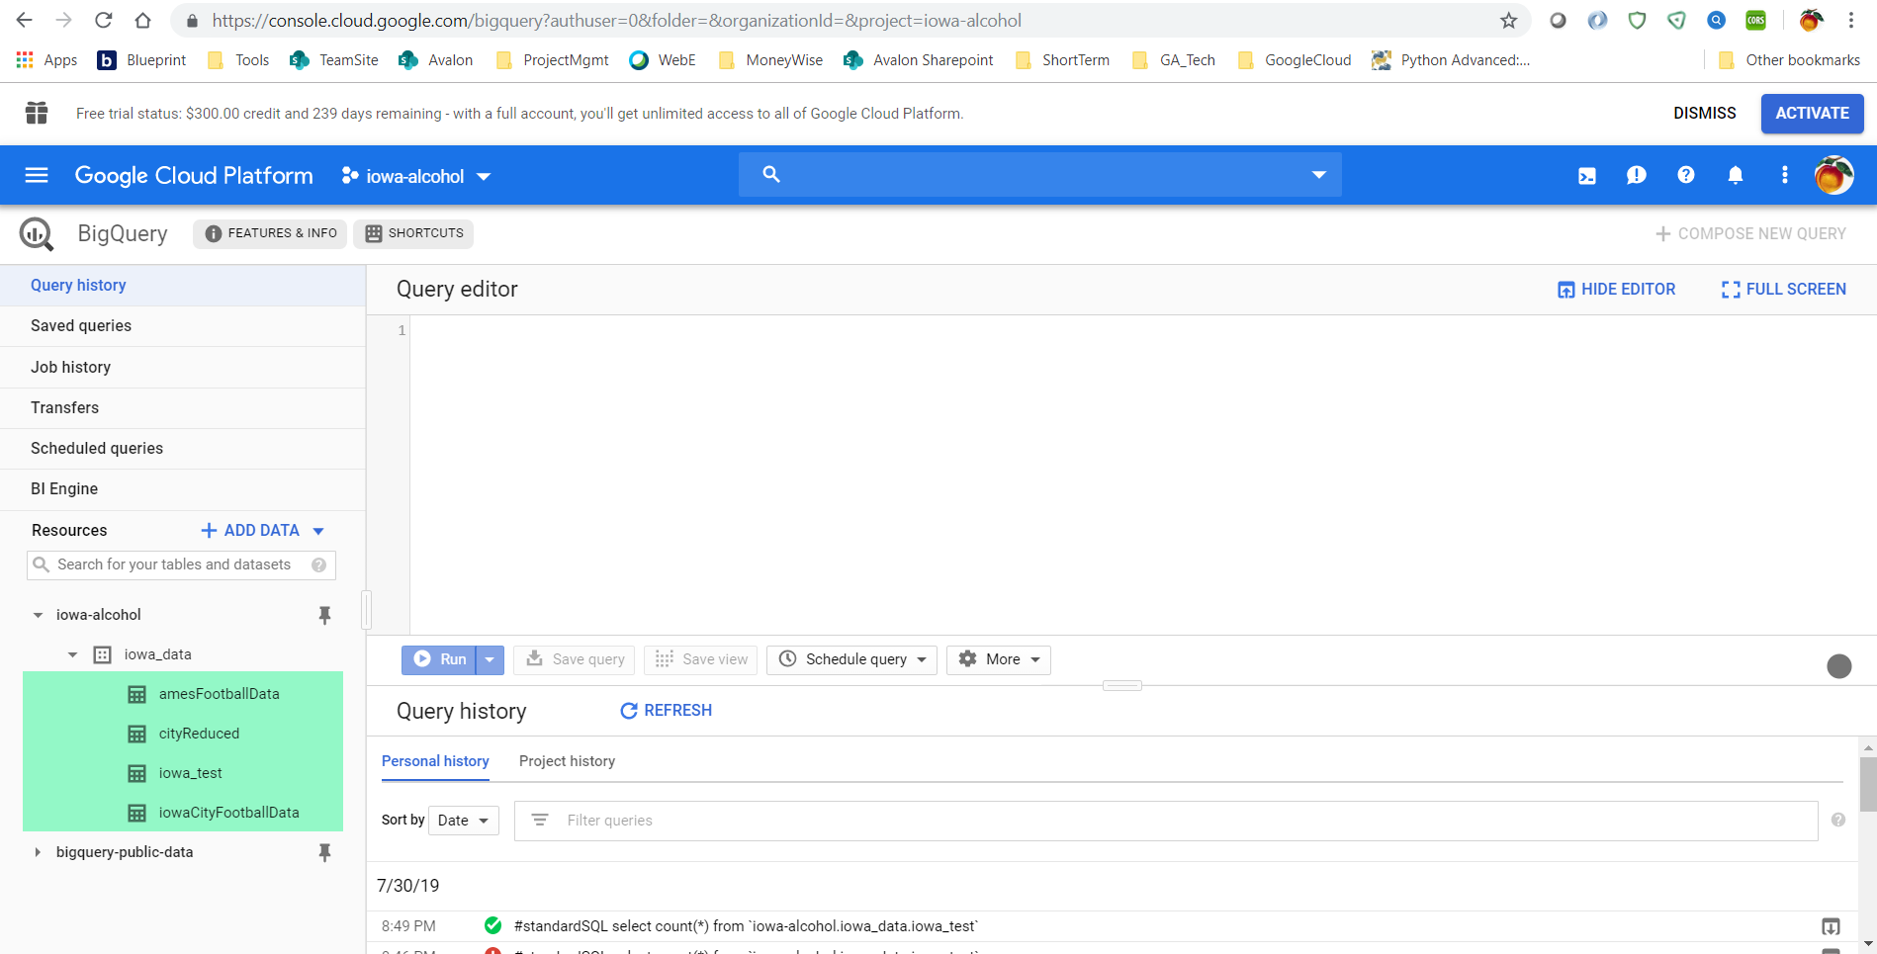
Google Cloud Platform (GCP)
Used Big Query to analyze data
Retrieved Big Query data via Jupyter Notebook
Created GCP project, granted permissions, and shared service account across the team
Copied Jupyter Notebook dataframes to Big Query tables

Slide 4
Overview
EDA + Preprocessing
Feature Engineering
Modeling
Hyperparameter
Tuning
Ensembling
Understand & Visualize Date
Tableau, Scatterplots, Boxplots, Correlation Matrix
Transforming & Scaling Features
Linear Based
ARIMA
Profit
Lasso
Ridge
Adjusting hyperparameters based on grid search
Stacking Regressor with Lasso, Ridge, Random Forest
Derived Variables
Analysis & Imputation of Missing Variables
Tree Based
Decision Trees
Random Forests
Gradient Boosting
‘Shortlist’ of most important features
Interaction Variables

Slide 5
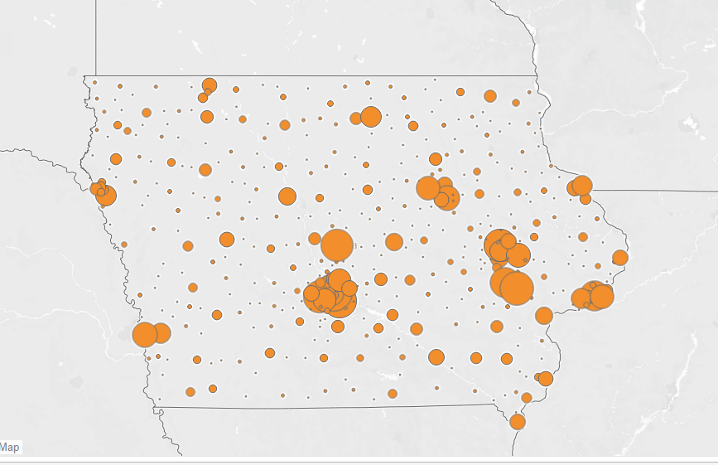
Exploring Iowa
Iowa City
Ames
Des Moines
Cedar Rapids

Slide 6
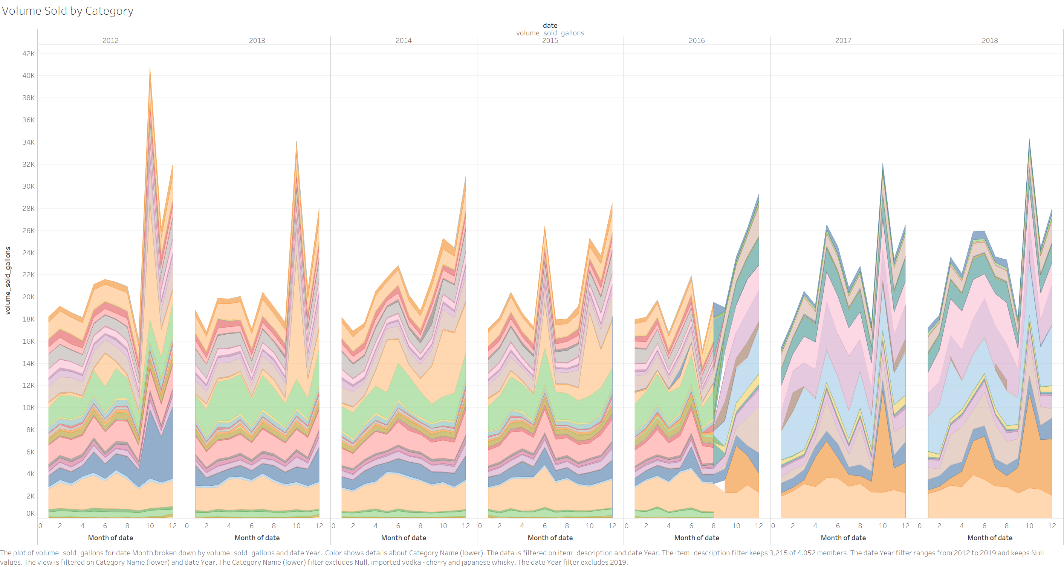
Tableau Visualizations
About the data:
4.17 GB file
16,494,826 rows
2012-2019(June)

Slide 7
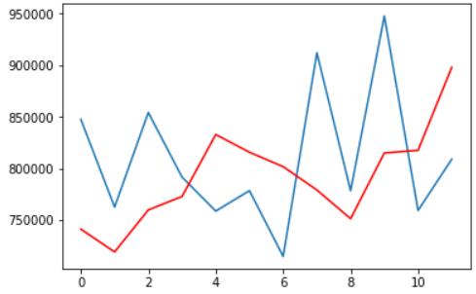
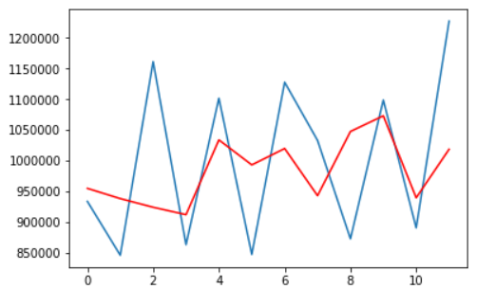


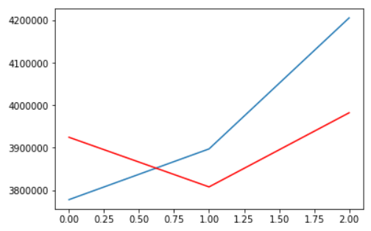
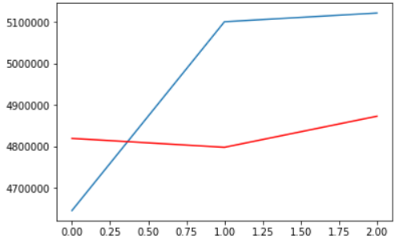
Arima Model
Can we predict the liquor sales in the two largest college towns during football season?
Ames –
Iowa State University
Sales $
Sales $
Iowa City – University of Iowa
Monthly Increments
Monthly Increments
Sales $
Sales $
Forecast
Actual
Yearly Increments
Yearly Increments

Slide 8
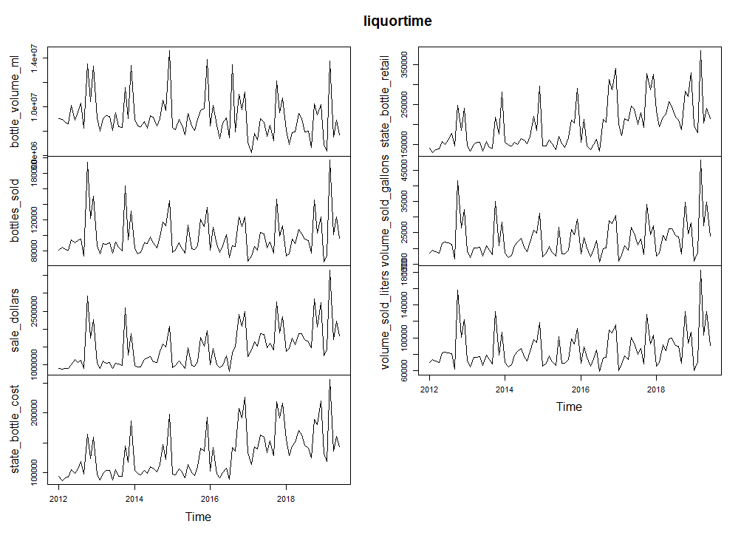
R - EDA Time Series

Slide 9
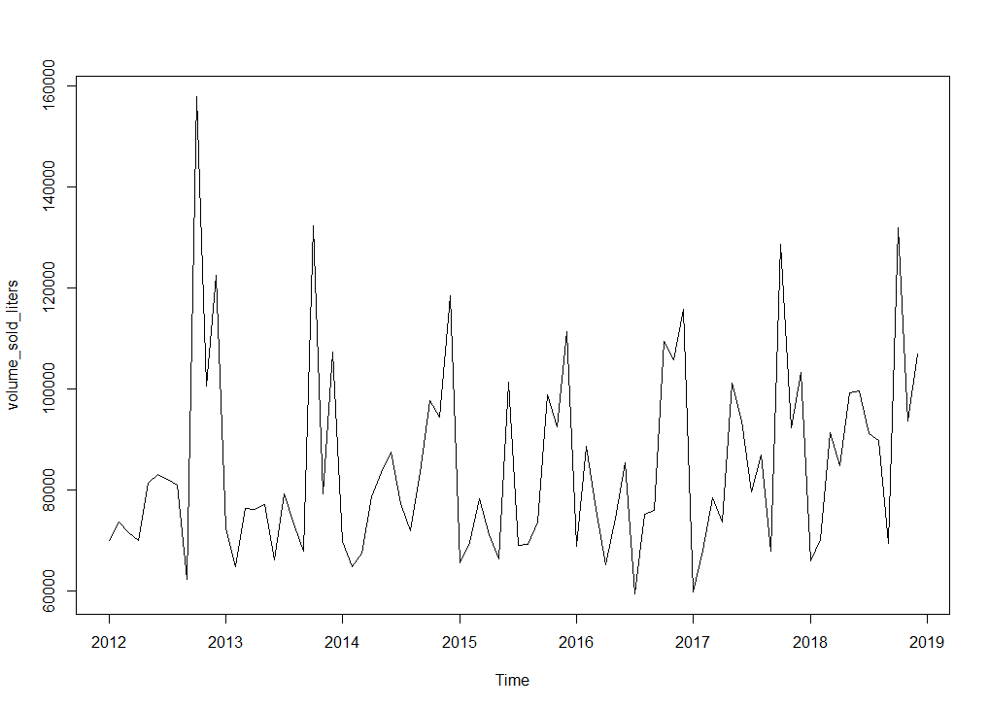
volume sold in liters (2012-2019)

Slide 10
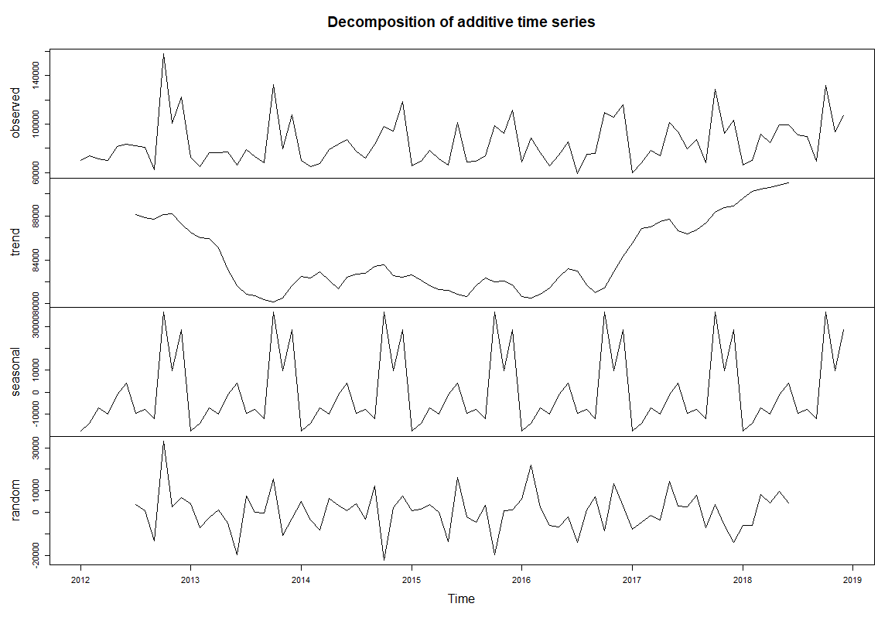
volume sold in liters, seasonal decomposition in R

Slide 11
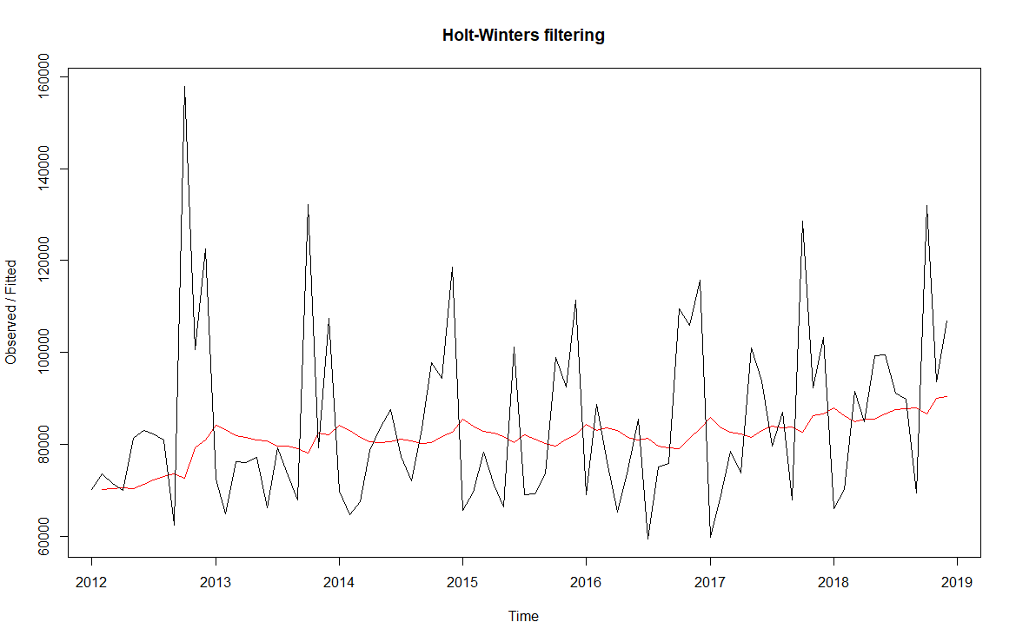
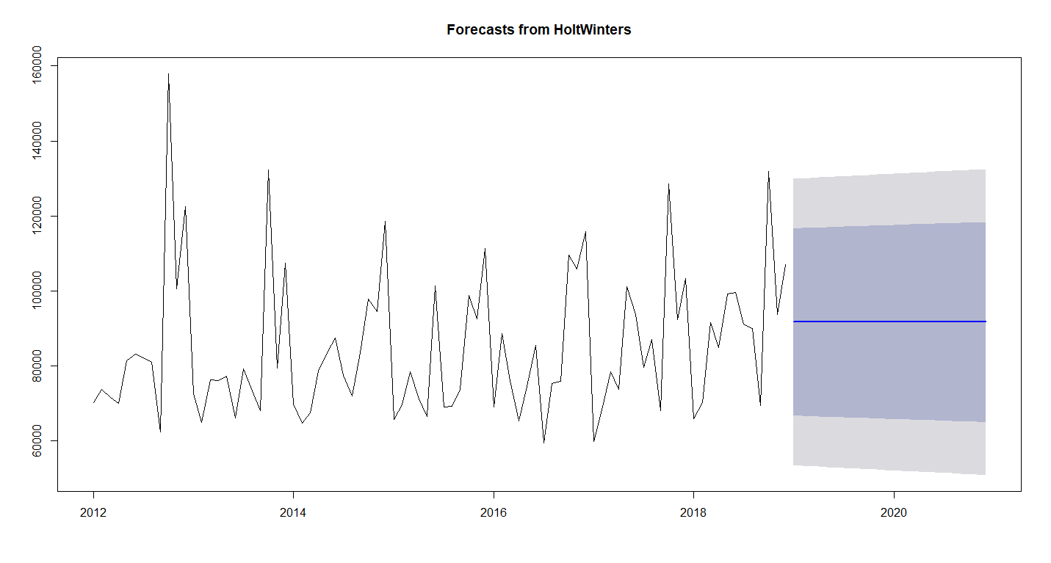
R - forecast using Holt-Winters methoD
Smoothing method (red line)
Initial forecast

Slide 12
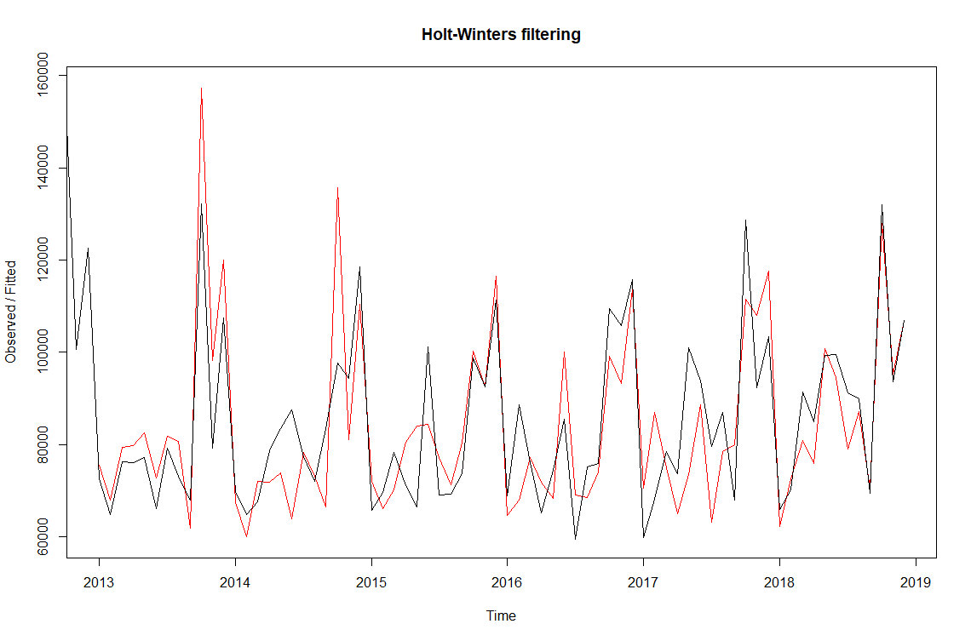
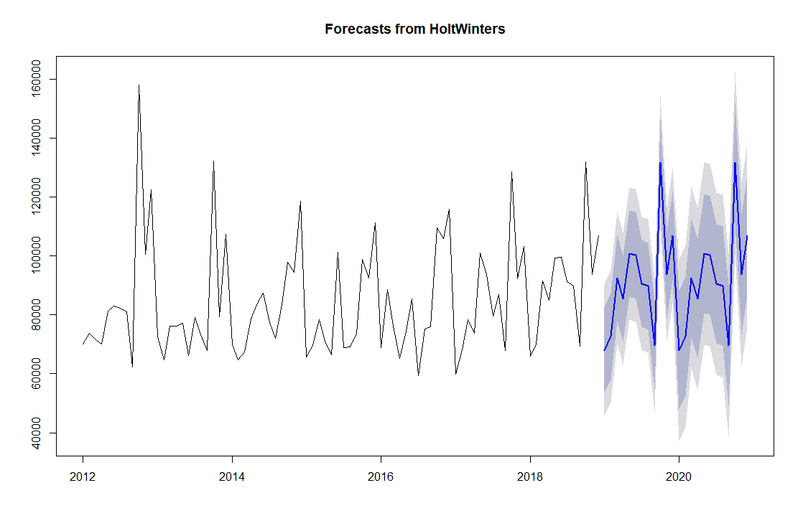
R - forecast using Holt-Winters methoD
Smoothing method with seasonality
Updated forecast

Slide 13
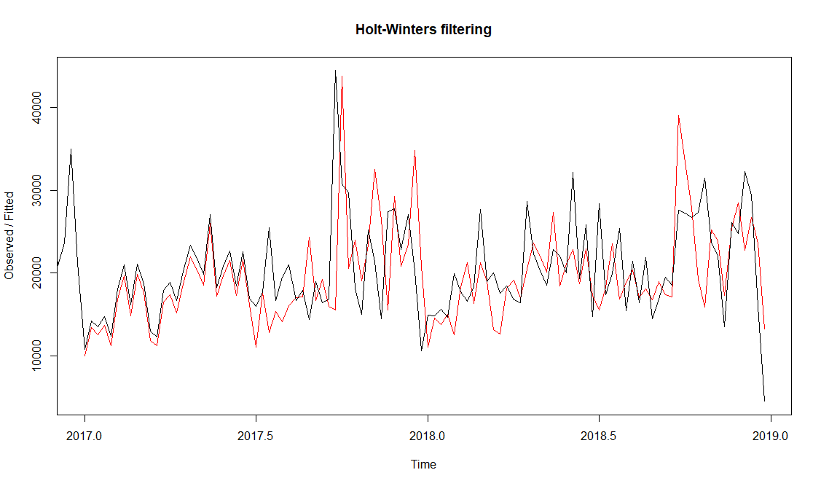
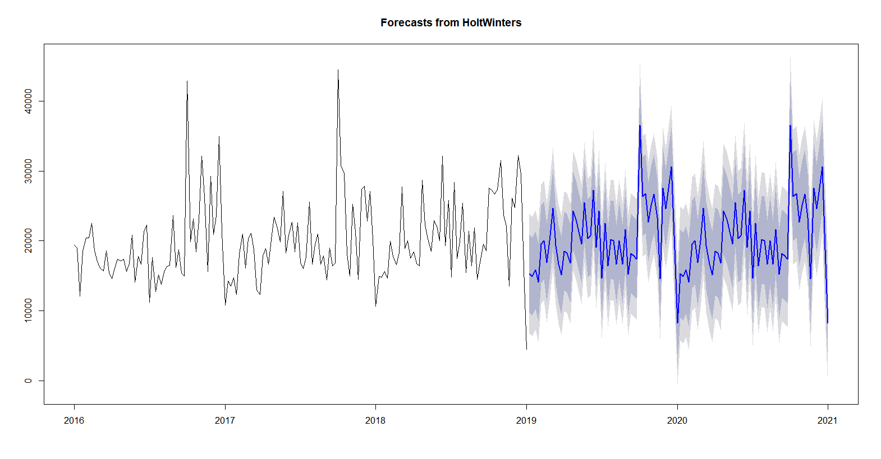
R - forecast using Holt-Winters methoD
Smoothing method with seasonality
Updated forecast

Slide 14
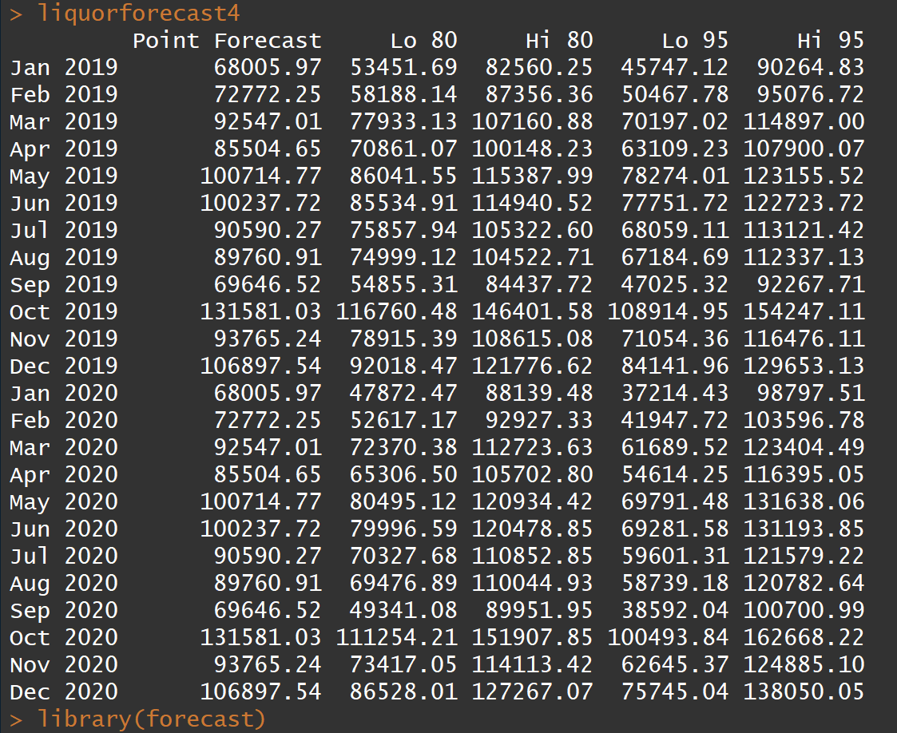
R - forecast using Holt-Winters methoD
Forecast Output (R)

Slide 15
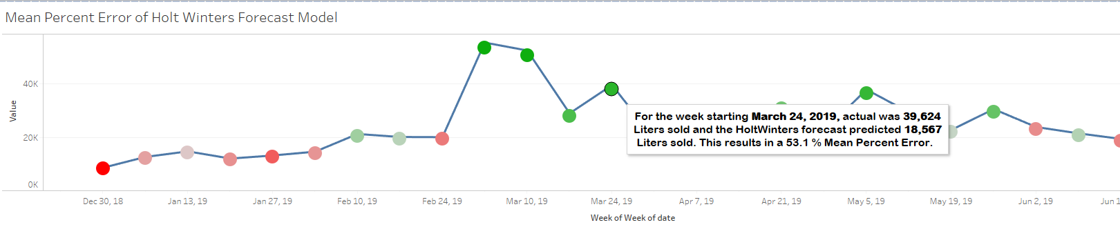
R - forecast Output in tableau
Output visualized in Tableau

Slide 16

Can we Forecast Demand?
Using the monthly forecast, For the month of September 2019 we believe ~70,000 liters of alcohol will be sold. This is a decrease compared to the previous month

Slide 17
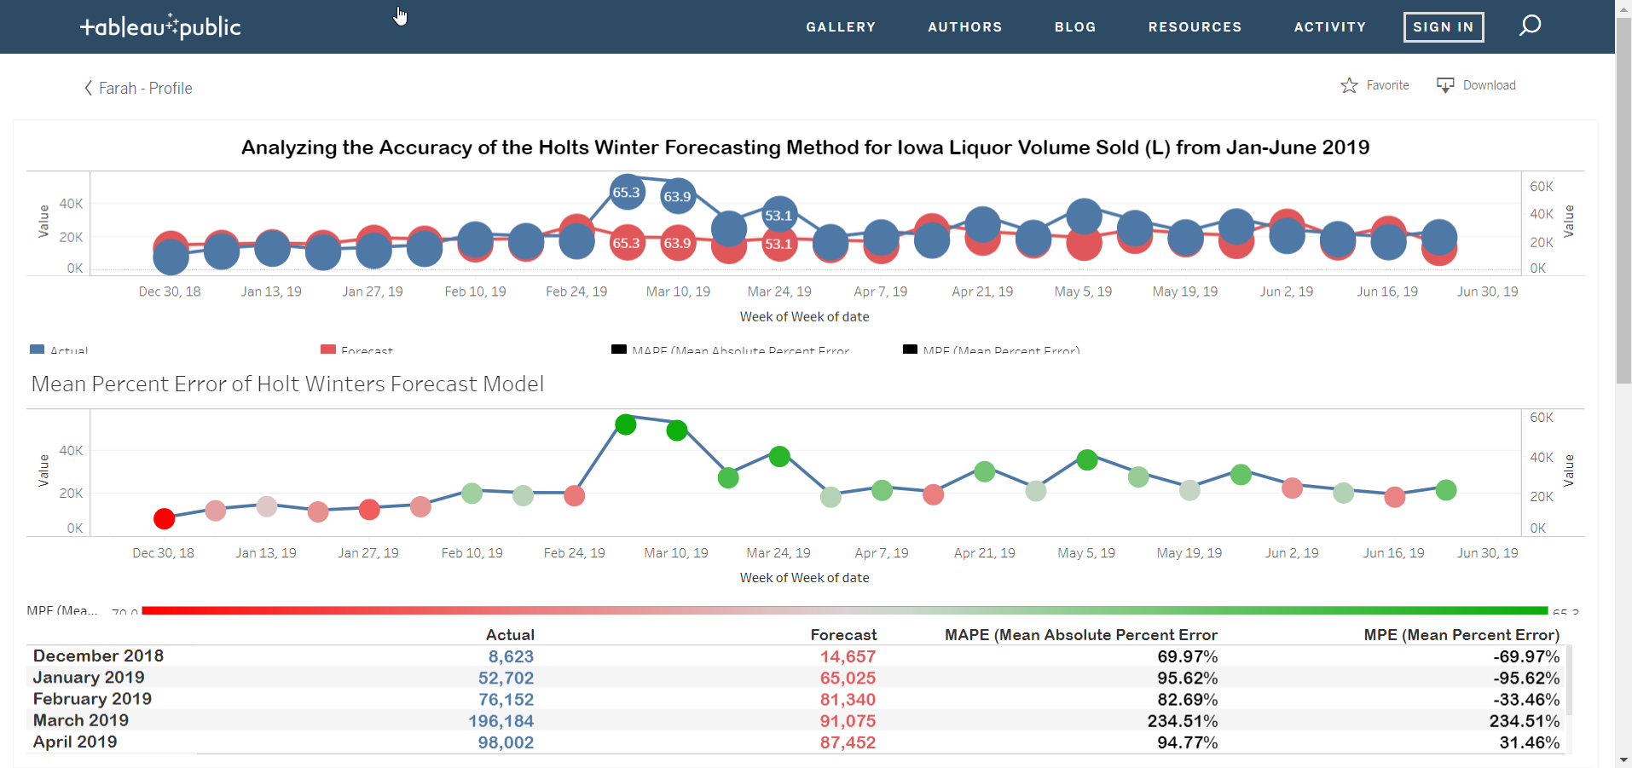
Tableau Visualization Forecast
https://public.tableau.com/profile/farah.clerveau#!/vizhome/Iowa_Tableau/HoltsWinter?publish=yes

Slide 18




Learnings
Crawl
Walk
Run
Fly
Have a simple question
Start with a small dataset
Make it work, then make it correct
Use interesting data
Invest in knowledge
Learn the math
Understand the model

Slide 19
Thank You

Slide 20
Links
PPT Presentation
https://github.com/loriepeach1/project3_iowa/blob/master/other/presentation.pptx
ARIMA Model
https://github.com/loriepeach1/project3_iowa
Tableau Dashboard Forecast vs. Actual
https://public.tableau.com/profile/farah.clerveau#!/vizhome/Iowa_Tableau/HoltsWinter?publish=yes
R Studio – Holt Winters Method
Includes screen images of Tableu used for analysis. (File is too large to upload.)
https://github.com/adrianjackson86/Final_Project_AJ.git
Linear Regression
https://github.com/franciskbg/Machine_Learning_Alchohol_sales_Prediction
Dataset
https://console.cloud.google.com/marketplace/details/iowa-department-of-commerce/iowa-liquor-sales?filter=solution-type:dataset&filter=category:machine-learning&id=18f0a495-8e20-4124-a349-0c4c167b60ab

