Slide 1
Next: the same model on real hardware
 | vTPU (the talk before) | this project
the model | Stories260K, a tiny storyteller | the same model, the same prompt
the accelerator | the vTPU, designed by our team | Gemmini, open source, from UC Berkeley
where it runs | in simulation, cycle by cycle | on an FPGA, in an AWS data center
what it shows | how a TPU works, inside | what it takes to run one on real hardware
Notes:
You just saw the vTPU: our team's own TPU design, running a small storyteller model, and showing how a TPU works from the inside. We took the next step with the same model and the same prompt: running it on real hardware. For that we used Gemmini, an open-source AI accelerator from UC Berkeley that works like a TPU, and put it on an FPGA: a chip that can be rewired to become any circuit, rented from AWS in Frankfurt. The two fit together: designing an accelerator, and learning what it takes to run one on real hardware.

Slide 2
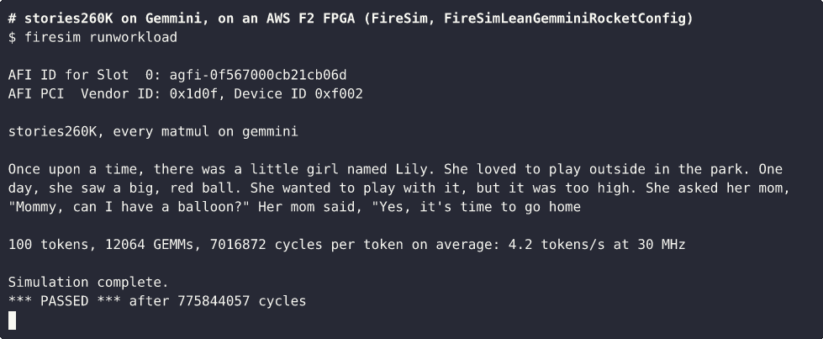
It runs on a real chip
An FPGA in an AWS data center, writing a story word by word.
Notes:
This is a recording of the FPGA, in real time. We gave it the start of a story, "Once upon a time", and it continues on its own, word by word. Every multiplication runs on the accelerator; a small processor next to it does the rest. If asked whether it's right: it writes exactly the same story as a simulator and as a laptop, and we checked every one of the 3,944 multiplications against the processor's own answer: all identical.

Slide 3
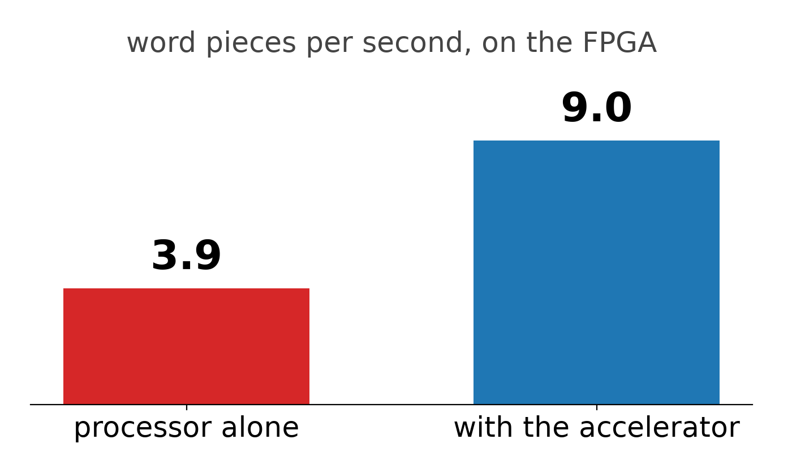
The accelerator makes it 2.3× faster
9.0 word pieces per second, against 3.9.
The multiplications: 35× faster.
Notes:
The model writes in word pieces (tokens), so we count those. With the accelerator, the FPGA writes 9.0 word pieces per second, against 3.9 on its processor alone. The multiplications themselves, the accelerator's job, get 35× faster. The FPGA only runs at 30 MHz, far slower than a real chip. The same design made as a real chip at 1 GHz would take the same steps, and write about 300 word pieces per second: a projection, not a measurement. If someone noticed the recording's lower number: it writes a longer story (100 word pieces instead of 30), and every word piece takes a little longer than the one before, so its average is 4.2 per second.

Slide 4
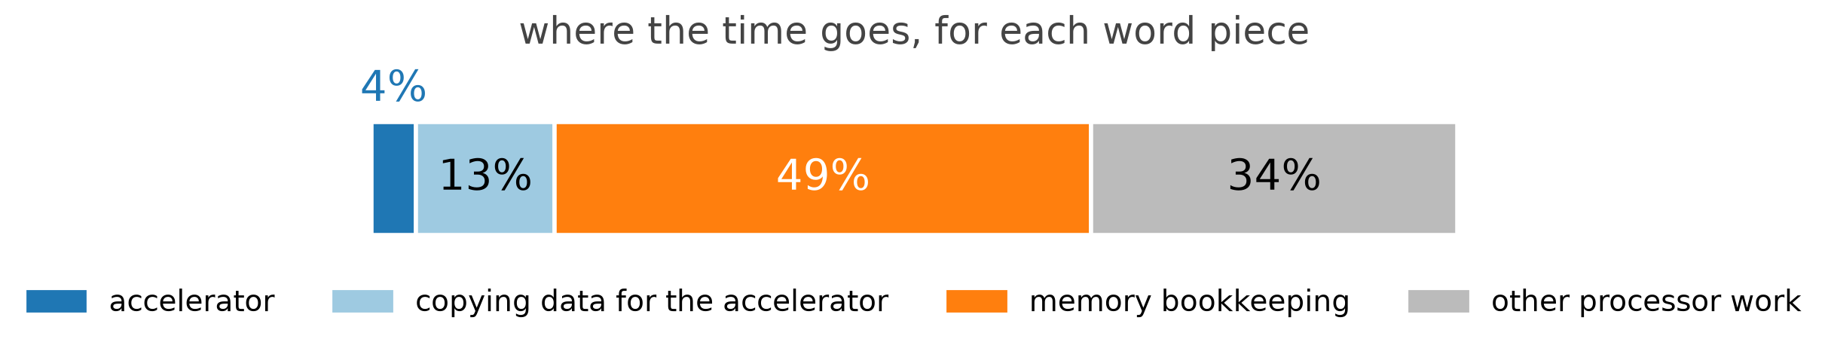
What we learned
The multiplier is the easy part. Feeding it data is the hard part.
The accelerator works 4% of the time; the rest is the processor's work around it. Known fixes: up to 2× faster.
Everything we used is open source: the processor, the accelerator and the tools.
Notes:
We measured where the time goes. The accelerator finishes its part in 4% of the time. The rest is the processor moving and preparing data for it. About half, 49%, is re-preparing the model's memory of the story so far, at every word. So the lesson for every TPU design, ours included: the multiplier is the easy part, and feeding it is the hard part. Known software fixes could make ours up to 2× faster, and the vTPU's idea of doing more of the steps on the chip itself points the same way. And every piece we used is open source: the processor, the accelerator and the tools to put them on the FPGA.

