Slide 1

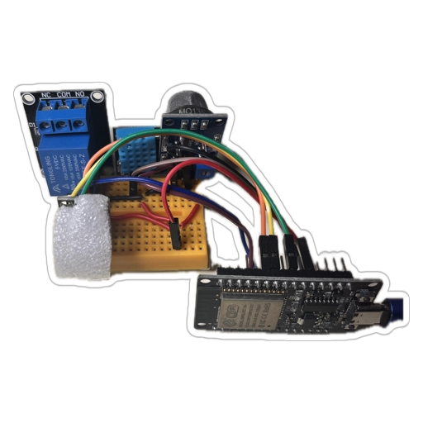
BathGuardian
No more stink, let the Guardian think!
Because even your bathroom deserves Wi-Fi.
"A refreshing and balanced space: the impact of BathGuardian, and the harmony of a fresh, fragrant bathroom."

Slide 2
Problem statement
Odor Detection | Odor perception varies, so a system is needed to objectively detect bad smells and act automatically.
Manual Fan Operation Is Inconvenient | People forget to turn on/off fans or lights. Fans may run too long or too short, wasting energy and reducing effectiveness.
High Humidity Leads to Mold & Damage | Prolonged humidity can cause mold growth, structural damage, and health issues. Bathrooms often retain high humidity after showers.
Limited Awareness of Bathroom Environment | Temperature and humidity fluctuate, impacting comfort and energy usage. Users cannot monitor bathroom conditions remotely without IoT solutions. Lack of cloud data limits the potential for smart home integration or analytics.
Energy and Cost Inefficiency | Running fans continuously consumes electricity unnecessarily. Automated control based on sensor data saves energy and reduces bills.
Health and Comfort Concerns | Poor ventilation can make bathrooms uncomfortable and unhealthy. Smart ventilation improves comfort and reduces respiratory risks from damp or odorous air.

Slide 3
Table of contents
01
02
03
04
05
06
Project Overview
System Architecture
Project Roadmap
Software and Connectivity
Features
Conclusion

Slide 4
01
Project Overview
Device name: BathGuardian
Core controller: ESP32
Sensors: DHT11 (temperature & humidity), MQ135 (odour)
Controls fan and bathroom light through relays
RGB led for system status
Local HTTP server for monitoring and setup
MQTT cloud integration via HiveMQ

Slide 5
02
System Architecture
ESP32 receive information from DHT11 and MQ135 sensors for environment monitoring.
Relays control fan and bulb based on readings and local web interface ( mobile ).
HTTP server hosts local web interface for configuration.
MQTT (HiveMQ) handles cloud data transfer.
RGB LED displays operational status.
*Refer to system diagram on next slide.

Slide 6
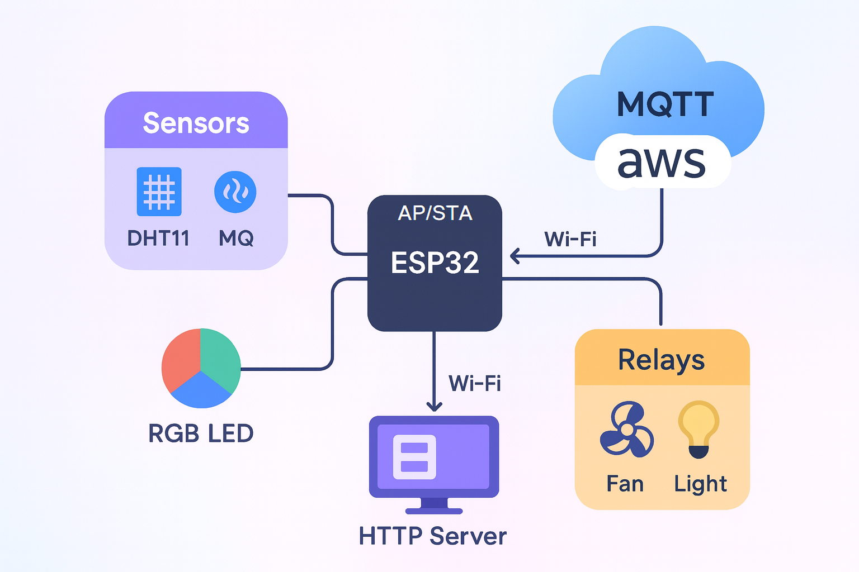

Slide 7
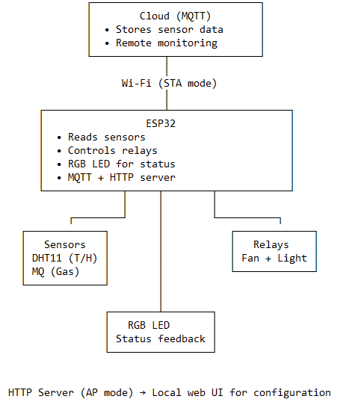

Slide 8
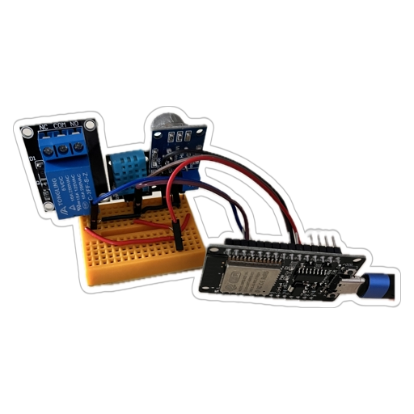
03
Project Roadmap
1️⃣ Research & Planning
Define problem, gather requirements, choose sensors and communication methods.
2️⃣ Hardware Assembly
Integrated the ESP32 microcontroller with sensors and relay modules.
3️⃣ Firmware Development
Implemented sensor reading, control logic,RGB LED indicators.
4️⃣ IoT Integration
Implement MQTT publishing, local HTTP server, and dual Wi-Fi mode (AP + STA).
5️⃣ Testing & Optimization
Verified automatic fan/light control and data transmission.
6️⃣ Future Enhancements
Add motion detection/touch switch remote, mobile app, and AI optimization.

Slide 9
0004
Software and Connectivity
Language: C
Protocol: MQTT (HiveMQ)
Local Interface: HTTP Web Server (AP + STA)
Logic:
• Humidity↑ → Fan ON
• Odour↑ → Fan ON
• RGB LED shows Wi-Fi and operation status

Slide 10
0005
Features
- Reading sensors data.
- Automatic fan activation under high humidity or odour.
- Smooth Wi-Fi mode switching (AP ↔ STA).
- Live monitoring via HTTP interface.
- Successful MQTT data publishing to HiveMQ.
- Successful MQTT data receiving to HiveMQ.
- Save credentials from the connected router AP. (internet connection)
- OTA firmware update

Slide 11
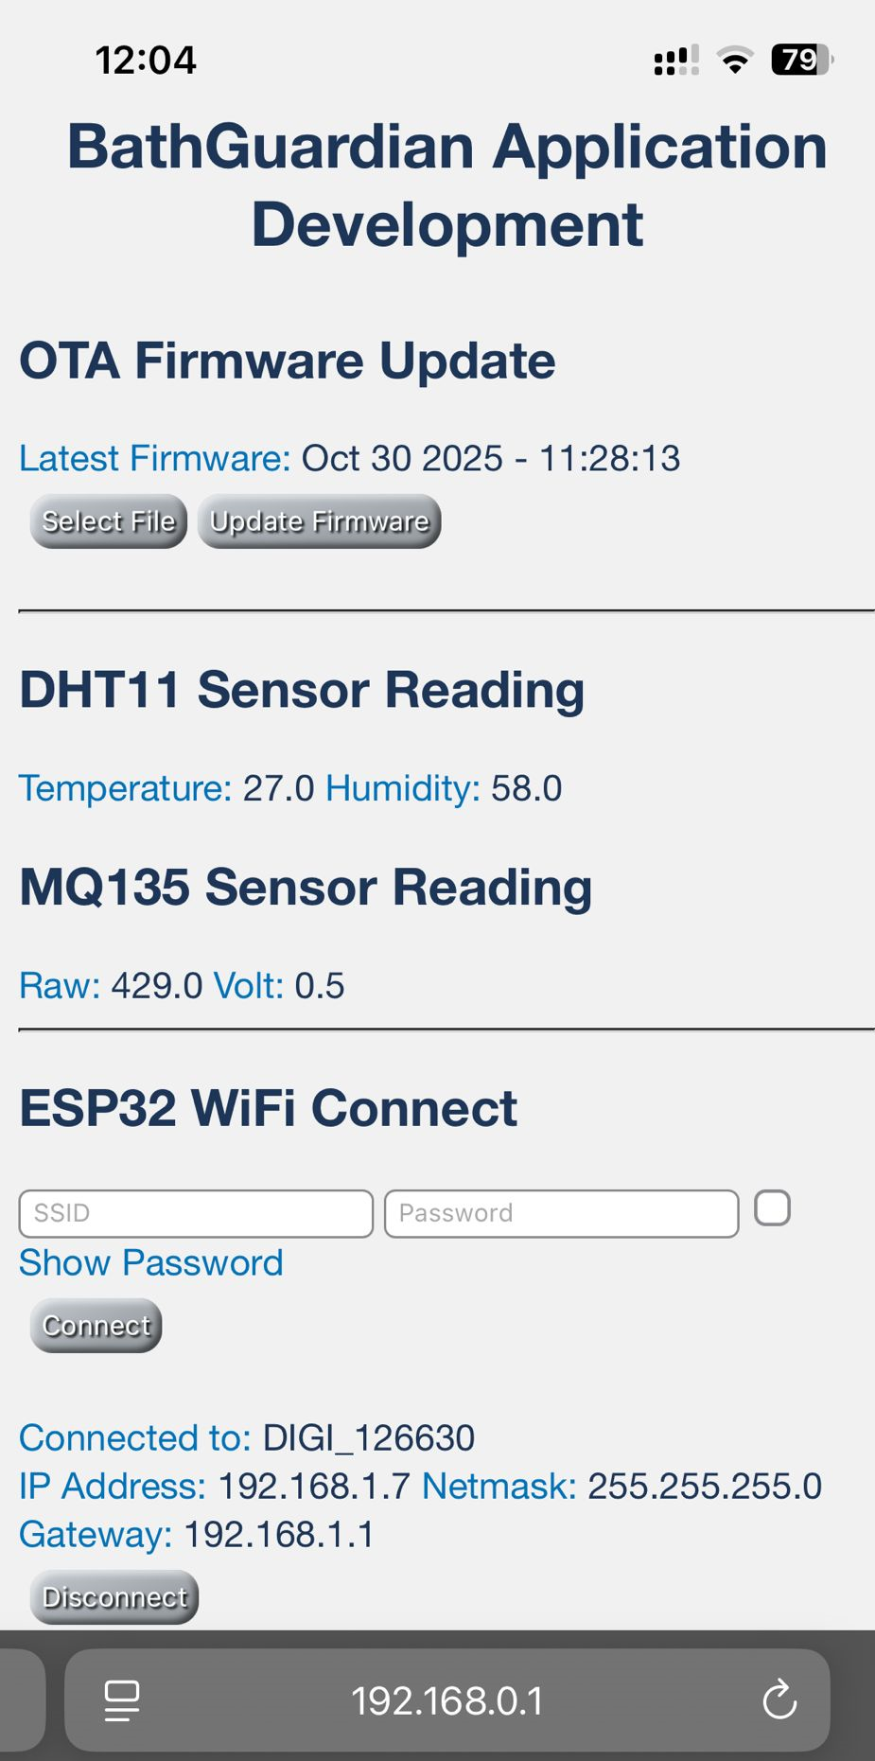
0006
Conclusion
BathGuardian successfully automates ventilation and lighting for bathrooms.
Combines IoT, automation, and web-based control in a single ESP32 system.
Offers improved comfort, energy efficiency, and hygiene.

Slide 12
Thanks!
Do you have any questions?
lorincz.stefanmihai@yahoo.ro

Slide 13
Resources

