Slide 1
AD1004 Multi-platform development
Steed Zheng

Slide 2
Agenda
Principle
Predefine Macro
Example
Source Structure
Task List

Slide 3
Principle
Add an abstraction layer
Use cross-platform libraries
STL
BOOST
ACE

Slide 4
OS
_WIN32
__linux__
__APPLE__
_WIN64
__x86_64__
__ppc64__

Slide 5
Compiler
__GNUC__
_MSC_VER
__BORLANDC__
__clang__
__llvm__

Slide 6
C++ standards
__cplusplus
C++ pre-C++98: __cplusplus is 1.
C++98: __cplusplus is 19971L.
C++0x/11: __cplusplus is 201103L.
__STDC__
__STDC_VERSION__
Unix standards: _POSIX_VERSION, _XOPEN_VERSION

Slide 7
Architectures
__amd64__
__x86_64__
__i386
_M_IX86
__ia64__
_M_IA64
__powerpc__

Slide 8
Example: sleep
Linux
unsigned int sleep(unsigned int seconds);
Windows
VOID WINAPI Sleep( _In_ DWORD dwMilliseconds );
Notes:
#include <unistd.h> unsigned int sleep(unsigned int seconds);

Slide 9
Solution 1 for sleep
Add an abstraction layer
Header file:
Source file:
namespace trend{
void sleep(int milliseconds);
}
namespace trend {
void sleep(unsigned int milliseconds) {
#ifdef _WIN32
Sleep(milliseconds);
#elif __linux__
::sleep(ceil(1.0*milliseconds/1000));
#else
assert(false);
#endif
}
}

Slide 10
Solution 2 for sleep
BOOST
boost:this_thread::sleep
boost:this_thread::sleep_for
boost:this_thread::sleep_until
c++11
std::this_thread::sleep_for
std::this_thread::sleep_until

Slide 11
Boost implementation
Check source code

Slide 12
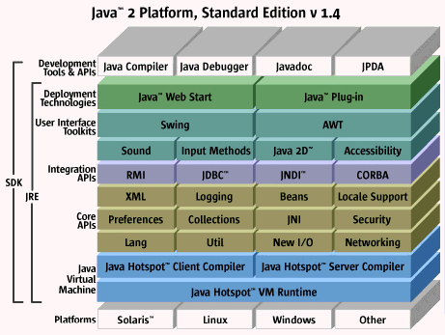
Why Java is Platform Independent

Slide 13
How to organize source code
Boost is a good sample

Slide 14
Boost libraries
Test (chapter 6) - Hailie Chou
Memory management (chapter 3) -- Lorin Wu
Smart Ptr
Scope Exit (added)
…
Time & Date (chapter 2) -- Ivan Qi
Utility (chapter 4) -- Sam Shi
Log (added) – Renter Ren
String (chapter 5) – Joe Wang
Xpressive is optional
Regex (added)
…

Slide 15
Boost libraries
Container & data structure (chapter 7) – David Dong
Algorithm & math (chapter 8/9, rational is optional) – Ouki Wang
OS (chapter 10 exclude filesystem) – Bruce An
Filesystem (section 10.4) – Ecular Xu
Function & callback (chapter 11) – Xandy Xu

Slide 16
Boost libraries
Thread (section 12.1)
Asio (section 12.2)
Interprocess (added)

Slide 17
Reference
http://sourceforge.net/p/predef/wiki/Home/

