Slide 1
https://github.com/githubanotaai/new-test-backend-nodejs
https://github.com/Fernanda-Kipper/desafio-anotaai-backend
https://youtu.be/a3tPHH8uwPc?si=nGr0XXatMl0gy4rz

Slide 2
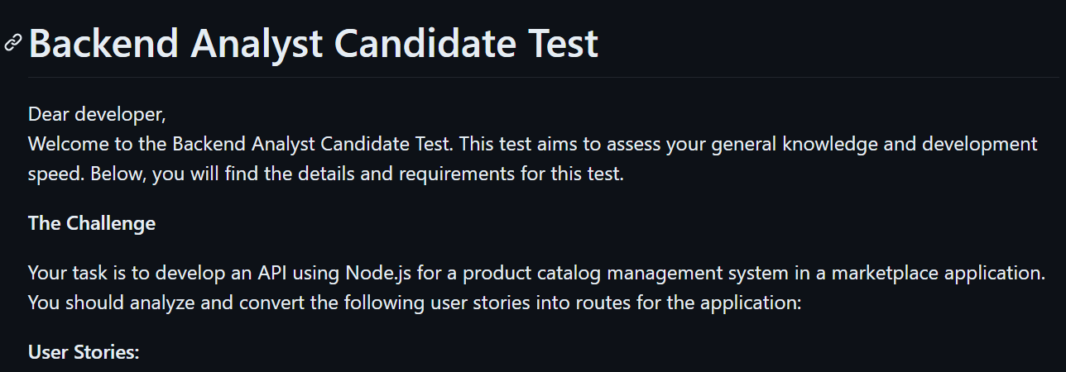

Slide 3
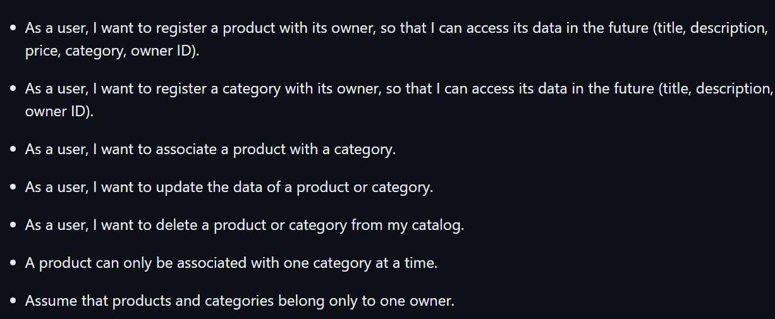

Slide 4
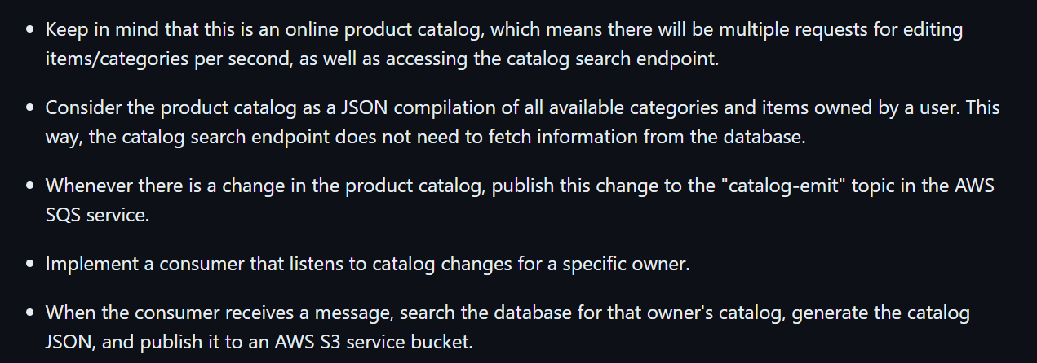
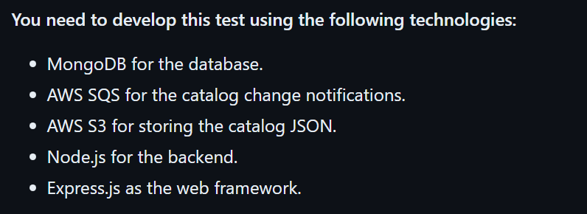

Slide 5
What i am going to do is slightly diferent from what ifood is asking me to do. The main difference is that i am going to have a endpoint to see the catalog of a owner. And this endpoint cant make requests to a database to avoid overcharge this database, so i am going to implemente a redis memory database to receive these requests.

Slide 6
