Slide 1
Diagram Software
A tool for diagram creation
Chris
Larisa
JAC, ipd-12, April 2018

Slide 2
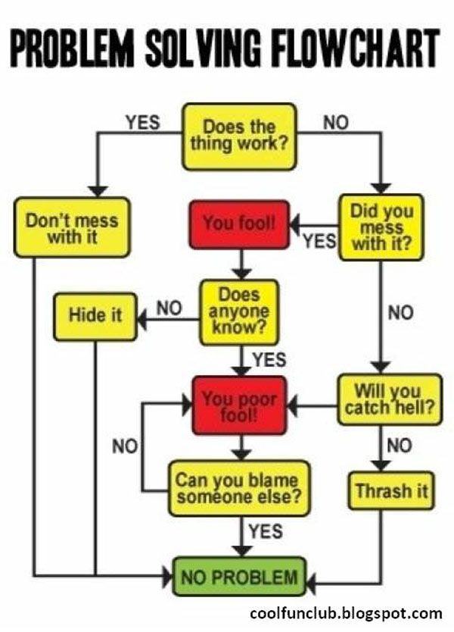
Background
How do I plan my actions.
I will draw it.

Slide 3
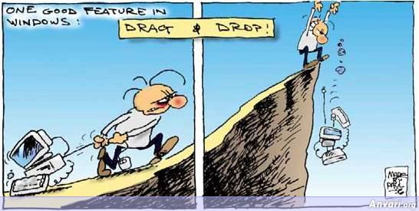
Background

Slide 4
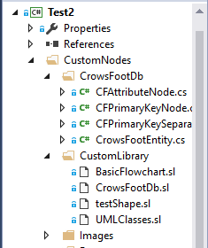
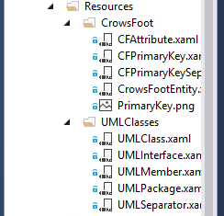
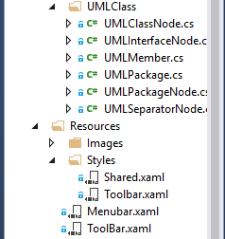
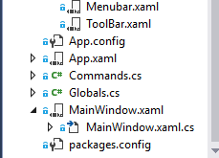
Our solution Overview
Mindfusion: https://www.mindfusion.eu/wpf-diagram.html

Slide 5
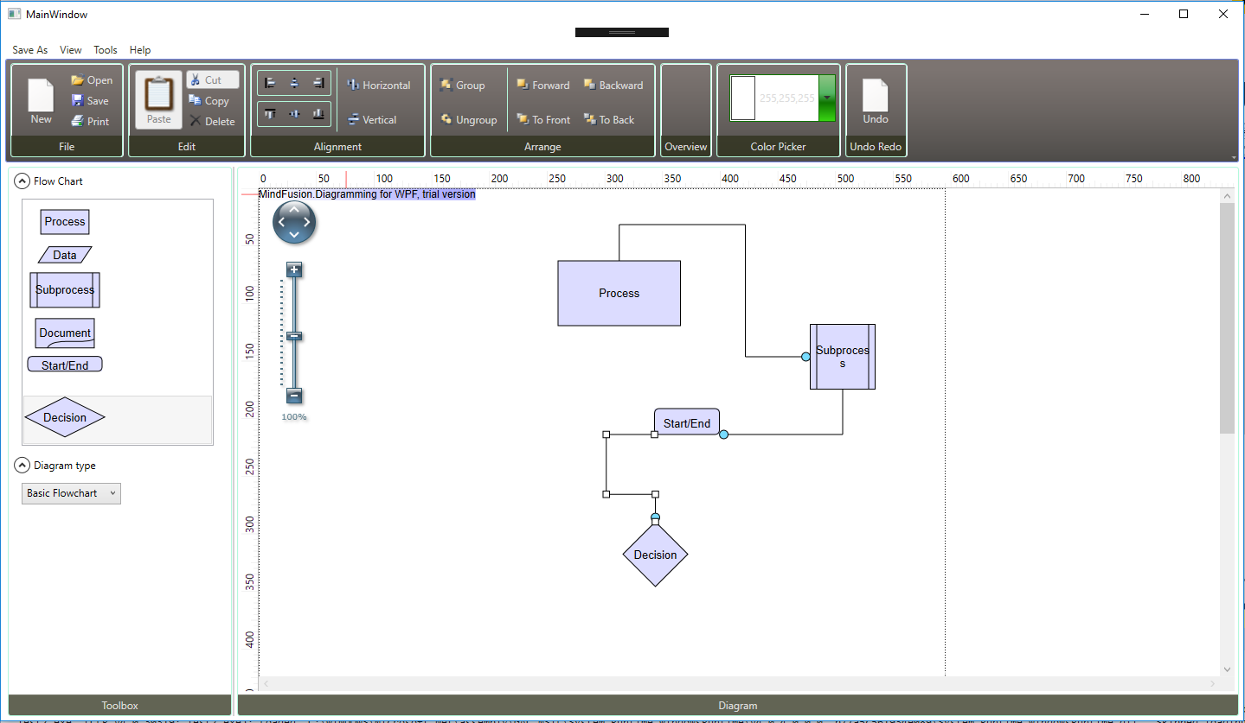
Our solution Overview

Slide 6
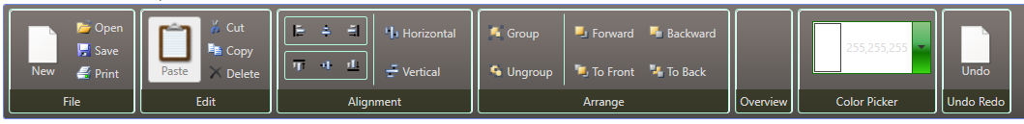

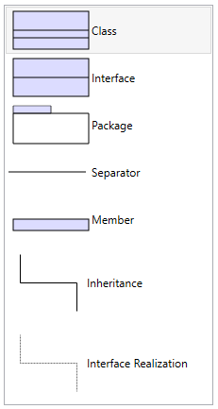
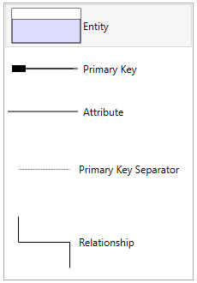
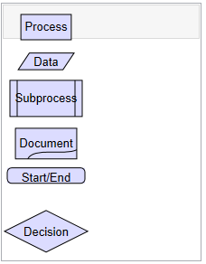



Our solution Overview:

Slide 7
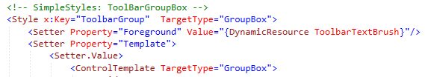



Challenges and solution: Design
Toolbar in the main XAML:
Toolbar style reference:
Additional shared style reference:

Slide 8
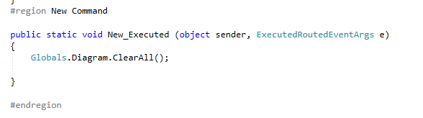


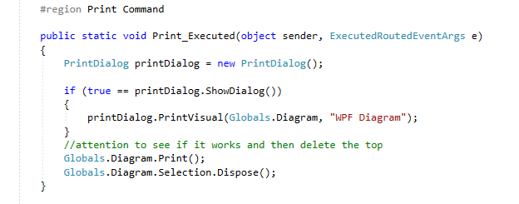

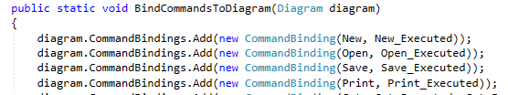
Challenges and solution: Commands
Commands:
static Commands()

Slide 9
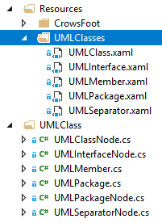
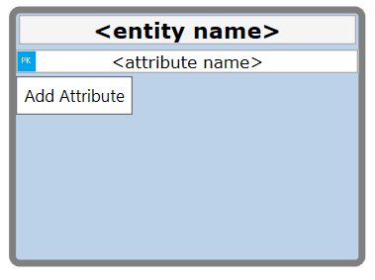
Challenges and solution: Custom Nodes / Templates
To begin with, only basic flowchart nodes were included in the library. All other diagram nodes had to be coded from scratch.
Solution: Download a sample, figure out how it works, and make it work for our diagrams.
Every diagram type has it’s own custom nodes, and each node has a template to define data and style.

Slide 10
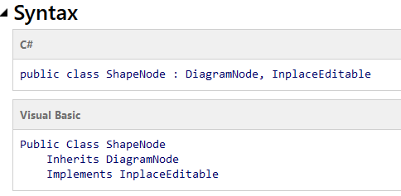
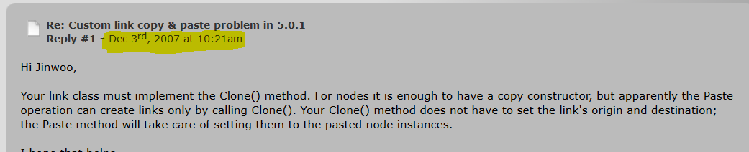
Challenges and solution : “Learning” a library
Toughest challenge by far:
Using a huge library with little to no help even from the mighty google.
This was done through reading very generic documentation and forum posts that could be decades old.

Slide 11
What we’ve learned
How to use and understand (more or less) official documentation for libraries.
Trial and error, as well as debugging skills. Less reliance on specific examples
Some more knowledge of events and event handlers.

Slide 12
What we’ve learned
How to work on one Window in a team( structure of files, connections of files, incorporating separate XAML file on one Window)
How to connect all the components(styles, commands, format, nodes)

Slide 13
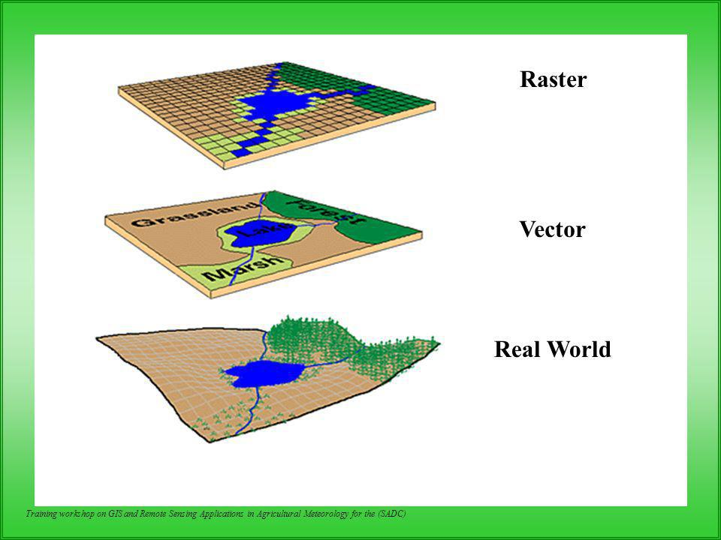
What we’ve learned
What are vectors and how to manipulate them.
How a visual object is created and manipulated in XAML and logic

Slide 14
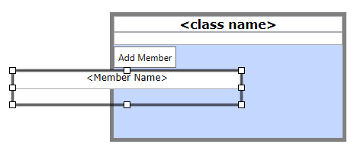
Future Work
Dragging and dropping certain nodes cause certain functions.
More toolbar functions.
More diagrams

Slide 15
Conclusion
When starting work with a NUGET package (or a library/API), you need to be sure that enough documentation is available and you have enough access to the original code logic.
Still managed to create most of what we had in mind using this library
Many lessons were learned

