Slide 1
Diagram Software
A tool for diagram creation
Chris
Larisa
JAC, ipd-12, March 2018

Slide 2
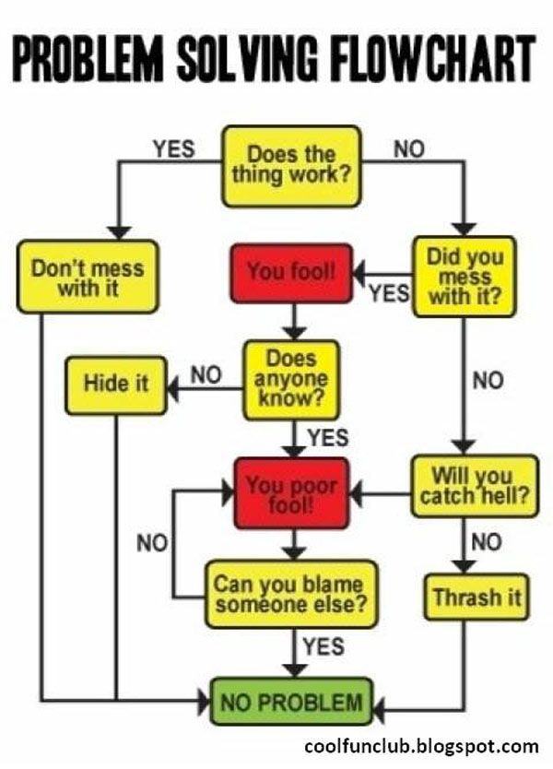
Background
How do I plan my actions.
I will draw it.

Slide 3
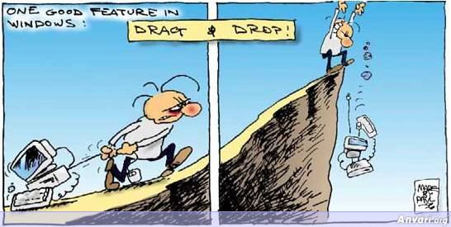
Background

Slide 4
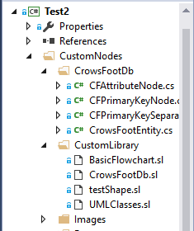
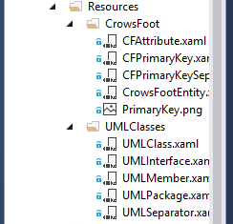
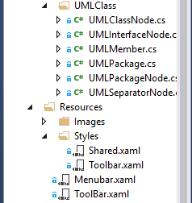
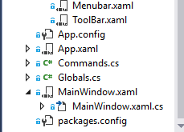
Our solution Overview
Mindfusion: https://www.mindfusion.eu/wpf-diagram.html

Slide 5
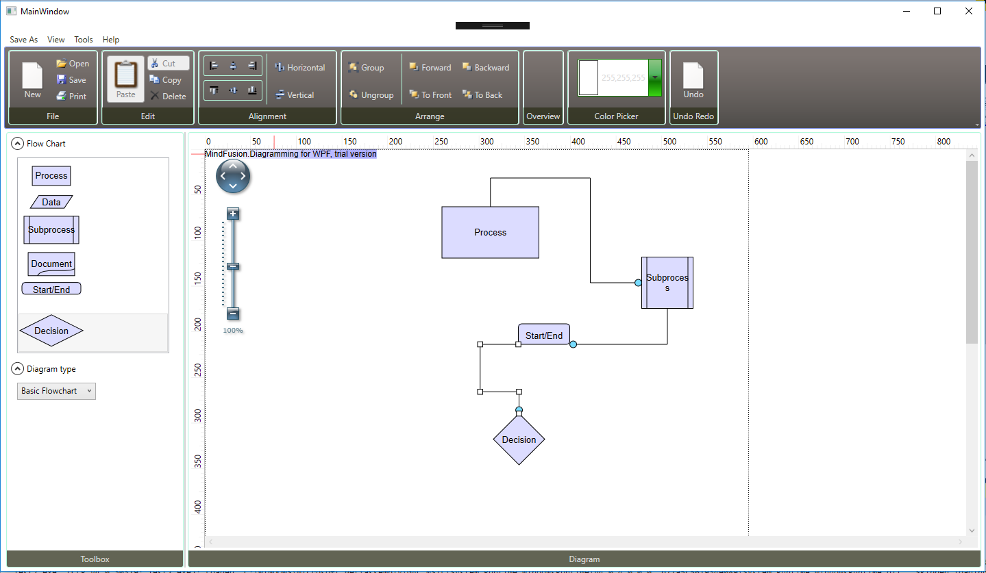
Our solution Overview

Slide 6
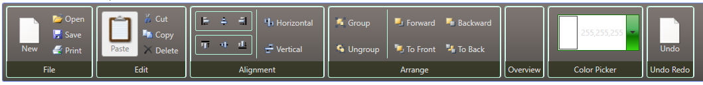

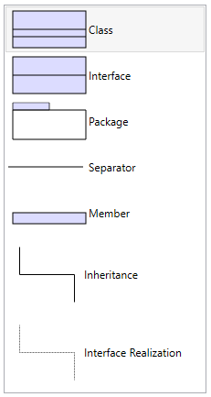
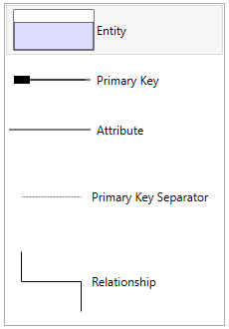
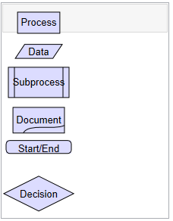



Our solution Overview:

Slide 7
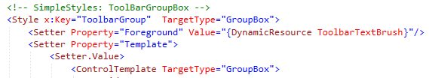



Challenges and solution: Design
Toolbar in the main XAML:
Toolbar style reference:
Additional shared style reference:

Slide 8
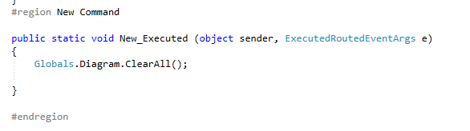


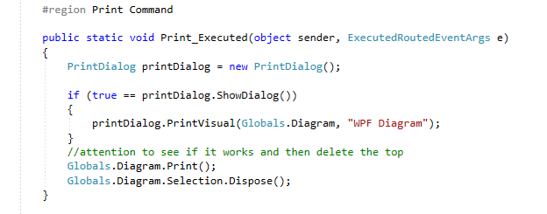

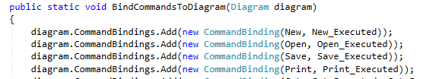
Challenges and solution: Commands
Commands:
static Commands()

Slide 9
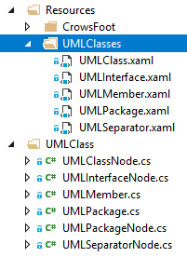
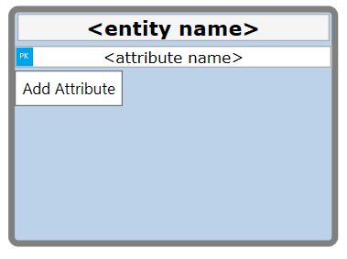
Challenges and solution: Custom Nodes / Templates
To begin with, only basic flowchart nodes were included in the library. All other diagram nodes had to be coded from scratch.
Solution: Download a sample, figure out how it works, and make it work for our diagrams.
Every diagram type has it’s own custom nodes, and each node has a template to define data and style.

Slide 10
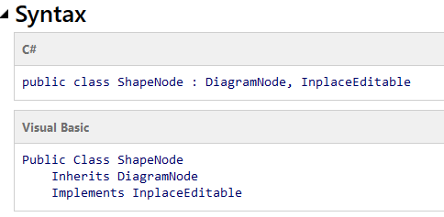
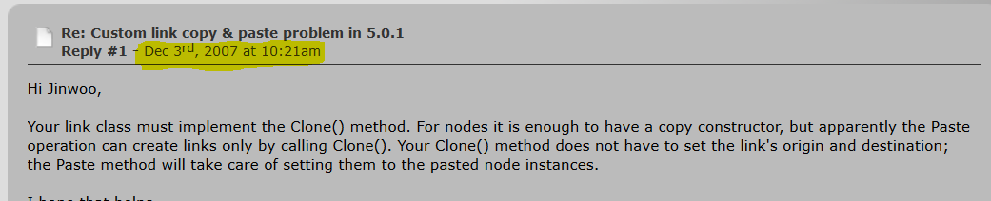
Challenges and solution : “Learning” a library
Toughest challenge by far:
Using a huge library with little to no help even from the mighty google.
This was done through reading very generic documentation and forum posts that could be decades old.

Slide 11
Challenges and solution

Slide 12
What we’ve learned
Learned how to use and understand (more or less) official documentation for libraries.
Trial and error, as well as debugging skills. Less reliance on specific examples
Some more knowledge of events and event handlers.

Slide 13
What we’ve learned

Slide 14
What we’ve learned

Slide 15
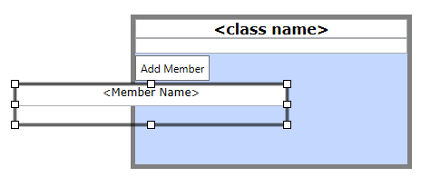
Future Work
Dragging and dropping certain nodes cause certain functions.
More toolbar functions.
More diagrams

Slide 16
Conclusion

