Slide 1
Diagram Software
A tool for diagram creation
Chris
Larisa
JAC, ipd-12, March 2018

Slide 2
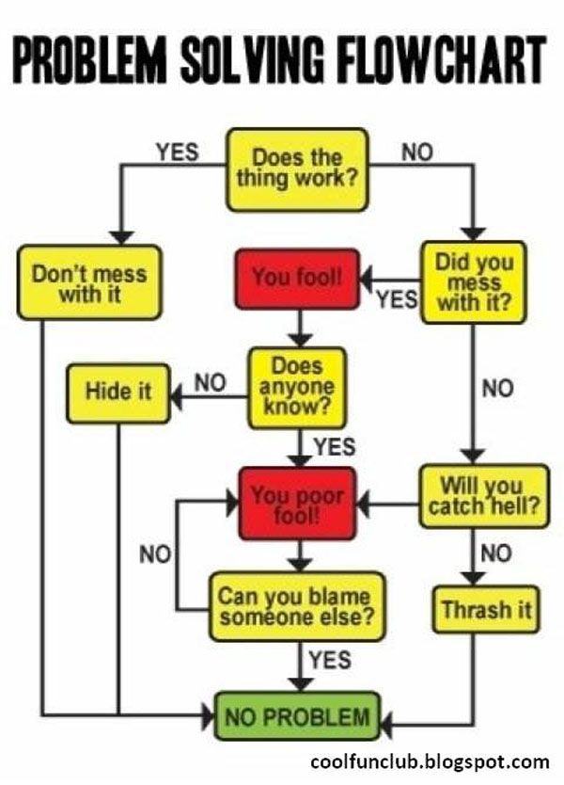
Background
How do I plan my actions.
I will draw it.

Slide 3
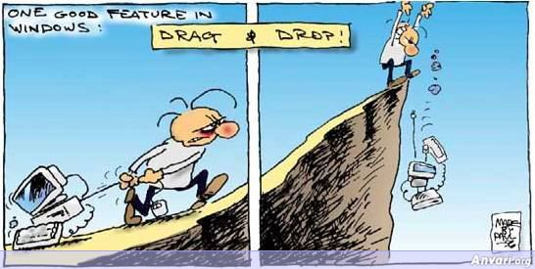
Background

Slide 4
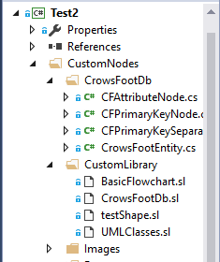
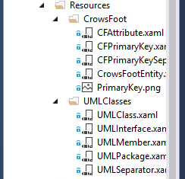
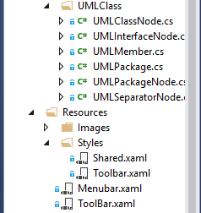
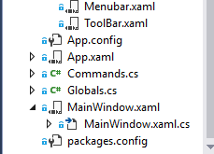
Our solution Overview
Mindfusion: https://www.mindfusion.eu/wpf-diagram.html

Slide 5
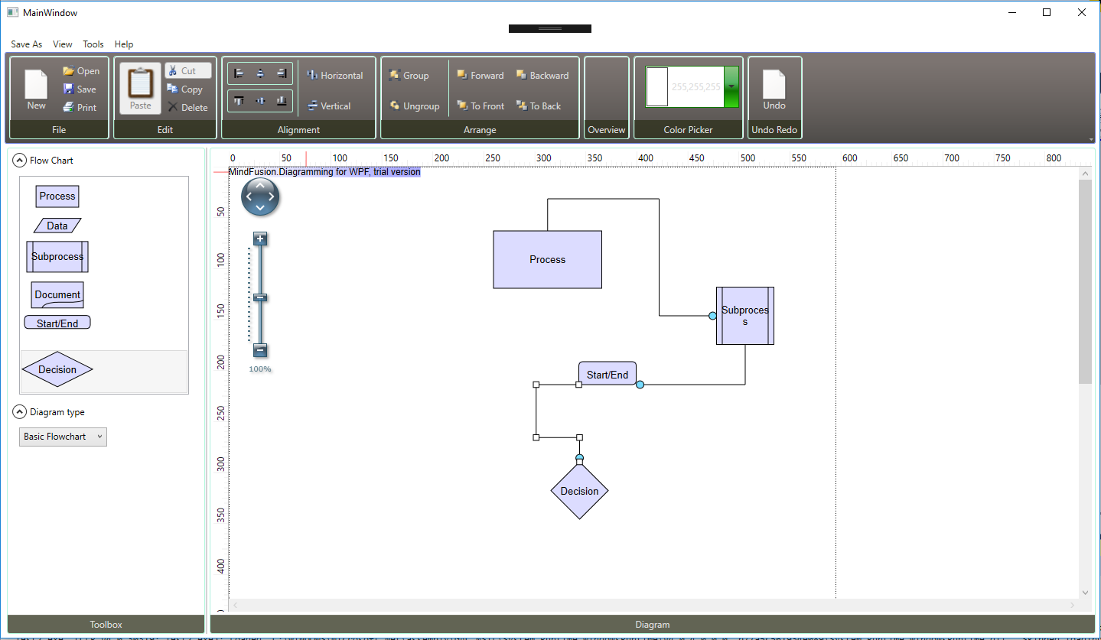
Our solution Overview

Slide 6
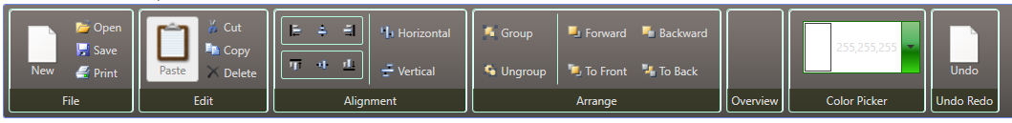

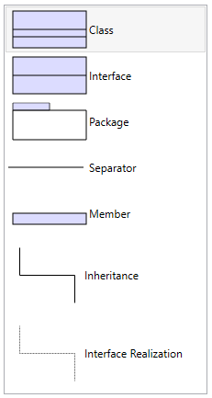
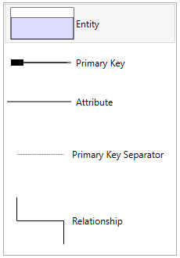
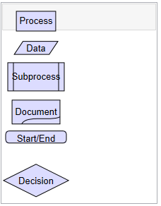



Our solution Overview:

Slide 7
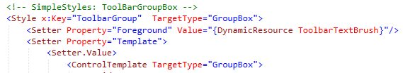



Challenges and solution: Design
Toolbar in the main XAML:
Toolbar style reference:
Additional shared style reference:

Slide 8
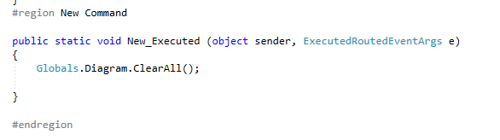


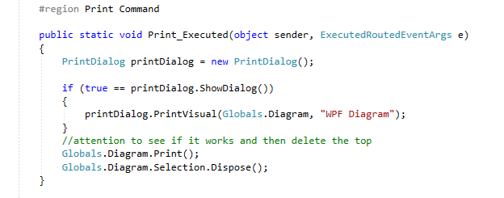

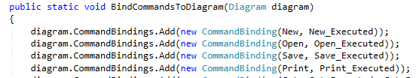
Challenges and solution: Commands
Commands:
static Commands()

Slide 9
Challenges and solution

Slide 10
Challenges and solution

Slide 11
Challenges and solution

Slide 12
What we’ve learned

Slide 13
What we’ve learned

Slide 14
What we’ve learned

Slide 15
Future Work

Slide 16
Conclusion

