Slide 1
Family budget project
An easy to use household finances management
Tung pham
Larisa sabalin
JAC, ipd-12, March 2018

Slide 2
When you may need this tool
When you want to understand on what are you spending too much.
When you decide to find the type of expenses you can lower in order to save some money for something else.
When you income changes suddenly and you need to change the spending behavior.
When you what to be more conscious of your spending vs income and vs budget.

Slide 3
What are the features it offers
Adding information on spending and income as well as planning a budget for the first time users.
Adding current instances of expenses and income.
Seeing in a table the current state on your file for past transactions and budget.
Saving to file the information on the past transactions and budget.

Slide 4
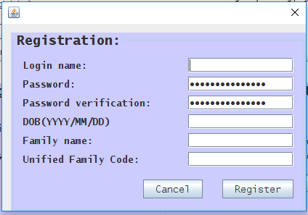
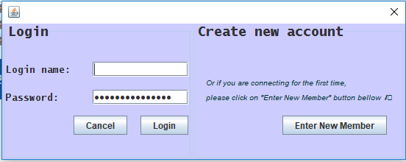
Solution overview
You open the app and you are prompted with a login window.
You have the option of registering to get started.
You will be assign to a unique family. So you need to keep in mind the Family name and the Family Unified Code to use for all your household members.

Slide 5
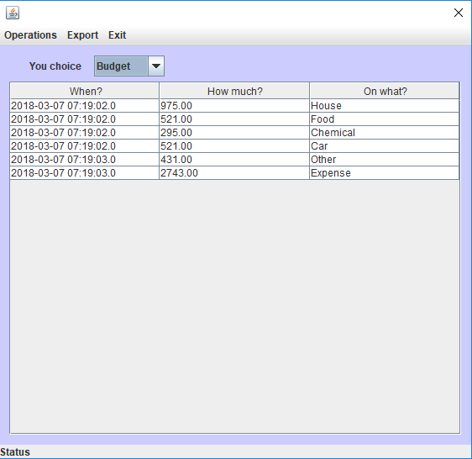
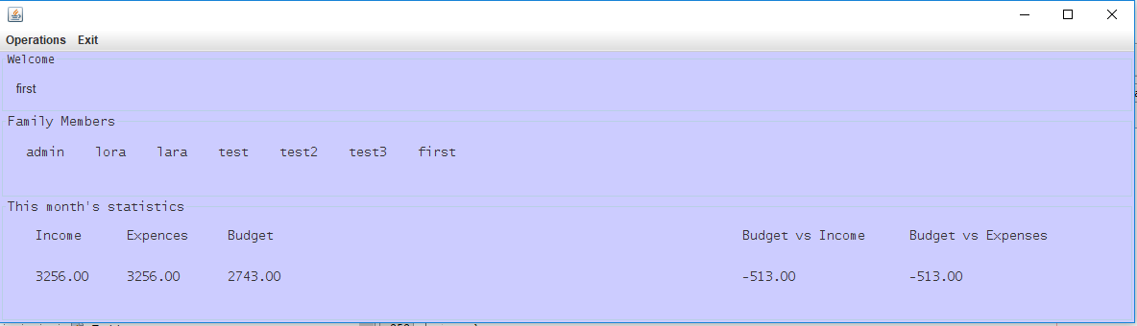
Solution overview
When accessing you file you get all the basic information about your file on the Welcome Frame.
Additional information on details may be accessed in the details view.

Slide 6
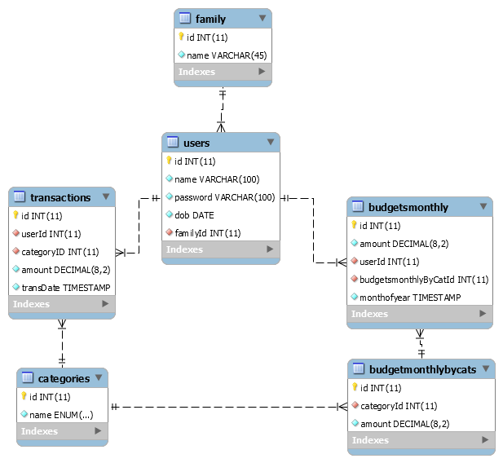
Challenges and solutions

Slide 7
Challenges and solutions
Git
Multi-Querying from a free database
Connecting all the information on one user to the whole system.
Login and Registration

Slide 8
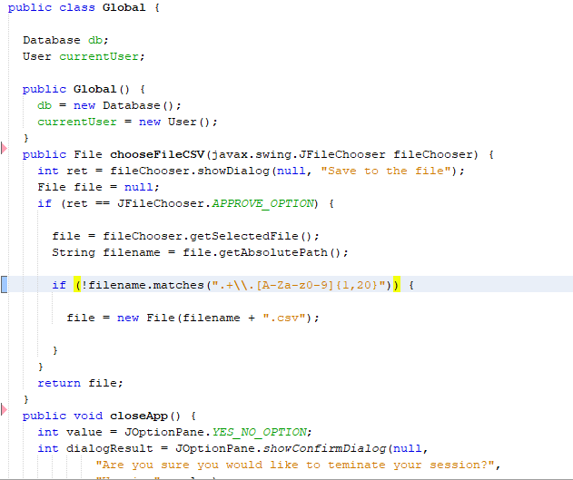
Challenges and solutions

Slide 9
Challenges and solutions

Slide 10
What we learned

Slide 11
What we learned

Slide 12
Future work
Export different parts of the file to CSV
Add more options to the Details view as: all the family information, category of the information written(expense, income, budget), give the option of pulling the information by month, quarter, year.
Add more categories for budgets and expenses.
Set the check for the uniqueness of the family.
Create the algorithm of the budget calculation based on percentage of the previous expenses.
Give the option of choice for the budget planning(Manual or Statistical).

Slide 13
Summary

