Slide 1
Family budget project An easy to use household finances management
Tung Pham Larisa Sabalin JAC, IPD-12, March 2018

Slide 2
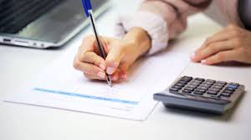
When you may need this tool
When you want to understand on what are you spending too much.
When you decide to find the type of expenses you can lower in order to save some money for something else.
When you income changes suddenly and you need to change the spending behavior.
When you what to be more conscious of your spending vs income and vs budget.
Instead of putting it all on paper and make the calculations.
Instead of using Excel as the information there is not as secured.

Slide 3
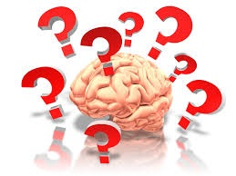
What are the features it offers
Adding information on spending and income as well as planning a budget for the first time users.
Adding current instances of expenses and income.
Seeing in a table the current state on your file for past transactions and budget.
Saving to file the information on the past transactions and budget.

Slide 4
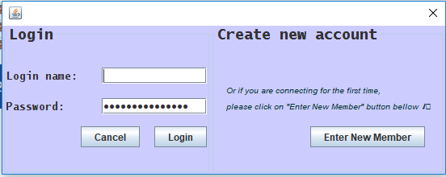
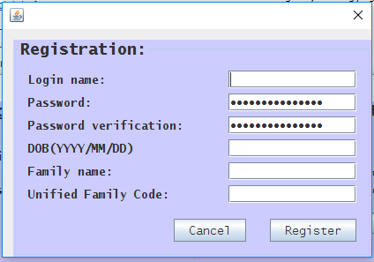
Solution overview
You open the app and you are prompted with a login window.
You have the option of registering to get started.
You will be assign to a unique family. So you need to keep in mind the Family name and the Family Unified Code to use for all your household members.

Slide 5
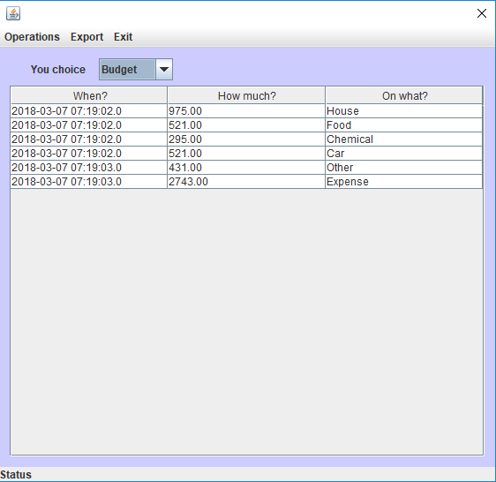
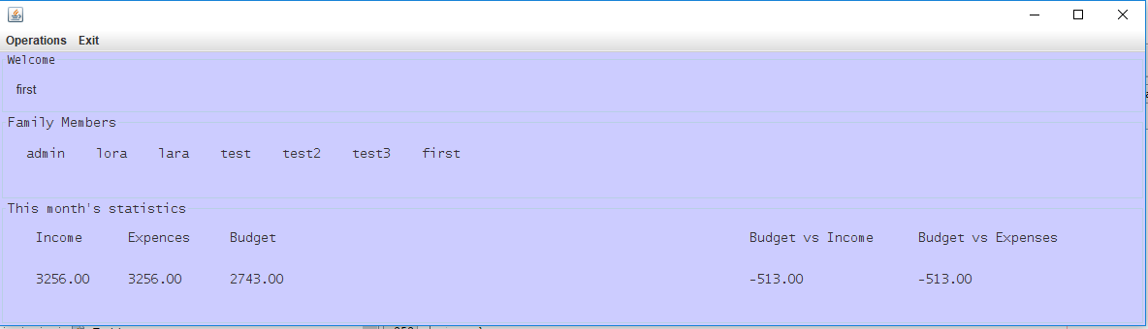
Solution overview
When accessing you file you get all the basic information about your file on the Welcome Frame.
Additional information on details may be accessed in the details view.

Slide 6
Challenges and solutions
Git – conflicts and changes that are not synchronized.
Multi-Querying from a free database
Git – Created 2 or 3 git repositories, 1 bitbucket, changed from sourcetree to github desktop. Created separate java files for each frame.
Had to limit the quantity of queries by limiting the type of information requested at once (the getAllTransaction() is looping thorough 2 tables in the Database).
Red
Is the color of blood, and because of this it has historically been associated with sacrifice, danger and courage.

Slide 7

Hello!
I am Jayden Smith
I am here because I love to give presentations.
You can find me at @username

Slide 8
1.
Transition headline
Let’s start with the first set of slides

Slide 9
“Quotations are commonly printed as a means of inspiration and to invoke philosophical thoughts from the reader”

Slide 10

This is a slide title
Here you have a list of items
And some text
But remember not to overload your slides with content
Your audience will listen to you or read the content, but won’t do both.

Slide 11
BIG CONCEPT
Bring the attention of your audience over a key concept using icons or illustrations

Slide 12

Split your content
White
Is the color of milk and fresh snow, the color produced by the combination of all the colors of the visible spectrum.
Black
Is the color of coal, ebony, and of outer space. It is the darkest color, the result of the absence of or complete absorption of light.

Slide 13
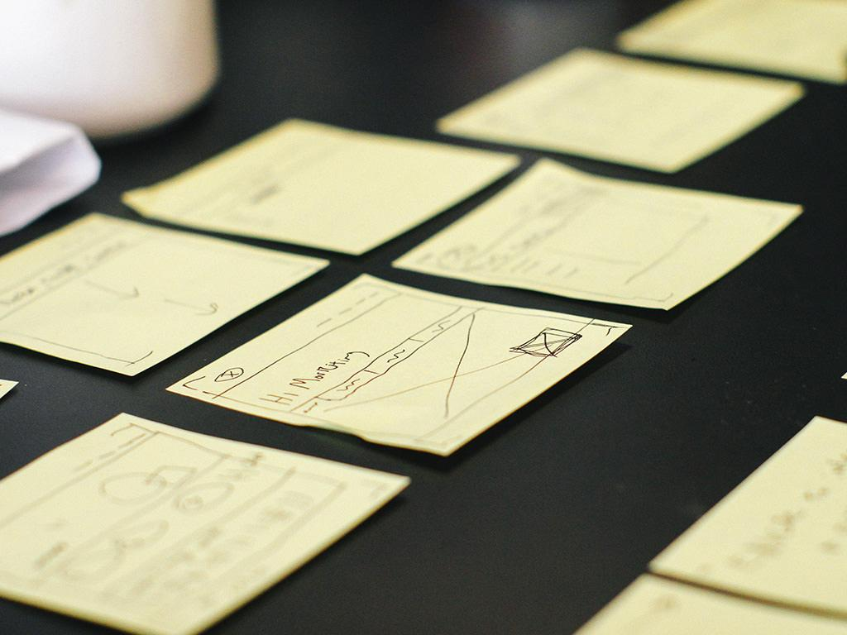
Want big impact?
Use big image.

Slide 14
Charts explain your ideas
Gray
White
Black

Slide 15

And tables compare data
 | A | B | C
Yellow | 10 | 20 | 7
Blue | 30 | 15 | 10
Orange | 5 | 24 | 16

Slide 16
Maps
our office

Slide 17
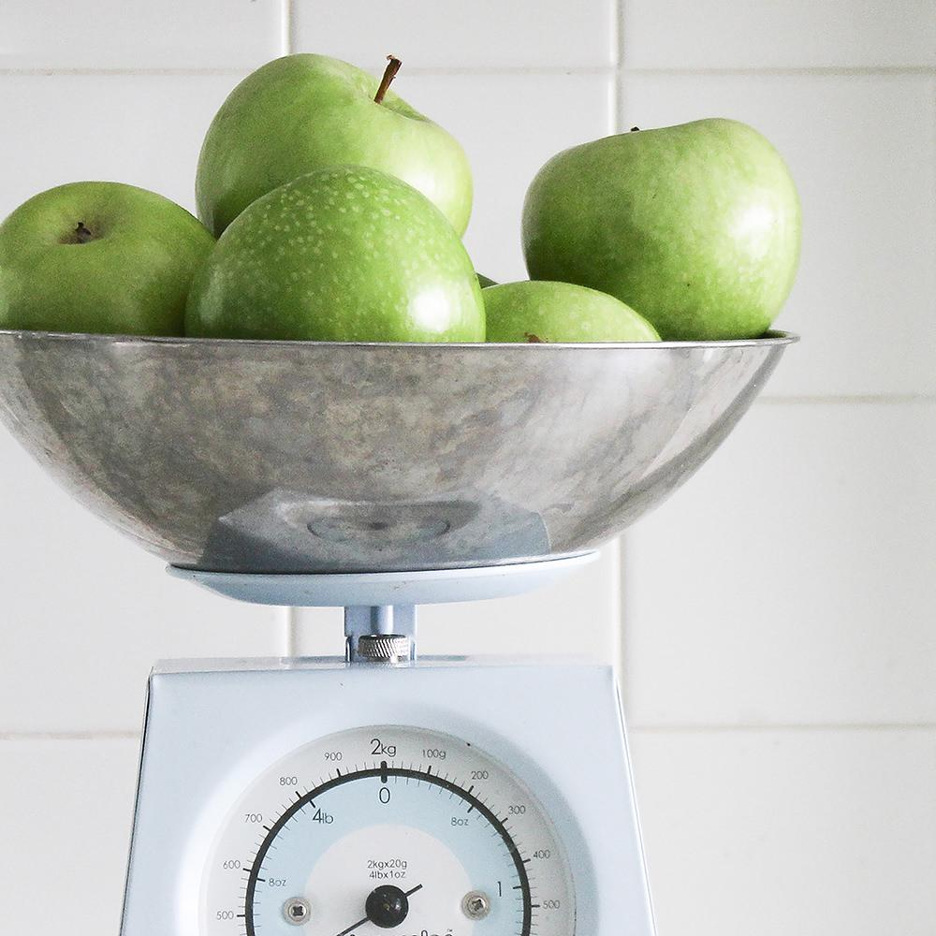
89,526,124
Whoa! That’s a big number, aren’t you proud?

Slide 18

89,526,124$
185,244 users
100%
That’s a lot of money
And a lot of users
Total success!

Slide 19
Our process is easy
first
second
last

Slide 20
Let’s review some concepts
Yellow
Is the color of gold, butter and ripe lemons. In the spectrum of visible light, yellow is found between green and orange.
Blue
Is the colour of the clear sky and the deep sea. It is located between violet and green on the optical spectrum.
Red
Is the color of blood, and because of this it has historically been associated with sacrifice, danger and courage.
Yellow
Is the color of gold, butter and ripe lemons. In the spectrum of visible light, yellow is found between green and orange.
Blue
Is the colour of the clear sky and the deep sea. It is located between violet and green on the optical spectrum.
Red
Is the color of blood, and because of this it has historically been associated with sacrifice, danger and courage.

Slide 21
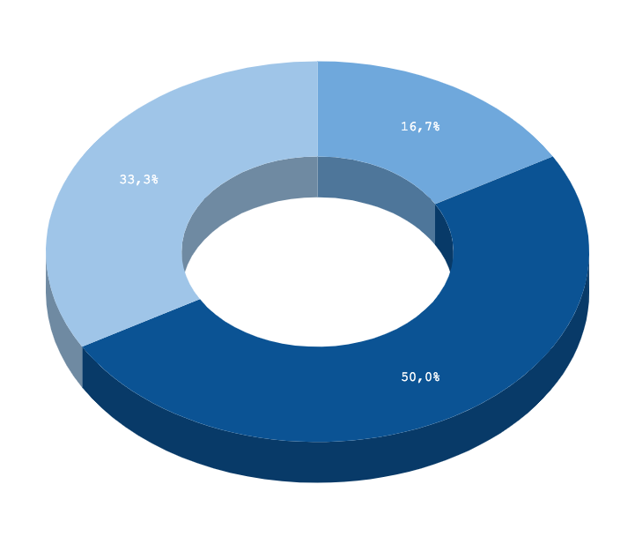
You can insert graphs from Google Sheets

Slide 22
Android project
Place your screenshot here
Show and explain your web, app or software projects using these gadget templates.

Slide 23
iPhone project
Place your screenshot here
Show and explain your web, app or software projects using these gadget templates.

Slide 24
Tablet project
Place your screenshot here
Show and explain your web, app or software projects using these gadget templates.

Slide 25
Desktop project
Place your screenshot here
Show and explain your web, app or software projects using these gadget templates.

Slide 26
Thanks!
Any questions?
You can find me at:
@username
user@mail.me

Slide 27
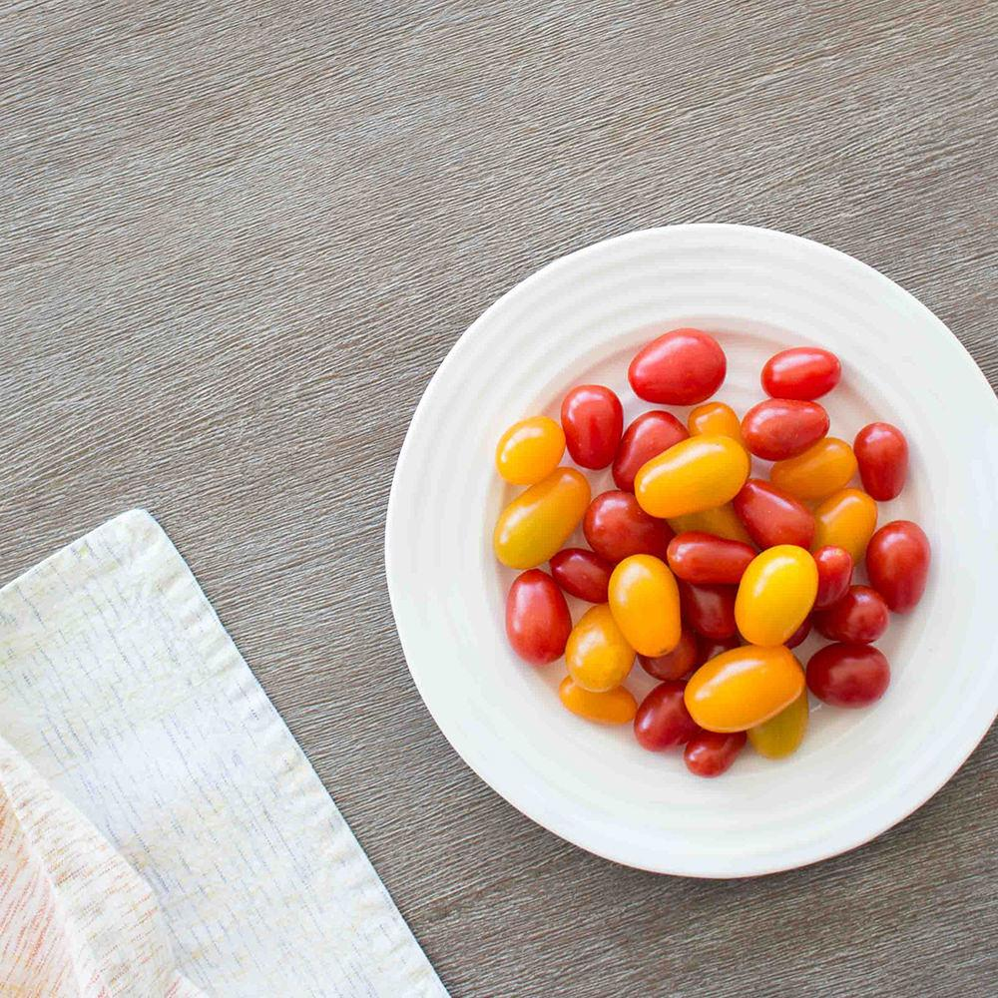
Credits
Special thanks to all the people who made and released these awesome resources for free:
Presentation template by SlidesCarnival
Photographs by Death to the Stock Photo (license)

Slide 28

Presentation design
This presentation uses the following typographies:
Titles: Inconsolata
Body copy: Pangolin
You can download the fonts on these pages:
https://www.fontsquirrel.com/fonts/inconsolata
https://www.urbanfonts.com/fonts/Pangolin.font
You don’t need to keep this slide in your presentation. It’s only here to serve you as a design guide if you need to create new slides or download the fonts to edit the presentation in PowerPoint®

Slide 29
SlidesCarnival icons are editable shapes.
This means that you can:
Resize them without losing quality.
Change fill color and opacity.
Isn’t that nice? :)
Examples:

Slide 30
😉
Now you can use any emoji as an icon!
And of course it resizes without losing quality and you can change the color.
How? Follow Google instructions https://twitter.com/googledocs/status/730087240156643328
✋👆👉👍👤👦👧👨👩👪💃🏃💑❤😂😉😋😒😭👶😸🐟🍒🍔💣📌📖🔨🎃🎈🎨🏈🏰🌏🔌🔑 and many more...

