Slide 1
Family budget project
An easy to use household finances management
Tung pham
Larisa sabalin
JAC, ipd-12, March 2018

Slide 2

When you may need this tool
When you want to understand on what are you spending too much.
When you decide to find the type of expenses you can lower in order to save some money for something else.
When you income changes suddenly and you need to change the spending behavior.
When you what to be more conscious of your spending vs income and vs budget.
Instead of putting it all on paper and make the calculations.
Instead of using Excel as the information there is not as secured.

Slide 3

What are the features it offers
Adding information on spending and income as well as planning a budget for the first time users.
Adding current instances of expenses and income.
Seeing in a table the current state on your file for past transactions and budget.
Saving to file the information on the past transactions and budget.

Slide 4
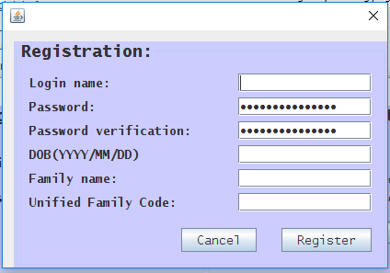
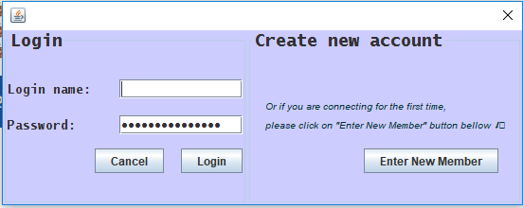
Solution overview
You open the app and you are prompted with a login window.
You have the option of registering to get started.
You will be assign to a unique family. So you need to keep in mind the Family name and the Family Unified Code to use for all your household members.

Slide 5
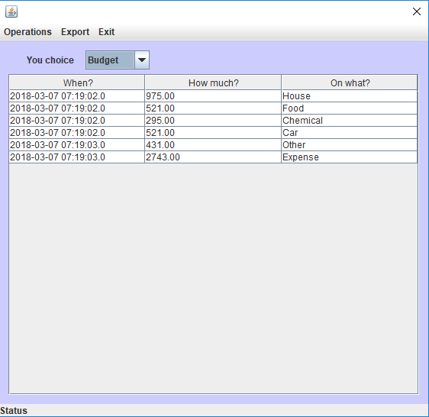
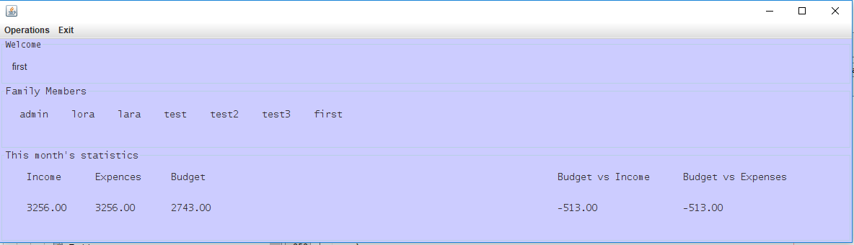
Solution overview
When accessing you file you get all the basic information about your file on the Welcome Frame.
Additional information on details may be accessed in the details view.

Slide 6
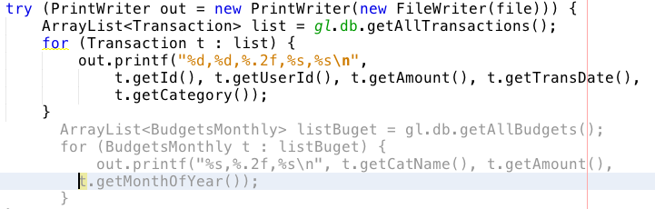
Challenges and solutions
Git – conflicts and changes that are not synchronized.
Multi-Querying from a free database
Git – Created 2 or 3 git repositories, 1 bitbucket, changed from sourcetree to github desktop. Created separate java files for each frame.
Had to limit the quantity of queries by limiting the type of information requested at once (the getAllTransaction() is looping thorough 2 tables in the Database).

Slide 7
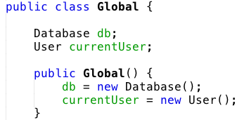

Challenges and solutions
Changing the start of the app to Welcome made the Login on close give access to the following windows(it was not supposed).
Connecting all the information on the current user to the whole system.
Removed the window closing option by setting it to no_action and allowing to close when cancel is hit inside the dialog(for both Login and Registration.
Created the Global but had to instantiate it as the current user was changing at the beginning. Left it like that for now as changing the class Global to Static takes a reengineering of the app.

Slide 8
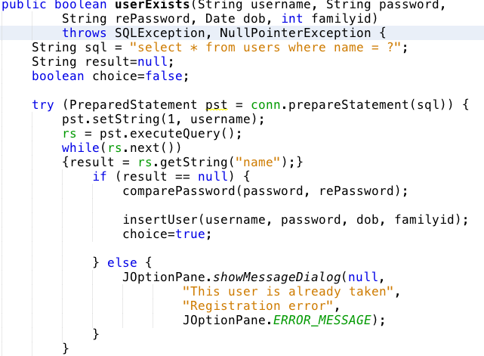
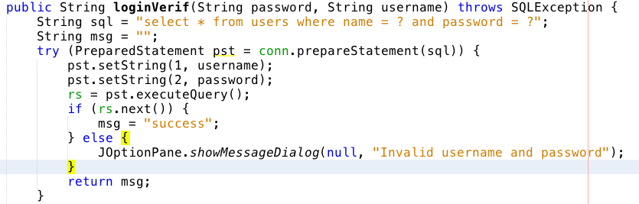
Challenges and solutions
Login and Registration logic.
Connecting all the frames together and make them work as a chain.
At the beginning the app was starting from that dialog. Then we changed to Welcome. The flow of information and fixing the writing to database took long.
Used gl as instance of Global and passed the value of the Welcome(as parent), currentUser and Database, inside the Global thorough the app. At initialization of each window..

Slide 9
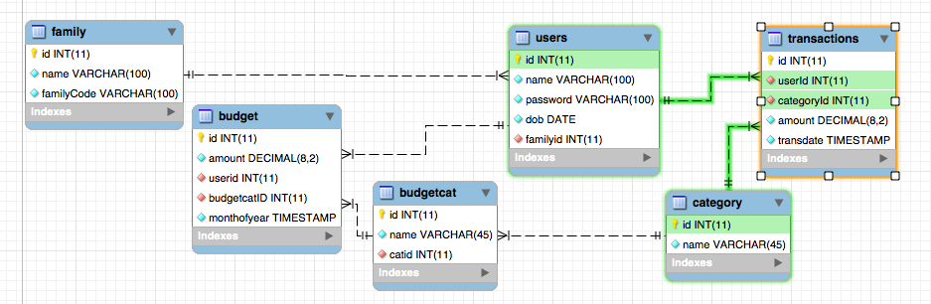
Challenges and solutions
Make a well organized display of the current information on existing transactions.
Make sure that the information is collected for the family. In order to be able to present it later for the entire household.
Choose to use a JTable for that.
Created a family table with id, name and family code. The family code and the name of the family are unique together.

Slide 10

What we learned
The structure of an app has to be decided since the beginning. For collaboration separate files is better.
If a variable is not global(user) it will not be read in other Dialogs after login.
The global variables have to be static-this we will have to figure out later. For now we learned how to make them pass through initialization of every Frame.
The app has to have only one Jframe the rest has to be Dialogs.
Troubleshooting when Database involved becomes complex.
Using web-based free database limits the quantity of connections in loops.

Slide 11
What we learned
The design of database has to be thought secure and also has to be thought in the way so the data can be accessed without looping or hardcoding.
The structure has to be put in place before starting to implement the logic in order to be effective.
Most of the things we’ve seen have been seen before. But we had the chance to apply them by our own initiative and there for went deeper in the understanding of them.
The way you plan it at the beginning has to get adjusted during the period of development.

Slide 12
Future work
Export different parts of the file to CSV
Add more options to the Details view as: all the family information, category of the information written(expense, income, budget), give the option of pulling the information by month, quarter, year.
Add more categories for budgets and expenses.
Set the check for the uniqueness of the family.
Create the algorithm of the budget calculation based on percentage of the previous expenses.
Give the option of choice for the budget planning(Manual or Statistical).
Improve the design.

Slide 13
Summary
It’s a tool for simple and efficient personal financial planning.
You can add expenses, income, plan budget and view all the data.
Biggest challenge was to arrange all together. Solving all in small steps helped us to complete the project.
We had the chance to really use the OOP as in the prior courses we didn’t have that chance on a proper project scale.
The app is currently usable but additional features as specific information by month, quarter, year, or totals for the family have to be added.

Slide 14

good luck at your presentations ! I hope you enjoyed our presentation, as much as, we did working on the project!

