Slide 1
ENTERPRISE TECHNICAL ARCHITECTURE & SYSTEMS SPECIFICATION
MaktabaBora Smart Library Management System
A modern hybrid library ecosystem uniting automated physical circulation, in-browser digital eBook access, cashless Safaricom M-Pesa payments, and grounded AI retrieval (RAG).
Core Stack: PHP 8.2+ · Laravel 11.x · React 18 · Tailwind CSS v4 · PostgreSQL 16 · Neon Cloud · OpenAI / Gemini RAG

Slide 2
STRATEGIC OVERVIEW
Executive Summary & Core Mission
Patron & Digital Services
Bridges physical book circulation with lifetime digital reading. Features an interactive in-browser EPUB/PDF reader, dynamic multi-tier perk subscriptions, and automated hold waitlists.
Staff Circulation Desk
Eliminates manual paper ledgers with automated barcode loans, dynamic overdue fine accrual (KES 10/day), 1-click Open Library ISBN catalog imports, and fine waiver auditing.
Enterprise AI & Payments
Features a conversational RAG AI Librarian grounded strictly in catalog records with a 20k daily token limiter, alongside simulated Safaricom Daraja M-Pesa STK push checkout.

Slide 3
TABLE OF CONTENTS
Architecture & Presentation Agenda
01. FOUNDATIONS
02. DATA & STRUCTURE
• Institutional Objectives & Features
• High-Level System Architecture
• Core Technology Matrix
• Multi-Tier Separation of Concerns
• Relational 3NF Database & ER Model
• Comprehensive Schema Dictionary
• Directory Layout & Model Classes
• REST Controllers & Domain Services
03. WORKFLOWS & CODE
04. OPERATIONS & QA
• Auth & JWT Token Lifecycle
• Circulation, Returns & Fines
• Hold Queue & Digital Purchase
• AI RAG Assistant & Code Highlights
• API Gateway & Integrations
• Multi-Layer Security Defenses
• Testing Suite (127 Passing Tests)
• Deployment, Roadmap & Conclusion

Slide 4
SECTION 1: OBJECTIVES
Institutional Objectives & Strategic Vision
1. Automated Physical Circulation
Eliminate paper ledgers via real-time barcode tracking, auto-computed return dates, and dynamic fine accrual.
2. Hybrid Physical + Digital Lending
Empower remote patrons with in-browser digital reading (EPUB/PDF), chapter navigation, and study notes.
3. Cashless Financial Operations
Direct integration with Safaricom Daraja M-Pesa for instant settlement of passes, digital rentals, and fines (simulated in MVP).
4. Grounded AI Catalog Discovery
Equip patrons with a conversational AI Assistant strictly grounded in real catalog holdings with a 20k token daily cost limiter.
5. Global Catalog Interoperability
Rapidly populate collections with 1-click ISBN metadata synchronization from Open Library REST APIs.
6. Defense-in-Depth & Privacy
Enforce stateless HMAC-SHA256 JWT tokens, granular RBAC, and absolute patron borrowing privacy.

Slide 5
SECTION 1: KEY FEATURES
Key Features: Patron Services & Hybrid Lending
Public Catalog & Discovery
FIFO Hold Reservation Queue
• Full-text search by title, author, genre, or ISBN
• Real-time physical copy availability indicators
• Reference-only restriction warnings for special collections
• Foreign currency book pricing with live KES estimates
• Place holds on checked-out titles with dynamic queue rank
• Automated allocation when physical copies are returned
• Printable and downloadable digital hold receipts
• 1-click patron hold cancellation
Digital Library & e-Reader
Membership Perk Passes
• One-time purchase granting lifetime in-app access
• In-browser EPUB & PDF reading without browser plugins
• Custom themes (Light, Dark, Sepia) and font scaling
• Chapter navigation and local margin notes notepad
• Configurable tiers: General, Student, Scholar, VIP
• Dynamic digital book discounts applied in cart (10%-25%)
• Higher physical borrow limits (up to 10 books)
• Transparent refund claim filing with staff review

Slide 6
SECTION 1: KEY FEATURES
Key Features: Circulation Desk & Administration
Librarian Circulation Desk
Open Library ISBN Integration
• High-speed barcode scanner checkout and return processing
• Automated overdue fine accrual at KES 10.00 / day past due
• Authority to waive patron fines with mandatory audit logging
• Custom physical borrow limit overrides per patron
• 1-click catalog import from Open Library REST API
• Auto-populates title, author, synopsis, and cover art
• Batch copy creation with unique shelf barcode generation
• Graceful degradation when external services are unreachable
AI Assistant & Quota Limiter
System Admin & Dynamic CRUD
• Conversational RAG assistant grounded strictly in library stock
• Anti-hallucination guardrails and PII protection filters
• Daily 20,000 token consumption cost limiter per member
• Dynamic OpenAI / Gemini API key rotation and testing
• Global circulation analytics: active loans, overdue, revenue
• User account governance with ban toggles and reason auditing
• First-time librarian password rotation enforcement
• Direct administrative table data management console

Slide 7
SECTION 2: ARCHITECTURE
Multi-Tier Client-Server Architecture
01
Client Presentation Layer
React 18 Single Page Application built with Vite 7. Manages client state via AuthContext and CartContext, with responsive Tailwind CSS v4 styling and Framer Motion micro-animations.
02
API Gateway & Security
Centralized /api/v1 gateway enforcing CORS headers, IP rate limiting, HMAC-SHA256 JWT validation, and RBAC privilege gates before requests reach controllers.
03
Domain Services Layer
Decoupled PHP services bound to strict interface contracts. Handles JWT signing, Daraja M-Pesa STK push, vector embeddings, TF-IDF recommendations, and loan quotas.
04
Data Persistence Layer
PostgreSQL 16 relational database utilizing 3NF normalization. Automatically toggles between Neon Cloud connection pooling and direct migration endpoints.

Slide 8
SECTION 2: ARCHITECTURE
Architectural Separation of Concerns
Providers (`app/Providers`)
Role: The Setup Crew
Runs before any request is handled. Binds service interfaces to concrete singletons in the IoC container and defines authorization Gates ('access-admin', 'access-librarian').
Middleware (`app/Http/Middleware`)
Role: The Security Gatekeepers
Inspects requests at the door. Validates JWT signatures, checks banned status, evaluates borrow quotas, and enforces daily 20k AI token limits before controllers execute.
Controllers (`app/Http/Controllers`)
Role: The Traffic Directors
Thin HTTP adapters. Validates request parameters, calls relevant services, and returns formatted JSON responses (200, 201, 401, 403, 422, 500). Contains zero business logic.
Services (`app/Services`)
Role: The Domain Brains
Pure business logic. Performs cryptographic token hashing, Daraja M-Pesa STK pushes, vector similarity calculations, and Open Library catalog imports independent of HTTP.

Slide 9
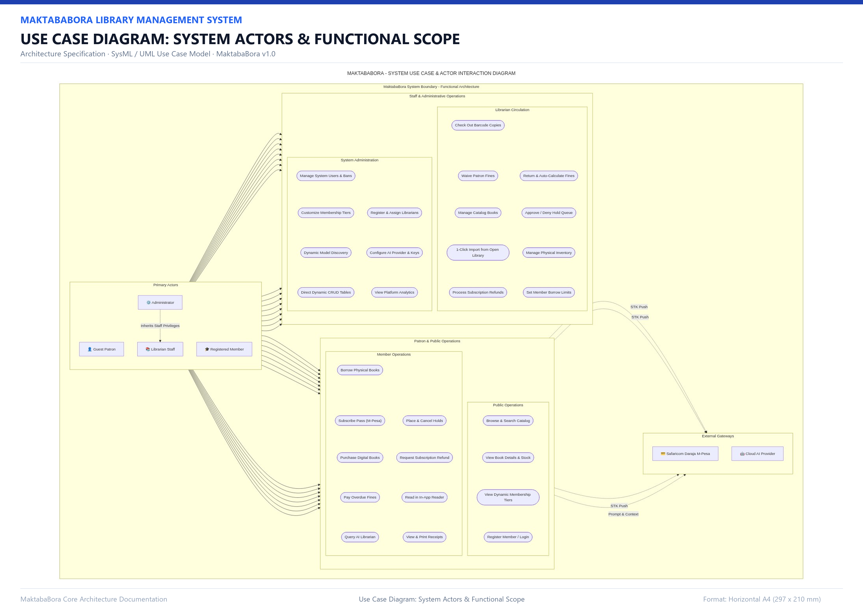
SECTION 2: UML USE CASE DIAGRAM
System Use Case & Actor Interaction Model
Technical Specifications
Primary Actors: 4 Human actors: Guest Patron, Registered Member, Librarian Staff, and Administrator.
External Gateways: Safaricom Daraja (M-Pesa STK Push), OpenAI/Gemini (Catalog RAG), and Open Library (ISBN Import).
Member Services: Physical borrowing, FIFO hold queues, in-app digital reader, M-Pesa pass subscriptions, and AI chatbot.
Staff Operations: Circulation desk checkout/return, fine waivers, hold approvals, and catalog inventory CRUD.
Administrative Core: User ban management, librarian creation, dynamic membership tiers, and encrypted AI settings.

Slide 10
SECTION 3: TECHNOLOGIES & FRAMEWORKS
Technology Stack Matrix: Core Architecture
Layer | Technology | Version | Key Responsibilities in MaktabaBora
Backend Runtime | PHP | 8.2+ | Type-safe runtime, native vector math, OpenSSL cryptographic functions
Backend Framework | Laravel Framework | 11.x | Headless RESTful API, Eloquent ORM, IoC Service Container, Gates
Dependency Mgr | Composer | 2.x | PHP package dependency resolution and class autoloader optimization
Relational Database | PostgreSQL | 16.x | 3NF ACID storage, JSONB indexing, foreign key constraints, cascading
Serverless Cloud DB | Neon Cloud PostgreSQL | Active | Cloud DB with pooled endpoints & automatic migration endpoint switching
Testing Database | SQLite (:memory:) | 3.x | Isolated in-RAM database executing 127 Unit/Feature tests in ~7 seconds
Frontend Framework | React | 18.3.1 | Single-Page Application, custom Context state (AuthContext, CartContext)
Build & Dev Server | Vite | 7.0.7 | Ultra-fast frontend build tooling and Hot Module Replacement (HMR)

Slide 11
SECTION 3: TECHNOLOGIES & FRAMEWORKS
Technology Stack Matrix: Integrations & Quality
Subsystem | Tool / Service | Version / Model | Integration Purpose & Functionality
Client Styling | Tailwind CSS | v4.0.0 | Utility-first design engine powering responsive layouts & reader themes
UI Components | Lucide React | 0.400.0 | Modern iconography suite across all patron, staff, and admin dashboards
UI Motion | Framer Motion | 12.43.0 | Fluid animations for drawers, reader controls, and checkout countdowns
HTTP Client | Axios | 1.11.0 | Client API library with request interceptors attaching Bearer JWT tokens
Payment Gateway | Safaricom Daraja API | v2.0 | Customer-to-Business STK Push and real-time transaction polling
Catalog AI RAG | OpenAI / Gemini API | gpt-4o-mini / flash | Text embeddings (1536-dim) & grounded conversational AI guidance
Metadata Provider | Open Library API | REST v1 | 1-Click automated ISBN metadata search and cover synchronization
Automated Testing | PHPUnit | 11.x | Unit test suite (80 tests) and Feature HTTP pipeline suite (47 tests)

Slide 12
SECTION 4: DATABASE STRUCTURE
Relational Database Design Principles
Third Normal Form (3NF)
Zero transitive dependencies. Tables store discrete, non-redundant domain entities with clear single-responsibility boundaries.
Strict Referential Integrity
Foreign key constraints with ON DELETE CASCADE for dependent records (e.g. book copies) and ON DELETE RESTRICT for critical financial loans.
High-Performance Indexing
Dedicated B-tree indexes on authentication emails, barcodes, ISBNs, loan due dates, and AI usage timestamps for instant querying.
ACID Financial Compliance
Multi-table state mutations (e.g. loan issuance, hold fulfillments, pass activations) run inside strict database transactions (DB::beginTransaction).
JSONB Semi-Structured Data
Utilizes native PostgreSQL JSONB columns for digital eBook chapter indexes, reader table-of-contents, and AI grounding metadata.
Serverless Pooler Awareness
Backend dynamically switches between PgBouncer pooled connections (app queries) and direct connections (schema migrations).

Slide 13
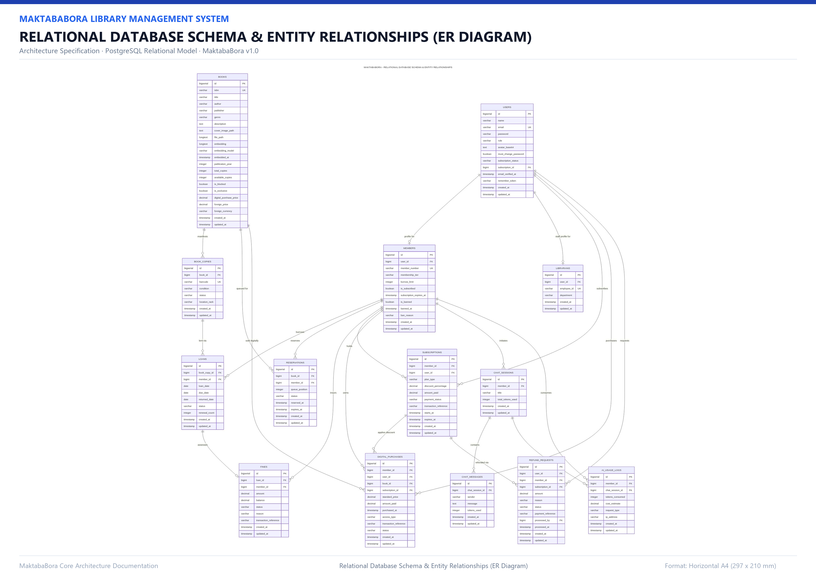
SECTION 4: DATABASE STRUCTURE
Relational Database Schema & ER Diagram
Technical Specifications
Core Entities: 17 Relational tables capturing Identity, Circulation, Digital Media, Subscriptions, AI, and Auditing.
Identity Model: Polymorphic extension: users (1) extends to members (patrons) and librarians (staff).
Circulation Triad: books (catalog) contains book_copies (physical barcodes) which are checked out in loans.
Financial Audits: Fines linked to loans; Subscriptions linked to tiers; Refund requests audited by librarians.
AI Memory & Logs: chat_sessions store chat_messages; ai_usage_logs track rolling 24-hour token consumption.

Slide 14
SECTION 4: DATABASE SCHEMA DICTIONARY
Data Dictionary: Identity, Patrons & Membership Tiers
Table | Column | Data Type | Constraints | Description & Operational Rules
users | id | BIGINT | PK, Auto-Inc | Unique global user identity primary key
users | email | VARCHAR(255) | UNIQUE, Indexed | User login address; validated against RFC standards
users | role | ENUM | admin, librarian, member | Primary RBAC gate attribute (Default: 'member')
members | member_number | VARCHAR(64) | UNIQUE, Indexed | Patron system barcode identifier (e.g. MEM-4F8A9B)
members | borrow_limit | INT | Default: 3 | Max concurrent active physical book loans allowed
members | is_banned | BOOLEAN | Default: false | Suspension flag; checked by CheckBannedStatus middleware
librarians | employee_number | VARCHAR(64) | UNIQUE, Indexed | Official staff identifier assigned upon creation
membership_tiers | price | DECIMAL(10,2) | NOT NULL | Monthly subscription price in Kenya Shillings (KES)
membership_tiers | digital_discount_pct | DECIMAL(5,2) | Default: 0.00 | Percentage discount applied to digital eBook purchases in cart

Slide 15
SECTION 4: DATABASE SCHEMA DICTIONARY
Data Dictionary: Inventory, Barcodes & Loans
Table | Column | Data Type | Constraints | Description & Operational Rules
books | isbn | VARCHAR(32) | UNIQUE, Indexed | 10 or 13-digit International Standard Book Number
books | available_copies | INT | Default: 1 | Current physical volumes on shelf; decrements on loan
books | rental_price | DECIMAL(10,2) | Default: 0.00 | Baseline digital eBook purchase price in KES
book_copies | barcode | VARCHAR(64) | UNIQUE, Indexed | Physical copy barcode scanned at circulation desk
book_copies | status | ENUM | avail, borrowed, lost... | State of physical volume (Default: 'available')
loans | due_date | TIMESTAMP | Indexed | Return deadline (Default: loan_date + 14 days)
loans | status | ENUM | active, returned, overdue | Circulation state; checked by cron/middleware
fines | amount | DECIMAL(10,2) | NOT NULL | Accrued overdue fine (calculated at KES 10.00 / day)
reservations | queue_position | INT | NOT NULL | FIFO waitlist rank for checked-out book (1, 2, 3...)

Slide 16
SECTION 4: DATABASE SCHEMA DICTIONARY
Data Dictionary: Digital Store, AI Memory & Auditing
Table | Column | Data Type | Constraints | Description & Operational Rules
digital_books | file_format | ENUM | 'epub', 'pdf' | Digital eBook MIME format served to in-browser reader
digital_books | chapter_index | JSONB | Nullable | Structured chapter list, anchors, and word counts
digital_rentals | access_type | ENUM | 'lifetime_purchase' | Permanent digital license for reading purchased eBook
subscriptions | transaction_reference | VARCHAR(128) | Nullable | Safaricom Daraja M-Pesa receipt verification code
chat_sessions | session_token | VARCHAR(64) | UNIQUE, Indexed | Cryptographic token isolating patron conversation context
chat_messages | grounding_metadata | JSONB | Nullable | Referenced catalog book IDs, authors, and similarity scores
ai_usage_logs | tokens_consumed | INT | NOT NULL | Prompt + completion tokens used for daily quota tracking
refund_requests | status | ENUM | pending, approved... | Formal patron reimbursement workflow audited by staff

Slide 17
SECTION 5: SYSTEM STRUCTURE
Application Structure & Modular Directory Layout
Backend Controllers (`app/Http/Controllers`)
Security Middleware (`app/Http/Middleware`)
18 REST controllers managing Auth, Physical Inventory, Loans, Fines, Reservations, Subscriptions, AI Chatbot, and Admin CRUD. Formats input and responses.
20 Custom gatekeepers enforcing JWT validation, CORS, token-bucket rate limits, borrow quotas, banned member blocks, and daily 20k AI token cost limits.
Domain Services (`app/Services`)
Frontend Single Page App (`frontend/src`)
19 Decoupled business logic classes implementing explicit interfaces. Covers JWT signing, Daraja STK push, vector cosine scoring, and Open Library imports.
13 Page views (`pages/`), reusable components (`components/`), React Context managers (`AuthContext`, `CartContext`), and Axios API service interceptors.

Slide 18
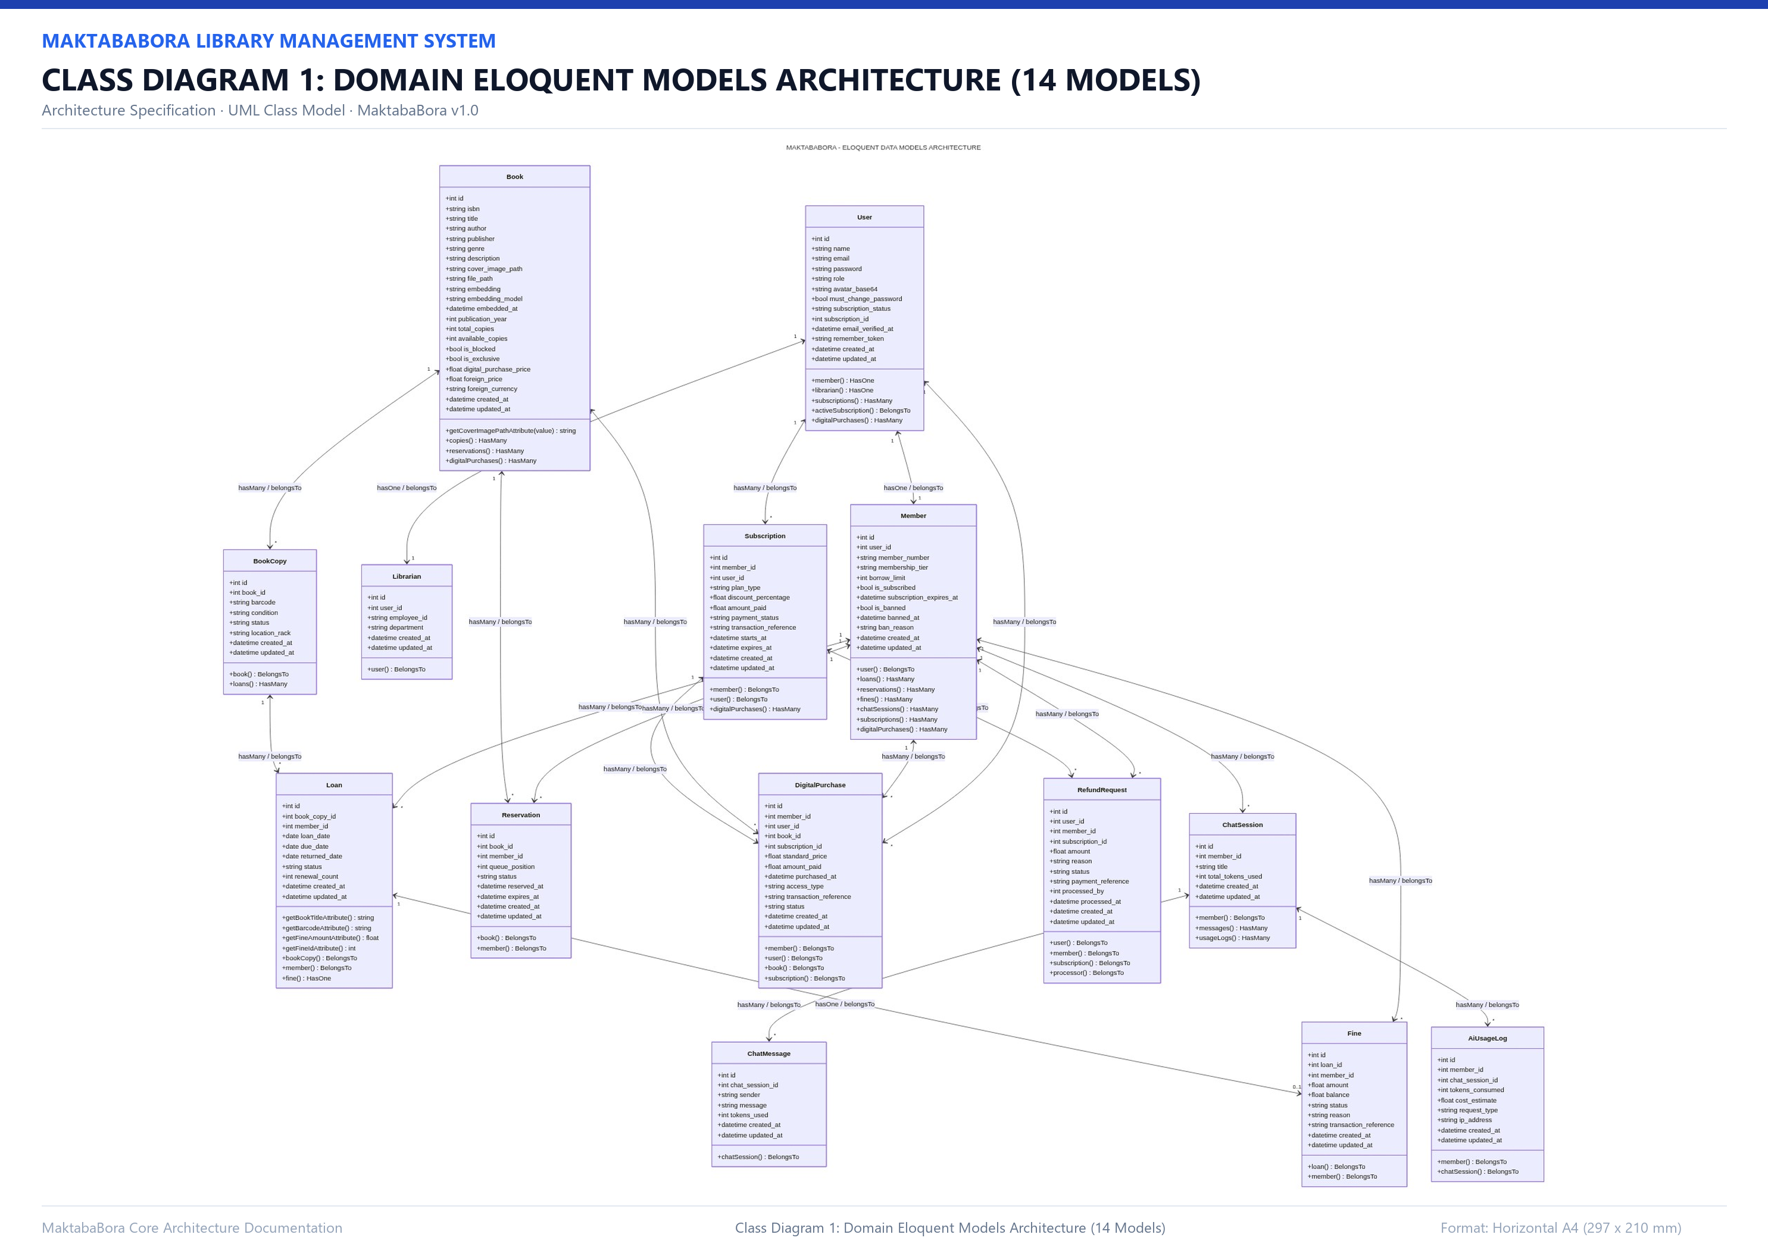
SECTION 5: CLASS DIAGRAMS
Eloquent Models Architecture & Relationships
Technical Specifications
Entity Classes: 14 Eloquent models encapsulating database attributes, mutators, and relationships.
Identity Hierarchy: User hasOne Member and Librarian; Member owns Loans, Holds, Passes, and AI Logs.
Catalog Composition: Book hasMany BookCopies; Book owns DigitalBook; BookCopy hasMany Loans.
Financial Links: Loan hasOne Fine; Subscription belongsTo MembershipTier and hasOne RefundRequest.
AI Chat Memory: ChatSession hasMany ChatMessages with grounding metadata and member ownership.

Slide 19
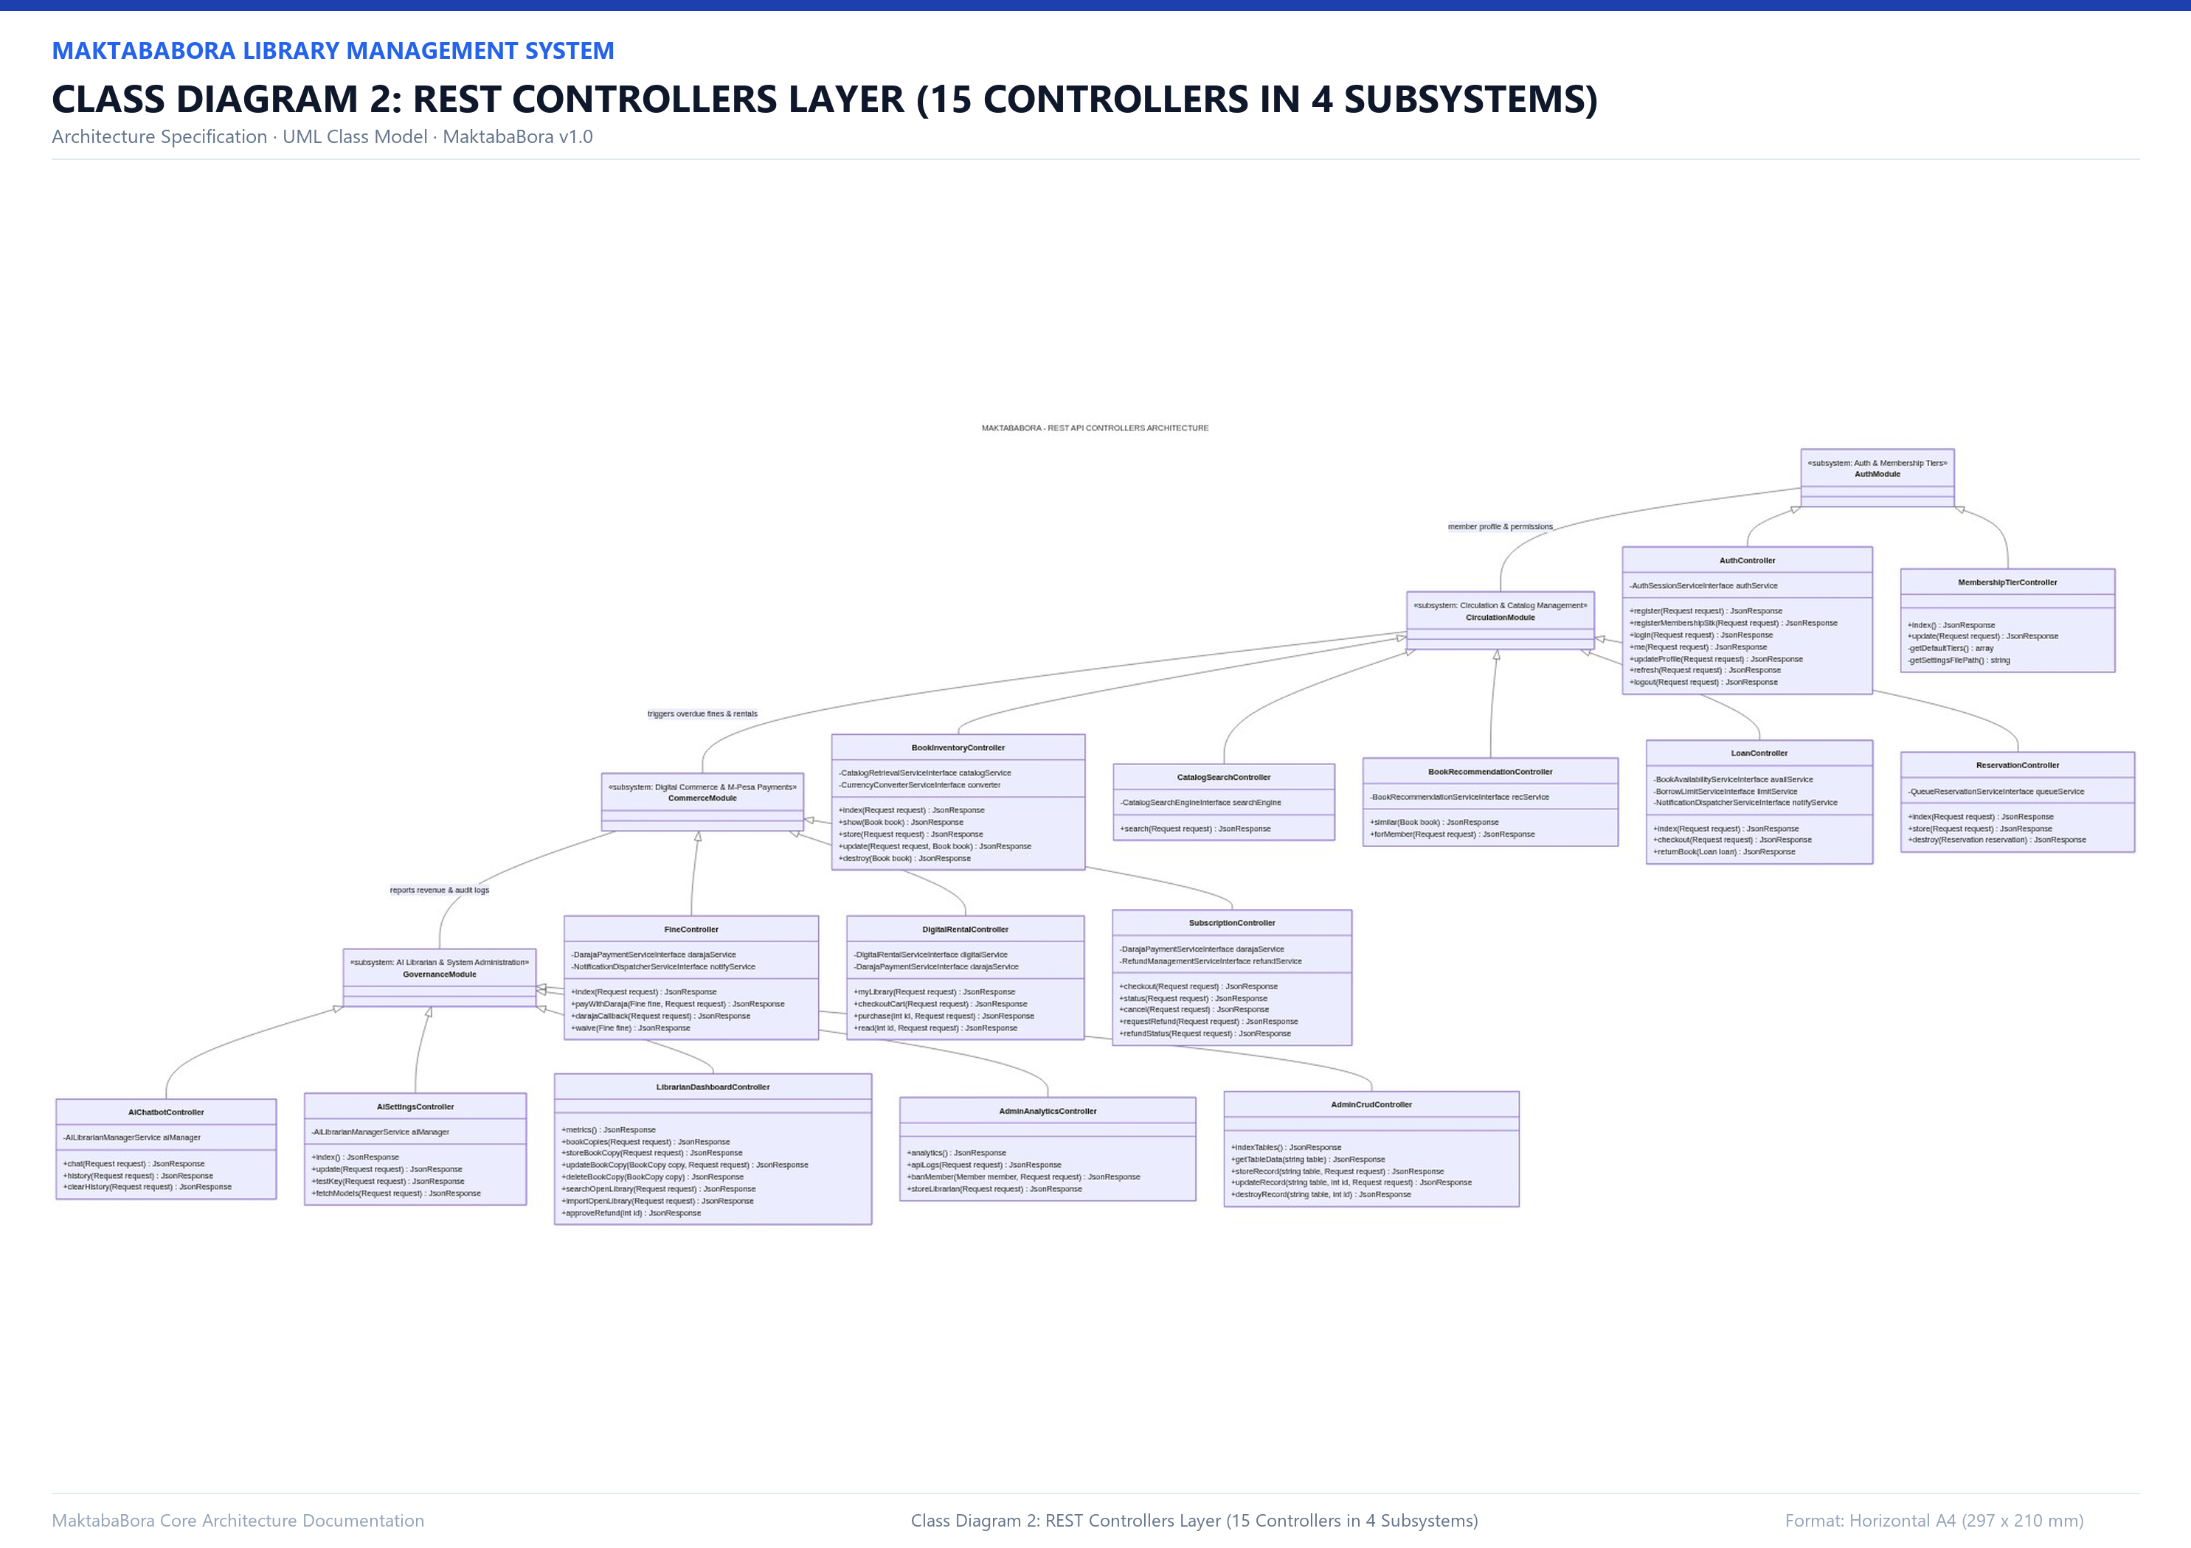
SECTION 5: CLASS DIAGRAMS
REST Controllers Layer Architecture
Technical Specifications
Subsystem 1: Auth & Patron: AuthController, LoanController, FineController, ReservationController.
Subsystem 2: Digital & Media: DigitalRentalController, SubscriptionController, MembershipTierController.
Subsystem 3: AI & Discovery: AiChatbotController, BookRecommendationController, CatalogSearchController.
Subsystem 4: Staff & Admin: LibrarianDashboardController, AdminDashboardController, AdminCrudController.
Architectural Rule: Controllers are thin HTTP adapters; all domain tasks delegate to injected Services.

Slide 20
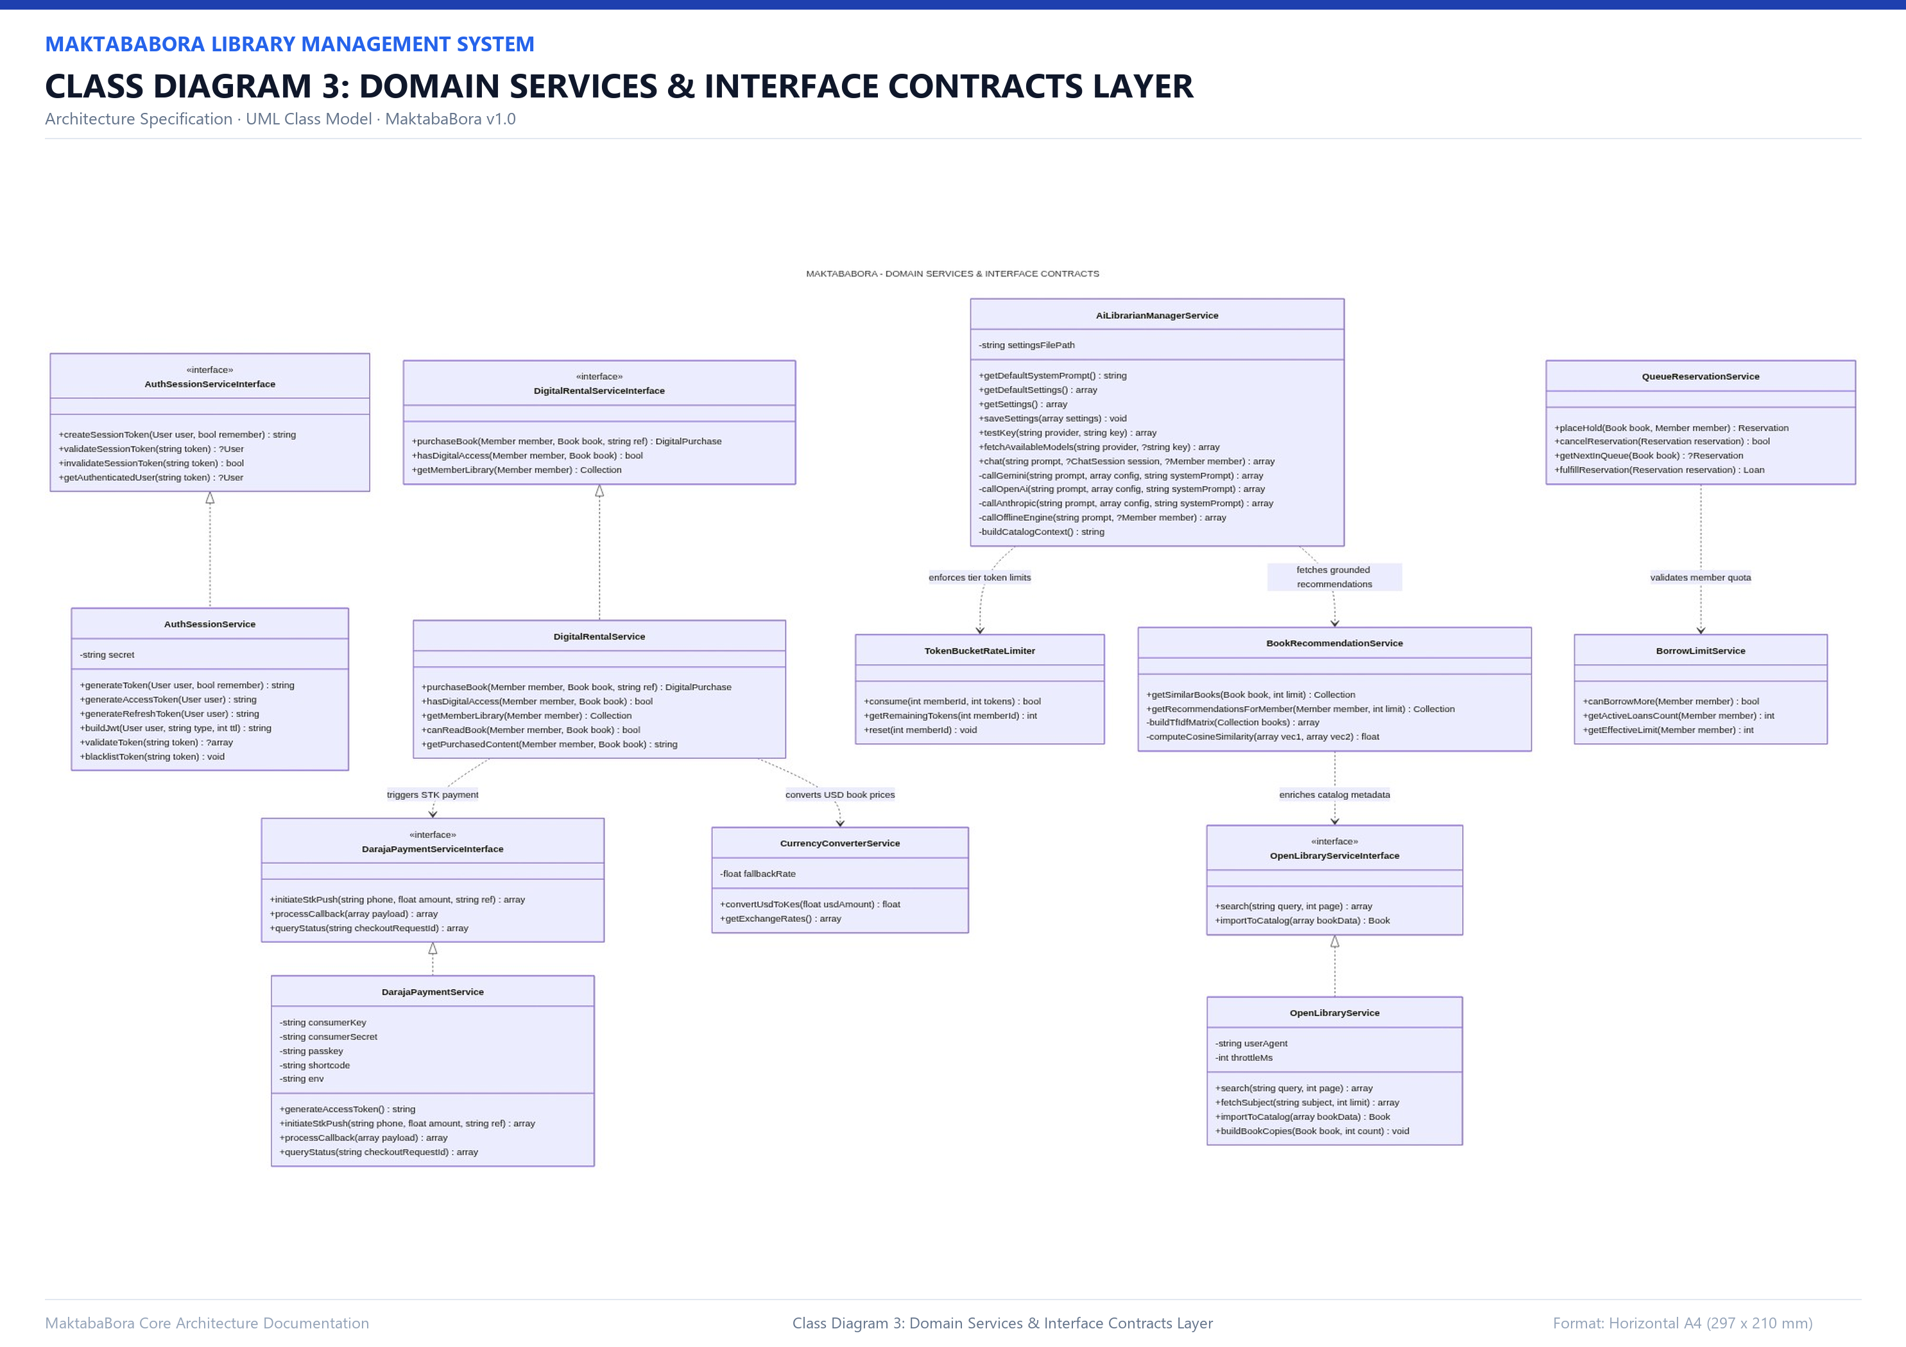
SECTION 5: CLASS DIAGRAMS
Domain Services & Contracts Layer Architecture
Technical Specifications
Interface Decoupling: All services implement strict PHP Contracts in app/Contracts/Services/.
IoC Container: Bound as singletons in Service Providers (e.g. AuthServiceProvider).
Core Domain Classes: AuthSessionService, DarajaPaymentService, DigitalRentalService, BookAvailabilityService.
Algorithms & Machine Learning: BookEmbeddingService (Cosine vector distance), CatalogRetrievalService (TF-IDF).
External Integration: OpenLibraryService (1-Click ISBN import), CurrencyConverterService (Forex parity).

Slide 21
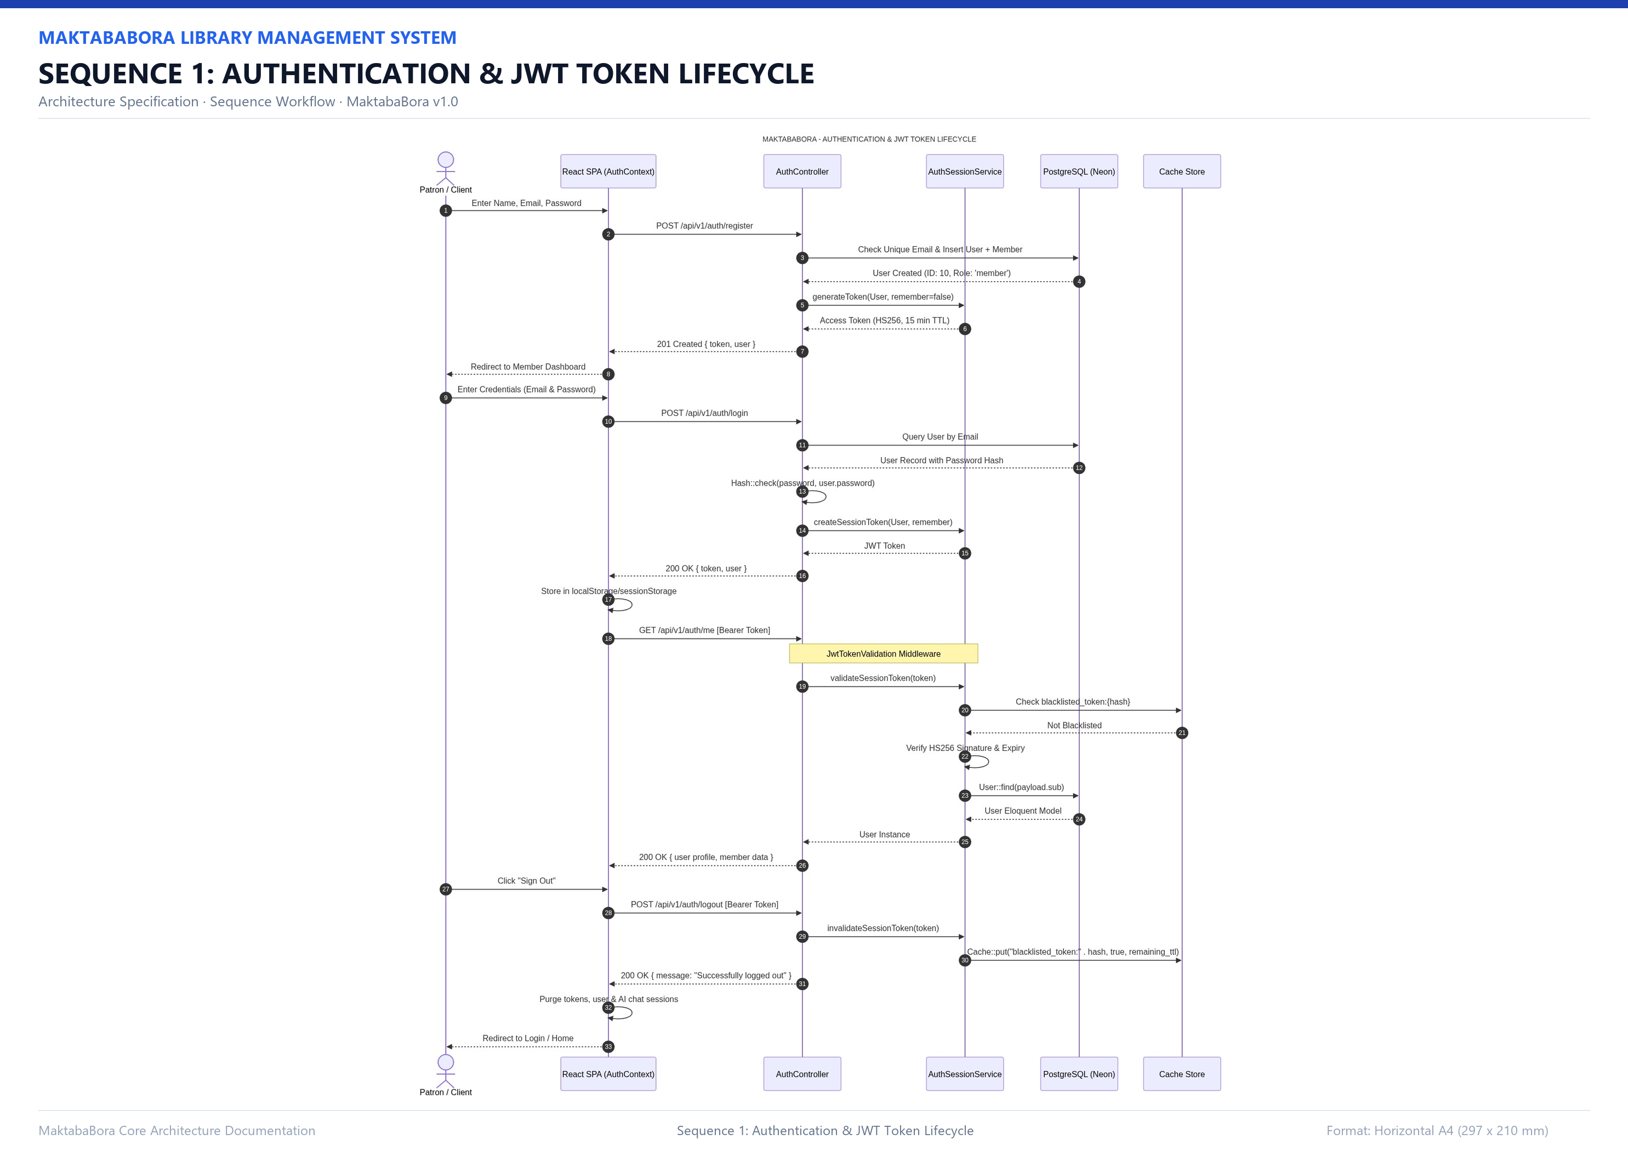
SECTION 6: OPERATIONAL WORKFLOWS
Workflow 1: Authentication & JWT Token Lifecycle
Technical Specifications
Stateless Architecture: Tokens signed using HMAC-SHA256 with server master key (APP_KEY); zero DB sessions.
Expiration Policies: Standard access tokens: 15 minutes; Persistent 'Remember Me' tokens: 30 days.
Middleware Checkpoint: JwtTokenValidation inspects Bearer header and sets UserResolver on the request.
Session Revocation: Logout explicitly writes token hash to Redis/Cache blacklist with remaining TTL.
First-Login Rotation: Librarians are forced to rotate temporary passwords before accessing portal.

Slide 22
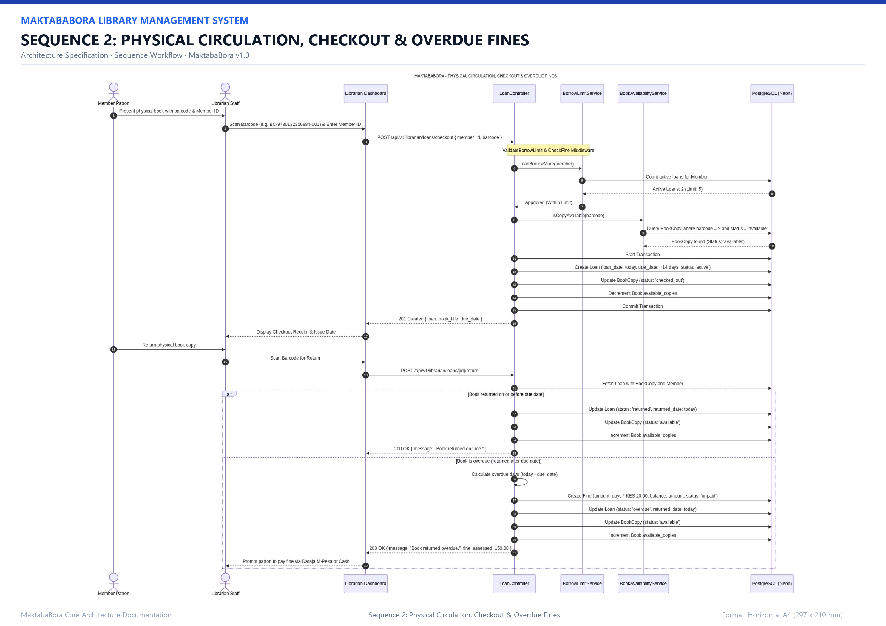
SECTION 6: OPERATIONAL WORKFLOWS
Workflow 2: Physical Circulation, Returns & Overdue Fines
Technical Specifications
Pre-Checkout Guards: ValidateBorrowLimit and CheckFineAmount verify patron eligibility before checkout.
Atomic Checkout: DB transaction updates BookCopy status = 'borrowed' and decrements available copies.
Automated Overdue Calculation: System computes difference between return date and due date at KES 10.00 / day.
Fine Settlement Options: Patron can pay online via Safaricom Daraja M-Pesa STK push.
Staff Fine Waivers: Librarians can waive fines with administrative justification and audit logging.

Slide 23
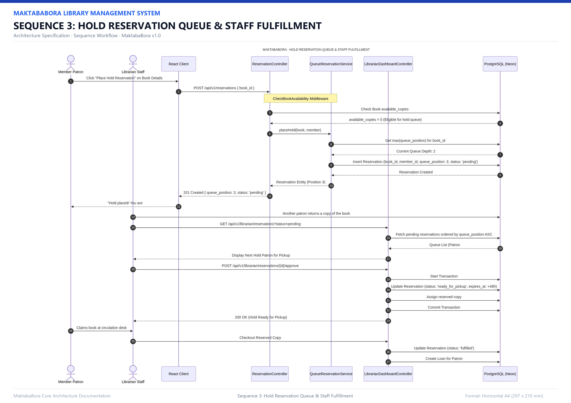
SECTION 6: OPERATIONAL WORKFLOWS
Workflow 3: Hold Reservation Queue Lifecycle
Technical Specifications
FIFO Queue Allocation: Patrons join waitlist when available_copies == 0; assigned position count + 1.
Automated Reordering: When a patron cancels or copy is fulfilled, all subsequent queue positions decrement.
Staff Approval Desk: Librarian approves next in line when copy is returned; allocates 3-day pickup window.
Printable Receipts: Patrons receive an interactive, printable digital reservation receipt with barcode.
Expiration Cleanup: Holds not picked up within the 3-day window are automatically expired.

Slide 24
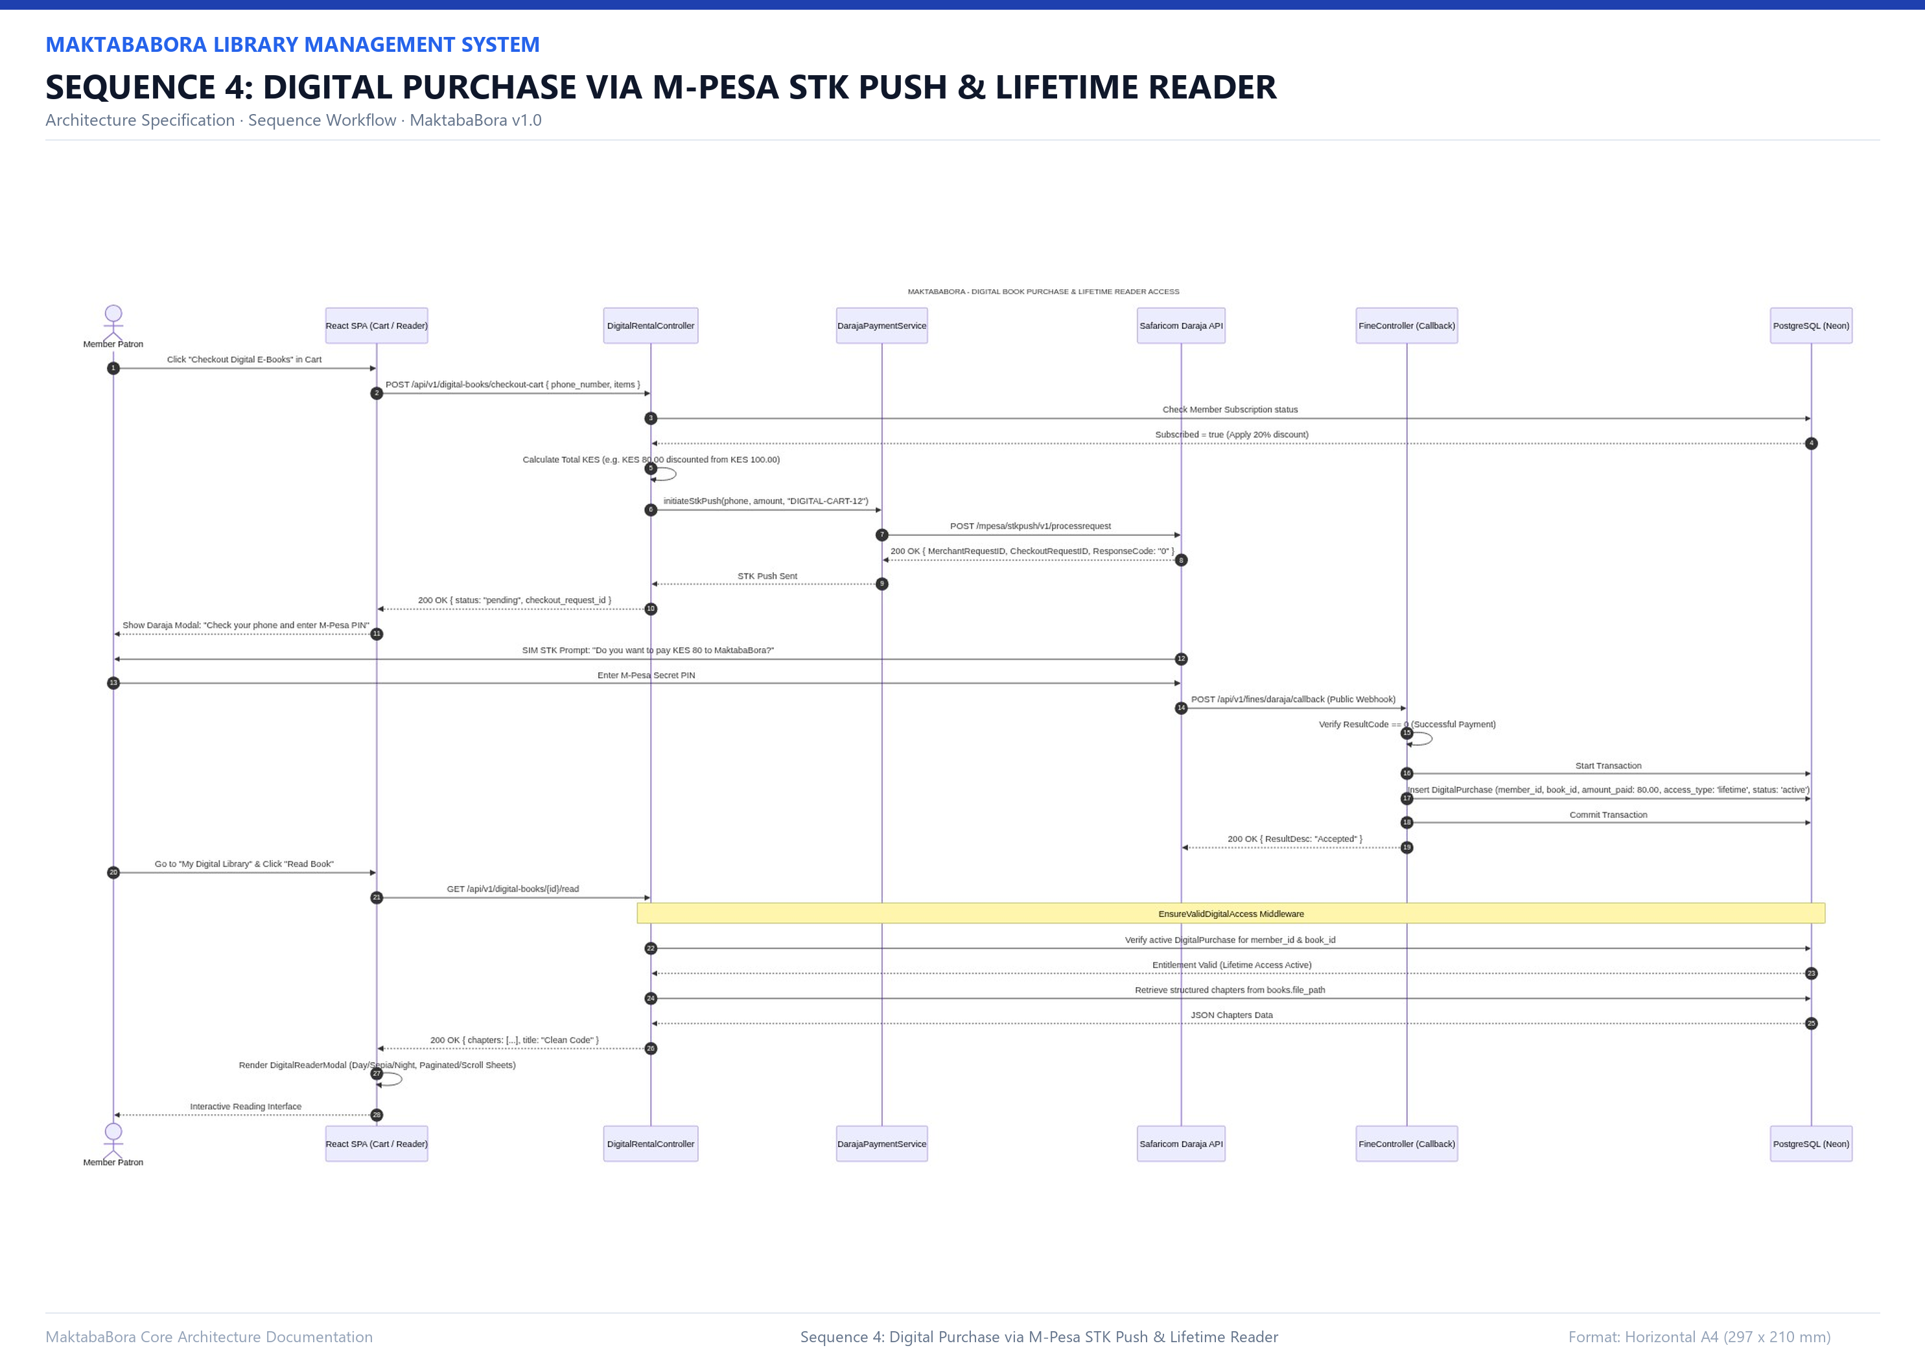
SECTION 6: OPERATIONAL WORKFLOWS
Workflow 4: Digital Book Purchase & In-App Reader
Technical Specifications
Multi-Item Shopping Cart: Patrons batch-purchase digital eBooks with automatic membership pass discounts.
Safaricom STK Prompt: DarajaPaymentService initiates STK push directly to patron's mobile phone.
Lifetime License: Confirmed payment mints a DigitalRental record with access_type = 'lifetime_purchase'.
Protected Reading Stream: EnsureValidDigitalAccess middleware verifies active purchase before file streaming.
In-Browser Reader: Supports EPUB & PDF reading, Light/Dark/Sepia themes, font scaling, and local notes.

Slide 25
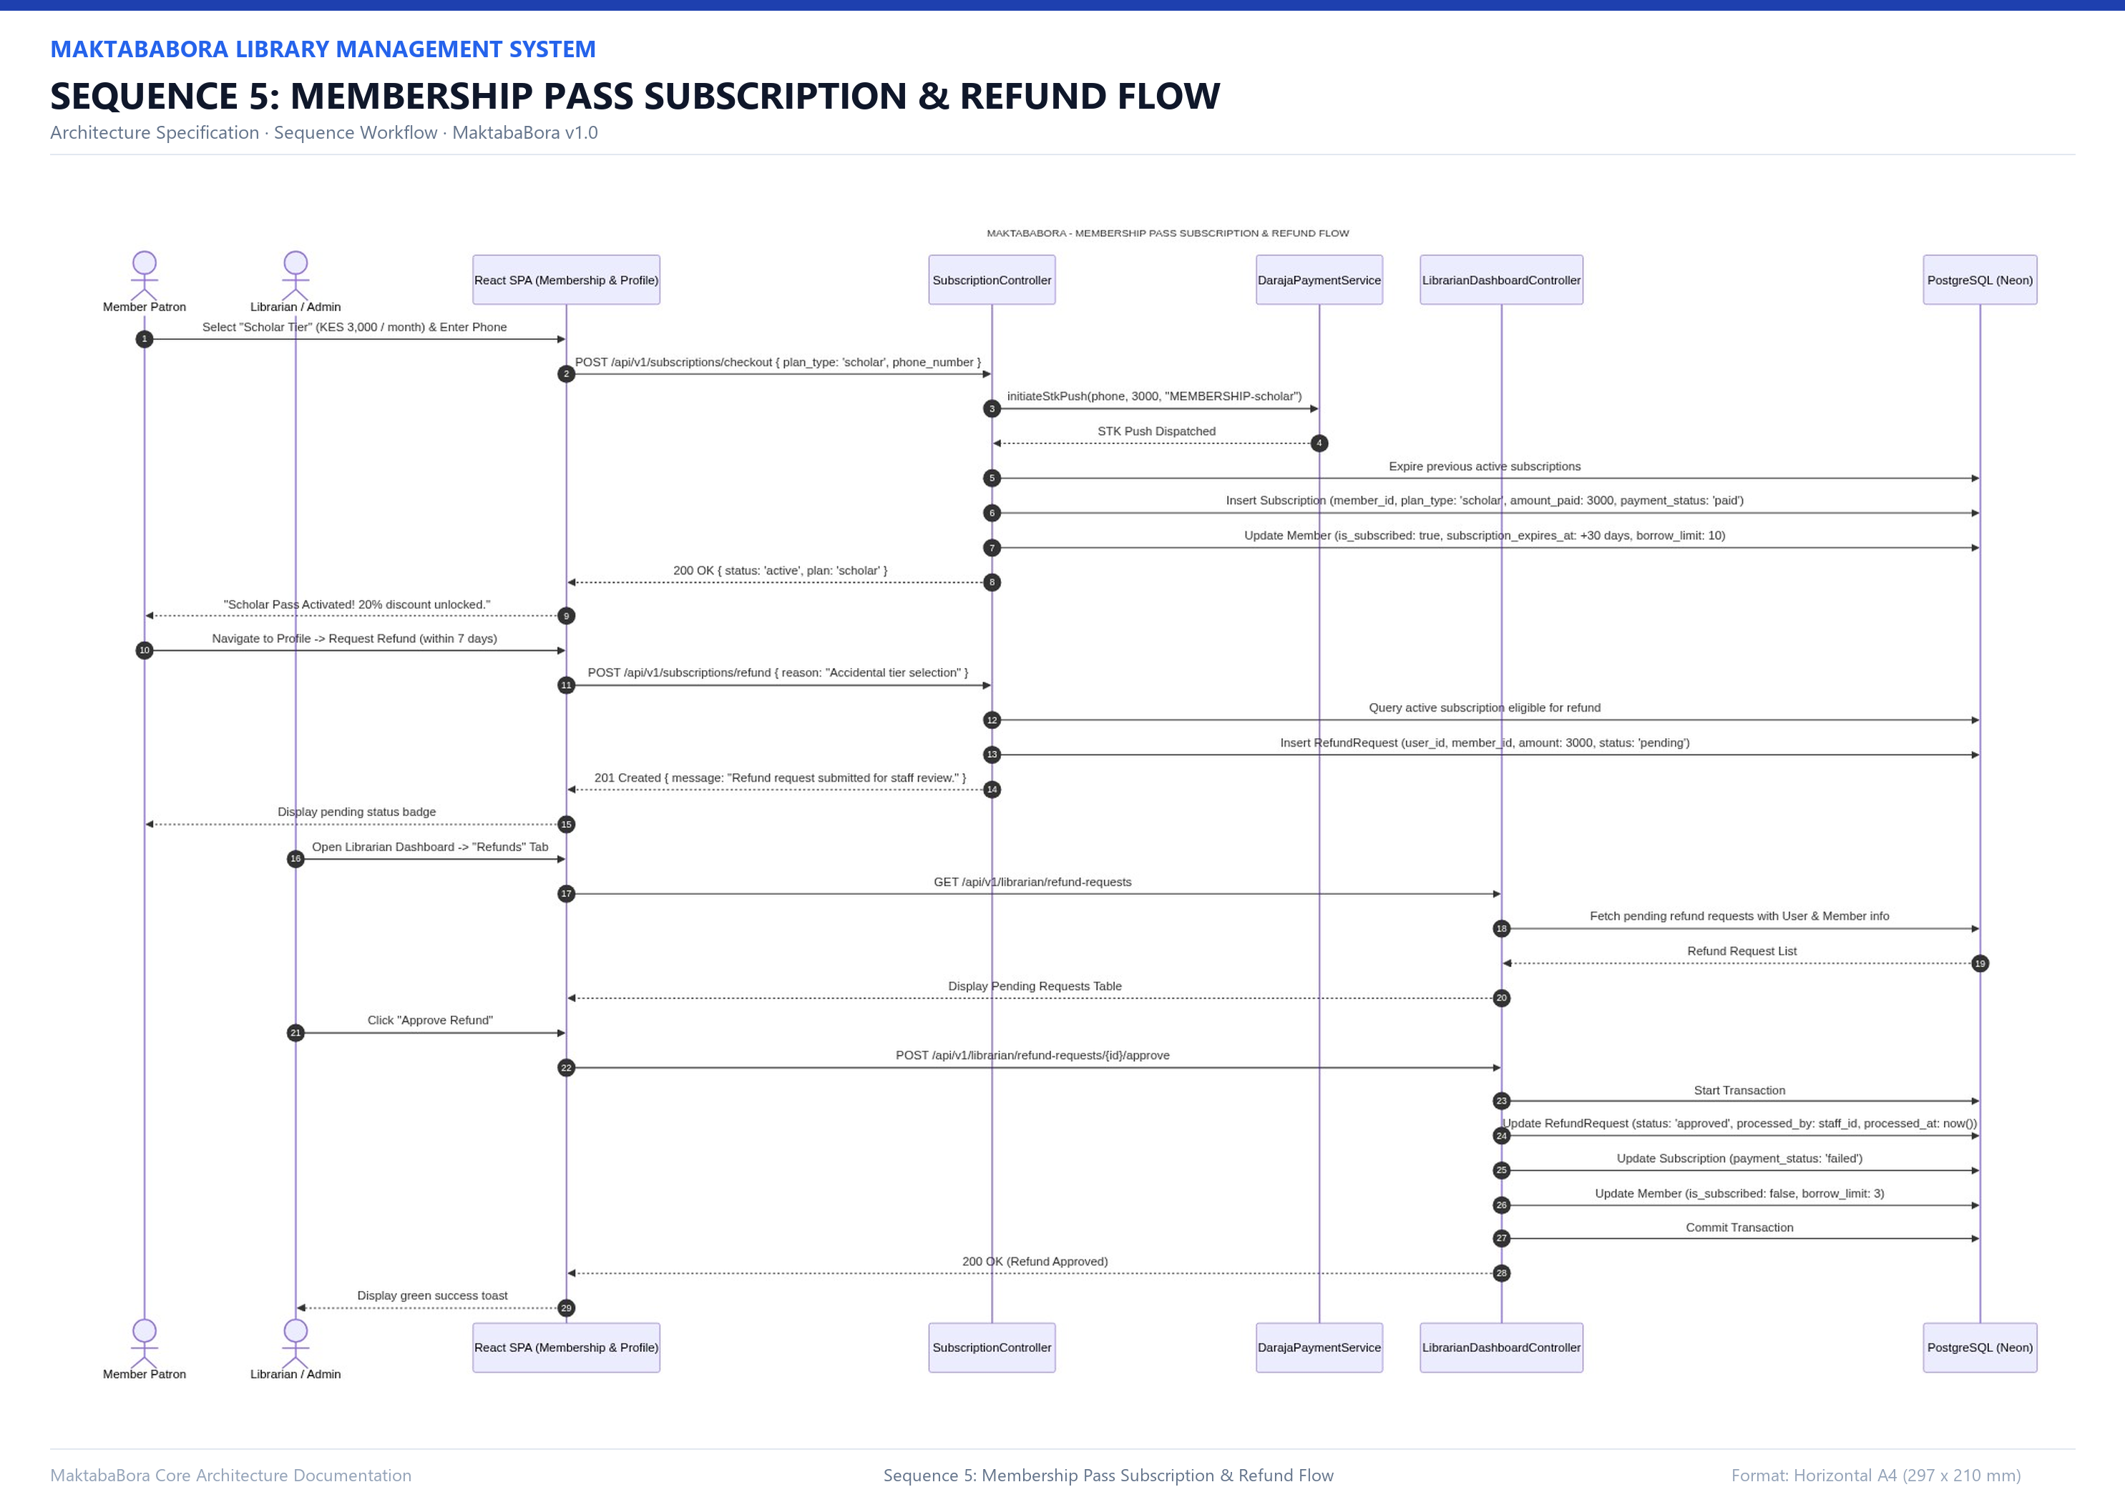
SECTION 6: OPERATIONAL WORKFLOWS
Workflow 5: Membership Perk Passes & Refund Flow
Technical Specifications
Pass Subscription: Patron subscribes to General, Student, Scholar, or VIP tier via M-Pesa STK push.
Auto-Upgrade Handling: Purchasing a new tier automatically retires and cancels any previous active pass.
Perk Activation: Instantly updates member borrow limits (up to 10 books) and cart discount rates.
Dispute Filing: Patron submits formal refund request with justification via member profile.
Staff Audit & Resolution: Librarian reviews claim; approving refund cancels pass and resets borrow quotas.

Slide 26
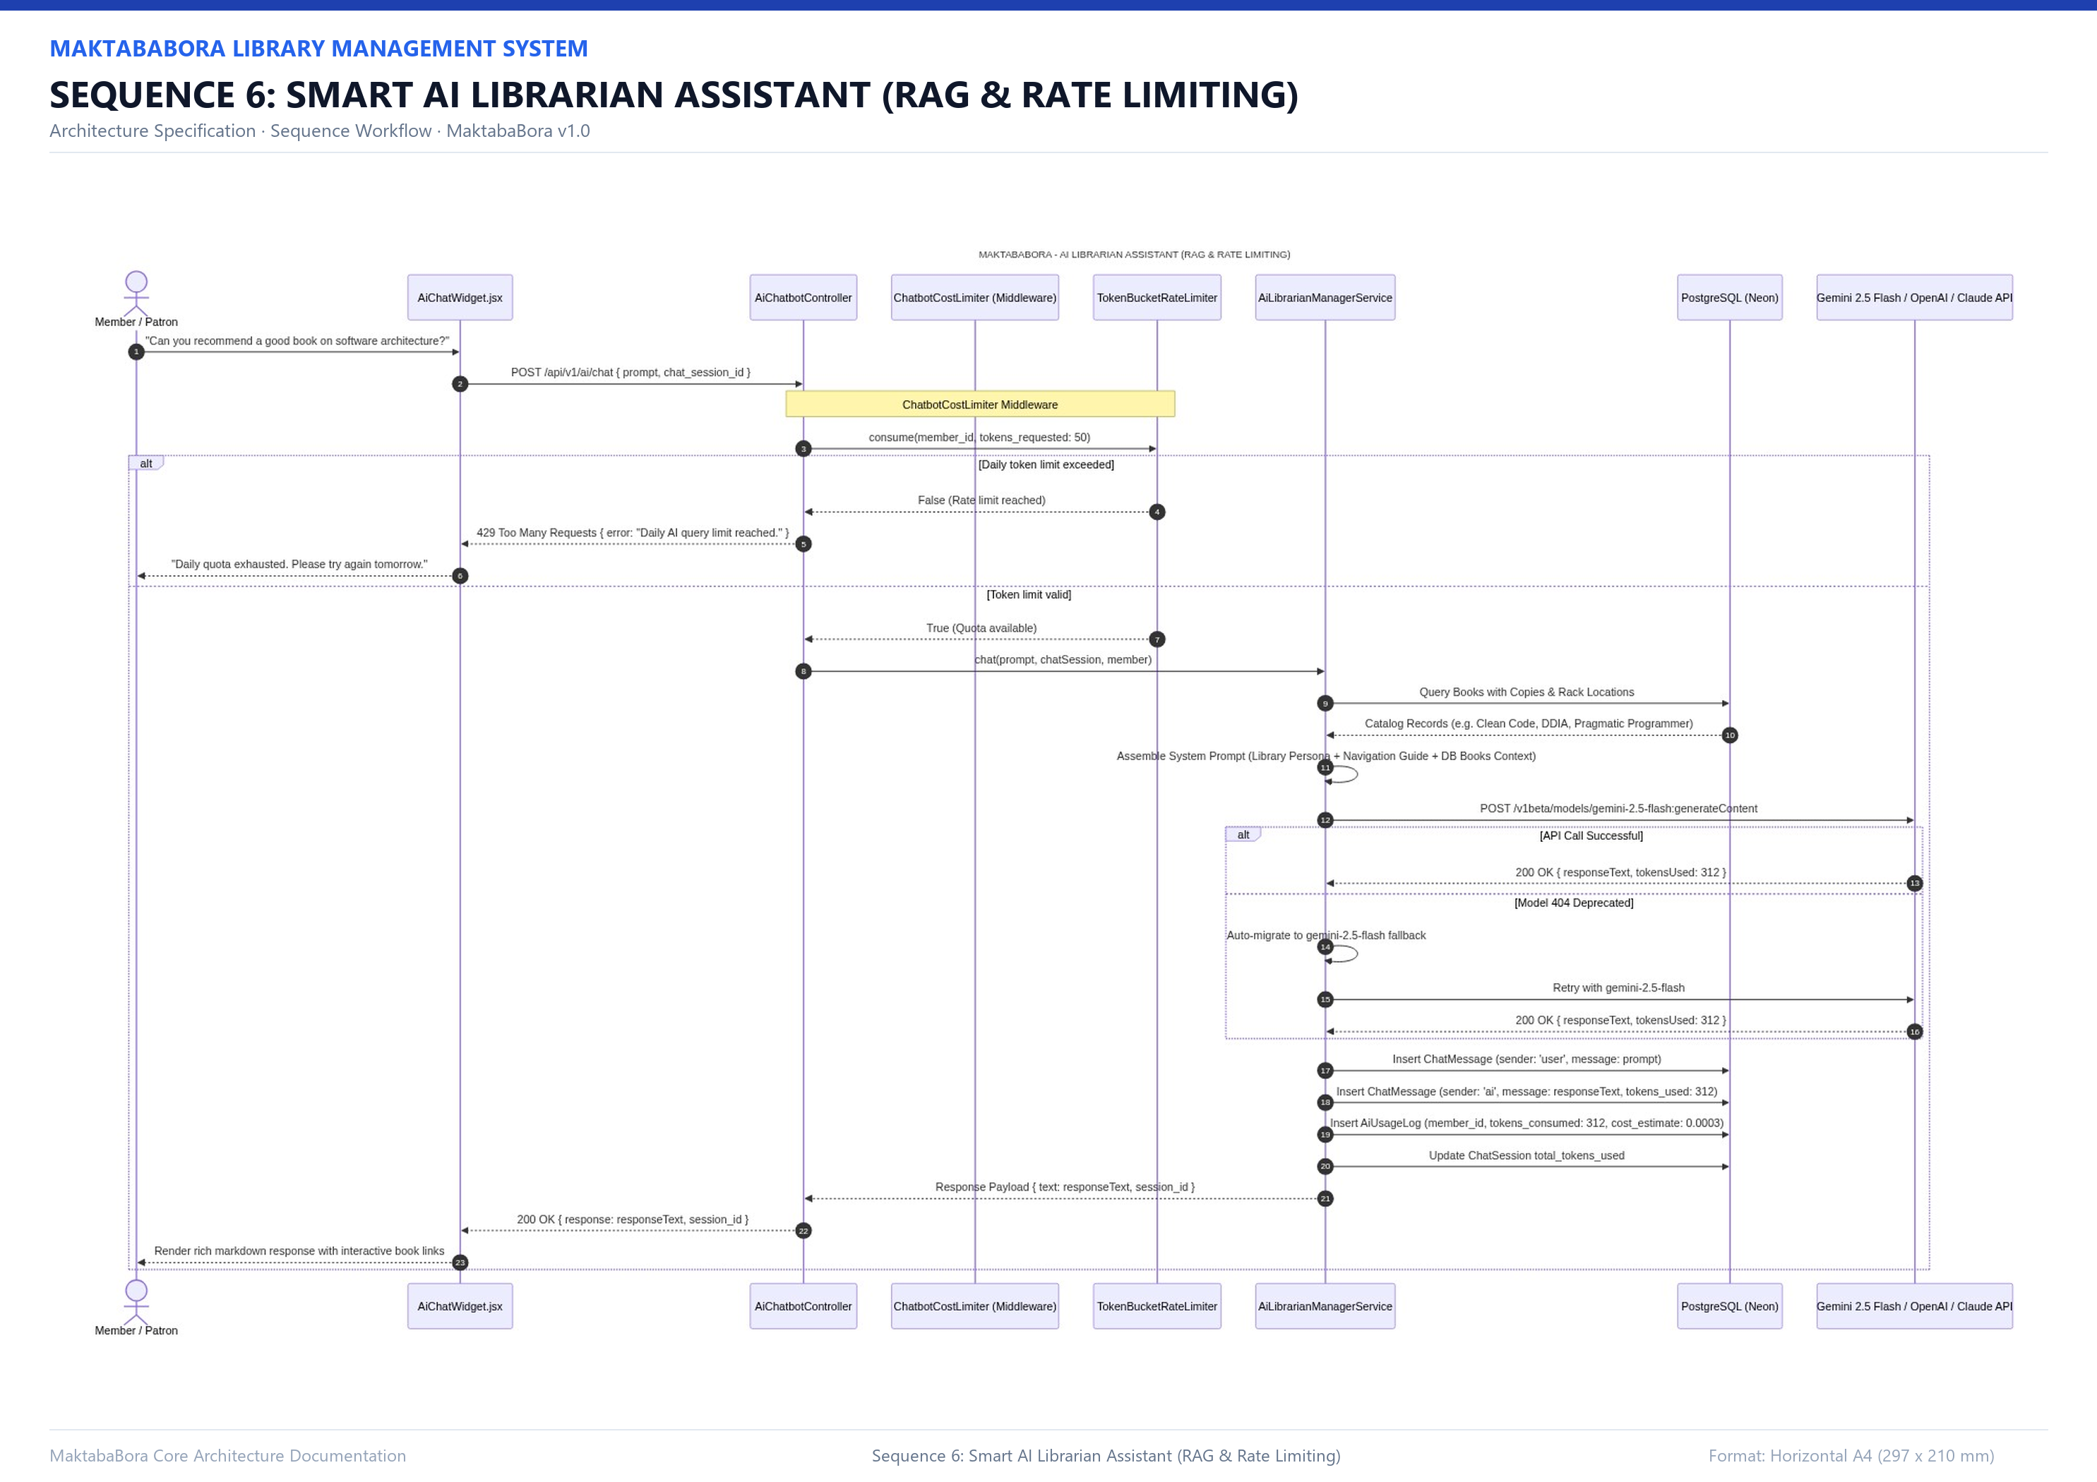
SECTION 6: OPERATIONAL WORKFLOWS
Workflow 6: AI Librarian Assistant (Rate-Limited RAG)
Technical Specifications
Daily Cost Limiter: ChatbotCostLimiter middleware checks cumulative 24h tokens; halts at 20,000 ceiling.
Semantic Embeddings: Query vectorized via text-embedding-3-small and matched using cosine similarity.
Catalog Context Injection: System prompt is augmented with real library holdings, authors, and shelf codes.
Anti-Hallucination Defense: Explicit system instructions bar LLM from fabricating non-existent books.
Token Consumption Logging: Prompt and completion tokens logged to ai_usage_logs on every turn.

Slide 27
SECTION 8: IMPLEMENTATION HIGHLIGHTS
Key Code: Stateless JWT & 24h AI Cost Limiter
PHP
Implementation Logic
// 1. Stateless JWT Generation (AuthSessionService.php)
public function generateToken(User $user, bool $remember = false): string {
$ttl = $remember ? (60 * 60 * 24 * 30) : (60 * 15); // 30d vs 15m
$header = base64_encode(json_encode(['typ' => 'JWT', 'alg' => 'HS256']));
$payload = base64_encode(json_encode([
'iss' => 'MaktabaBora', 'sub' => $user->id,
'role' => $user->role, 'iat' => time(), 'exp' => time() + $ttl
]));
$sig = hash_hmac('sha256', "{$header}.{$payload}", $this->secret, true);
return "{$header}.{$payload}." . base64_encode($sig);
}
// 2. Rolling 24h AI Quota Enforcement (ChatbotCostLimiter.php)
public function handle(Request $request, Closure $next): Response {
$user = $request->user();
if ($user && ($member = Member::where('user_id', $user->id)->first())) {
$recentTokens = AiUsageLog::where('member_id', $member->id)
->where('created_at', '>=', now()->subDay())->sum('tokens_consumed');
if ($recentTokens >= 20000) {
return response()->json(['error' => 'AI Quota Exceeded (20k)'], 429);
}
}
return $next($request);
}
Stateless Authentication
JWTs encode user ID and RBAC role, cryptographically signed with HMAC-SHA256. Avoids costly database lookups on routine requests.
Cache Blacklisting
Logout immediately writes the token hash to Redis/Cache with a TTL matching the token's remaining lifetime.
AI Cost Ceiling
ChatbotCostLimiter aggregates token consumption over a rolling 24-hour window, halting requests with HTTP 429 before expensive LLM API invocations.

Slide 28
SECTION 8: IMPLEMENTATION HIGHLIGHTS
Key Code: Vector Cosine Similarity & TF-IDF
PHP
Implementation Logic
// 1. Native High-Dimensional Cosine Similarity (BookEmbeddingService.php)
public static function cosine(array $a, array $b): float {
$dot = 0.0; $normA = 0.0; $normB = 0.0;
$len = count($a);
if ($len === 0 || $len !== count($b)) return 0.0;
for ($i = 0; $i < $len; $i++) {
$dot += $a[$i] * $b[$i];
$normA += $a[$i] * $a[$i];
$normB += $b[$i] * $b[$i];
}
$denom = sqrt($normA) * sqrt($normB);
return $denom > 0.0 ? ($dot / $denom) : 0.0;
}
// 2. Content-Based TF-IDF Cosine Ranking (CatalogRetrievalService.php)
public function searchCatalog(string $query, ?string $genre = null): Collection {
$books = Book::query()->when($genre, fn($q) => $q->where('genre', $genre))->get();
return $books->map(function ($book) use ($query) {
$book->similarity_score = TextSimilarity::cosineSimilarity(
$query, "{$book->title} {$book->author} {$book->description}"
);
return $book;
})->filter(fn($b) => $b->similarity_score > 0.15)
->sortByDesc('similarity_score')->values();
}
Pure PHP Vector Math
Computes dot product and L2 norms between 1536-dimensional embedding vectors without requiring specialized PostgreSQL vector extensions.
Hybrid Recommendation
Combines semantic vector embeddings with term-frequency inverse-document-frequency (TF-IDF) string distance as an offline fallback.
Grounded Catalog Context
Matched titles, authors, and shelf codes are extracted and injected into the LLM system prompt to prevent hallucination.

Slide 29
SECTION 8: IMPLEMENTATION HIGHLIGHTS
Key Code: Safaricom Daraja M-Pesa & Forex Caching
PHP
Implementation Logic
// 1. M-Pesa STK Push Prompt Dispatch (DarajaPaymentService.php)
public function initiateStkPush(string $phone, float $amount, string $ref): array {
$timestamp = date('YmdHis');
$password = base64_encode($this->shortcode . $this->passkey . $timestamp);
$res = Http::withToken($this->generateAccessToken())
->post('https://sandbox.safaricom.co.ke/mpesa/stkpush/v1/processrequest', [
'BusinessShortCode' => $this->shortcode,
'Password' => $password,
'Timestamp' => $timestamp,
'TransactionType' => 'CustomerPayBillOnline',
'Amount' => (int) ceil($amount),
'PartyA' => $this->formatPhoneNumber($phone),
'PartyB' => $this->shortcode,
'PhoneNumber' => $this->formatPhoneNumber($phone),
'CallBackURL' => config('services.daraja.callback_url'),
'AccountReference' => substr($ref, 0, 12),
'TransactionDesc' => 'MaktabaBora Pay',
]);
return $res->json() ?? [];
}
// 2. 24-Hour Currency Exchange Rate Caching (CurrencyConverterService.php)
public function convert(?float $amount, ?string $from, string $to = 'KES'): ?float {
if (!$amount || !$from || strtoupper($from) === strtoupper($to)) return $amount;
$rates = Cache::remember('forex_rates_kes', 86400, fn() => $this->fetchLiveRates());
if (!isset($rates[$from]) || !isset($rates[$to])) return null;
return round(($amount / $rates[$from]) * $rates[$to], 2);
}
Base64 Security Token
Generates dynamic Daraja timestamp password and bearer token for authenticated Safaricom gateway communication.
Simulated Evaluation Flow
Constructs compliant Daraja 2.0 payload envelopes and mock settlements for safe zero-cost MVP demonstration.
24-Hour Cache Layer
Live exchange rates are cached for 86,400 seconds (24h) to avoid third-party API latency and rate-limit penalties.

Slide 30
SECTION 9: APIS & INTEGRATIONS
REST API Architecture & Public / Member Routes
Verb | Endpoint URI | Controller Action | Middleware Guards & Authorization
POST | /api/v1/auth/register | AuthController@register | Public: Validates unique email, creates member
POST | /api/v1/auth/login | AuthController@login | Public: Verifies credentials, mints Bearer JWT
GET | /api/v1/books | BookInventoryController@index | Public: Paginated catalog with availability & pricing
GET | /api/v1/books/{book} | BookInventoryController@show | Public: Full synopsis, physical shelf code, copies
POST | /api/v1/fines/daraja/callback | FineController@darajaCallback | Public: Safaricom M-Pesa webhook callback receiver
GET | /api/v1/auth/me | AuthController@me | jwt.validation, ensure.account: Returns user & profile
GET | /api/v1/loans | LoanController@index | ensure.member: List member active and historical loans
POST | /api/v1/digital-books/checkout-cart | DigitalRentalController@checkoutCart | ensure.member: M-Pesa STK push for eBook cart checkout
GET | /api/v1/digital-books/{id}/read | DigitalRentalController@read | ensure.digital_access: Streams chapter index & reader text

Slide 31
SECTION 9: APIS & INTEGRATIONS
REST API: Circulation Desk & Administration Routes
Verb | Endpoint URI | Controller Action | Middleware Guards & Authorization
POST | /api/v1/ai/chat | AiChatbotController@chat | chatbot.cost_limiter: Grounded RAG conversational AI
GET | /api/v1/librarian/metrics | LibrarianDashboardController@metrics | ensure.librarian: Circulation statistics, active loans, fines
POST | /api/v1/librarian/loans/checkout | LoanController@checkout | validate.borrow_limit, check.fine: Barcode scan checkout
POST | /api/v1/librarian/loans/{id}/return | LoanController@returnBook | ensure.librarian: Check-in volume & auto-accrue fines
POST | /api/v1/librarian/fines/{id}/waive | FineController@waive | ensure.librarian: Waive overdue fine with audit trail
POST | /api/v1/librarian/openlibrary/import | LibrarianDashboardController@import | ensure.librarian: 1-Click Open Library ISBN catalog import
GET | /api/v1/admin/users | AdminDashboardController@users | ensure.admin: List system users, roles, and ban statuses
POST | /api/v1/admin/users/{user}/toggle-ban | AdminDashboardController@toggleBan | ensure.admin: Suspend user account with mandatory reason
GET | /api/v1/admin/crud/{table} | AdminCrudController@getTableData | ensure.admin: Direct administrative table maintenance

Slide 32
SECTION 10: SECURITY CONSIDERATIONS
Security Architecture & Defense-in-Depth
Stateless Cryptographic Tokens
HMAC-SHA256 JWT tokens signed with master secret. Payload tampering invalidates signatures instantly. Logout adds token hashes to Redis cache blacklist with automatic TTL eviction.
Sequential Middleware Gatekeepers
Requests traverse an ordered inspection pipeline: CORS -> Rate Limiting -> JWT Verification -> Account Active Check -> Non-Banned Check -> Borrow Limit -> Fine Check.
Financial Transaction Integrity
M-Pesa STK callbacks verify merchant shortcodes and transaction IDs. Multi-table asset grants and fine clearances execute inside ACID database transactions to prevent race conditions.
AI Anti-Hallucination & PII Safety
RAG prompts strictly constrain LLM context to real database catalog holdings. Explicit system prompts bar the assistant from discussing user accounts or disclosing patron borrowing history.
SQL Injection Defense
All database read and write operations are routed through Eloquent ORM or parameterized PDO prepared statements, fully immunizing the platform from SQL injection attacks.
Credential & API Key Encryption
External third-party API keys (OpenAI, Gemini, Daraja) are stored encrypted using OpenSSL AES-256-CBC and masked when displayed in administrative interfaces.

Slide 33
SECTION 11: CHALLENGES & SOLUTIONS
Engineering Challenges & Implemented Solutions
Challenge 1: Neon Connection Pooling vs DDL
Neon's PgBouncer transaction pooling aborts DDL schema migrations. -> Solution: Implemented an automatic detector in config/database.php that strips the -pooler. suffix during artisan migrate commands to connect directly.
Challenge 2: PostgreSQL SSL Mode Mismatch
Neon requires sslmode=require, while local Windows Postgres throws SQLSTATE[08006]. -> Solution: Configured sslmode fallback to 'prefer', allowing local connections without SSL while negotiating SSL with Neon Cloud seamlessly.
Challenge 3: Unbounded AI API Cost Exposure
Uncontrolled patron AI queries risk catastrophic monthly API billing spikes. -> Solution: Authored ChatbotCostLimiter middleware enforcing a hard 20,000 token limit per member across rolling 24-hour periods.
Challenge 4: Localhost M-Pesa Webhooks
Safaricom cannot dispatch callbacks to local private IP development environments. -> Solution: Built a hybrid polling mechanism in DarajaPaymentService to query transaction status continuously while the modal is displayed.
Challenge 5: Vector Search without Vector DB
Hosting dedicated vector database extensions increases infrastructure overhead. -> Solution: Implemented pure PHP high-dimensional cosine similarity ranking, backed by TF-IDF keyword cosine similarity as an offline fallback.

Slide 34
SECTION 12: TESTING & QA
Testing Suite & Quality Assurance Metrics
80 / 80 Passed
Unit Tests (185 Assertions)
47 / 47 Passed
Feature Tests (212 Assertions)
127 Total Tests
397 Assertions in ~7.5 Seconds
Isolated In-Memory Test DB
Unit Test Coverage (`tests/Unit`)
Feature Test Coverage (`tests/Feature`)
• Configured in phpunit.xml via SQLite :memory:
• Tests execute in RAM in ~7.5 seconds
• Uses RefreshDatabase trait for clean state isolation
• Zero risk of mutating local or Neon PostgreSQL data
• 15 Services tests (JWT, Cosine math, M-Pesa, RAG guardrails)
• 17 Middleware tests (Rate limiters, borrow caps, token guards)
• 6 Provider tests (IoC container resolution & singletons)
• ContractsIntegrityTest asserting strict interface compliance
• Full HTTP pipeline tests (POST /api/v1/auth/login, loans)
• Digital eBook purchasing and streaming permission checks
• Safaricom M-Pesa webhook callback simulation
• Admin user ban toggles and dynamic CRUD operations

Slide 35
SECTION 13: DEPLOYMENT & OPERATIONS
Unified Fullstack Container Architecture
1. Multi-Stage Docker Build
node:20-alpine + php:8.2-fpm-nginx
Stage 1 compiles React 18 SPA with Vite into /dist. Stage 2 serves Nginx + PHP-FPM 8.2 and copies static SPA into Laravel public/ folder.
2. Single Turnkey Service
Render Blueprint (render.yaml)
Deploys both frontend UI and backend API as a single web service, eliminating CORS complexity and hardcoded local ports.
3. Serverless Cloud Database
Neon PostgreSQL (AWS Ohio)
High-availability serverless PostgreSQL 16 with PgBouncer connection pooling and dynamic direct-migration fallback detection.
4. SPA Catch-All Route
Laravel routes/web.php
Nginx serves static assets directly; web routes (/, /catalog, /login) are routed to index.html for client-side React Router navigation.
5. Production Optimizations
OPcache & Bytecode Caching
Bytecode caching enabled (PHP_OPCACHE_ENABLE=1) and Composer dependencies bundled with optimized autoloader (--no-dev --prefer-dist).
6. Simulated M-Pesa Evaluation
Compliant Sandbox Payment Flow
Constructs standard Daraja 2.0 payload envelopes and polling loops in simulation mode for zero-cost, safe evaluation.

Slide 36
SECTION 13: DEPLOYMENT & OPERATIONS
Continuous Integration & Deployment (CI/CD)
GitHub Actions Automated Pipeline
Quality Assurance & Security Controls
Stage 1: Multi-Branch Trigger
Workflow activates on push and pull-request events targeting 'main' and 'kimura' development branches.
Stage 2: Container Environment Setup
Spins up ubuntu-latest virtual runner, installs PHP 8.2 and Node 20 runtimes, and restores caches.
Stage 3: Automated Test & Build Gates
Executes complete PHPUnit suite (127 tests, 397 assertions) and builds the React SPA bundle with Vite.
Stage 4: Zero-Downtime Deploy Trigger
On 100% test passage, curls Render Deploy Hook URL with commit metadata. Broken builds are automatically blocked.
Strict Quality Gatekeeping
No commit reaches production without passing every assertion. Prevents regressions in loan quotas, fine calculations, and JWT validation.
Encrypted Webhook Secrets
The Render Deploy Hook URL is stored strictly in GitHub Encrypted Repository Secrets (RENDER_DEPLOY_HOOK_URL), preventing credential leaks.
High-Velocity Execution
Complete test suite runs in under 15 seconds, providing immediate feedback to developers on pull requests.
Audit Trail & Traceability
Every deployment links commit SHA, test execution results, and container build logs directly in GitHub and Render consoles.

Slide 37
SECTION 13: DEPLOYMENT & OPERATIONS
MVP Deployment: Advantages vs. Disadvantages
PROS: ARCHITECTURAL ADVANTAGES
CONS: MVP TRADE-OFFS & LIMITATIONS
1. Zero Infrastructure Expenditure ($0/mo)
Render Free Tier + Neon DB
Fully functional containerized web service and scalable cloud PostgreSQL database with zero financial hosting costs for MVP evaluation.
1. Free-Tier Inactivity Sleep
15-Min Inactivity Timeout
Render puts free containers to sleep after 15 minutes of inactivity; the initial wake-up request incurs a 30 to 50-second cold start latency delay.
2. Fullstack Single-Origin Simplicity
Unified Container + Auto SSL
UI and API share the exact same origin, eliminating CORS issues and hardcoded ports with automated Let's Encrypt SSL.
2. Compute & Memory Ceiling
0.1 CPU & 512 MB RAM
Free tier bounds high concurrency and memory-intensive batch operations (easily upgraded to Starter $7/mo for dedicated CPU and no sleep).
3. Automated CI/CD Test Gate
GitHub Actions Deployment Hook
127 automated tests must pass before the Render deploy hook is triggered, guaranteeing broken code never reaches production.
3. Ephemeral Disk & Simulated Flow
Stateless Container Architecture
Container filesystem resets on redeploy (all state safely stored in Neon DB); Daraja M-Pesa operates in simulated flow for evaluation safety.

Slide 38
SECTION 13: DEPLOYMENT & OPERATIONS
Alternative Bare-Metal / Local CLI Setup
Step 1: Clone Repository & PHP Dependencies
git clone https://github.com/lornaarwa/Smart-library-management-system.git
cd backend && composer install --no-dev --optimize-autoloader
Step 2: Environment Configuration & Key Generation
cp .env.example .env
php artisan key:generate # Generates 32-char master secret for JWT & encryption
Step 3: Database Schema Migration & Seeding
php artisan migrate --force --seed # Populates baseline catalog, tiers & test users
Step 4: Cache Optimization & Configuration Locking
php artisan config:cache && php artisan route:cache && php artisan view:cache
Step 5: Frontend Single Page App Build
cd ../frontend && npm install && npm run build # Generates static assets in frontend/dist

Slide 39
SECTION 14: FUTURE ROADMAP
Strategic Roadmap & Future Enhancements
1. Hardware RFID & Barcode Scanners
WebUSB & HID Scanner Listeners
Enable hands-free, high-throughput book checkout and inventory auditing directly from browser workstations without auxiliary client drivers.
2. Encrypted Offline-First PWA Reader
Progressive Web App & Web Cryptography
Cache purchased digital eBooks securely via Service Workers with client-side AES-GCM decryption, enabling reading during internet outages.
3. Automated SMS via Africa's Talking
Telephony Gateway Integration
Dispatch automated SMS notifications to patrons 48 hours prior to loan due dates and immediate alerts when waitlisted hold copies are available.
4. Multi-Branch Inter-Library Sync
Multi-Tenant Enterprise Scaling
Synchronize catalogs and manage inter-library loans across multiple university or county library campuses with central governance.

Slide 40
SECTION 15: CONCLUSION
Conclusion & Architectural Summary
A Superior, Production-Ready Library Management Ecosystem
MaktabaBora redefines modern library management by uniting physical inventory administration with an advanced digital ecosystem. By combining a headless, interface-driven Laravel 11 REST API, an intuitive React 18 frontend, robust PostgreSQL 3NF data modeling, cashless Safaricom Daraja M-Pesa payments (simulated for MVP), and grounded Retrieval-Augmented Generation (RAG) AI, the platform delivers an enterprise-grade, secure, and production-ready solution.
✔ 100% Passing Automated Tests (127/127)
✔ 11 High-Resolution Horizontal A4 UML Diagrams
✔ Zero Database Session Bloat (Stateless HMAC-SHA256 JWT)
✔ Containerized Render & Neon DB Deployment with GitHub Actions CI/CD

