Slide 1
Vision Processing in Humanoid Robots

Slide 2
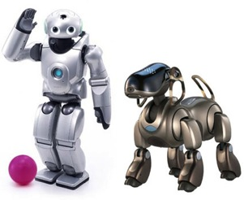
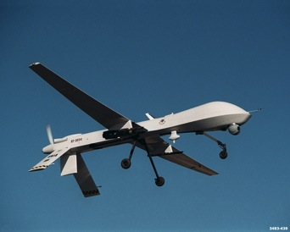
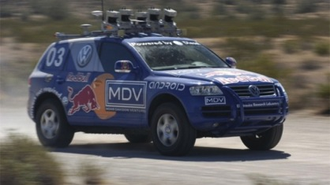
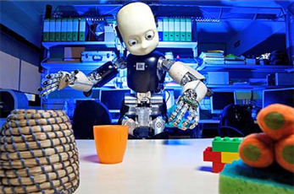
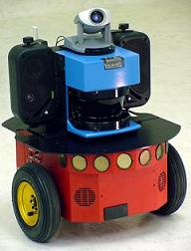
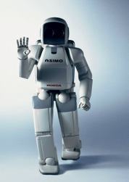

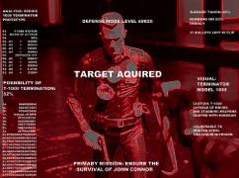
Meet the Robots

Slide 3
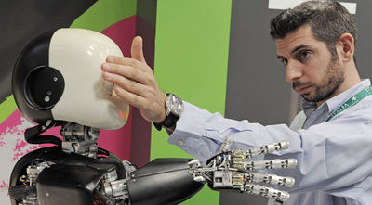
What is Robot Vision?
Used mainly for part identification and navigation
Knowing what objects it can interact with
Knowing how to interact with its environment
Learning about its environment (map building)
Some Vision applications:
  Find a part and orient it for handling or inspection
  Find a person/other robot and interact/avoid
  Obstacle avoidance, road + sign recognition for navigation
  Learn how to interact (eg: grasp) with objects

Slide 4
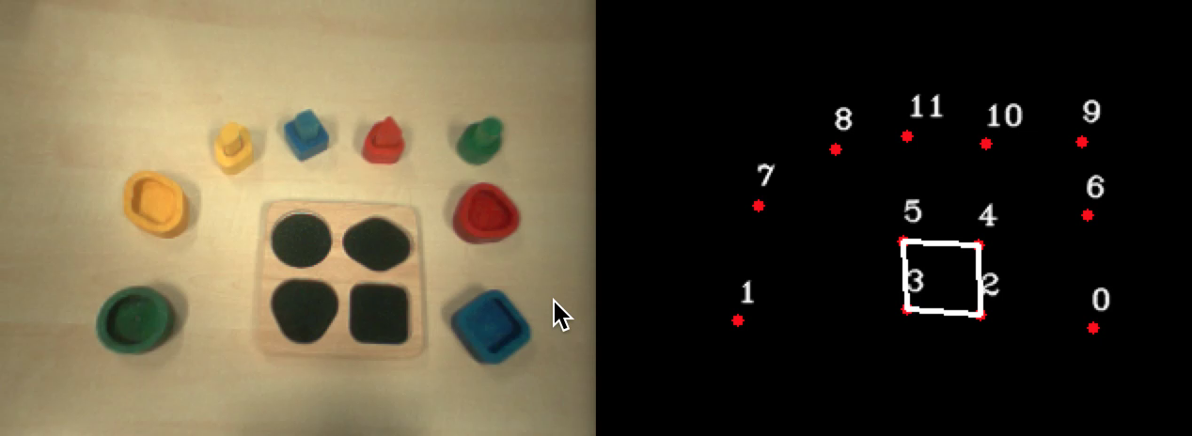
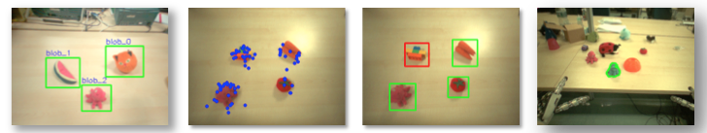
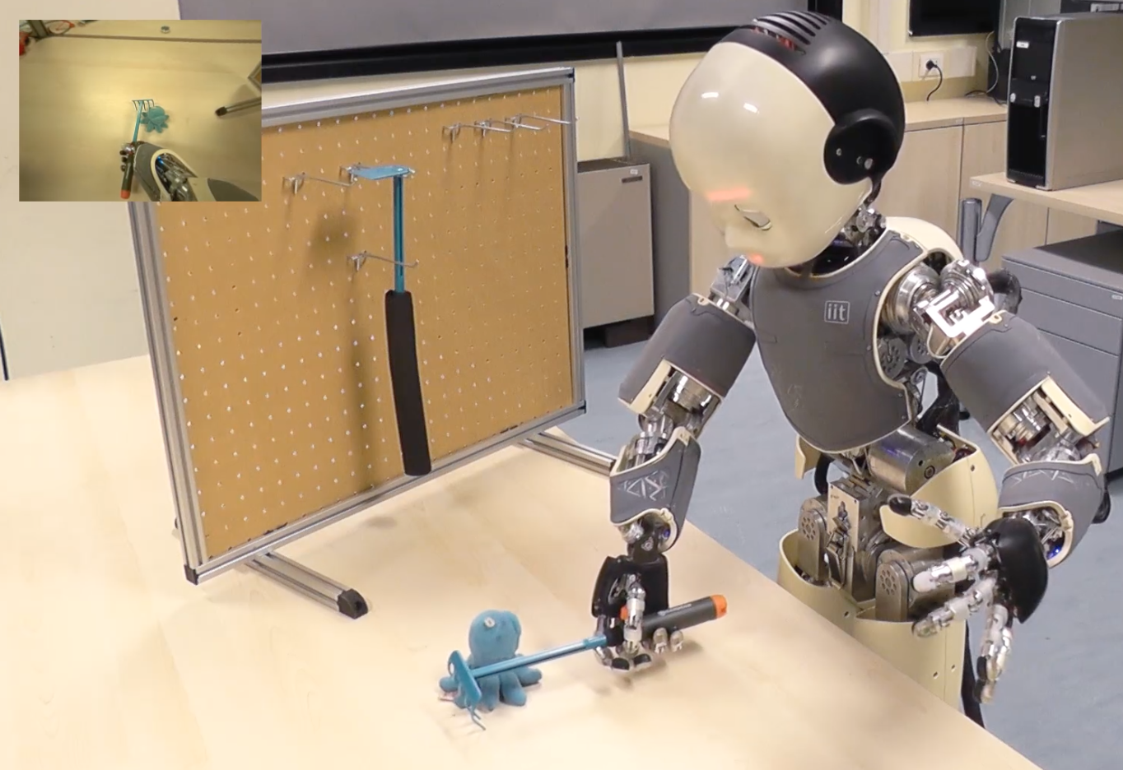
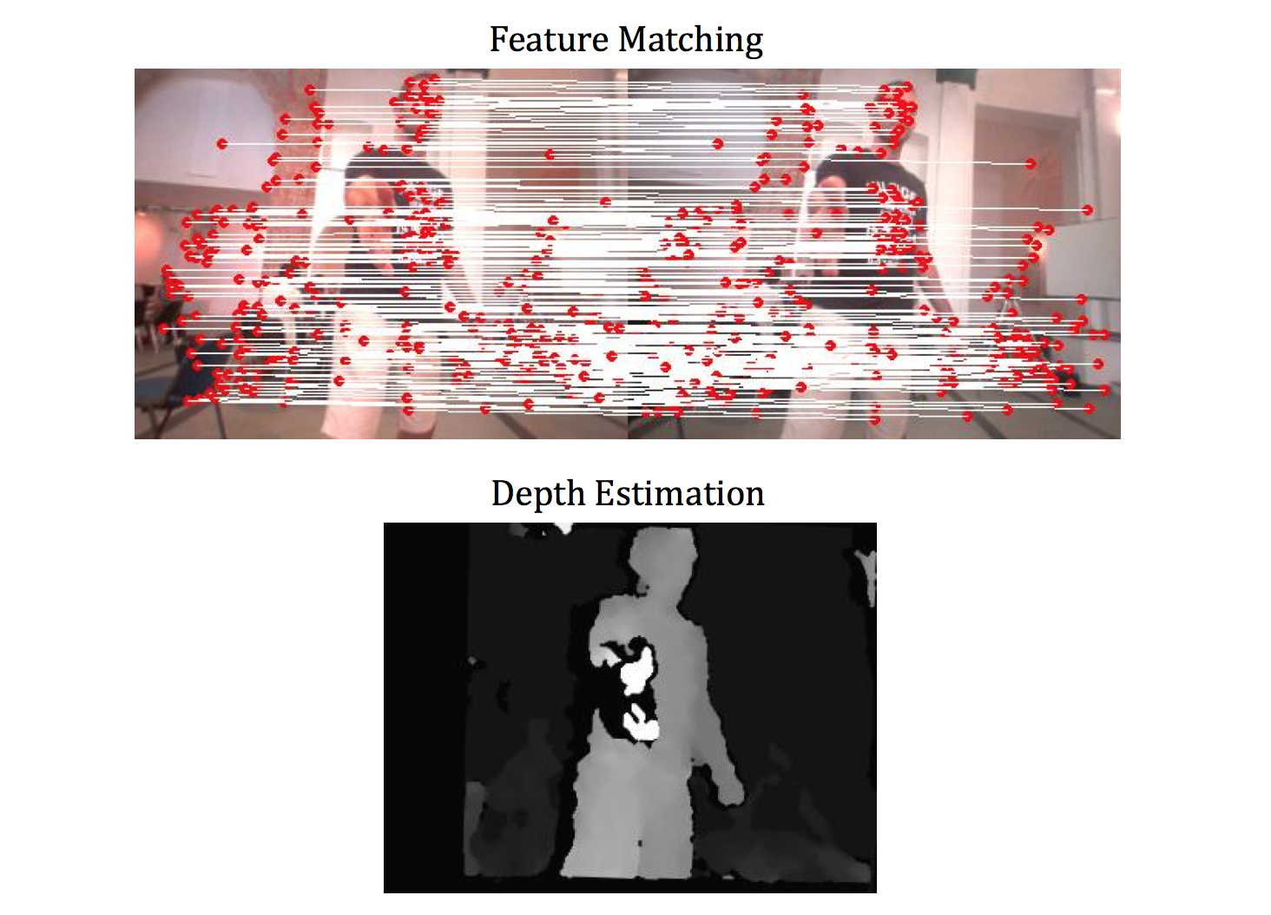
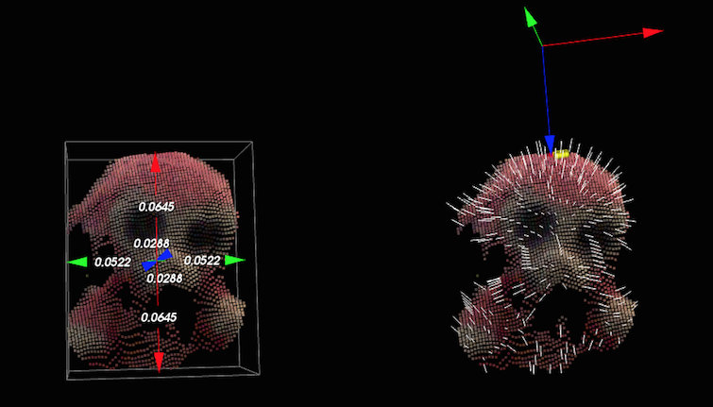
What is Robot Vision?
Questions:
  What information should the robots extracts from cameras?
  How should it build models of objects?
  What is perception of spatial layout?
  Should it stabilize images?
  How to infer three dimensional reality from two-dimensionals images?
  What to do and how to manage the large amount of data that will be processed?

Slide 5
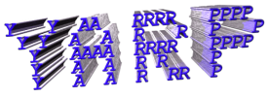

Simple Vision Processing
Course goal:
Acquire images from the iCub cameras using YARP
Do some simple color tracking in YARP
Move the iCub’s head to track the object
IIntro to OPENCV
Do some simple color tracking in OPENCV

Slide 6
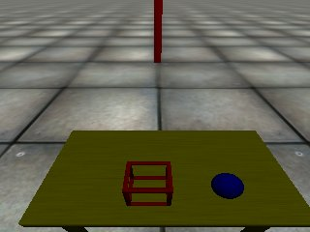
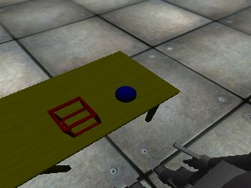
Simple Vision Processing
Few programs:
Find location - input from a camera and decide what location within it looks interesting
Look at location - take an image location and try to move the camera to look towards it
Ball mover – connects to the world and moves the ball in circles

Slide 7
Simple Vision Processing
We need to use the camera on the robot or the robot simulator
With the simulator, use the RENDER::objects on flag in the activation configuration file (conf/iCub_parts_activation.ini) so that the robot has a blue ball on a table in front of it
Move head down using the following commands:
In YARP, camera images are sent from one program to another using ports. In C++, we can create a port for reading or writing images like this:
yarp rpc /icubSim/head/rpc:i
set pos 0 -60
BufferedPort<ImageOf<PixelRgb> > port;

Slide 8
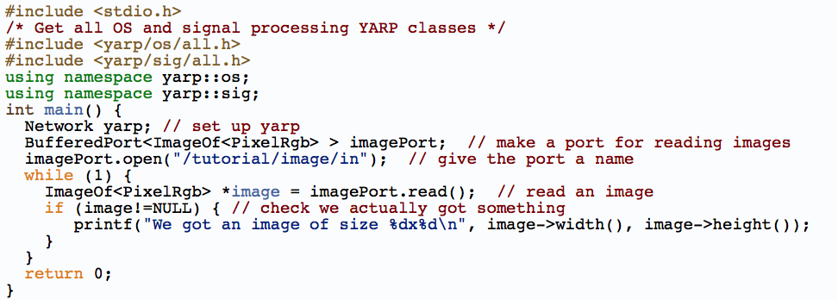
Basic Program
You can connect an image source to that port using:
yarp connect /icubSim/cam/left /tutorial/image/in

Slide 9
Interface Commonalities
OPENING THE CARTESIAN INTERFACE:
Property option;
option.put("device","cartesiancontrollerclient");
option.put("remote","/icub/cartesianController/right_arm");
option.put("local","/client/right_arm");
PolyDriver clientCartCtrl(option);
ICartesianControl *icart=NULL;
if (clientCartCtrl.isValid()) {
clientCartCtrl.view(icart);
}

Slide 10
Open CV
  It is an image processing library created by Intel and maintained by Willow Garage
  Available for C, C++, and Python
  Open Source and free
  Easy to use and install

