Slide 1
Comparing the works of William Shakespeare and Christopher Marlowe

Slide 2
Training and testing
Training data
Testing data
Shakespeare | Marlowe
Midsummer night’s dream | Dr faustus
Hamlet | Edward the second
King lear | Hero and the lender
Romeo and julliet
Shakespeare | Marlowe
Julius Caesar | Dido
Macbeth | The jew of malta
Othello | Tamburlaine part 1
Tempest

Slide 3
Models used
Scikit Learn
  Logistic Regression
  Random Forrest Classifier
  Multinomial Naive Bayes
  SVC – a type of Support Vector Machine
  Linear SVC – also an SVM
  A model created with tensorflow

Slide 4
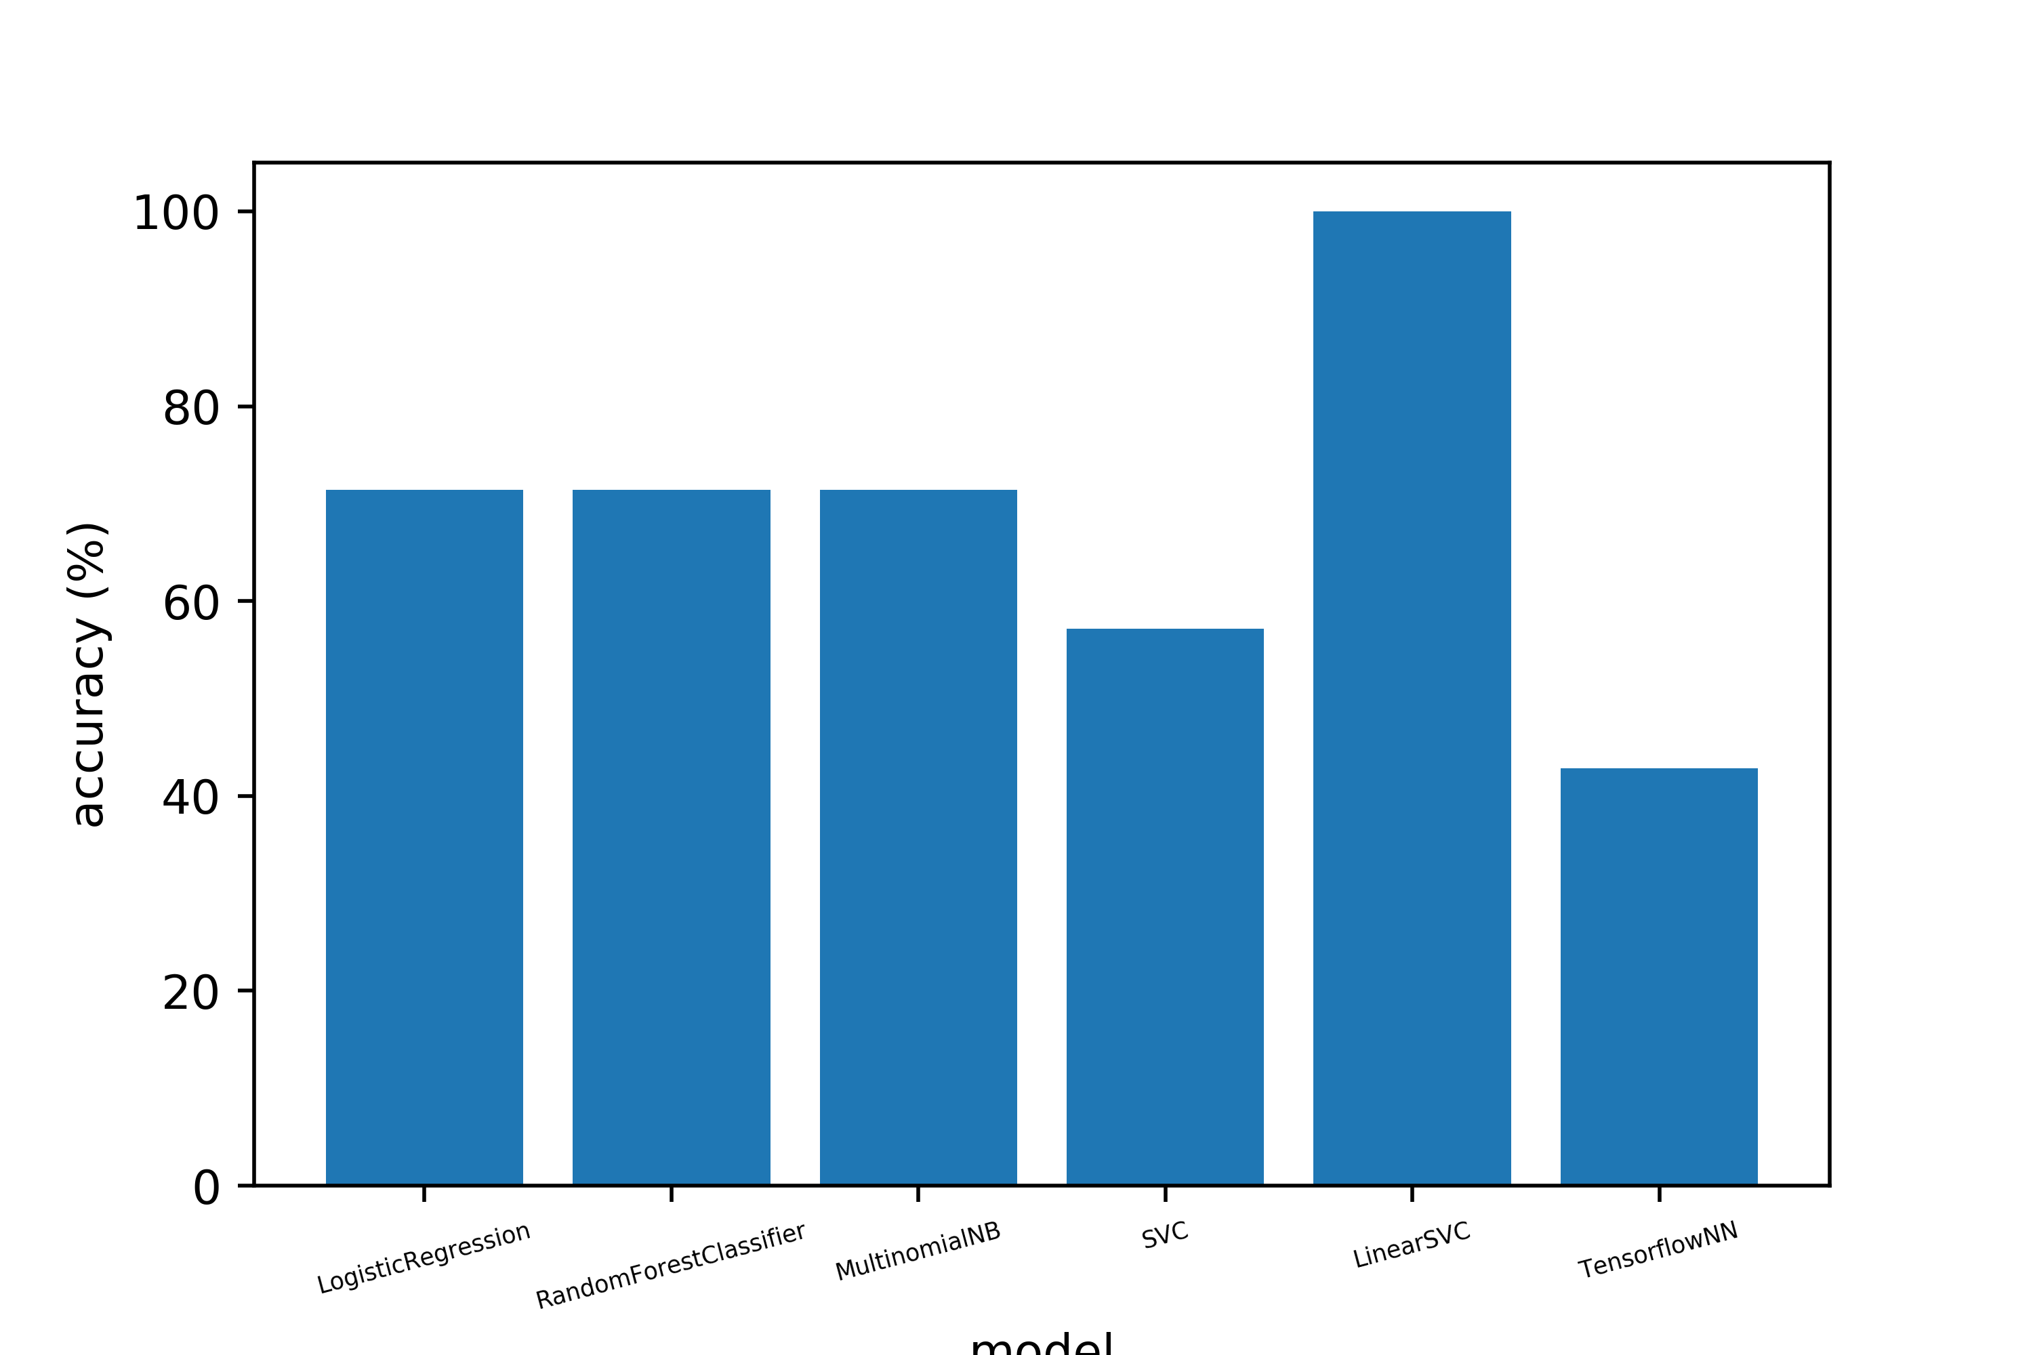
Accuracies of the models

Slide 5
But what about other authors
Predictions for Pride and Prejudice by Jane Austen
Model | Prediction | Probability (if applicable)
Logistic Regression | Marlowe | 100%
Random Forest Classifier | Shakespeare | 60%
Multinomial Naive Bayes | Shakespeare | 100%
SVC | Shakespeare
Linear SVC | Marlowe
Tensorflow Neural Network | Shakespeare

Slide 6
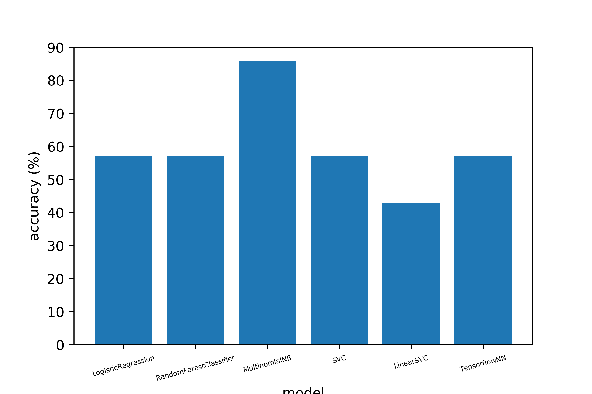
Switching training and testing data

Slide 7
Processing the plays
Bag of words
Feature vector is created based on the frequency of known words in a document

