Slide 1
LiteList
A lightweight grocery store app.

Slide 2
LiteList
Definition statement:
LiteList is a lightweight, straightforward app that is intended to be used by anyone to keep and maintain a grocery list. LiteList allows users to add items to a grocery list, check them off once they have been collected, and delete unneeded or unwanted items. It also has a feature to check out and reset the list once shopping is completed, saving the list for future uses.

Slide 3
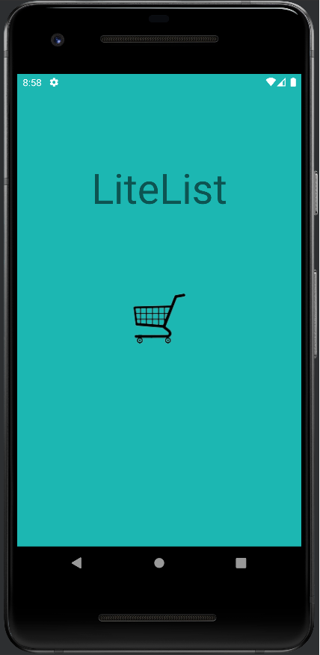
Splash Screen
The splash screen is minimalistic, showing only the title of the app and the logo. Tapping anywhere on the screen will hide the splash screen and move the user to the next screen.

Slide 4
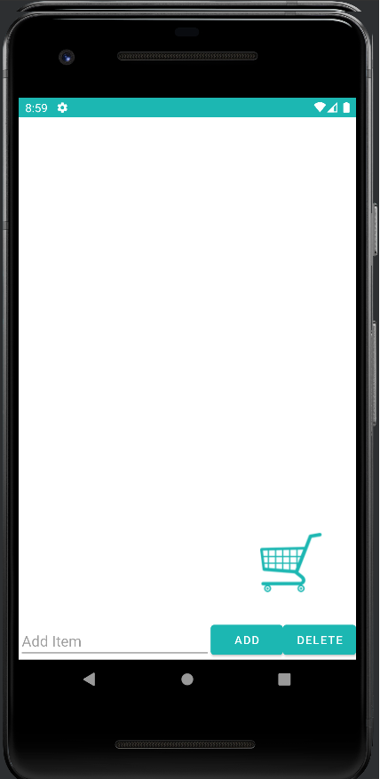
List Screen
The list screen is where the user will spend the majority of their time. When launching it for the first time, the list has nothing on it, but has an option to type in and add items at the bottom. Originally there was a dedicated button to create a popup window for a new screen, but in the interest of saving clicks, the add item feature was just integrated into the list screen.

Slide 5
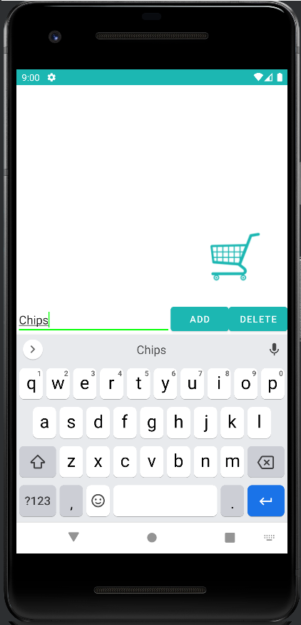
Adding an Item
When the user taps on the text box, a keyboard appears and they can enter a new item. By tapping on the “Add” button, whatever they have typed will be added to the list.

Slide 6
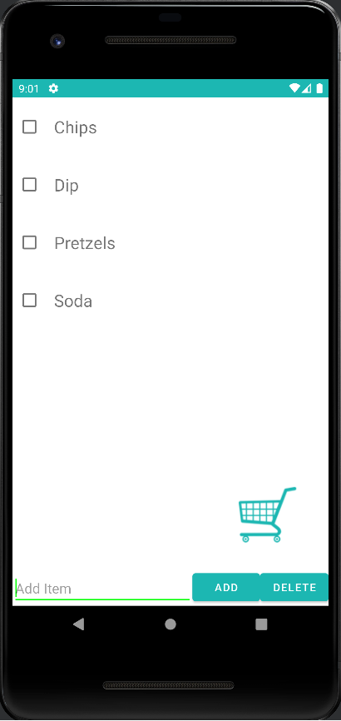
Listing the Items
As the user adds items, they appear on the list. This app uses a RecyclerView to hold all of the items, which are each broken down into their own class. This means that lists do not have a limit, but excessively long lists will not be loaded into memory all at once, giving the app better performance.

Slide 7
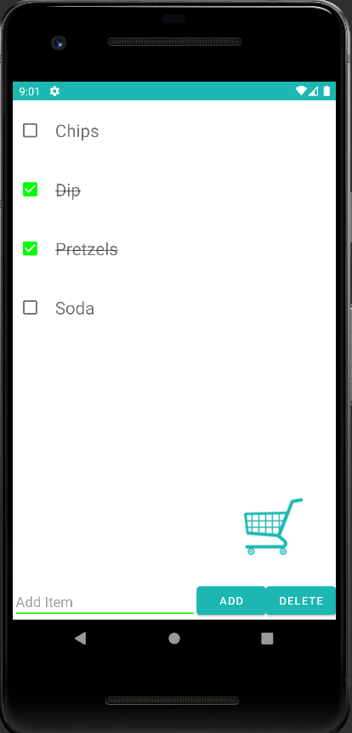
Checking off Items
As a user shops for items, they can tap on an item to put a checkmark next to it and to cross an item off the list. This allows the user to keep track of what they’ve already collected, and the strikethrough allows users to immediately recognize what items can be ignored if they are scrolling through the list.

Slide 8
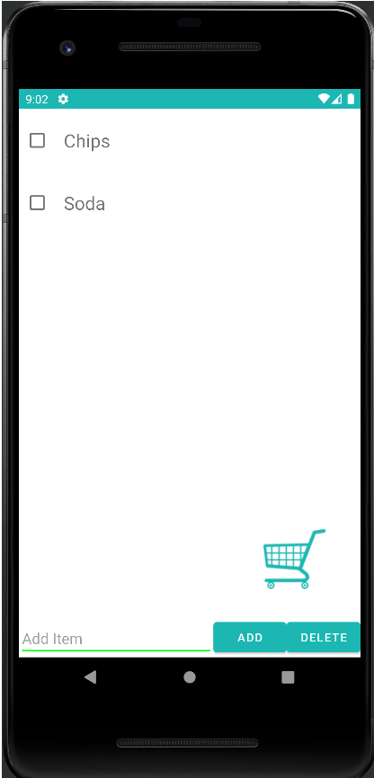
Deleting Items
Items can also be deleted with the button in the bottom righthand corner. Once deleted they are permanently removed from the list, which is helpful if the user is only shopping for an item once.

Slide 9
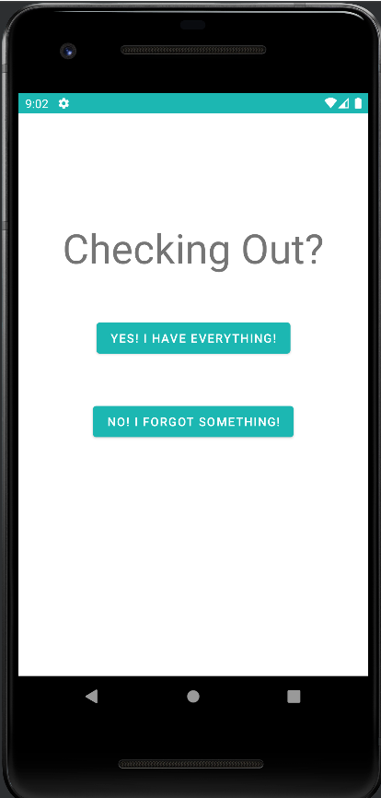
Checking Out
Once the user has completed shopping, they can tap the shopping cart icon in the bottom righthand corner to bring them to this page, which gives the user two options. If they’ve completed shopping and want to reset everything, they can select the “Yes” option to clear the checkmarks and close the app, whereas the “No” option will return them to the previous page so they can continue shopping.

Slide 10
Checking Out
Once the user has completed shopping, they can tap the shopping cart icon in the bottom righthand corner to bring them to this page, which gives the user two options. If they’ve completed shopping and want to reset everything, they can select the “Yes” option to clear the checkmarks and close the app, whereas the “No” option will return them to the previous page so they can continue shopping.

Slide 11
Testing
Technical Standpoint: Testing any and all input on the app, including trying to add pictures to the list just to make sure the app doesn’t crash to seeing if emojis work on the list. Because it’s an incredibly basic and straightforward app, final tests were unable to break it. (Pictures can’t be added, emojis work inside the lists)
User Experience Standpoint: Originally the app was broken down into different categories, using the different departments of a grocery store as separate categories. While this sounds great in theory, it would require the user to separate those items by category themselves or to keep a huge database of what items are in what department, which was often wrong or inaccurate so it was scrapped.
Testing on the app was done both from a technical standpoint and from a user experience standpoint.

Slide 12
Conclusion
LiteList is an app that is designed to be a no-frills app that is designed to create and manage a list without any distractions or unneeded processes running in the background. This is an app that is designed for users of any age and any technical knowledge with a straightforward user interface.

